Slide 1


Intergovernmental Coordination Group for Indian Ocean Tsunami Warning and Mitigation System (ICG/IOTWMS)
Mr. Eluri Pattabhi Rama Rao
Chair, ICG/IOTWMS
IOC/UNESCO Eighteenth Meeting of the Working Group on Tsunamis and Other Hazards related to Sea Level Warning and Mitigation Systems (TOWS-WG-XVIII) Hybrid 24-25 February 2025

Slide 2
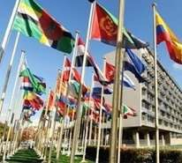



Governance in ICG/IOTWMS
UNESCO-IOC
Assembly/Executive Council
WMO, IHO, IMO, UNDRR, UNDP,
UN OCEAN DECADE
UNESCAP…
Task Team Disaster Management & Preparedness
Global Coordination
Working Group for Tsunami & Other sea level
UN Ocean Decade
related Warning & mitigation Systems (TOWS-WG)
[4x ICG Chairs, WMO, UNISDR, UNDP, IMO, IHO]
UNESCO-IOC Tsunami Resilient Section
Tsunami Programme Science Committee
UNESCO Disaster Risk Reduction Section
Task Team Tsunami
UNESCO-IOC Member States
Watch Operations
ICG/IOTWMS Secretariat Srinivas Tummala Kumar Nora Gale
ICG
Caribbean & Adjacent Seas (CARIBE-EWS)
Intergovernmental Coordination Group (ICG) Indian Ocean Tsunami Warning & Mitigation System (IOTWMS) Chair: Mr. Pattabhi Rama Rao Eluri (India) Vice Chair: Dr. Yuelong Miao (Australia) Vice Chair: Dr. Harkunti Rahayu (Indonesia)
Steering Group: Officers, WG Chairs/VCs, TT Chairs
ICG
Pacific Tsunami Warning & Mitigation System (PTWS)
ICG
NE Atlantic & Mediterranean Seas (NEAMS-TWS
WG1 Tsunami Risk, Community Awareness and Preparedness - DMOs,
Chair: Ms. Weniza (Indonesia)
WG2 Tsunami Detection, Warning & Dissemination
Mr Jijjavarapu Padmanabham (India)
Indian Ocean Tsunami Information Centre (IOTIC) Ardito Kodijat
WG3 Tsunami Ready Implementation
Chair: Ms. Suci Anugrah (Indonesia)
Task Team –New Technologies Observations and Forecasting (under WG2) Chair: Dr. Wahyu Pandoe (Indonesia)
Task Team – IOWAVE25
Chair: Dr. Ajay Kumar Bandela (India)
RWG North-West Indian Ocean
Chair: Ms. Sunanda Manneela (India)
Task Team –Mid-Term Strategy (MTS)
Chair: Dr. Yuelong Miao (Australia)
18th session of TOWS-WG, 24-25 Feb 2025
IOC Regional Programmes and Offices

Slide 3
TOWS-WG XVII Key Recommendations & Status
ICGs
Risk Knowledge, Detection, Warning and Dissemination
Secretariat
Risk Knowledge, Detection, Warning and Dissemination
TSPs may need to provide services for TGVs that may impact several MS – TSP-Australia has implemented and other two TSPs are in progress
Multi-purpose sea level monitoring stations to support MHEWS - Ongoing
Use Exercises and Communication tests for monitoring data
Distribute report on Monitoring and warning for TGVs including the list of tsunamigenic volcanoes to Member States and Volcano Observatories – Completed
Initiate consideration of whether TSPs may need to provide new services for TGVs – Ongoing
availability and quality – Considered and recommended to implement for the upcoming COMMS Test
Sharing of info on deployment of new technologies to monitor sea level variations – Ongoing
TSPs to trial and operationalise dissemination of maritime bulletins to respective NAVAREA operators – TSP Australia and TSP-India have developed the capability and will be exercised for the upcoming COMMS Test
Circular letter to all Member States on Closure of Fax services by TSPs unless advised otherwise - Circulated to IO member states
Develop reporting mechanism on Ocean Decade projects and against ODTP-RDIP KPIs aligning with Global KPI Framework
Preparedness and Response
Webinars for each ICG on Maritime Services and on TGVs by involving Volcano Observatories and VAACs – Monitoring and warning for tsunamis generated by volcanoes webinar by UNESCO-IOC during 16 - 23 April 2025
Preparedness and Response
Exercises outside of working hours (night) - Considered
ICG/IOTWMS WG1 & WG3 to develop and share guidelines for TR Critical Infrastructure – Ongoing
Development of Tsunami Ready Toolkit with TICs’ lead - Ongoing
18th session of TOWS-WG, 24-25 Feb 2025

Slide 4
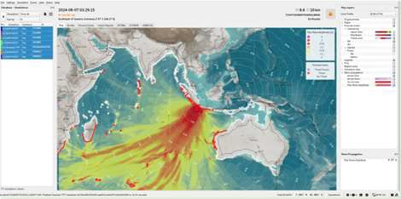
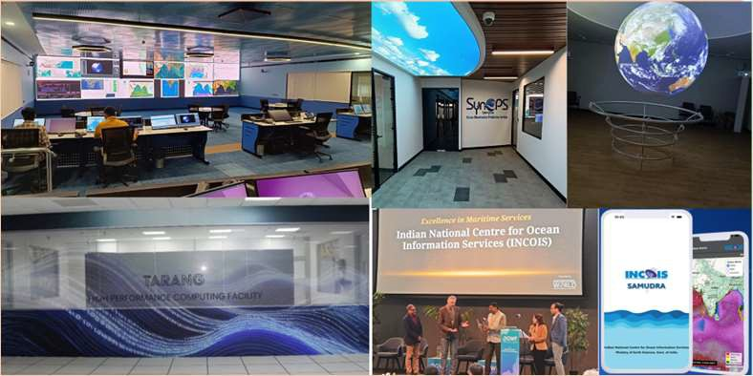
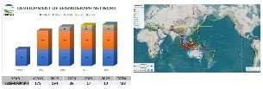
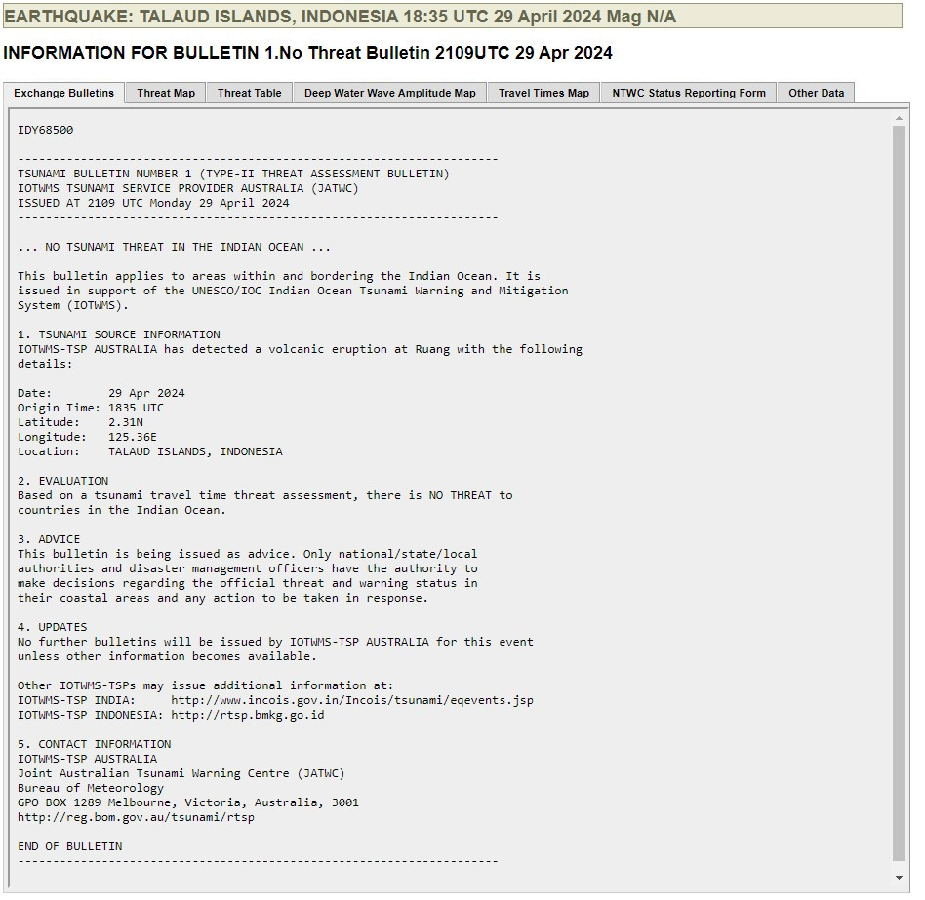
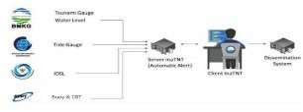
TSP Progress Report
TSP Australia TSP India
TSP Indonesia
Maintaining CFZs Layers for IOTWMS Capability to deliver NAVAREA maritime products SAMUDRA Mobile App. It is a comprehensive multi-hazard early warning app to the coastal communities about oceanic threats. Established SynOPS Lab: A cutting-edge facility advancing ocean monitoring and predictive capabilities. HPC facility “TARANG” at INCOIS - Dedicated to real-time tsunami inundation modeling, operational oceanography, and advanced simulations. Working towards implementation of SOP for the Non-Seismic (TGV) events. Established 15 new GNSS stations co-located with tide guages | Integration of the New 4000 TsunAWI Scenarios Into TOAST Progressive deployment of the seismometers (535 in 2024) Indonesia Tsunami Non- Tectonic monitoring system (InaTNT) to monitor the sea-level anomalies Multi-Hazard Platform (InfoBMKG mobile App) Establishment of the National Consortium of the EQ and Tsunami Experts Developed impact based real time system of InaTEWS supported by National Consortium
 | 3
Capability to produce Indian Ocean products for Non-Seismic events.
Capability to deliver NAVAREA maritime products.
Bureau-Joint Australia Tsunami Warning Center in progress with ISO 9001 recertification
Non-seismic tsunami source SOPs
No threat Bulletin for the IO was issued in response to the eruption of Ruang on the 29th of April 2024.
Bureau-JATWC has replaced the current tsunami Decision Support Tool with TOAST on 15 Oct 2024.
1
8th session of TOWS-WG, 24-25 Feb 2
025

Slide 5

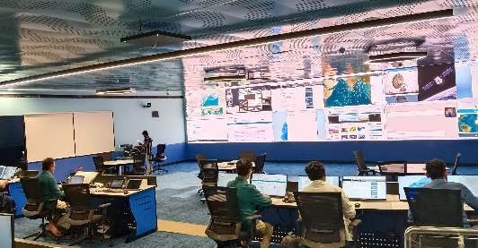
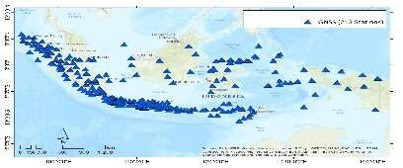

TSP Future Plans
TSP India
TSP Australia
TSP Indonesia
Developing SOPs and implementing products for non-seismic tsunamis
Utilizing GNSS & SMA for precise rupture characterization.
Establishing the GPS co-located tide Gauges along the Indian coast.
Archiving Makran source PTHA Data for access to member states.
Establishing new technologies
(Under sea cable) for rapid tsunami detection
Providing on-the-job trainings for IO member states.
GA-JATWC to integrate, test and operationalise seismic array processing as input to rapid earthquake detection and characterization.
GA-JATWC to commence work towards ISO 9001 accreditation for GA-JATWC systems
Deploy 100 Tsunami Gauges
Utilization of GNSS data for
earthquake parameter calculation
Research on non seismic tsunami
Provide sea level observation portal for the Indian Ocean area
Support the On-the-job Training for the IO member states
Development of processing system for Earthquake Early Warning

Slide 6
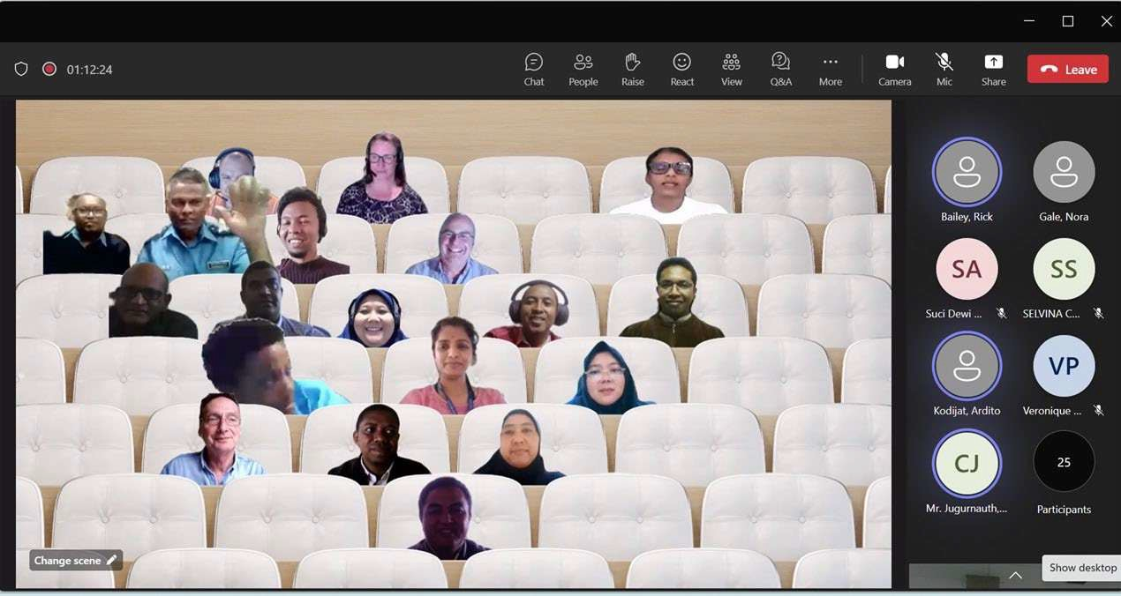
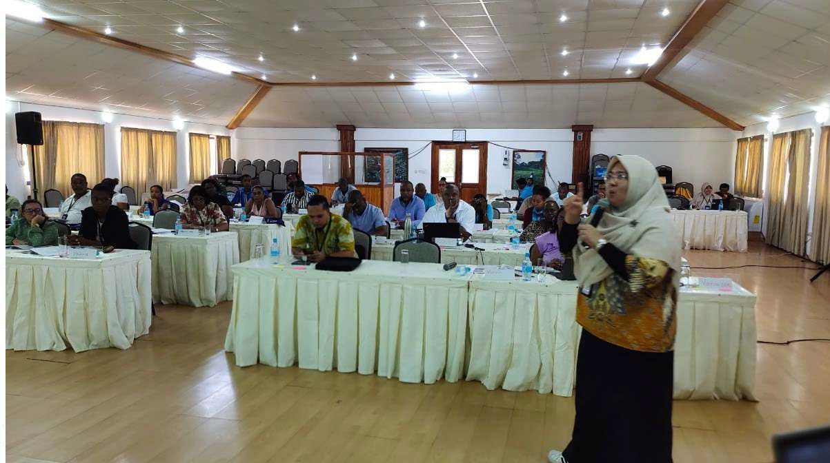
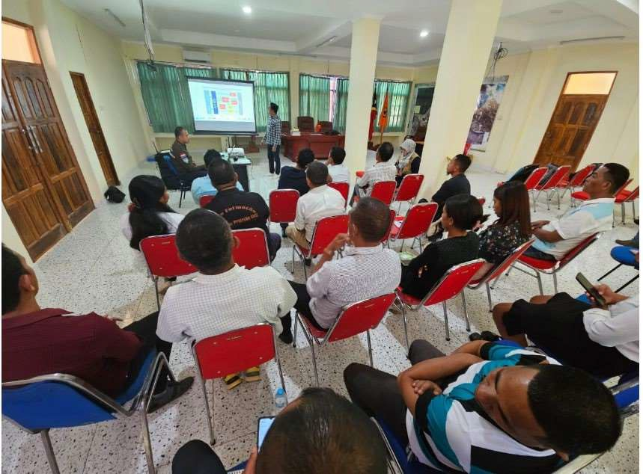
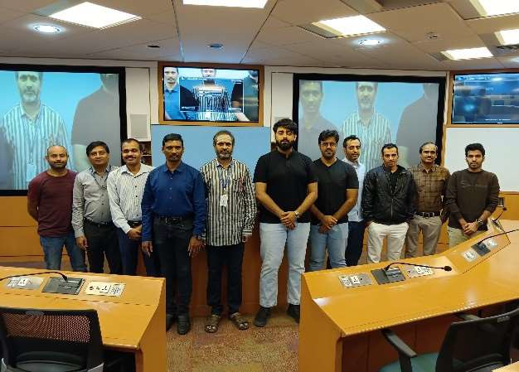
CAPACITY DEVELOPMENT ACTIVITIES IN 2023 - 2024
No | Activities | Date
1 | SOP Workshop for the West Indian Ocean | 03-06 July
2 | SOP Workshop for the Eastern Indian Ocean, | 10-13 July 2023
3 | SOP Workshop for the North-West Indian Ocean, | 7-8 August 2023
4 | Tsunami Ready Training Timor Leste | 31 July- 1 August 2023
5 | Tsunami Ready Training Seychelles | 31 July- 1 Agustus 2023
6 | On-the-job trainings for the Indian Ocean Member States (Oman and Timor Leste) | 13-21 March 2023
7 | TSP-India at INCOIS, conducted in-person on-job training course for Oman on “Tsunamis & Other Ocean Hazards” | 11-22 December 2023 & 2-6 September 2024
8 | Workshop on the UNESCAP Capacity Assessment Validation to result recommendation | 4-6 September 2024
SOP Training
Tsunami Ready Training in Seychelles
Tsunami Ready Training in Timor Leste
Oman, On-the-Job Training
5

Slide 7
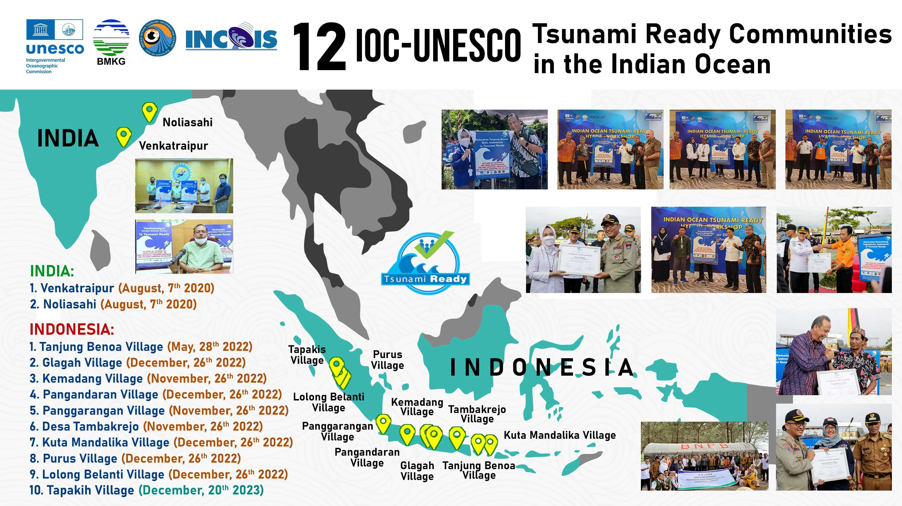
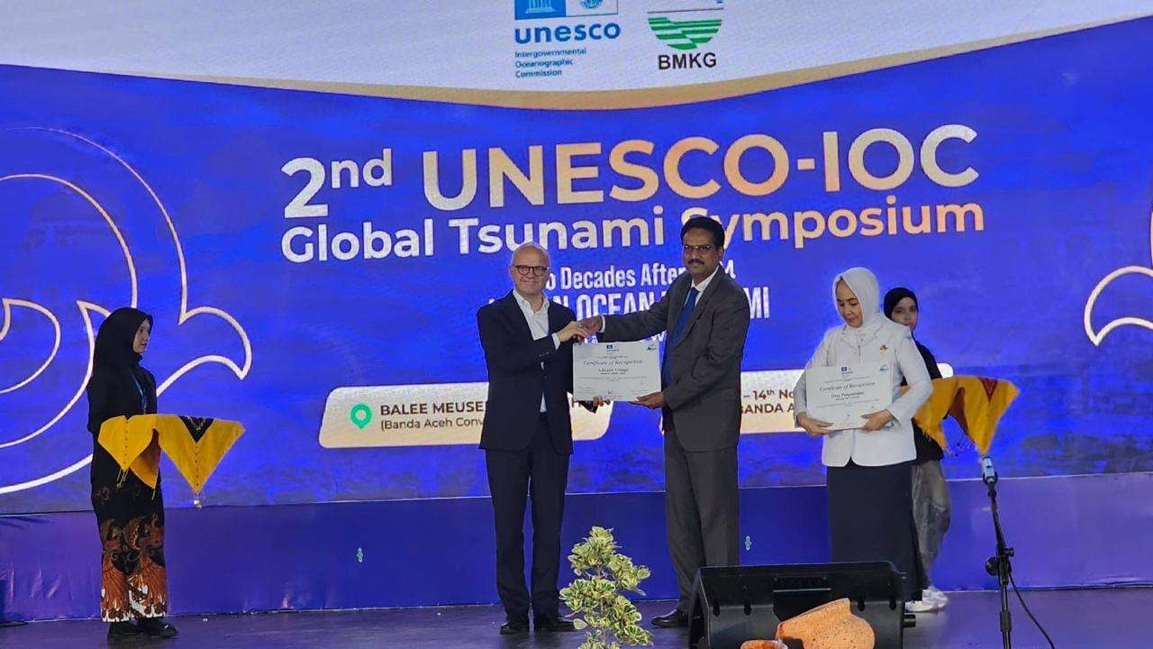
48
36 New communities of India [24] and
Indonesia (12) were recognized as Tsunami
Ready at the 2nd UNESCO-IOC Global Tsunami Symposium

Slide 8
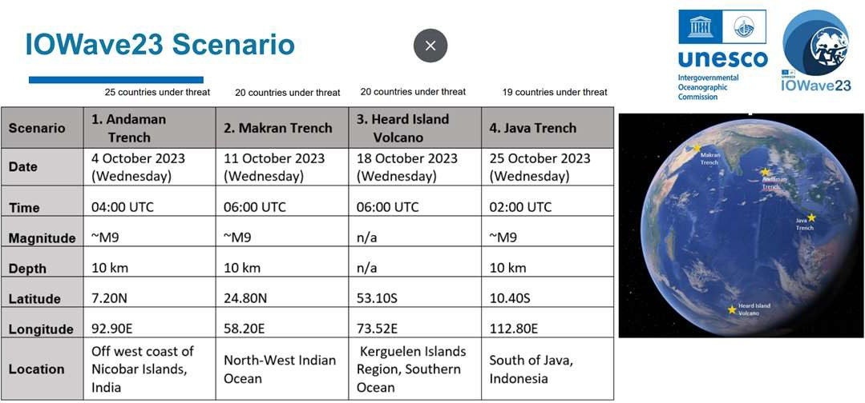
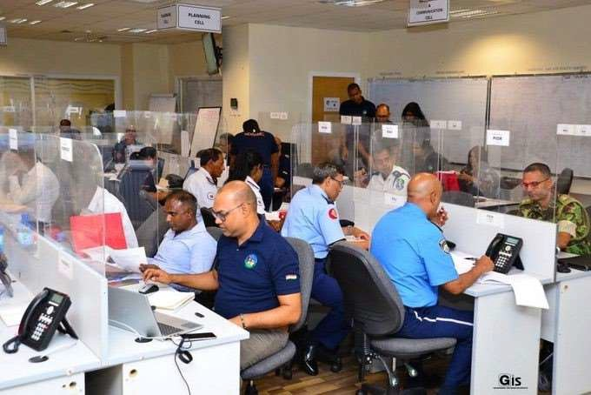
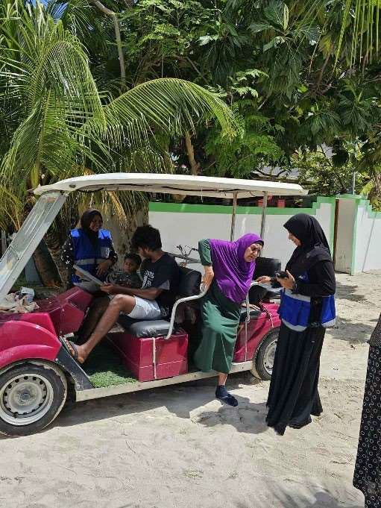
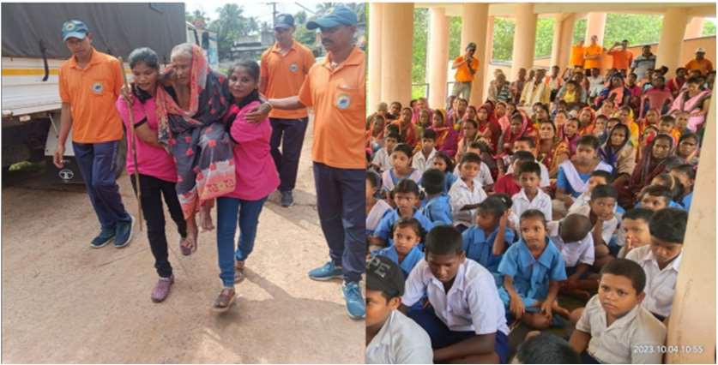
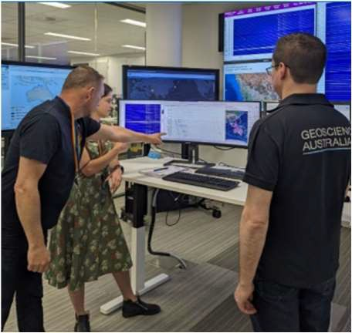
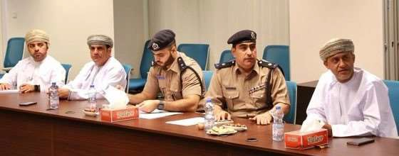
IOWAVE 2023 (4, 11, 18, and 25 October 2023)
IOTWMS Member States participation in the scenarios included:
4 scenarios including a non-seismic tsunami scenario
20 Member States
More than 45.000 people participated tsunami evacuation drill, including disabilities people
Critical infrastructure and decision makers
Propose for the next Exercise:
to conduct sub regional exercise, based on the needs and potential tsunami hazards
to carry out the Multi-Hazard exercise
8

Slide 9
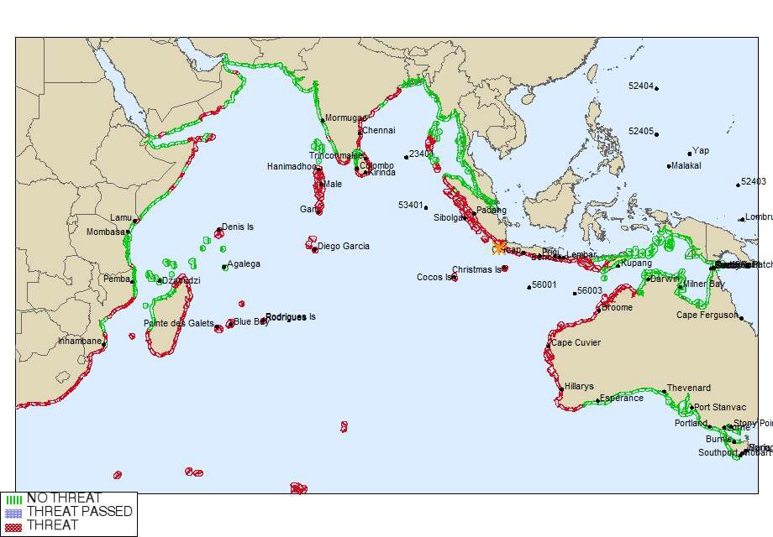
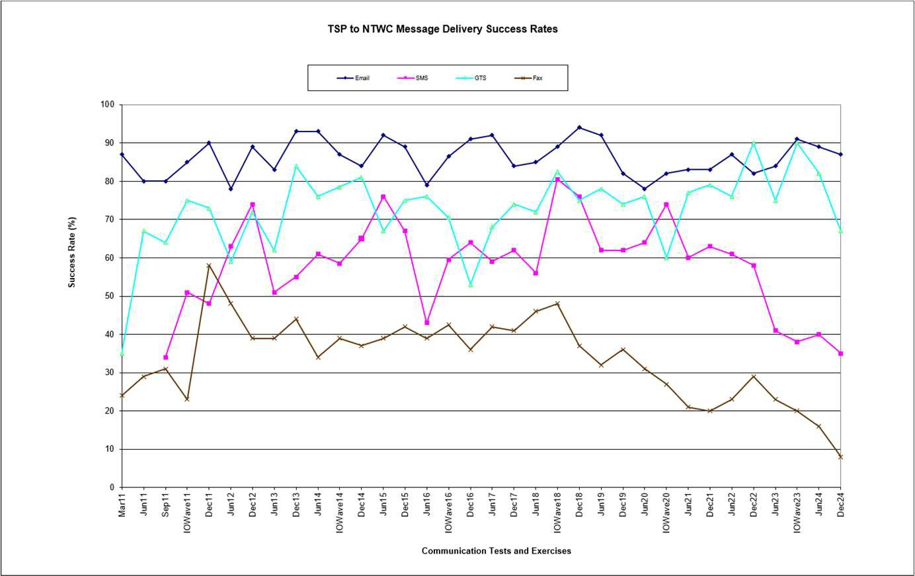
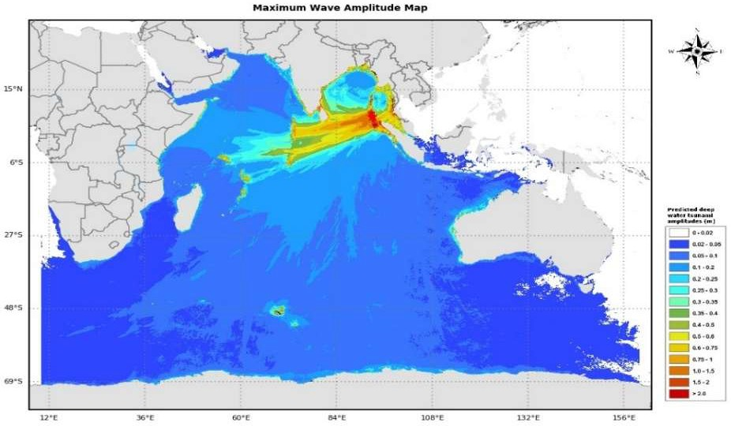
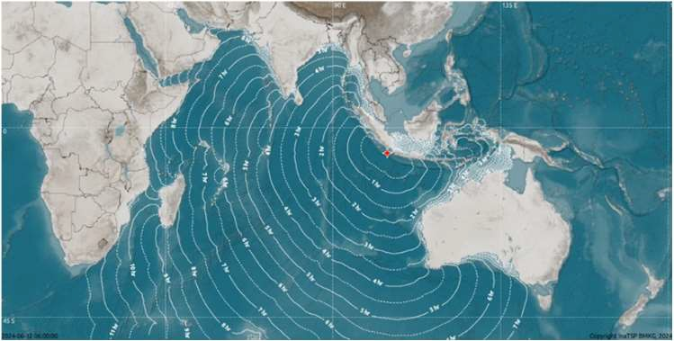
IOTWMS Communication Tests
As of today, 7 IOWave Exercises and 28 Communication Tests were conducted.
During the reporting period, 2 COMMS tests were conducted (June & December 2024)
E-mail
GTS
SMS
FAX

Slide 10

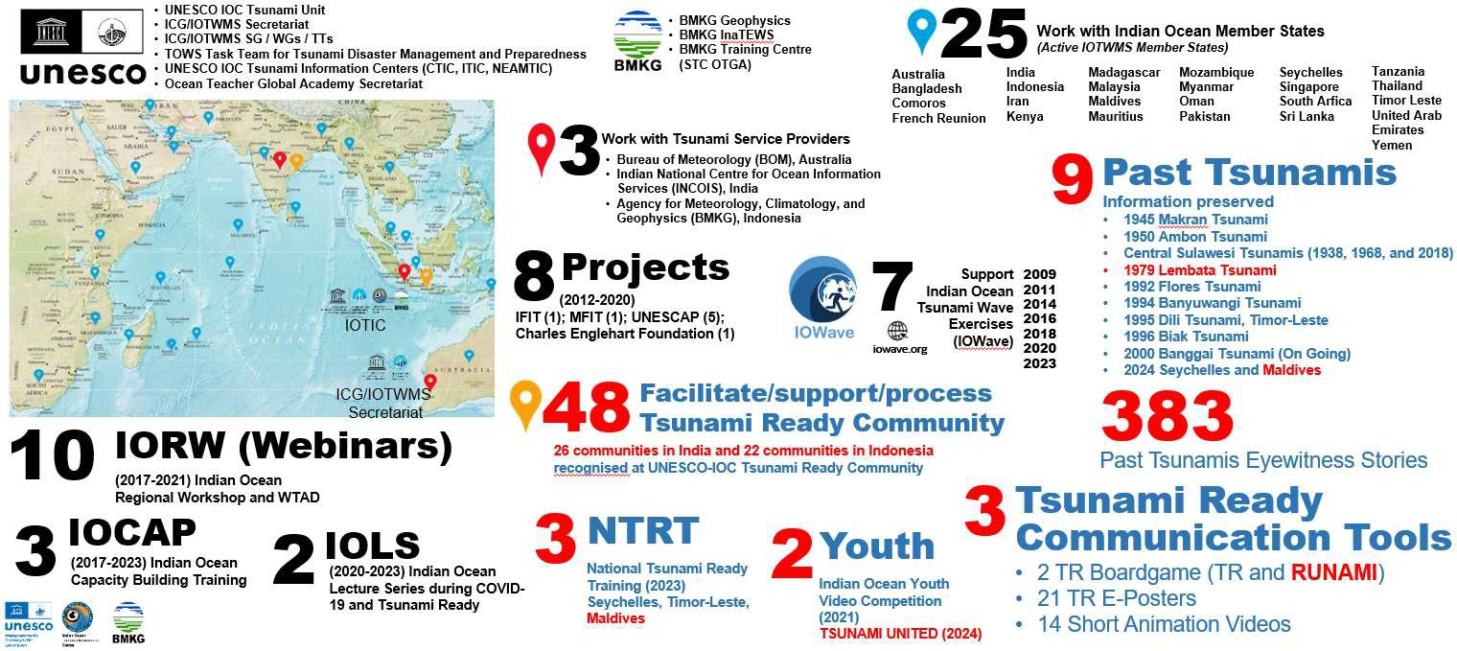



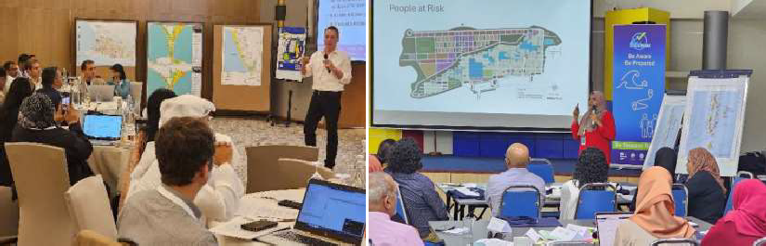
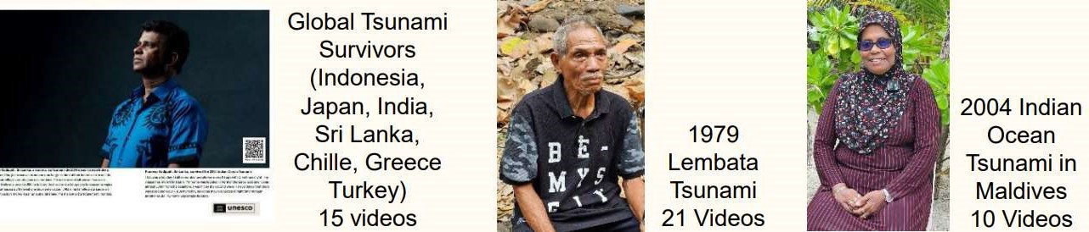


IOTIC Achievement in a Flash (~ 2024)
Key Achievements (2023-2024):
Capacity Building & Training
National Tsunami Ready Training in Timor-Leste (Jul. 2023), Seychelles (Nov 2023), and Maldives (Aug 2024)
Workshops and Webinars, including IORW, IOCAP, and IOSAP
Tsunami Ready Recognition Programme (TRRP)
48 communities recognized (India -26 & Indonesia - 22)
Development of Tsunami Ready Training Modules &
Tsunami Ready Board Game (RUNAMI)
Engagement & Outreach
TSUNAMI UNITED: Indian Ocean Youth Video Competition
UNESCAP Project: Workshops on tsunami modeling & evacuation planning ; WTAD Webinars: Promoting accessible early warning systems
Preserving Past Tsunami Information
39 new documented eyewitness stories from past Indian Ocean tsunamis were recorded in the year 2024 ; Development of educational materials on non-seismic tsunami warnings

Slide 11
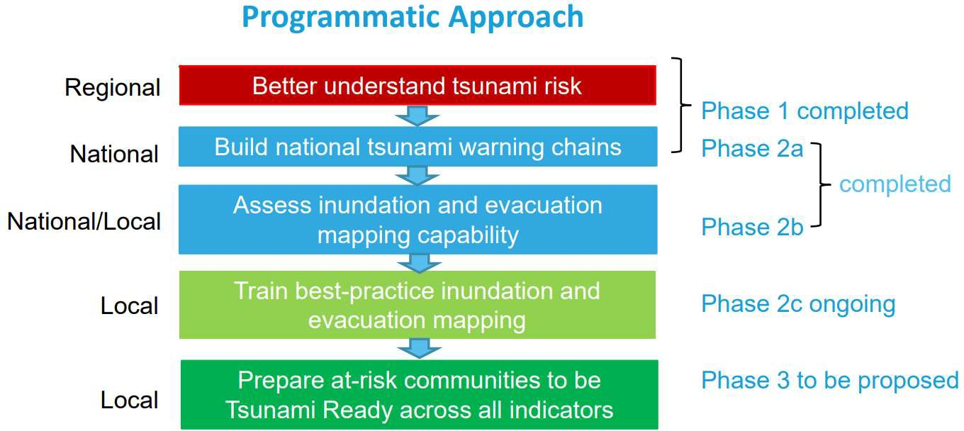
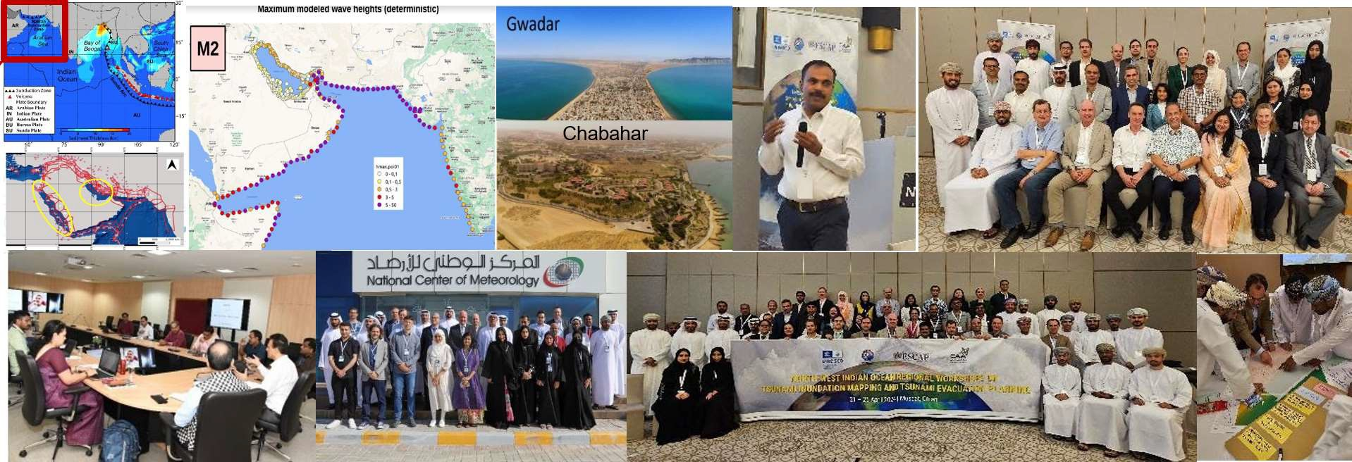
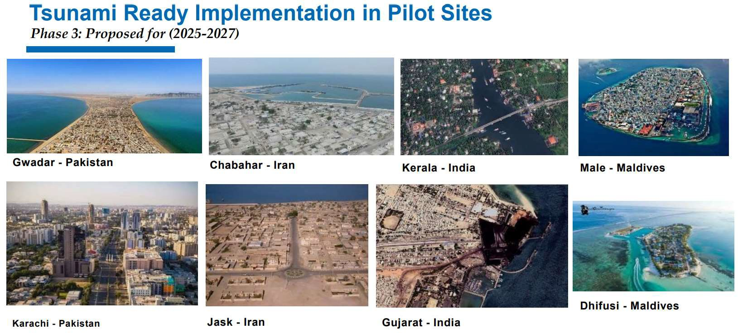
Strengthening tsunami warning in the North- West Indian Ocean through regional cooperation
Phase 1, 2a & 2b Achievements:
PTHA for NW Indian Ocean Completed: Supported by experts (GFZ, INGV, NGI, INCOIS); PTHA results will be hosted by INCOIS for NWIO countries.
Workshops/Trainings Conducted:
  “Makran Subduction Zone Science Strengthening Tsunami Warning and Preparedness”: 14–16 Nov 2023, Abu Dhabi, UAE.
  UNESCO-IOC Indian Ocean Tsunami Ready Hybrid Workshop: 22–26 Nov 2022, Bali, Indonesia.
  Training in tsunami inundation mapping, “Enhancing Capacities in Tsunami Modelling”, Muscat, Oman (19–23 Apr 2024).
Tsunami Ready Recognition Programme (TRRP): Guide countries to prepare at-risk communities.
Phase 2c ongoing/planned activities:
The project on “Strengthening tsunami warning in the North- West Indian Ocean through regional cooperation – Phase 2c”, was launched on 15 November 2023
Phase 2c funded by the ESCAP Tsunami Trust Fund over a 12-month period
A capacity-building workshop on Tsunami Evacuation Maps, Plans, and Procedures is planned for early 2025 supported by IOTIC, UNESCAP, UNESCO-IOC, INCOIS and BMKG. India will host this training at the INCOIS
Translate Manual and Guides – Ongoing
Engaged National Consultants to support the facilitation coordination at the local level to Pilot the Tsunami Evacuation Plan in selected sites in the country. – On Going
Phase 2a, 2b, 2c ➔ 3

Slide 12

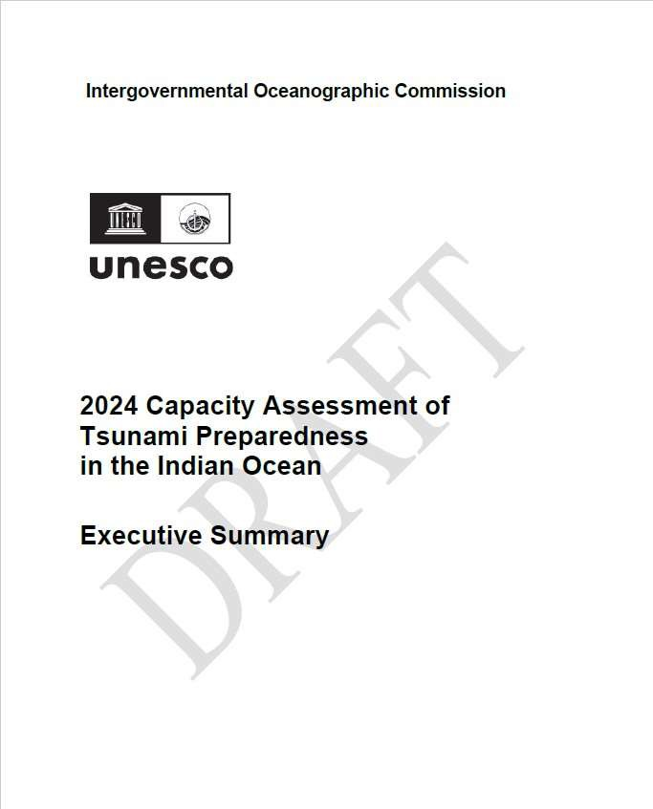
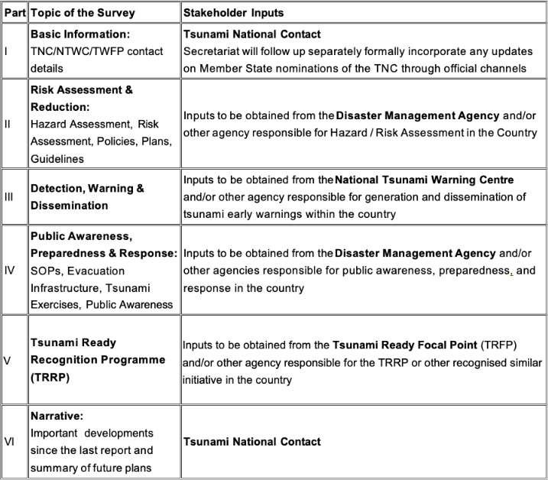
ICG/IOTWMS 2024 Capacity Assessment Survey
ICG/IOTWMS conducted the 2024 UNESCO-IOC Capacity Assessment of Tsunami Preparedness in the Indian Ocean to track regional change and to identify gaps and challenges that could be addressed through future projects and activities.
Survey responses from twenty-two (22) Member States have been received.
The University of Huddersfield analysed the data and compared with the results of the 2018 Assessment to produce a draft report.
The Capacity Assessment Team, supported by the ESCAP Tsunami Trust Fund and the Asian Development Bank, convened a meeting in Bangkok from 4–6 September to formulate recommendations.
The preliminary draft report are now available for review on the meeting website.

Slide 13
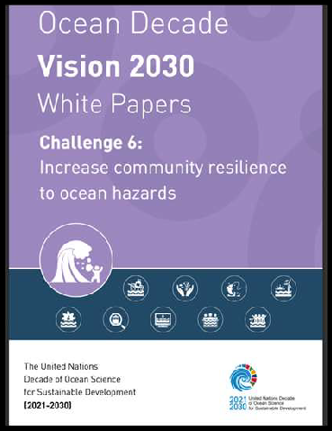
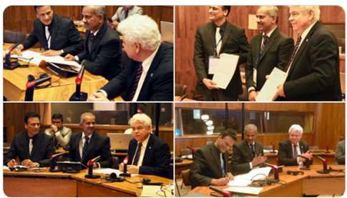
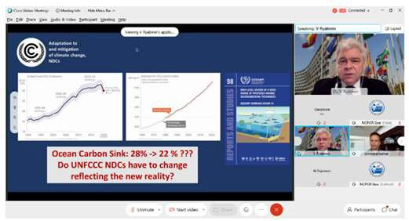
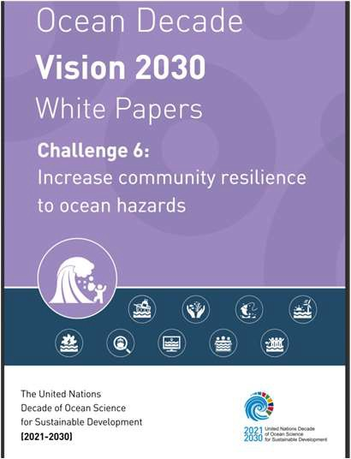
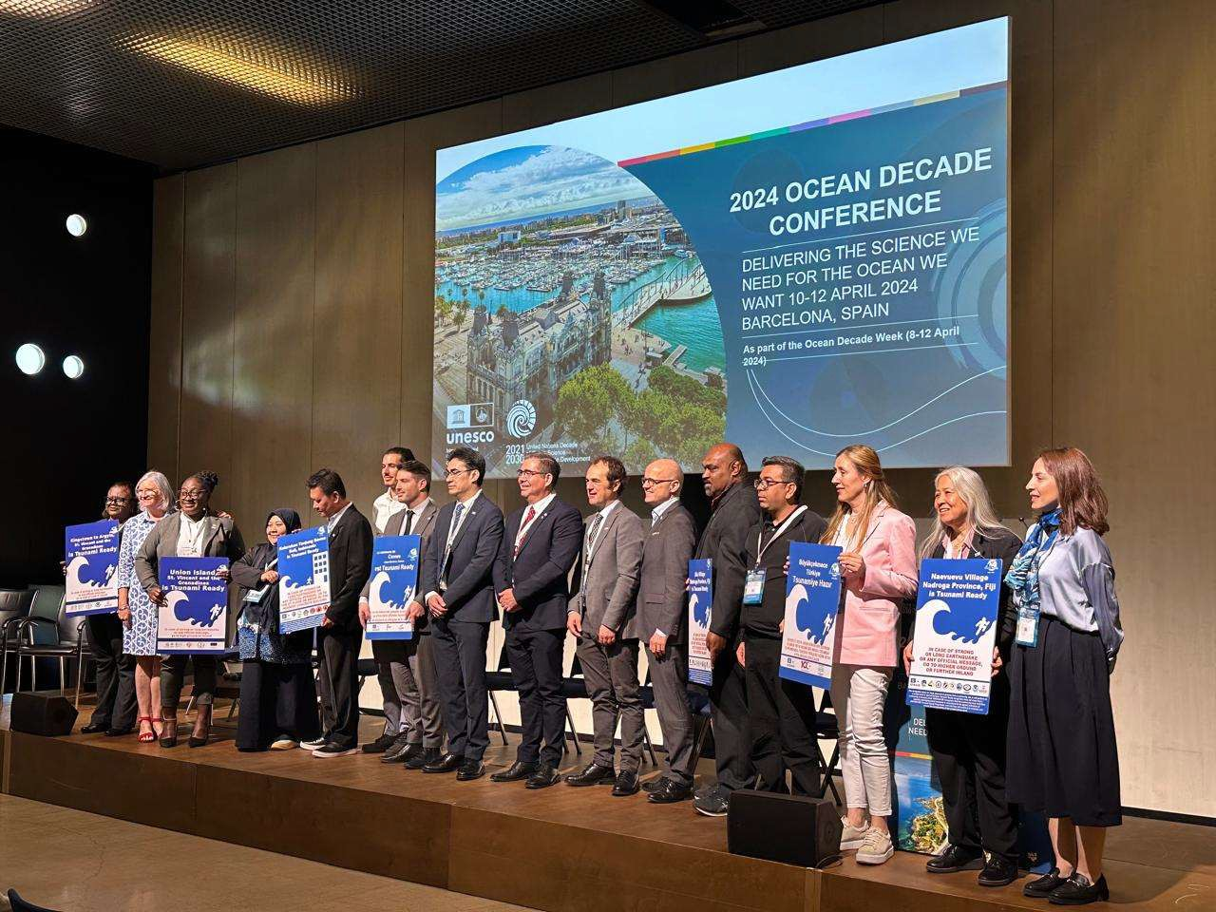
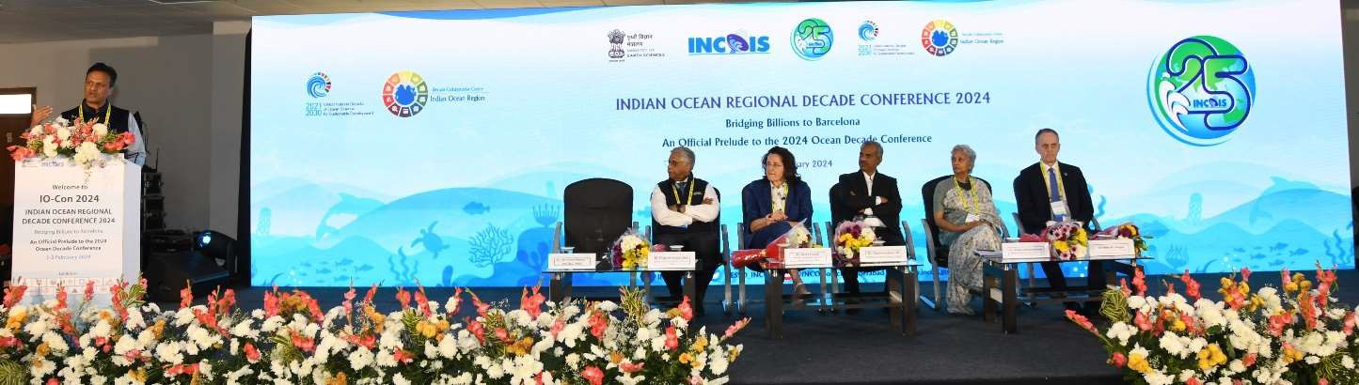
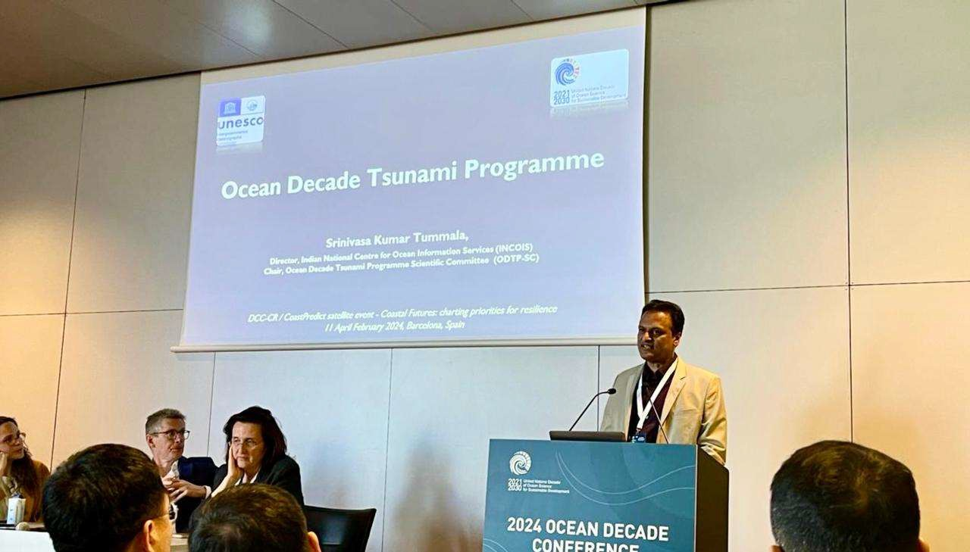
UN Ocean Decade Tsunami Programme
Decade Collaborative Centre for the Indian Ocean Region
UN Ocean Decade Barcelona Conference Indian Ocean Event
National Decade Coordination Committee (NDCC)
Indian Ocean Regional Ocean Decade Conference (IOCon-24)
Coastal cities and communities joining Tsunami Ready
As part of Call for Decade Actions No. 07/2024, India proposed 3 projects namely
Coastal Futures: Charting priorities for Coastal Resilience
Tsunami Night: 3 Films related to tsunami
•
TSUNAMI READY ODISHA (TRO)
•
2630 onsite & 3000+ online participants from 124 countries,
18th session of TOWS-WG, 24-25 Feb 2025
165 satellite events

Slide 14
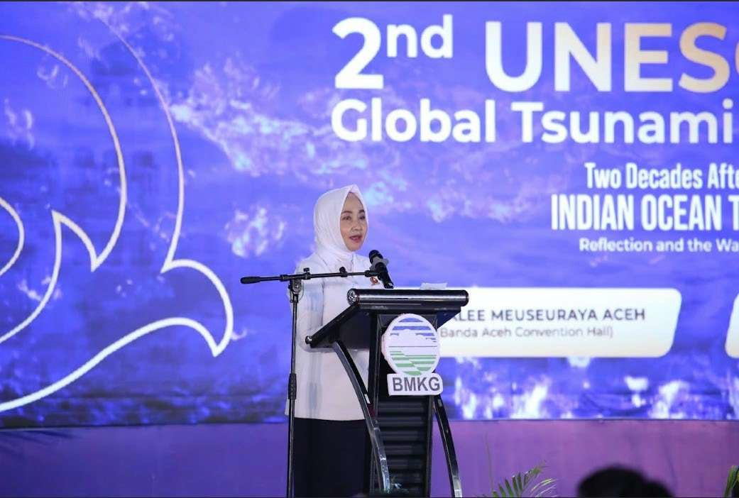
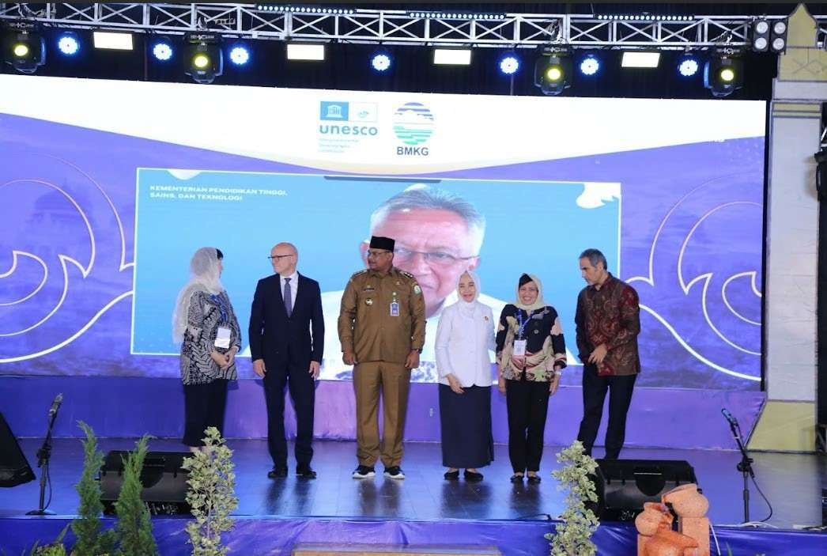
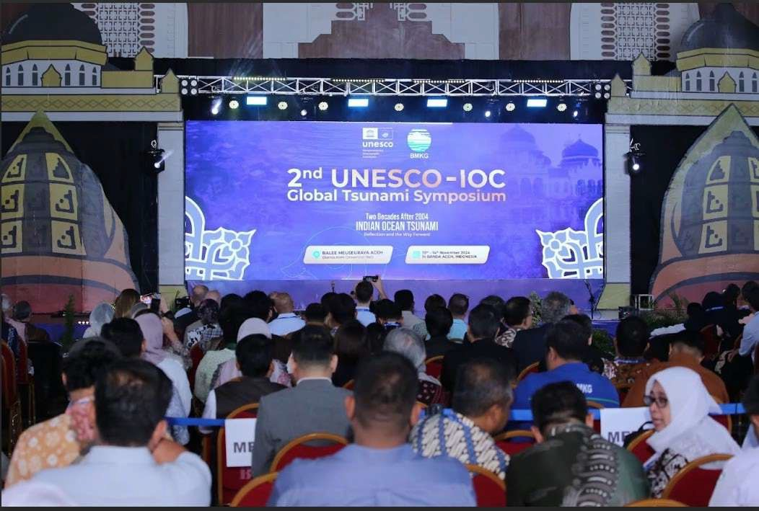
UNESCO-IOC 2nd Global Tsunami Symposium, Banda Aceh, Indonesia (10-14 Nov 2024)
Outcomes:
Showing the achievement of the technical development of tsunami warning and mitigation system
Showing the achievement of the community’s engagement in the Tsunami Preparedness capacity and response
Identifying priorities and gaps
Banda Aceh Statement:
Participants:
− 682 participants
− 170 online participants
− 1200 viewers of Youtube
− From about 32 countries
Global Tsunami Warning and Mitigation: Building Sustainability for The next decade through Transformation and Innovation.
Engaged many parties including:
− Scientists, Policy Makers, Academia, Professionals, Practitioners, Private Sector, School, Communities, Youth, NGO, UN Organizations
UNESCO and its partners call on States and civil society to drastically step up their investments and efforts to achieve 100% of Tsunami Ready Communities across the world by 2030.

Slide 15
Major Decisions from the 14th Session of ICG/IOTWMS
(14-19 Nov 2024, Jakarta, Indonesia)
Include the instructions from 57th Session of the IOC Executive Council, and the recommendations from TOWS-WG XVI and XVII in the work plans of the ICG for the next inter-sessional period;
ICG/IOTWMS Steering Group released the Service Definition Document version 5.0 that covers templates for NAVAREA and Non-Seismic templates.
Extend the TSP services to include tsunamis generated by non-seismic and complex sources
Instructs the Steering Group to finalize the 2024 Capacity Assessment Report and Executive Summary in 4 weeks, for further review by the Member States, incorporate feedback if any, and endorse the final report for publication as UNESCO-IOC Document
Establish a new intersessional Task Team on Indian Ocean Wave 25 Exercise (IOWave25) reporting to the Steering Group
Establish a new intersessional Task Team on New/Emerging Technologies for Observations and Forecasting under the WG2
Establish a new intersessional Task Team on Mid-Term Strategy (MTS) to prepare a draft MTS
Request the Steering Group to supervise the work of the Task Team and to finalise the MTS 2025-2030 by early half of 2025
Instructs the Steering Group, Working Groups and Task Teams to consider the recommendations of the ODTP RDIP, IOWave23, 2024 Capacity Assessment and 2nd Global Tsunami Symposium into their work plans.
Decides to continue the capacity development initiatives related to SOPs, TEMPP, TRRP and on-the-job training for warning center operators by TSPs. TEMPP, hosted by INCOIS, is scheduled to take place in April 2025.
Request the Steering Group to explore if there is a need of expanding sub-regional working groups to address regional gaps and strengthen collaborations.
Develop the summary statement of the 2nd UNESCO-IOC Global Tsunami Symposium together with the Program Committee for publication as a UNESCO-IOC document.
Optimal sea level and seismic network design for the Area of Service (AoS) and work with Member States to fill identified gaps, including the strategic and coordinated submission of projects to the UN Ocean Decade and potential funding sources for support.

Slide 16
THANK YOU
Mr. Eluri Pattabhi Rama Rao
Chair, ICG/IOTWMS
pattabhi@incois.gov.in
13

