Slide 1
TOWS-WG 18th Session
Task Team on Tsunami Watch Operation
21 – 22 February 2025
Agenda 6. Updates to Area of Coverage and ESZ Maps of the ICGs
NISHIMAE Yuji
TTTWO Chair

Slide 2
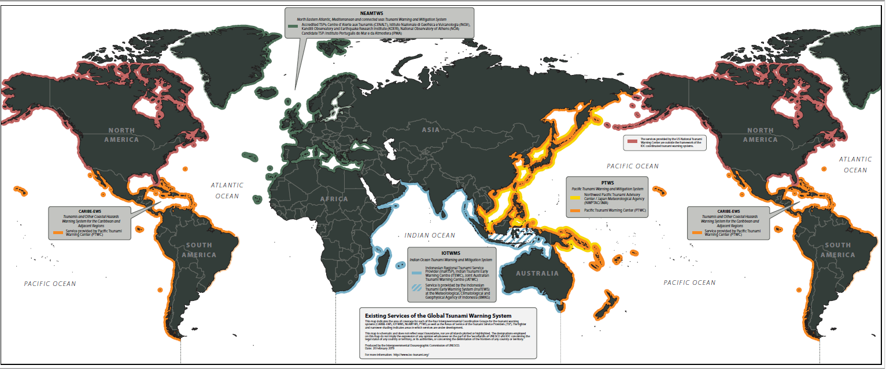
Area of Service of each TSP of the ICGs
Figure 1: Global coverage of the four IOC Regional Tsunami Warning Systems and their Tsunami Service Providers (Reference: IOC/TOWS-WG-XII/3 Annex IV, page 19 )
This map will need to be latest at the time of GSDD publication and may need to reflect the coastal service area of CATAC.

Slide 3
TOWS-WG 18th Session
Task Team on Tsunami Watch Operation
21 – 22 February 2025
Agenda 7. Tsunami Service Provision Considerations for Events Outside ICG Earthquake Source Zones
NISHIMAE Yuji
TTTWO Chair

Slide 4
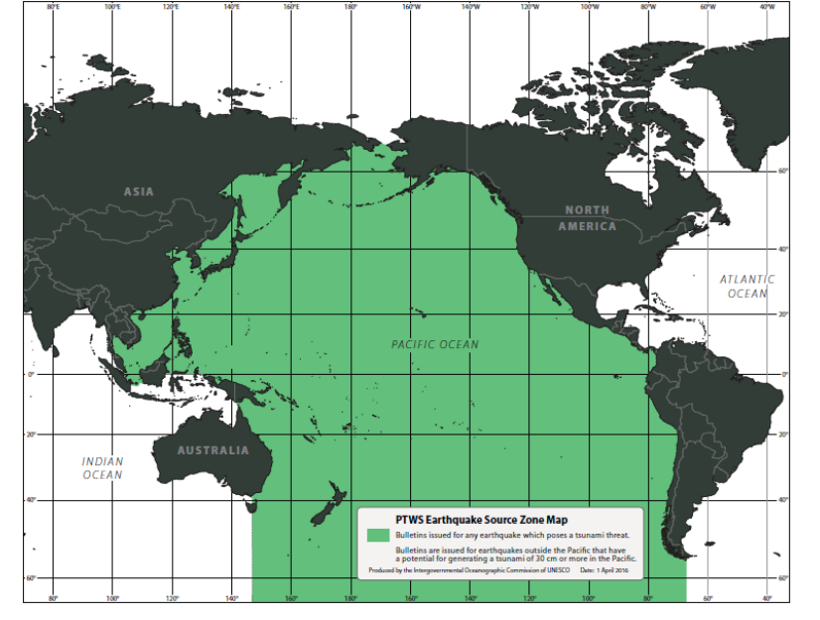
Earthquake Source Zone Map of the ICG/PTWS
Bulletine issued by any earthquakes which poses a tsunmi threat
Bulletines are issued earthquakes outside the Paicific that have a potensial for generating a tsunami 30 cm or more in the Pacific
PTWS Earthquake Source Zone Map (Reference: IOC/TOWS-WG-IX/3 Annex IV, page 52)

Slide 5
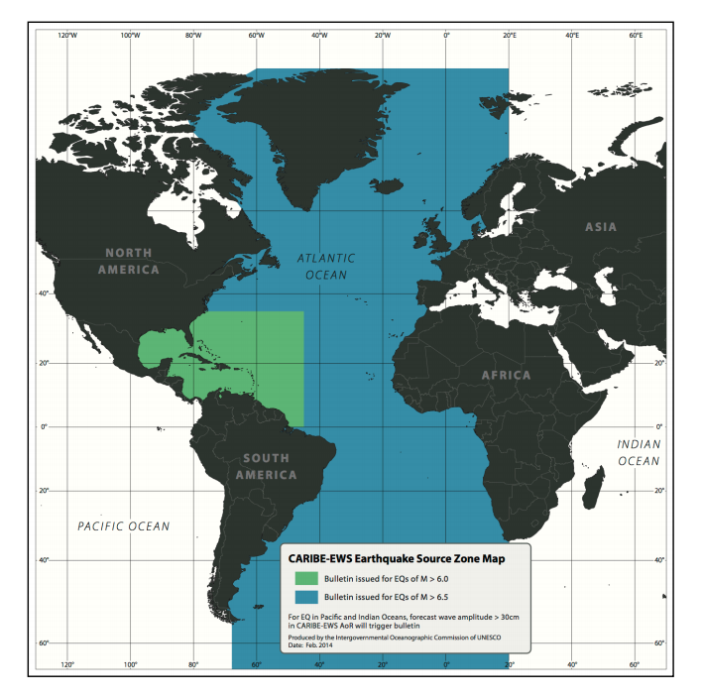
Earthquake Source Zone Map of the ICG/CARIBE-EWS
Bulletine issued for EQs of M > 6.0
Bulletines issued for EQs of M> 6.5
for EQ in the Pacific and Inidian Oceans, forecast wave amplitude > 30 cm in CARIBE-EWS AoR will trigger bulletine
CARIBE-EWS Earthquake Source Zone Map (Reference: IOC/TOWS-WG-VII/3 Annex V, page 19)

Slide 6
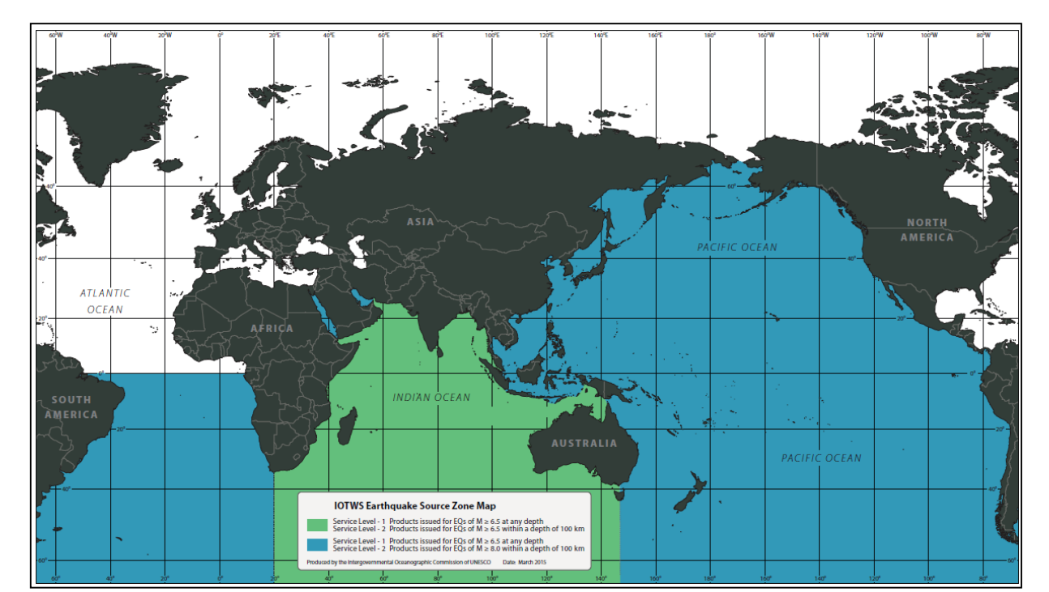
Earthquake Source Zone Map of the ICG/IOTWMS
Service Level - 1 Products issued for EQs of M ≥ 6.5 at any depth
Service Level - 2 Products issued for EQs of M ≥ 6.5 within a depth of 100 km
Service Level - 1 Products issued for EQs of M ≥ 6.5 at any depth
Service Level - 2 Products issued for EQs of M ≥ 8.0 within a depth of 100 km
IOTWMS Earthquake Source Zone Map (Reference: IOC/TOWS-WG-VIII/3 Annex VI, page 14)

Slide 7
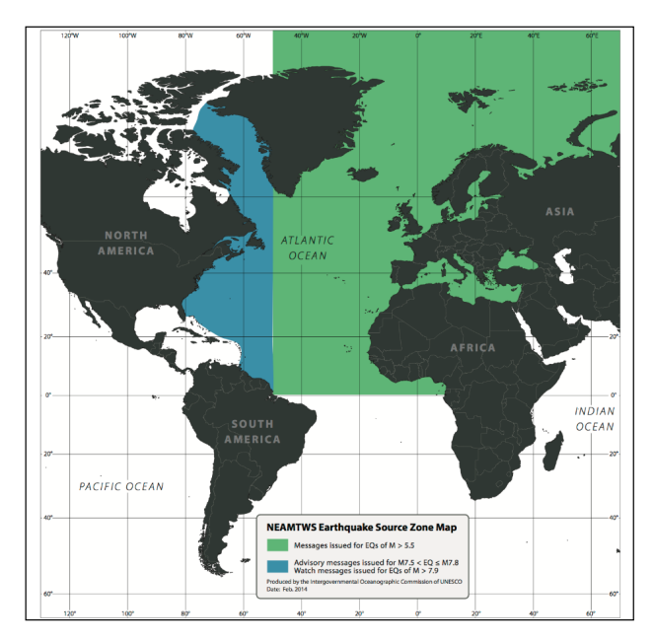
Earthquake Source Zone Map of the ICG/NEAMTWS
Messages issued for EQs of M > 5.5
Advisory messages issued for M 7.5 < EQ ≤ M 7.8 Watch messages issued for EQs of M >79
NEAMTWS Earthquake Source Zone Map (Reference: IOC/TOWS-WG-VII/3 Annex V, page 21)

