Slide 1
Tsunami Ready
Establishment of the
National Tsunami Ready Board, Workflow and Certification Process for TRR
Denis Chang Seng. PhD
Programme Specialist
ICG/NEAMTWS and TOWS Task Team Disaster Management and Preparedness Technical Secretary
NEAMTIC Officer/Manager
CoastWAVE Project
UNESCO-IOC Focal Point for TRS ODTP, EW4ALL MSF and UNDRR
UNESCO IOC

Slide 2

Establishment
M & G 74, (5.2.2) States that a National Tsunami Ready Board (NTRB) has to be established.

Slide 3
The National Tsunami Ready Board (NTRB)
The National Tsunami Ready Board is comprised of, but not limited to, and depending on each country’s settings:
M & G 74
Function, role, and responsibility:
General oversight of the National Tsunami Ready Program (TRP) Advocate, supervise, and support actions Manage resources for the TRP Maintain consistency of the TR guidelines Coordinate and liaise with technical institutions and organizations Directs and oversees service improvements to the TRP Oversees national Tsunami Ready database
National and Local Disaster Management Office (NDMO and LDMO)
National Tsunami Warning Centre (NTWC)
Ministries, national agencies, institutions and other relevant organizations,
NGOs for Community Based Disaster Risk Reduction (DRR) or Disaster Risk Management (DRM)
Tsunami National Contact (TNC)
Community Representatives (Non-decision Member)
NTRB: Formal structure /arrangement
Need to look into the mandate of relevant agencies: Hazard preparedness, climate change, climate change adaptation committees and civil protection agencies, DMOs etc
Notes:
The establishment of the NTRB should be informed to the UNESCO/IOC ICG Technical Secretary of the region (Pacific, Indian, North-eastern Atlantic and Mediterranean, and Caribbean) and the corresponding Tsunami Information Centre (TIC).

Slide 4
Members are responsible:
  1
  2
  3
  4
To guide the community
To review and approve the TR application of the community
To oversee the TRRP and its administrative paperwork and implementation.
To review existing and proposed changes

Slide 5

In the case of small countries and territories, the Tsunami Ready recognition may be granted at the national/territorial level. [ Entire Coast or Island?]
In this case, the Regional Tsunami Ready Board (RTRB) would
  be responsible for reviewing and approving recognition.
  Membership
    The ICG Chair (serves as the RTRB Chair)
    TIC Director/ Manager
    ICG Technical Secretary
    ICG Working Group Chairs or relevant TT that cover the topics of tsunami warning and dissemination, disaster management, preparedness and risk reduction, the and
    other guests at the discretion of the RTRB Chair
Under Consideration in NEAMTWS

Slide 6

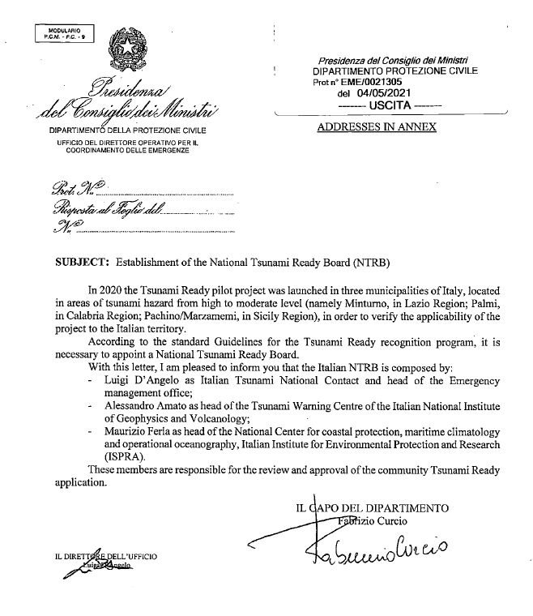
The Italian NTRB
Members
TNC, Head of the Emergency Management Office
Head of NTWC of the Italian National Institute of Geophysics and Volcanology
National Center for Coastal Protection, Maritime Climatology and Operational Oceanography , Italian Institute for Environmental Protection and Research ( ISPRA)
Responsibility/role
NTRB are responsible for the review and approval of the community Tsunami Ready application
Documentation
A decree for the establishment, formation and appointment of members of the NTRB?

Slide 7

Spain NTRB
Source : Ignacio Aguirre Ayerbe. IH Cantabria
Members
Head of the Seismic and Meteorological Risk Service of the National CPA (DGPCE). Directorate-General for Civil Protection and Emergencies.
Senior officer of National CPA (DGPCE).
Head of the National Seismic Network and NTWC (IGN) National geographic Institute.
Head of Geophysical Hazards Management Area (IGN).
Specialist on Disaster Risk Management (IHCantabria).
Tsunami National Contact Point (TNC).
Responsibility/role
NTRB are responsible to review and approve Tsunami Ready Recognition applications from requesting communities liaise with ICGNEAMTWS and NEAMTIC.
Documentation
Minutes of Panel constitution, issued by the Spanish Institute of Oceanography ( IEO-CSIC )of the Ministry of Science and Innovation, signed by all the participants.
It was established on May 6, 2024, and called Panel Nacional Tsunami Ready.

Slide 8


Greece NTRB
Members
Head of the Emergency & Response Planning Directorate of the Secretary General for Civil Protection, and deputy as head of the Natural Disasters Department of the same Directorate.
Greek TNC and operational head of NOA-National Observatory of Athens
Representative of the Institute of Geodynamics of the National Observatory of Athens and member of the scientific community.
Responsibilities/Role
Monitoring and approval of the results of the Tsunami Ready Recognition Program in accordance with the "Standard Guidelines for the Tsunami Ready Recognition Program - no 74" IOC/UNESCO document.
Documentation
A decree for the Establishment, formation and appointment of members of the NTRB
Publication in the Government Gazette (both documents in Greek).

Slide 9
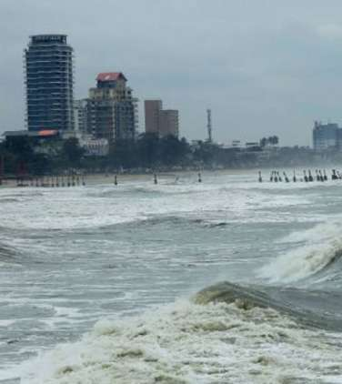
INDIA NTRB
Members
Chair: Director, INCOIS
Representatives from: Ministry of Home Affairs, Ministry of Earth Sciences, DMO
Secretary: Head TWG, INCOIS
Odisha becomes first state to get 'tsunami ready' tag
Image Source : PTI

Slide 10
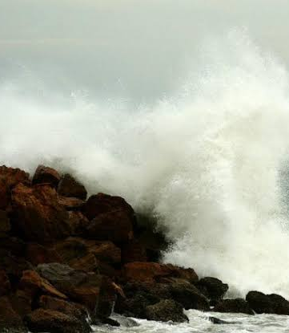
Roles of India NTRB (Cont)
To implement and monitor TRRP and IOWave Exercises
Review, advocate, approve tsunami recognition request
Regularly monitor and evaluate approved tsunami ready community
Recommend tsunami ready community for regional recognition
General oversight of the national Tsunami Ready Programme
Maintain consistency of the Tsunami Ready guidelines
Review proposed tsunami ready application
Monitor and evaluate existing Tsunami Ready community
Review existing and proposed changes to the Tsunami Ready Guidelines and publish updates as needed
Monitor IOWave related activities
Assess probabilistic Tsunami Hazard

Slide 11
TR Workflow & Certification Process

Slide 12

PHASE 1:Expressions of Interest to Establish UNESCO IOC Tsunami Ready Community
  The TNC and or NTRB
Informs the respective Technical Secretary/ TIC Manager of IOC/ TSR through a Letter regarding
members and roles
Lessons Learned
Early Expressions of interest is very important in terms of planning 2. Start engaging with authorities early to establish NTRB.
DO NOT LEAVE IT TOWARDS LAST STEPS!!
Notes:
If the community is determined not to be Tsunami Ready as defined in the indicators, the application will be returned to the community with information about what is missing. Once these issues are addressed, an updated application should be submitted following the same steps as in the first application.
The NTRB approves the application and informs the UNESCO/IOC ICG Technical Secretary, with copy to the TIC, of the region.

Slide 13
PHASE 2:
Community Ready to Apply for Recognition after having achieved all 12 Indicators
  If NTRB approves application, it informs UNESCO IOC via the ICG Technical Secretary/TICs Manager for the region
NTRB reviews application form.
Sets date for site verification visit and review meeting
Completes the application form and submits to the NTRB
  TR Local Community
Notes:
If the community is determined not to be Tsunami Ready as defined in the indicators, the application will be returned to the community with information about what is missing. Once these issues are addressed, an updated application should be submitted following the same steps as in the first application.
The NTRB approves the application and informs the UNESCO/IOC ICG Technical Secretary, with copy to the TIC, of the region.

Slide 14
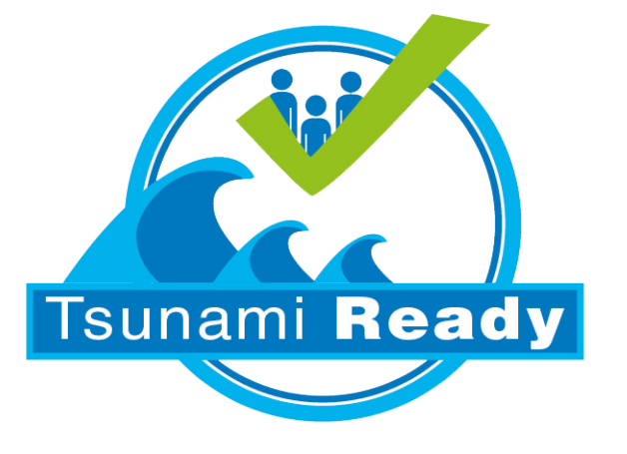
Workflow for Certification (TSR)
IOC Informs TICs and Technical Secretaries and send TR summary and documentation files for web posting
IOC post on website a news article on the community that has been recognized
NTRB writes summary text with images on TR recognized community and send to IOC (Tec Sec) copied to TIC
NTRB organize certificates delivery
IOC (Tec Sec/TICs) request the Chair of NTRB to nominate a contact point for the process and to provide the list of certificates (recognition and appreciation) copied to TIC
IOC (Tec Sec) prepares a first draft of the required certificate/sign and send them for revision to the National Tsunami Ready contact point, copied to TIC.
Once the files are validated , IOC send certificates for signatures.
After signed, they are sent to NTRB , copied to TICs
TICs /Tech Sec Verifies
IOC (Tech Sec/ TICs)receives the final support documentation (Files organized accordingly) from NTRB and the endorsed submission form copied to TIC
IOC (Tech Sec/TICs) receives from NTRB the letter and signed application form copied to TIC
NTRB

Slide 15
UNESCO-IOC TRR TOOLKIT TO BE RELEASED
MARCH 2025

Slide 16
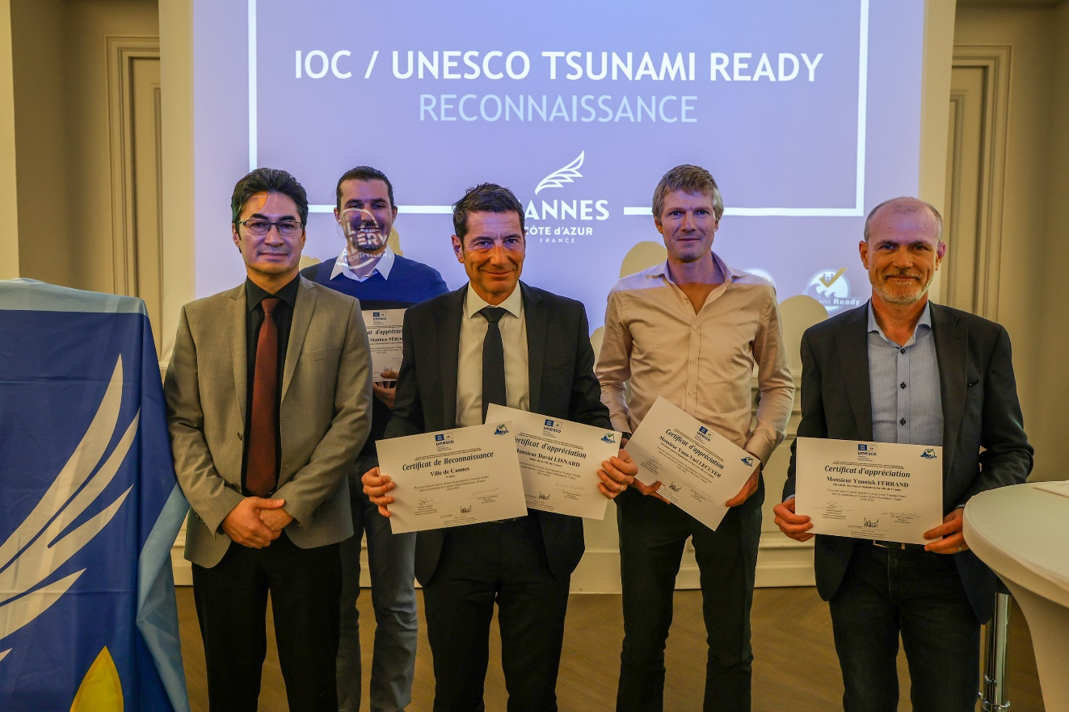
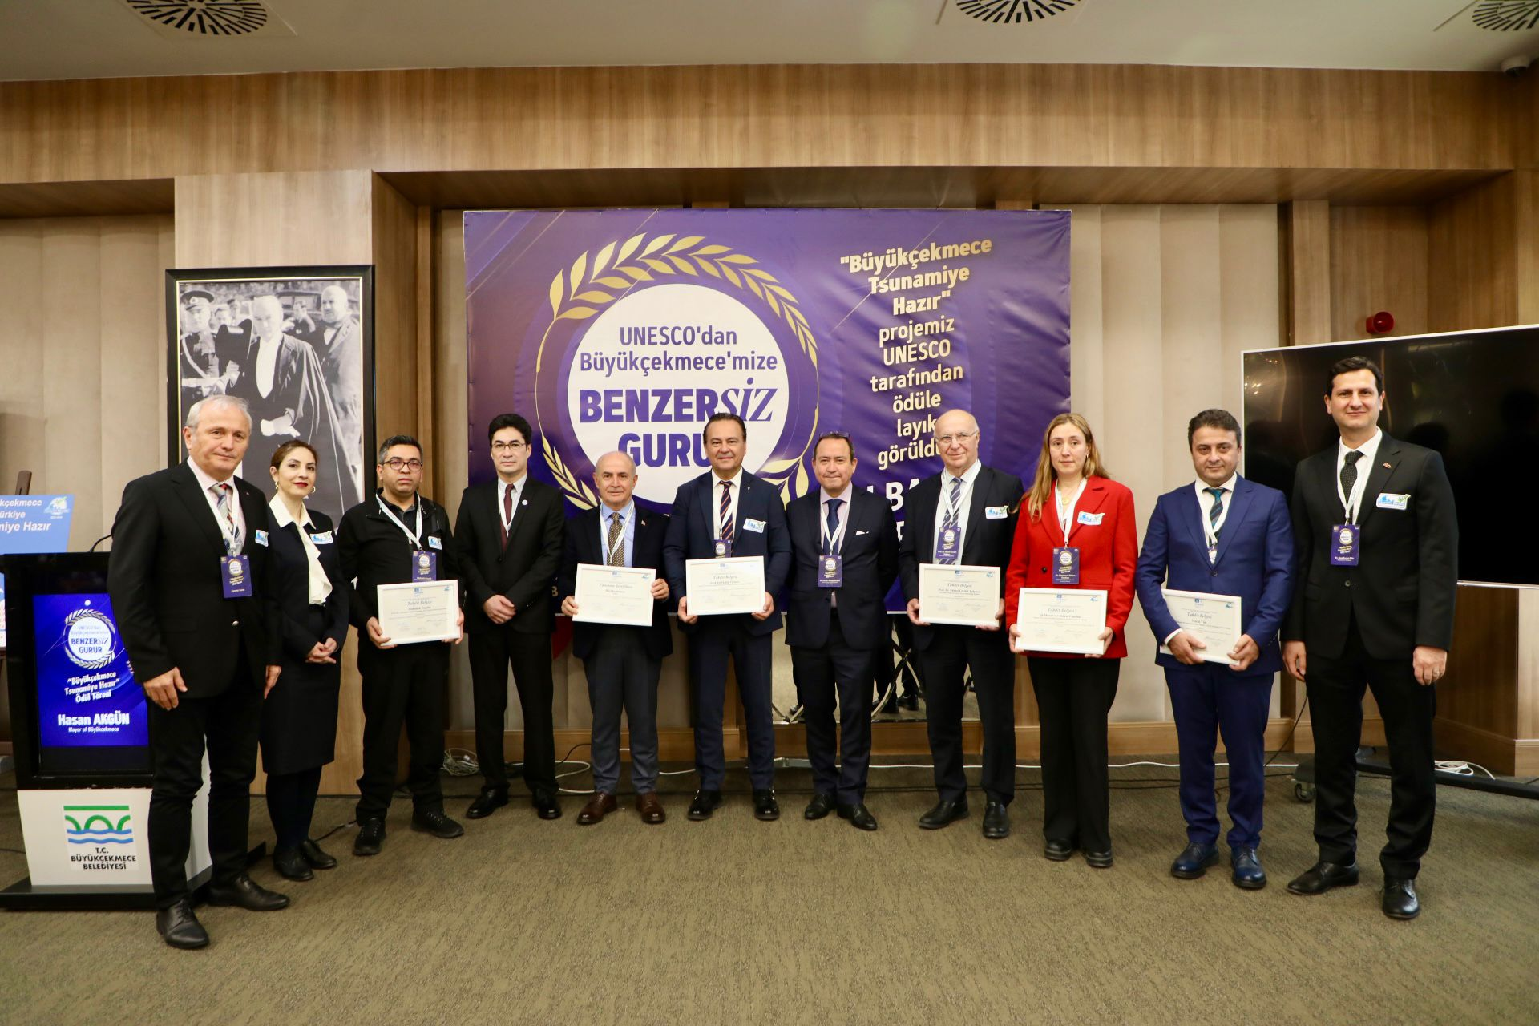

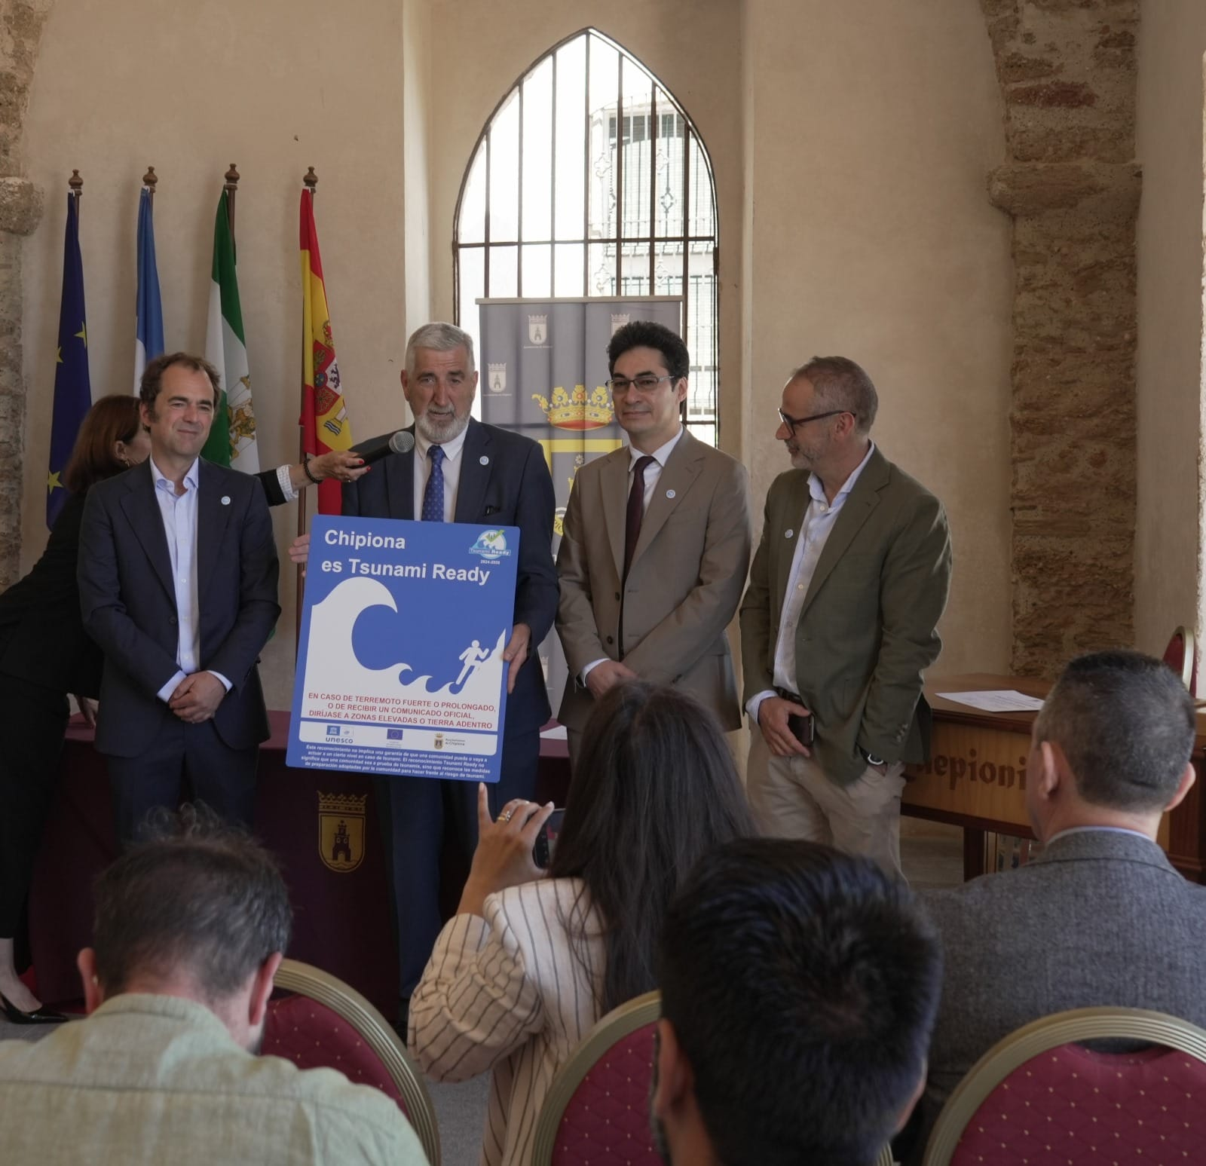

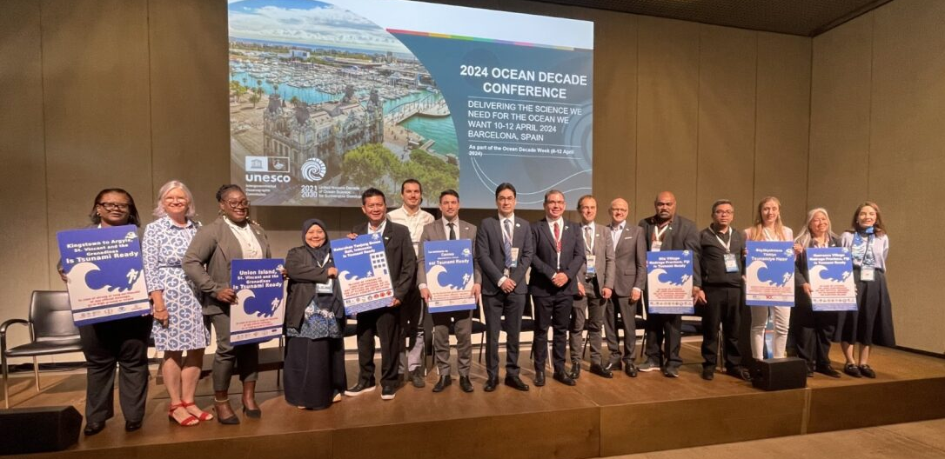
International, National, Local Engagements
City Mayors and Governor
Cannes, France
Büyükçekmece, Itanbul, Turkeye
Alexandria, Egypt
Chipiona, Spain
Samos, Greece
2024 Ocean Conference, Barcelona 11 April 2024

Slide 17
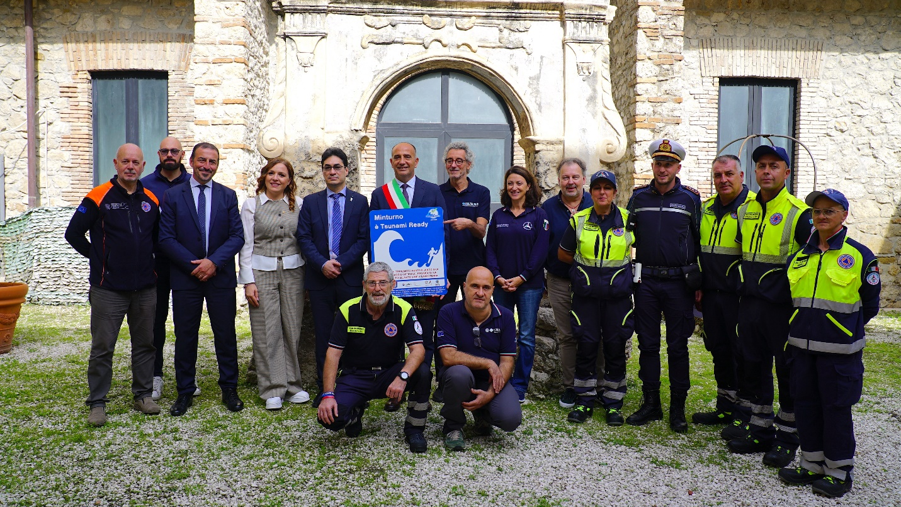
Minturno, Italy joins the UNESCO-IOCTsunami Ready Programme

Slide 18
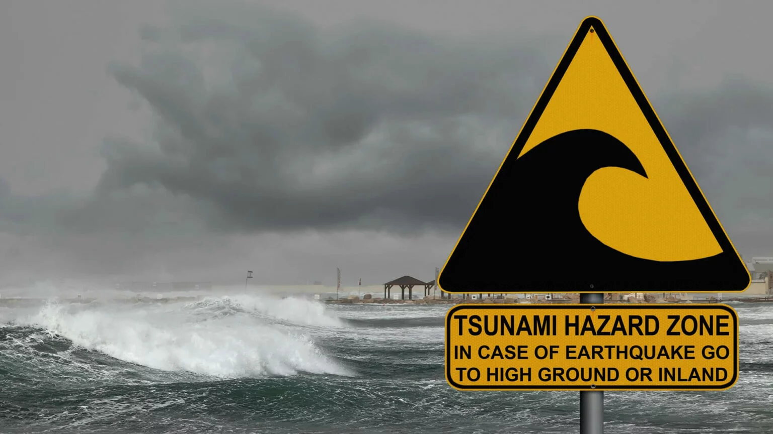

END
Web: https://tsunami.ioc.unesco.org/en/neam/icg-neamtws

