Slide 1



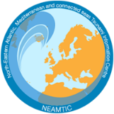
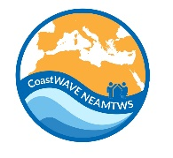
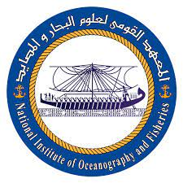
Prep-4: Outreach or educational activities are held at least three times a year.
Prof. Suzan El Gharabawy
National Institute of Oceanography and Fisheries (NIOF)
UNESCO-IOC EU DG ECHO CoastWAVE 2.0 Project
UNESCO-IOC Regional Tsunami Training
Online, January 14-15, 2025

Slide 2
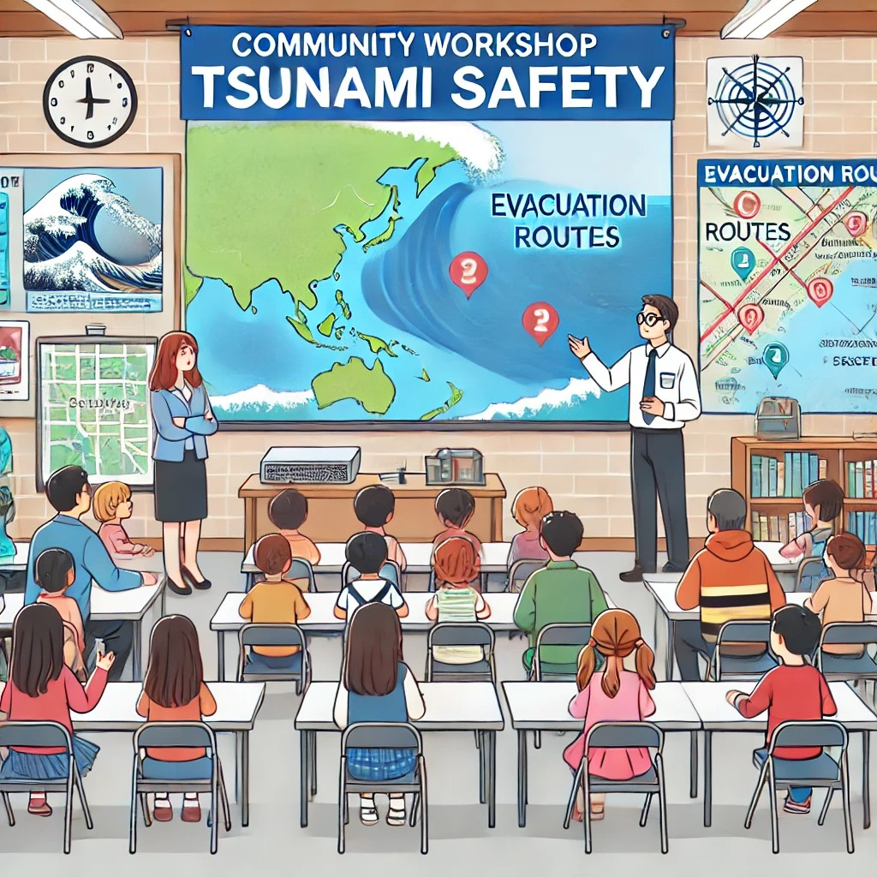
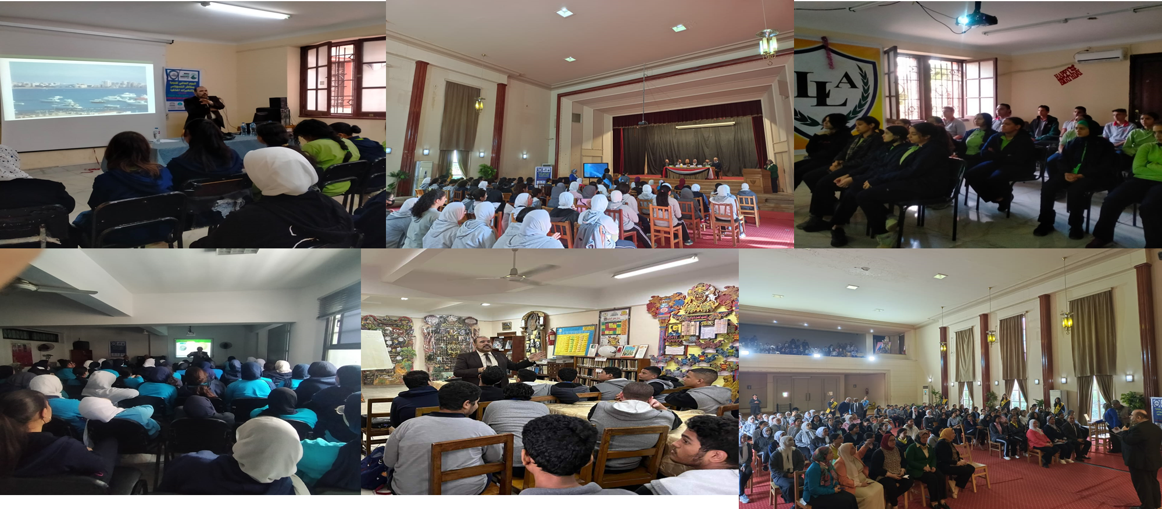
UNESCO-IOC Regional Tsunami Ready Training for NEAM Region
The aim is to educate community residents, businesses, and visitors, with an emphasis on those in the tsunami hazard zone, on tsunami hazards, evacuation routes, how warning information will be received (including natural warnings for regions with a local tsunami threat), safety, and response. These activities may be multi-hazard as long as they include tsunamis in the content. ”
Prep-4 focuses on conducting at least three outreach or educational activities annually to enhance community awareness.
These activities help promote a culture of safety and resilience within coastal communities.

Slide 3
UNESCO-IOC Regional Tsunami Ready Training for NEAM Region
Why Outreach and Educational Activities Matter
Life-saving Awareness
Empowerment
Resilience Building
How to Plan Three Activities a Year
Identify Partners
Plan a Timeline
Leverage Local Knowledge
Use Resources
Goals of Outreach Activities
Educate
Prepare
Engage
Sustain
Measuring Impact
Attendance Metrics
Engagement Levels
Feedback Collection
Documentation

Slide 4
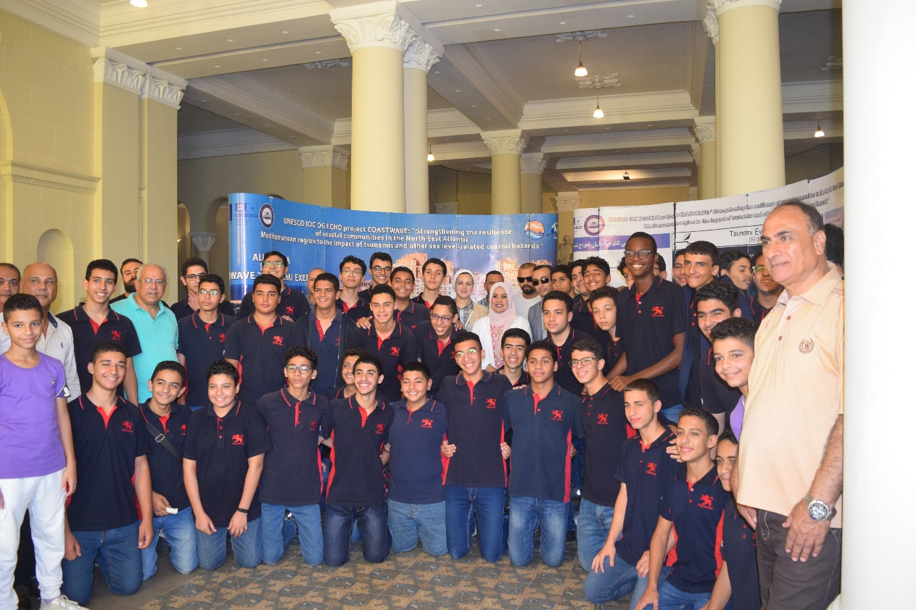
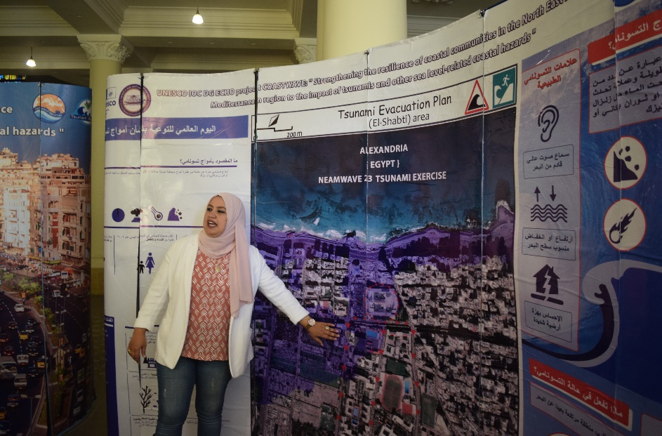
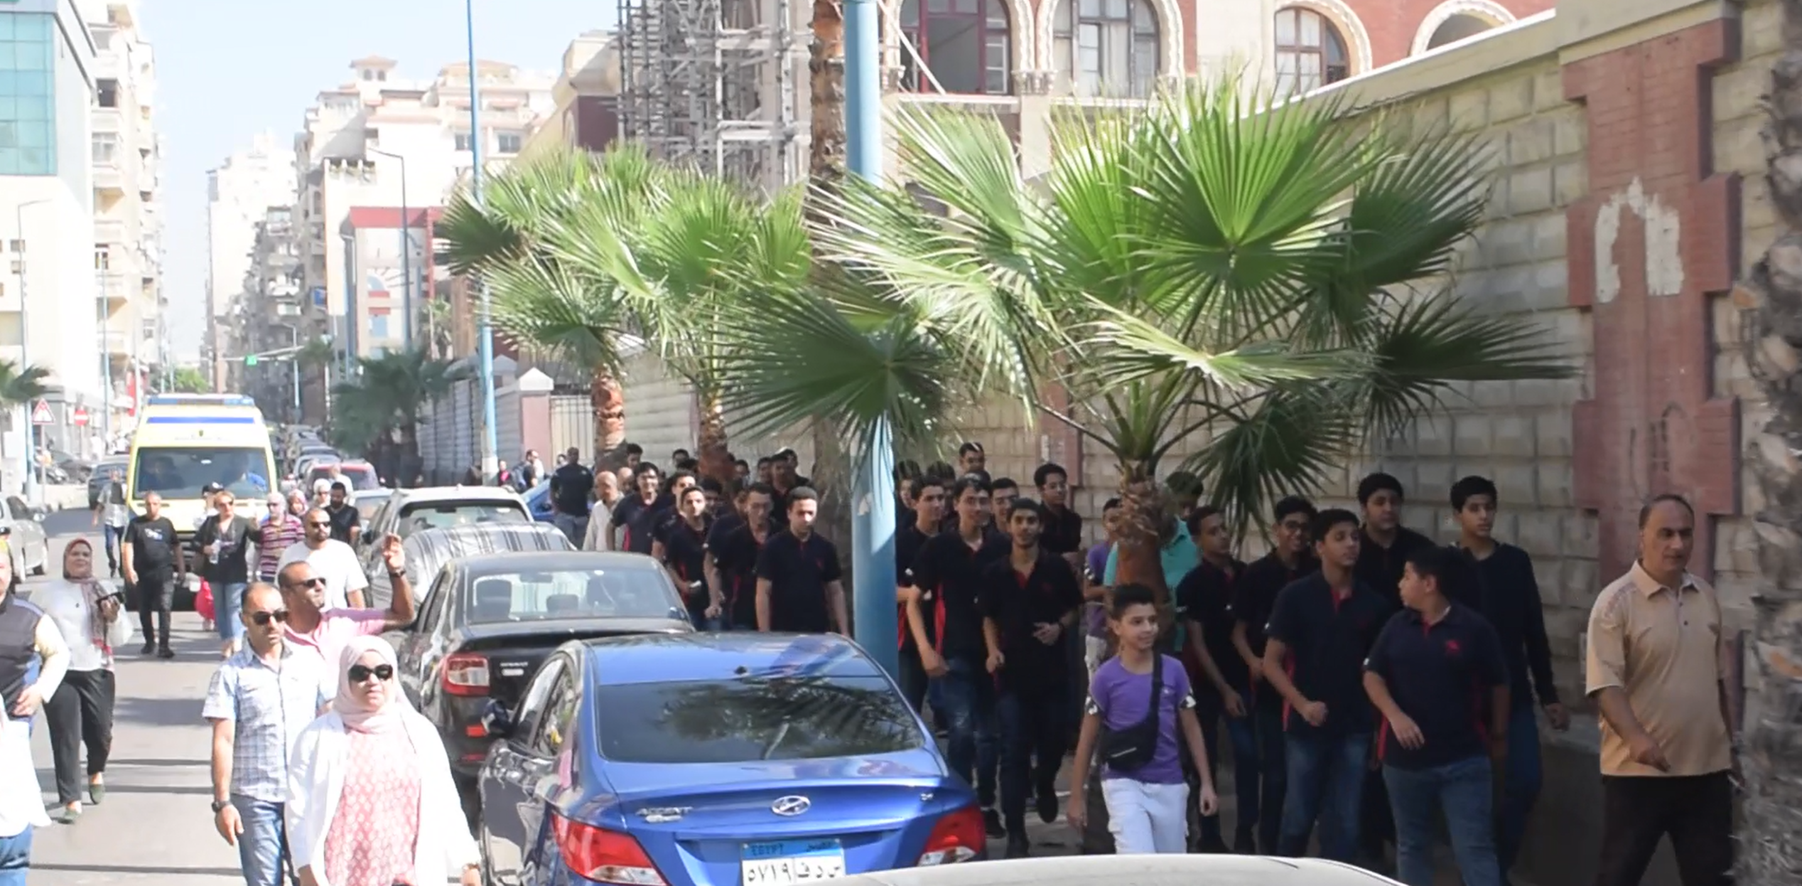
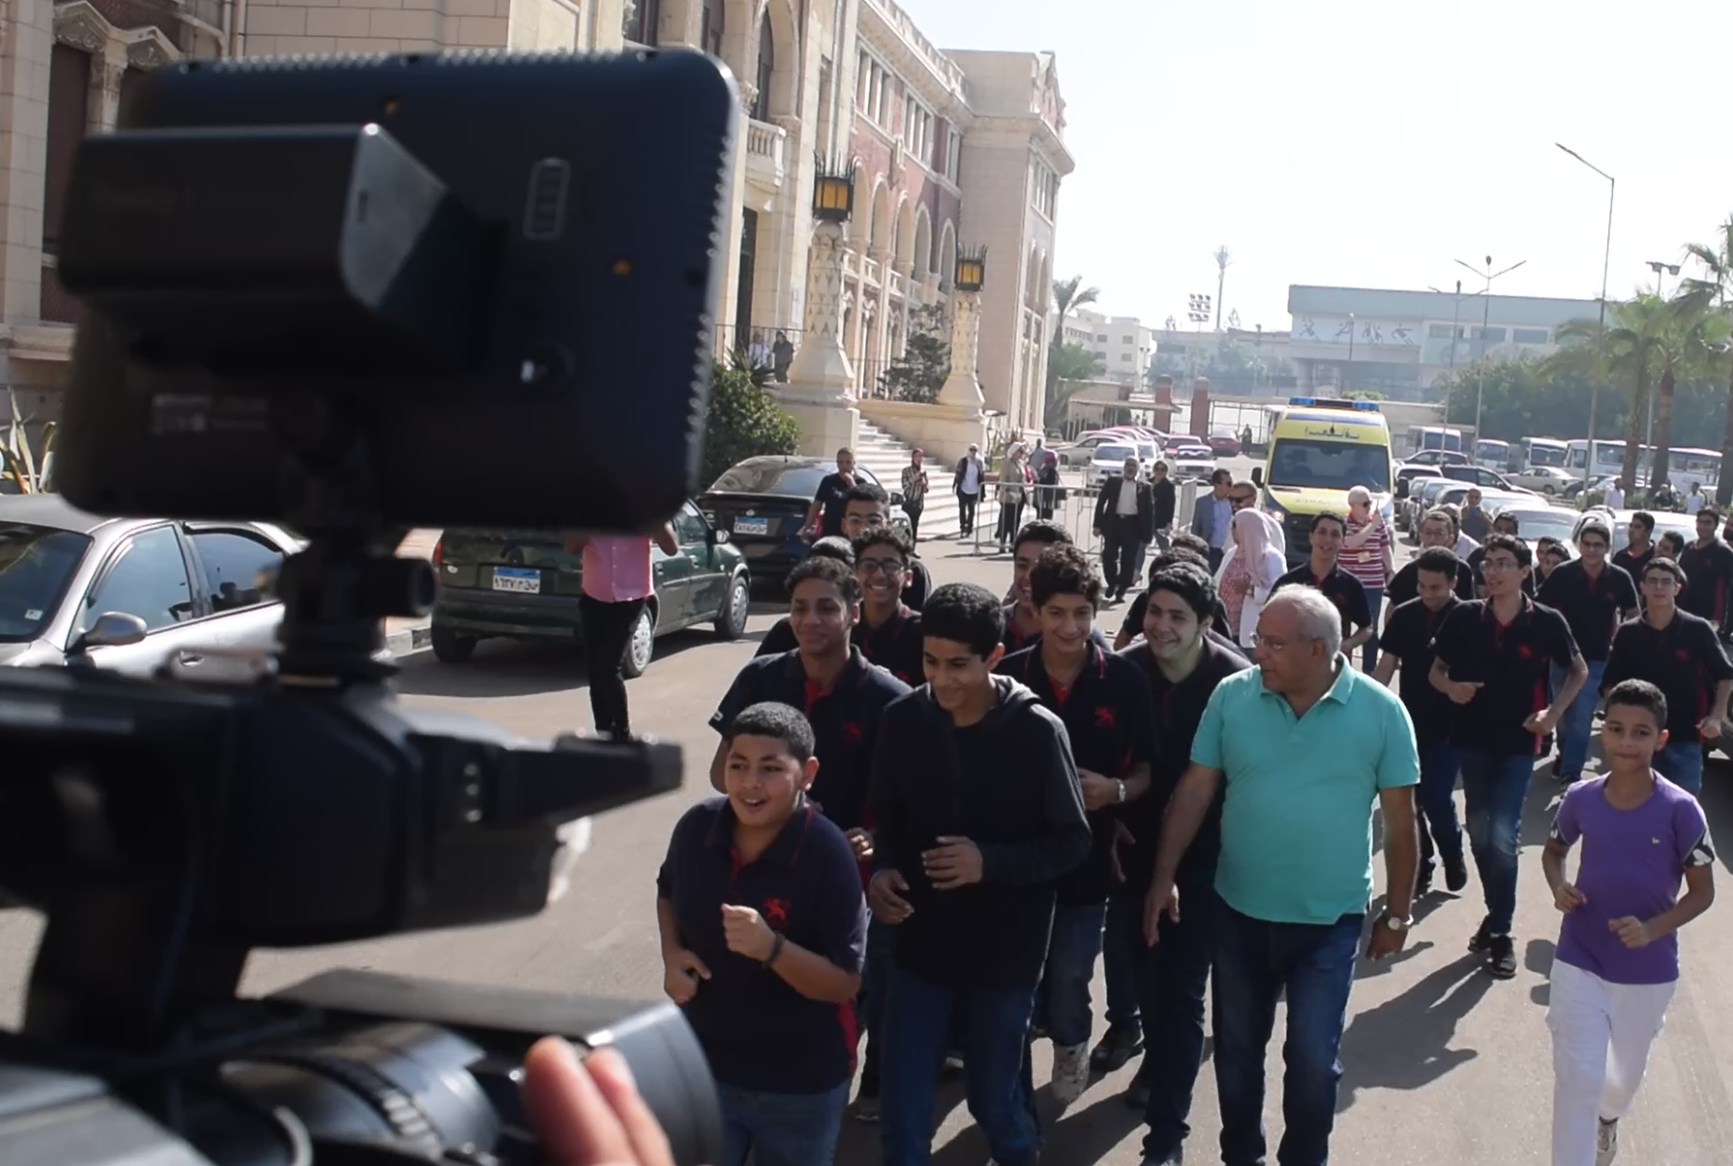
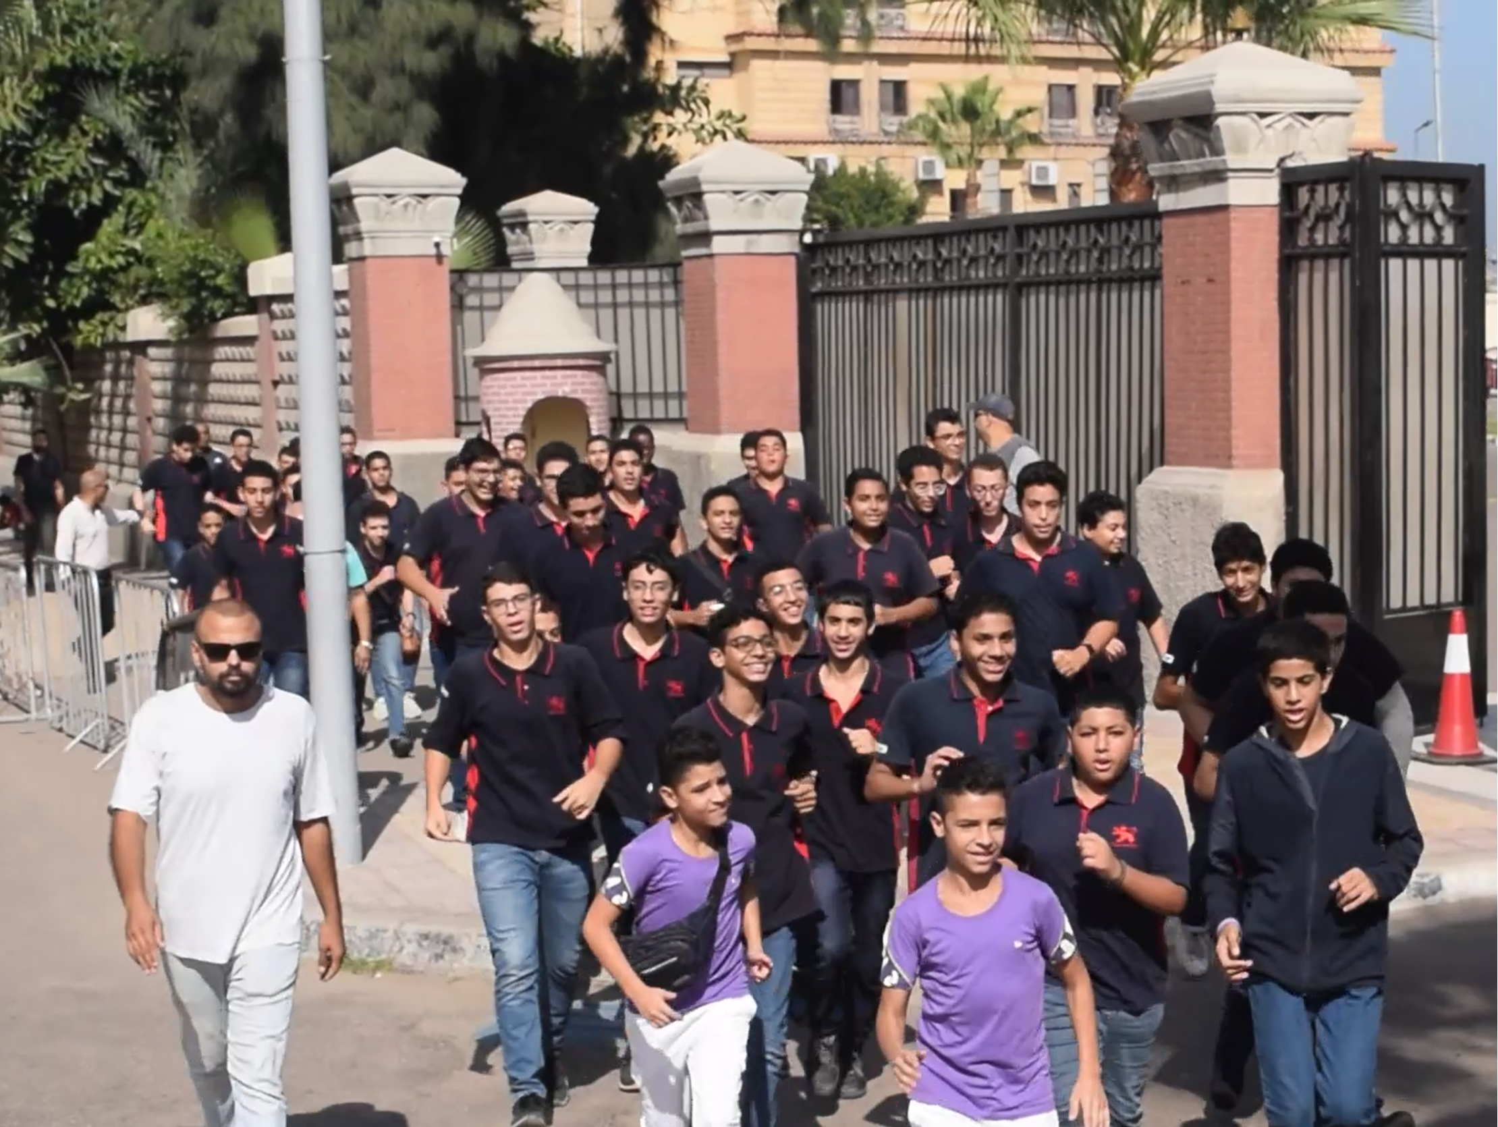
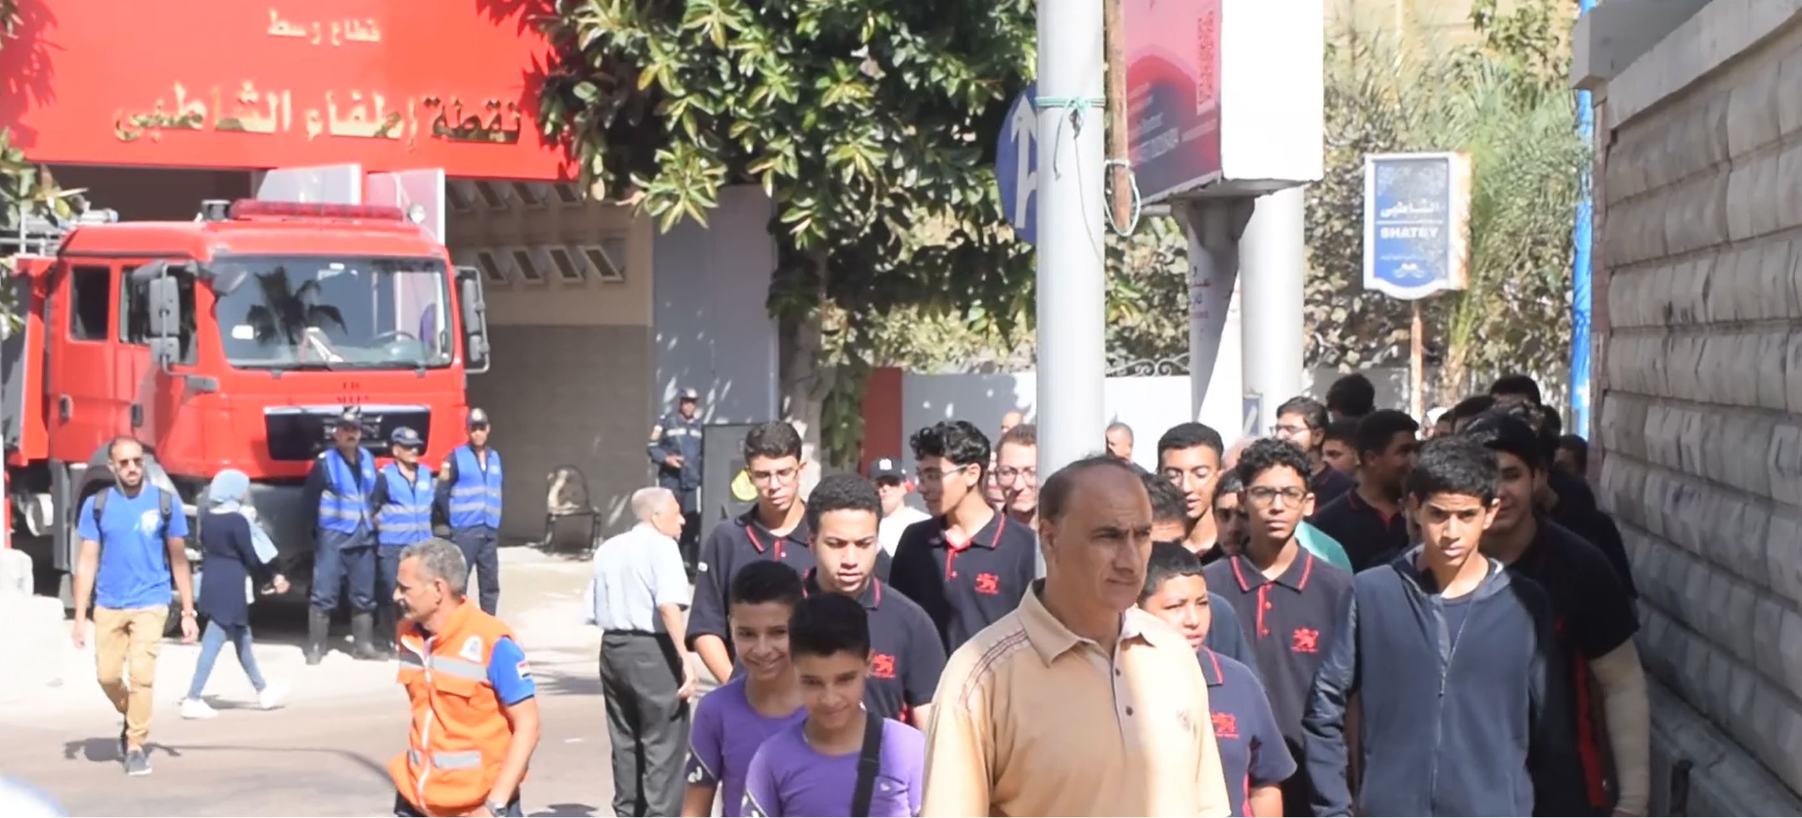
IOC-UNESCO Regional Tsunami Ready Training for NEAM
Effective Activities for Tsunami Awareness
Community Workshops: Discuss evacuation plans and early warning systems.
School Programs: Organizing tsunami drills, safety quizzes, and presentations.
Public Awareness Campaigns: Using posters, flyers, and social media to spread messages.
Evacuation Drills: Community-wide simulations to practice responses.

Slide 5
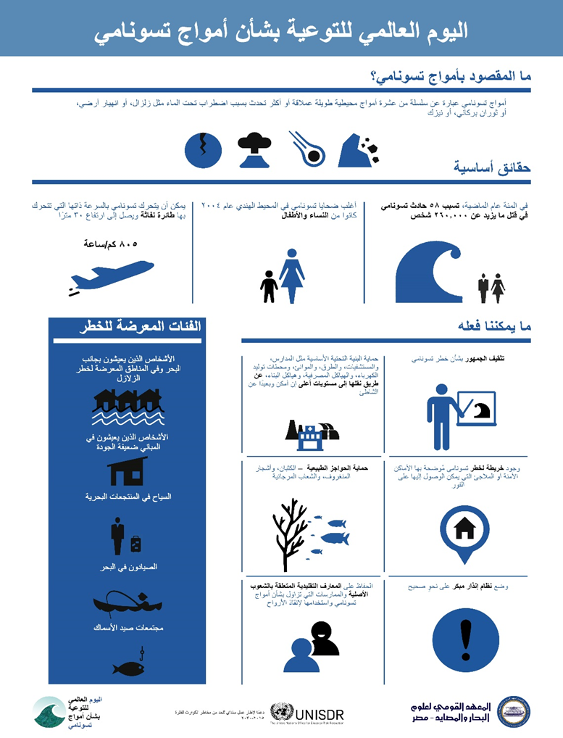
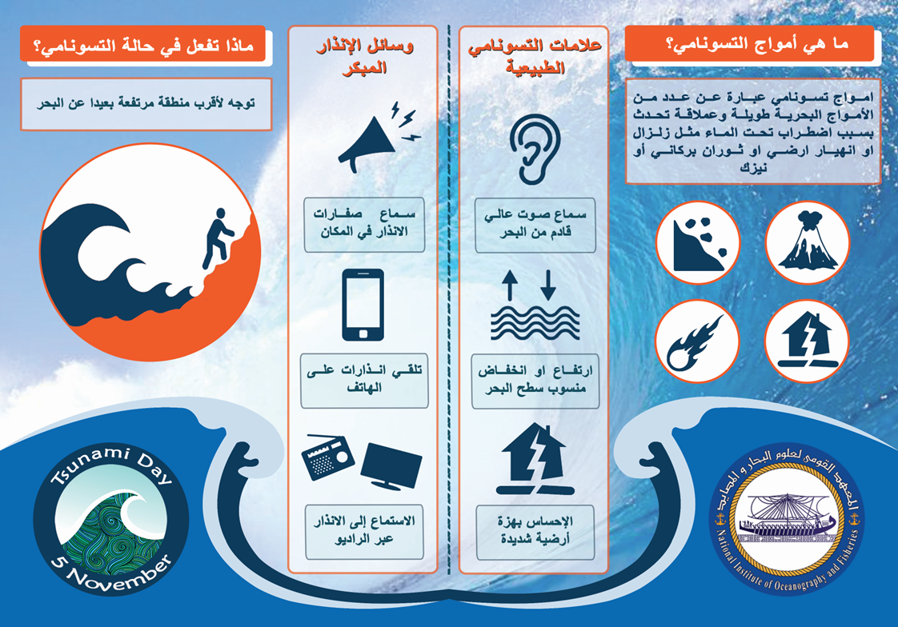
UNESCO-IOC Regional Tsunami Ready Training for NEAM Region
Effective Activities for Tsunami Awareness

Slide 6

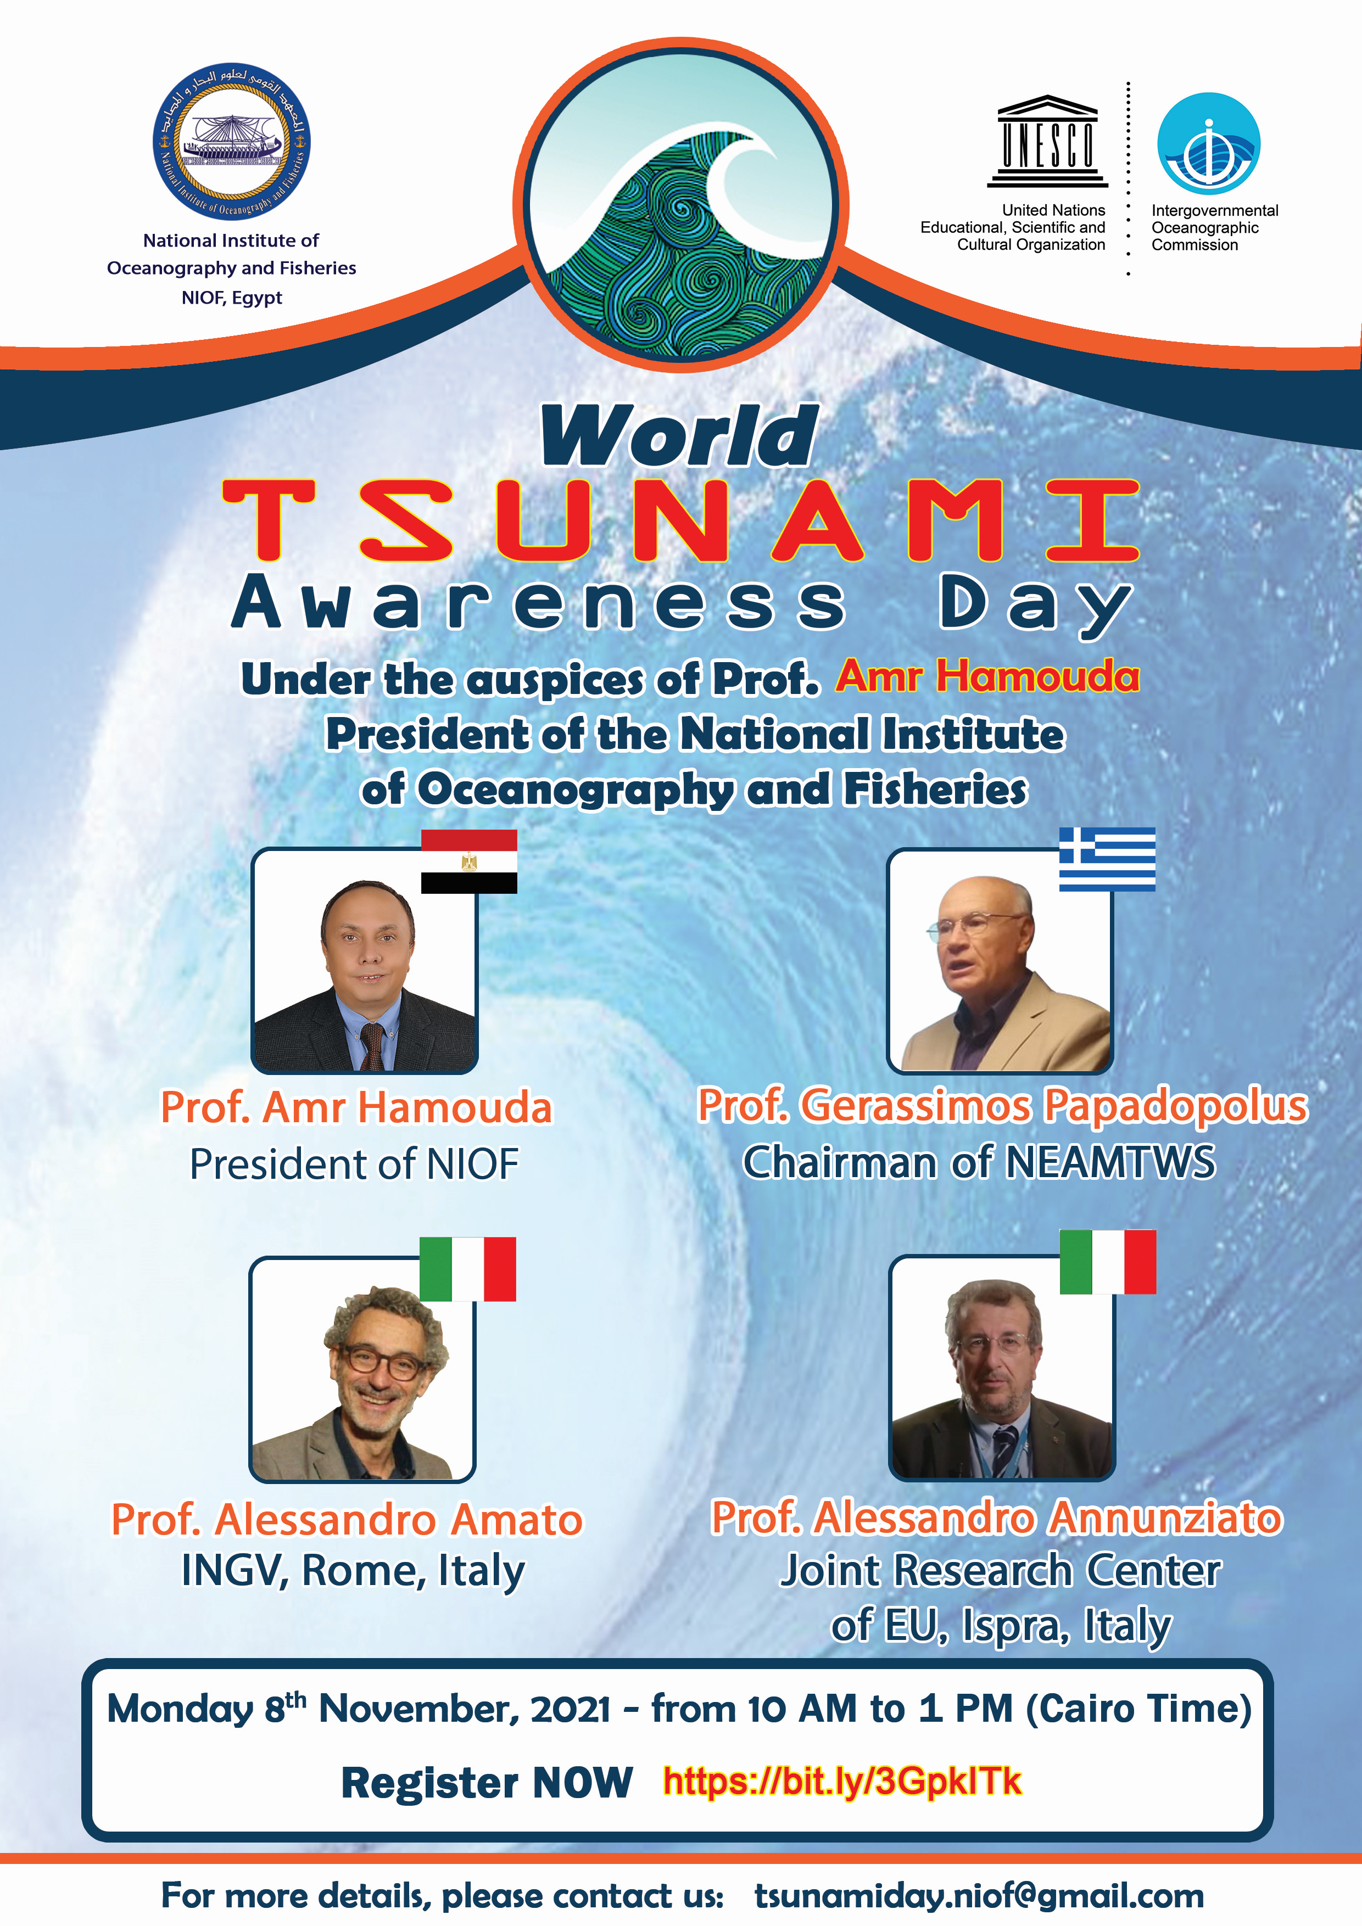
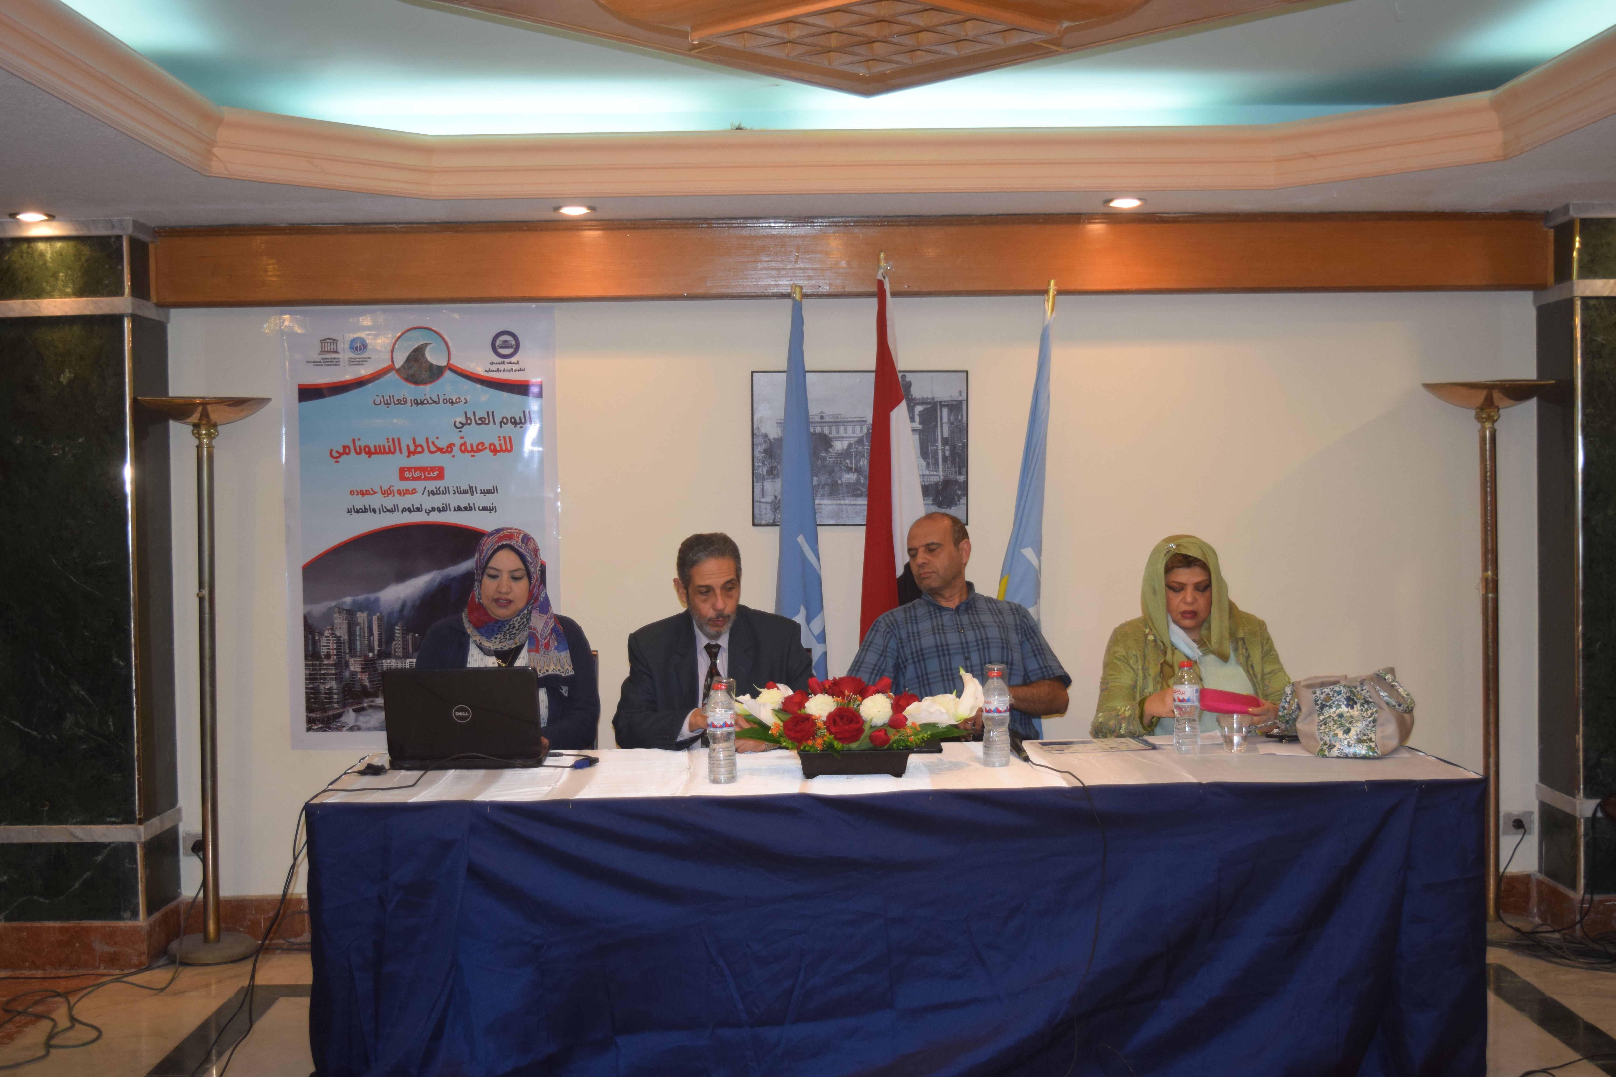
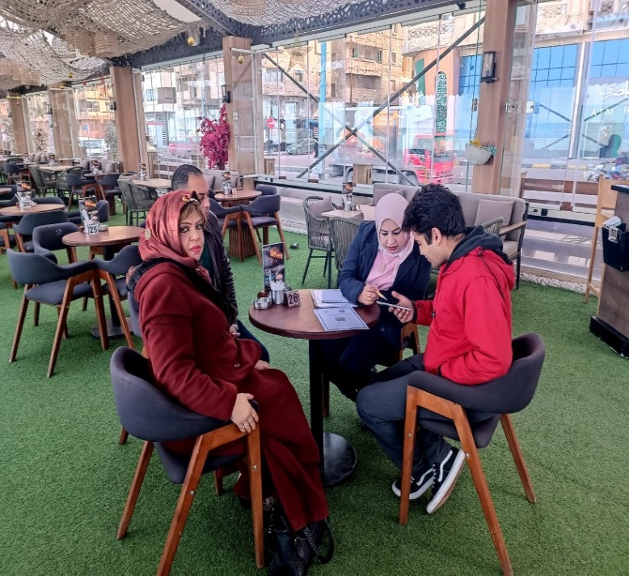
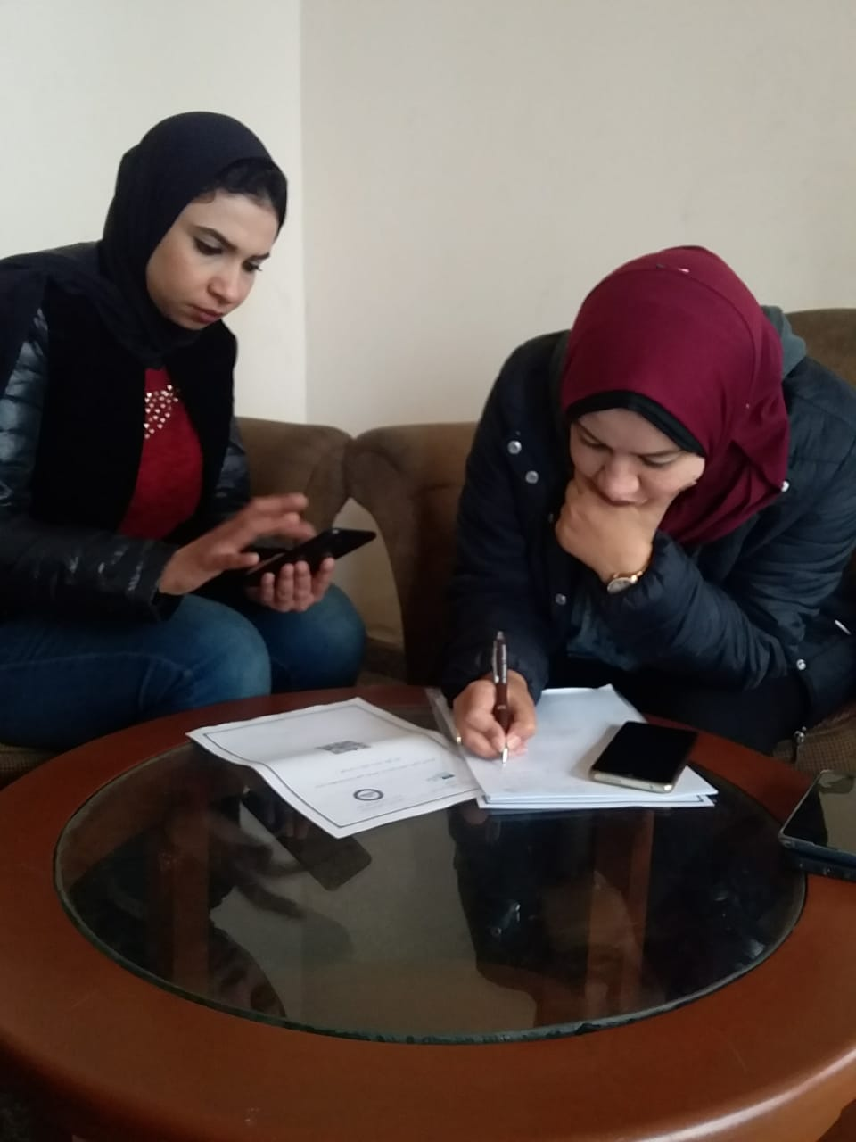
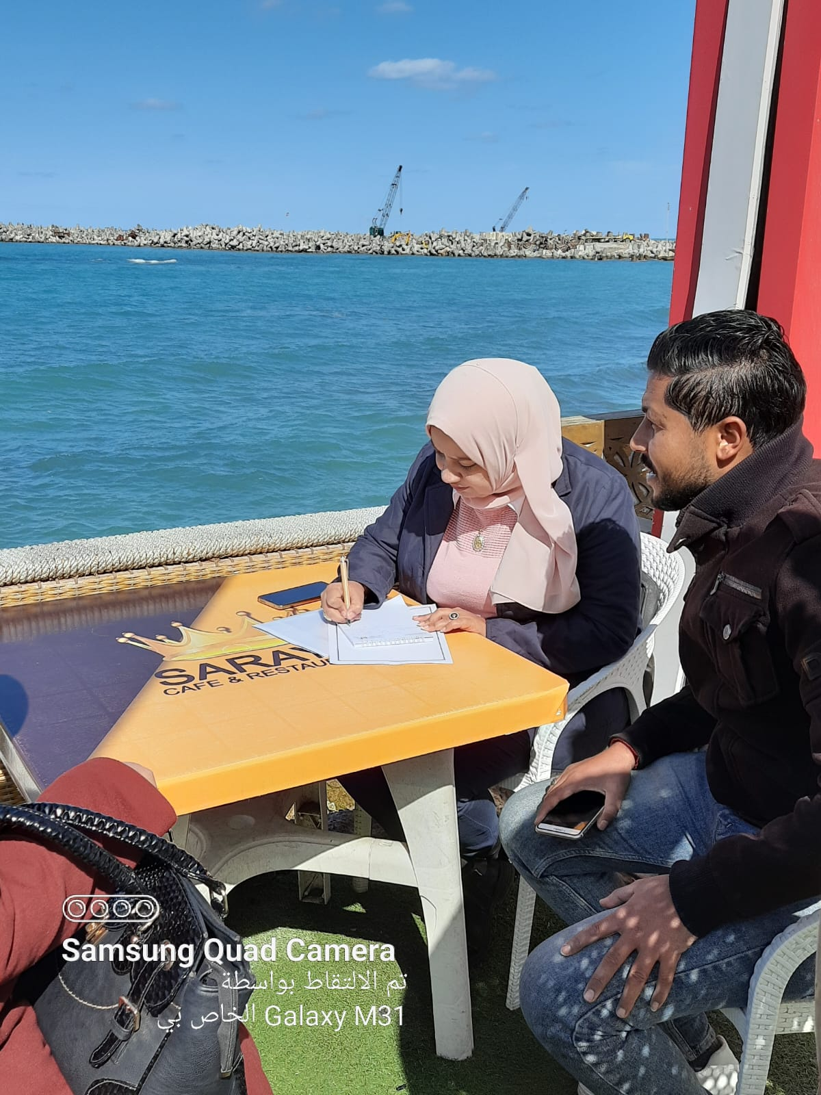
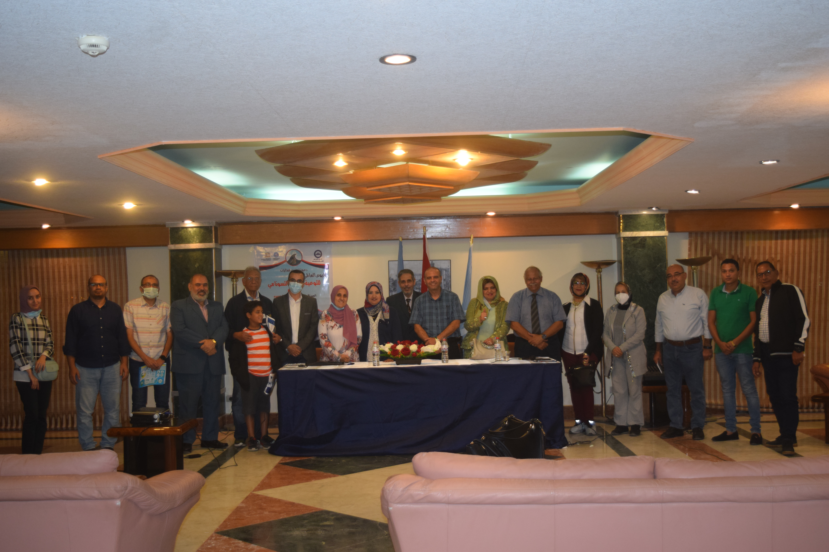
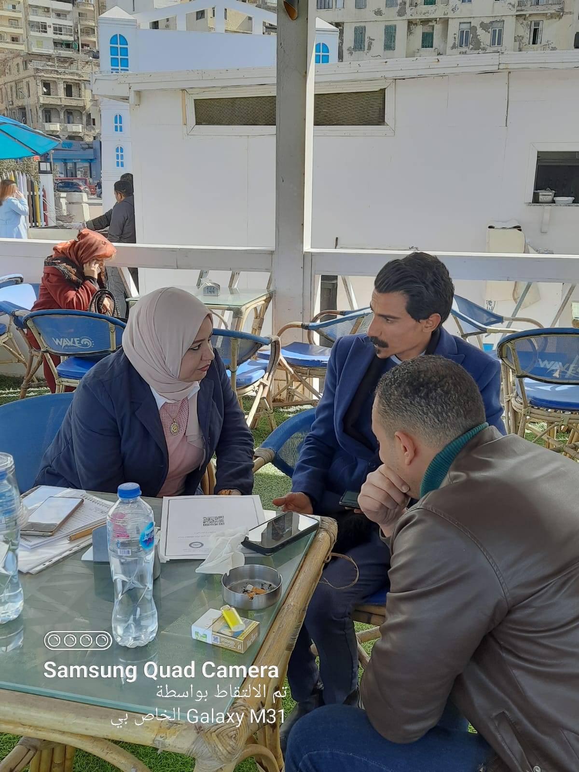
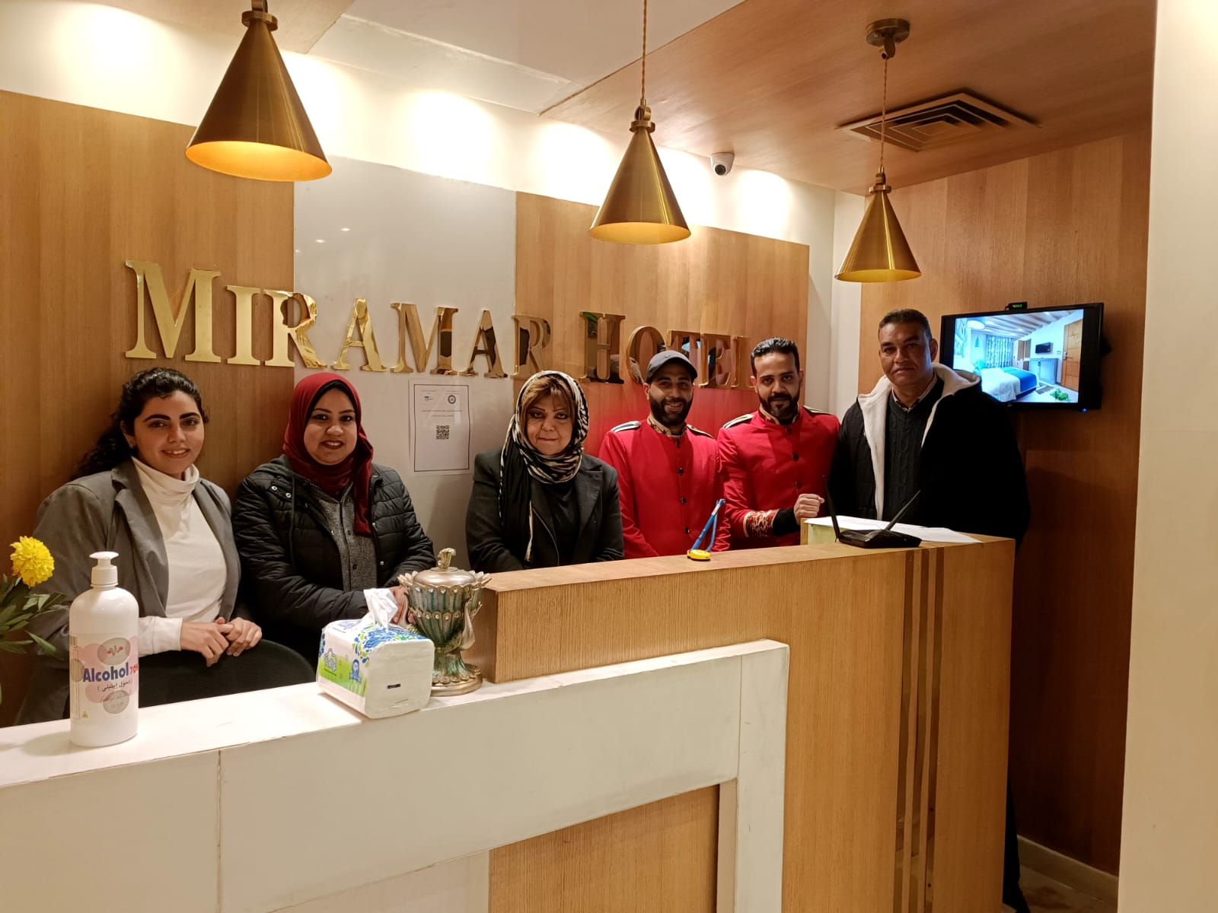
IOC-UNESCO Tsunami Ready Recognition Programme (TRRP) Workshop
Conclusion
Outreach and education are key pillars of tsunami preparedness.
Small, consistent efforts lead to resilient and informed communities.
Together, we can minimize risks and ensure safety for all.
Preparedness Saves Lives.

Slide 7
UNESCO
Intergovernmental Oceanographic Commission (IOC)
UNESCO-IOC DG ECHO CoastWAVE 2.0 project
Tsunami Resilience Section

