Slide 1
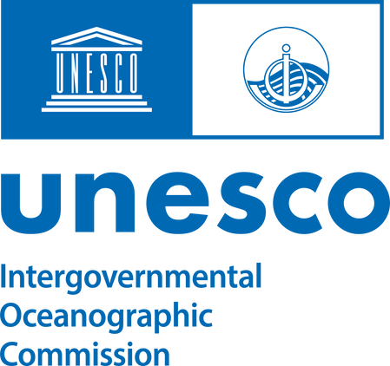

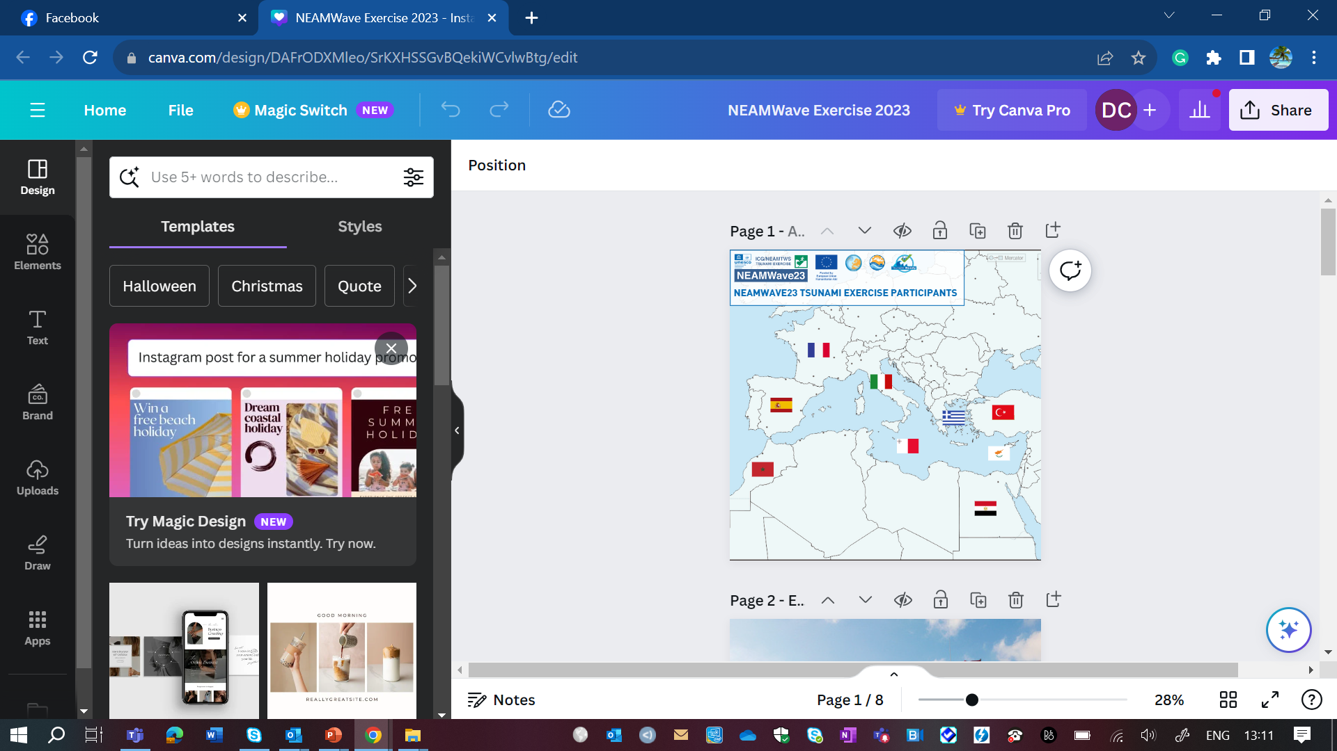

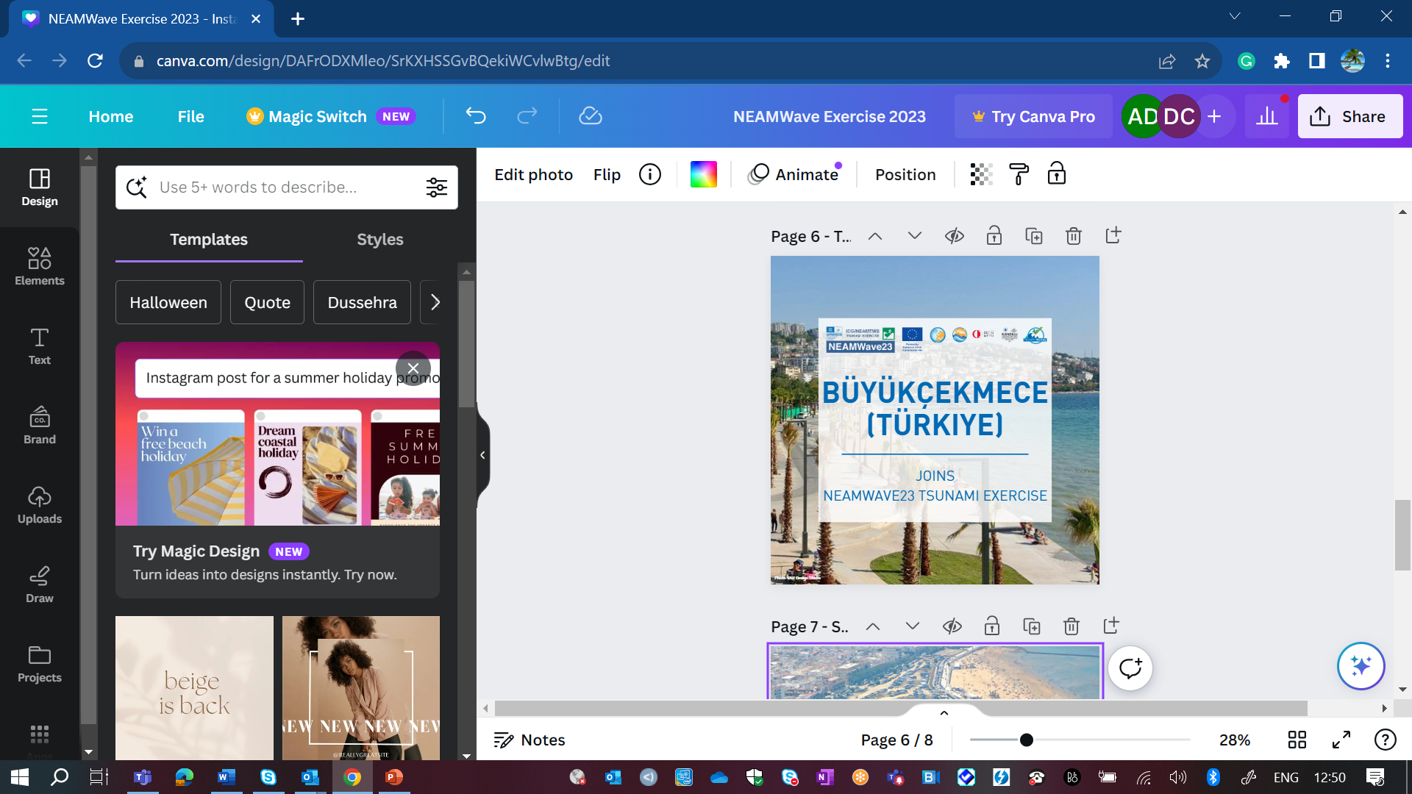





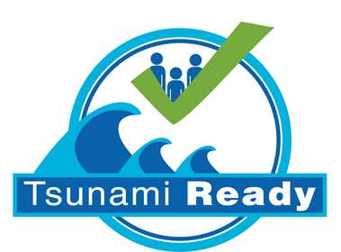

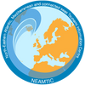








Funded by the European Union (EU) Directorate-General for European Civil Protection and Humanitarian Aid Operations (DG ECHO)
COASTWAVE PROJECT
Risk Perception Survey:
Key Findings and Recommendations
Presenter: Derya Itir VENNIN, PhD
Assoc. Project Officer UNESCO IOC/TSR
CoastWAVE Project Coordinator
d.dilmen-vennin@unesco.org
May 13, 2024, Paris

Slide 2
OVERALL KEY FINDINGS
Respondents exhibit high to moderate awareness of sea level hazards, particularly tsunamis.
A firm belief in the likelihood of sea level rise, one and a half times higher than that of a tsunami
Respondents express deep concern over impacts from tsunamis and sea level rise, while their concern for storm surge impacts remains moderate.
Respondents anticipate tsunami waves exceeding 2 metres.
Less than 40% of respondents believe that tsunami waves will arrive within 10 minutes following an earthquake, a perception contingent on the source.

Slide 3
OVERALL KEY FINDINGS (cont.)
Up to 40% of respondents do not see the municipality as capable of alerting and informing the population, yet over a quarter of them need awareness about existing capacities and infrastructures.
Half of the respondents concerns about tsunamis and sea-level rise, yet they take almost no precautions or measures against them.
A quarter of respondents believe that the impact of a disaster is irreducible.
A prevailing sense of collective action to mitigate and respond to sea level hazards exists among respondents.
Upon sensing or being informed of an earthquake, half of the respondents are ready to evacuate, with only a few showing interest in making their observations.
Respondents prefer receiving alert messages through audible alerts, although civil protection agencies recently favoured SMS messages for disseminating warnings.

Slide 4
RECOMMENDATIONS
Authorities or relevant organisations should launch or enhance public awareness campaigns to provide accurate information about tsunamis. Employing various channels such as social media, TV, radio, and posters can reach a broad audience.
Conducting workshops and educational sessions in schools and local communities to teach people about tsunamis, their causes, warning signs, and appropriate response actions will help prepare them better for the impact of the disaster.
Warning authorities should communicate about the existing alerting systems.
Educators or relevant authorities should educate the coastal population on self-preparedness. They should provide information on creating a tsunami go-bag, for instance, and encourage individuals not to rely solely on sirens but also to follow natural signs and other self-preparedness measures, enabling individuals to take an active role in their safety during emergencies.
Local stakeholders should organise evacuation exercises tailored explicitly for dependent individuals
Municipalities should allocate more resources to invest in sirens or similar alerting technologies to warn their communities. This investment will also build trust within the younger generation regarding the municipality/city's institutional capacity to address sea-level hazards and risks.

Slide 5
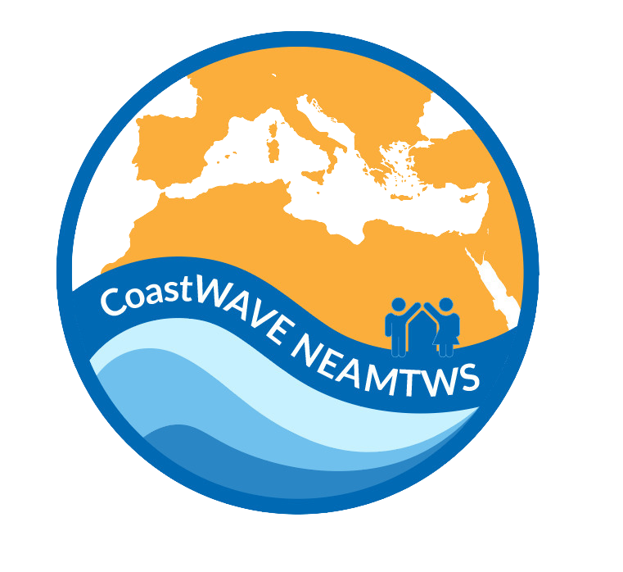


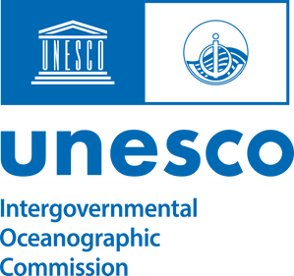
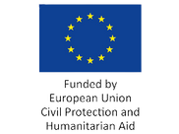
Thank you for your attention.
coastwaveproject
CoastWave_IOC
DERYA VENNIN, PHD
d.dilmen-vennin@unesco.org

