Slide 1


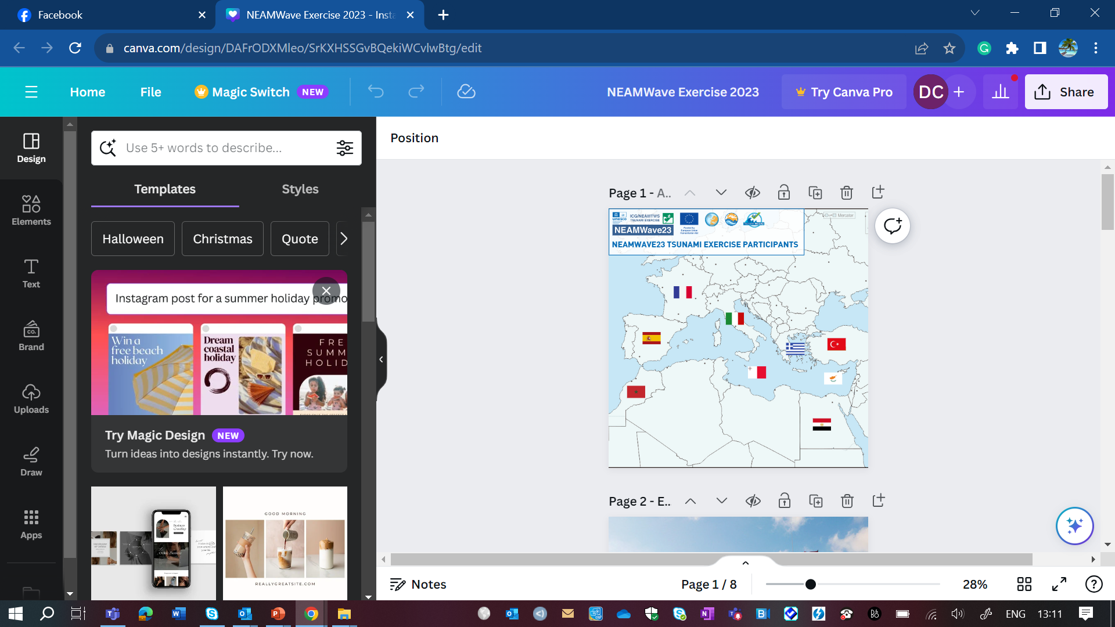
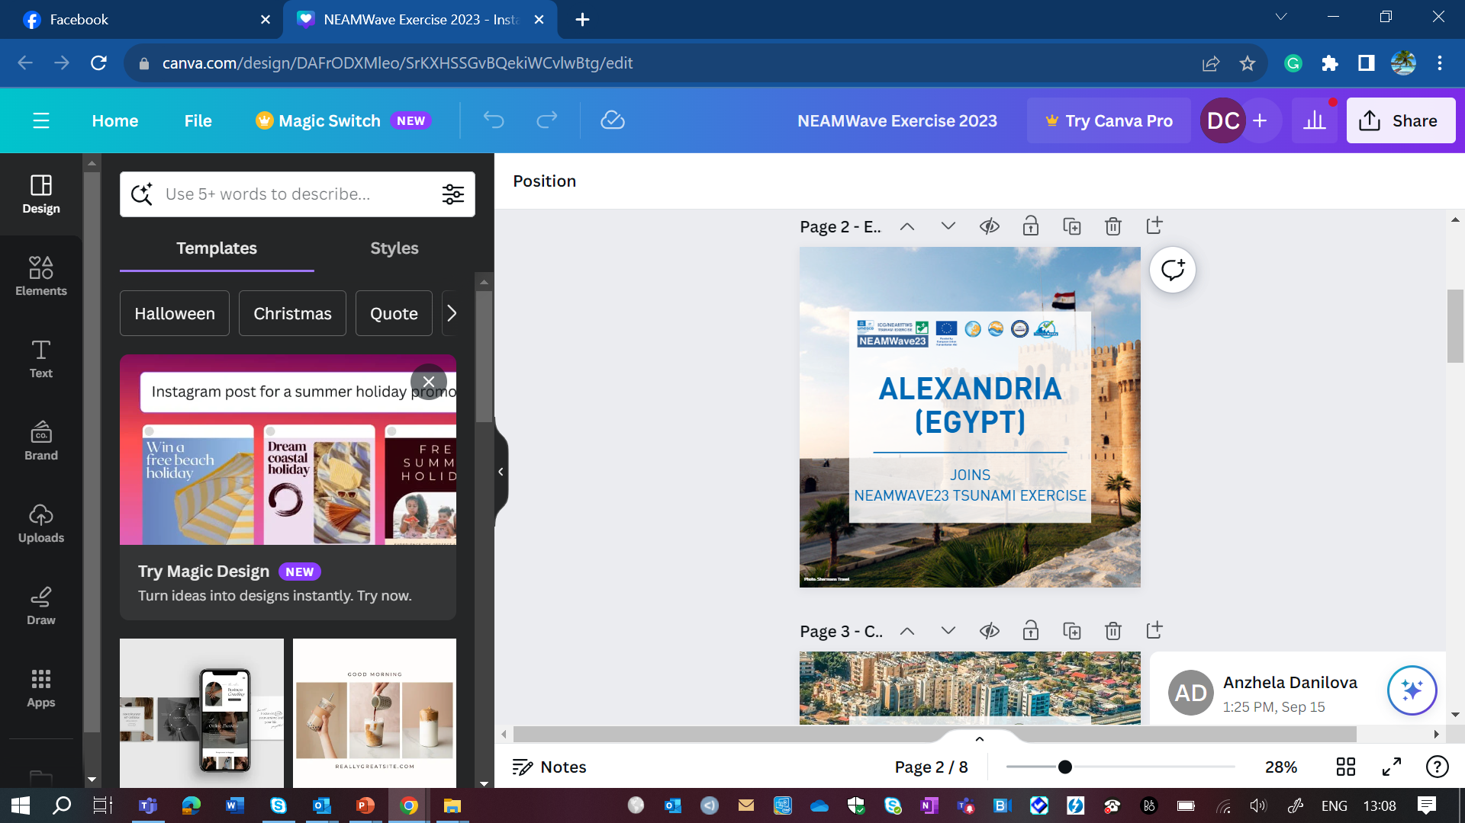
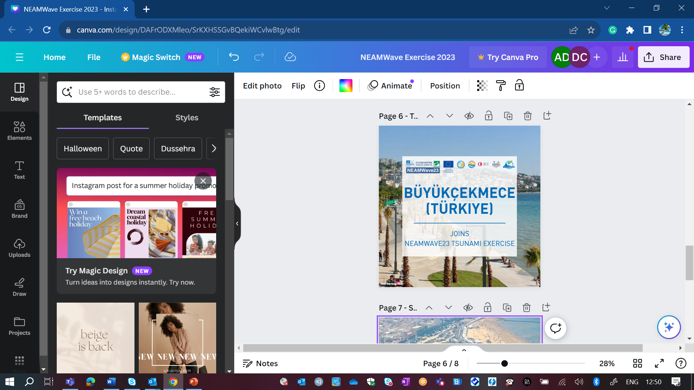
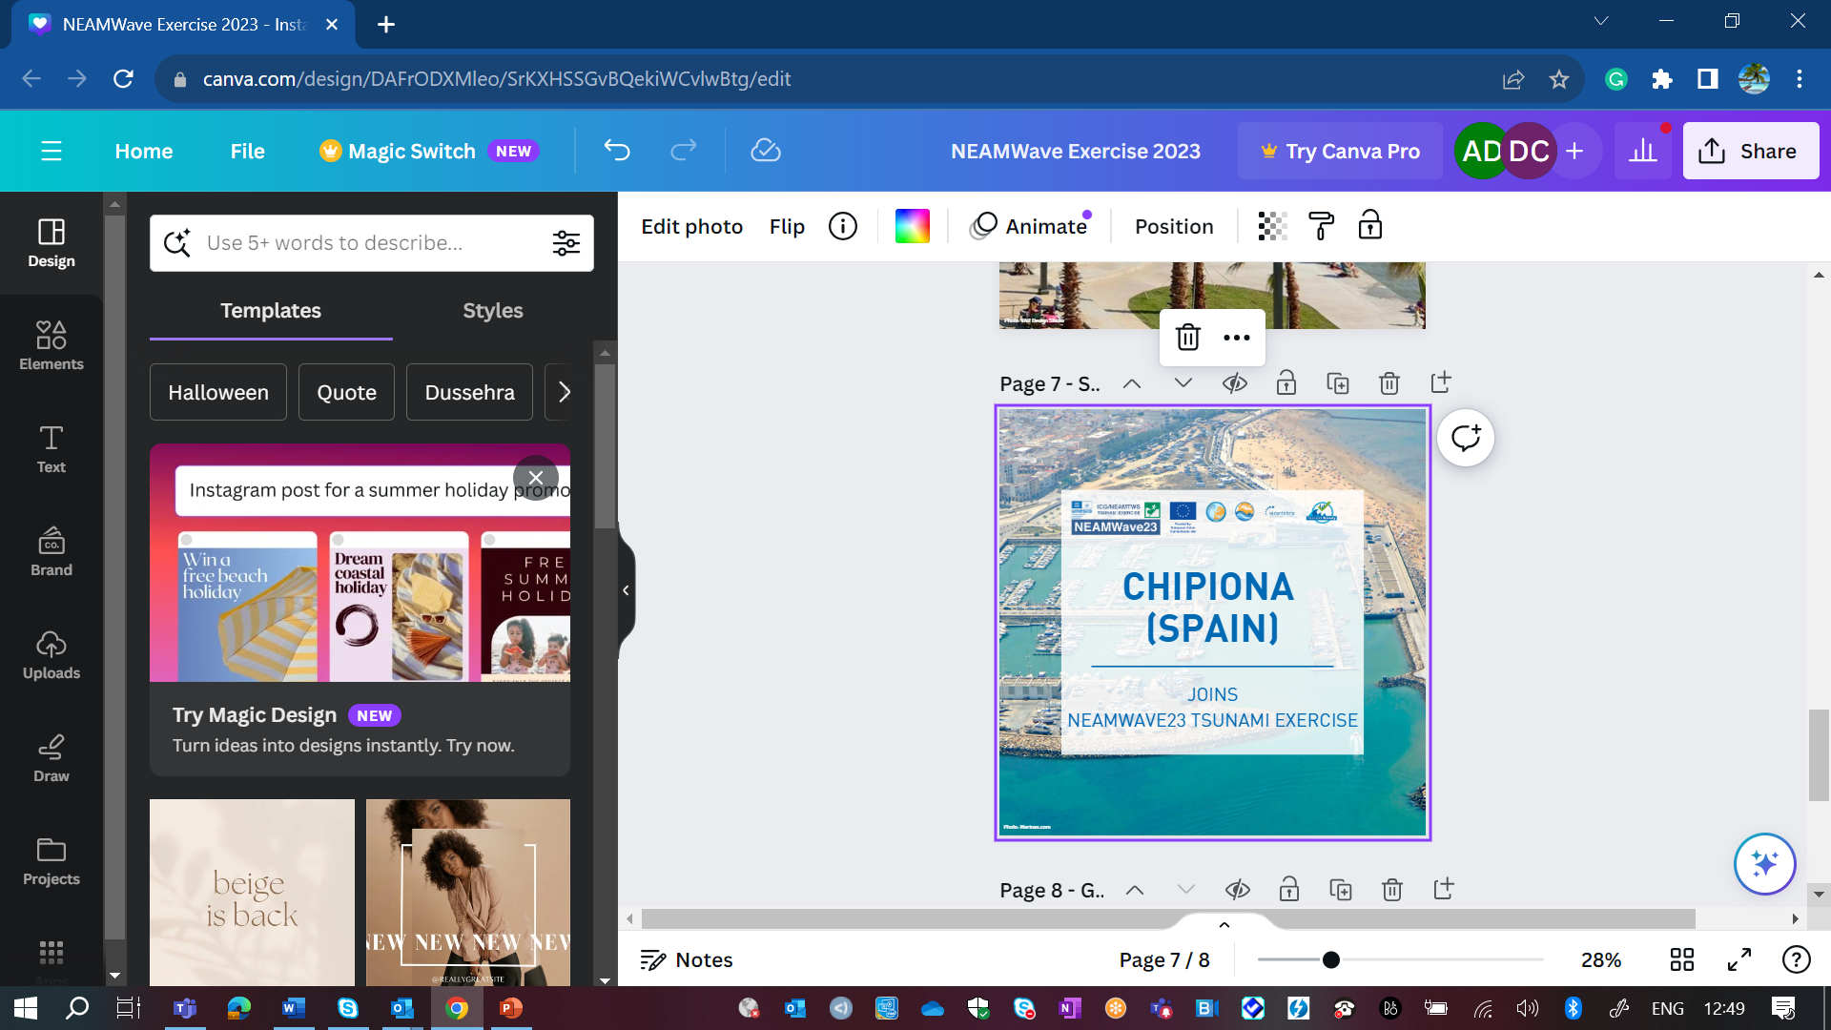
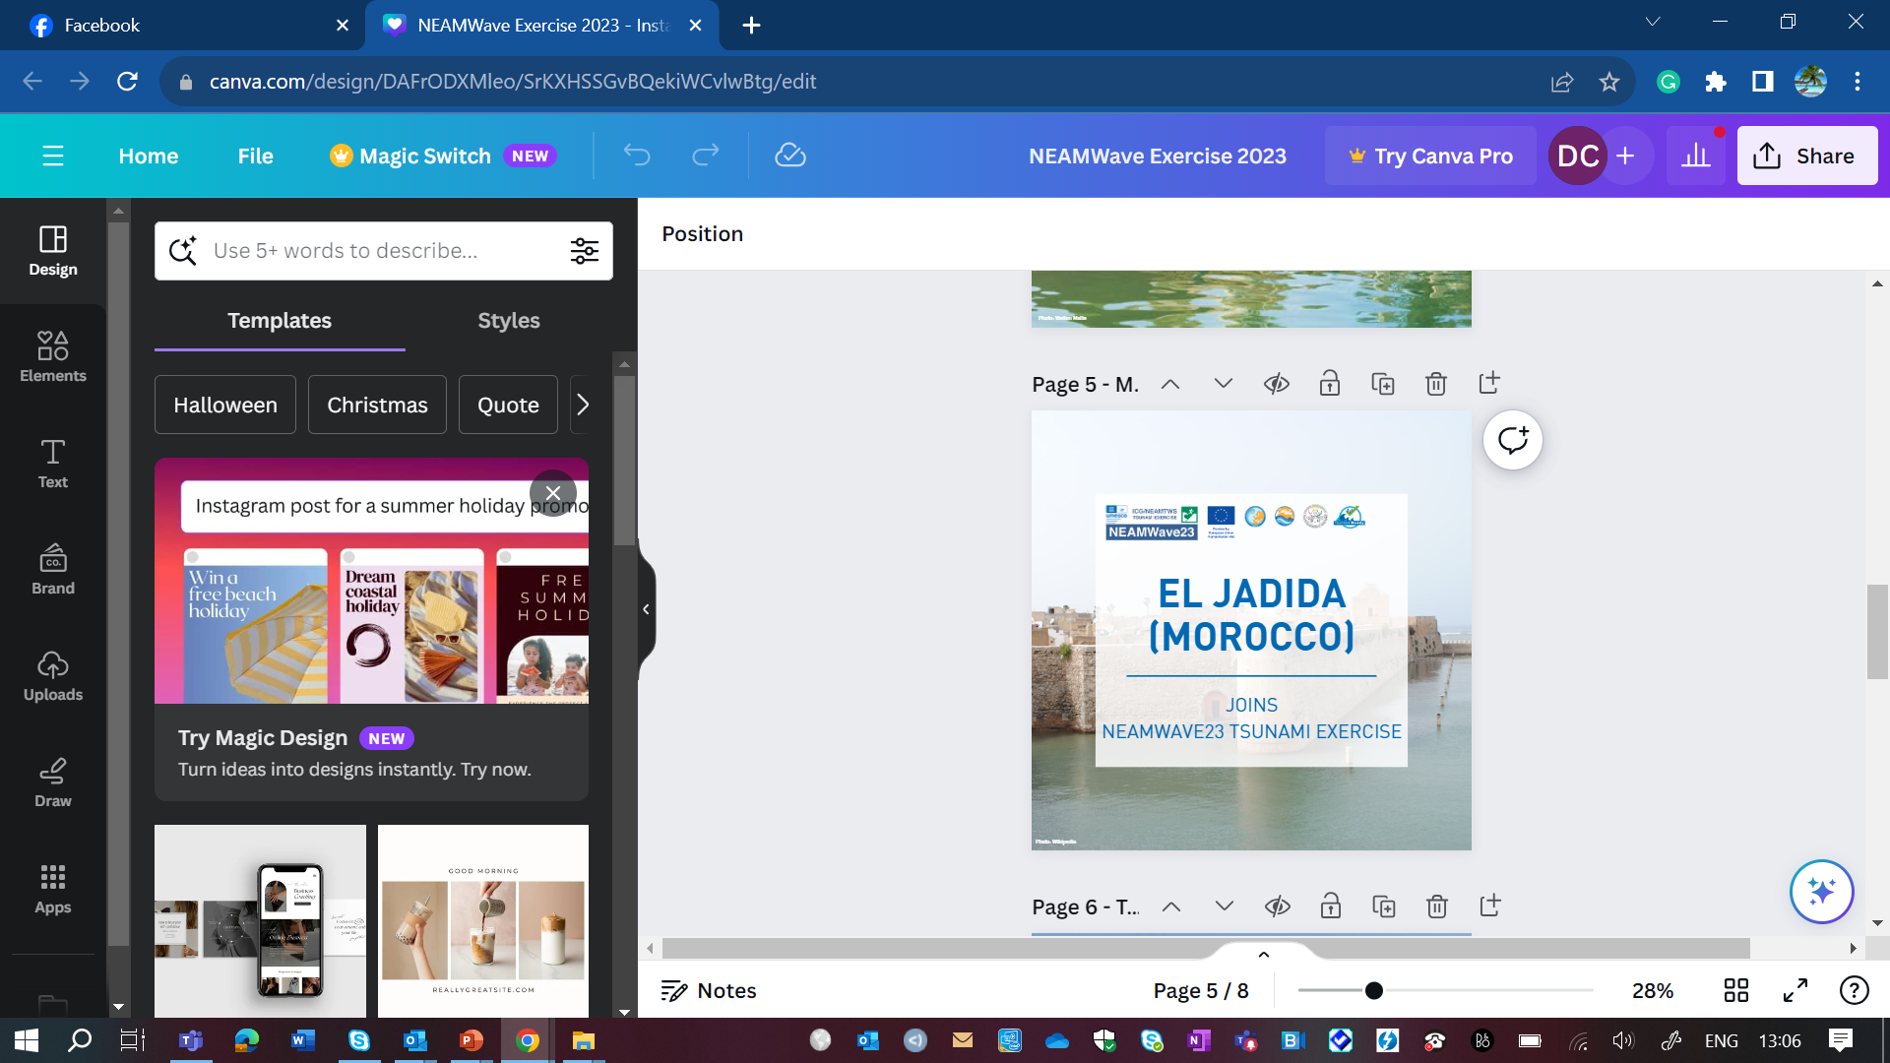
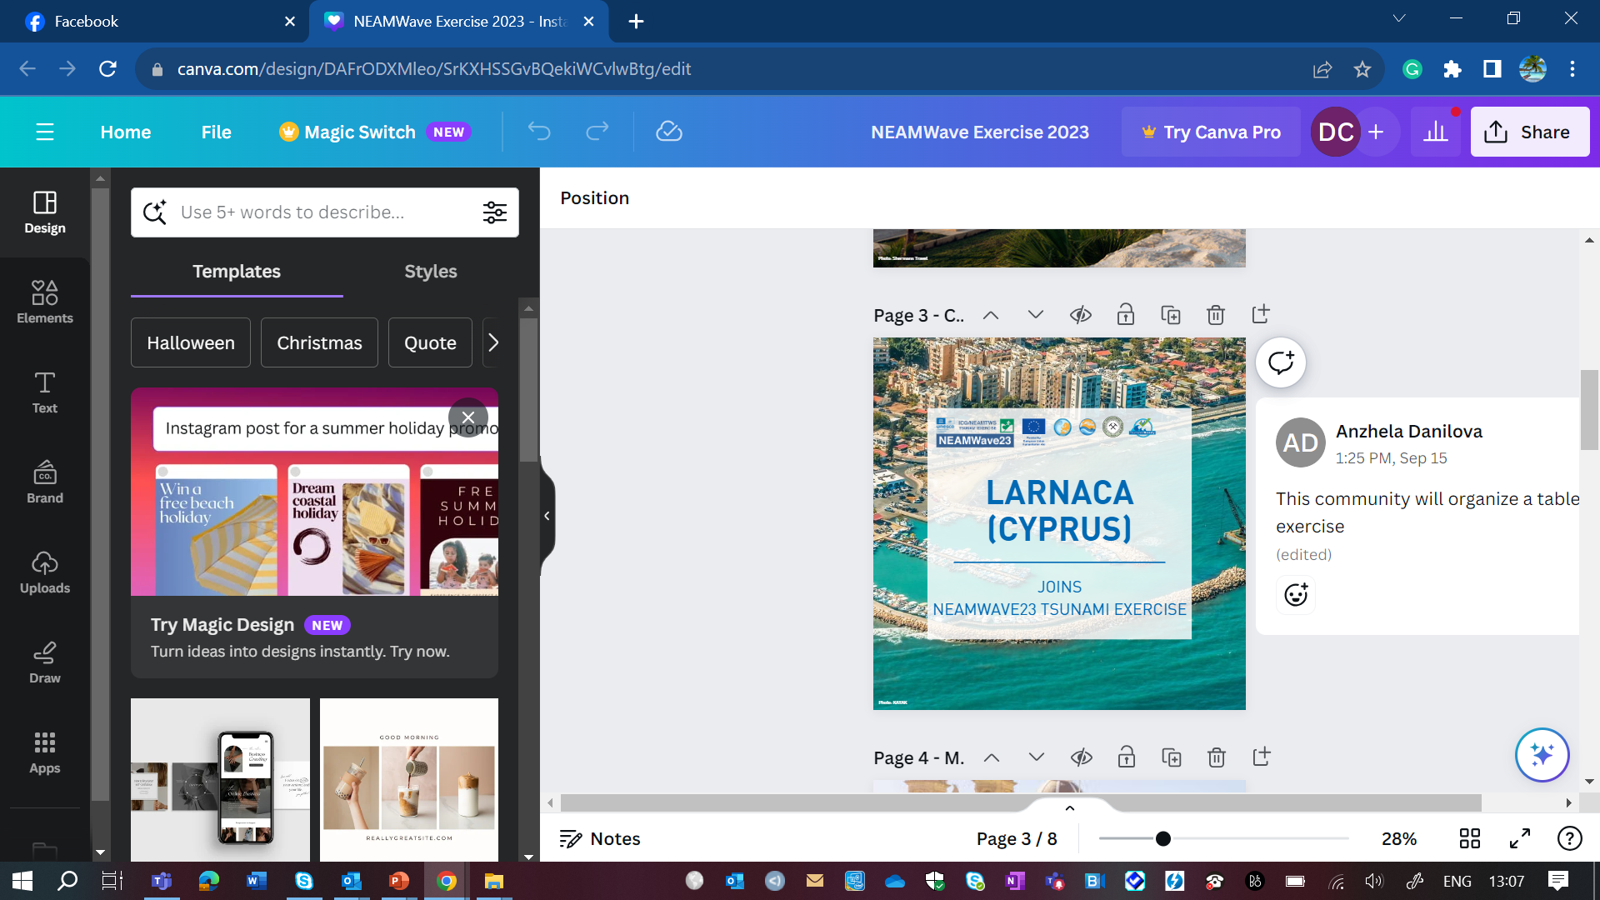
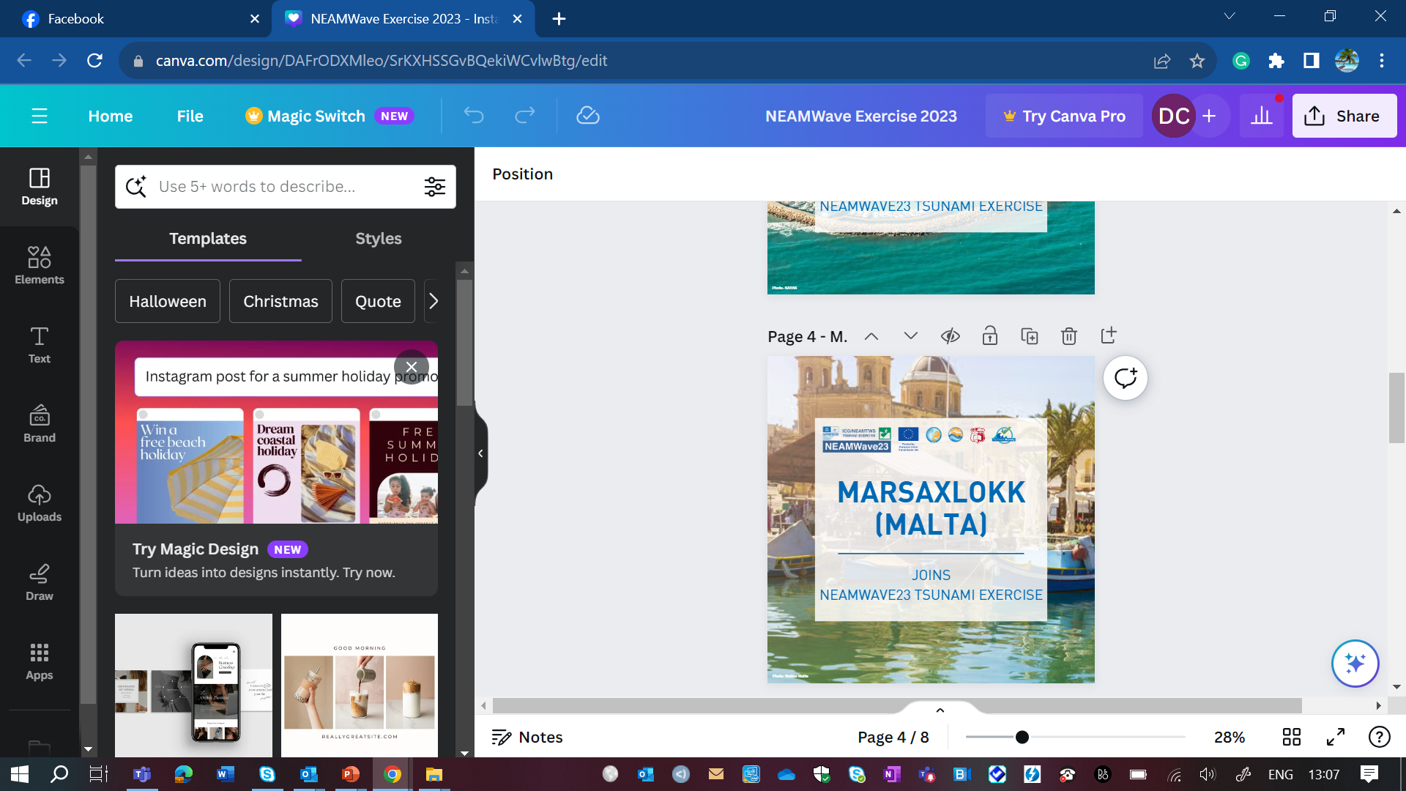
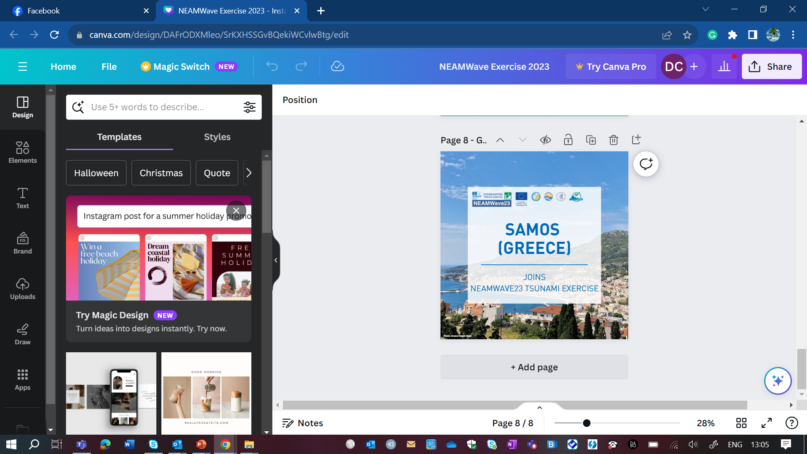











Funded by the European Union (EU) Directorate-General for European Civil Protection and Humanitarian Aid Operations (DG ECHO)
COASTWAVE PROJECT
Evaluation of IDSLs
Presenter: Derya Itir VENNIN, PhD
Assoc. Project Officer UNESCO IOC/TSR
CoastWAVE Project Coordinator
d.dilmen-vennin@unesco.org
May 13, 2024, Paris

Slide 2
COMPONENT 3 (Evaluate The Effectiveness, Compatibility, Performance of the IDSLs) Activities
Activity | Completed
Activity 4 Conduct an evaluation of the effectiveness and compatibility of IDSL stations in NEAMTWS countries under the auspices of the ICG/NEAMTWS and in collaboration with JRC, GLOSS and hydrographic departments in participating countries | Evaluation surveys Report of the surveys and maintenance established a contract with a senior consultant to technically evaluate the devices

Slide 3
IDSL Evaluation
Calibration and Verification: Evaluate if IDSLs can be calibrated according to existing guidelines and best practices.
Data Quality: Examine recorded data for consistency and quality.
Comparison with Reference Gauges: Compare IDSL data with data from nearby well established gauges
Accuracy and Precision: Evaluate the IDSL’s accuracy and precision.
Long Term Stability: Evaluate the IDSL’s performance over an extended period of time.
Maintenance and Reliability: Inspect the IDSLs’ maintenance needs and long-term reliability.
Data Gaps and Downtime: Assess the IDSL gauges’ operational efficiency, including data gaps and downtimes.
Environmental Interference: Consider environmental factors that may interfere with IDSL measurements.
User Feedback: Obtain feedback from users who rely on IDSL data.
Compliance with Standards: Evaluate if the IDSL meets relevant international standards for sea level measurement and reporting.
Cost-effectiveness: Evaluate the cost-effectiveness of the IDSLs in terms of performance relative to maintenance and operational expenses.

Slide 4
IDSL Status Report- Summary
 | Country | Station | IDSL No. | Date installed | Operational Status | Days since last data | JRC/VLIZ | Notes
1. | Cyprus | Zigy Port | IDSL-32 | 2017 | No | 738 | JRC | Data 2020-21
2. | Egypt | Alexandria | IDSL-23 | 2018 | Yes | - | JRC/VLIZ | Spikes but useable
3. | Greece | Plomari | IDSL-41 | 15 Nov 2019 | No | 138 | JRC/VLIZ | Data in short bursts
4. |  | Kos Port | IDSL-25 | 14 Jul 2018 | No | 785 | JRC | Useable data Nov’19 – Nov’21
5. |  | Kos Marina | IDSL-33 | 6 Aug 2019 | No | 7 | JRC | Data Mar’20 – Jan’21. Some data Nov’23 onwards but spikey
6. |  | Corinth | IDSL-13 | 15 Dec 2015 | Yes | - | JRC/VLIZ No recent data on VLIZ | Data from Oct’23 on useable. Earlier data also OK, but many gaps
7. |  | Panormos | IDSL-24 | 16 Nov 2017 | Yes | - | JRC/VLIZ No recent data on VLIZ | Gaps and spikes but some useable
8. |  | Preveza | IDSL-35 | ? | No | 9 | JRC/VLIZ No recent data on VLIZ | Might be some data if large spikes removed
19. | Malta | Cirkewwa | IDSL-34 | 19 Oct 2019 | No | 846 | JRC | Some data in 2020-21
20. |  | La Valletta | IDSL-42 | ? | Yes | - | JRC | Poor quality
21. |  | Marsaxlokk | IDSL-43 | ? | No | 751 | JRC | Data Apr’21-Mar’22
22. | Morocco | Saida Marina | IDSL-02 | Apr 2016 | No | 722 | JRC | Data 2020-22
30. | Spain | Cadiz | IDSL-06 | 4 Oct 2015 | Yes | - | JRC/VLIZ No recent data on VLIZ | Good quality
31. |  | Cartagena | IDSL-07 | 3 Oct 2015 | Yes | - | JRC/VLIZ No recent data on VLIZ | Large spikes but useable
32. |  | Ceuta | IDSL-31 | ? | No | 62 | JRC/VLIZ No recent data on VLIZ | Useable data 2019-2023
33. |  | Minorca | IDSL-29 | 24 Oct 2017 | No | 60 | JRC | Some useable data 2018-2020
34. |  | Menorca | IDSL-30 | 23 Oct 2017 | No | 80 | JRC | Some useable data 2019-2022
35. |  | Garachico | IDSL-37 | ? | Yes | - | JRC/VLIZ No recent data on VLIZ | Useable data Jan’22 – Dec’22
36. |  | La Palma | IDSL-50 | ? | Yes | - | JRC | Useable data Oct’21 – Aug’23
37. | Turkiye | Fethiye | IDSL-15 | 17 Dec 2015 | No | 915 | JRC | Data May’19 – May’20
38. |  | Bozcada | IDSL-14 | 18 Nov 2016 | No | 110 | JRC/VLIZ | Some data in bursts 2017 - 2022
39. |  | Samsun | IDSL-16 | 25 Sep 2018 | No | 310 | JRC/VLIZ | Useable data 2020-22
40. |  | Bodrum | IDSL-17 | 12 Sep 2019 | No | 5 | JRC/VLIZ | Useable data May’20 – Apr’23

Slide 5
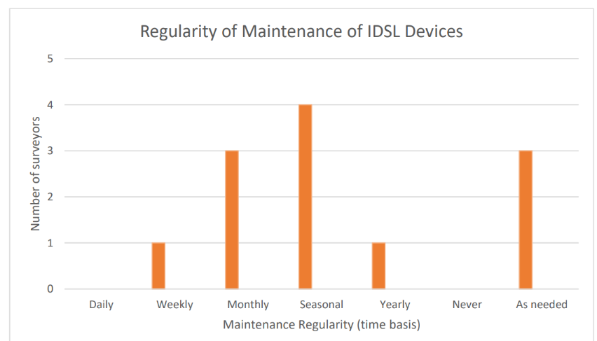
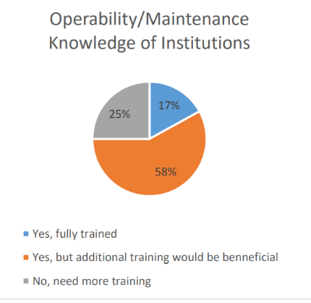
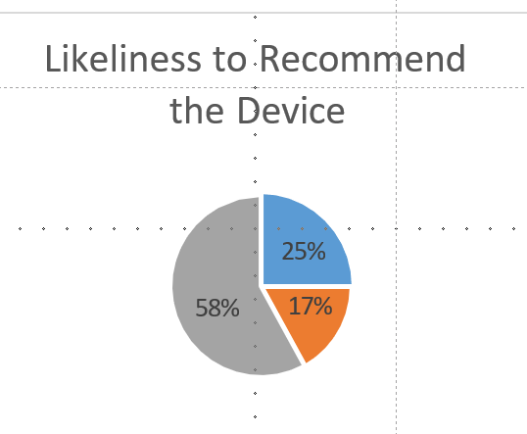
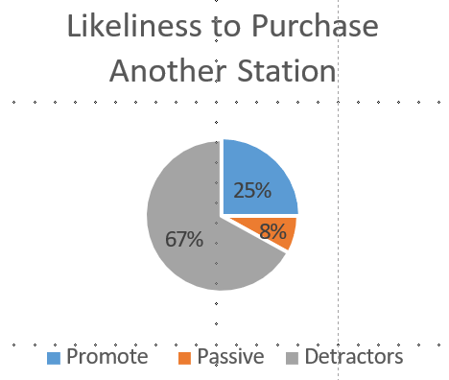
IDSL Operator Survey Results

Slide 6
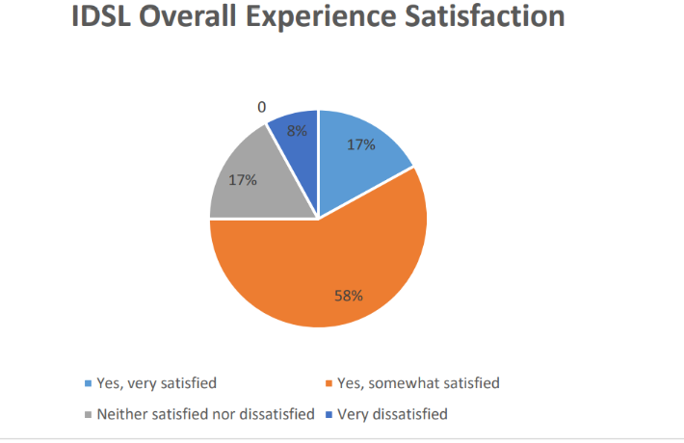
IDSL Overall
Parts such as sensors, memory cards, and control boxes require constant repairs.
Survey further highlighted the lack of robustness and endurance of the stations
Difficult to continuously go to the field to do maintenance and need to find other ways to remotely fix or do troubleshooting in the devices.
The evaluation survey also recognizes the lack of a state of the art user guide that explains how to best conduct maintenance and operate the stations.

Slide 7





Thank you for your attention.
coastwaveproject
CoastWave_IOC
DERYA VENNIN, PHD
d.dilmen-vennin@unesco.org

