Slide 1
WG2: Tsunami Detection, Analysis and Forecasting
17th Session Caribe-EWS
May 6-9, 2024

Slide 2
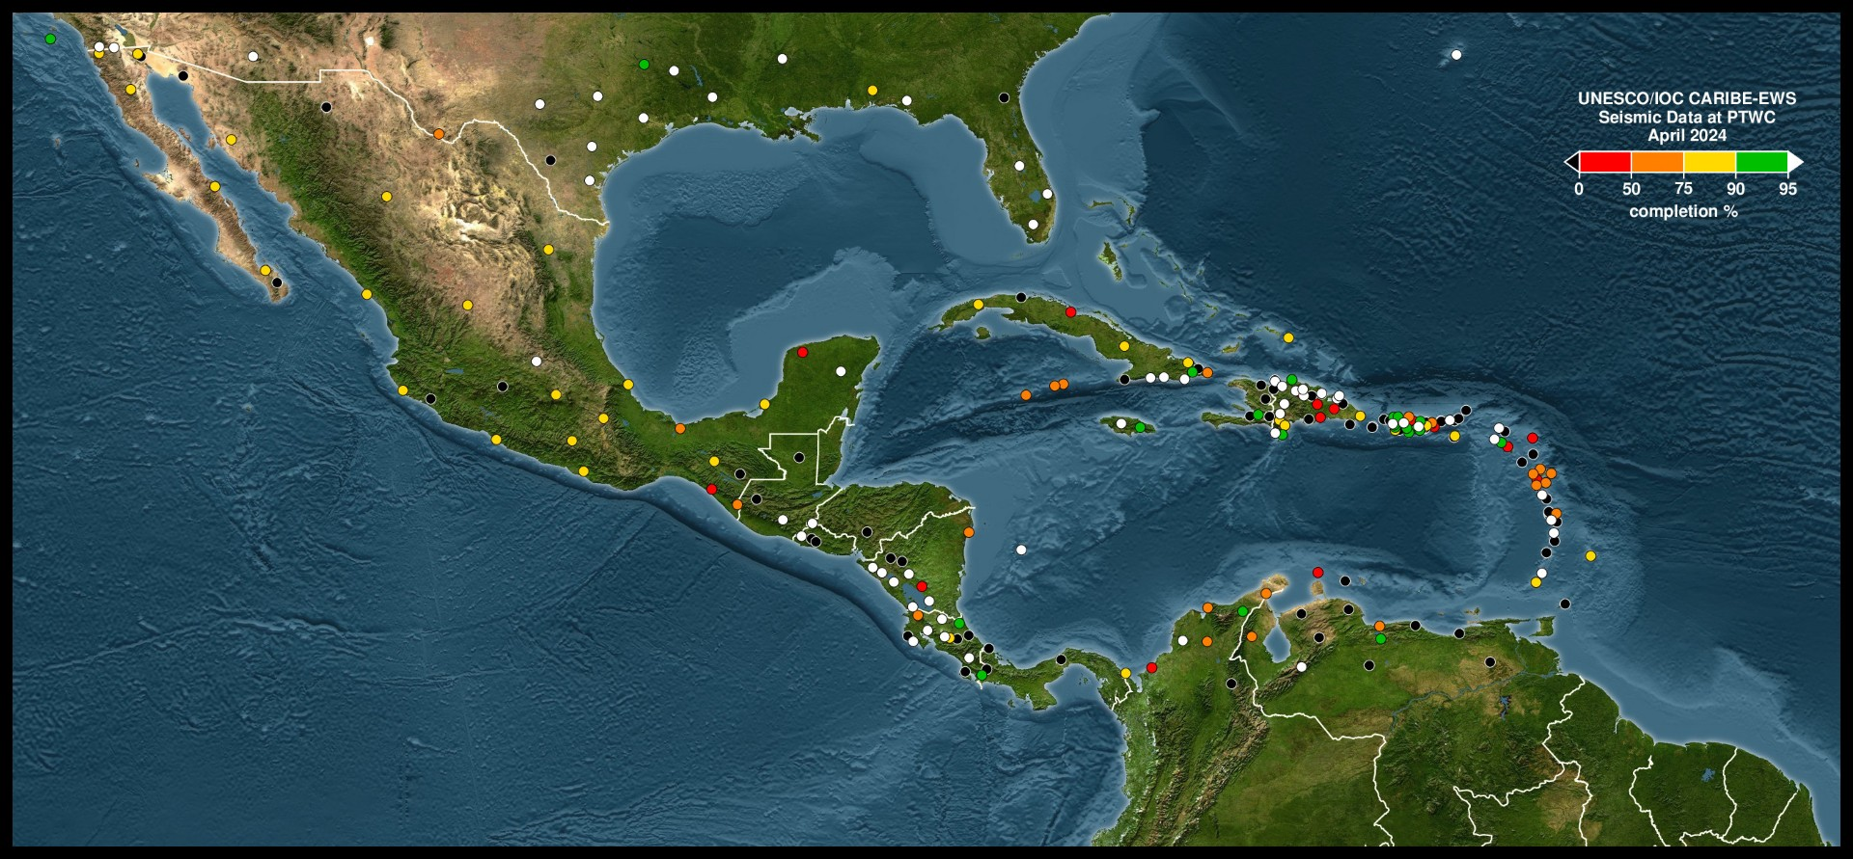
Current Status of Seismic (April 2024)
Courtesy NOAA PTWC

Slide 3
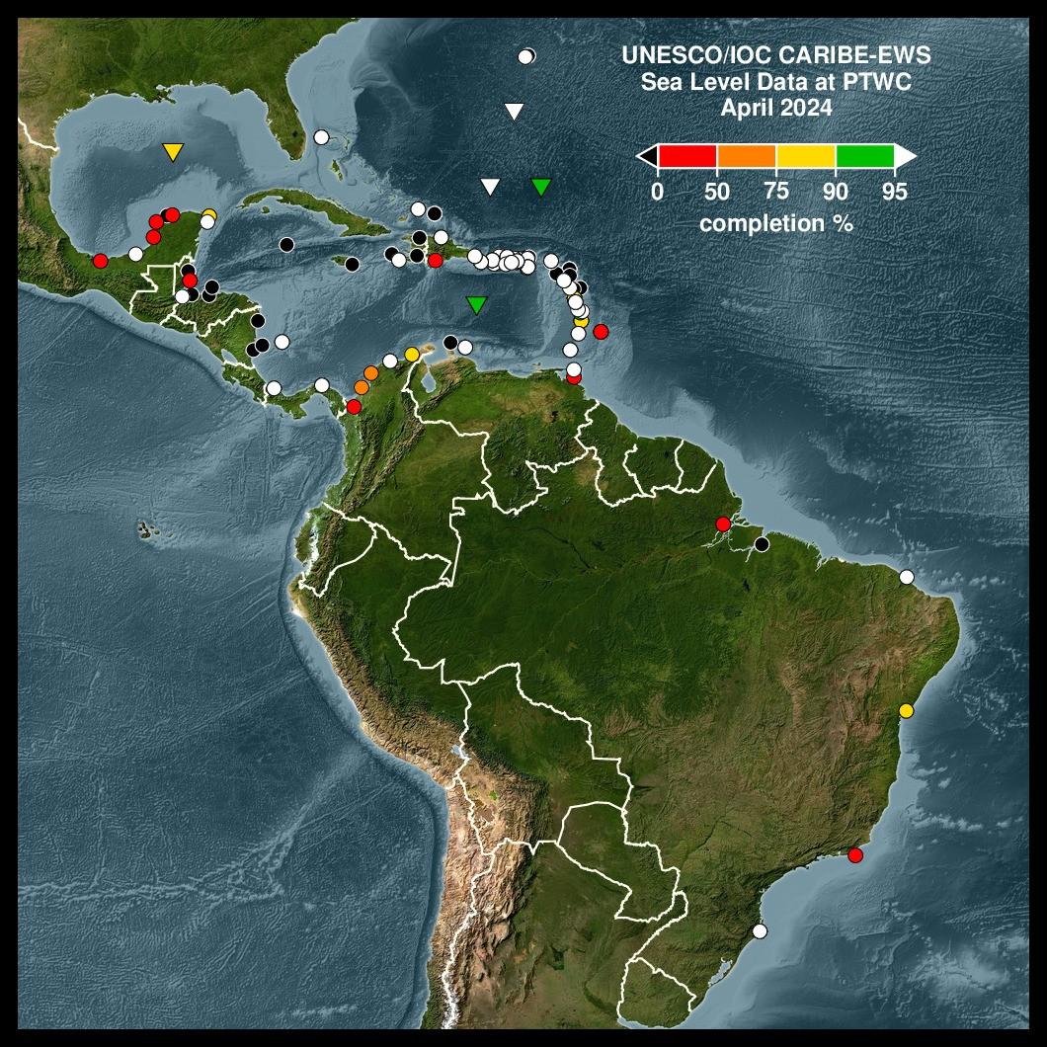
Current Sea Level Status (April 2024)
Note the high level of outages in the western Caribbean.
Courtesy NOAA PTWC

Slide 4
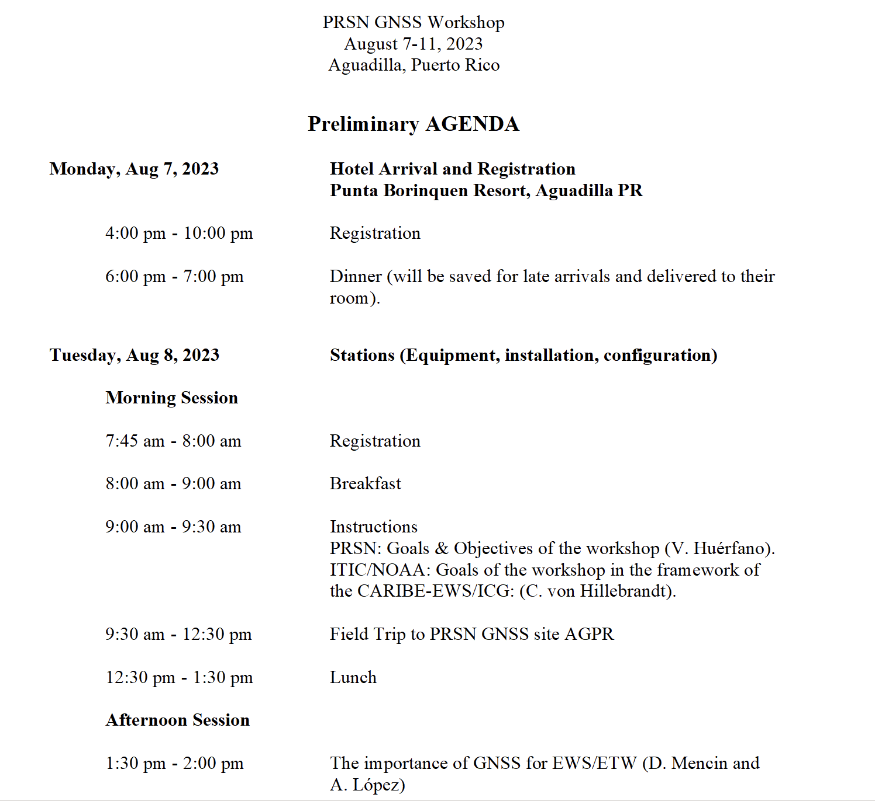
August 2023 GNSS workshop (PR)
~40 particpants
Field trip to PRSN GNSS station installation in Aguadilla (co-located with AGPR)
English Language workshop
Need for complete updated inventory for Caribe-EWS noted

Slide 5
IOCARIBE GOOS -TAC-OOFS Initial Working Group Meeting Jan 27, 2024
Opprotunity for tsunami community directly interface with ocean observing data centers
Based on the Jan 27 meeting currently looking for volunteers
Possible avenue to standardize data and metadata formats for sea level data.

Slide 6
February 2024 First Official meeting Key Outcomes:
Suggest adding a technical webinar to meetings/series
Identified the need to develop a working group of specialists to support implementation of cable based data into tsunami monitoring
Further develop the monthly reports to indicate the impact of data availability on tsunami detection

Slide 7
March 2024: 1st Planning meeting for Sea Level Workshop in English
Meeting with UNESCO and NOAA representatives to start the organization of an English language sea level training/workshop modelled after the Spanish language workshop previously held in Costa Rica
Small working group to plan workshop; possible host USVI.

Slide 8
To Do:
Determine the best way to transmit monthly reports to network operators/ best way for operators to communicate station updates
Create set schedule for meetings: Suggestion 1st Friday of the month 1700 UTC?
Create Cable task team
Volunteers to work on update/improved monthly reports (volunteers needed).

Slide 9
Draft Recommendations For ICG/CARIBE EWS
Notes and appreciates the member States role of network operators in the region for the installation, maintenance, and data transmission from seismic, sea level and GNSS stations in the region
Appreciates the NOAA ITIC-CAR and PTWC for improving the automated processing and continued reporting on the status of seismic and sea level stations;
Notes that a high percentage of the stations in the CARIBE-EWS sea level network are currently non-operational and therefore can delay the proper assessment of tsunami events and the issuance of timely and accurate tsunami alerts;
Urges Member States and operators of sea level stations contributing to CARIBE EWS to maintain their sea-level stations in an operational status and regularly review and update the status of its stations, in the IOC Sea Level Monitoring Facility, and inform ITIC-CAR and Secretariat on plans for repair;

Slide 10
Draft Recommendations For ICG/CARIBE EWS Cont.
Recommends WG2 perform a quantitative study of the impact of outages in the Caribbean
Further Recommends WG2 work with partners to develop a tool to include the impact of outages in the monthly reports.
Appreciates the work of the UN Ocean Decade on smart cables;
Further Recommends the formation of a task team under WG2 to specifically address the implementation of such technology in the Caribe-EWS.
Recognizing the importance of digital technologies for capacity building;
Suggests that WG2 explore developing a monthly or bi-monthly webinar on topics regarding Tsunami Detection Analysis and Forecasting.
Recognizing and Appreciating the success of the Spanish language sea level training in Costa Rica
Recommends that WG2 organize an English language sea level station workshop with the support of NOAA and the secretariat.

Slide 11
EarthScope Contributions ICG/CARIBE-EWS 2024
Annie Zaino
Manager of Global Field Operations
Network of the Americas - International Region
Gerente de Operaciones de Campo Globales
Red de las Américas - Región Internacional
May 6-9, 2024

Slide 12
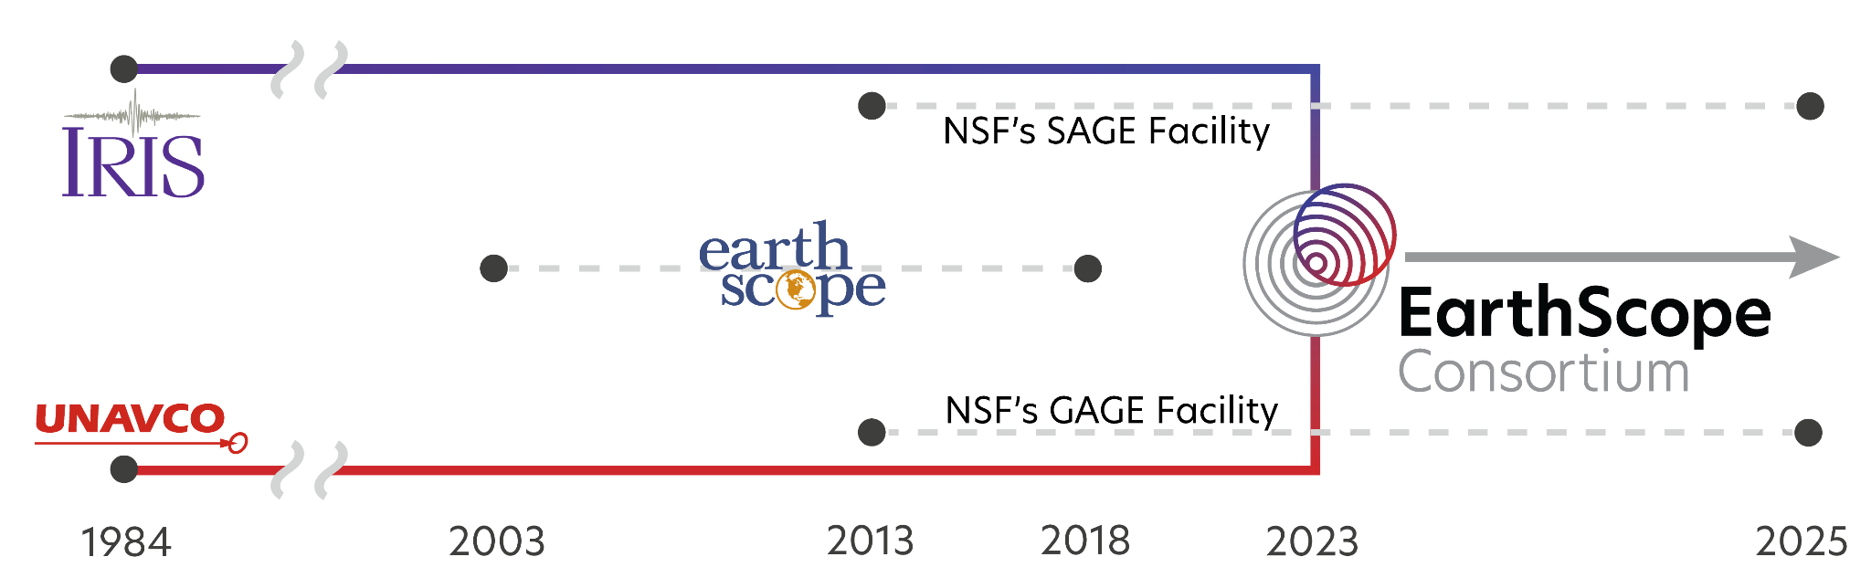
NSF National Geophysical Facility
Instalación Geofísica Nacional NSF
Proposal due June 2024
New funding cycle begins October 2025
Funding for 5-10 years
Performance review after 5 years
Propuesta prevista para junio de 2024
El nuevo ciclo de financiación comienza en oct de 2025
Financiación durante 5-10 años.
Evaluación de desempeño después de 5 años

Slide 13
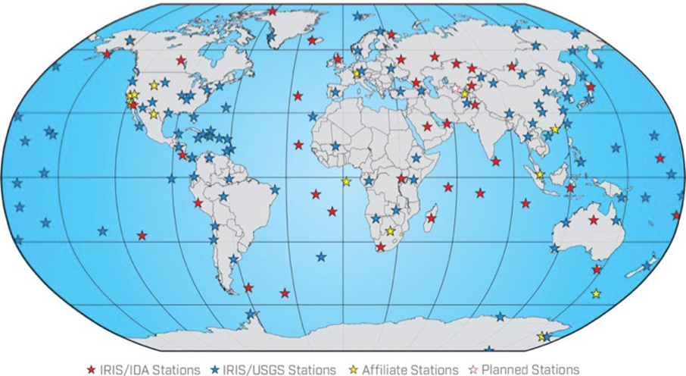
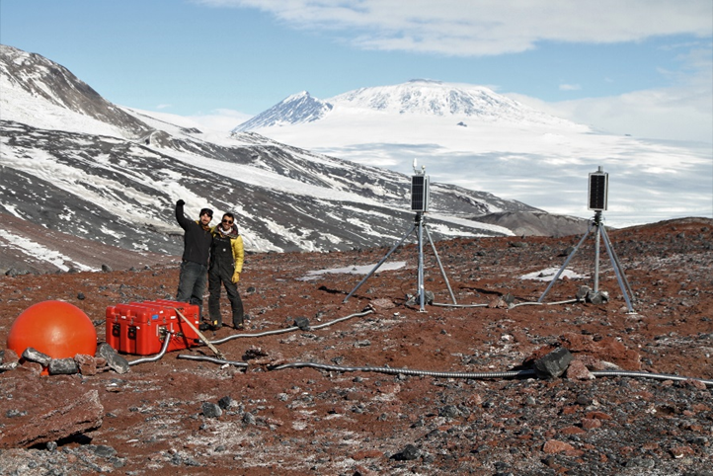
Seismology Support
Soporte de sismología
•Data archiving: raw seismic and derived products
•Global Seismographic Network
•Portable instrumentation services: seismometers, active-source support, magnetotelluric, ground penetrating radar
•Archivo de datos: sísmica bruta y productos derivados.
•Red Sismográfica Global
•Servicios de instrumentación portátil: sismómetros, soporte de fuente activa, magnetotelúrico, radar de penetración terrestre.

Slide 14
Global Seismographic Network
Red Sismográfica Global
IDA/UCSD Stations to be supported directly under EarthScope
Continuing collaboration with USGS
Las estaciones IDA/UCSD recibirán soporte directamente bajo EarthScope
Colaboración continua con el USGS

Slide 15

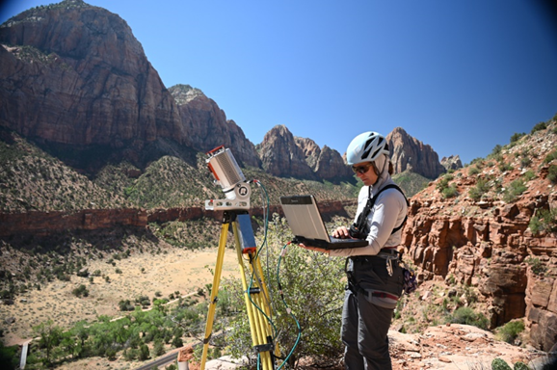
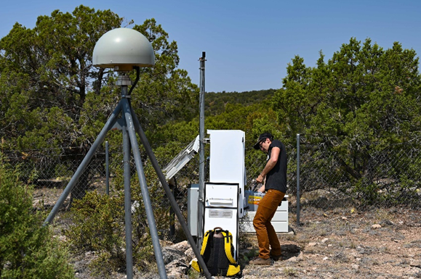
Geodesy Support
Soporte de geodesia
•Archivo de datos: GNSS, tensión de pozo/etc., SAR
•Operación Red de las Américas (GNSS y pozo de sondeo)
•Soporte de la Red Global GNSS de la NASA
•Servicios de instrumentación portátil: GNSS, escaneo láser terrestre, estructura UAV a partir del movimiento.
•Data archiving: GNSS, borehole strain/etc., SAR
•Network of the Americas operation (GNSS and borehole)
•NASA Global GNSS Network support
•Portable instrumentation services: GNSS, terrestrial laser scanning, UAV structure from motion

Slide 16
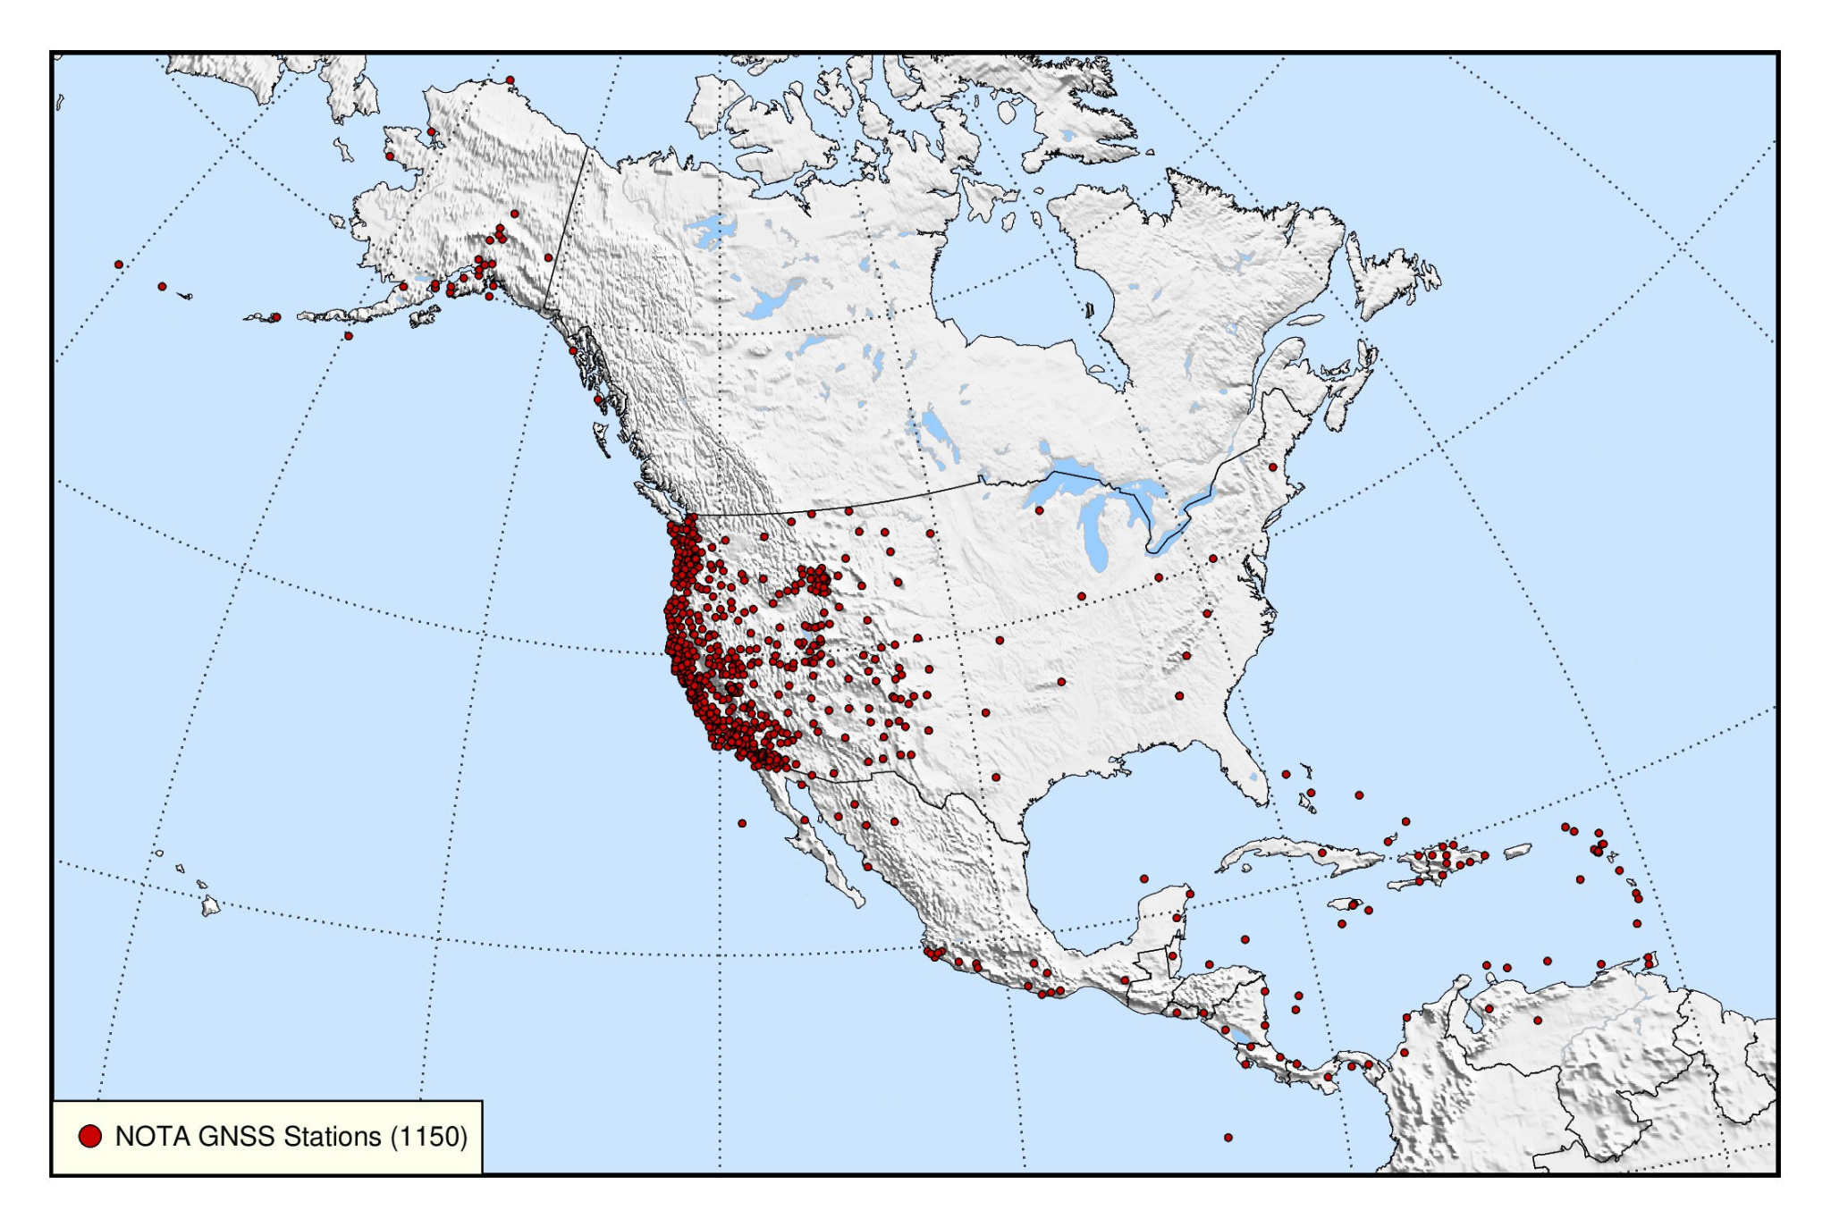
Network of the Americas (NOTA)
Red de las Américas (NOTA)
Funded by the US National Science Foundation
Network of 1150 GNSS Stations
Some borehole seismometer/strainmeters
Some meteorological equipment (heavily focused in the Caribbean and Central America
Caribbean and Central American stations original funded under COCONet project; funding ended in 2016
Incorporated into NOTA in 2018
Financiado por la Fundación Nacional de Ciencias de EE. UU.
Red de 1150 Estaciones GNSS
Algunos sismómetros/extensímetros de pozo
Algunos equipos meteorológicos (muy centrados en el Caribe y América Central)
Estaciones del Caribe y Centroamérica financiadas originalmente bajo el proyecto COCONet; la financiación finalizó en 2016
Incorporado a NOTA en 2018

Slide 17
Network of the Americas (NOTA)
Red de las Américas (NOTA)
Funding for repairs, upgrades, engineering support, data archiving
Majority of stations are full GNSS
In the process of upgrading to 1Hz realtime data where communications supports it
Earthquake response or by special request: high rate downloads of 5Hz data
Financiamiento para reparaciones, actualizaciones, soporte de ingeniería, archivo de datos.
La mayoría de las estaciones son GNSS completos.
En proceso de actualización a datos en tiempo real de 1 Hz donde las comunicaciones lo admitan
Respuesta a terremotos o por solicitud especial: descargas de alta velocidad de datos de 5Hz

Slide 18
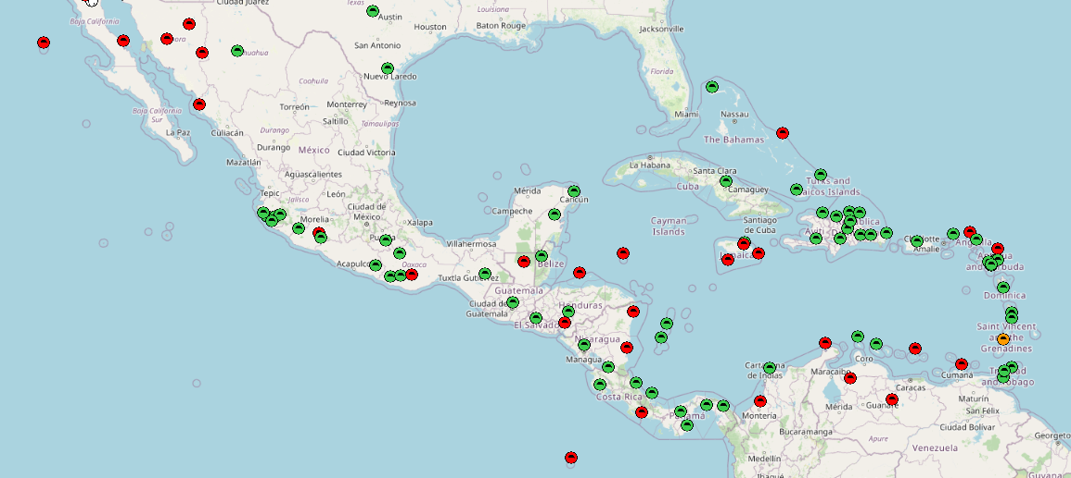
NOTA - International
NOTA - Internacional
Online, Streaming 1Hz data
Offline, Realtime capable
Online, daily files only
Offline, daily files only

Slide 19

Data Services Update
Actualización de Servicios de Datos
Migrating Data Operations to the AWS cloud
Migración de operaciones de datos a la nube de AWS
Real-time and Batch data services
Input, archive and distribution
GAGE/UNAVCO completed September 2023
SAGE/IRIS beginning June 2024
Servicios de datos por lotes y en tiempo real
Entrada, archivo y distribución.
GAGE/UNAVCO finalizado en septiembre de 2023
SAGE/IRIS a partir de junio de 2024

Slide 20
Data Services Update
Actualización de Servicios de Datos
Ventajas
Latencia reducida en tiempo real
Costos reducidos para NSF
Abre/amplia el acceso a los datos
Permite la ciencia en conjuntos de datos grandes y multidisciplinarios
IA/ML
Capacidad de descubrimiento de datos en tipos de datos multidisciplinarios
tipos de datos actuales: GNSS, sísmicos, magnetotelúricos, InSAR, SAR, topografía
Nuevos tipos de datos propuestos: DAS, GNSS cercano a la superficie y del fondo marino
Migrating Data Operations to the AWS cloud
Migración de operaciones de datos a la nube de AWS
Advantages
Reduced real-time latency
Reduced costs to NSF
Opens/Broadens access to data
Enables Science on large and multidisciplinary datasets
AI/ML
Data Discoverability across multidisciplinary data types
current data types: GNSS, seismic, Magnetotelluric, InSAR, SAR, Topography
Proposed new data types: DAS, near-surface, sea-floor GNSS

Slide 21
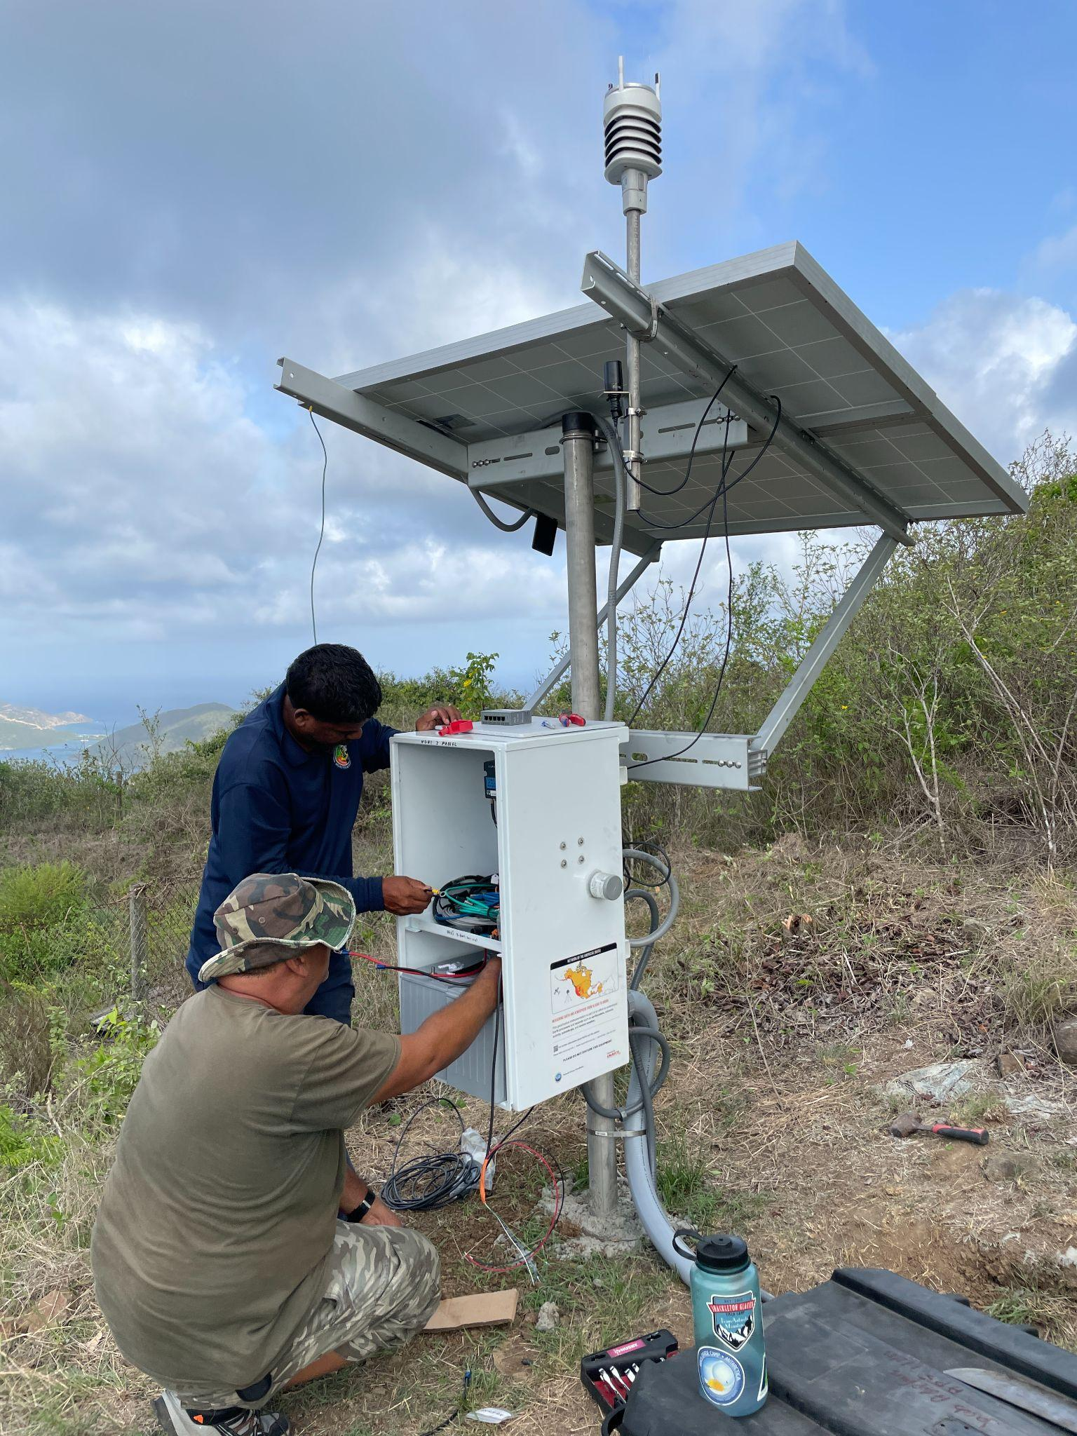
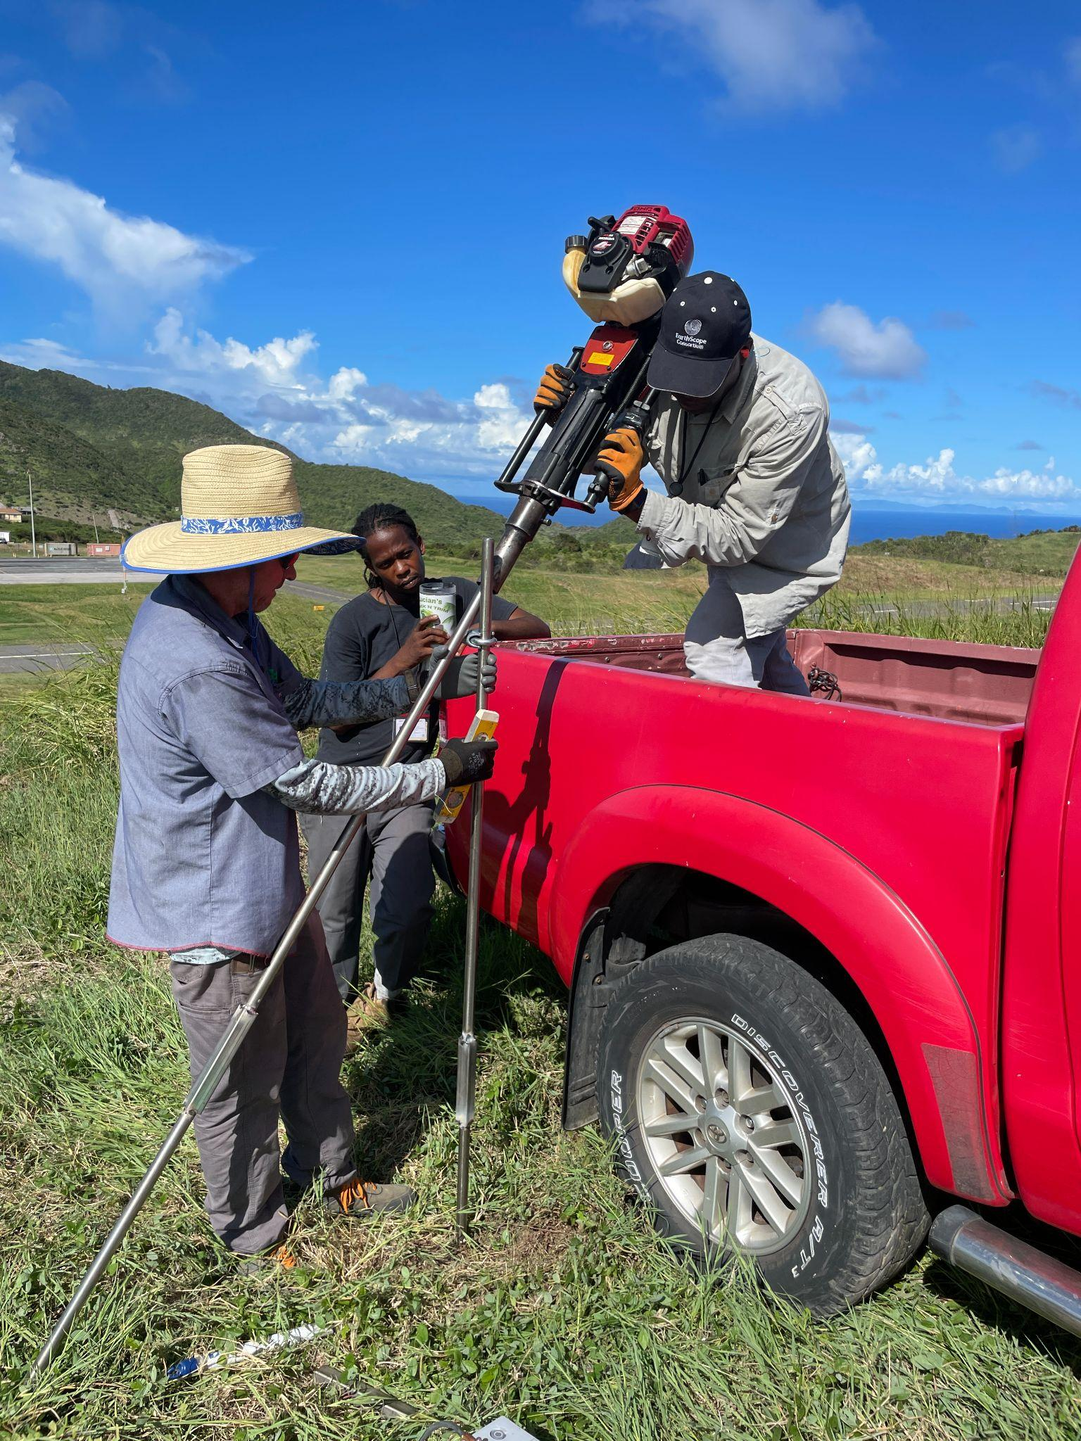
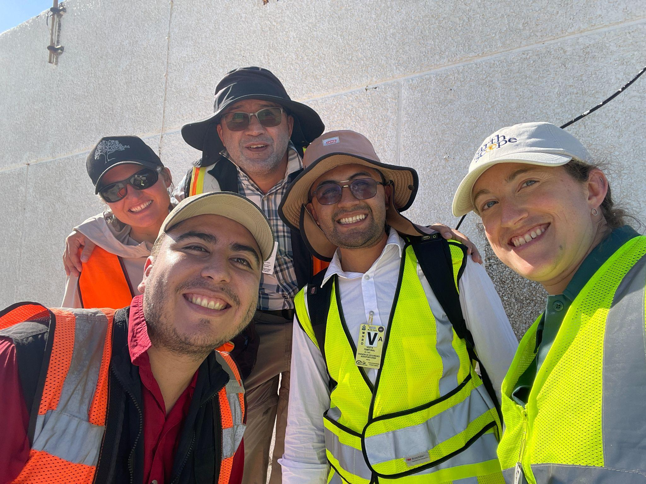
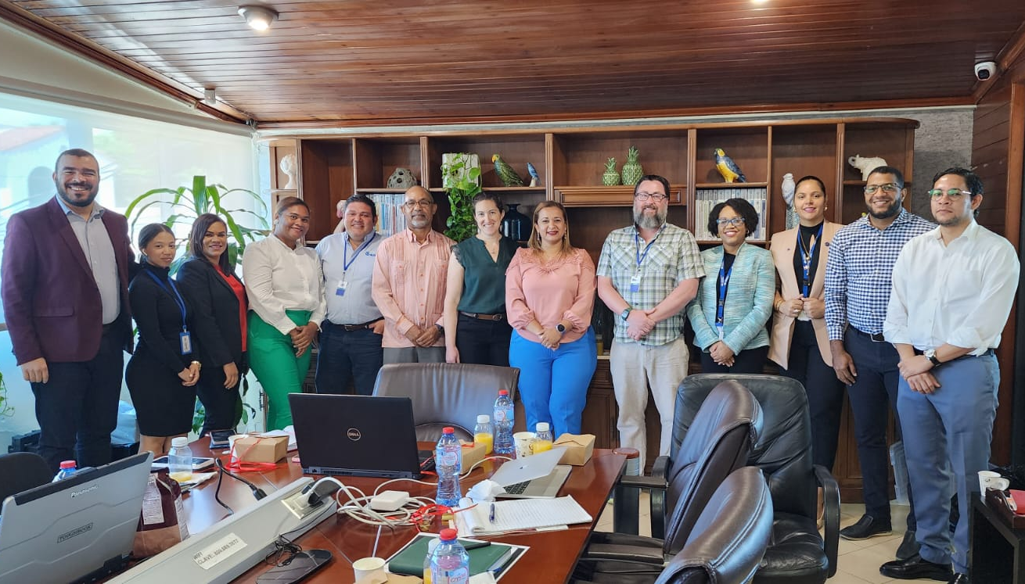
International Collaboration
Colaboración Internacional
El éxito de la red y nuestra capacidad para mantener las operaciones se debe en gran medida a las sólidas asociaciones que tenemos con agencias y colaboradores locales.
Como podemos integrar completamente los datos GNSS en los modelos de pronóstico de tsunamis, tenemos la capacidad de aumentar en gran medida el número total de estaciones de monitoreo y la densidad general de la red al aumentar esta colaboración.
Los departamentos gubernamentales de Tierras y Estudios y los grupos de topógrafos comerciales también mantienen redes de estaciones GNSS en tiempo real en toda la región.
Fomentar las asociaciones proporciona beneficios mutuos
The success of the network and our ability to maintain operations is in great thanks to the strong partnerships that we have with local agencies and collaborators
As we are able to fully integrate GNSS data into the tsunami forecasting models, we have the ability to greatly increase the total number of monitoring stations and overall network density by increasing this collaboration
Government Lands and Surveys departments and commercial surveyor groups also maintain networks of realtime GNSS stations across the region
Encouraging partnerships provides mutual benefit

