Slide 1

The Intergovernmental Coordination Group for the Tsunami and Other Coastal Hazards Warning System for the Caribbean and Adjacent Regions (ICG/CARIBE-EWS)
XVII Session
4.3 WG3: Tsunami Warning Dissemination and Communication Progress Report and Recommendations
Christa von Hillebrandt-Andrade, Chair
Susan Hodge, Vice Chair
May 7, 2024
#TSUNAMIREADY

Slide 2
Terms of Reference
Purpose: To examine current and developing capacities and advise the ICG about the definition and composition of early warnings and tsunami products and the methods and best practices for effective end-to-end dissemination and communication.
Tasks:
- Explore and document the dissemination capabilities and existing alert guidance in the countries of the region.
- Identify the difficulties and challenges existing in the region that hinder the impact of “end to end” dissemination and communication of early warnings.
- Establish strategies for the development and implementation of methods and technologies to strengthen the interaction with the media and dissemination of early warnings within the countries of the region.
- Evaluate communication tests and tsunami exercises, in order to identify weaknesses and make recommendations to help strengthen these delivery systems
- Create communication protocol and standardized information identifying the minimum acceptable levels for communication and dissemination of tsunami early warning in all countries for approval by the ICG.
- Provide feedback to the Tsunami Service Providers on its products and communication procedures.
- Serve as a reviewing and approving body for proposed changes to TSP products for the CARIBE-EWS, or determine if proposed changes warrant going to the ICG for review and approval.
- Present a progress report based on the Key Performance Indicators related to the UN ODTP.
- Promote the sharing of experience and expertise, and capacity building essential to effective tsunami warning dissemination and communication.
#TSUNAMIREADY

Slide 3
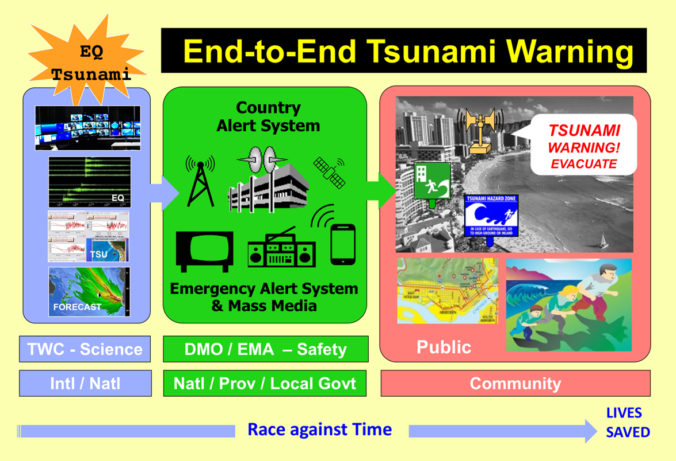
The Focus Area of WG 3

Slide 4
Activities
Received and Reviewed Membership – December 2023
Meeting of Chair and Vice Chair – December 7, 2023
Inventory of Tsunami Warning Dissemination and Communication Systems
Input for CARIBE WAVE 24
Two Meetings
  January 11
  April 4

Slide 5
Membership
19 members, 18 regular (including TSP’s PTWC and CATAC), 2 Ex Officio (ICG Chair and ICG Technical Secretary)
Invited Expert: UNDRR TBC
CARIBE-EWS Member States in WG 3
  Barbados, Colombia, UK (Cayman Islands, Anguilla), USA (PR, USVI, PTWC), Costa Rica, France, Guatemala, Nicaragua, Saint Lucia
CARIBE-EWS Observers in WG 3
  PRSN

Slide 6
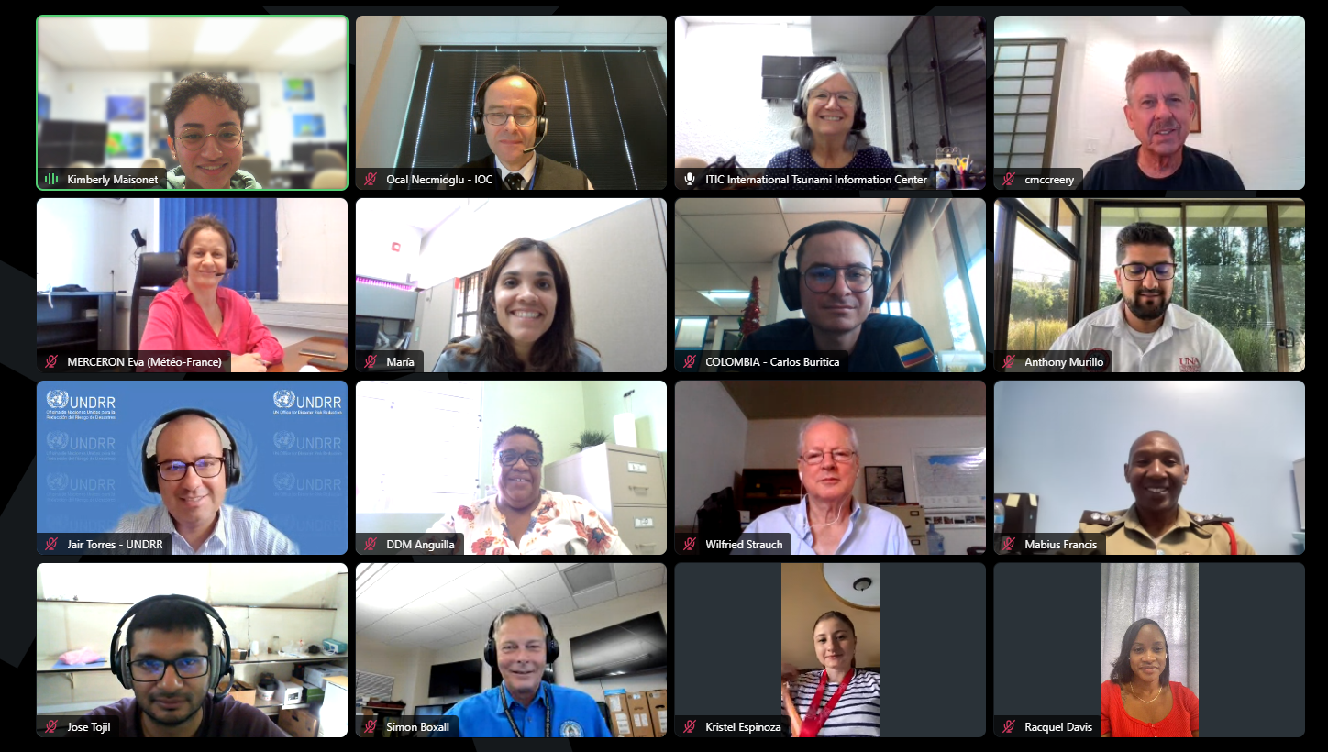
Participants in January 11 Meeting

Slide 7
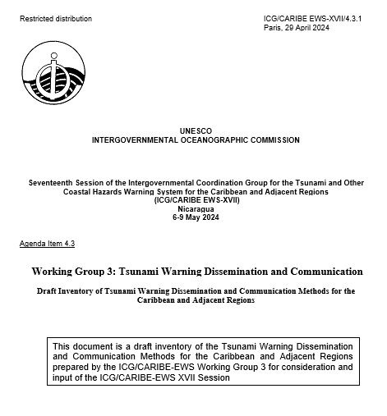
Working Group 3 with support of ITIC-CAR
Inventory of > 30 methods available for the reception of TSP products and dissemination and reception of tsunami warnings and other related products.
Overview of the methods and mechanisms used at different level and agencies from TSP’s through national authorities down to the private sector, media and communities and local governments.
Challenges of redundant and robust methods.
Systems for people with disabilities.
Basis for inventory within MS and to identify Capacity Development activities
#TSUNAMIREADY

Slide 8
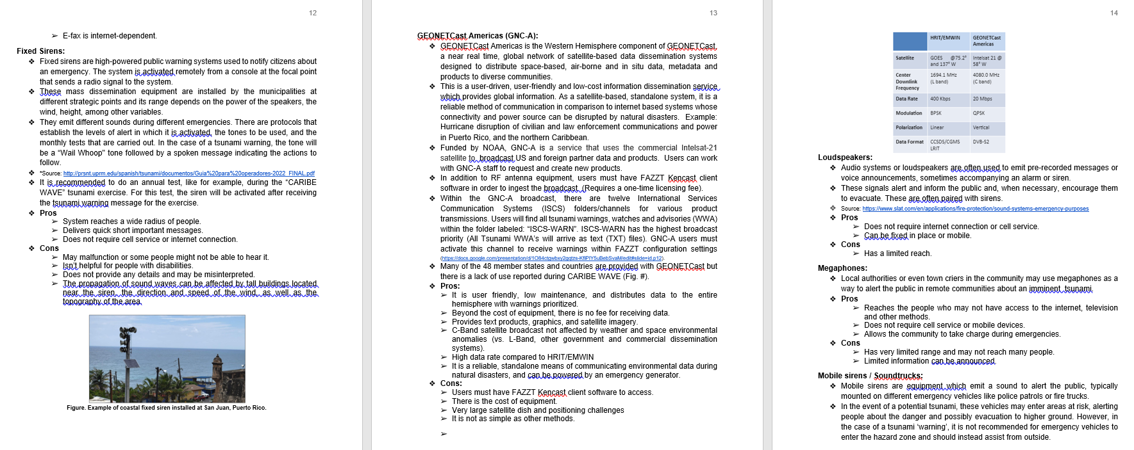
Examples from Inventory

Slide 9
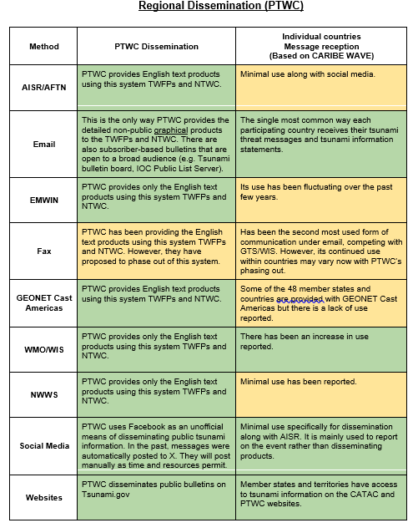
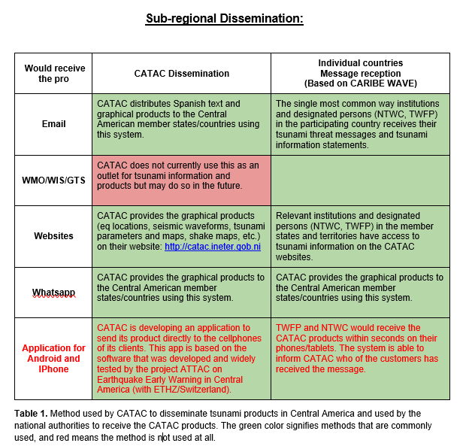
Examples from Inventory

Slide 10
Feedback from CARIBE WAVE and TSPs PTWC and CATAC
CATAC:
  Creating awareness of CATAC services with the Central America warning authorities and disaster risk reduction agencies
  Relies on Email, Web, Messaging and Social Media
  No capacity to generate GTS messages
  Concern on out of date tsunami protocols of CA stakeholders
  Understands there is potential for integration of Earthquake Early Warning for Tsunami Analysis and Forecasting
  CATAC TSP products for CW included warning language
PTWC
  Consolidating into one Users Guide the 2006 CARIBE EWS Communication Plan and the 2017 PTWC Enhanced Products User's Guide (IOC TS 135)
  Hoping to resume unannounced communication tests
  Evaluating Slack as a Potential resource for communication with TWFP/NTWC during events
  Tsunami.gov being updated
  Strong dependency on Emails, some use of satellite systems, reduced use of FAX
#TSUNAMIREADY

Slide 11
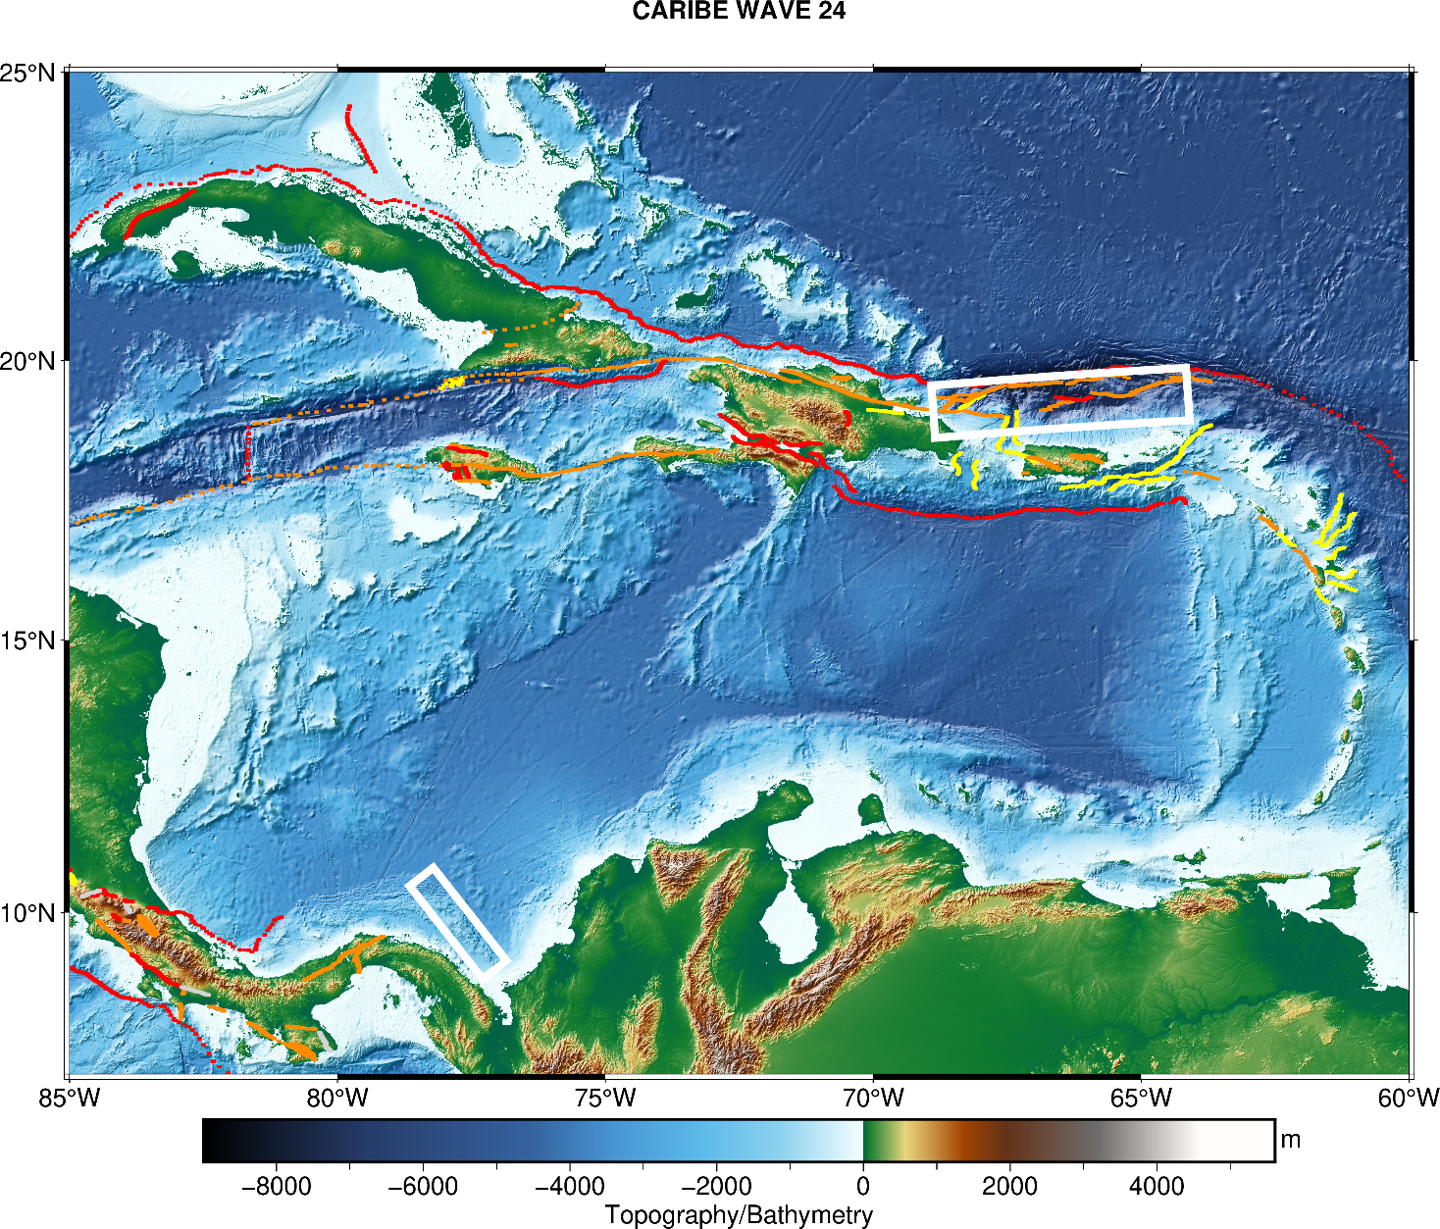
CARIBE WAVE 24
Earthquake and Tsunami Scenarios
#TSUNAMIREADY
Puerto Rico Trench
Panama
Scenario | Origin Time | Mw | Epicenter
Puerto Rico Trench | 15:00:00 UTC 21 March 2024 | 8.7 | 19.25ºN, 66.5ºW
Panama |  | 8.47 | 9.80ºN, 77.75ºW

Slide 12
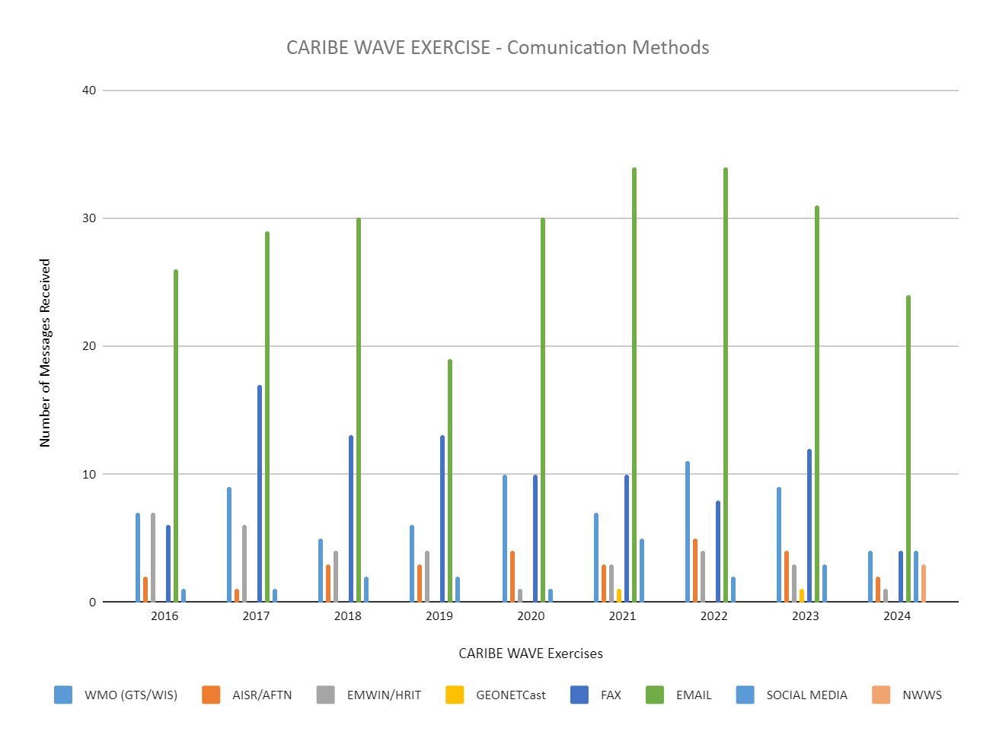
CARIBE WAVE – Receipt Methods PTWC Messages
#TSUNAMIREADY

Slide 13
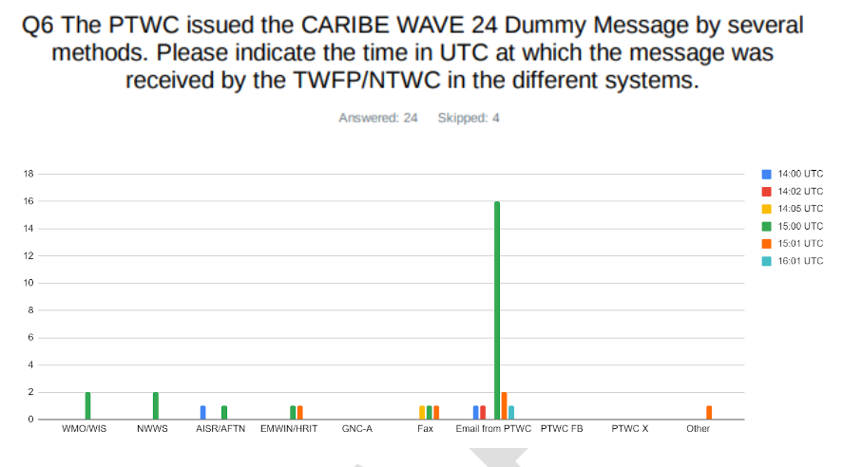
PTWC Dummy Message Timing

Slide 14
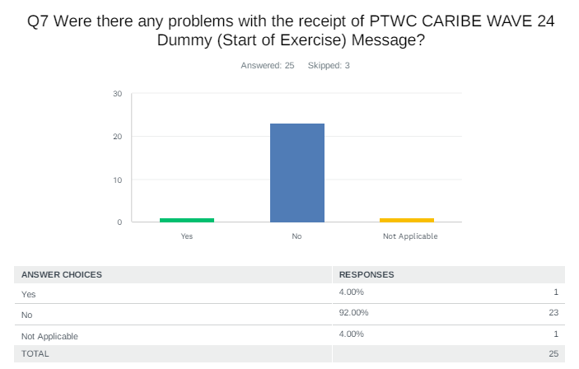
PTWC Dummy Message
Haiti: lots of problems with emails

Slide 15
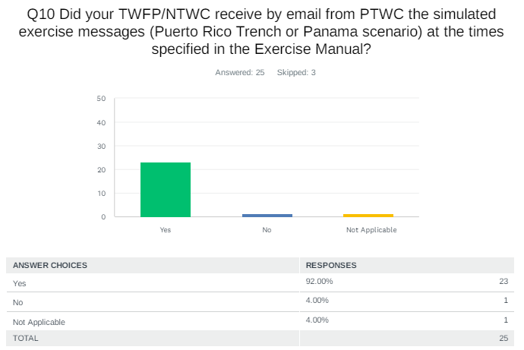
Reception of PTWC Emails with Simulated Products

Slide 16
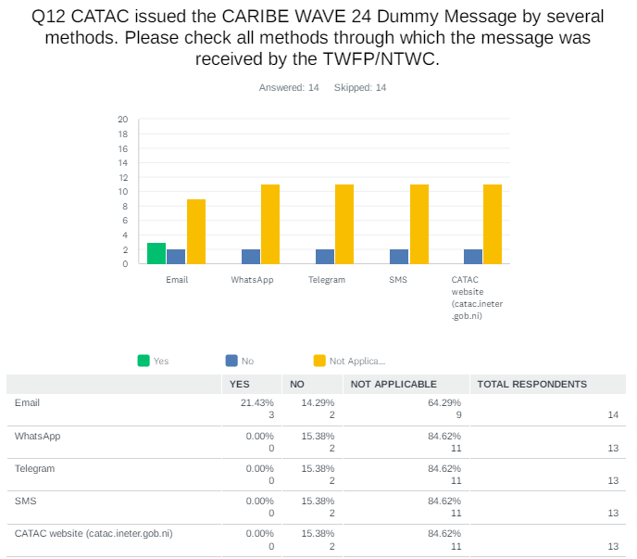
CATAC Dummy Message

Slide 17
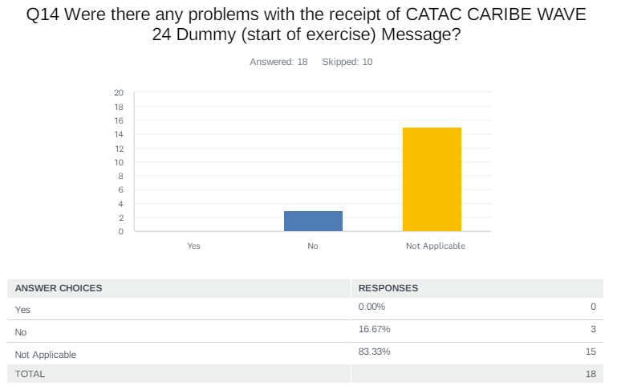
CATAC Dummy Message

Slide 18
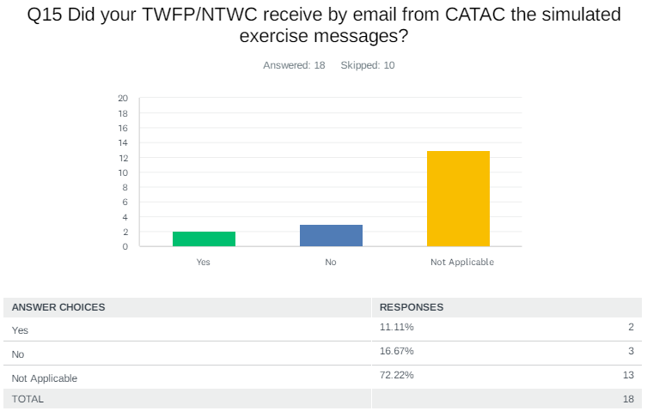
CATAC Exercise Message

Slide 19
CATAC Exercise Message*
Guatemala: Some messages were received not in order
*CARIBE-EWS Countries of Central America which answered survey: Panama, Costa Rica and Guatemala

Slide 20
Simulated Products CARIBE WAVE
PTWC
CATAC
NWS PACIFIC TSUNAMI WARNING CENTER HONOLULU HI
1600 UTC THU MAR 21 2024
...THIS MESSAGE IS FOR TEST PURPOSES ONLY...
...TEST TSUNAMI THREAT MESSAGE TEST...
**** NOTICE **** NOTICE **** NOTICE **** NOTICE **** NOTICE *****
THIS IS A TEST MESSAGE. THIS MESSAGE IS ISSUED FOR INFORMATION
ONLY IN SUPPORT OF THE UNESCO/IOC TSUNAMI AND OTHER COASTAL
HAZARDS WARNING SYSTEM FOR THE CARIBBEAN AND ADJACENT REGIONS
AND IS MEANT FOR NATIONAL AUTHORITIES IN EACH COUNTRY OF THAT
SYSTEM.
THIS IS A TEST MESSAGE. NATIONAL AUTHORITIES WILL DETERMINE THE
APPROPRIATE LEVEL OF ALERT FOR EACH COUNTRY AND MAY ISSUE
ADDITIONAL OR MORE REFINED INFORMATION.
**** NOTICE **** NOTICE **** NOTICE **** NOTICE **** NOTICE *****
TEST... PRELIMINARY EARTHQUAKE PARAMETERS ...TEST
-------------------------------------------------
* MAGNITUDE 8.5
* ORIGIN TIME 1500 UTC MAR 21 2024
* COORDINATES 9.8 NORTH 77.8 WEST
* DEPTH 25 KM / 16 MILES
* LOCATION NEAR THE NORTH COAST OF COLOMBIA
Central America Tsunami Advisory Center - CATAC
XXXXXXX THIS IS JUST AN EXERCISE XXXXXXXXXXXXXXXXXXXXXXXXXXXXXXXXXXXXXXXXXXXXXXXXXXXXXXXXXXXXXXXXXXXXX
NOTICE : This message is published for information purposes only in support of
Central American countries. National authorities are responsible for determining
the level of alert and for taking appropriate measures for their country.
appropriate measures for their country.
Tsunami Bulletin N° 03
Issued: 2024-03-21 09:30 Central American Time
2024-03-21 10:30 Panama Time
2024-03-21 15:30 UTC Time
A tsunami warning is in effect for the coastal areas of Central American countries.
An earthquake has occurred with the following parameters:
Magnitude : 8.5
Date : 21/03/2024
Time : 09:00 Central American Time, 10:00 Panama Time, 15:00 UTC Time
Latitude : 9.80 N
Longitude : 77.75 O
Depth : 25 Km
Location : Near the North Coast of Colombia

Slide 21
Pending Action
Report of ICG XVIII was posted on May 3 2024
Noted as part of the CATAC recommendation WG3 was recommended to review and revise Technical, Logistical and Administrative Requirements of a Regional Tsunami Service Provider for CARIBE EWS and report to the ICG/CARIBE-EWS-XVI
This had not been included in the work plan
WG3 will add to its work plan.

Slide 22
Recommendation of WG 3
Recognizes the actions of the Working Group 3 towards the advancement of tsunami warning dissemination and communication
Highlights the importance of the active participation of all its members and
Invites Member States to support and encourage the members to actively engage in the Working Group.
Notes the approval by the IOC Executive Council of the Research, Development and Implementation Plan for the Ocean Decade Tsunami Programme and its recommended actions for advancing Tsunami Warning, Dissemination and Communication;
Additionally notes the findings and recommendations of the UN Early Warnings for All Initiative (EW4ALL);
Further notes in CARIBE WAVE reports, the strong dependency of Member States on alerting systems based on landlines/submarine cable internet;
Acknowledges the WG 4 Inventory of Tsunami Warning Dissemination and Communication Methods for the Caribbean and Adjacent Regions;
Appreciates the support that the Caribbean Office of the International Tsunami Information Centre has provided to prepare this document as well as the contributions of other stakeholders;

Slide 23
Recommendation of WG 3 (cont)
Recommends WG 4 to finalize and submit the Inventory document including the results of the CARIBE WAVE 24 exercise.
Further recommends the UNESCO/IOC Tsunami Resilience Section to promote and make available the final document to ICG Member States and other stakeholders.
Additionally recommends WG 3 to use the Inventory to document the dissemination capabilities and existing alert guidance and needs in each of the Member States of the ICG CARIBE EWS, especially best practices, including traditional and technological solutions.
Reminds WG 3 to review and revise Technical, Logistical and Administrative Requirements of a Regional Tsunami Service Provider for CARIBE EWS and present at its XVII session
Encourages WG 3 to explore with the Member States and thru the ODTP and EW4ALL, alternatives, including capacity enhancement, to expand methods and systems for the reception of products from the TSPs and dissemination of warnings

Slide 24
Recommendation of WG 3 (cont)
Noting advances by CATAC in Earthquake Early Warning, and potential applications for Tsunami warning and communication.
Recommends CATAC to explore integrating EQEW applications into its tsunami services and products for its TWFP and NTWCs. (Working Group 2?)
Notes the importance of SOPS being up to date, include timelines, define warning authorities, and address local tsunamis.
Further notes the findings of CATAC and thru the implementation of Tsunami Ready that many member states have out of date Tsunami Response Plans and SOPS
Urges Member States to have up to date Tsunami Response Plans and SOPs, including addressing local tsunamis, as well as designated and trained warning authorities.

Slide 25
Recommendation of WG 3 (cont)
Notes the task to present a progress report based on the Key Performance Indicators related to the UN ODTP.
Requests the CARIBE EWS Secretariat to provide guidance and facilitate the reporting of the actions of the Working Group.
Recognizes Climate Change as well as multiple recent, ongoing and future emergencies and disasters and their cascading effects as a manifestation of the systemic nature of risks, and its impact on investments in warning dissemination and communication.
Urges the IOC Secretariat to work with the CARIBE EWS officers to develop a strategic plan to mobilize funding and in-kind support for more effective Tsunami Warning and Dissemination with a particular focus for LDC’s and SIDS.

Slide 26
WG 3 Workplan (as of April, 2024)
ACTION | Lead | DEADLINE
Hold quarterly meetings of the WG | Chair/Co-Chair | July 2024 November 2024 February 2025 April 2025
Finalize the Inventory of Communication Methods, including integration of the findings of CARIBE WAVE 24 | WG3 | June 2024
Using the Inventory document the dissemination capabilities and existing alert guidance in the countries of the region, especially best practices, including traditional and technological solutions. | WG 3 with support ITIC-CAR | ICG XVIII
Evaluate CARIBE WAVE 24, in order to identify weaknesses and make recommendations to help strengthen these delivery systems and develop recommendations tsunami warning dissemination and communication actions for CARIBE WAVE 25 and future exercises | WG 3 | July 2024 April 2025
Evaluate and Provide input to the SOPs of the TSP and the UNESCO/IOC Tsunami Watch Operation Global Service Definition Document | WG 3 | November 2024
Evaluate how WG 3 could support the MS and the Secretariat to have up to date SOPs and designations of warning authorities | WG 3 | February 2025
Upon request, provide feedback to the Tsunami Service Providers on its products and communication procedures and reviewing and recommend actions for proposed changes to TSP products

Slide 27
Thank You!
#TSUNAMIREADY

