Slide 1
Establishment of Task Team Tsunami Ready
Proposed Restructuring

Slide 2
Recommendations of the Midterm Officers’ Meeting
Section 4.4 “WORKING GROUP 4: PREPAREDNESS AND RESPONSE CAPABILITIES” of the Midterm Officers’ Meeting Report.
Relevant follow up actions: Action Item(s):
  CEWS-2023-APR-09: The ICG requested CTIC with WG4 Sub-group on Tsunami Ready and Member States determine the target number of communities in the CARIBE-EWS for Tsunami Ready recognition by 2030 (CTIC/WG4/Secretariat).
  CEWS-2024-FEB-09: Propose ICG/CARIBE EWS-XVII to establish a stand-alone Tsunami Ready Task Team (WG4/Chair).

Slide 3
Task Team of Tsunami Ready be established under the ICG/CARIBE-EWS
Task Team Tsunami Ready Chair
Deputy Chair ?
WG
Risk Knowledge
WG
Tsunami Detection, Analysis & Forecasting
WG
Tsunami Warning Dissemination & Communication
WG
Tsunami Warning Dissemination & Communication
WG
Preparedness & Response Capabilities
Task Team
CARIBE Wave
Vice Chair
&
WG Members
Vice Chair
&
WG Members
Vice Chair
&
WG Members
Vice Chair
&
WG Members
Vice Chair
&
WG Members
Vice Chair
&
WG Members

Slide 4
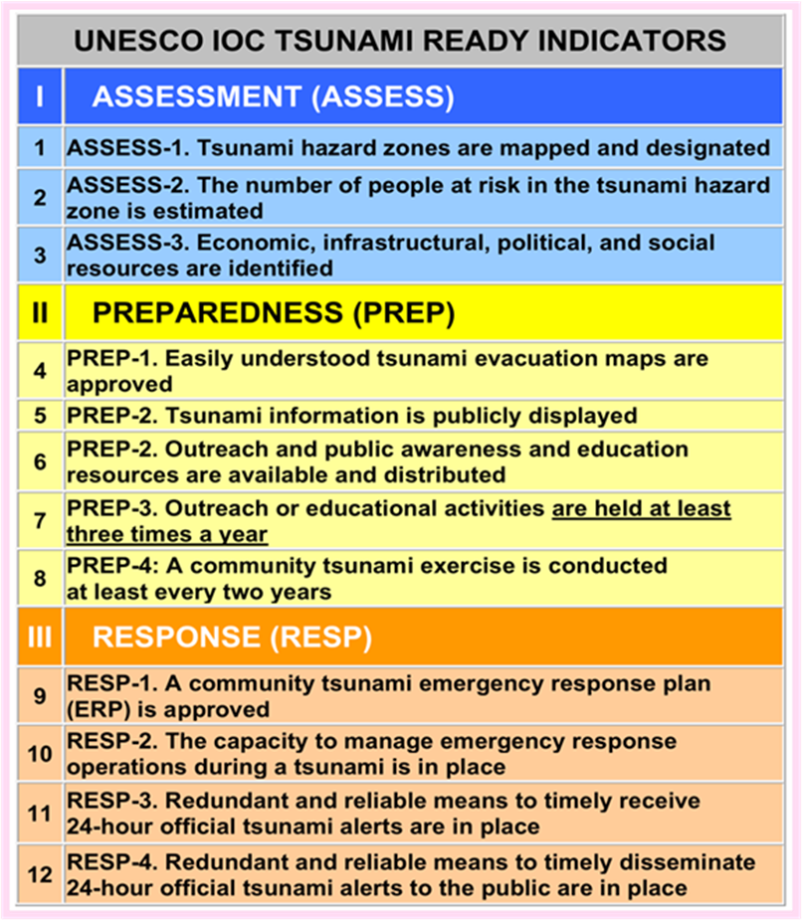
UNESCO IOC Tsunami Ready Indicators
Each proposed working group is relevant to the successful implementation of the twelve (12) Tsunami Ready Indicators
The ToR for CARIBE EWS Working Groups and Task Teams is still relevant and may just need reformatting to match the proposed new structure for the Task Team.

