Slide 1

5.4 UN Decade for Ocean Science for Sustainable Development
ICG/CARIBE-EWS XVII
Nicaragua
May 6-9, 2024
Dr. Silvia Chacon (CR)
Ms. Christa von Hillebrandt-Andrade (US)

Slide 2
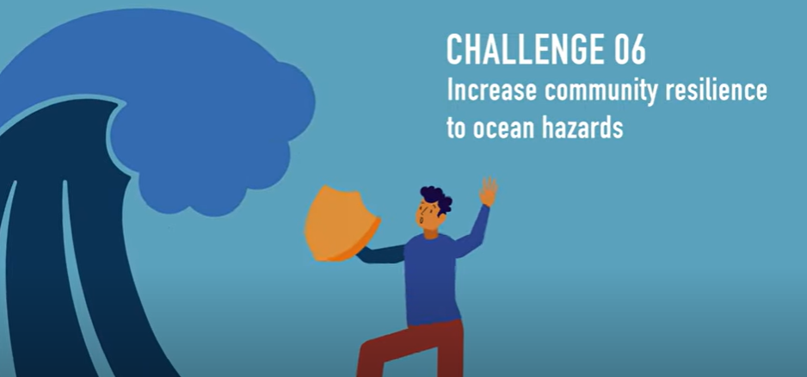

UN Decade of Ocean Science for Sustainable Development
IOC Ocean Decade Tsunami Programme
Click
for video
https://www.youtube.com/watch?v=xxLarl5E59Q

Slide 3


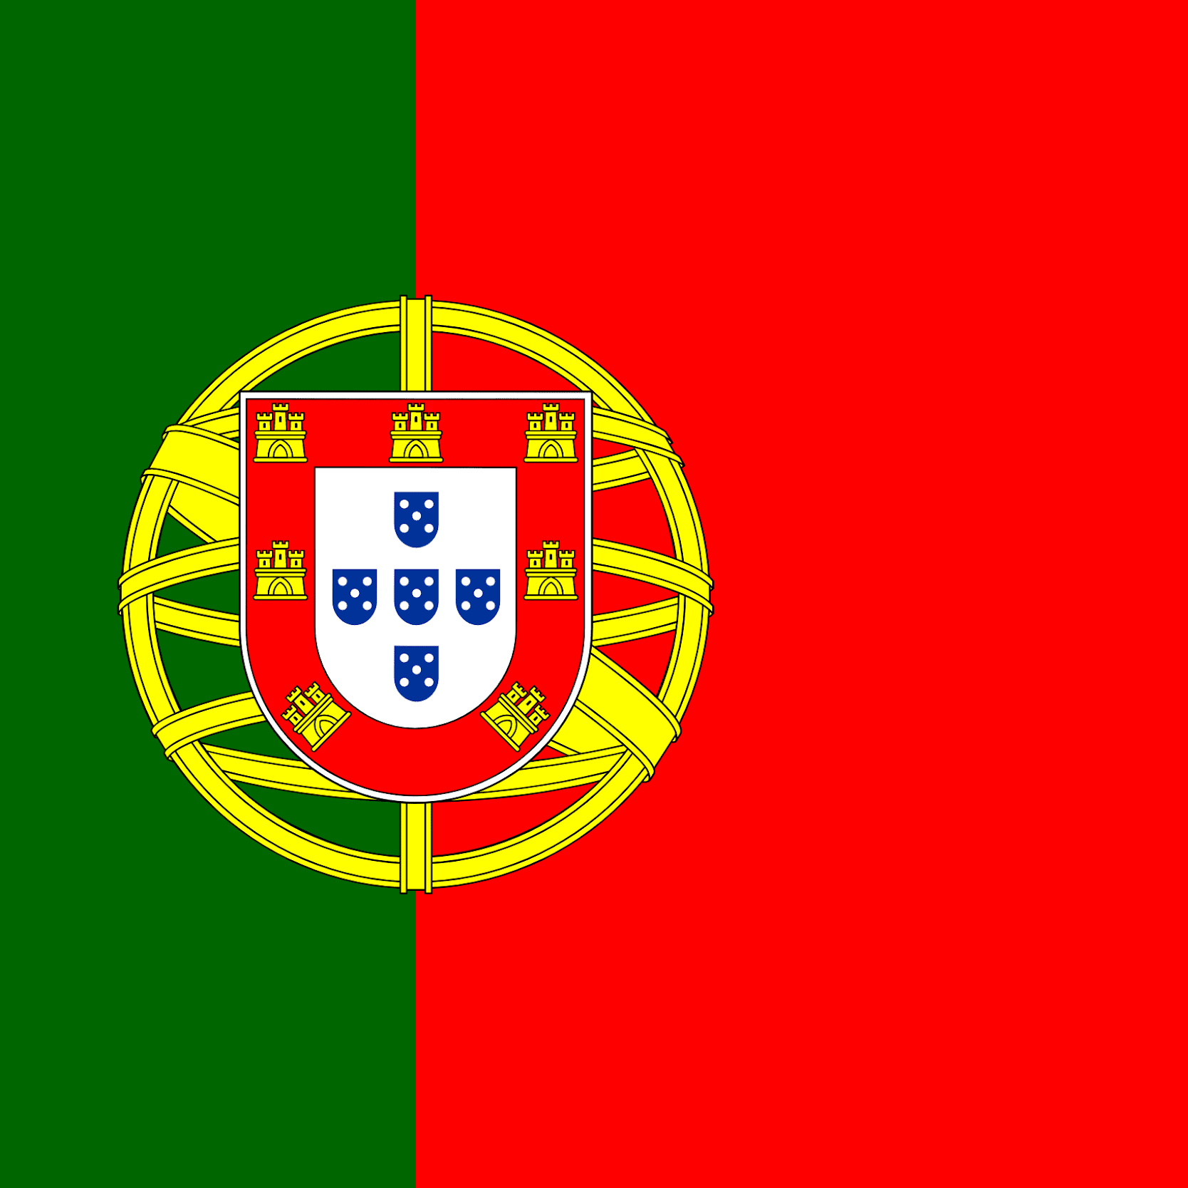


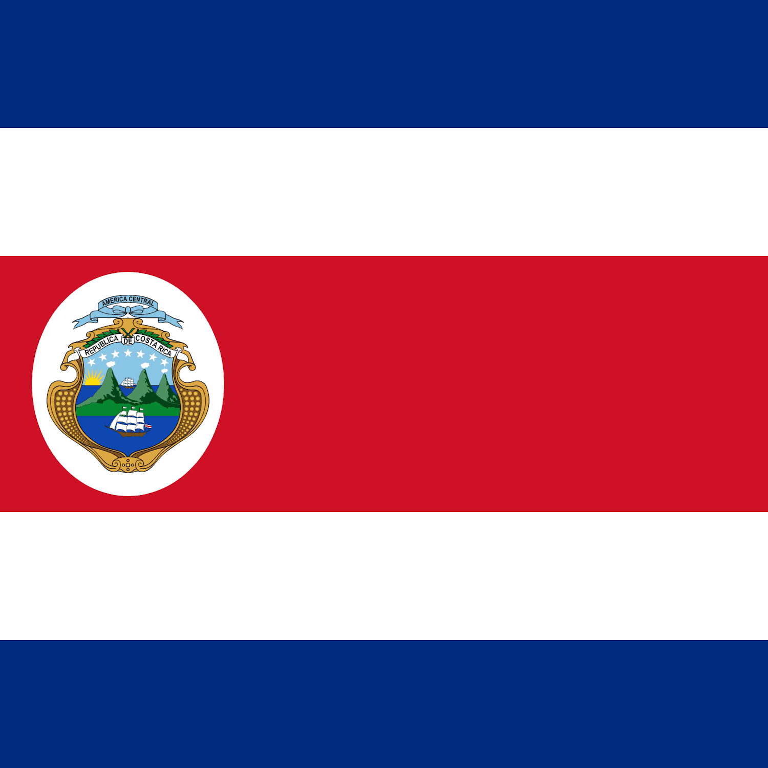


UN Ocean Decade Tsunami Programme Scientific Committee 2024-2025
Srinivasa Kumar Tummala
Chairperson
Christa von Hillebrandt
Maria Ana Baptista
Harkunti Pertiwi Rahayu
David Coetzee
Silvia Chacon
Srinivasa Kumar Tummala
Helene Hebert
Yutaka Hayashi
Michael Angove
Sergio Barrientos
Alexander Rabinovich

Slide 4


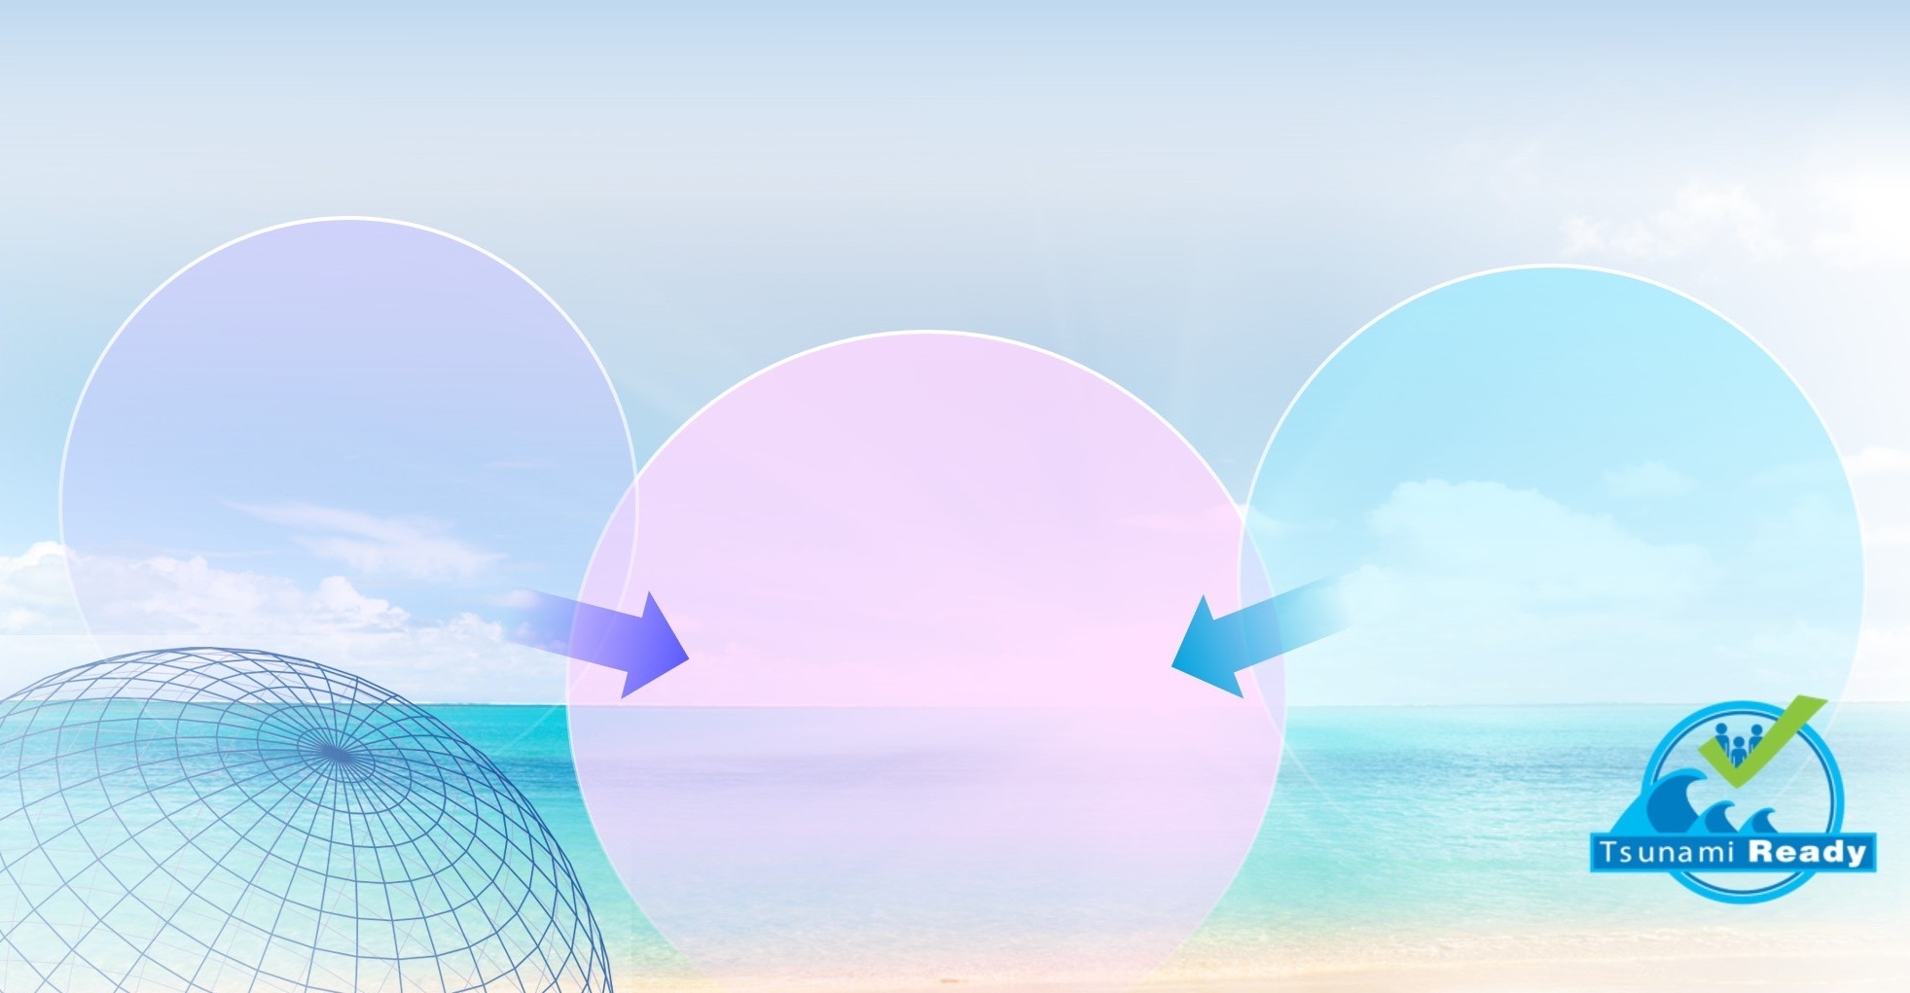
OCEAN DECADE TSUNAMI PROGRAMME
Seeking Major Advances in SCIENCE and PREPAREDNESS
New
observational and
analysis technologies to
move from a high-uncertainty
assumption-based capability
to a low-uncertainty
dynamic-based
capability
RESILIENCE!
Communities
respond to tsunami threats
by combining accurate
1. Real-time impact forecasts
with
2. Deep community preparedness
Tsunami disaster impacts
are minimized, enabling rapid
restoration of critical
infrastructure and services
Comprehensive
institutional & community
preparedness
and capacity building
efforts aimed at achieving
IOC Tsunami Ready
designation across
all socio-economic
categories

Slide 5
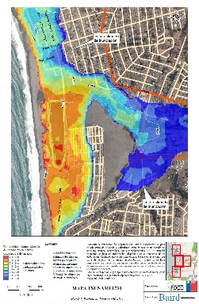
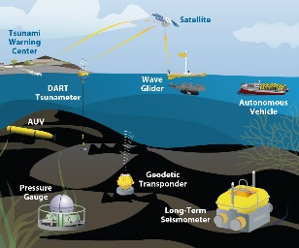
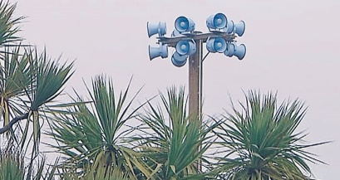


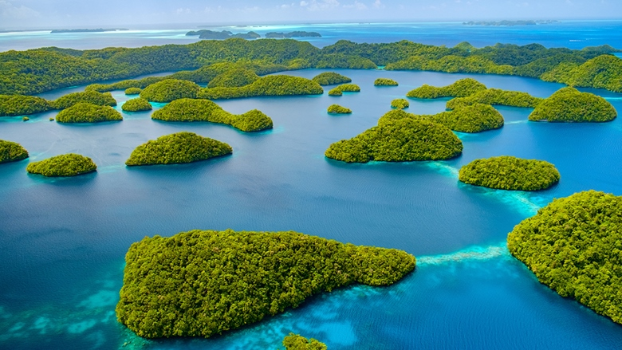
Key Elements of the Research, Development & Implementation Plan
1. Tsunami Risk Knowledge: Identify and prioritise at-risk communities
2. Tsunami Detection, Analysis and Forecasting: Expand existing, and deploy new observing technologies and warning systems
3. Warning, Dissemination and Communication: Access to data, tools, communication platforms, protocols and training to effectively warn coastal and maritime communities
4. Preparedness and Response Capabilities: To build tsunami-resilient communities
5. Capacity Development, SIDS and LDCs, Multi-hazard Framework: Underpinning elements
6. Governance and Pathways to Implementation
Notes:
Enhance tsunami risk assessments and the research on technologies for it, so the countries know their expected threat and vulnerability, and are able to identify and prioritise the at-risk communities.
Expand and improve existing detection and monitoring systems, including seismographs, coastal tide gauges, and deep ocean tsunameters, to fill identified gaps, and deploy new technologies to address observational gaps that cannot be covered by existing networks.
Ensure all National Tsunami Warning Centres (NTWCs) have access to data, tools and communication platforms, protocols and training to timely and effectively warn coastal and maritime communities threatened by tsunamis and other coastal hazards that are integrated into a multi-hazard framework
Emphasise the importance of building tsunami resilient communities through the IOC-UNESCO Tsunami Ready Recognition Programme, which is achieved through involvement of stakeholders at all levels.

Slide 6
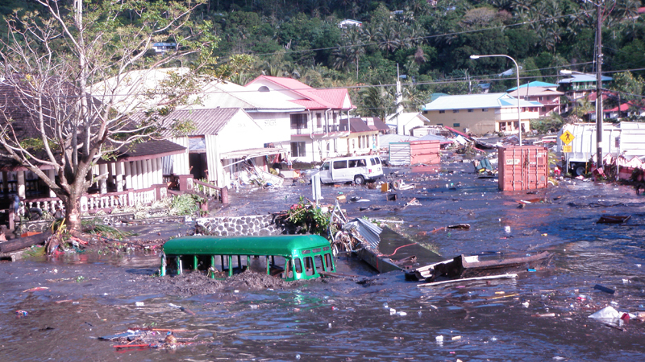
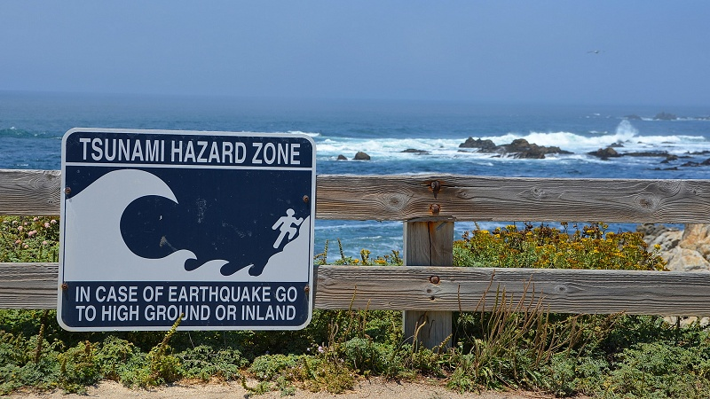
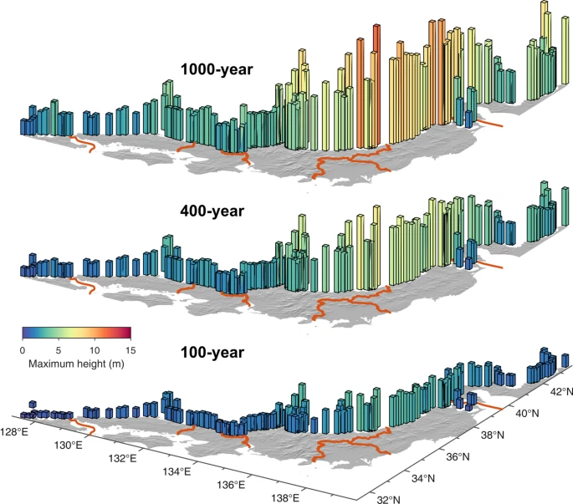
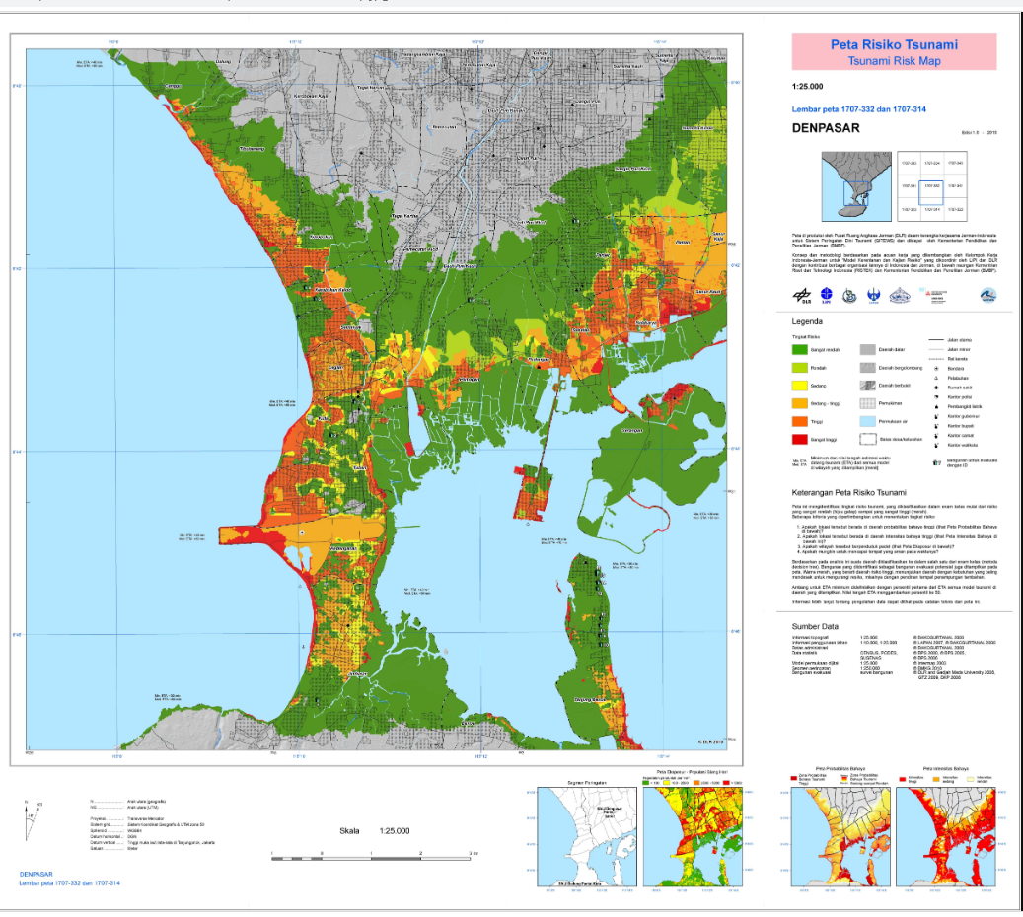
Tsunami Risk Knowledge - Goals
    Definition of inundation areas, flow depths and arrival times through Tsunami Hazard Assessments
    Catalogue of historical tsunami records
    Database of tsunami source scenarios
    Coastal digital elevation data
    Access to Tsunami numerical models
    At least one person able to do tsunami modelling
    Defined the inundation area for the chosen community
    Definition of vulnerability and exposure
    Identified critical infrastructure at risk
    Identified vulnerable groups
    Identified number of population
    Identified economic assets
    Identified built & natural environment
    Definition of methodology to calculate risk
    Definition of capacity to respond
    Bridged the gaps on legal framework
    Bridged the gaps on institutional framework
    Bridged the gaps on EWS
    Using results from Tsunami Risk Assessments
    Performed TRA studies
    Developed tsunami risk reduction tools

Slide 7
Tsunami Risk Knowledge
    Definition of inundation areas, flow depths and arrival times through Tsunami Hazard Assessments
Challenges | Solutions | Goals
Historical tsunami records are scarce or absent | Densify sea level networks, perform historical data research and perform paleo-tsunami studies | Each country to have their catalogue of historical tsunami records by 2025
Scenario definition (seismic and non-seismic) are required as input forcing for numerical models | Seismic, GNSS, Geophysical Volcanic Monitoring; Densify Sea level networks; Scientific Research; Experts Meetings | Each ICG to have a database of tsunami source scenarios, including non-seismic by 2025
High-resolution digital elevation data is required for numerical models but is lacking in many countries. Lack of qualified staff to conduct surveys; lack of equipment including boats. | Increase staff; Capacity building; Funding to buy/rent equipment | Each country has coastal digital elevation data in chosen communities by 2026 and each ICG has database of existing data and metadata
Lack of data to validate numerical models | Densify sea level networks; Perform historical data research; Perform paleo-tsunami studies | Each country has access to tsunami numerical models by 2026
Lack of qualified staff to conduct numerical modelling | Funding to hire and train staff | Each country has at least one person able to do tsunami modelling by 2025
 |  | Each country has defined the inundation area for the chosen community by 2026

Slide 8
Tsunami Risk Knowledge
    Definition of vulnerability and exposure
Challenges | Solutions | Goals
Inventories of critical infrastructure inside the inundation area (accessibility e.g., airport, ports) (telecomms, energy, food, fresh water & medical supply) | Multistakeholder resources (trained staff and funding) and coordination | Each Member State has critical infrastructure identified and prioritized by 2026
Ability to identify the vulnerable groups within the inundation area |  | Each country has identified vulnerable groups within tsunami inundation areas by 2026
Number of residents and visitors with their fluctuation (daily and seasonal) within the inundation area |  | Each country has identified number of populations at-risk within tsunami inundation areas by 2026
Identifying and prioritizing economic assets |  | Each country has identified and prioritized economic asset at land and ocean by 2026
Identifying and prioritizing critical infrastructure for economic impact |  | Each Member State has identified and prioritized critical infrastructure for economic impact at land and ocean by 2026
Identifying and prioritizing the built environment |  | Each Member State has identified and prioritized the built environment at land and ocean by 2026
Identifying and prioritizing the natural environment |  | Each Member State has identified and prioritized the natural environment at land and ocean by 2026

Slide 9
Tsunami Risk Knowledge
    Definition of capacity to respond
Challenges | Solutions | Goals
Definition of legal framework existing and desirable. Identifying gaps and priorities. | Strategy and funding to bridge the gap | Each Member State has bridged the gaps on legal framework by 2026
Definition of institutional framework existing and desirable. Identifying gaps and priorities. |  | Each Member State has bridged the gaps on institutional framework by 2026
Definition of EWS elements available and desirable. Identifying gaps and priorities. |  | Each Member State has bridged the gaps on EWS by 2026
    Definition of methodology to calculate risk
Challenges | Solutions | Goals
Develop methodologies for tsunami risk assessments including multi-scenario, location-based risk assessment of tsunami hazard characteristics, vulnerability, exposure, likelihood and Consequences | Document methodology (include multi-scenario, location-based hazard inundation mapping) | Each Member State has defined their tsunami risk assessment methodology by 2026
Multistakeholder definition of methodologies for tsunami risk Assessments | Developing and publishing of Supporting guidance and templates

Slide 10
Tsunami Risk Knowledge
    Using results from Tsunami Risk Assessments
Challenges | Solutions | Goals
Conduct and periodically review tsunami hazard risk assessments, using agreed methodologies | Resources (trained staff and funding) and coordination | Each Member State has performed TRA studies by 2026
Translate risk assessment findings to the appropriate stakeholders and sectors. | Coordination | Each Member State has developed tsunami risk reduction tools according with results from TRA studies by 2028

Slide 11
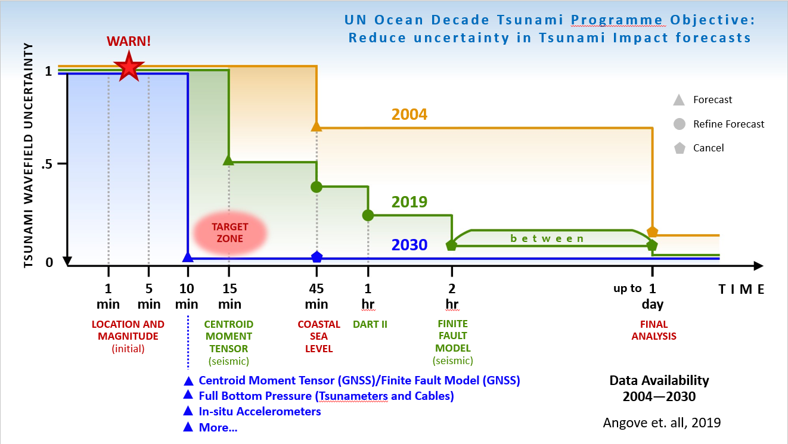
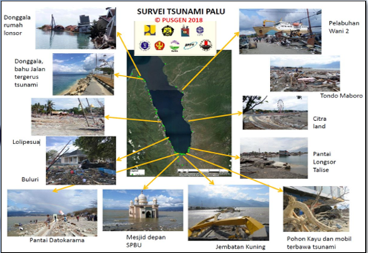
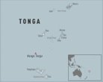

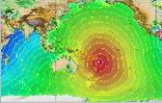
II. Tsunami Detection, Analysis And Forecasting - Goals
  Tsunami Threat Life Cycle : Initial indicators, confirmation, forecasting, validation and cancellation
  Throughout the threat life cycle it is possible to provide information on the potential threat
  Initial indicators based on seismic proxy provide necessary timelines but can be inaccurate
  Additional challenges with non-seismic and near-source tsunamis
  Greatly expand international cooperation in tsunami warning and mitigation, to improve capability to directly detect and measure tsunamis and reduce reliance on seismic proxy relationships in terms of projecting impacts
  To develop the warning systems’ capability to issue actionable and timely tsunami warnings for tsunamis from all identified sources to 100% of coasts at risk
  Most urgently, the ODTP will aim to provide tsunami confirmation within 10 minutes or less of origin for the most at-risk coastlines

Slide 12
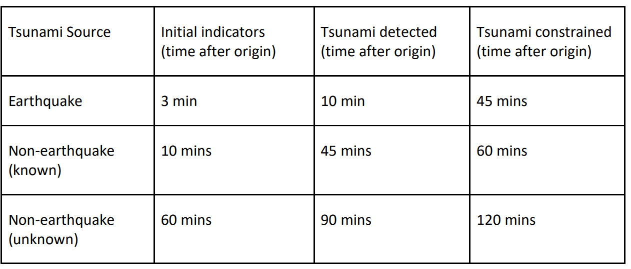
II. Tsunami Detection, Analysis And Forecasting - Goals
  Greatly expand international cooperation in tsunami warning and mitigation, to improve capability to directly detect and measure tsunamis and reduce reliance on seismic proxy relationships in terms of projecting impacts
  To develop the warning systems’ capability to issue actionable and timely tsunami warnings for tsunamis from all identified sources to 100% of coasts at risk
  Most urgently, the ODTP will aim to provide tsunami confirmation within 10 minutes or less of origin for the most at-risk coastlines

Slide 13
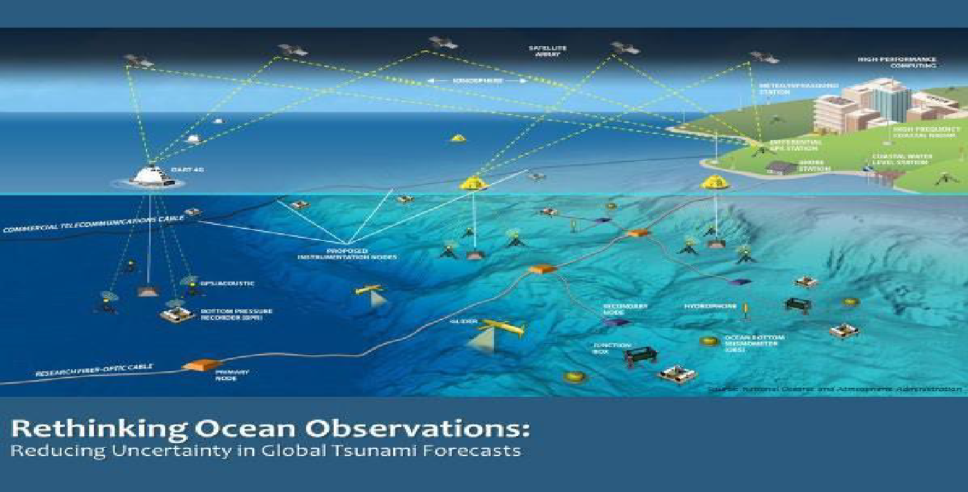
II. Tsunami Detection, Analysis And Forecasting
Detection and Measurement
Maximize and expand current capabilities
  Seismic networks, Tsunameters, Coastal sea level gauges, GNSS, Dedicated observatories
  Supporting capabilities - Coastal bathymetry, Sensor siting analysis, Global digital synthetic database, Model codes, Potential tsunami sources including non-seismic, Science to practice, Training on tsunami warning operations
Implementation of existing capabilities not being applied to tsunami operations
  Coastal RADARs
  Passive/Active Remote Sensing
  Infrasound
Identification of new candidate capabilities
  Ionospheric tomography – TEC
  Fibre Optic Applications – Distributed acoustic sensing
Characterization and Forecasting
Research on nature of tsunamis, source mechanisms and characterisation
Probabilistic Tsunami Forecasting Techniques
New Forecast methods
  Database Applications and matching Schema for updated Global Threat Database including non-seismic sources
  AI – ML to relate, discrete or combine observations to potential outcomes
  Dynamic Characterization using Rapid update cycle models
Optimal notional global network design in all ICGs
  Mix of observational platforms for tsunami operations in terms of locations, sensors, telemetry, data formats, etc
  New Technologies for Communication, Sensors, Repeaters,
  New use cases for Data (multi-hazard, climate, science)
  Collaboration with Scientific Groups, International Organisations, Industry, etc. for expansion of networks, R&D of new systems, Operationalisation
Optimal observing network implementation in all ICGs
Enhanced data sharing in all ICGs
High-Resolution Coastal Bathymetry and Topography
Advanced computing/modelling/impact forecasting/assimilation/analytics in all TSPs
Access to data, tools and communication platforms in all TWCs

Slide 14
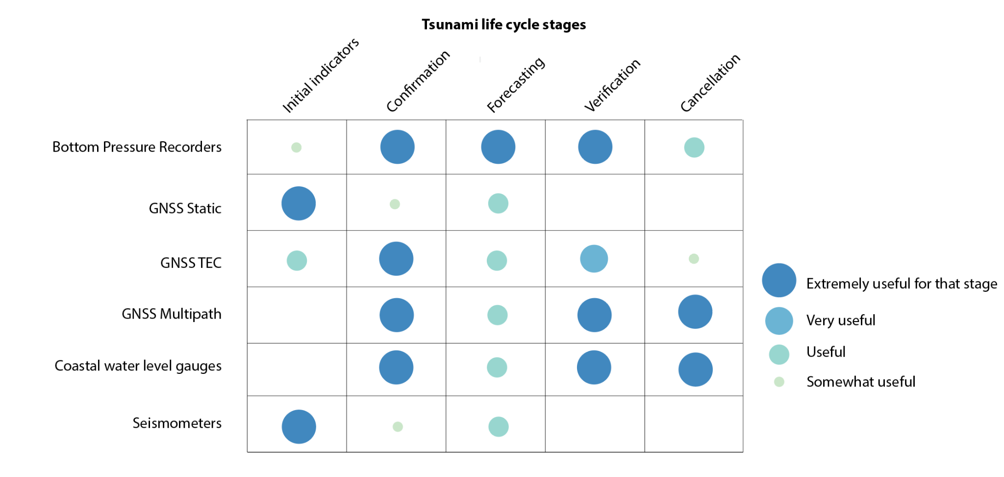
II. Tsunami Detection, Analysis And Forecasting
Detection and Measurement
Maximize and expand current capabilities
  Seismic networks, Tsunameters, Coastal sea level gauges, GNSS, Dedicated observatories
  Supporting capabilities - Coastal bathymetry, Sensor siting analysis, Global digital synthetic database, Model codes, Potential tsunami sources including non-seismic, Science to practice, Training on tsunami warning operations
Implementation of existing capabilities not being applied to tsunami operations
  Coastal RADARs
  Passive/Active Remote Sensing
  Infrasound
Identification of new candidate capabilities
  Ionospheric tomography – TEC
  Fibre Optic Applications – Distributed acoustic sensing
Characterization and Forecasting
Research on nature of tsunamis, source mechanisms and characterisation
Probabilistic Tsunami Forecasting Techniques
New Forecast methods
  Database Applications and matching Schema for updated Global Threat Database including non-seismic sources
  AI – ML to relate, discrete or combine observations to potential outcomes
  Dynamic Characterization using Rapid update cycle models
Optimal notional global network design in all ICGs
  Mix of observational platforms for tsunami operations in terms of locations, sensors, telemetry, data formats, etc
  New Technologies for Communication, Sensors, Repeaters,
  New use cases for Data (multi-hazard, climate, science)
  Collaboration with Scientific Groups, International Organisations, Industry, etc. for expansion of networks, R&D of new systems, Operationalisation
Optimal observing network implementation in all ICGs
Enhanced data sharing in all ICGs
High-Resolution Coastal Bathymetry and Topography
Advanced computing/modelling/impact forecasting/assimilation/analytics in all TSPs
Access to data, tools and communication platforms in all TWCs

Slide 15


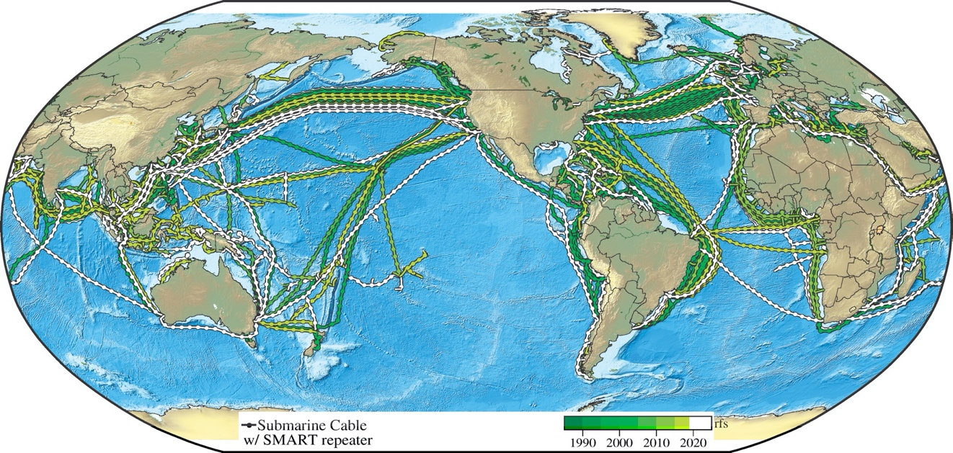

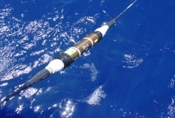


SMART Subsea Cables
Global Array: Climate, Oceans, Sea Level, Earthquakes, Tsunamis
Create Planetary Sensor, power, Internet network
1st order addition to Ocean-Earth observing system
Share
submarine cable infrastructure
Telecom + science
$
€
NO Interference
➜
SMART: UN Decade for Ocean Science Project
1.2+ Gm
~20,000 repeaters
20 year refresh
repeaters ~70 km
CAM: 3700 km, Gov’t, install 2025 SMART
Continent/Lisbon-Azores-Madeira ring
1755 Lisbon - Seismic, tsunami, ocean, environment
3700 km, 50 SMART repeaters, €120M
➜
1st Sensors: Bottom temperature, pressure, seismic acceleration
Notes:
Intro Map (shorten a bit)
The JTF mission is to implement telecom plus sensing, or SMART subsea cable systems, on a global scale, -- to be able to support climate, ocean circulation, sea level monitoring, and tsunami and earthquake early warning and disaster risk reduction.
We will share the submarine telecommunications network that links countries and continents together, and that enable our society and civilization.
Telecom is the primary mission, with SMART secondary.
The basic sensors are ocean bottom temperature, pressure and seismic acceleration.
The circles show a number of systems are in various stages of planning, requests for proposals, and implementation. The green circle represents the CAM system that is underway with SMART capability in Portugal’s Atlantic domain.

Slide 16
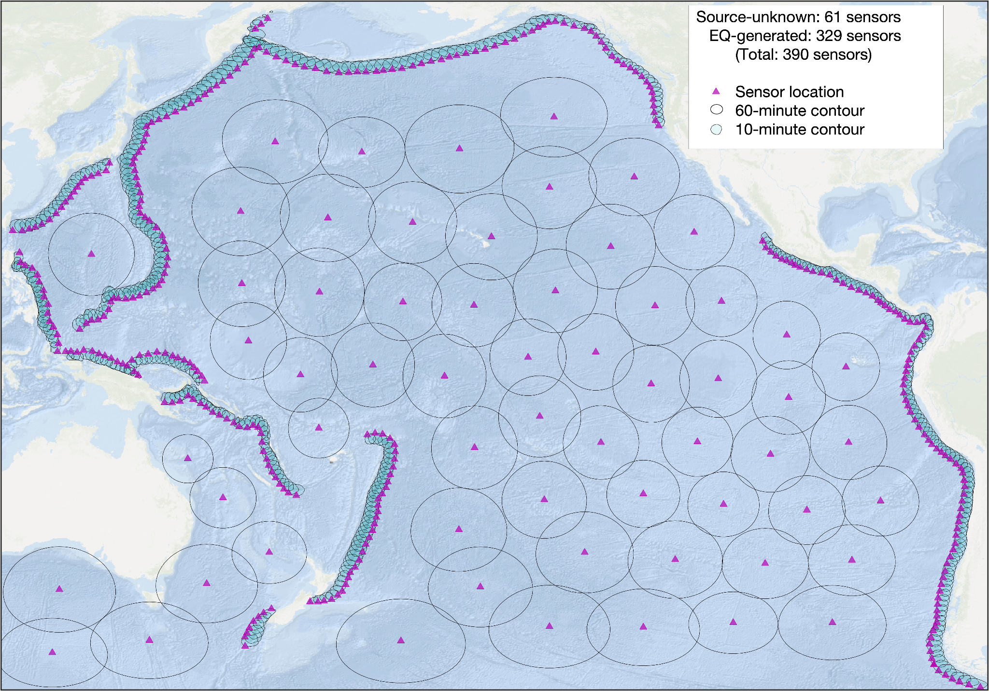
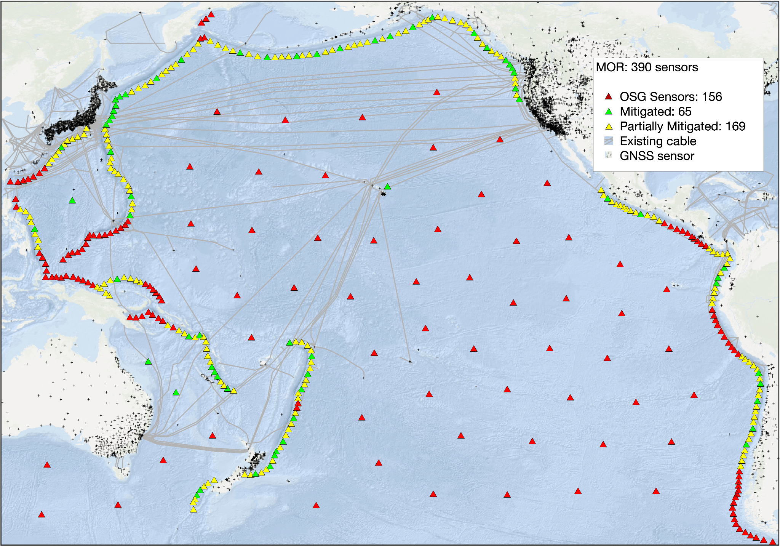
Developing an Optimised Sensing Grid To Achieve UNODTP Goals
(Pacific Example)
Minimum Observations Required: 390 (new)
Optimised with new technologies: 156 (new)
Notes:
Fig. 2 (left): Minimum Observations Required (MOR) to satisfy the 60-minute detection threshold for a tsunami source of unknown origin and the 10-minute threshold for the earthquake-based sensor locations (magenta triangles). The 60-minute contours are unshaded - the 10-minute contours are cyan-shaded.
Fig. 4 (right): Optimised Sensor Grid: fully mitigated by existing sensors (green triangles), unmitigated sensors (red triangles), and sensor locations partially mitigated by GNSS TEC measurement. Existing GNSS sensor positions represented by black crosses. The full network of existing and proposed fibre telecommunications cables (grey lines) is added to demonstrate the large number of additional sensors that could be mitigated with a fully realised SMART cable network.

Slide 17
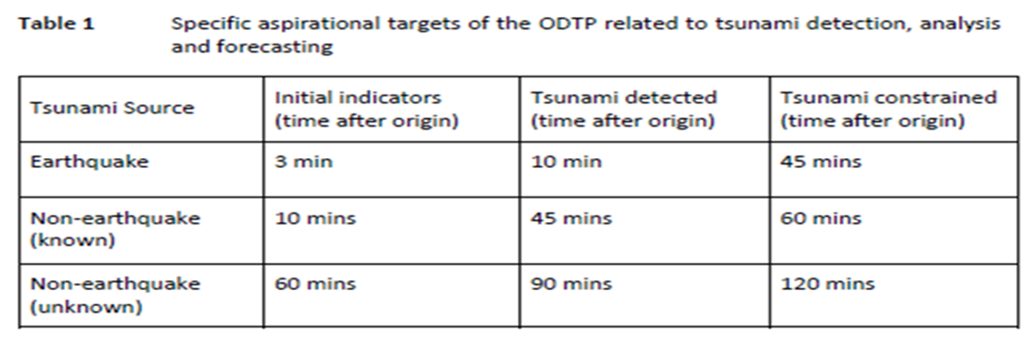
Tsunami Detection, Analysis And Forecasting
Overall
Challenges | Solutions | Goals
100 percent detection and measurement of all significant tsunamis within an actionable timeframe from generation (Table 1) | Optimal notional global network design consisting of a mix of observation platforms/types including seismographs, tide gauges, tsunameters, GNSS, SMART, research cables, interferometers, etc. | Optimal global network design in all ICGs by 2023
 | Optimal observing network implementation | Optimal network implementation in all ICGs from 2025 onwards
 | Enhanced data sharing | Enhanced data sharing in all ICGs by 2024
 | Coastal Bathymetry and Topography where necessary (GEBCO/2030) | High-resolution digital elevation data in all vulnerable coastal regions by 2030
 | High Performance Computing / modelling and impact forecasting / assimilation / analytics including AI-ML / uncertainty reduction | Advanced computational capabilities in all Tsunami Service Providers by 2027
 | Warning centres have access to the analysis (data, tools and communication platforms) for effective warning to impacted populations | Access to data, tools and communication platforms in all Tsunami Warning Centres by 2030

Slide 18
Tsunami Detection, Analysis And Forecasting
Coastal Sea Level Measurements (Tide Gauges)
Challenges | Solutions | Goals
Current network is not adequate from the perspective of: a) Not all gauges measure time (1 min) /height (1mm) /spatial resolution that is optimal for operational warning and better scientific understanding of the hazard b) Not all existing gauges transmit data in real-time | Review and update TOWS WG report on requirements - recommendations on optimal core network for tsunami operations from the perspective of locations, sensors, telemetry, standardized formats, reporting units, etc. | Review and update TOWS-WG report by 2023
 | Ensure groups working on other sea level applications such as GLOSS take onboard the requirements of tsunami so that the stations address multi-hazard requirements | Engage with all relevant groups by 2025
 | Identify hotspots from tsunami / climate perspective for prioritization and redundancy of installations | In all ICGs by 2025
 | Advocacy and Awareness among Member States, Network Operators, International Organisations (IHO, etc) to install new or enhance existing tide gauge networks that comply with agreed standards recommendation; real-time data sharing and access | In all ICGs by 2025
 | Multi-purpose instrumentation and platforms | In all ICGs by 2030

Slide 19
Tsunami Detection, Analysis And Forecasting
Open Ocean Sea Level Measurements (Tsunameters)
Challenges | Solutions | Goals
The current networks of tsunameters are used primarily for tsunami warning validation and unit source inversion of seismic sources for limited range of locations and forecasting of tsunamis; The networks are not adequate for characterising tsunamis from all tsunamigenic zones and for all types of sources; Challenges with long-term maintenance; | Design a global optimal network of ocean bottom pressure sensors that can provide the capability for direct detection of tsunami wave fields from all sources in reasonable time for tsunami warning (not tied to unit sources) | In all ICGs by 2023
 | Technical solutions for better communication (acoustic modems, cable-connected, hybrid, etc.) | Pilot implementation by 2027
 | Technological solutions to implement sensors (pressure gauges and seismometers, etc.) to deep sea floors for high S/N, high reliability, and high durability of observations | Pilot implementation by 2027
 | New use cases of Tsunameter Data for other applications such as ocean circulation, climate, MJO, etc. and promote technologies for possible co-deployment of sensors (pressure gauges and seismometers) with met-ocean moorings to enhance network coverage and maintenance | Pilot implementation by 2025
 | Big data Analytics, High Performance Computing and Processing techniques for real-time data analysis and Forecasting | Pilot implementation by 2024
 | A workshop involving observing, data utilisation, analysis, modeling and data assimilation communities for tsunami and other ocean applications | In all ICGs by 2025

Slide 20
Tsunami Detection, Analysis And Forecasting
Seismic / GNSS
Challenges | Solutions | Goals
Lack of adequate offshore broadband seismic stations; Lack of adequate onshore GNSS stations for direct measurement of co-seismic displacement; Lack of adequate onshore low gain (strong-motion) broadband seismic stations as countermeasures for tsunami earthquakes and huge earthquakes; | Design a global optimal network of ground-based and offshore Broadband/Strong motion/GNSS stations with priority deployment areas identified that can provide the capability for detection of tsunamigenic earthquakes in all source zones within a reasonable time for tsunami warning | A global optimal observational network design document in all ICGs by 2023
 | Instrument/communications design | Pilot Implementation by 2025
 | Keep track of the new technology developments in geodetic observing systems and include them in the update of the plan | In all ICGs by 2027

Slide 21
Tsunami Detection, Analysis And Forecasting
SMART
Current networks (S-net, DONET) are targeting very limited seismic source zones; Lack of adequate network for detecting large non-seismic tsunami before arrival to coastal area; Currently not used for operational tsunami warning; Industry dependencies related to deployment locations, repeater design, etc; Significant upfront cost; | Design a global optimal network of SMART cables that can provide the capability for direct detection of tsunami wave fields from all sources in reasonable time for tsunami warning and other ocean applications | In all ICGs by 2023
 | Technical solutions for production of Commercially Off The Shelf (COTS) repeaters, sensors and allied components to be deployed on SMART cables that meet the purpose of tsunami warning and other ocean Applications | Pilot Implementation by 2024
 | Advocacy with all stakeholders including Private Industry, Intergovernmental organisations and Scientific Expert Teams for rapid development and implementation of SMART cables | Ongoing in all ICGs
Other future potential observing technologies (Coastal Radars, Altimeters, Infrasound & TEC Measurements, etc.)
Challenges | Solutions | Goals
Challenges with network coverage, data latency, accuracy, data analysis methodologies for implementation in operational tsunami warning | Promotion of Research & Development in potential future observing technologies and analysis methodologies that could enhance operational tsunami warning of tsunamis from all sources. | In all ICGs by 2027
 | Development and testing of instruments and methodologies to detect tsunami waves | Pilot Implementation by 2028

Slide 22
Tsunami Detection, Analysis And Forecasting
Characterisation and forecasting of all significant tsunamis within an actionable timeframe from generation
Challenges | Solutions | Goals
Challenges with integration of data from enhanced observing networks and new methodologies for defining the tsunami wave fields for operational tsunami warning including detection, verification, characterisation and impact | Research on the nature of tsunamis, source mechanisms and characterisation from various observation data | Contributing capabilities identified by 2024
 | Probabilistic Tsunami Forecasting Techniques - assign confidence level (0.0-1.0) to wavefield definition | Prototype wavefield predictor developed by 2023
 | Development of new forecast methods for operational impact forecasting of all significant tsunamis within an actionable timeframe from tsunami generation – Database applications and matching schema for updated global threat database including non-seismic sources AI-ML applications to relate, discrete or combine observations to potential outcomes Dynamic characterization using rapid update cycle models | Improved forecasting methods deployed and operationalised at the TSPs and NTWCs by 2030

Slide 23
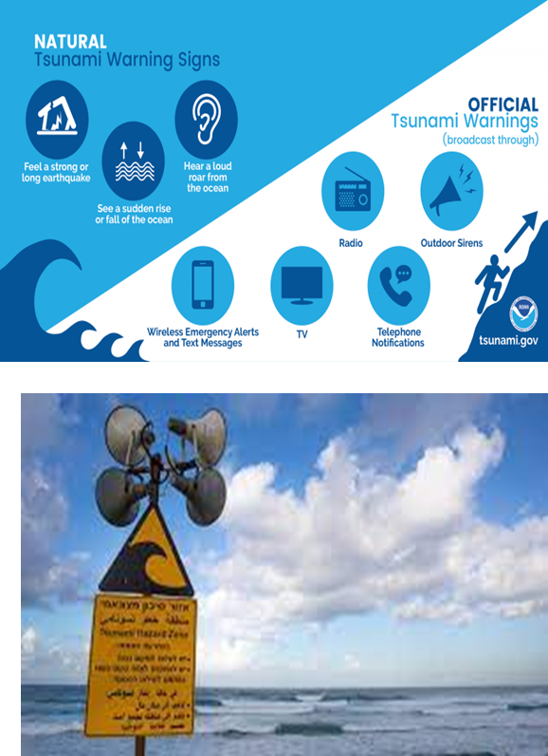
III. Tsunami Warning, Dissemination and Communication – Goals
    The ODTP goal is that by 2030 there will be significant improvements in the national decision making to warn, and mechanisms in place for the effective and inclusive construction, dissemination and communication of warnings.
    100% of the national authorities will be able to effectively warn communities and population at risk.
    Communities at risk will be able to use these advances to improve local tsunami preparedness and response capabilities and become Tsunami Ready
    Key elements that need to be addressed
    Effective decision making to warn - National/local tsunami warning chains and standard operating procedures; Decision Support Tools (Co-design, Competency Development)
    Effective construction of warnings – Time constraints, Inclusive, Actionable content (Use of IT, understand target audience, impact-based warning content)
    Effective dissemination and communication of warnings – Institutional capacity, Communication mechanisms, Multi-Hazard Warning Systems, Multiple sources of information (Standards & Formats, CAP, Broadcast & Social Media)

Slide 24
Tsunami Warning, Dissemination and Communication
    National and local tsunami warning chains and SOPs
Challenges | Solutions | Goals
Parameters needed by the National and Local DMO to advice response | Co-design of warning information and SOP requirements among the TSPs, NTWC, N/L DMO, and other relevant stakeholders | Updated Global Service Definition Document for Tsunami Watch Operations by 2024
Decision Matrix on Warning | Competency training for NTWC and National and Local DMO staff | 100% countries at-risk for tsunamis have national tsunami warning response plans and SOPs by 2027
Construction of the Warning
Time Constrain | The use of IT | 100% countries at-risk of tsunamis by 2027
Languages and fit for audience (not inclusive) | Understanding the target audience (culture, education, capacity, abilities, inclusiveness, etc.) | 100% countries at-risk of tsunamis by 2027
The lack of actionable content of warning. | Develop impact based warning content (consequences) | 100% countries at-risk of tsunamis by 2025

Slide 25
Tsunami Warning, Dissemination and Communication
    Warning Dissemination and Communication Options
Challenges | Solutions | Goals
The lack of redundant mechanism in receiving and disseminating warning and Communication | Redundant mechanism in receiving and disseminating warning and communication | 100% countries at-risk of tsunamis by 2027
The lack of standard format for warning and Communication | Promote Common Alert Protocol (CAP) and Training of NTWC staff on CAP | 100% countries at-risk of tsunamis by 2030
The lack of national standard format and mechanism for warning and communication for people with Different Functional Abilities (Difable) - check with SFDRR | National standard format and mechanism for warning and communication for People with Difable
Conflicting and multiple source of warning information | Effective use of Broadcast and Social Media. Media Training for NTWC staff and Training for Media Broadcaster and Social Media Influencers
Technology Gap and/or not fully utilized | New/emerging technologies (Digital and Communication) | In all ICGs by 2024
Lack / limited Interoperability | Multi-hazard Early Warning Alignment (resources, capacity, information, SOP, etc.) | 100% countries at-risk of tsunamis by 2027

Slide 26
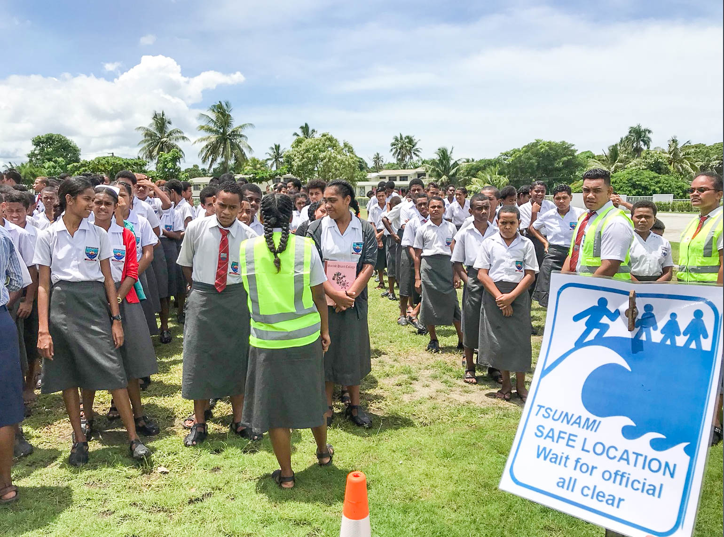
IV. Preparedness and Response Capabilities - Goals
  Aspirational social outcome of the Ocean Decade Tsunami Programme is that 100% of communities at risk from tsunamis are prepared for and resilient to tsunamis by 2030 through efforts like the IOC-UNESCO Tsunami Ready Recognition Programme
  Key elements to be addressed
    Risk Perception and Awareness – Risk perception studies need to be encouraged across all regions
    Preparedness
      All at-risk communities have tsunami hazard, inundation, evacuation maps, TEMPP trainings
      Public display of tsunami information, Tsunami Signage
      Locally relevant education and awareness resources, institutionalizing tsunami education
      promote communities to actively participate in the World Tsunami Awareness Day
      100% of communities at risk conduct a local tsunami exercise every two years
  Response Capability
      All countries with tsunami risk should have agreed parameters at the national and local level for warning and have approved response plans
      100% of at-risk communities have multiple effective and sustainable communication methods in place
      Inclusive, inventory of resources, natural signs and self-evacuation, multihazard, capacity building
    Mitigation
      Communities have access to an inventory of best practices of plans and structural and nature-based solutions
      More communities have implemented plans and measures to minimize impacts to critical infrastructure and marine assets from tsunamis and other coastal hazards,
      Mainstreaming disaster risk reduction into urban planning

Slide 27


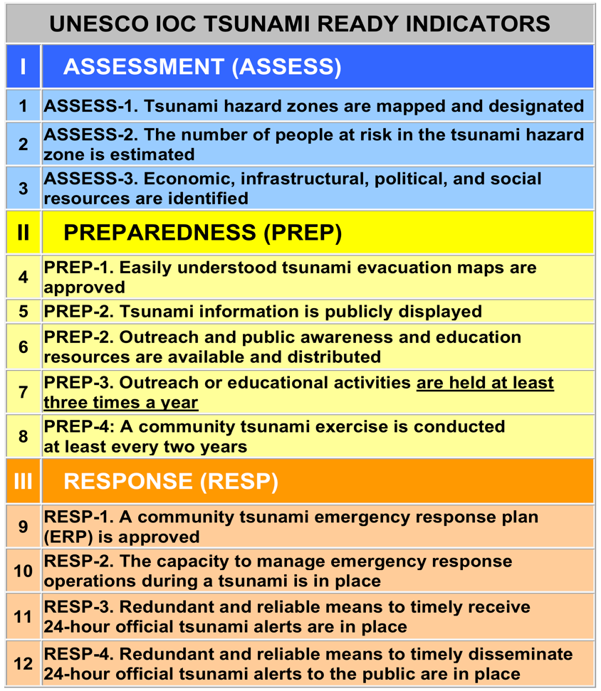
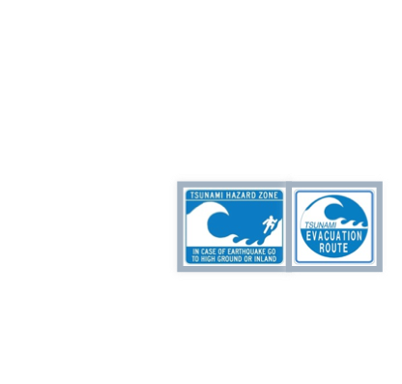
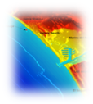
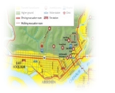





100% AT-RISK COMMUNITIES PREPARED FOR AND RESILIENT TO TSUNAMIS THROUGH EFFORTS LIKE TSUNAMI READY
UN OCEAN DECADE TSUNAMI PROGRAMME:
STRATEGY: Be Aware, Be Prepared
FRAMEWORK:
  Harmonized global guidelines UNESCO IOC Tsunami Ready
  Performance-based Community Recognition
ACTION: National programs empower Communities, Communities empower National programs
GLOBAL MEASURE
Standard Guidelines for the Tsunami Ready Recognition Program, UNESCO IOC TS 74

Slide 28

OCEAN DECADE TSUNAMI PROGRAMME
A SAFE OCEAN
THE MAIN SOCIETAL OUTCOME
TO MAKE
100%
OF COMMUNITIES AT RISK OF
TSUNAMI PREPARED FOR AND RESILIENT TO TSUNAMIS
BY
2030
Tsunami Coalition: collaborative with critical UN stakeholders, civil protection, others ==> Raise profile. Facilitate resourcing
Capacity Development: “Tsunami Ready” training, augmented by online IOC Ocean Teacher Global Academy (OTGA) ==> Global reach, deep curricula
CHAIR is LAURA KONG

Slide 29
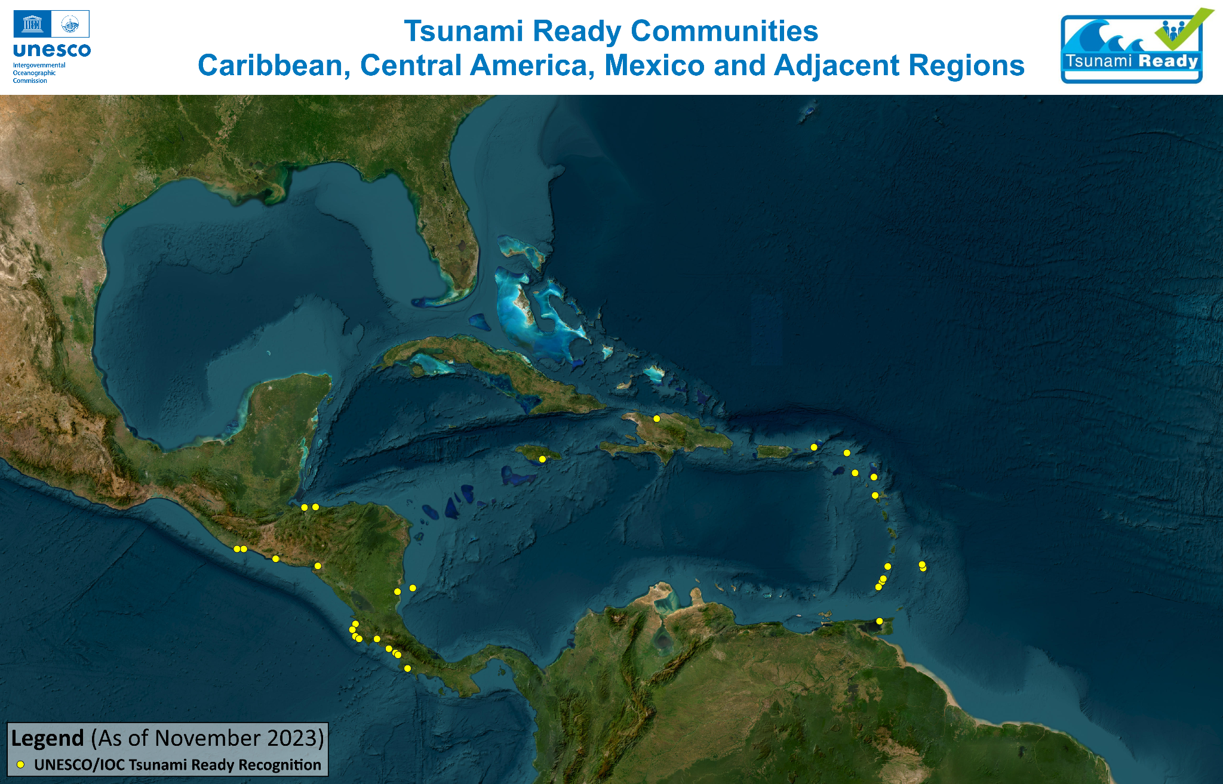

Slide 30
Preparedness and Response Capabilities
Preparedness
Challenges | Solutions | Goals
Limited availability of easily understood tsunami evacuation maps | Training on Tsunami Evacuation Maps, Plans and Procedures (TEMPP) | 30% of community to have easily understood evacuation maps by 2025 75% by 2027 100% by 2030
 | Identification of Tsunami Hazard Zones and development of Tsunami Inundation Map
 | Enhancing GIS capacity within country
 | Data and information for evacuation maps (sensitive and critical infrastructures)
 | Inclusion and guidance on effectiveness of tsunami evacuation map (social and culture)
 | Community participatory approach in tsunami evacuation map
Limited public display of tsunami information in tsunami prone areas | Establish a national standard of Tsunami Signage (i.e. take ISO) | 100% by 2030
 | Inventory of the type of tsunami signages used by different countries, Engage local artist

Slide 31
Preparedness and Response Capabilities
Preparedness
Challenges | Solutions | Goals
Limited local context in tsunami awareness and education resources (language, culture, local threat, risk, etc.) | Adaptation of tsunami education resources to the local context (language, culture, local threat, risk, etc.) | 100% by 2030
 | Use local authority social media and website for public awareness and Education | Increment of 10% annually
Limited people with difable are included in preparedness and response actions | Development of specialized tsunami awareness education resources for people with difable | At risk communities have engagement and inclusion of people with Difable 100% by 2030
 | Engagement and inclusion with People with difable (association, communities, authorities, etc.)
Limited inclusion of tsunami in school curricula | Institutionalizing tsunami education and awareness into school curricula | 100% by 2030
 | Share best practices and lessons learnt on tsunami education and awareness in school curricula
 | Engage with other global frameworks on School DRR, i.e. GADRRRESS

Slide 32
Preparedness and Response Capabilities
Preparedness
Challenges | Solutions | Goals
Limited effective outreach -activities for people in tsunami prone area | Community at risk to conduct at least three outreach activities annually | Community at risk engagement in World Tsunami Awareness Day 100% by 2030
Lack of validation of tsunami response capacity due to infrequent Tsunami | Community at risk to conduct tsunami exercise | Community tsunami exercise at least once every two years 100% by 2030. Engagement of community at risk in ICGs wave exercises as well as other national tsunami exercises 100% by 2030
Response Capabilities
Lack of understanding of the Tsunami Ready Community, especially to scope and definition of community | Advocacy and promote of Manual and Guide 74 on Tsunami Ready | 100 % Number of at risk community in each country by 2024
 | Training of UNESCO-IOC Tsunami Ready Recognition Programme (i.e. OTGA)

Slide 33
Preparedness and Response Capabilities
Response Capabilities
Challenges | Solutions | Goals
Undetermined number and location of at-risk Communities | To identify the location and number of at-risk communities | 100% of at-risk communities prepared and Resilient by 2030
 | To include the location and number of at-risk communities in the national tsunami response Plan
Limited National support/ structure/ mechanism to implement Tsunami Ready Recognition Programme | Establishment of the National Tsunami Ready Board | Number countries that implement Tsunami Ready Recognition Programme established NTRB by 2025 Number of at-risk communities that implement UNESCO-IOC Tsunami Ready community are recognized by 2030
 | Advocacy and campaign (Global, Regional, and National) of UNESCO-IOC Tsunami Ready Recognition Programme (i.e through the Tsunami Ready Coalition, ICGs, TICs, Permanent Delegation to UNESCO, UNESCO National Commission, IOC National Contact
 | Training of UNESCO-IOC Tsunami Ready Recognition Programme (i.e. OTGA)
 | Share best practices and lessons learnt on the Implementation of Tsunami Ready Recognition Programme

Slide 34
Preparedness and Response Capabilities
Response Capabilities
Challenges | Solutions | Goals
In near field tsunami, the time to issue tsunami warning might exceed the time for effective response | Understanding of natural signs | 100% of at-risk communities prepared and Resilient by 2030
 | Self-evacuation (escape / run) arrangement (evacuation decided by individuals)
 | Preventive evacuation arrangement (evacuation decided by authority)
Un-known resources and capacities within the community to support tsunami emergency response | Inventory of the available resource and capacity for tsunami emergency response within at risk Community | 100% by 2030
Local tsunami response plan do not exist in all at risk Communities | To use TEMPP training or other multihazard trainings
Insufficient capacity to manage tsunami response activities in at risk Communities | Optimising resources available for all Hazards
Lack of redundant mechanism to receive tsunami warning at risk communities | To use existing methods of other hazards and traditional means of communication for receiving warnings
Lack of redundant mechanism to disseminate tsunami warning at risk communities | To use existing methods of other hazards and traditional means of communication for disseminate warnings

Slide 35
Preparedness and Response Capabilities
Mitigation
Challenges | Solutions | Goals
Lack of availability of safe area in tsunami at risk communities considering the lead time of tsunami arrival. | Best practices of structural mitigation intervention and consult with experts (engineers, scientist, and researchers) | 100% by 2030
Availability of coastal protection infrastructures | Best practices of structural and nature intervention consult with experts (engineers, scientist, and researchers)
Plans to minimize impacts to critical infrastructure and marine assets | Best practices of structural and nature-based mitigation intervention consult with experts (engineers, scientist, and researchers)

Slide 36
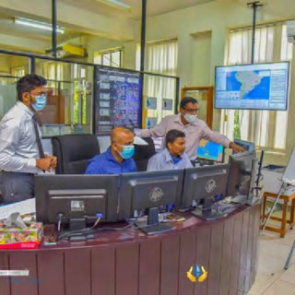
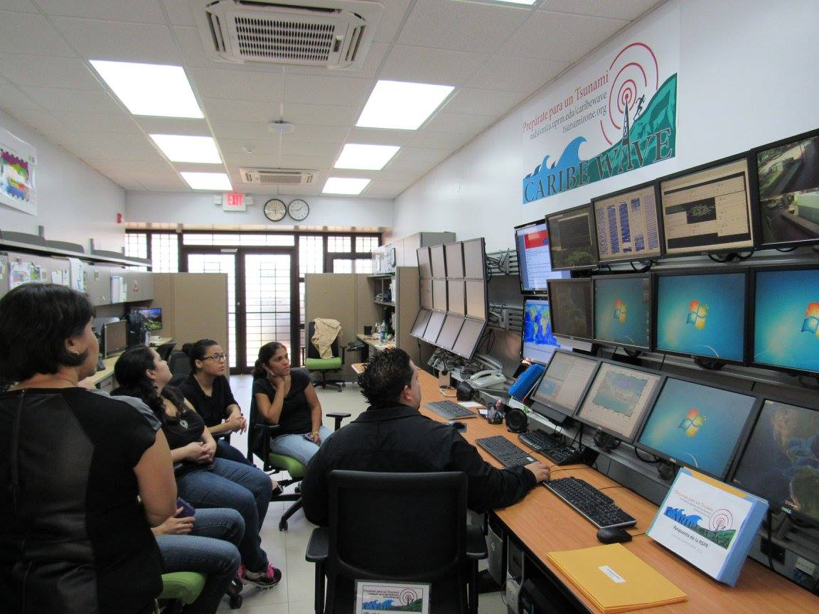
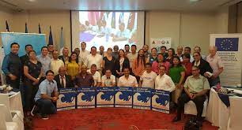
V. Capacity Development - Goals
  Ensure investment in capacity development for the different stakeholders including the generators and the users of the tsunami early warning system
    National, regional and local level initiatives to reach the objective of 100% at-risk communities to be prepared and resilient to tsunami
    Facilitate equitable access to data, information, knowledge, technology, and infrastructure, leaving no-one behind
    ICG-TICs and OTGA – STCs as the means for the delivery of capacity development
    Special consideration to be capacity requirements of SIDs and LDCs

Slide 37
VI. Pathways to Implementation
  The ODTP provides a framework for identifying gaps, suggesting solutions, prioritise resources, and implementing actions within the timeframe of the Ocean Decade
  This plan outlines the pathways for achieving overall objectives of ODTP including challenges, solutions, performance indicators, milestones and target dates for the four main components of the tsunami early warning system
  Considering the nature of tsunami hazard, the optimal solutions should have a global design, address regional imperatives, and be implemented through contributions and actions of Member States and other stakeholders
  Scientific objectives of the tsunami warning enhancements will be achieved by maximizing and expanding current capabilities, identifying capabilities that exist but are not currently applied to tsunami, and developing new capabilities through innovation and research
  Member States should endeavour to dovetail their national tsunami warning system plans/programmes with the ODTP objectives
  Member states, academic institutions and industries will seek, possibly through ICG consultation to identify candidate proposals aimed at addressing the solutions
  R&D community and Industry has the opportunity to develop and contribute to scientific understanding, technological solutions, product development and capacity building.
  The intent of the plan is to offer contribution pathways that cover the full spectrum or financial commitment by targeting the objectives most important to advancing Member State capabilities

Slide 38
What we have Done
CARIBE EWS governance (WG/TT) reflect match the priority areas of ODTP
TR is being implemented in many of the MS and there is desirability to implement or there is an analogous program
  CTIC
  ITIC-CAR/USAID
  Natl Initiatives - Costa Rica
SL Training course in Spanish, November 2023, Costa Rica
GNSS Workshop August, 2023 in Puerto Rico
Tsunami Evacuation Workshop in Spanish, April 2024, Costa Rica

Slide 39
Suggested Actions
(decide which are High priority and doable vs may take some time)
ICG CARIBE EWS update reporting schema for MS and WG/TT
MS Submit actions in support of the OD, eg. Implementing Tsunami Ready, installing/upgrading seismic, sea level, GNSS
MS Implement Tsunami Ready - implementation plan
UNESCO/IOC recognize a mechanism to cross validate UNESCO TR with national programs so that they count towards the 100%
Develop a strategy for SMART in Caribbean
Identify # of at risk communities – jurisdictions
Identify the funding required for sensing/forecasting and 100% prepared and resilient
MS request that tsunami activities conducted be recognized as contributions to UNOD
Participate or Support/Urge establishment of National Ocean Decade Committees
Develop a sensing strategy for tsunamis (EQ, Volcanoes, Landslides)
Prepare document for WGs to report according to the KPI’s

