Slide 1
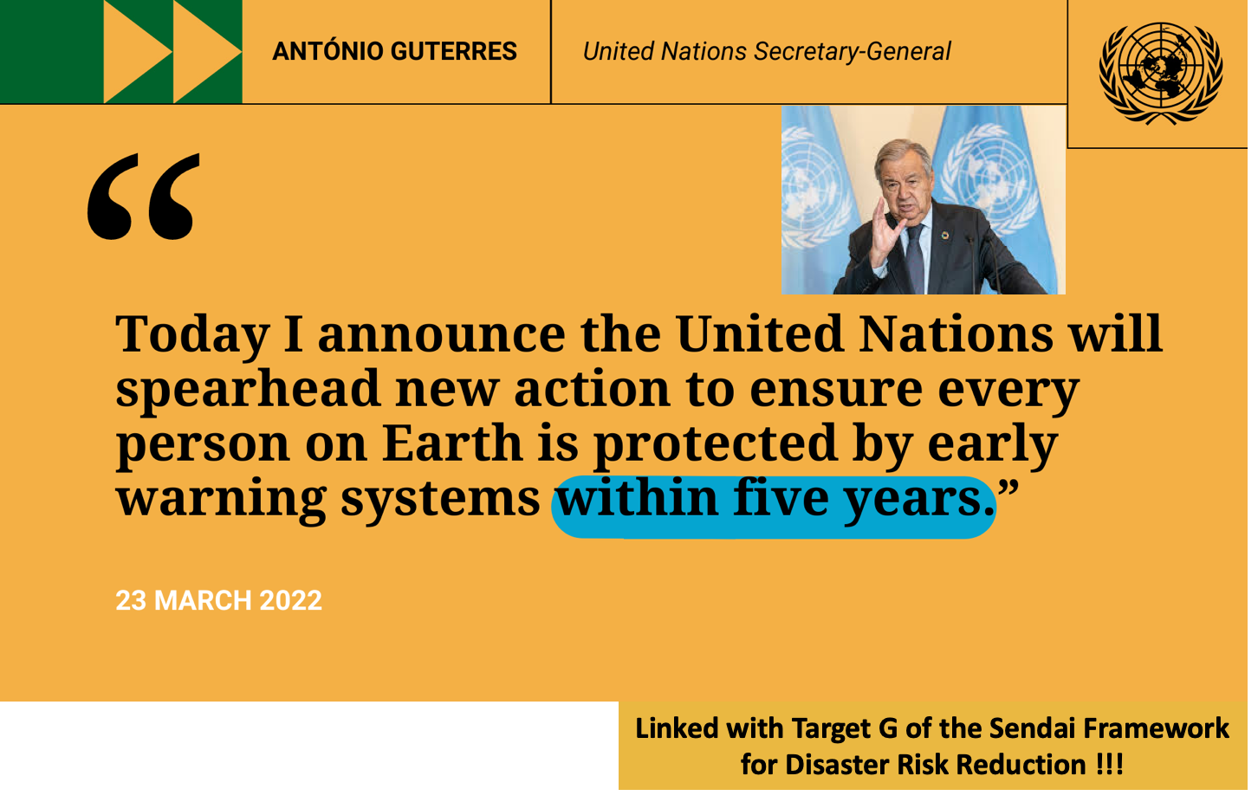
Notes:
The United Nations Secretary-General Antonio Guterres, has called for every person on Earth to be protected by early warning systems within five years, in line with Target G of the Sendai Framework for Disaster Risk Reduction 2015-2030, and with the priority to support the most vulnerable first. In order to make this ambition a reality, during the COP27 climate change conference, in Sharm el-Sheikh, Egypt, last November, the “Executive Action Plan for the Early Warnings for All Initiative (EW4ALL)” was unveiled.
An early warning system (EWS) is “An integrated system of hazard monitoring, forecasting and prediction, disaster risk assessment, communication and preparedness activities, systems and processes that enable individuals, communities, governments, businesses and others to take timely action to reduce disaster risks in advance of hazardous events”. There is not sense for an early warning that not trigged early action.
An MHEWS addresses several hazards and/or impacts of similar or different type in contexts where hazardous events may occur alone, simultaneously, cascadingly or cumulatively over time, and taking into account potential interrelated effects. An MHEWS with the ability to warn of one or more hazards increases the efficiency and consistency of warnings through coordinated and compatible mechanisms and capacities. It involves multiple disciplines for updated and accurate hazard identification and monitoring for multiple hazards.

Slide 2
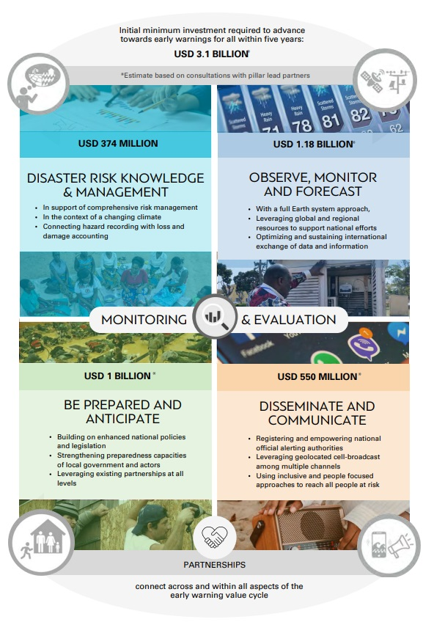

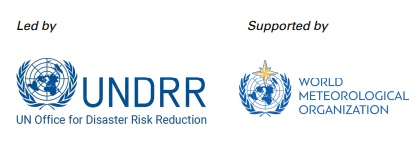

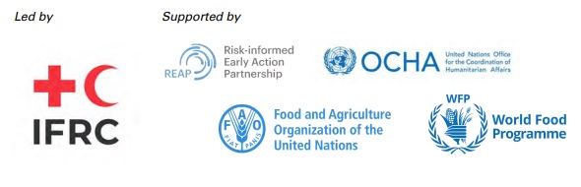
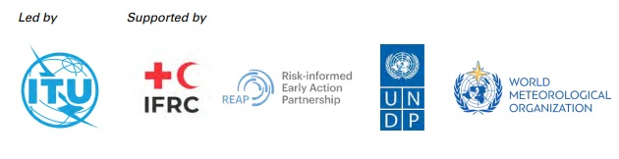
Notes:
Pillars
Disaster Risk Knowledge
Monitoring and Forecasting
Warning Dissemination
Response Capabilities
MHEWS Governance
An EWS should include the following four key and interrelated components: disaster risk knowledge based on systematic collection of data and disaster risk assessments; detection, monitoring, analysis and forecasting of hazards and possible consequences; dissemination and communication, by an official source, of authoritative, timely, accurate and actionable warnings, and associated information on likelihood and impact; and preparedness at all levels to respond to the warnings received. There is an additional component that bring all of these four pillars together: Governance.

Slide 3
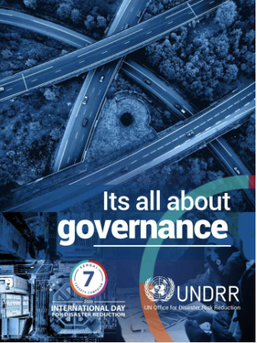
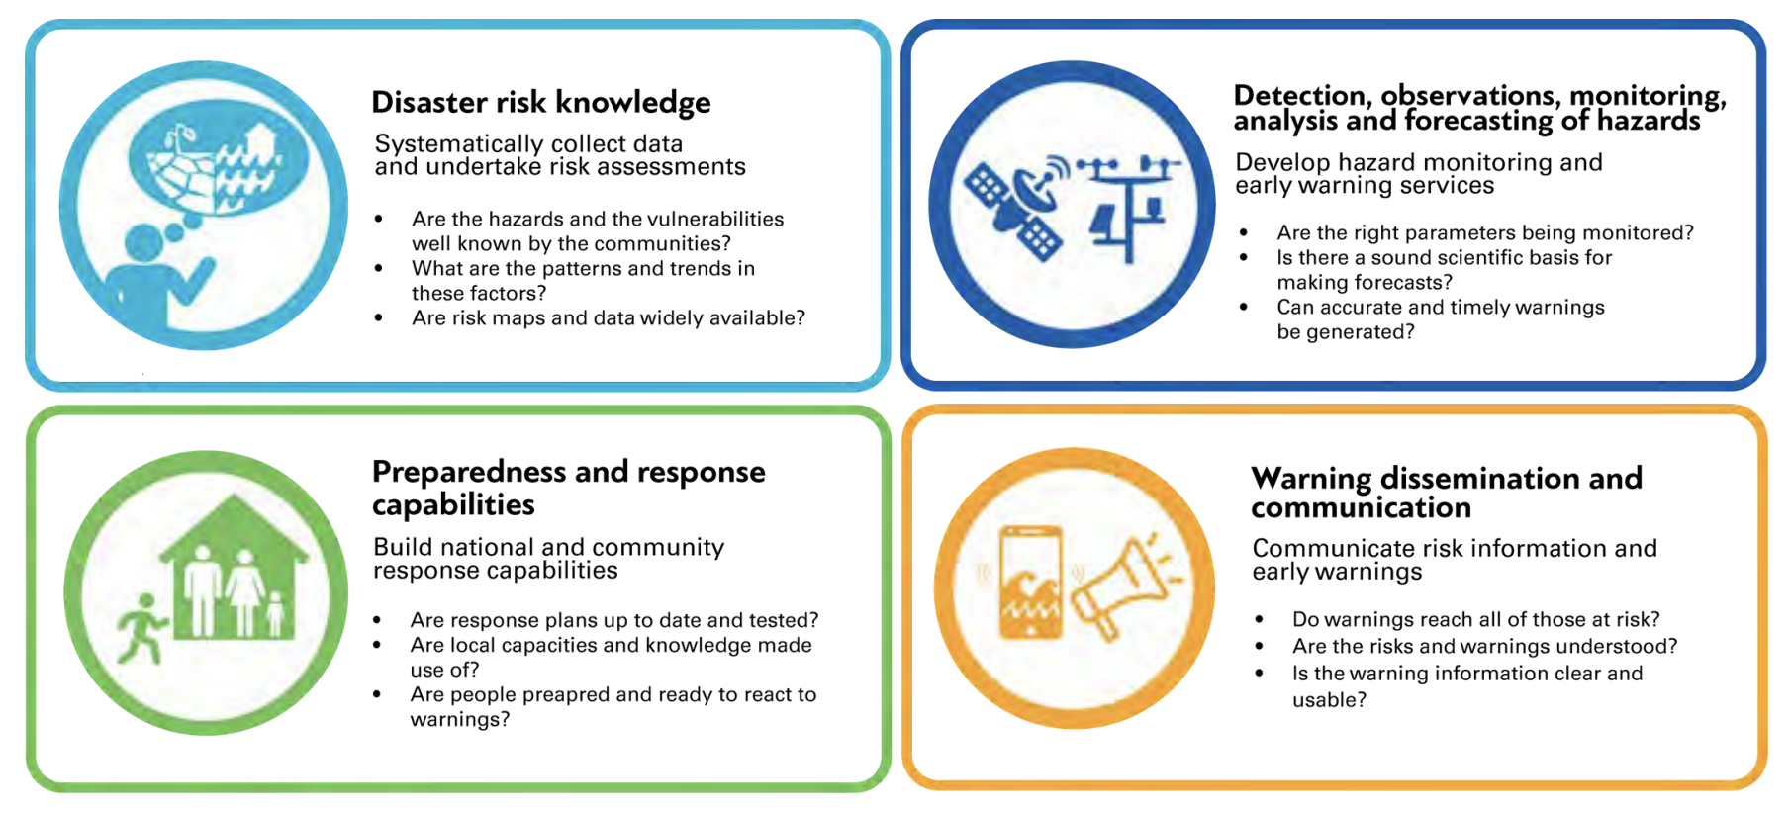
4+1 Pillars of MHEWS
Inter-Pillar = GOVERNANCE

Slide 4


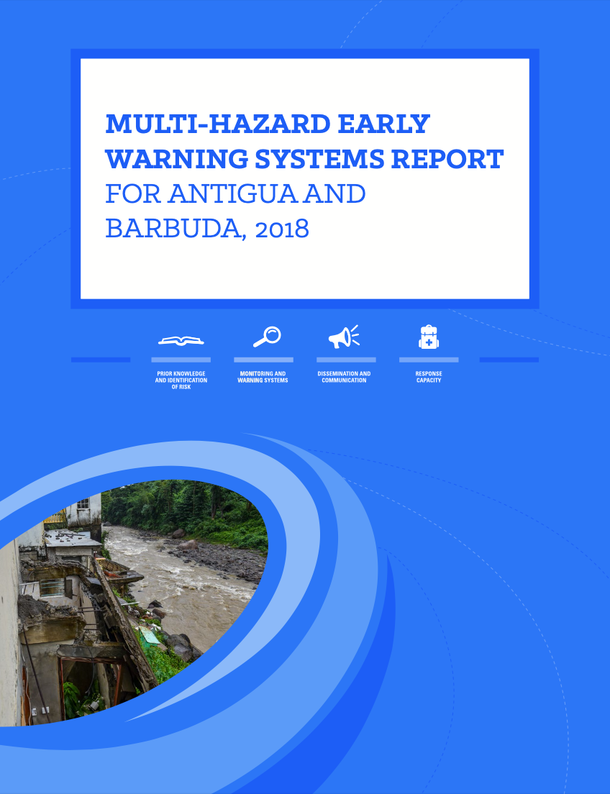
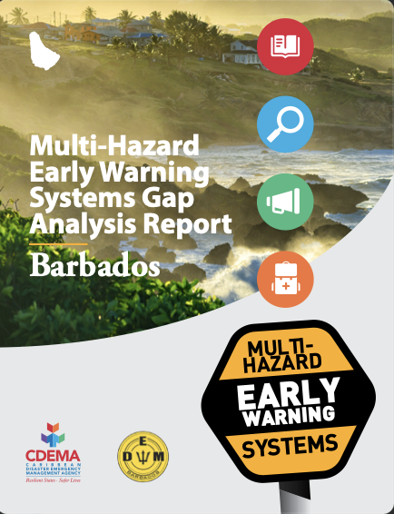
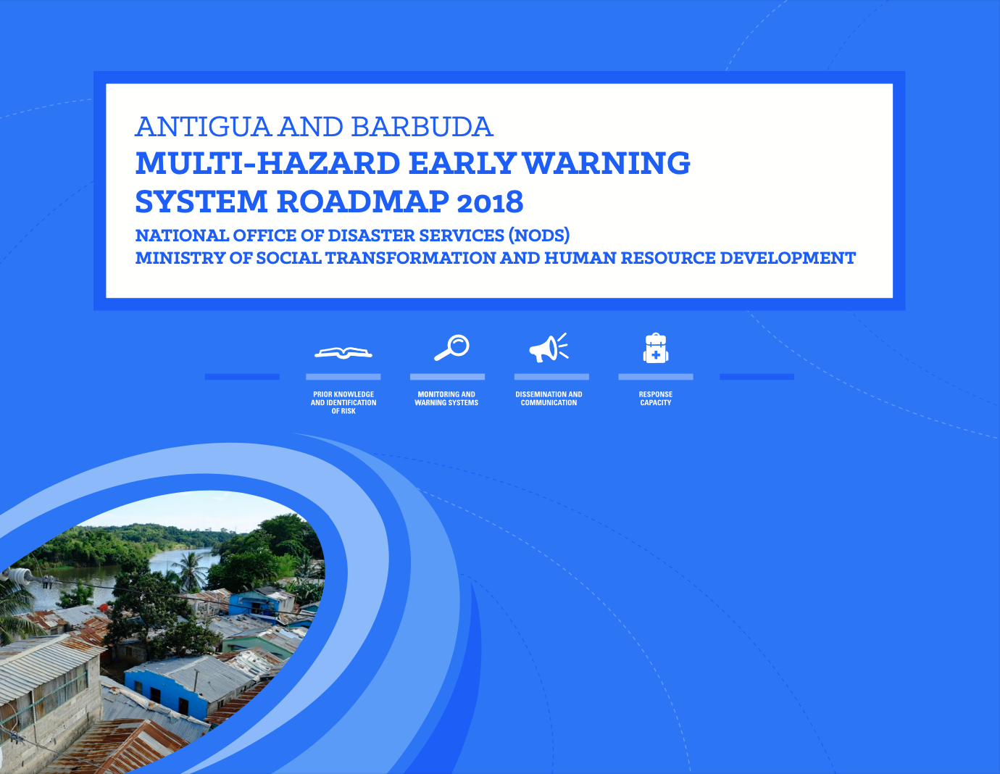
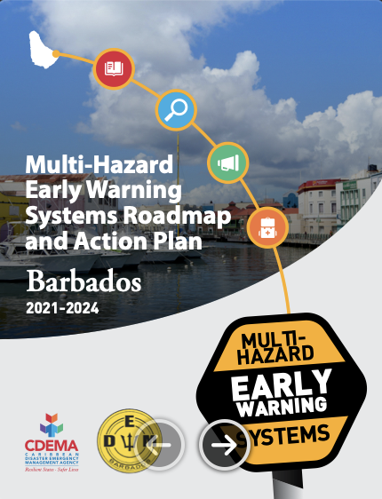
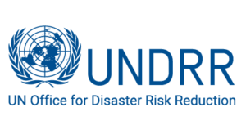


Designed process for the implementation of the roll-out phase
Step 1:
Gap Analysis
(update/revision)
Step 2: Roadmap Design
(update/revision)
Step 3: Budgeting of Activities
Step 4: Preparation of Project Proposals
Step 5:
Roadmap
Implementation
6 months
6-12 months
3 Years
Sustainability
Notes:
Designed process for the implementation of the roll-out phase (Max of 18 months):
Revision of the Gap Analysis (see attached);
Revision of the Roadmap (see attached);
Budgeting activities of the roadmap that will close the identified gaps;
Preparation of project proposals to the three main financing mechanisms through the accelerate frameworks/windows (GCF, CREWS and SOFF) by the accredited agencies;
SOFF will finance gaps on equipment (radars, stations, etc.)
CREWS will support regional collaboration, risk knowledge, capacity building and policy (governance).
GCF, will cover other major gaps identified in the roadmap and not included in SOFF and CREWS. There is an agreement at the global level with GCF were funding has been put aside for the 30 countries selected (10 to 25 Millions per country). GCF has offered their consultant to develop the project proposal based on the agreed roadmap.
Roadmap Implementation (Implementation Phase – 3 years)
Antigua and Barbuda (2018), and Barbados (2021), have already made their MHEWS Gap Analysis, and their Roadmap. A final revision and update is foreseen if needed.

Slide 5
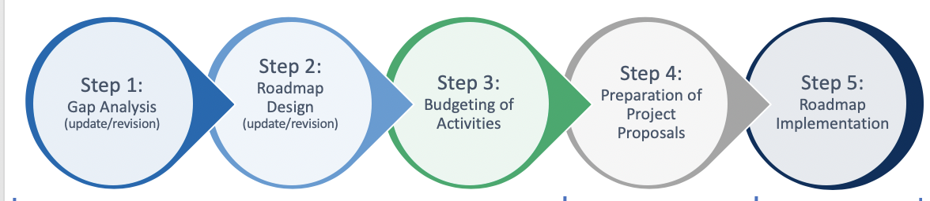

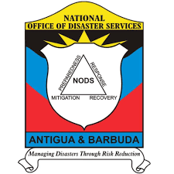





National
Regional
International
Regional Early Warning System Consortium (REWSC)
+ Development Partners

Slide 6
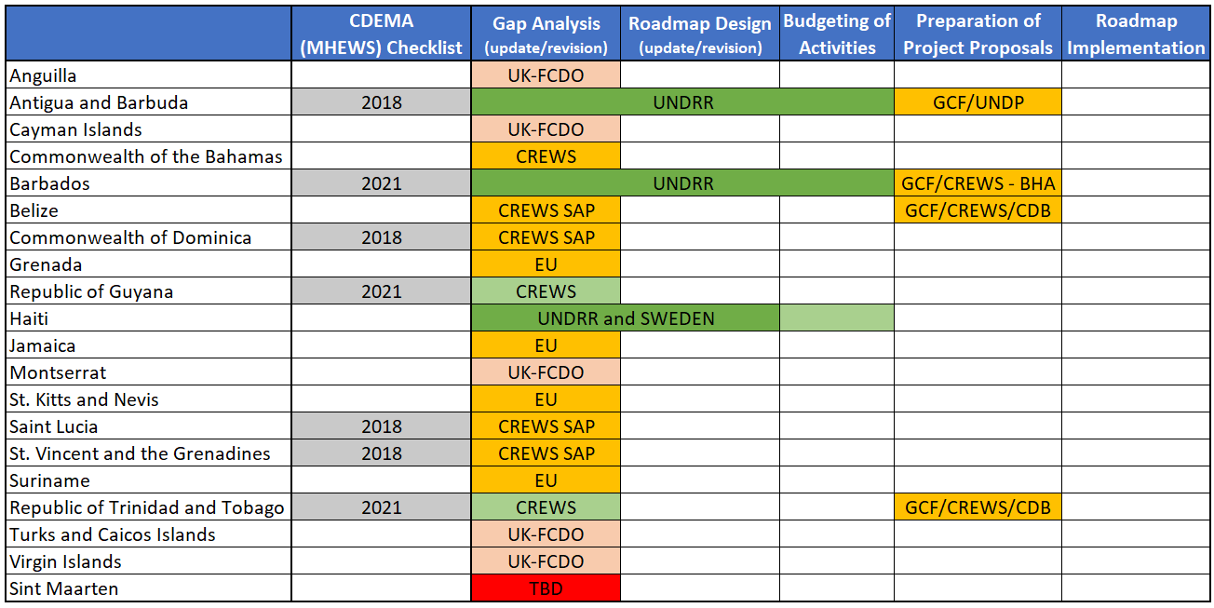

Slide 7
Recommendations to guide going forward
Express your interest by communicating to the co-chairs of the Initiative your willingness to start working on MHEWS in the framework of the Initiative.
Make the EW4All roll-out phase and its implementation a whole government and society approach LNOB. (e.g. Important role of National Designated Authorities).
As part of the EW4All process, we are aiming to adopt a Result Based Management Approach by CDEMA. As such, we look forward as we are finalizing the development of the implementation plan, to continue to discussions with CDEMA to develop a performance monitoring framework for each country.

Slide 8

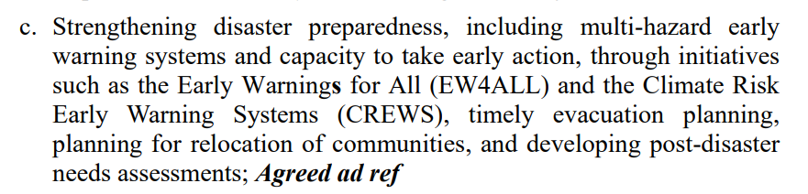
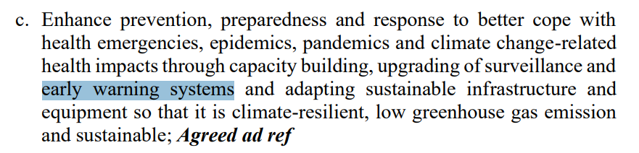
The Antigua and Barbuda Agenda for SIDS (ABAS)
A Renewed Declaration for Resilient Prosperity
(Agreed ad ref)
iv. Mainstream Disaster Risk Reduction by:
i. Strengthen health systems by:

Slide 9

Jair Torres
Programme Management Officer
Caribbean Region
jair.torres@un.org

