Slide 1
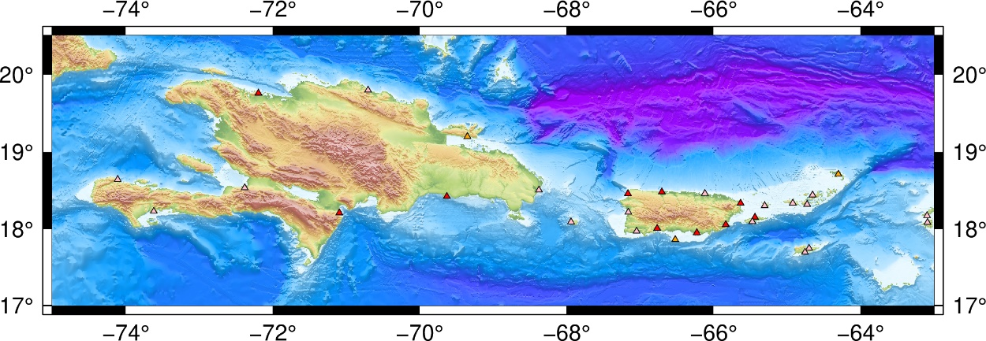
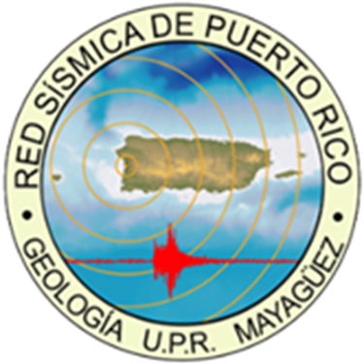
Sea Level Network
The PRSN of the University of Puerto Rico at Mayagüez (UPRM)
operates 7 sea level stations in Puerto Rico and help NOAA/NOS
in the maintenance of 10 more stations.
Support the operations of three regional stations (Tortola, Sto Domingo, Barahona).
The data are transmitted every 6 minutes on GOES or via EarthWorm export/seedlink modules each minute for selected stations.
The data can be accessed via the PRSN GOES/tk, Tides and Currents/tsunami site of NOAA, and the IOC Sea Level Data Facility.
PRSN operates three tsunami cameras.
Future Plans
Installation of two new Tide Gauges: (1) Samana, DR, (2) Anegada, BVI. Reinstall Isla Caja de Muertos, PR
Upgrade the PRSN web site
Install additional tsunami cameras
Incorporate the CARICOOS - HF radars

Slide 2

Seismic Network
The PRSN currently operates 35 seismic stations in Puerto
Rico, the Virgin Islands and the Dominican Republic.
Twelve of them use VSAT (PRSN & USGS)
PRSMP operate 120+ accelerometers.
Reinstallation of the seismic station in Aruba.
Two new stations were installed in Ceiba PR (strong motion seismometer), and Salinas, PR.
One hundred type-C were installed in Puerto Rico. Fifty-five operational
Seismic processing was upgraded to the ANSS/AQMS.
The data can be accessed via the PRSN seedlink, and the EarthScope Data Facility.
Future Plans
Installation of one station in the northeastern part of the Island.
Two more accelerometers.
Upgrade the PRSN web site.

Slide 3

GPS/GNSS Network
The PRSN operates a GPS/GNSS Network of
twenty-two permanent high-rate stations.
All the permanent GPS stations are equipped with either a Trimble NetRs,
NetR9 or Alloy GPS/GNSS receiver and Choke ring antennae.
Twelve stations were upgraded to add RTX correction.
Continuous data are simultaneously logged to three sessions with different sampling rate, 15-sec per sample, 1-sec per sample (1 Hz), and 10-samples per second (10 Hz).
GPS/GNSS short course in August 2023.
Data are available via the EarthScope server, and PRSN caster or seedlink.
Future Plans
Installation of two new stations in the eastern part of the Island.
Implementation of the TEC and IR algorithms in PRSN.
Software upgrades.
Upgrade the PRSN web site.

Slide 4
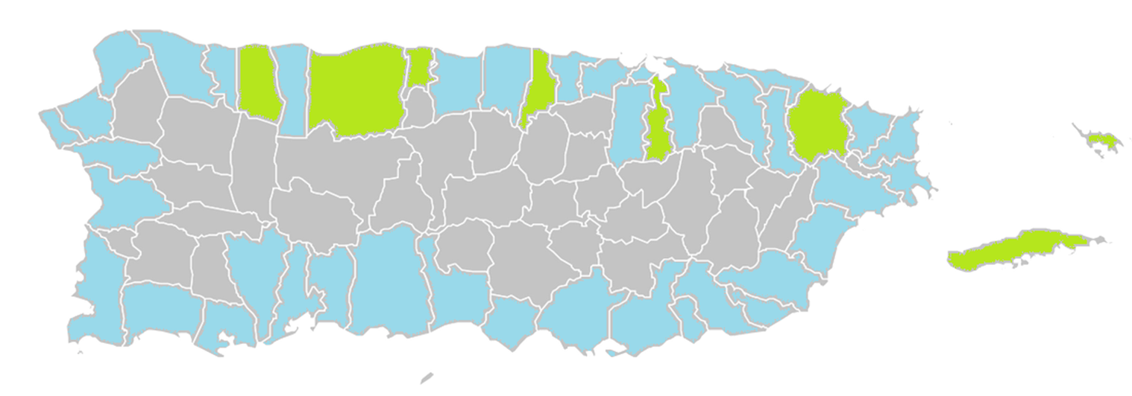
TsunamiReady® / NTHMP.
Forty-six TsunamiReady communities and eighteen TsunamiReady supporters.
Fifty-eight EMWIN/NWWS systems installed in PR, four of then equipped with
DartCom hardware.
Hundreds of NOAA radios distributed, updated and tested.
Tsunami signage maintenance, thousands installed.
Education & Outreach program (conferences, workshops, activities, etc), thousands impacted.
Tsunami vulnerability profiles upgrade to use new census-2020 data, and new generation of tsunami maps.
More the 135,000 participants in the CaribeWave 2024, and more than 400,000 in ShakeOut 2023. Drills and
exercises.
Participation in the WTAD (750k FB followers).
Future Plans
Two new DartCom installations, sign language support and not conventional tsunami signage .
Financial uncertainty.

Slide 5

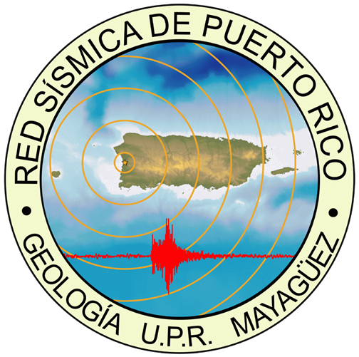
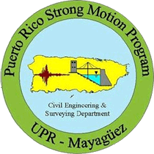
Nodal Arrays and SPAC for Vs30
PRISTINA experiment
M/V Langseth
SWPR: Seismic reflection profiles
TPHA
PR
R
E
S
E
A
R
C
H
Earthquake and Tsunami Outreach
Earthquake and Tsunami Threat, Hazard and Risk Assessment
Tsunami Preparedness
Seismic Hazard Map
Real Time SOP and Processes
Earthquake Early Warning

