Slide 1
ICG/CARIBE-EWS XVII
Managua, Nicaragua, 6-9 May 2024
Status of the ICG/NEAMTWS
Alessandro Amato
Chair
Ignacio Aguirre Ayerbe & Amr Hamouda
Vice Chairs
Denis Chang Seng
Technical Secretary

Slide 2
NEAMTWS 2023-2024
ORGANIZATION
EVENTS/MEETINGS
HAZARD
WARNING
MITIGATION

Slide 3

ICG/NEAMTWS Structure
Task Team on Tsunami Exercises
Ceren Ozer Sozdinler (Gebze Teknik Universitesi, Turkey)
Marinos Charalampakis (National Observatory of Athens, Greece)
Task Team on Operations
Alessio Piatanesi (Istituto Nazionale di Geofisica e Vulcanologia, Italy)
Fernando Carrilho (Instituto Português do Mar e da Atmosfera, Portugal)
Task Team on Documentation
Nikos Kalligeris(National Observatory of Athens, Greece)
Stefano Lorito (Istituto Nazionale di Geofisica e Vulcanologia Roma, Italy)
Task Team on Tsunami Ready
Maria Ana Baptista (Instituto Superior de Engenharia de Lisboa, Portugal)
Elena Daskalaki (National Observatory of Athens, Greece)
NEW
Task Team on Non-Seismic Tsunami Sources (ICG/NEAM in February 2024)
Rachid Omira (Instituto Português do Mar e da Atmosfera, Portugal)
Fabrizio Romano (Istituto Nazionale di Geofisica e Vulcanologia, Italy)
Working Group 1 - Hazard Assessment and Modelling
Jorge Macias (University of Malaga, Spain)
Audrey Gailler (Commissariat à l’Energie Atomique et Energies Alternatives, France)
Working Group 2 and 3- Seismic, Geophysical and Sea Level Measurements
Anna von Gyldenfeldt (Federal Maritime and Hydrographic Agency, Germany)
Didem Cambaz (Bogazici University Kandilli Observatory and ERI, Turkey)
Working Group 4 - Public Awareness, Preparedness and Mitigation
Cecilia Valbonesi (UnitelmaSapienza, Rome, Italy)
Raluca Partheniu (National Institute for Earth Physics, Romania)
Technical Secretary: Denis Chang Seng

Slide 4
NEAMTWS
MEETINGS 2023-2024

Slide 5
NEAMTWS MEETINGS 2023-2024
12-13 Apr 2023: Steering Committee
18 Oct 2023: Joint Meeting of TT on Operations, TT on Documentation, TSP representatives
6-7 Nov 2023: NEAMWAVE23 Exercise (2 joint scenarios)
Meetings of CoastWave Project
1 Feb 2024: Joint Meeting of TT on Operations and TT on Documentation
5 Feb. 2024: Steering Committee
6-8 Feb 2024: ICG/NEAMTWS XVIII Session (postponed by 2 months)
10-12 April 2024: Ocean Decade Conference (Barcelona, Spain) and Sat event on TR
13 May 2024: Steering Committee

Slide 6
Some achievements and new goals
NEAMTWS 2030 Strategy approved in 2023
Achievements in DG-ECHO ‘CoastWAVE’ project in Cyprus, Egypt, Greece, Malta Morocco, Spain, and Türkiye on “Strengthening the Resilience of Coastal Communities in NEAM region…” (Phase 1);
CoastWAVE Phase 2 approved and starting in July 2024 ”Scaling up….”;
First Tsunami Ready communities in 2024 and others Almost Ready
New phase of COST Action AGITHAR - (Accelerating Global Science in Tsunami Hazard and Risk Analysis) to establish the Global Tsunami Model (GTM) organization;
Formal recognition of the TSUNAMI Thematic Core Service (TCS) within EPOS The European Plate Observing System (EPOS General Assembly in Dec. 2023);
Some other projects funded by EU contributing to the advancement of Tsunami science, including both R&D (DT-GEO) and warning-oriented (EPOS, GeoInquire)
SMART Cables initiatives (Portugal, France, Italy…) and first DART-like buoys in NEAM region (2025).

Slide 7
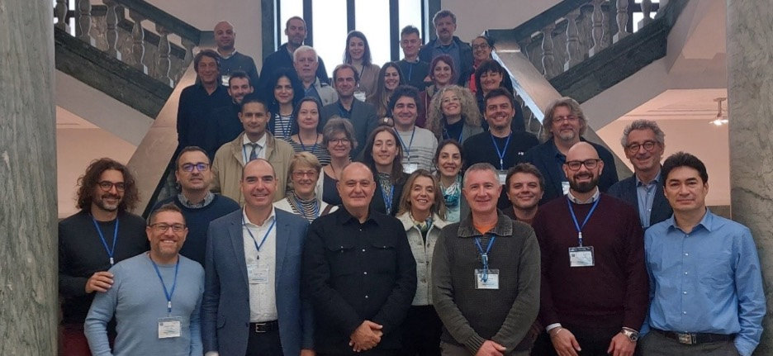
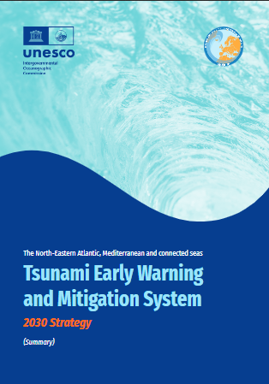

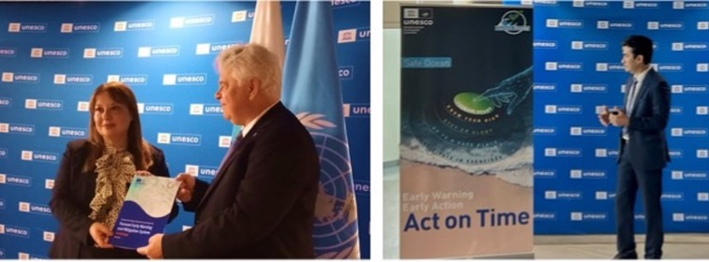
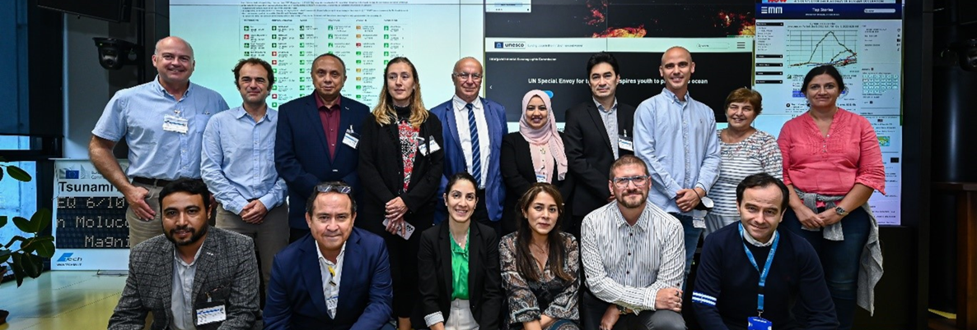
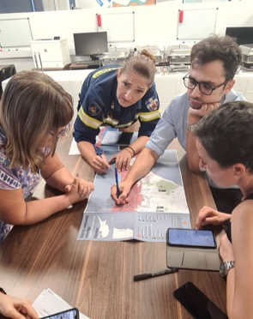
ICG/NEAMTWS
2023
Key Meetings &
Events
Ceremony event with UNESCO Permanent Delegations of Tsunami Service Provider (TSP) countries to launch NEAMTWS 2030 Strategy, 12 April 2023, HQ, Paris, France
Expert meeting on the Implementation of the new ICG/NEAMTWS 2030 Strategy to Further Advance NEAMTWS, Naples, Italy from 28-30 November 2022
Tsunami Evacuation mapping and validation workshops in Larnaka, Cyprus, June and Sep 2023.
First country in NEAM to conduct evacuation mapping using PTHA withsupport of partners (Italy, Greece and Spain) (CoastWAVE Project)
Regional workshop to set the benchmark for the development of Tsunami Standard Operating Procedures (SOPs), JRC, Ispra, 6 October 2023 ( CoastWAVE Project)

Slide 8
NEAMTWS
PILLAR 1 - HAZARD

Slide 9

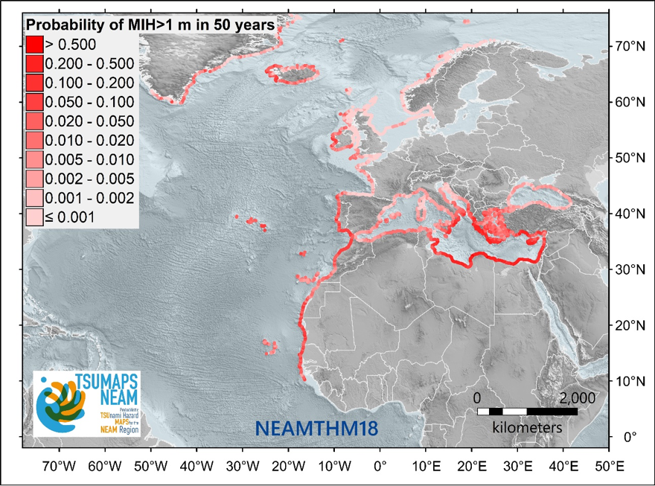
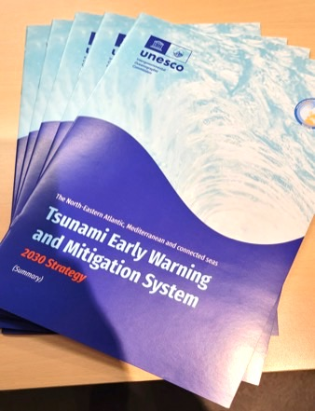
S-PTHA assessment at various scales (global to local)
In some countries (e.g., Italy) the TSUMAPS-NEAM S-PTHA have been used to define the inundation zones. Others may follow.
Other HR approaches at regional / local scale are being adopted (e.g. France, Cyprus, etc.).
Ongoing discussion on how to balance HR approaches with the need of covering thousands of communities.
Notes:
A discussion is ongoing on how to balance between a local high-resolution approach including S-PTHA (time- and HPC-consuming) and a more

Slide 10

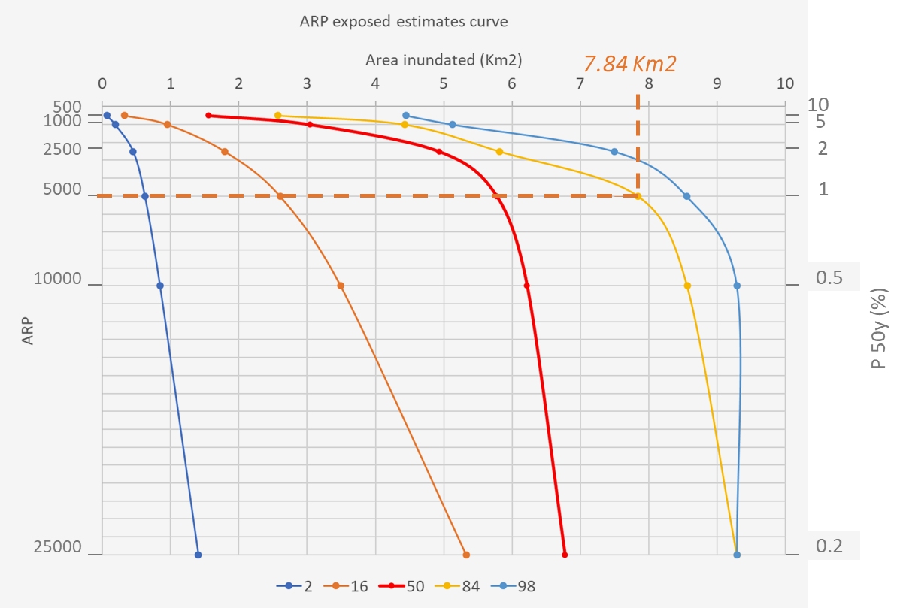
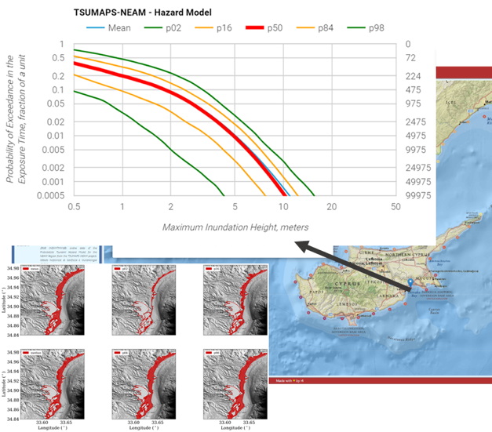
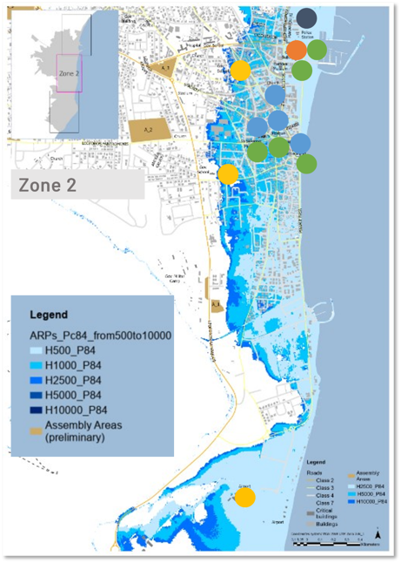

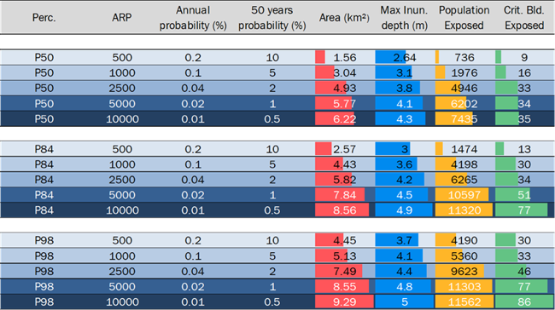
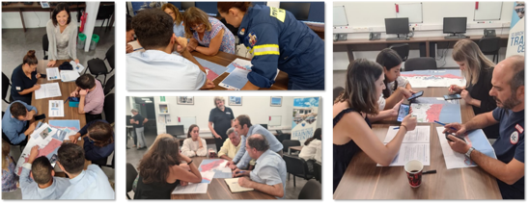
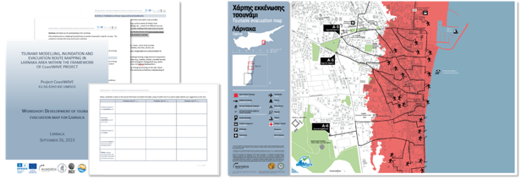
TRRP IMPLEMENTATION NEAM REGION
Larnaca, Cyprus case study (CoastWave)
From PTHA to Evacuation Planning
PTHA
1
3
2
4
ANALYSIS TO FACILITATE DECISION MAKING
Decision adopted by the national authorities
5
Multi-stakeholder development of evacuation maps based on PTHA and Evacuation models

Slide 11
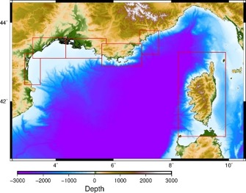
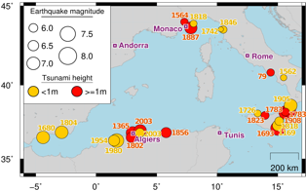
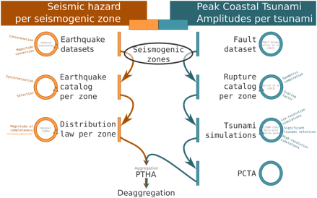
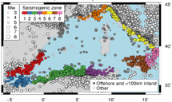
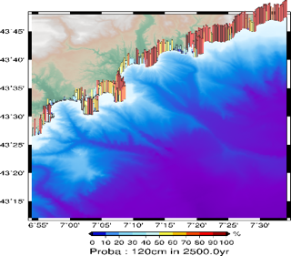
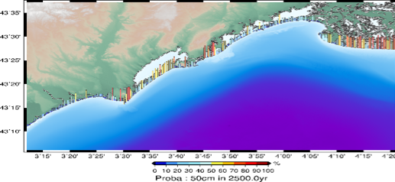
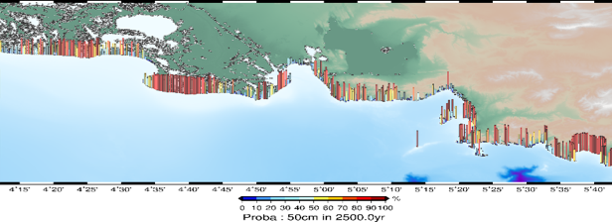
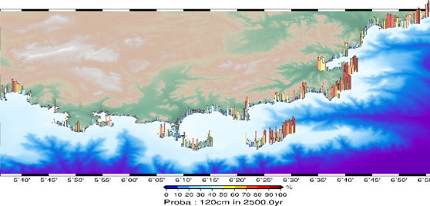
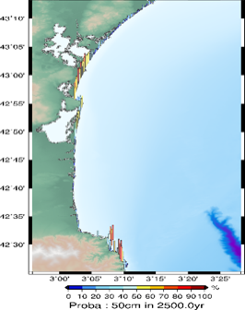
High-Resolution Seismic-Probabilistic Tsunami Hazard Assessment (S-PTHA) along the French Mediterranean coastlines
Approach
S-PTHA HR optimized in computation time, site independent method
Scenarios based on CENALT faults and seismogenic zones
Integration of heterogeneous sources, application to the entire French Mediterranean coastline
a) Tsunamigenic
seismicity.
b) Seismicity per
Seismogenic zone
Extent of target zones at 25 m resolution (red rectangles) based on bathy-topo Litto3d® data.
Overview of the method (from Souty & Gailler, 2021).
Hérault
Bouches-du-Rhône
Var
Alpes Maritimes
Aude
Probability of occurrence of waves with a maximum height of 0.5 m to 1.2 m over a 2500-year period, considering the seismogenic zones of the Algerian margin (z03+z05) and the Ligurian Sea (z05+z06) along the French coastline at 25 m resolution.
Pyrénées
Orientales
Probability over 2500 years
Stronger maximum waves heights expected in easternmost areas
  up to 100% probability of 1.2 m waves in the Alpes Maritimes and Var departments
Lower amplitudes expected toward the west
  up to 100% probability of 50 cm waves in the Bouches-du-Rhône department
  up to 80-90% probability of 50 cm waves locally in the Hérault, Aude and Pyrénées Orientales departments

Slide 12
NEAMTWS
PILLAR 2 - WARNING 2023

Slide 13
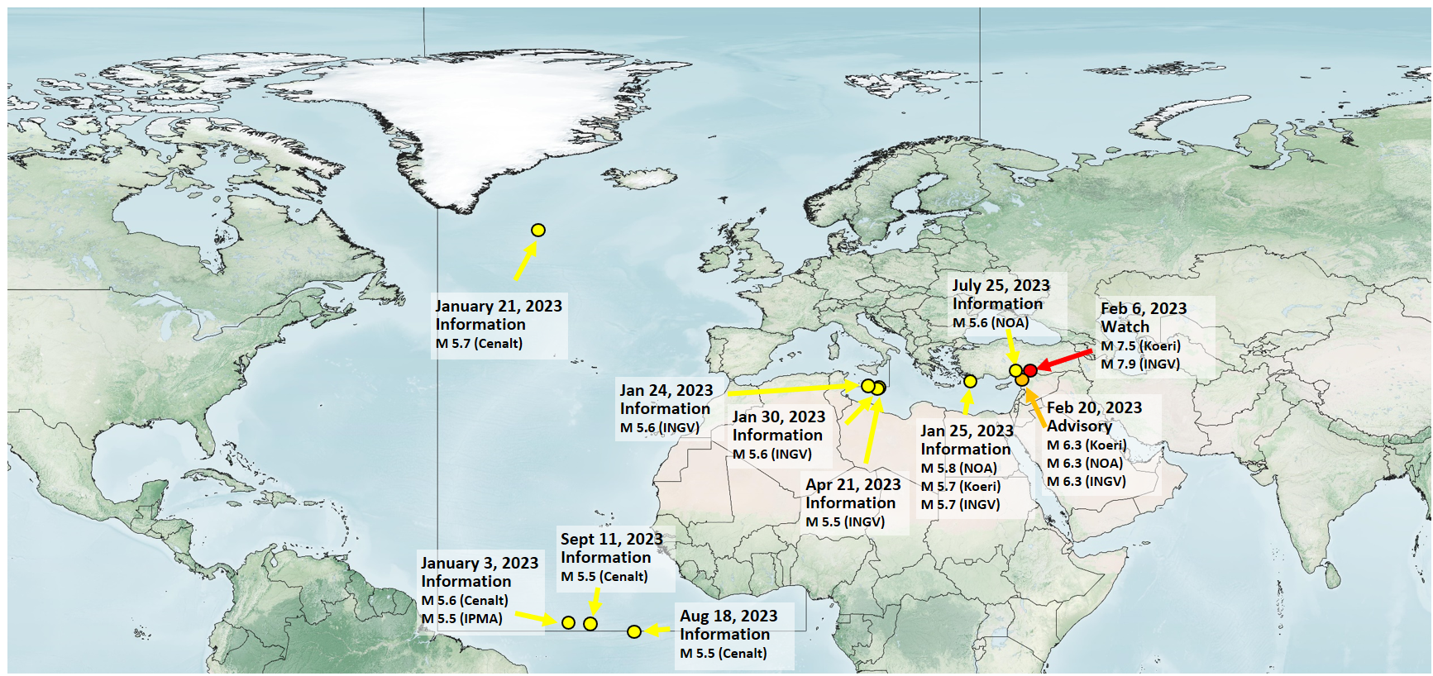
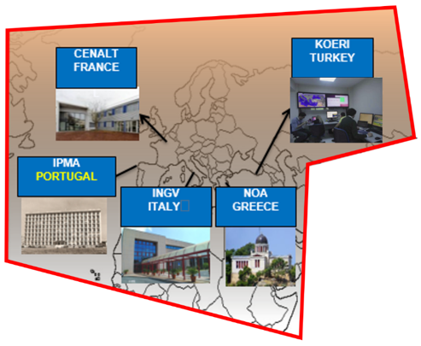
NEAMTWS 2023 Events
11 events M 5.5 to 7.9
  4 NE Atlantic
  7 Mediterranean
Mostly information level
  Feb. 6 – M 7.9 - Watch
  Feb 20 - M 6.3 - Advisory

Slide 14
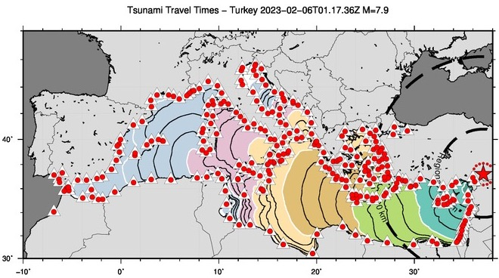
Turkey event Feb. 6, 2023
First event having triggered a basin-wide Maximum Alert level, further highlighting the DM problems
First event to have triggered DRR actions in many countries
First event to have attracted strong media attention in many countries
Poor coverage of sea level stations in Eastern Med coasts
Acceleration of the path towards the adoption of the Probabilistic Tsunami Forecasting

Slide 15
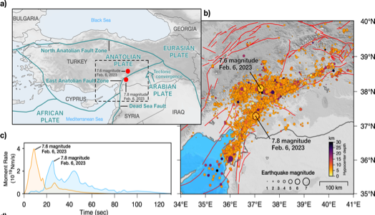
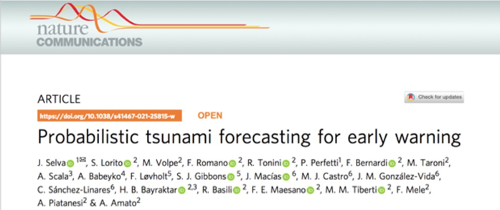
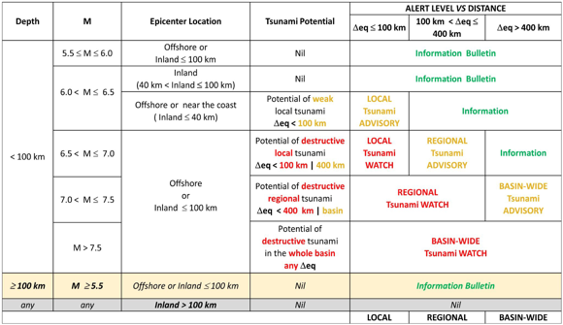
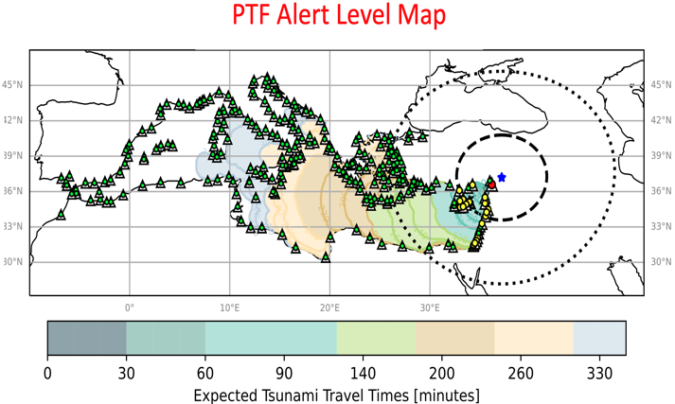

ONGOING ACTIVITIES: PROBABILISTIC TSUNAMI FORECASTING
The Mw 7.8 earthquake shook Türkiye and Syria on Feb. 6, 2023, causing about 60,000 casualties.
Since the epicenter is at just under 100 km from the coast it also triggered a tsunami alert.
Three TSPs provided different estimates due to the sharp boundaries of the Decision Matrix.
In response to the tsunami warning (issued ~8’ after the event) trains were stopped in different locations in Southern Italy for several hours, and evacuation of some coastal areas was enforced.
However, only a relatively small tsunami was recorded by Turkish close-by tide-gauges in the Eastern Mediterranean, with a maximum recorded amplitude of less than 50 cm.

Slide 16
From Decisions and Recommendations (ICG/NEAM 2024)
That each TSP continues to provide alert-level information based on their best practices, including … other methods …
  Supports the investigation and possibility to adopt tsunami forecasting methods by TSPs ….. which consider tsunami numerical modeling and uncertainty quantification (e.g., the Probabilistic Tsunami Forecasting PTF, pre-calculated scenario databases, etc.).
  Supports the ongoing transition of CAT-INGV from the decision matrix to the PTF, and requires …. that TSP subscribers are informed accordingly.

Slide 17
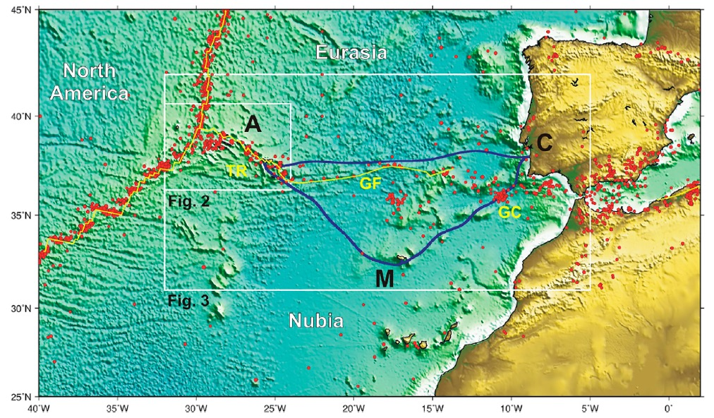
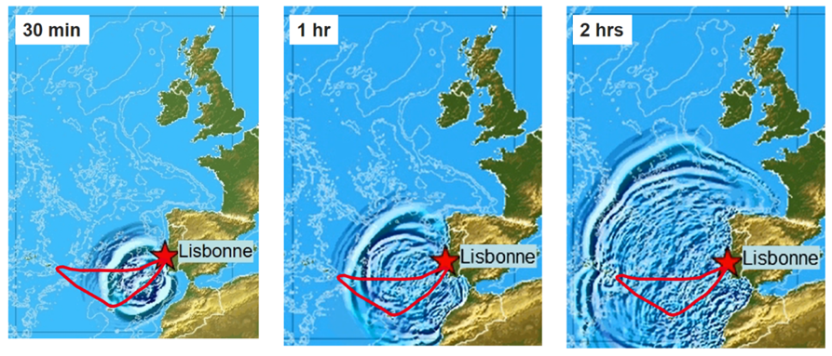
ONGOING ACTIVITIES: SMART CABLES
New Submarine Cable Ring connecting Portugal Mainland-Azores-Madeira
Opportunity for a SMART system (SMART CAM) supported by Portugal
Operational in 2025-2026
Timeline of 1755-like tsunami propagation in NE Atlantic

Slide 18
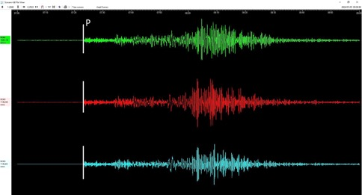
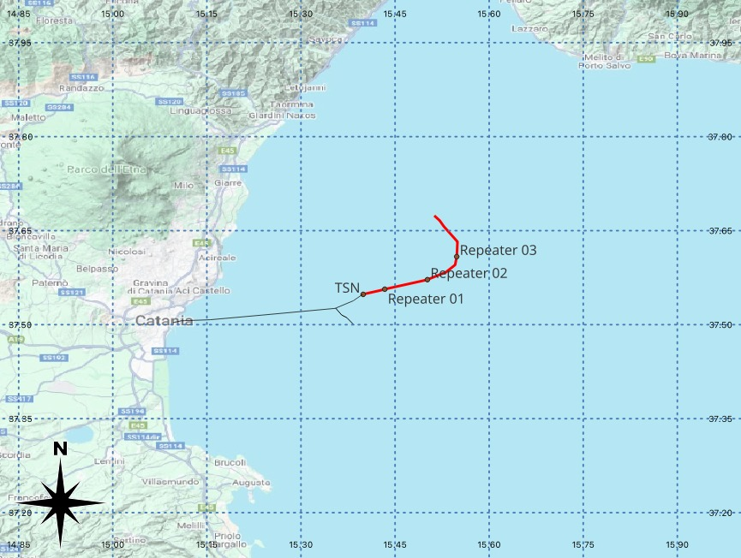
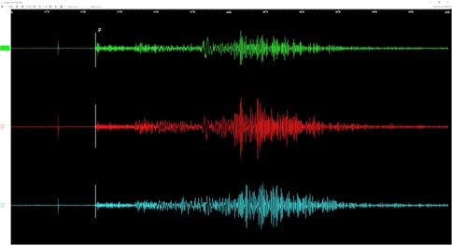
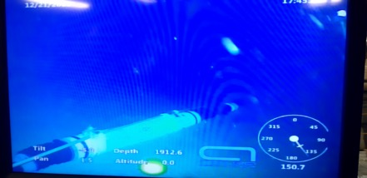
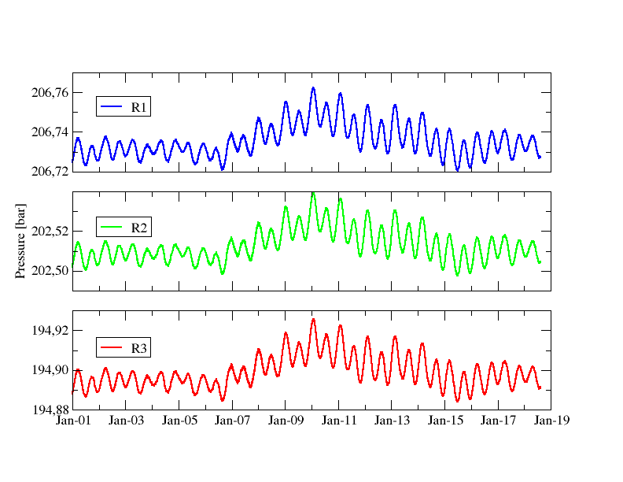
WESTERN IONIAN SEA INFRASTRUCTURE
Deployed December 2023
WEST COAST, EASTERN HONSHU, JAPAN
01/01/2024 07:10 M_{wpd} 7.4
G. Marinaro, INGV

Slide 19
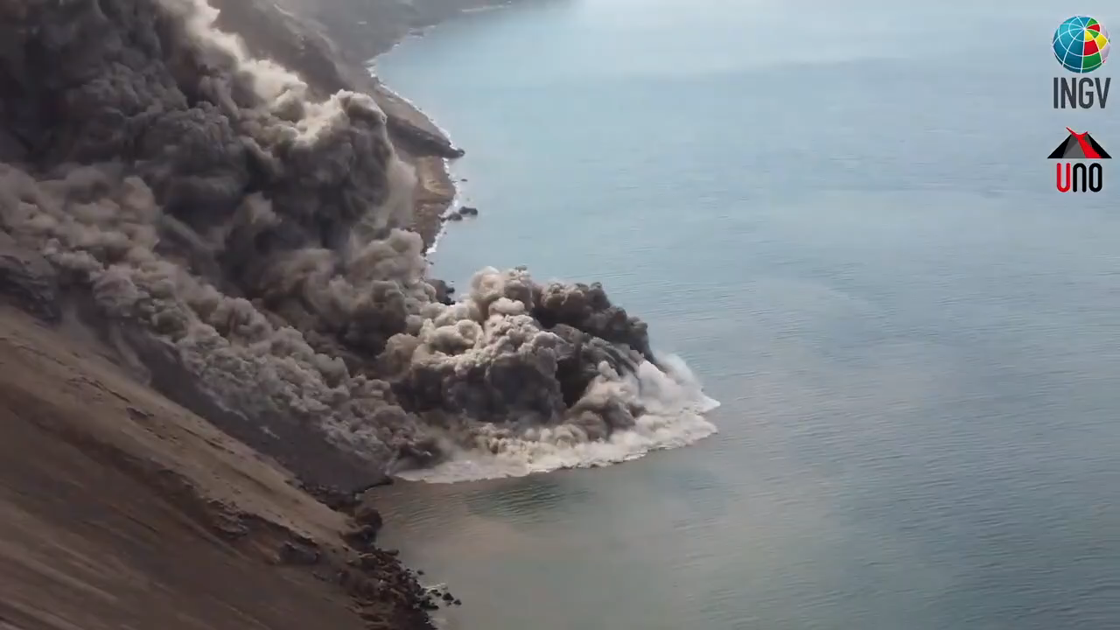
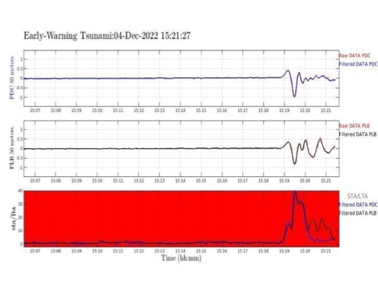
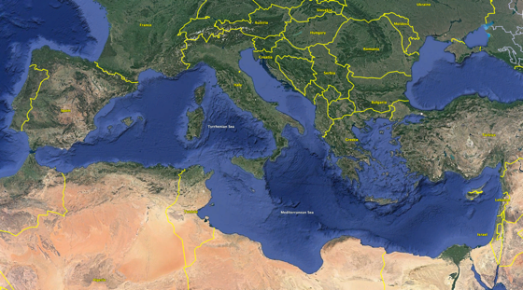
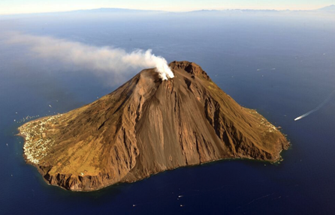
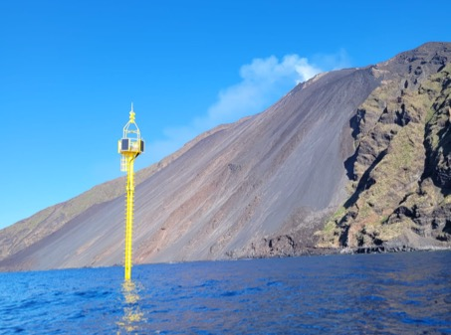
ONGOING ACTIVITIES: NON-SEISMIC TSUNAMI SOURCES
The ICG/NEAMTWS at the February 2024 session DECIDED to establish a new
Task Team on Non-Seismic Tsunami
Among other issues, this TT will be important to foster the integration of TWS specifically conceived for non-seismic tsunami with those already operating for seismic tsunami
TEWS for Stromboli volcano, Italy

Slide 20
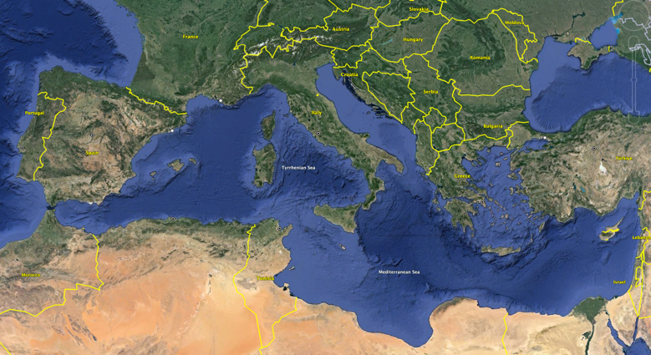
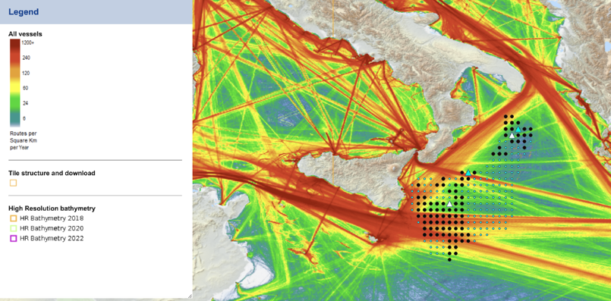
ONGOING ACTIVITIES: TSUNAMI BUOYS
Two Deep Ocean pressure sensors will be deployed in the Ionian Sea in 2025.
Sites were selected considering possible tsunami sources and the ship traffic

Slide 21
NEAMTWS
PILLAR 3 - MITIGATION 2023-2024

Slide 22

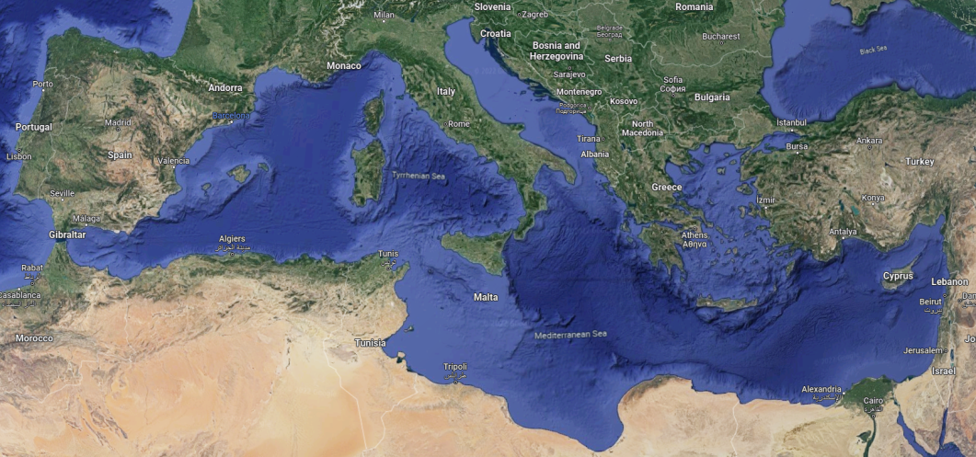
NEAMWave23 & Tsunami Ready
Istanbul
NE Atlantic Scenario
(Mw=8.5) by IPMA & CENALT
Chipiona
Minturno
Samos
El Jadida
Larnaka
Malta
Eastern Mediterranean Scenario (Mw=8.1) by INGV, NOA & KOERI
Alexandria

Slide 23
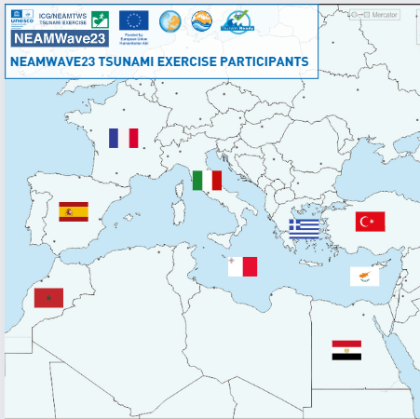
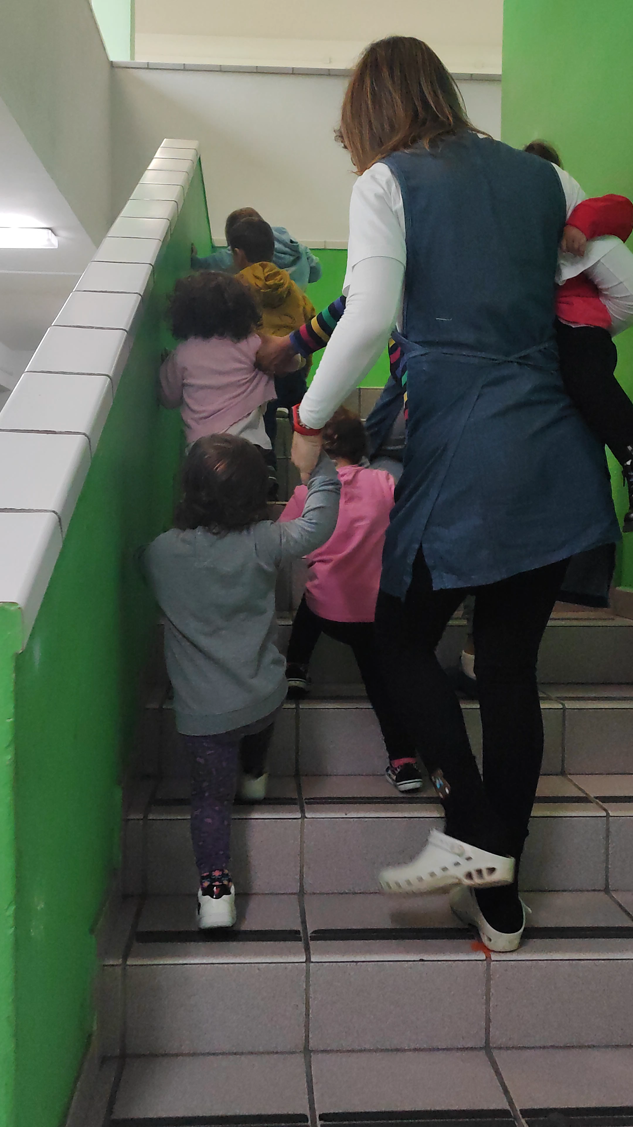
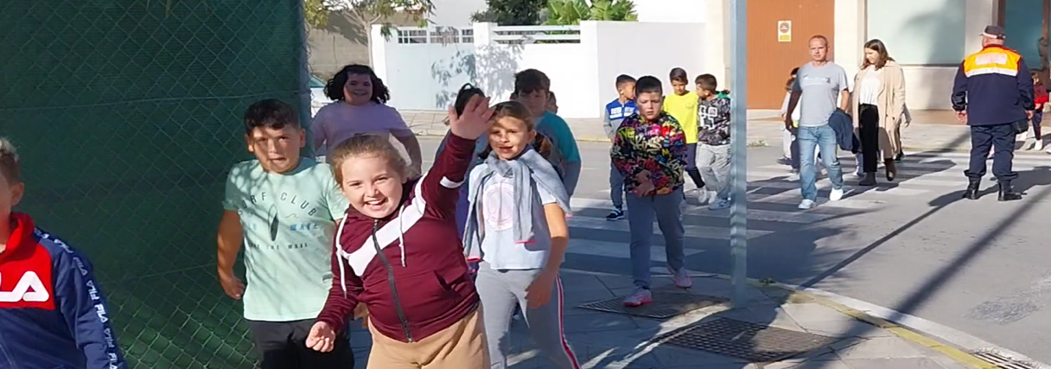
NEAMWave23 / WTAD
15 Tsunami Exercises Organised
Regional NEAMWave23 conducted on 6-7 November 2023
For the first time, NEAMWave 23 exercises was also conducted at the local communities in all the seven pilot "Tsunami Ready" CoastWAVE project countries.
Exercises also conducted in Italy, France, and Portugal (Non CoastWAVE Project countries)
.
School evacuation in Chipiona, Spain, 6 November 2023
Vertical evacuation in a nursery in Minturno, Italy
7 November 2023

Slide 24
Tsunami Ready achievements
Cannes Municipality (France) was the first UNESCO IOC Tsunami Ready Recognized Community in NEAM region (January 2024);
Büyükçekmece (Türkiye) followed (March 2024);
Other NEAM communities are almost ready for Tsunami Ready recognition: Cyprus (Larnaca), Egypt (Alexandria), Greece (Samos), Italy (Minturno, Palmi, Marzamemi, Otranto and Stromboli), Israel (entire coast), Malta (Marsaxlokk), Morocco (El Jadida), Spain (Chipiona), others in Portugal.

Slide 25
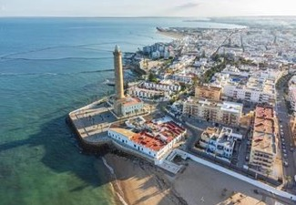
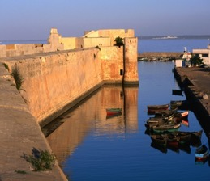
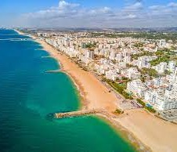












Tsunami Ready Implementation in the NEAM REGION
Chipiona
El Jadida
Loulé
Büyükçekmece
11 Countries
15 Communities
…more coming!
Cannes
Marzamemi
Otranto
Marsaxlokk
Israel
Palmi
Minturno
Stromboli
Larnaca
Samos
Alexandria

Slide 26








Communication and Outreach
28 Articles Produced and Published
+ others on TSPs websites
9 Brochures/Leaflets and Posters
  NEAMTWS 2030 Strategy Brochure
  NEAMWave Exercise – Information Brief
  NEAMWave23 Exercise – Information leaflet
  Tsunami Fact Sheet Brochure
  Tsunami What to do Brochure.
  Tsunami Ready Recognition Programme Brochure
  Tsunami Ready Poster
  Coastal Hazard Ready Poster
  ICG/NEAMTWS Poster update

Slide 27









Communication and Outreach
10 Videos Produced and Published
2 Stromboli Volcano - Tsunami Warning System documentary, 3 min, 10 min versions) (To be launched in Feb 2024)
Tsunami Exercise in Chipiona, Spain, Dec 2023
2 Tsunami Risk in Malta (documentary, 3 min, 10 min versions), 5 Nov 2023
Supporting Children Prepare, 5 Nov 2023
Commemorating the Aegean Sea event, October 2023.
Tsunami Evacuation Workshop in Cyprus, Sep 2023.
CoastWAVE Project Standard Operating Procedures (SOPs) Workshop, Ispra, Italy.
Tsunami Exercise, Istanbul during WTAD 2022
+ others on TSPs websites
Including a 3.4 million views on the 2020 SAMOS tsunami:
https://www.youtube.com/watch?v=YM6hha4n5W4&t=5s
Story Maps: Traveling through Mediterranean tsunamis
https://storymaps.arcgis.com/stories/32091c82e42a4d30a2f24b1e7b5955b6

Slide 28

THANK YOU
The Stromboli MULE carrying new sirens around the volcano
(Dec. 2023)

