Slide 1
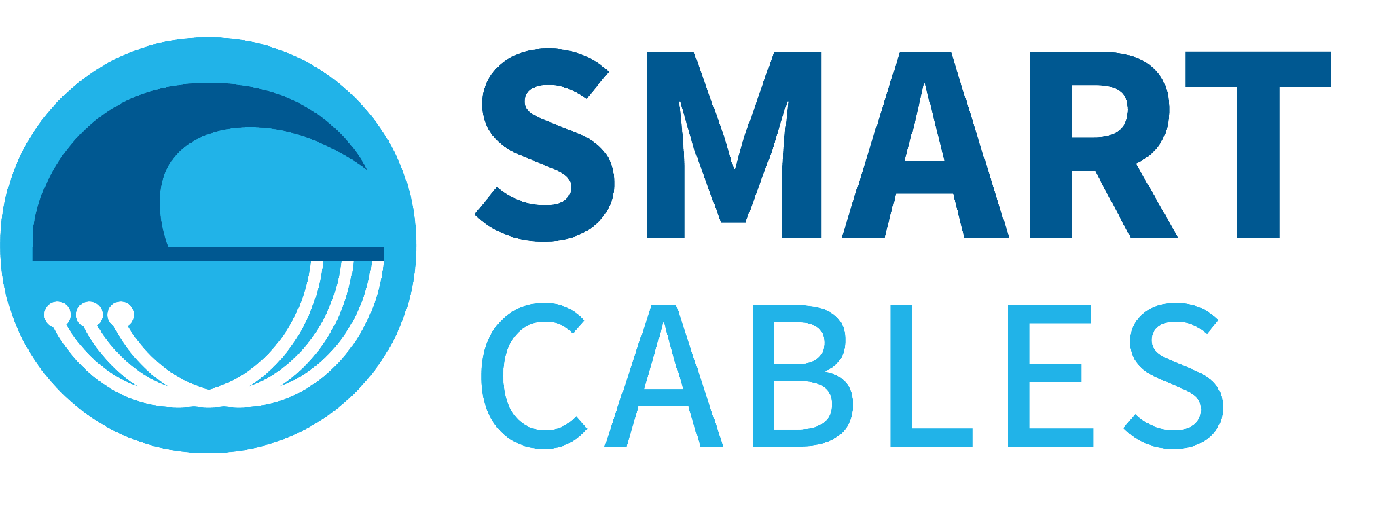


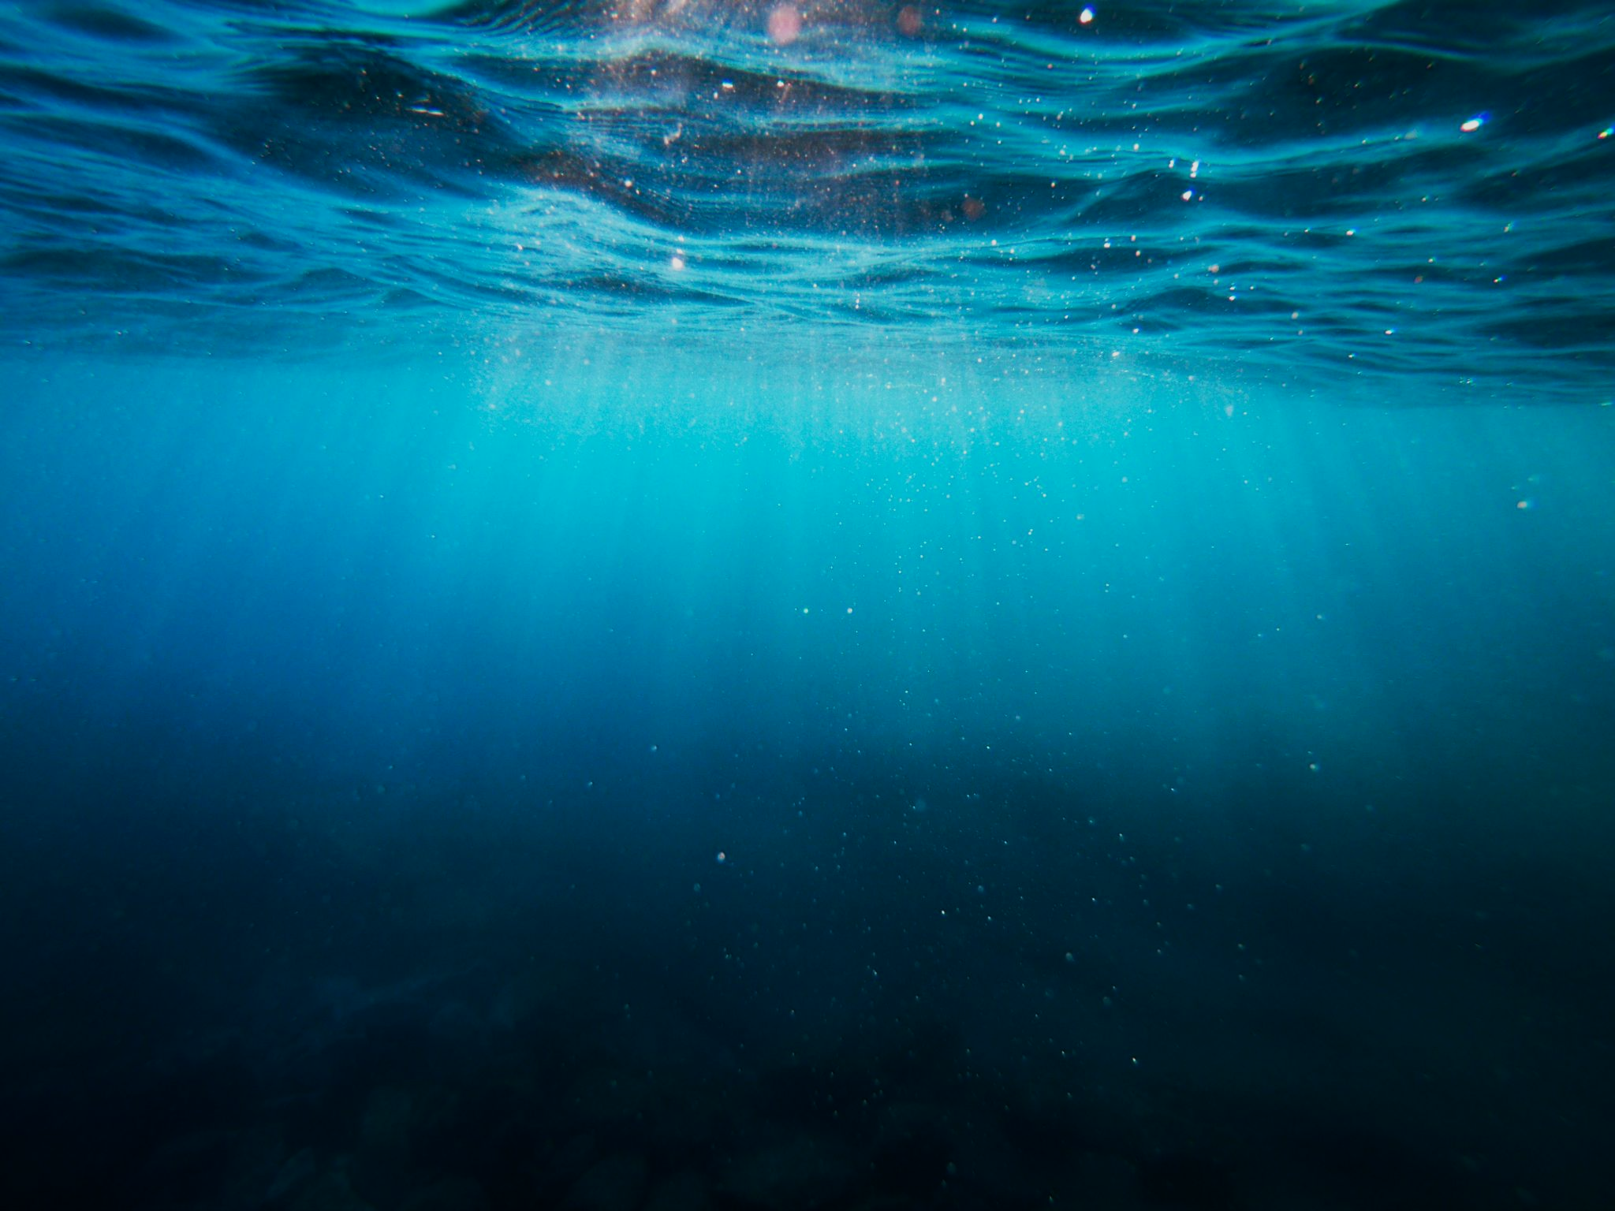

SMART Cables:
Applications to Caribbean Early Warning
Observing the Ocean and Earth with
Dr. Matt Fouch
President, Subsea Data Systems
Member, JTF SMART Cables matt.fouch@subseadatasystems.com
ICG/CARIBE-EWS XVII
Managua, Nicaragua
6 May 2024

Slide 2
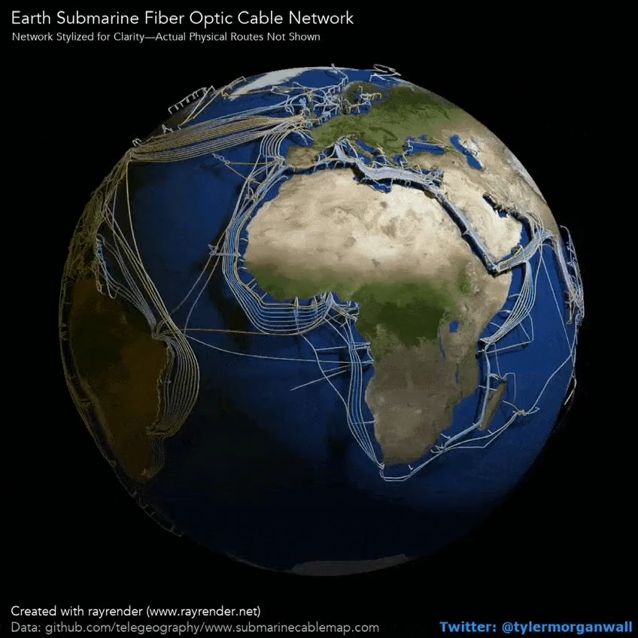
Earth’s Submarine Fiber Cable Network
99.5%
1.4M km
Total Intercontinental Internet Traffic
Total Submarine Fiber Cable In Use
$10B/day
0.2-0.4M km
Financial Transactions Transmitted
New Cable Installed Each Year
<0.1%
Cable Used for Non-Telecom Purposes

Slide 3
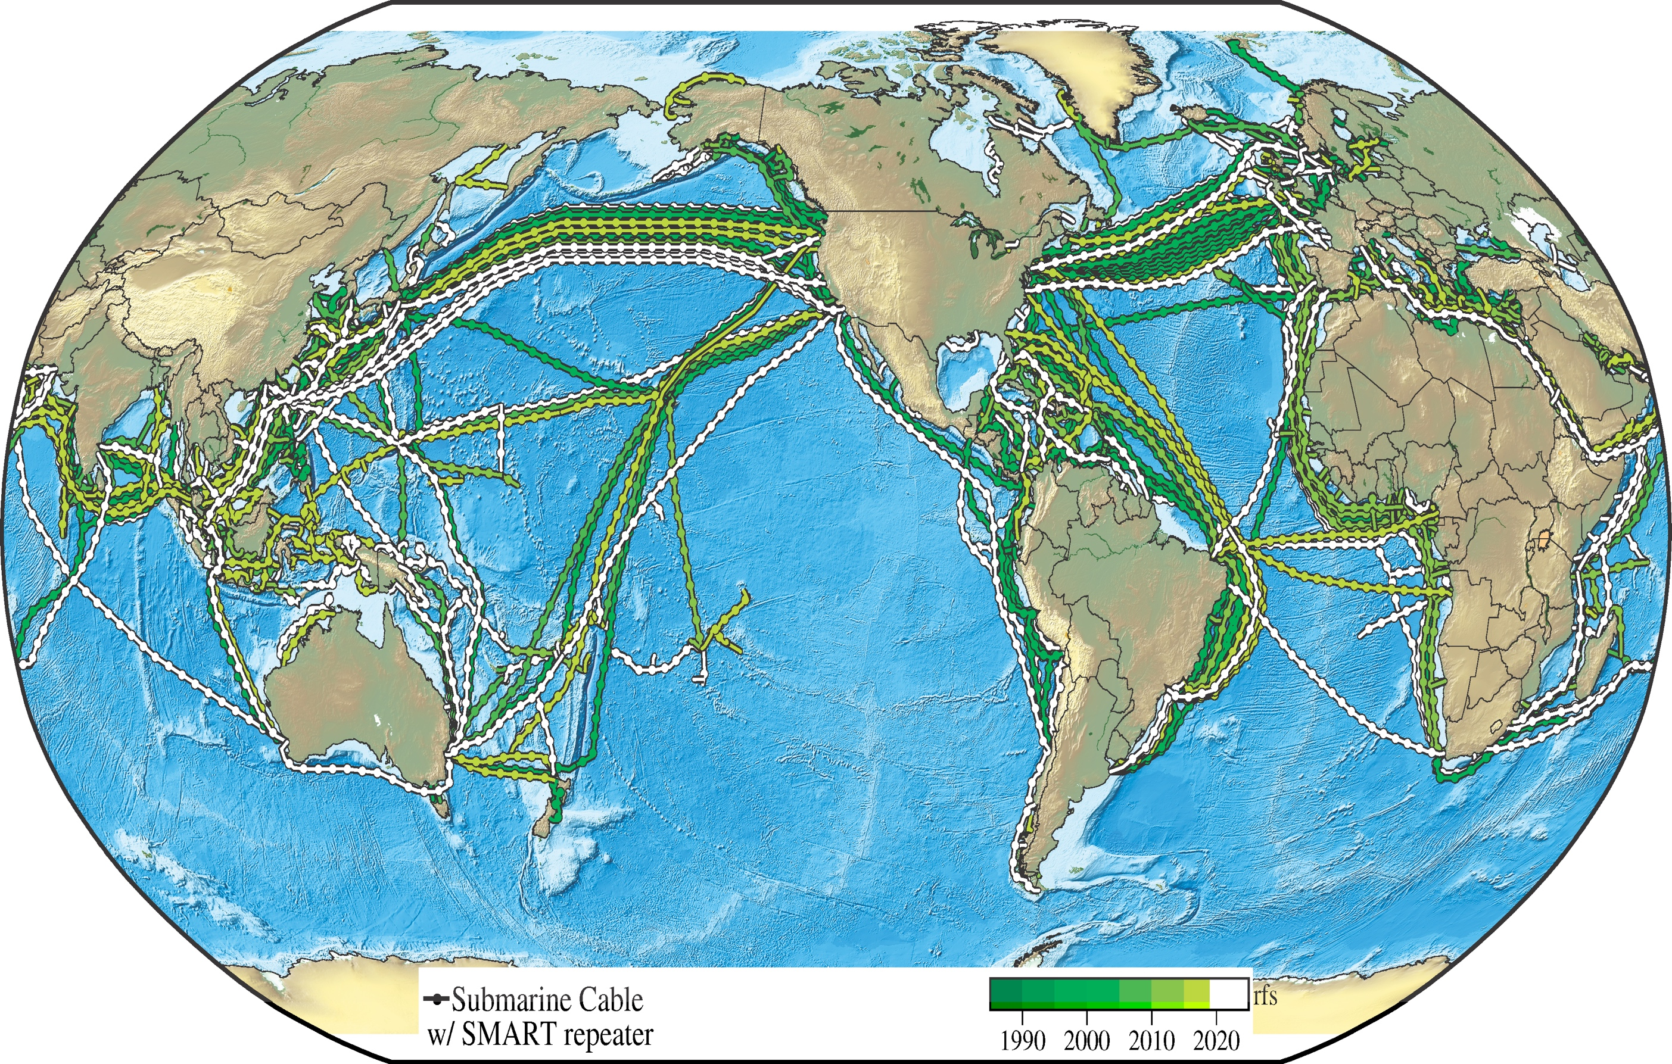
SMART Repeaters on Subsea Cables
SMART = Science Monitoring And Reliable Telecommunications
Subsea fiber comprises 99.5% of international Internet traffic
1.4M+ km total cable length
Repeaters (amplifiers) located every 60-100 km along the cable (~20,000 at present)
Virtually untapped for science and monitoring capabilities
SMART Cables: leverage commercial cable infrastructure
Sensors (pressure, temperature, seismic) on some/all cable amplifiers (repeaters)
Power & communications provided over cable
Engineering / replenishment lifespan of ~25 years
U.N. multi-agency Joint Task Force leading adoption push
Hardware development underway by Subsea Data Systems
Adoption by fiber cable suppliers required
Key opportunity to leverage commercial infrastructure for CARIBE-EWS earthquake and tsunami early warning
Submarine fiber optic cable network age progression
(Courtesy JTF SMART Cables)

Slide 4
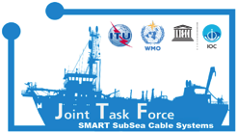

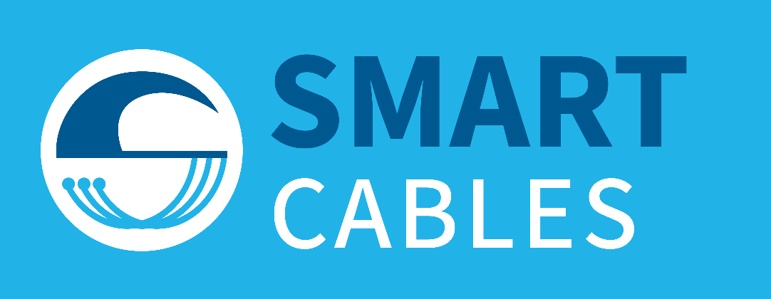

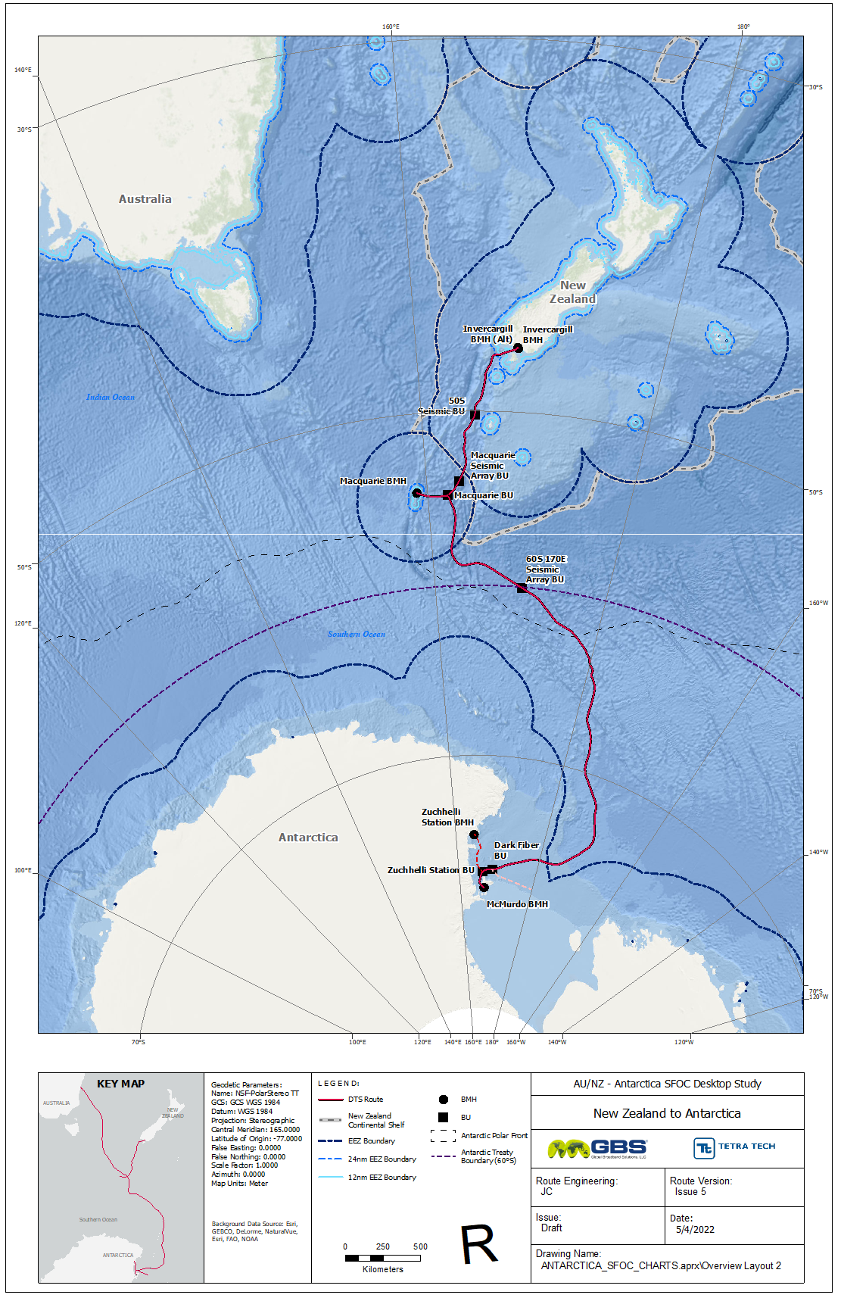
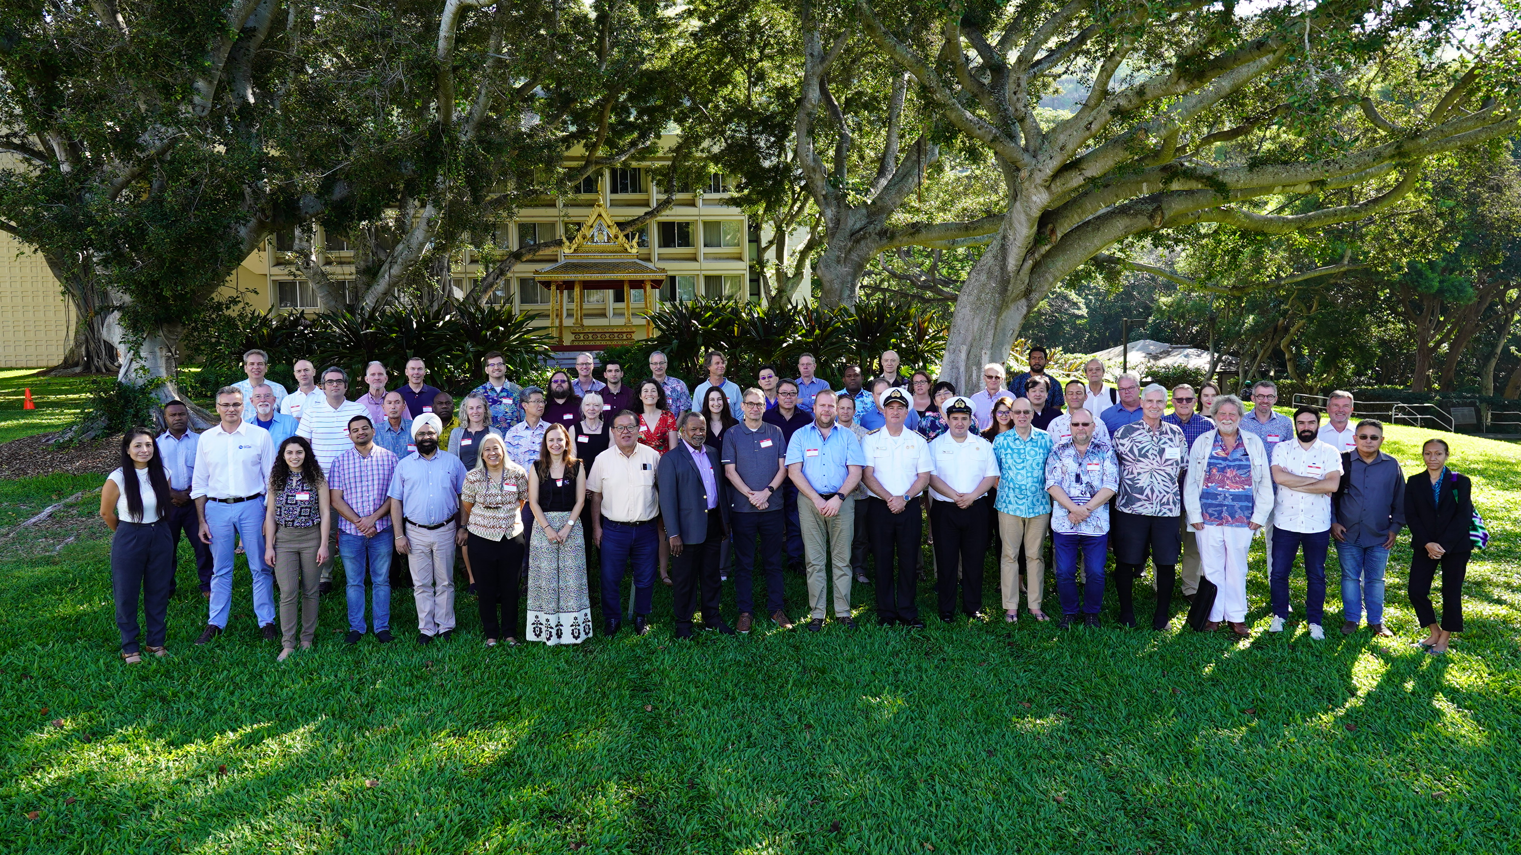



What is the Joint Task Force for SMART Cables?
Status Southern Ocean – SMART Can Help
JTF SMART Cables is a United Nations effort, uniting over 200 dedicated volunteers from various disciplines from science and society, engineering, marketing, business development, regulatory, and SMART data management.
Comprehensive guidance to stakeholders Promote a positive environment for discussions
Facilitate recommendations through
UN organizations
ITU, WMO, UNESCO-IOC
GOOS, Tsunami Resilience,
UN Ocean Decade
Promote the development of future SMART cable systems
Notes:
The Southern Ocean is an engine of global ocean circulation. It is a poorly observed, rapidly warming, major carbon sink that interacts with and threatens the stability of the Antarctic Ice Sheets.
High capacity telecom in the Southern ocean area is very limited – almost non-existent. The Southern Ocean is very difficult to sample.
The SMART cable solution can address both – it will definitely help to improve the science of the region.
Thje NSF proposed SMART cable system connecting New Zealand with Antarctica (as David Porter will describe in more detail),
will provide real time estimates of the temporal change of the coldest Antarctic Bottom Water between NZ and Antarctica,
the layer thickness, and the time series of the contraction/expansion of the layer along this transect.
Coupling these temperature results with the ocean bottom pressure gradient derived bottom currents will provide the choke point heat transport with reasonable horizontal resolution.
Just in case..
OBP observations from SMART cables can significantly contribute to the improvement of the GRACE-derived oceanic products, i.e., ocean bottom pressure,
and help resolve land-ocean ambiguities in the GRACE gravity data. The high temporal rate sampling of the OBP will help resolve aliasing of GRACE satellite data (with 30 day repeat cycle).
SMART cable sensors significantly improve ray coverage for characterizing seismic propagation in the Southern hemisphere.
Improving attenuation models will enable better resolution of active tectonic processes in the region, including the Puysegur Trench-Macquarie Ridge-Hjort Trench system, which are not well-understood.
Currently there is lack of constant, high resolution, long term fixed platform ocean data in the southern ocean
What we have now is data from taken by ships, floats and other instruments in a specific period of time, usually a short time because of limited funding duration.
SMART cables in the Southern Ocean can observe the Antarctic Circumpolar Current and Antarctic A Bottom Water which Influence all ocean basins and climate.
Gaining high-ﬁdelity SMART cable observations across the Paciﬁc Southern Ocean and Ross Sea would revolutionize observations of critical processes, trends, and fundamental ocean variability

Slide 5

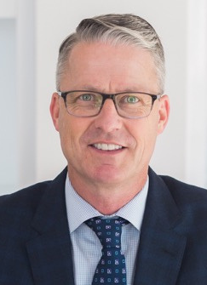

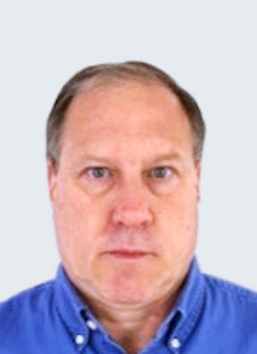
Proprietary Corporate Information: Do Not Distribute Without Permission
Team
Matt Fouch, President and Co-Founder
Also Chief Scientist, Samara/Data
Former Professor of Geophysics, Arizona State University
Former Staff Scientist, Carnegie Institution of Washington
Member, JTF SMART Cables
Steve Lentz, CTO and Co-Founder
Also Director of Network Development, Ocean Specialists Inc.
Former Chief Architect, NEPTUNE Canada
Chair, Engineering Subcommittee, JTF SMART Cables

Slide 6
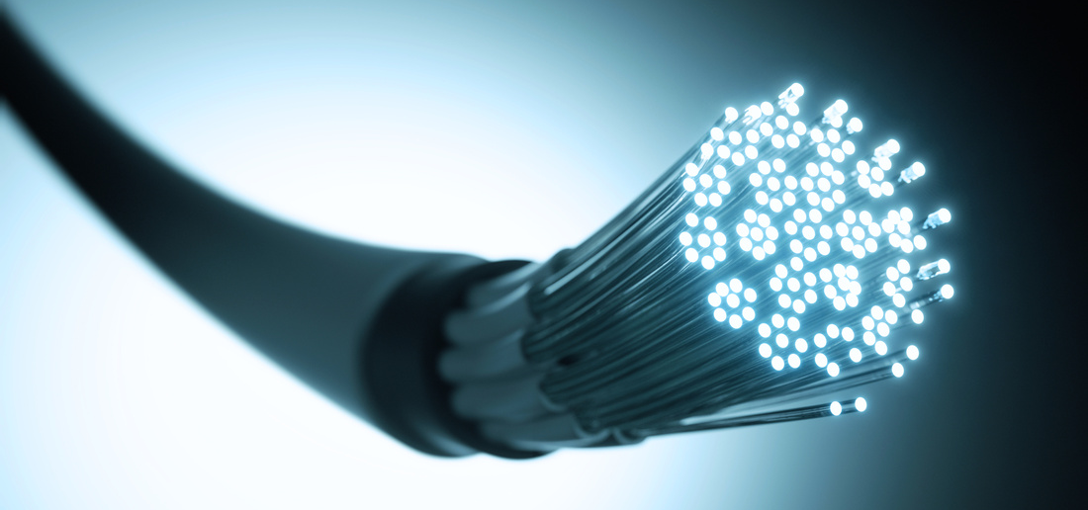

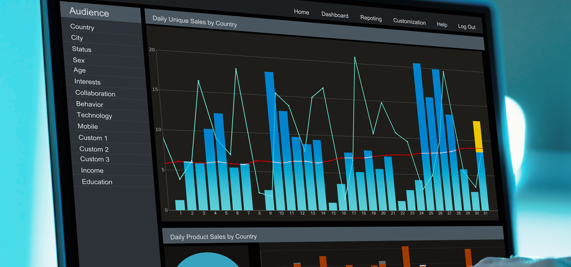
Services
01
02
03
SMART Cable Sensor Systems
SMART Cable Data Management
SMART Cable Data Products
Integrated sensor solutions for submarine fiber cable suppliers
Consulting services for SMART cables and built-for-purpose cabled systems
Calibration / validation (Cal/Val) of SMART sensor systems
Trusted partner in SMART data Quality Assurance / Quality Control (QA/QC)
Bespoke SMART data products for cable operators and government agencies
AI-driven system monitoring and event alerts for essential cable security and integrity

Slide 7

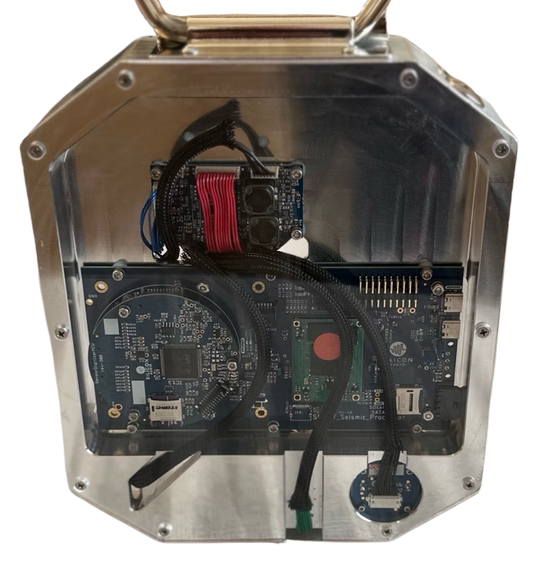



Proprietary Corporate Information: Do Not Distribute Without Permission
3-Axis Omni-Tilt Seismic Sensor
Low-noise intermediate band switchable seismometer
Silicon Audio 205 (acceleration); 215 (velocity)
0.01 to 500 Hz bandwidth
Best in class noise performance
183 dB dynamic range (high+low gain digitization)
30 mm diameter x 35 mm length (each sensing element)
20 cm
SMART Repeater Sensor System
Temperature Sensor (external)
Glass Coated Thermistor (GCT)
Sea-Bird SBE 03S
±0.002ºC accuracy
Maintains calibration over time
49 mm diameter x 256 mm length
Pressure Sensor (external)
Absolute Pressure Gauge (APG)
Paroscientific 4*K-101-0
1 part in 10⁷ resolution
Few parts in 10⁶ accuracy; mainly limited by drift
Signals of interest between 0.001 and 1 Hz
35 mm diameter x 108 mm length
SMART electronics /
seismic sensor in ~20cm / 8in radius cylinder

Slide 8

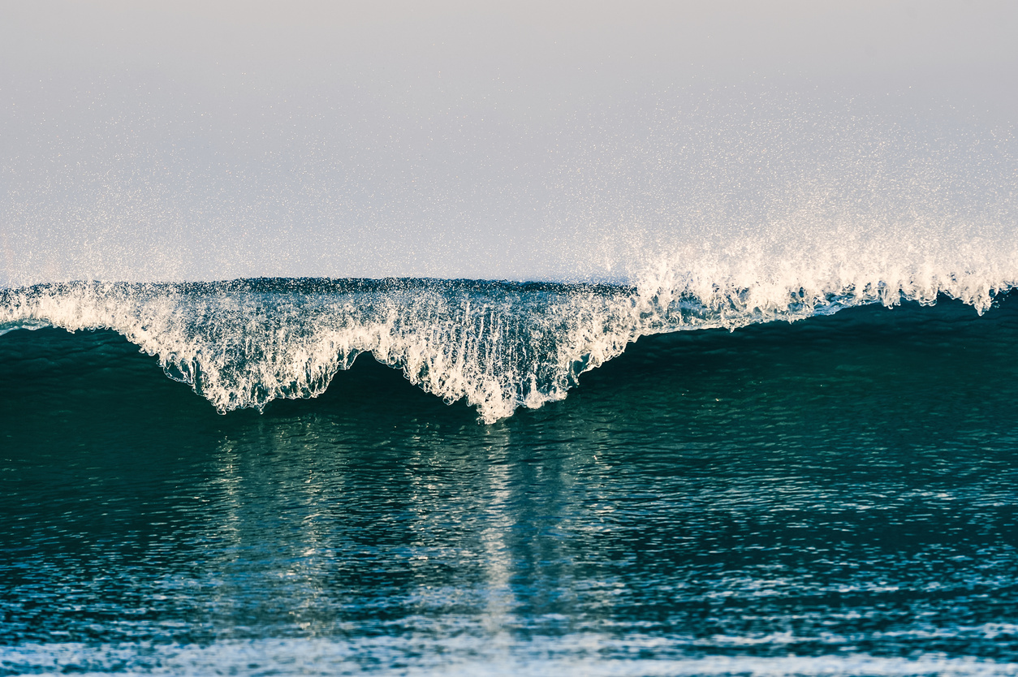
Proprietary Corporate Information: Do Not Distribute Without Permission
SMART Cables For Natural Hazards Monitoring
Turnkey earthquake and tsunami monitoring solutions
Data products for hazards warning from other agencies
Earthquake and tsunami alerts
Earthquake/tsunami monitoring
Tsunami forecasting services
Actionable Warnings and Alerts For:
Earthquakes
Tsunamis
Other natural hazards

Slide 9
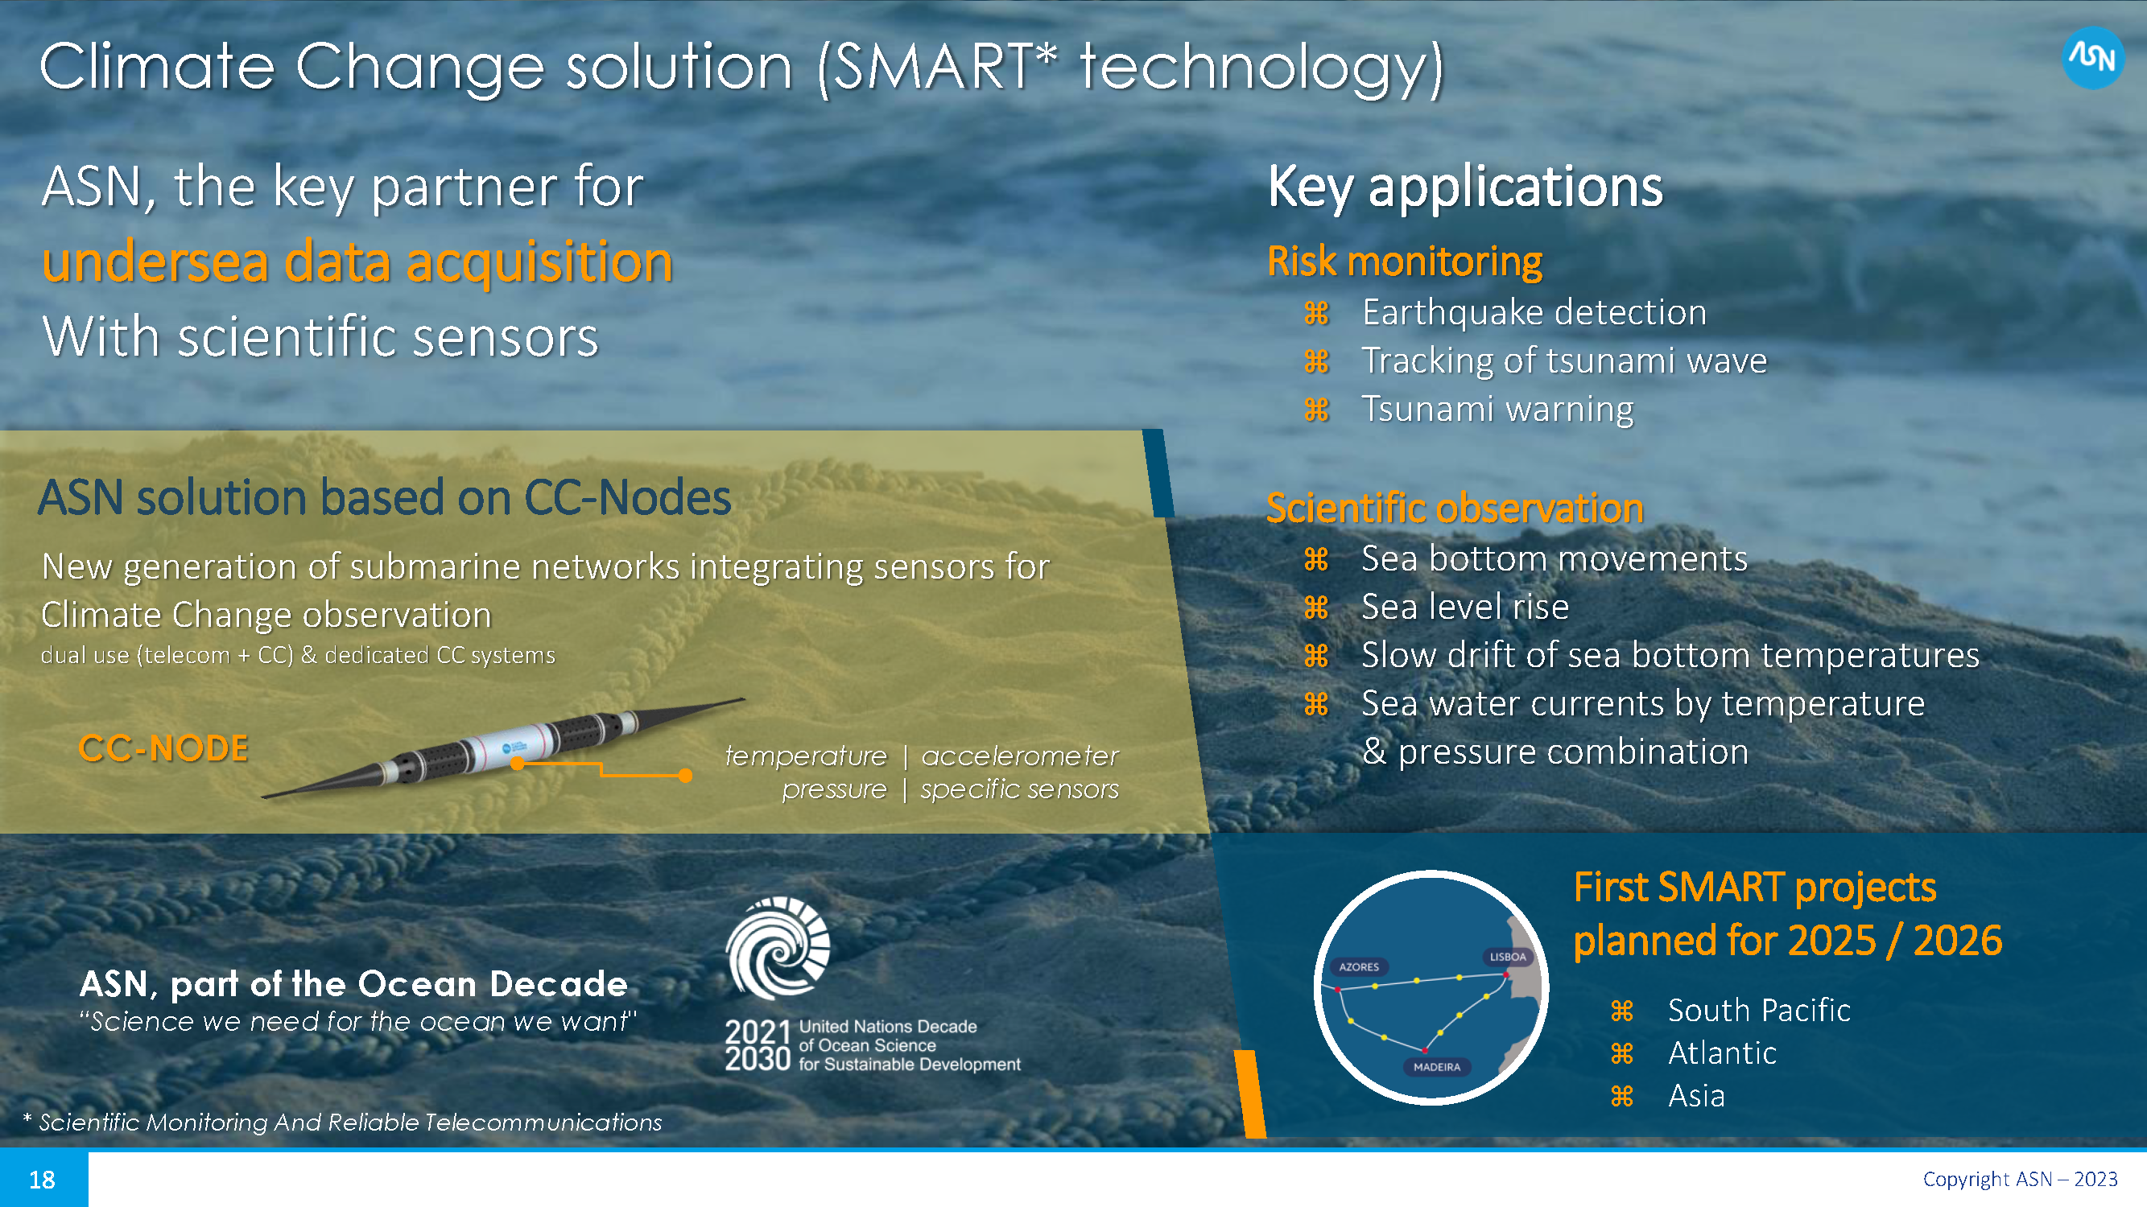
Commercially
available

Slide 10
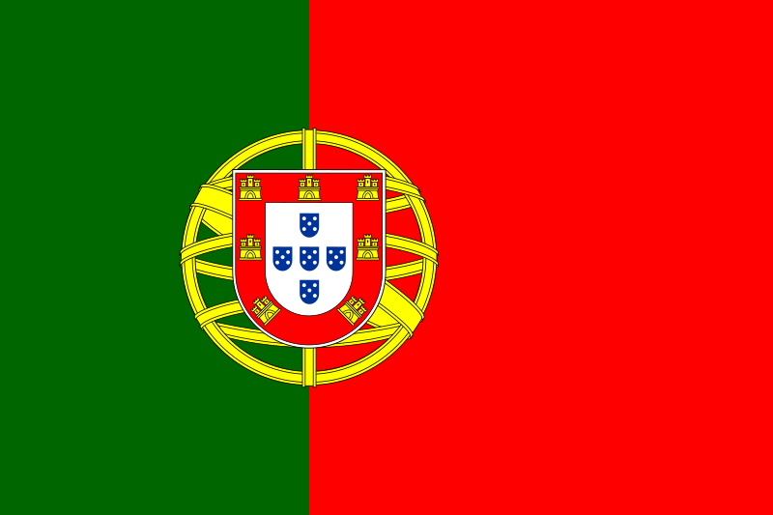
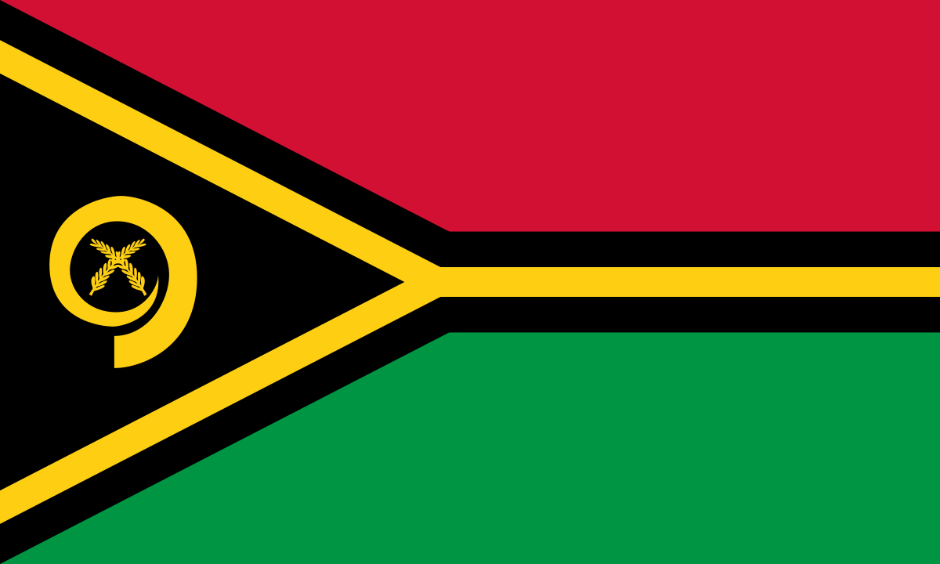
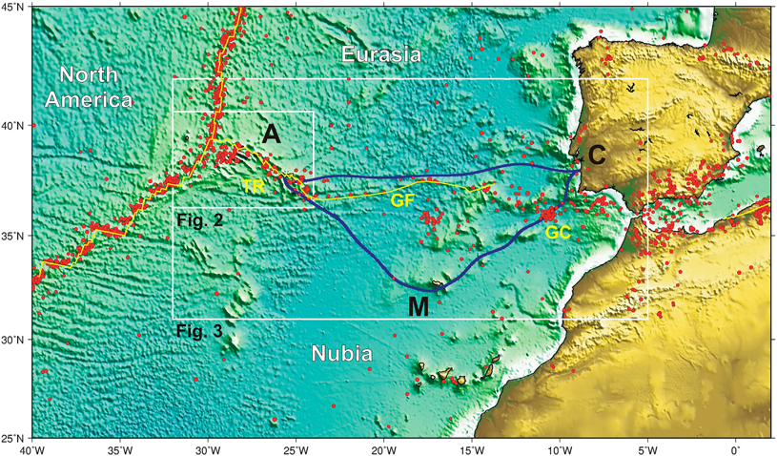
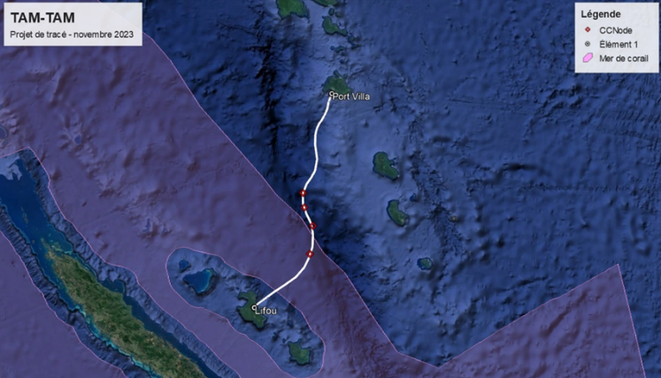



Funded SMART Cable Systems
Portugal SMART Atlantic CAM
Lisbon – Azores - Madeira
TAMTAM SMART Cable System
New Caledonia - Vanuatu
Lisbon
Azores
Both Ready for Service 2026
Madeira
3700 km long, ~20 SMART nodes
Gov’t funding €154M; EU support
€154M ~ 1 ship+sensors
25 years (€6M/y)
SMART 10% €15M ~ €1.5/citizen/25 y
Supplier: ASN
450 km long, 4 SMART nodes
France funding SMART
Supplier: ASN
25+ year life, reliable, low lifetime cost
Leverage $5B/y industry, 170 y
Notes:
Two SMART subsea cables are funded, with both to be ready for service in 2025/2026.
President Macron of France just announced support for SMART capability this last July 27.
The system will have 4 SMART repeaters between Vanuatu and New Caledonia.
This will be the second international cable for Vanuatu – extremely important for economic resilience, and improving earthquake, tsunami, and volcano early warning.
The Portuguese SMART Atlantic CAM system, replacing an old system, will link the Continent to the Azores and Madeira in a ring - CAM.
The government is bearing the cost for reducing disaster risk with the prime motivator being the very destructive 1755 earthquake and tsunami.
SMART capability will have an incremental cost about 10% of the cost of the telecom system.
For the Portuguese government, this means1.5 euros per citizen per 25 years.
We are leveraging this $5 billion per year industry to our advantage - and theirs.

Slide 11
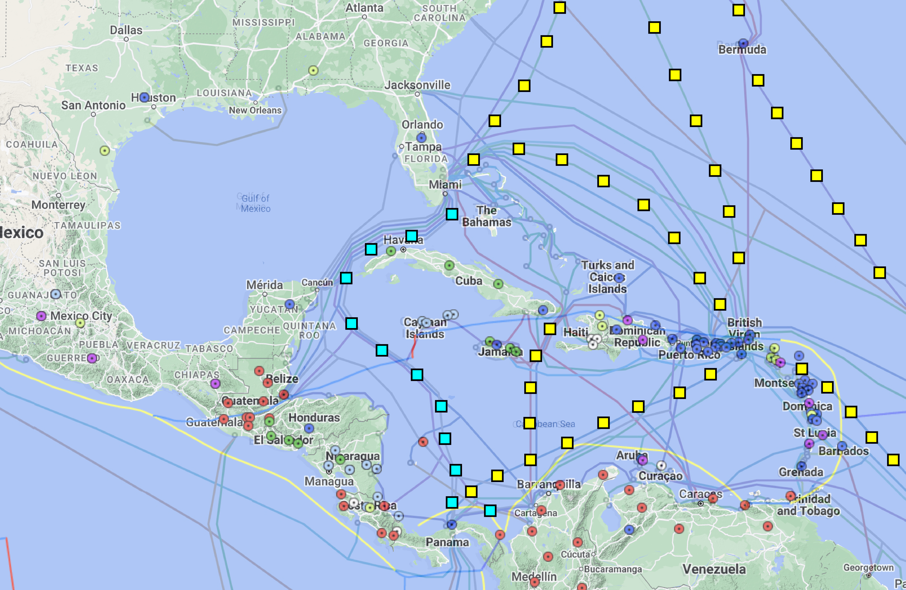
Example CARIBE SMART Cable Concepts
(Courtesy Matt Fouch, Subsea Data Systems)
Older cables in CARIBE-EWS region scheduled for replacement in next 1-6 years
Prime opportunity to include SMART repeaters in region
Enhance current CARIBE seismic and tsunami detection capabilities
Improve societal resilience
Protect / harden telecom infrastructure
Circles: Existing CARIBE-EWS seismic stations
Squares: Notional SMART Cable sensor-enabled repeaters
Notes:
Since 1998, more than 250,000 people have died due to tsunami.
Since 1998, tsunami have accounted for over $280 billion in economic losses.
More than 700 million people live in low-lying coastal areas and Small Island Developing States and are exposed to extreme sea-level events including tsunami.

