Slide 1
1.4 ICG/CARIBE-EWS Secretariat Report
ICG/CARIBE-EWS XVII
Managua - Nicaragua
6-9 May 2024
Öcal Necmioğlu
Technical Secretary of ICG/CARIBE-EWS
Tsunami Resilience Section

Slide 2
Introducing the New Technical Secretary
Education:
1993-1997 BSc Geophysical Engineer
Istanbul Technical University, Istanbul-Türkiye
2008-2014 PhD Geophysics (Tsunami Hazard in Turkey and its Surroundings)
Boğaziçi University, Istanbul-Türkiye
Work Experience:
1997-2001 Western Geophysical/WesternGeco (Global Offshore Operations)
Field Geophysicist / Processing Geophysicist and Seismic Analyst
2001-2008 Comprehensive Nuclear-Test-Ban Treaty Organization (CTBTO), Vienna-Austria
International Data Centre (IDC) / Seismic, Hydroacoustic and Infrasonic Analyst
2008-2021 Kandilli Observatory and Earthquake Research Institute (KOERI), İstanbul-Türkiye
KOERI/Regional Earthquake and Monitoring Center (TSP) Tsunami Working Group Technical Coordinator (2010-2021)
Tsunami National Contact for Türkiye (2012-2021)
Member of the ICG/NEAMTWS Steering Committee and Chair/Co-Chair/Member of various WGs/TTs (2011-2021)
Manager of the Turkish National Data Centre (for CTBTO) (2015-2021)
CTBTO-Working Group B Task Leader on Performance Assessment (2011-2016)
CTBTO-Working Group B Task Leader on Testing, Provisional Operations, Performance Assessment (2016-2021)
2021-2023 European Commission – Joint Research Centre (EC-JRC), Ispra, Italy
Scientific Project Officer
Global Disaster Alert Coordination System (GDACS) and European Crisis Management Laboratory (ECML)
CTBTO-Working Group B Task Leader on Testing, Provisional Operations, Performance Assessment (2021-2023)

Slide 3
Secretariat support to the ICG/CARIBE-EWS during the intersessional period
CL-2965 Call for nomination for ICG/CARIBE-EWS Working Groups and Task Team
CL-2979 Announcement of the CARIBE WAVE 24 Tsunami Exercise in the Caribbean and Adjacent Regions on 21 March 2024
CL-2990 Invitation to the Seventeenth session of the IOC Intergovernmental Coordination Group for the Tsunami and Other Coastal Hazards Warning System for the Caribbean and Adjacent Regions (ICG/CARIBE-EWS-XVII), Managua, Nicaragua, 6–9 May 2024
ICG/CARIBE-EWS Midterm Officers Meeting (online, 1-2 February 2024)
Manuales y guías 86-Programa plurianual de ejercicios comunitarios de simulación de tsunamis
MG-86 Multi-annual community tsunami exercise programme: guidelines for the tsunami and other coastal hazards warning system for the Caribbean and Adjacent Regions
Regional Tsunami Evacuation Workshop organized by the Florida International University Extreme Events Institute (FIU-EEI) Disaster Risk Reduction and Resilience program and the United States Development Agency's Bureau of Humanitarian Affairs (USAID/BHA), in close coordination with the National Tsunami Monitoring System of Costa Rica (SINAMOT) and IOC/TSR, 22-24 April 2024, San José-Costa Rica.
Final Report of the ICG/CARIBE-EWS XVI (published online on 3 May 2024)
ICG/CARIBE-EWS XVII, 6-9 May 2024, Managua-Nicaragua

Slide 4
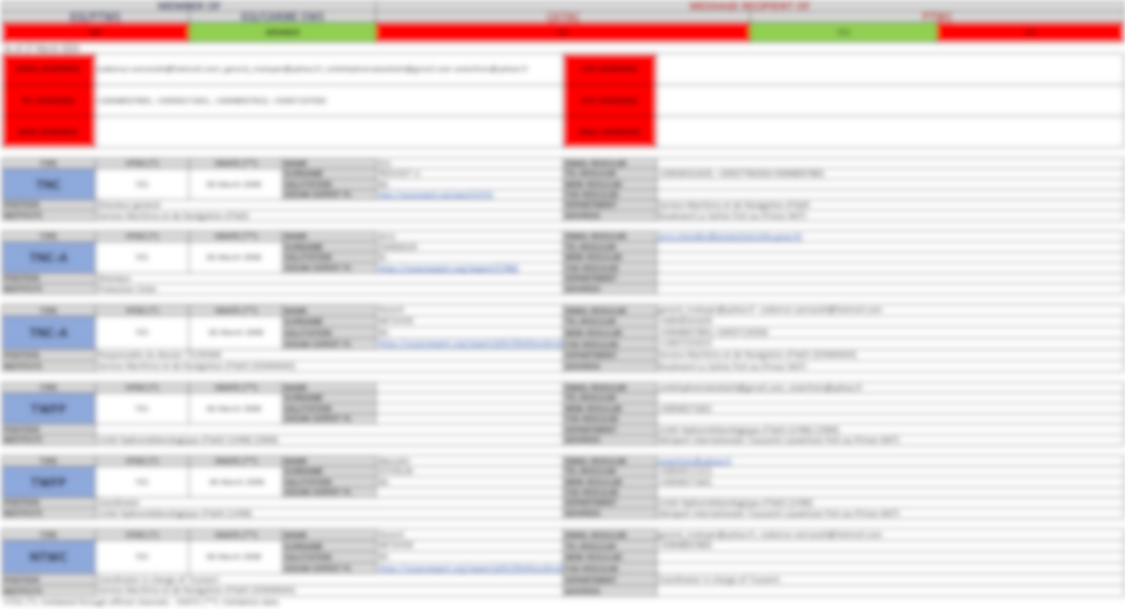
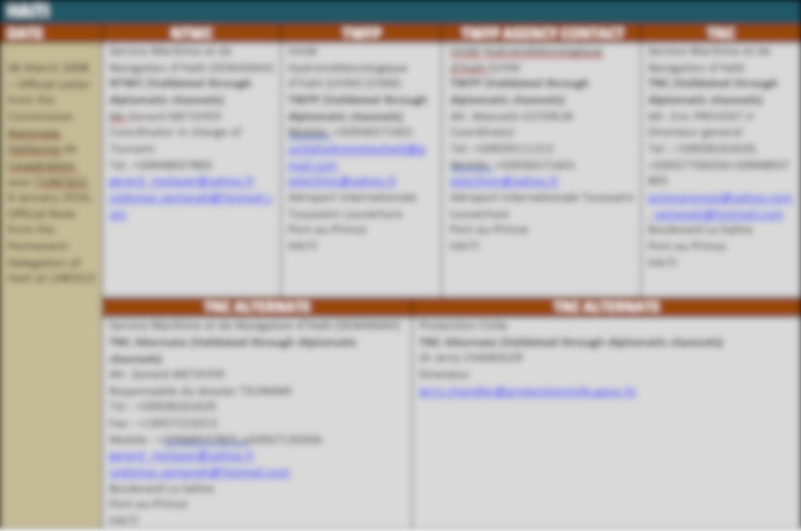
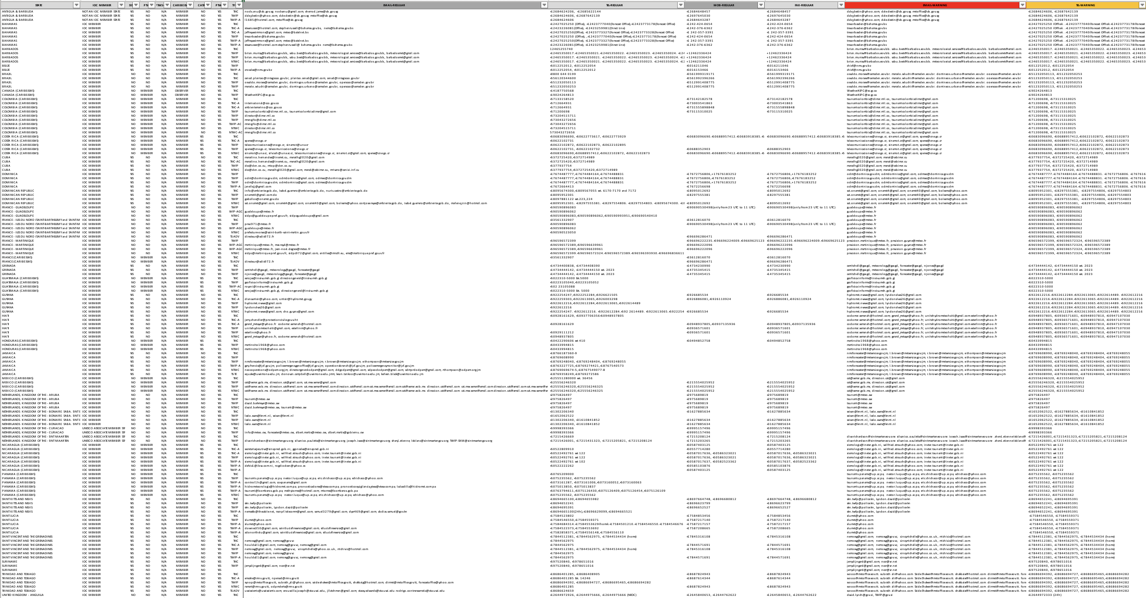
New TNC/TWFP/NTWC Database
Standard format for all Member States
Human error minimized
Global database automatically updated from Member State entry

Slide 5
Roles and Responsibilities of the TNC and TWFP
Tsunami National Contact
The person designated by an ICG Member State government to represent his/her country in the coordination of international tsunami warning and mitigation activities. The person is part of the main stakeholders of the national tsunami warning and mitigation system programme. The person may be the Tsunami Warning Focal Point from the national disaster management organization, from a technical or scientific institution, or from another agency with tsunami warning and mitigation responsibilities.
Tsunami Warning Focal Point
A 24x7 point of contact (office, operational unit or position, not a person) officially designated by the NTWC or the government to receive and disseminate tsunami information from an ICG Tsunami Service Provider according to established national Standard Operating Procedures. The TWFP may or not be the NTWC.
Tsunami Glossary (2019)

Slide 6
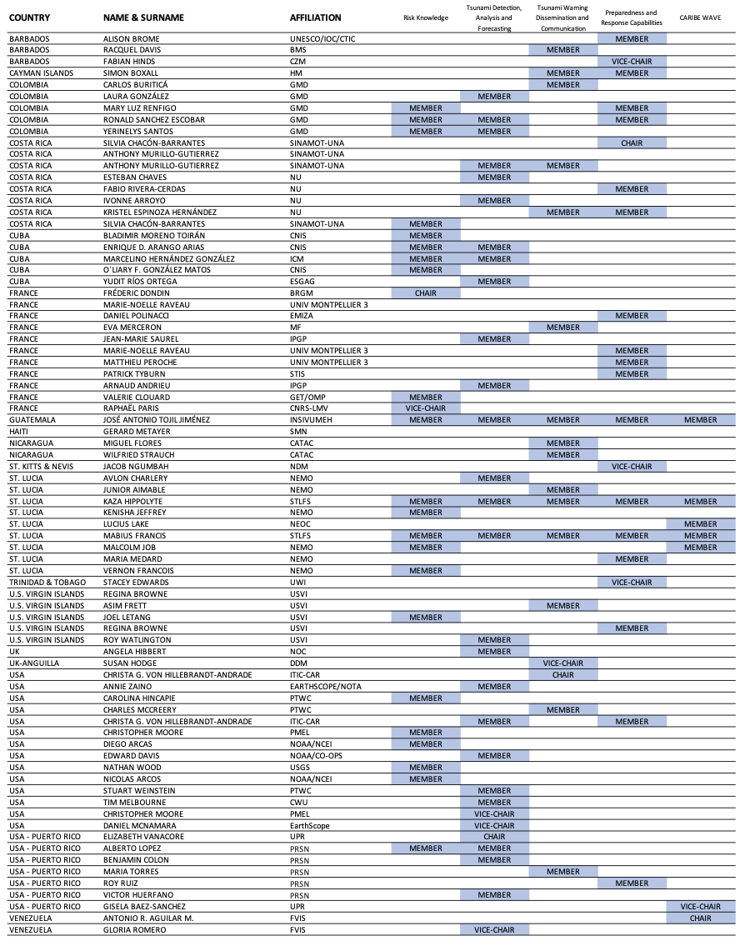
ICG/CARIBE-EWS WGs/TT Membership Status
Member States were invited on 9 October 2023 through CL-2965 to nominate experts to the ICG/CARIBE-EWS Working Groups and Task Team.
As of 5 May 2024, there are 78 experts from 15 Member States (including territories), with the following distribution:
BARBADOS: 2
CAYMAN ISLANDS: 1
COLOMBIA: 5
COSTA RICA: 8
CUBA: 5
FRANCE*: 11
GUATEMALA: 1
HAITI: 1
NICARAGUA: 2
ST. KITTIS & NEVIS: 1
ST. LUCIA: 9
TRINIDAD & TOBAGO: 1
UK*:2
USA*: 26
VENEZUELA: 2
Registration to OceanExpert
is essential!
* Including territories
Delegations are invited to inform the Technical Secretary in case of any updates to the ICG/CARIBE-EWS Working Groups and Task Team Membership status

Slide 7
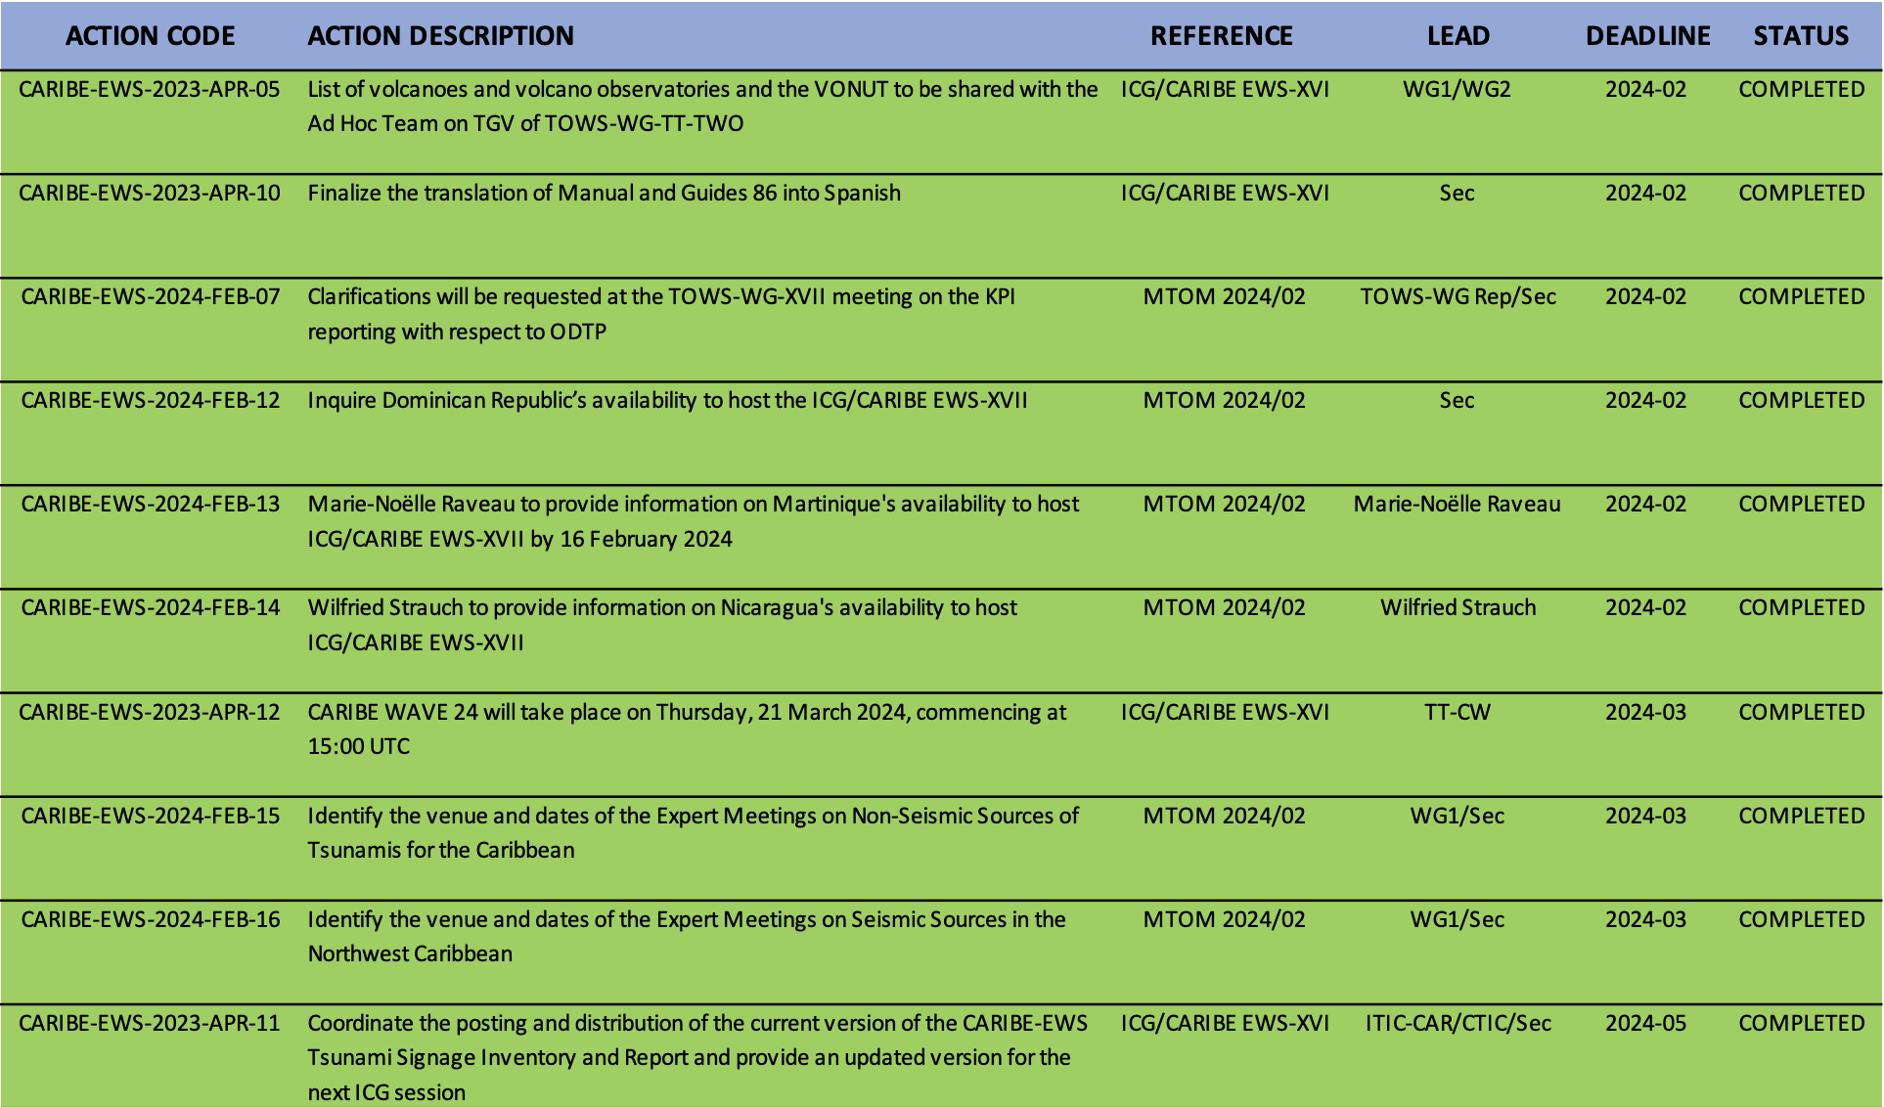
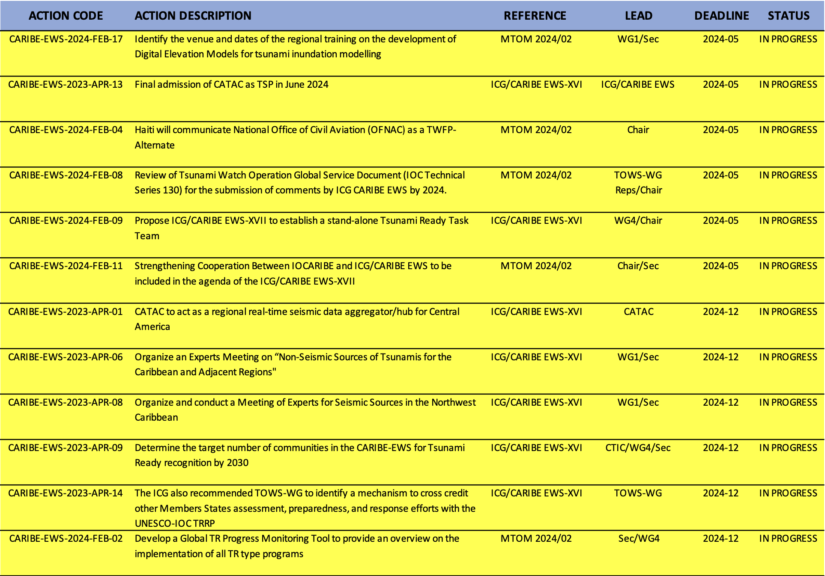
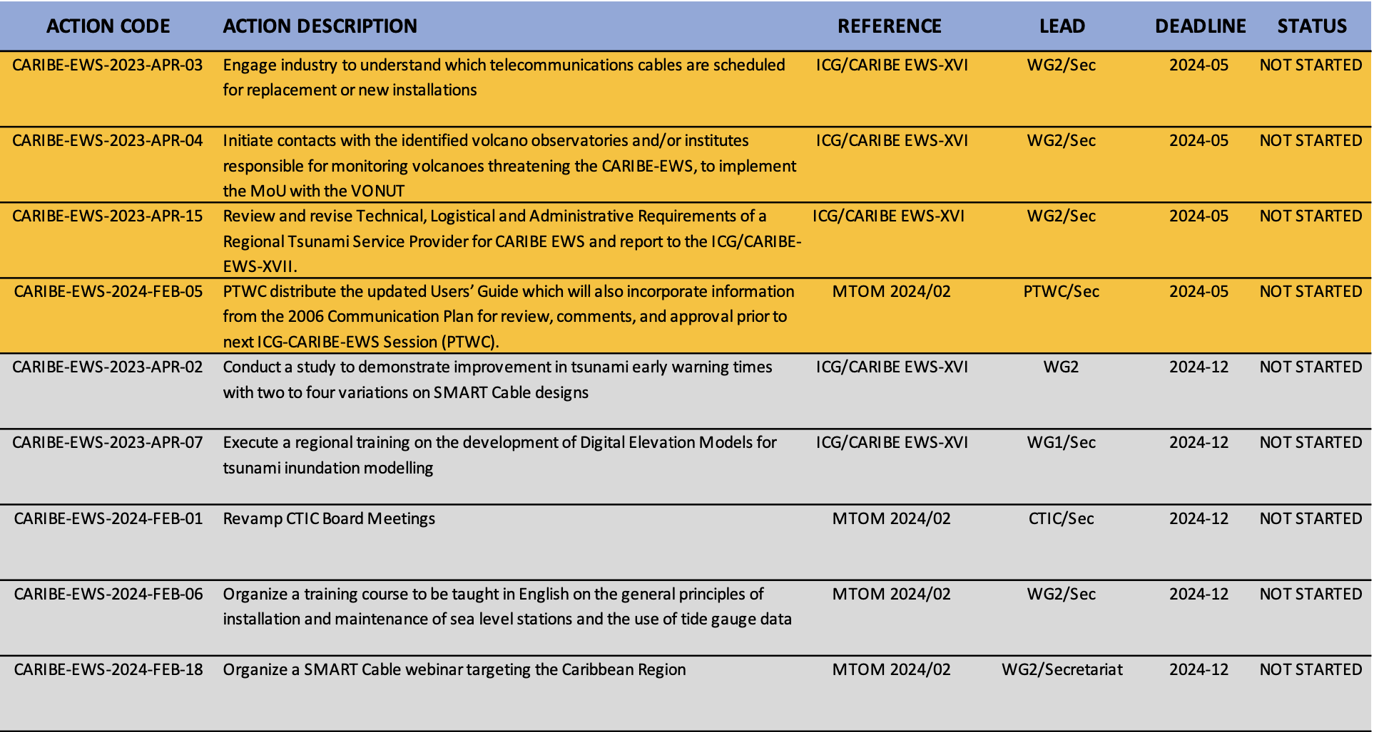
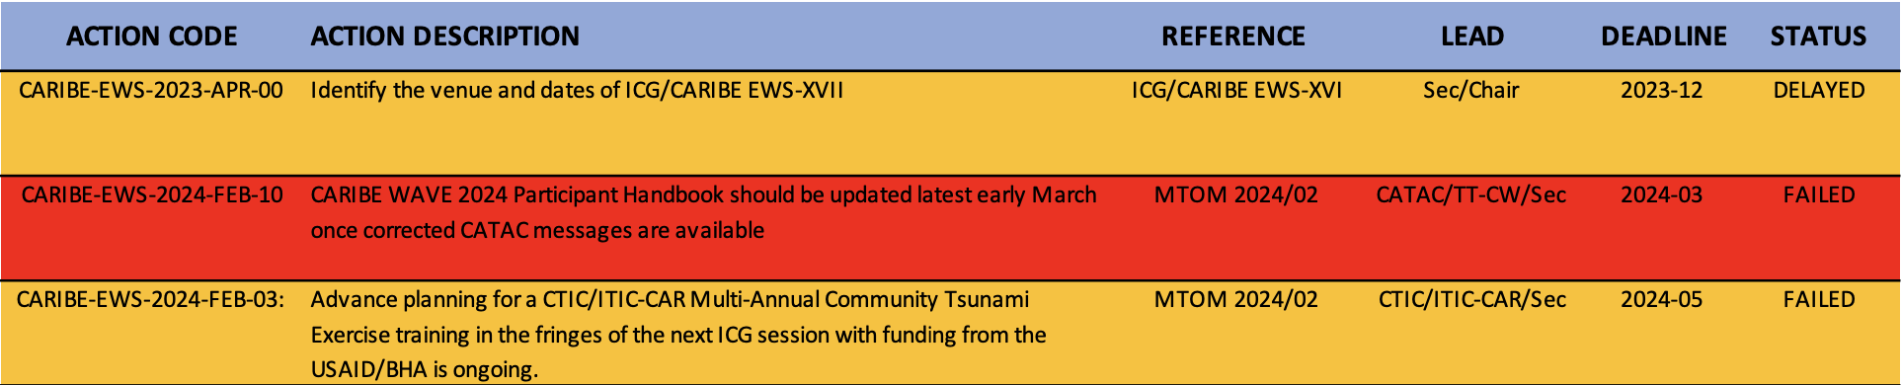
Status of CARIBE-EWS Action Monitor
Completed / Failed-Delayed / In Progress / Not Started
10 Tasks Completed (29%)
12 Tasks In Progress (35%)
9 Tasks Not Started (27%)
3 Tasks Failed/Delayed (9%)

Slide 8
Proposal for a revision in the Governance Structure
ICG/CARIBE-EWS Steering Committee
ICG/CARIBE-EWS is the only ICG that has no Steering Committee
In-person Steering Committee Meetings could take place in Member States where an ICG can not be organised for one reason or another.
Member State targeted capacity building activities can be organized back-to-back with SC Meeting.
Example Terms of Reference
CARIBE-EWS Steering Committee
1. The Steering Committee shall act in an advisory capacity to the Chair of the ICG/CARIBE-EWS during the inter-sessional period.
2. The Steering Committee shall coordinate and integrate the work of ICG/CARIBE-EWS in the inter-sessional periods, as implemented through the various technical and regional working groups and task teams, including but not limited to:
● ...
● ...
● Guide the work and direction of the ICG/CARIBE-EWS to help deliver the goals of the UN Ocean Decade Tsunami Programme in support of its 10-year Scientific Research Implementation and Development Plan.
The Steering Group will be composed of the ICG/CARIBE-EWS Officers (Chair and the Vice-Chairs), Chairs of the Working Groups and Task Teams, Representatives of the TSPs and CTIC, and other members’ representatives by invitation of the Chair.

Slide 9
Requirements for an in-person ICG
Host Country
UNESCO Requirement is 6 months in advance counter-signature of the Host Country Agreement
It’s critical to reach a decision on the date and place of the next ICG within the current ICG to ensure efficiency, optimization of the administrative procedures, and maximization of the in-person participation.
In case this is not possible, then the ICG could consider
to decide automatically for an online next session if no Member State expresses its availability under the respective agenda item on the last day of the current ICG session,
or
if no Member State expresses its availability under the respective agenda item on the last day of the current ICG/CARIBE-EWS session, to request the Secretariat to issue a Circular Letter within two weeks after the current ICG/CARIBE-EWS session inviting all Member States of ICG/CARIBE-EWS to host the next session of the ICG/CARIBE-EWS with a deadline of 3 months after the current ICG/CARIBE-EWS session, and in case no Member State expresses its availability by then, to automatically decide on the next session of the ICG/CARIBE-EWS to be conducted online.

Slide 10
Outlook
2025 will mark the 20th anniversary of the establishment of the ICG/CARIBE EWS.
2026 will mark the 20th anniversary of the first ICG/CARIBE EWS session in Barbados.
Under the current schedule, ICG/CARIBE-EWS XX will take place in 2027.
A UNESCO-IOC “Joint Expert Meeting on Seismic Sources in the Northwest Caribbean and on Non-Seismic Sources of Tsunamis for the Caribbean and Adjacent Regions” is planned during 2-5 December 2024 in San José, Costa Rica under the scientific leadership of WG1 co-chairs to be kindly hosted by the Universidad Nacional of Costa Rica. So far, 16 experts expressed their availability (14 in-person / 11 need funding, 2 virtual).
Efforts are in place in collaboration with NOAA National Ocean Service - Center for Operational Products & Services (NOAA/NOS/CO-OPS) to continue with the good example of the 2023 Tides Training course in Costa Rica and aim at both Spanish (Member State to be determined) and English in-person courses (in Puerto Rico or US Virgin Islands) (maybe in alternating years), possibly supported through online modules.

