Slide 1

Costa Rica National Report
Silvia Chacón-Barrantes
SINAMOT-UNA (NWTC)
Tsunami National Contact

Slide 2
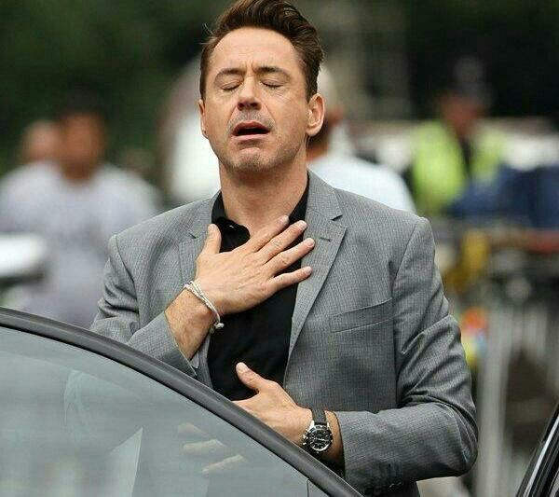
Tsunami events
No events during intersessional period

Slide 3
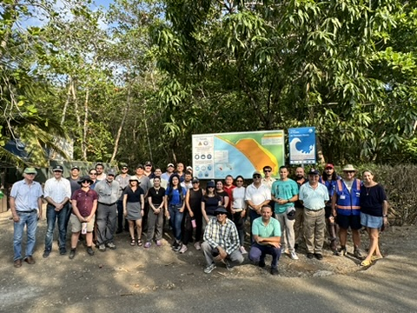
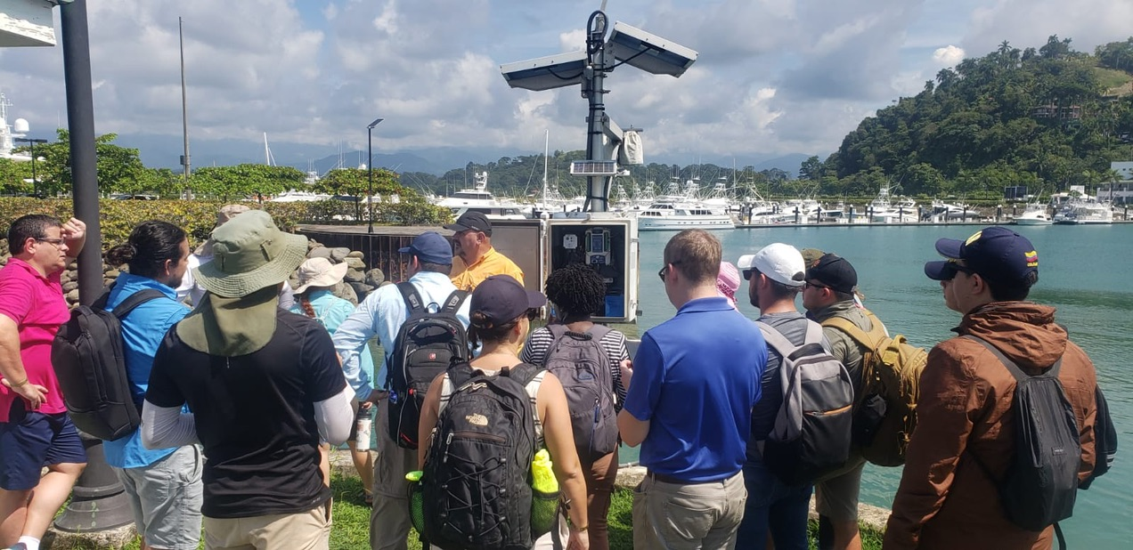
Hosted activities
November 2023: SL Training in Spanish
April 2024: WS on Tsunami Evacuation in Spanish

Slide 4
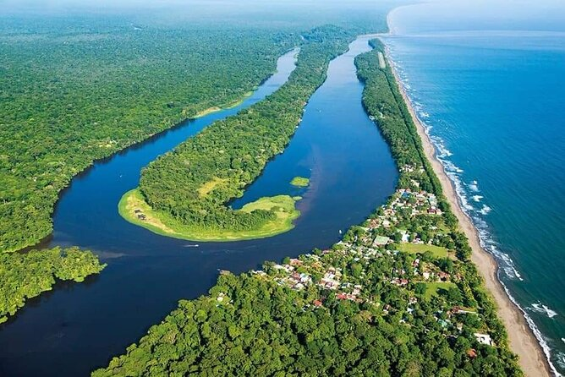
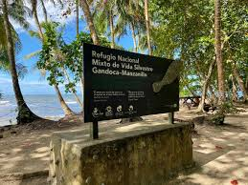
Work with communities and National Parks
Bathymetric surveys are scheduled for the second half of the year for better sea conditions
Tortuguero
Gandoca-Manzanillo

Slide 5
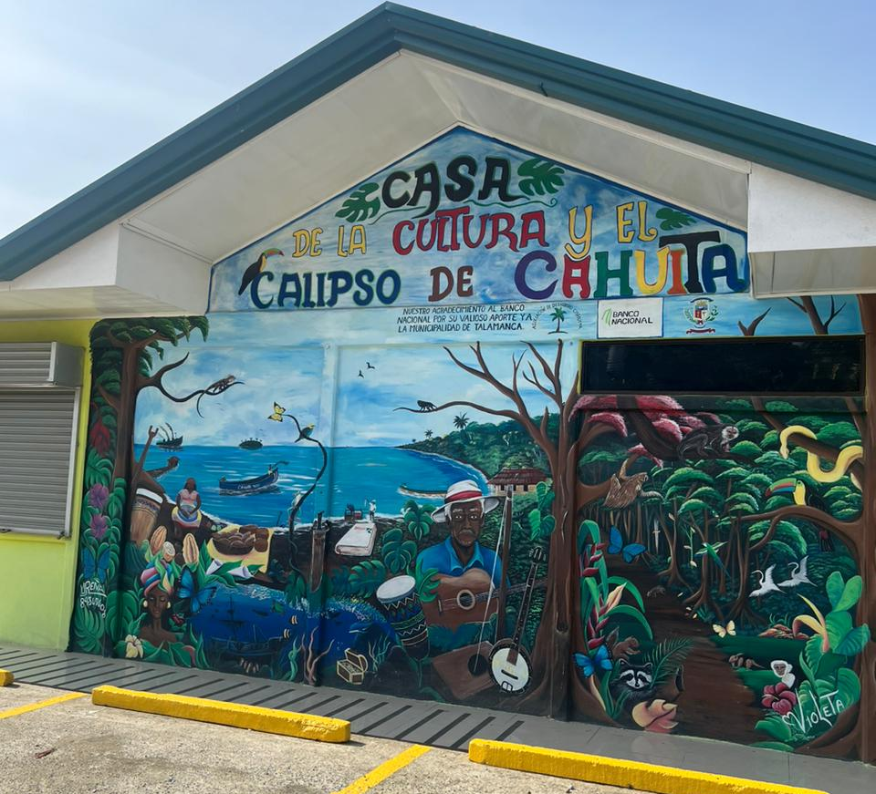
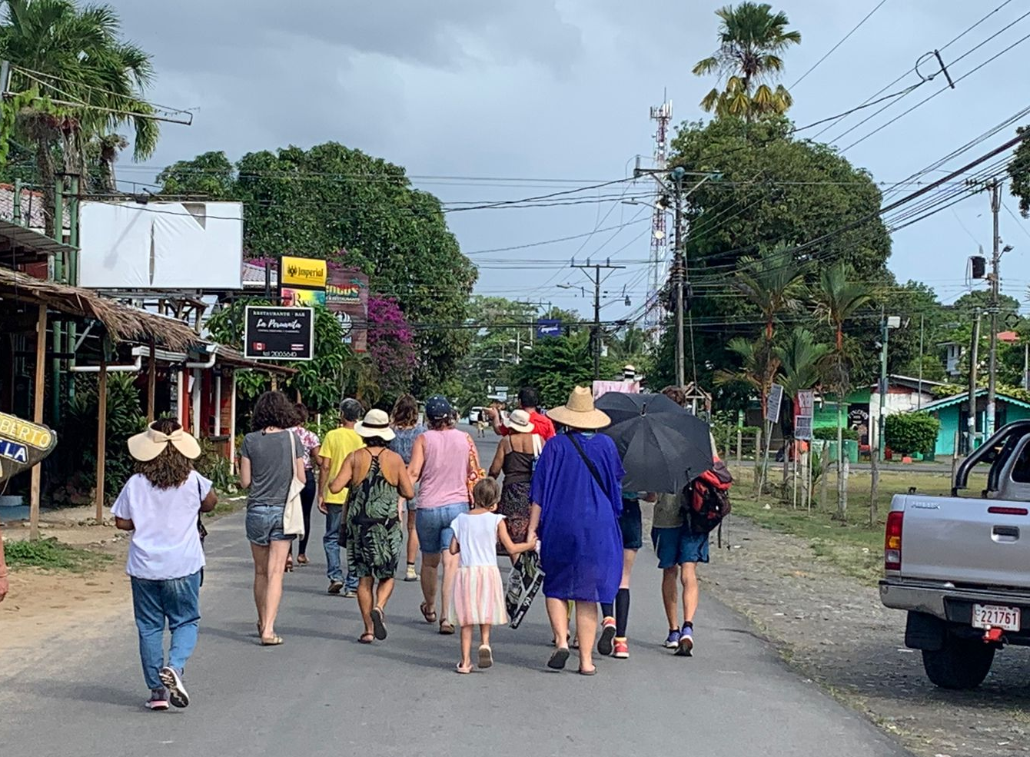
Tsunami Ready
Mid-April: Cahuita submitted their Tsunami Ready application
May: expected to have NTRB meeting
8 June: expected to have the TR ceremony with local and national authorities at Immersed in Change
11 June: expected to have the TR ceremony with the community
First community at Costa Rica Caribbean Coast
11th community at Costa Rica

Slide 6

Planned activities
5 April: Tsunami Ready panel as part of CISOS 24:
Representative from CNE
Christa von Hillebrandt-Andrade (ITIC-CAR)
Alison Brome (CTIC)
Silvia Chacón
https://eventos.una.ac.cr/114706/detail/cisos-2024-foro-cientifico-academico-congreso-de-integracion-de-saberes-para-un-oceano-sostenible.html

Slide 7
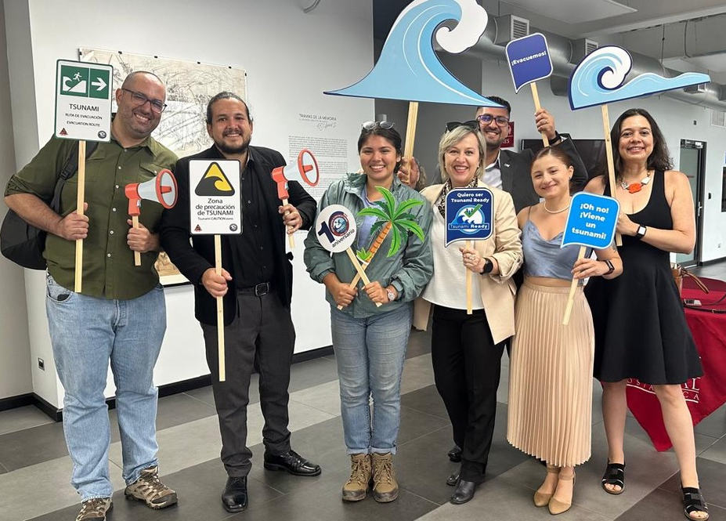
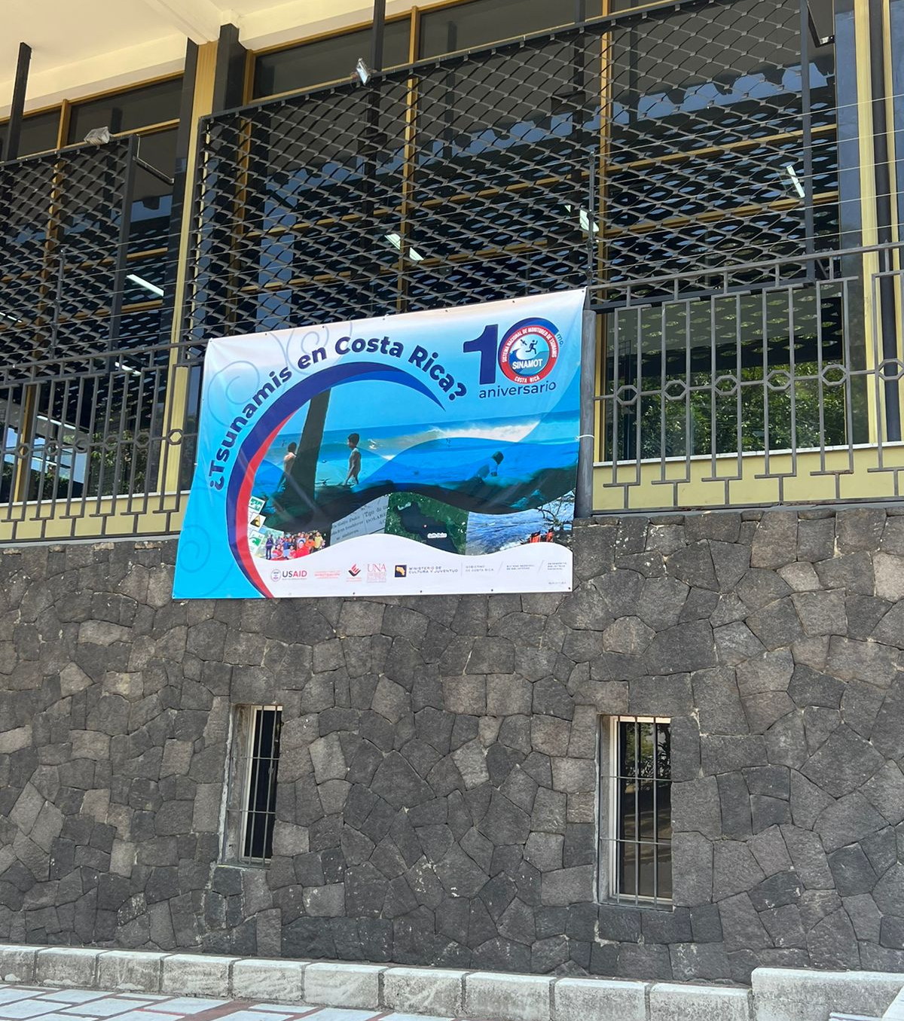
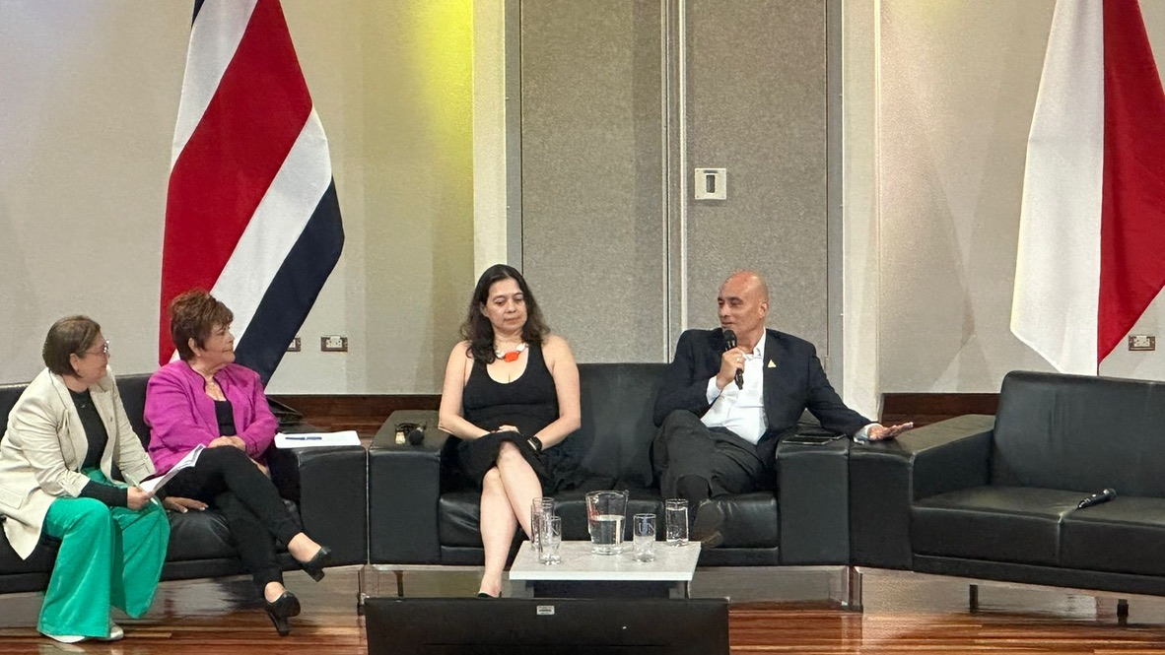
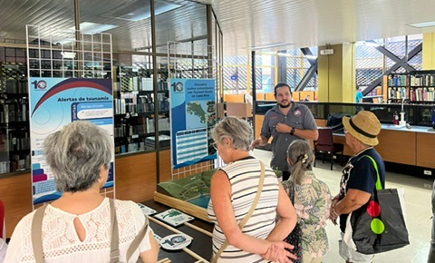
Our 10th anniversary!
2 - 29 May: Exhibition at National Library on historical tsunamis
30 April: 10th Anniversary Panel

