Slide 1
17th session ICG/CARIBE EWS, May 6-9, 2024
Working Group 1: Risk Knowledge
Chair: Frédéric Dondin (France)
Vice-Chair: Raphaël Paris (France)
Purpose of the WG: to advise the ICG on the identification and characterization of the risk associated with tsunami and other coastal hazards, and their assessment and required modelling.
Tasks:
• Review and evaluate required methods and data sets, including bathymetry and coastal topography for determining coastal hazards.
• Advise Member States on the requirements for operating the appropriate models for risk assessment.
• Advise and build capacity for risk assessments and their interpretation.
• Present a progress report based on the Key Performance Indicators related to the United Nations (UN) Ocean Decade Tsunami Programme (ODTP).
• Advise and seek advice from Member States about other coastal hazards that can be included into the warning system.
• Promote the sharing of experience and expertise, and capacity building essential to effective tsunami risk knowledge.

Slide 2
Recommendations last ICG CARIBE EWS meeting, April 2023:
To member states:
Member States to nominate members to actively engage in the Working Group.
  Last updated list of members dates back to April 2023
  New nominated member: Joël Letang (USVI).
Member States to nominate members with modeling experience to assist to get files prepared for display on CATSAM.
  Forthcoming expert meetings will be the opportunity to imply experts with modeling experience, and possibly to nominate them as new experts of WG1.
Member States to upload their elevation data, at a minimum to provide status of available data (e.g., extent, resolution, access, etc.).
  WG Chair and co-chair will initiate a new consultation this year to encourage Member States to provide updated data.

Slide 3
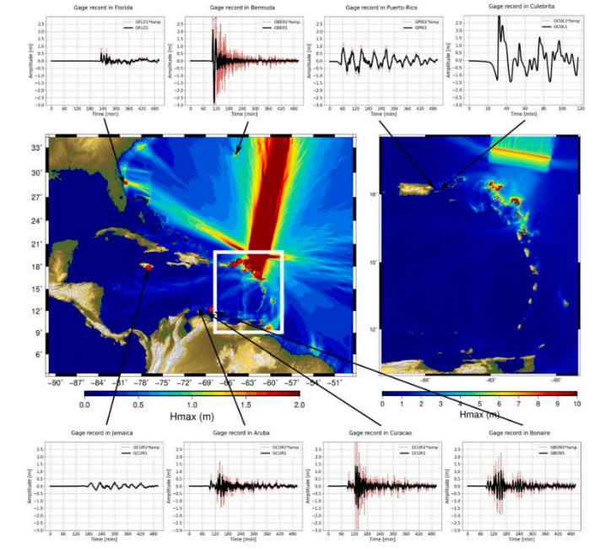
Recommendations last ICG CARIBE EWS meeting, April 2023:
To WG1:
To provide WG2 with the parameters, including associated files (e.g., shapefiles, geotiff, etc.) of tsunami scenarios once they are available for future Caribe Wave exercises.
  WG1 had recent discussions (online) on new scenarios (seismic sources) to be implemented to CATSAM:
  Rashidi et al. (2023): 6 new scenarios in the Lesser Antilles, some of them having no equivalent in the CATSAM database.
  Useche et al. (2022): 1839-like scenario, no equivalent in CATSAM.
  Cordrie et al. (2022): new megathrust scenario in the Anegada passage as a source of the pre-Colombian tsunami, likely similar to some scenarios of CATSAM but slightly different geometry. Not a priority.
  These scenarios were not validated by all the experts contacted, as there is a debate on the realibility of some of them. A second round of discussion is needed.

Slide 4
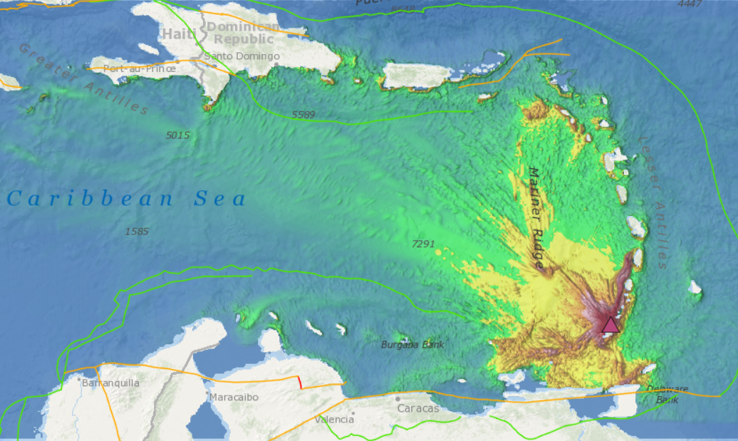
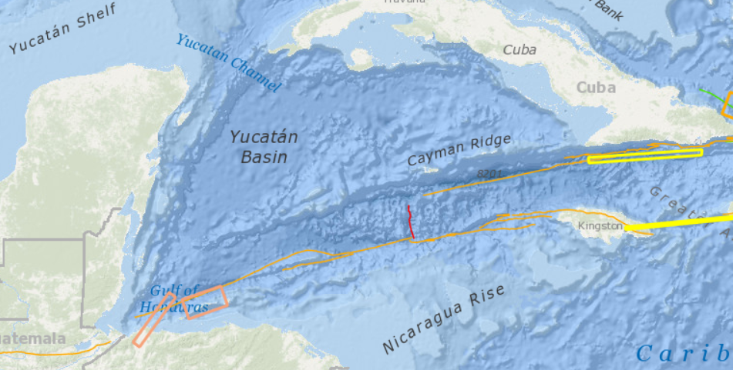
Recommendations last ICG CARIBE EWS meeting, April 2023:
To organize an Experts Meetings on “Non-Seismic Sources of Tsunamis for the Caribbean”.
To organize an Experts Meetings on “Seismic Sources of Tsunamis in the NW Caribbean”.
  The two meetings are scheduled for December 2-5, 2024 in San José, Costa-Rica, kindly hosted by the Universidad Nacional de Costa Rica (thanks to Silvia!).
  25 experts contacted - we are waiting for information on their availability and funding.
  CATSAM: only one non-seismic scenario included (landslide at Kick’em Jenny submarine volcano) and two scenarios in the NW Caribbean (in the Gulf of Honduras) – an update is needed after the meetings (2025).

Slide 5
Recommendations last ICG CARIBE EWS meeting, April 2023:
To compile and prioritize a list of non-seismic sources; encourages models of scenarios to be available, when possible.
  This task will be mostly addressed after the meeting on non-seismic sources of tsunamis.
  We’ll also benefit from:
    new publications on volcanic / landslide sources of tsunamis in the Caribbean (the WG has a list of references that is frequently updated).
    the work by the Task Team leaded by Valérie Clouard (cf. new paper published in Bulletin of Volcanology on the implementation of a VONUT procedure for volcanic tsunamis).
    and the new IOC Technical Series report on volcanic tsunamis (TOWS ad-hoc task team leaded by François Schindelé).

Slide 6
Recommendations last ICG CARIBE EWS meeting, April 2023:
To organize a regional training on the development of digital elevation models (DEMs) for tsunami inundation modeling.
    Still relevant but ranked as priority 2 compared to the two expert meetings.
    As a reminder, the aims of the training would be to:
        1. Review and evaluate the required methods and data sets, including
        bathymetry and coastal topography for determining the coastal hazards.
        2. Advise the member states on the requirements for operating the
        appropriate models.
        3. Develop capacity building for the appropriate modelling.

Slide 7
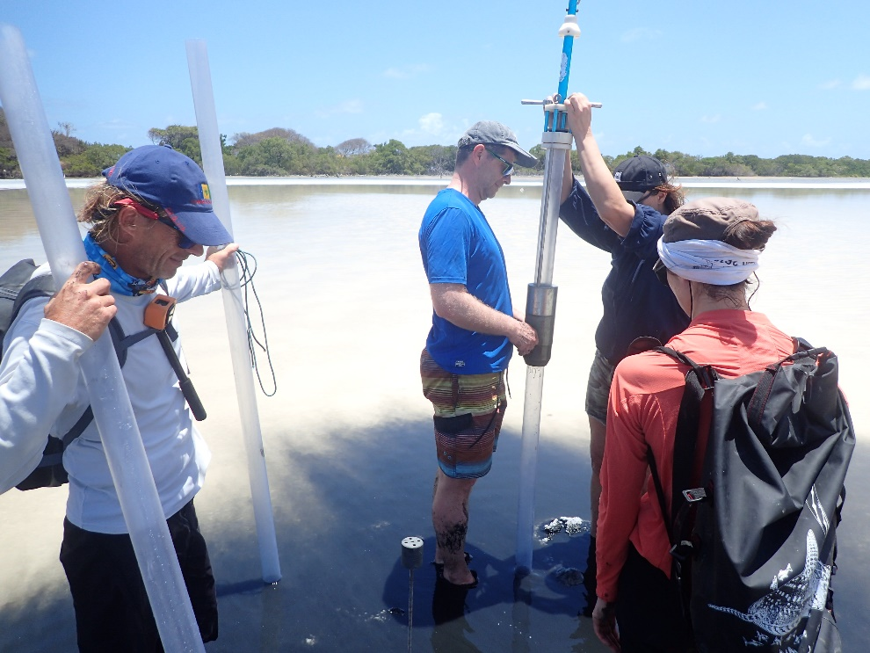
Activities of WG1 are also fed by studies on past tsunamis in the Caribbean, including those on tsunami deposits.
Recent publications in Scrub, St Martin and Martinique
Complete and enlarge the record of tsunamis in the Lesser Antilles during the last 3500 years.
+ ongoing project in the Grenadines leaded by Raphaël Paris (coring in 6 coastal lagoons in Mustique, Mayreau, Union, Carriacou and Saline islands).

