Slide 1

IOC Group of Experts on Capacity Development
5th Session
Agenda 2.3 Capacity Development Needs Assessment Survey
Johanna Diwa-Acallar
27 February 2024
Paris

Slide 2
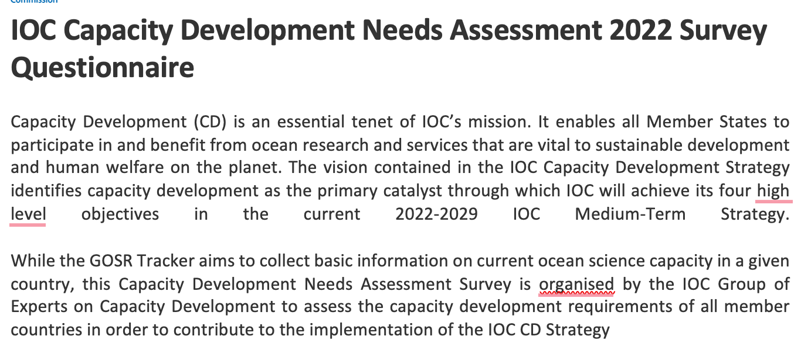
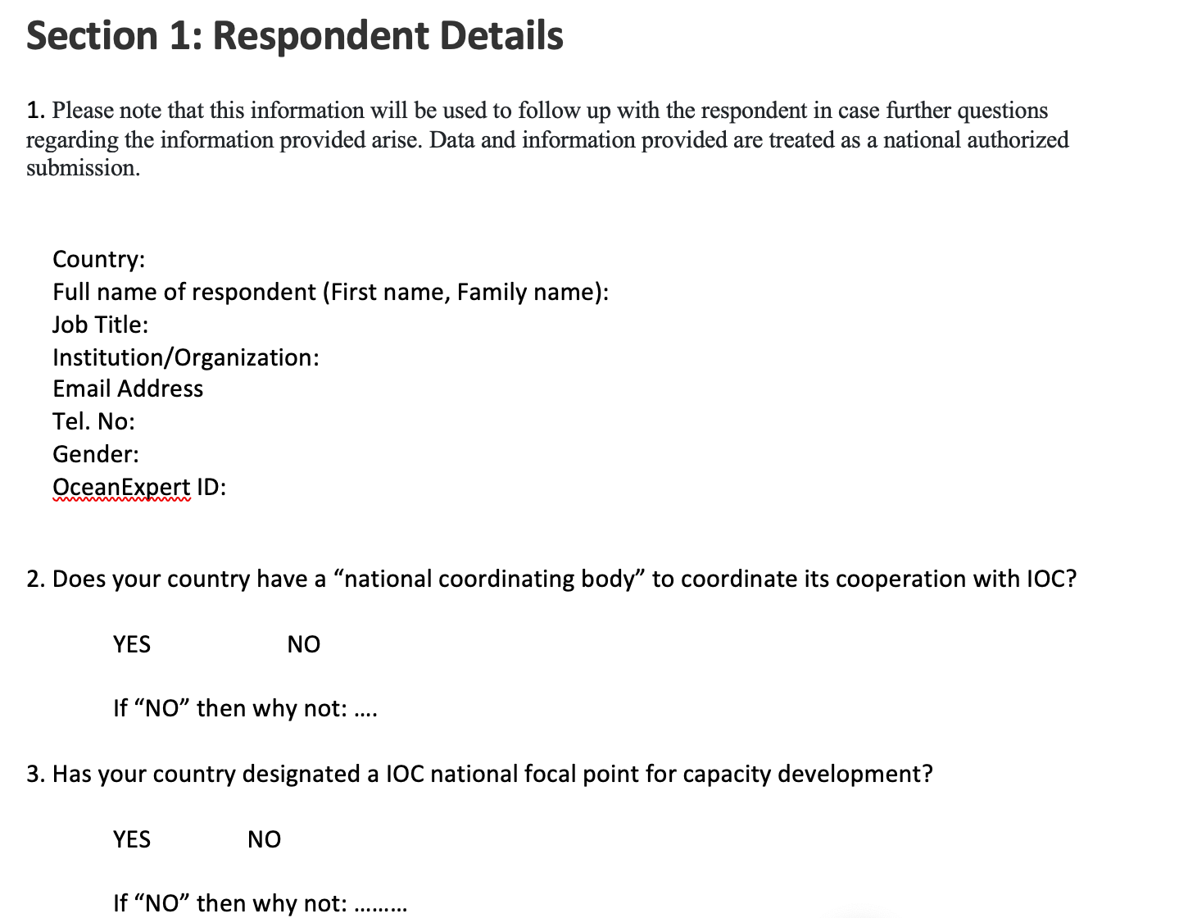
OVERVIEW
2 Sections
Section 1:
Respondent details
Section 2:
Capacity development needs
Ocean Decade
Joint review in close collaboration with the GOSR team
Complementary approach and joint effort in launching both surveys
Synthesized questions resulting to shorter questionnaire with no other subset questionnaires for subset groups
Respondents:
  only IOC National Focal Points as ONE NATIONAL RESPONSE
Launched: 4 January 2023 (through CL 2919)
Results:
from 17 out of 150 IOC member states (11%);
13 out of 115 developing country IOC member states (12%).
Gender breakdown
56% male, 44% women

Slide 3
TOP CAPACITY DEVELOPMENT NEEDS
1. funding and investment,
2. strengthened international partnerships and regional networks for collaboration, and
3. research vessels and inshore boats.
Related to human resources…
higher education degree (BSc-PhD) programmes in ocean science,
advanced professional development training courses,
management training for senior researchers and heads of institutions, and
access to on-board, research vessel-based training.
In terms of increased access to physical infrastructure…
establishment and maintenance of a register of regional scientific research infrastructure (facilities, instruments, vessels),
observation facilities and equipments (remote sensing equipment, buoys, tide gauges, shipboard and other means of ocean observation) and
technical training for ocean science related to ocean observation.

Slide 4
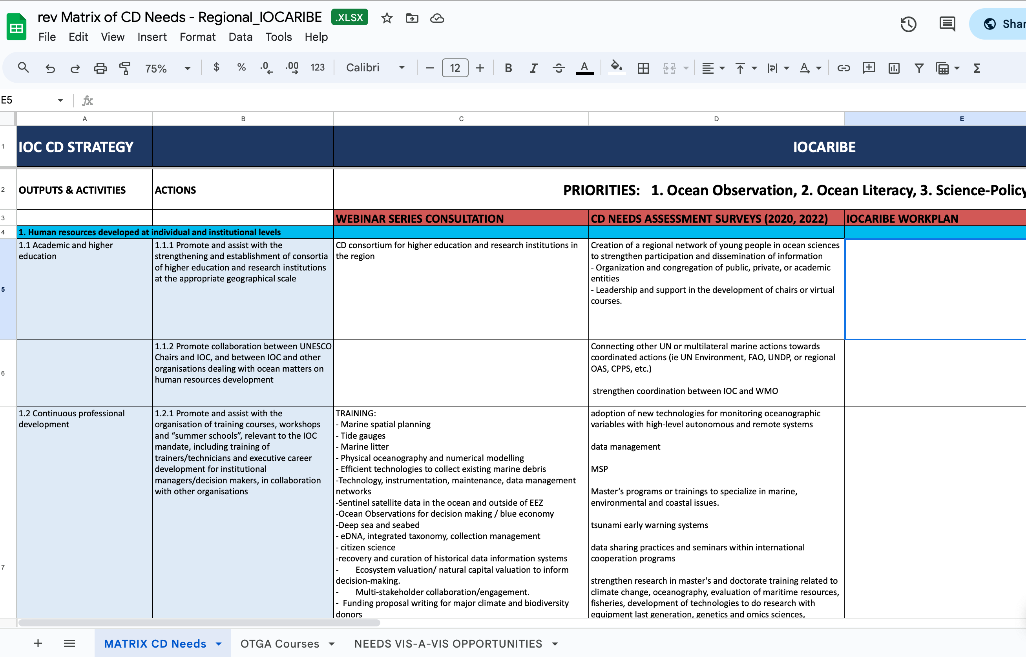
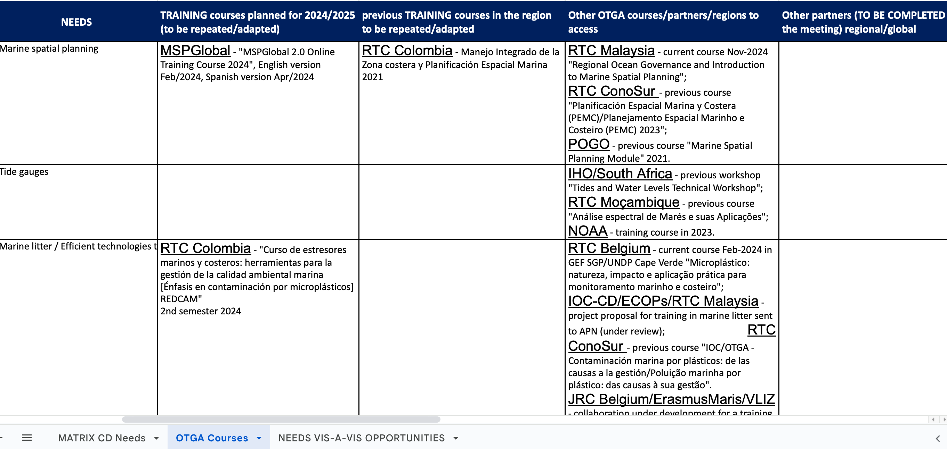
REGIONAL CD MATRIX VIS-À-VIS CD STRATEGY

Slide 5
Recommendations:
Joint development and implementation with the regions
Make arrangements to reach more respondents to contribute to the survey so as to generate statistically representative results
Involve stakeholder groups for a wider and diverse group of respondents
Separated sets for targeted stakeholders, with relevant question set more directly accessible, and less complicated to manage;
Promotion and outreach to targeted respondents identified through the regional secretariats
NEXT STEPS
design the structure and methodology of the 2024 survey in close collaboration with global and regional programmes to capture specific CD needs in the regions;
conduct the CD survey through the regional secretariats, especially in identifying and reaching out to key stakeholder groups as targeted respondents in their respective regions;
collaborate with other survey requirements of other programmes, e.g. GEBCO, CD Facility, Ocean Policies, GOSR, etc.

Slide 6
2024-2025 CD NEEDS ASSESSMENT SURVEY
PROPOSED TIMELINE
Draft the design and methodology and development of survey questionnaires | CD Secretariat/RSB Secretariats | March – April 2024
Identification of targeted key stakeholder respondents | RSB Secretariats | March – April 2024
Review and approve the survey | GE-CD | June 2024
Conduct of the survey | CD Secretariat (CL) and RSB Secretariats | June – July 2024
Analysis | CD Secretariat (overall); RSB Secretariats (regional) | August – September 2024
Report to the GE-CD | CD Secretariat | October 2024

