Slide 1
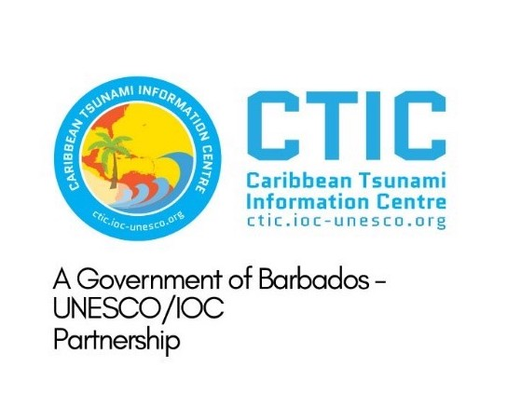
CaribeWave and tsunami events
Silvia Chacón-Barrantes
Chair WG4

Slide 2
Tsunami events
The Caribbean did not have tsunami events during 2023
Paper submited to Ocean and Coastal Research:
Characterizing Sea Level and Barometric Disturbances in the Caribbean and Adjacent Regions from the Hunga Tonga-Hunga Ha’apai 2022 Eruption

Slide 3
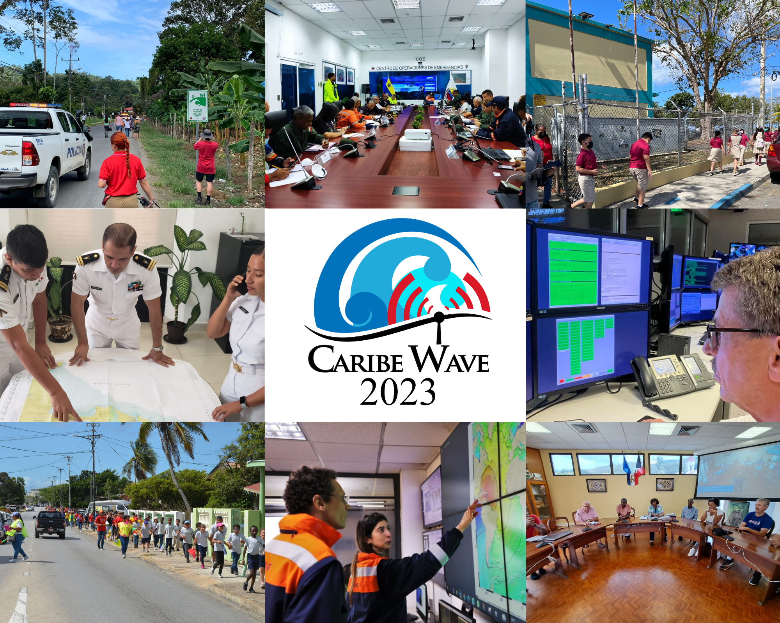
CARIBE WAVE 2023
Held on 23 March 2023.
Two scenarios (Gulf of Honduras and Mount Pelée)
MS/T decided if any additional activity would be carried out.
43 Member States and Territories participated
Total of over 430,000 people engaged.
The participation of MS represents a rate of 90% (down from 100% in 2022).
Several institutions indicated that it was problem that it was held the same day as World Meteorology Day
b
a
#CARIBEWAVE #TSUNAMIREADY

Slide 4
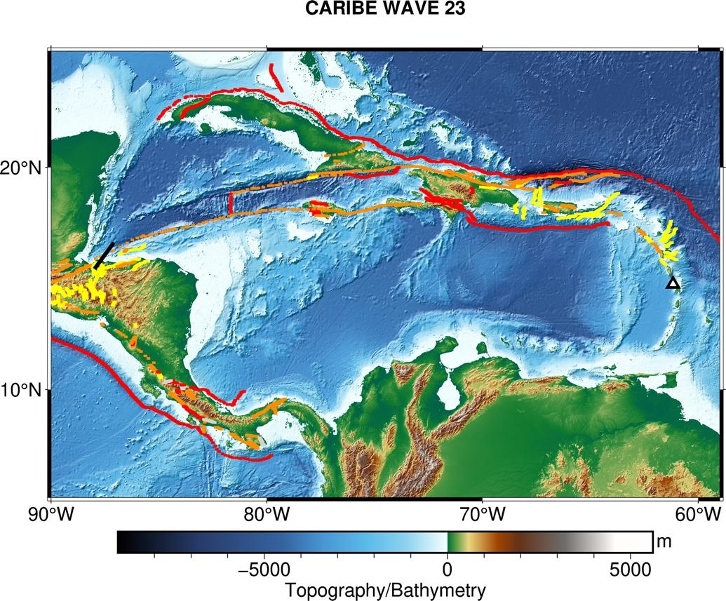
CARIBE WAVE 23 Earthquake and Tsunami Scenarios
Gulf of Honduras
Mount Pelée
Scenario | Origin Time | Mw | Epicenter
Gulf of Honduras | 14:00:00 UTC 23 March 2023 | 7.6 | 16.07⁰N, 87.54⁰W
Mount Pelée |  |  | 14.48⁰N, 61.10⁰W

Slide 5
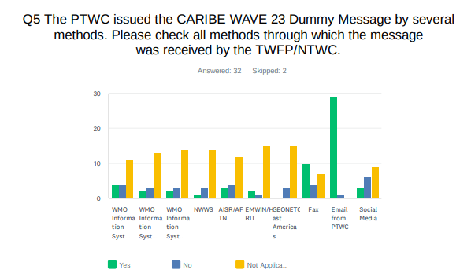
Evaluation Form – Dummy Message
As in past years, the most common methods to receive the Dummy message were the Email and Fax. WMO Information System (GTS) was also a method where several countries received the message.
Email from PTWC

Slide 6
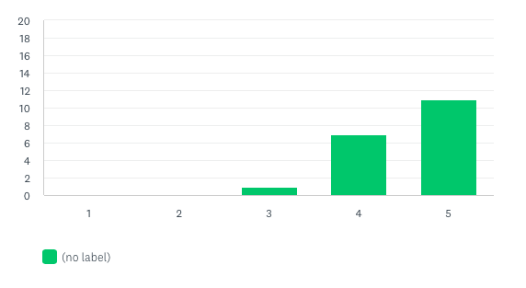
Evaluation Form – Rating of PTWC message

Slide 7
Evaluation Form – Type of Participation

Slide 8
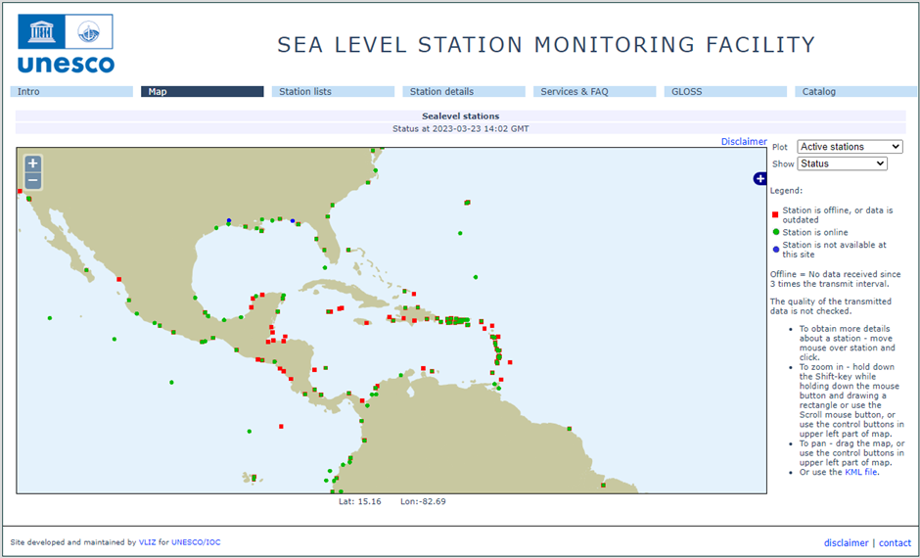
Status of Sea Level Stations during the exercise
Western Muertos Trough scenario
Northern Panama scenario
The PTWC provided simulated forecasted maximum wave heights for 65 CARIBE EWS stations in the simulated bulletins.
Only about 61% of these sea level stations were online on the IOC Sea Level facility during the exercise period.

Slide 9
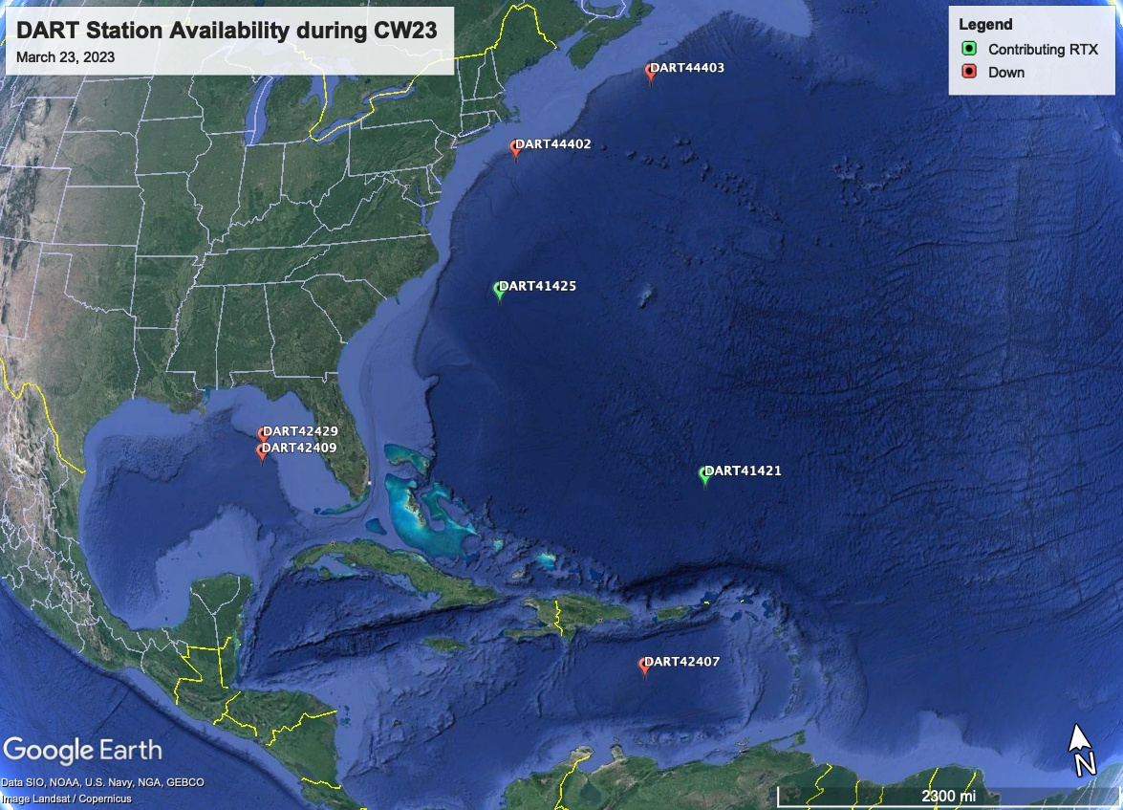
Status of DART’s
Only 2 of the 7 DART stations were streaming data in the Caribbean/Gulf and Atlantic thru the National Buoy Center during the day of the exercise.

Slide 10
Media Arrangements
The hashtag tracker Brand24 was used to monitor #CaribeWave and #CaribeWave23 from February 28 to March 30.

Slide 11
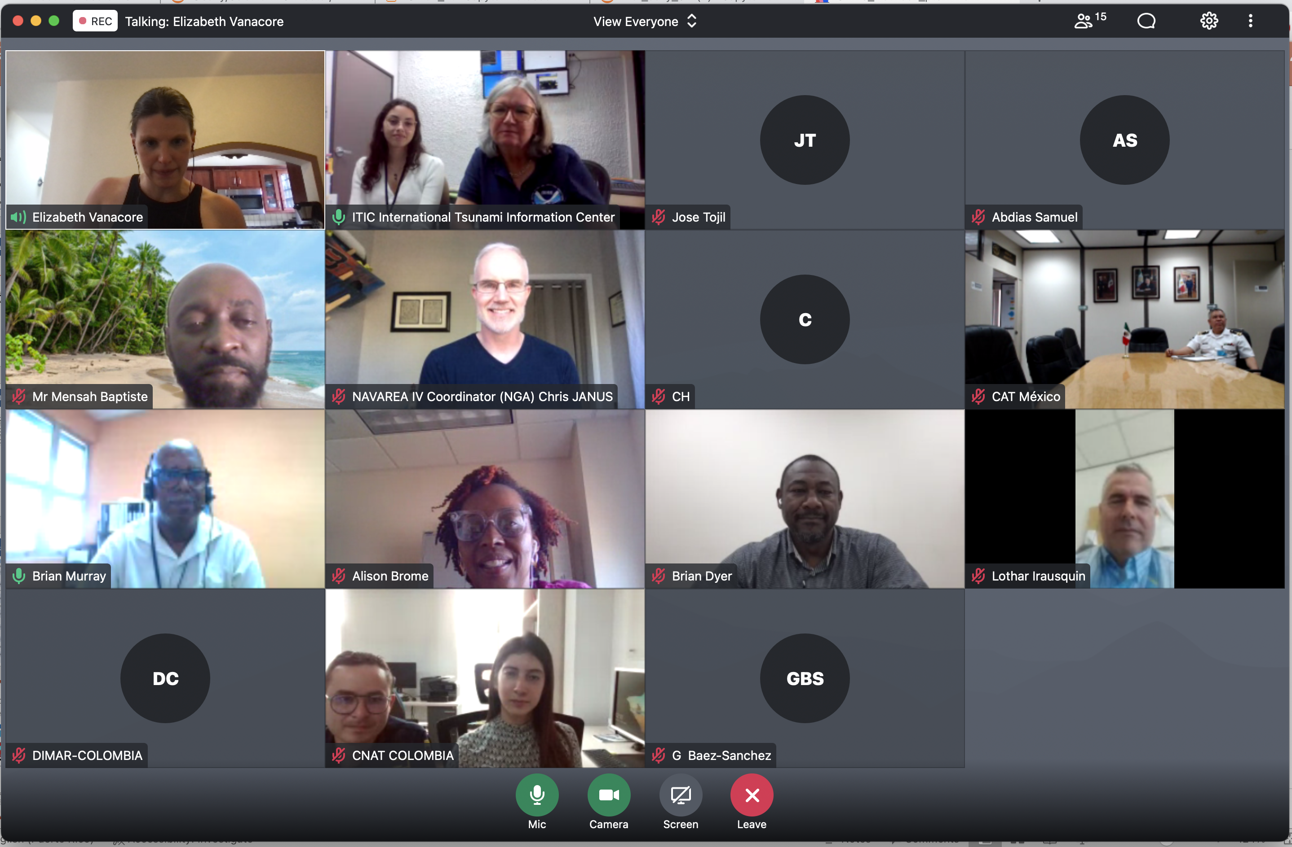
Hot-Wash
After the exercise, the CARIBE WAVE 23 Task Team organized a post-exercise “hot-wash” webinar to permit Member States and Territories discuss and provide feedback on the exercise in an open forum on April 4, 2023.
Some of the Member States feedback were on the successful execution of tsunami evacuations in schools and business. The exercise also helped Emergency Managers identify the need for redundant communication and to adjust their Standard Operating Procedures.
Future CARIBE WAVE exercise scenarios was discussed during the webinar, some countries suggested the use of other volcano generated tsunamis, as well as historical tsunamis such as the Jamaica 1692 Port Royal earthquake, and other earthquake scenarios from the Northwest Caribbean.

