Slide 1


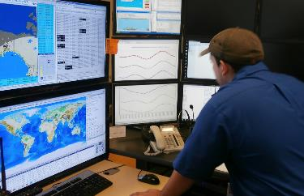

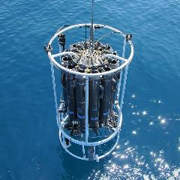
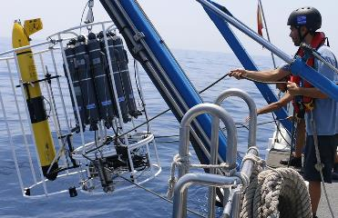
Ocean Best Practices System (OBPS) : Overview
SG-OBPS-V 12 December 2023
Rene Garello & George Petihakis
SG-OBPS Co-Chairs
www.oceanbestpractices.org

Slide 2



Ocean Best Practices System - Introduction
OBPS provides services to the ocean observation, research, data management, modeling and applications communities.
OBPS Mission: To develop and sustain an evolving system which fosters collaboration, consensus building, and innovation by providing coordinated and global access to best practices and standards across ocean sciences and applications
OBPS facilitates the evolution of methods into best practices
through convergence and endorsement.
With GOOS, OBPS supports the evolution, convergence, and endorsement of best practices for EOVs
OBPS is co-sponsored by GOOS and IODE as an IOC Project
The advanced OBPS was developed from a collaboration of IODE,
GOOS and EC and US projects with guidance from the 'community of
users'
Notes:
GOOS was a member of JCOMM which was a partner in Joint JCOMM-IODE Ocean Data Standards and Practices Project (2012) . Ocean Data Practices Repository was a deliverable of the ODSPP and the JCOMM Catalogue of Practices (163 records) was migrated (2014) to form the foundation collection which is now known from 2018 with a broader all-ocean related remit, as OBPS

Slide 3

Achievements so far...
Summary 2023
Image credit: GEO Blue Planet

Slide 4
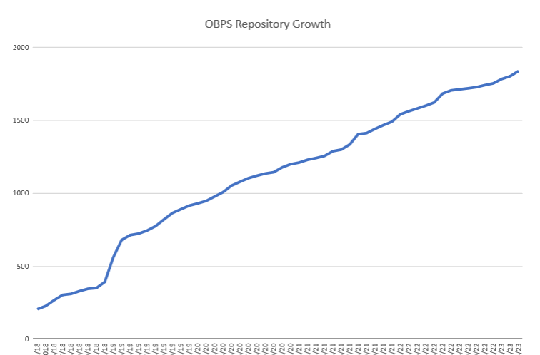
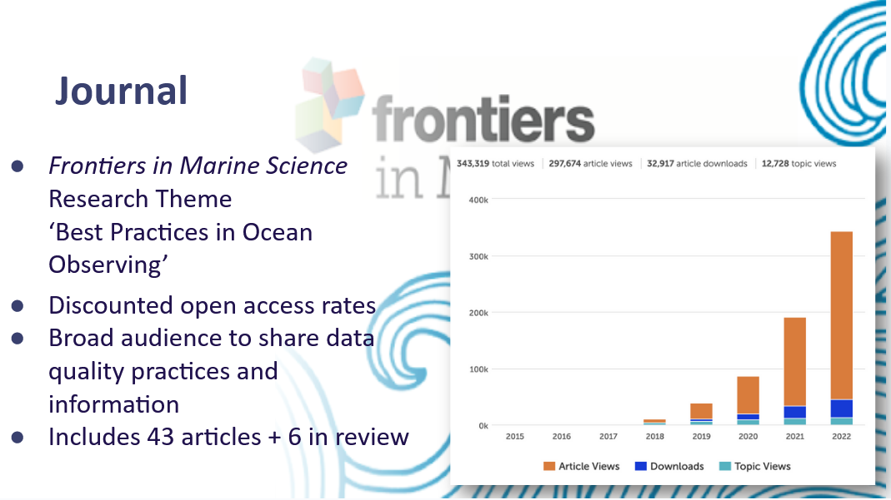
OBPS – a perspective repository, journal, capacity development, community engagement
Repository: Expanding number of records in the repository
and community collections: 2041 records/ 70 Communities
Journal: evolving number of articles and readershIp
(>340,000 article views)
Capacity Development: 4 x OBPS Training Modules; Training
Courses/Videos, Task Team on BP with limited infrastructure
Community Engagement: Global participation in annual OBPS
Workshops (>400 active participants in 2023)
Expanded SG Participation (continents include Africa, SA, Europe, Asia, Australia)

Slide 5
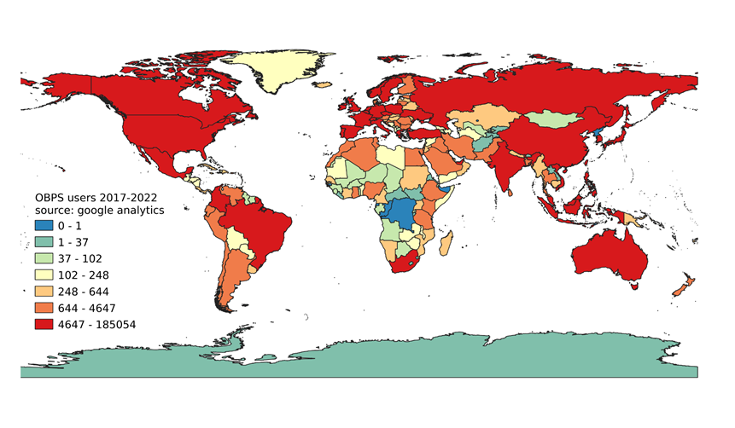
Impact of the OBPS
Best Practices creation and use is now an expected component of most project proposals
Active ocean best practice community
Global spread of users (25-32K accesses per month)
Training and workflow to find or develop an ocean best practice
Support of GOOS international endorsement

Slide 6
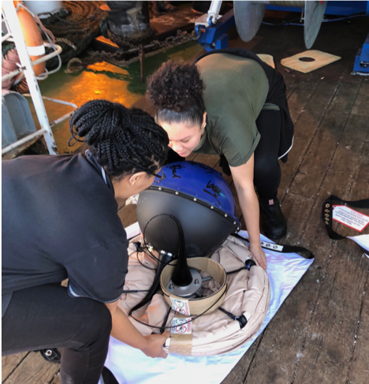
OBPS 2023
Leadership of Ocean Decade “OceanPractices”
Participation in international projects: EUROSEA; CAPARDUS; JERICO-S3; ILIAD (a Digital Twin of the Ocean project), BLUE CLOUD 26, Research Coordination Network
Creation of Stakeholder Community Forum
Introduction of an OBPS ECOP Ambassador programme
Acceptance of non-English BP documents
Synergy with Ocean Info Hub (IODE Programme)
Task Teams: Diversity, eDNA, BP adaptation for DC, Decision trees (tbc), KPIs

Slide 7
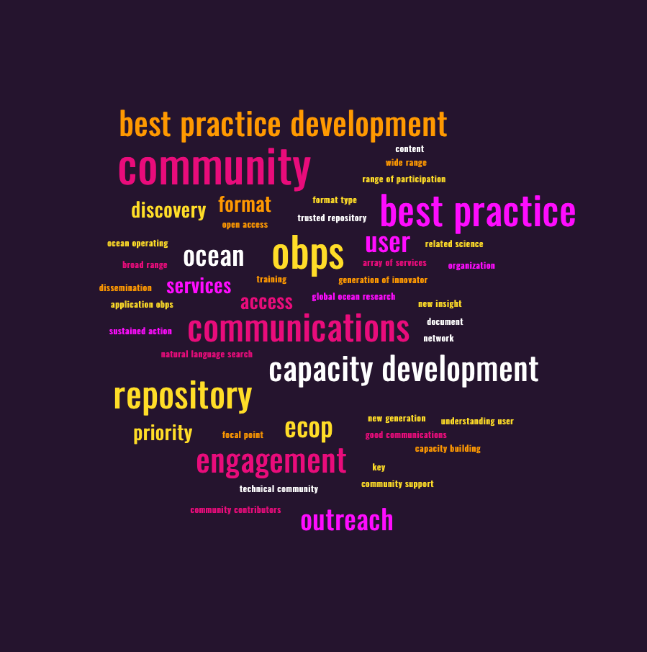
OBPS 2023-and beyond – continuing our core work
OceanPractices broadly supports Ocean Decade
Expanding work with developing nations, remote regions and Indigenous Peoples: Africa, Arctic, South Pacific, …
New ADAPT Project started in the Caribbean supported by NORAD funding through IOC
Broader inclusion of ECOP, in OBPS leadership roles and as ambassadors for BP
Global level for access to best practices in multiple languages (Ocean Decade project)
Reflections on Best practices & Standards
Federated Network of methodological management systems pilot to be inplace 2024

Slide 8

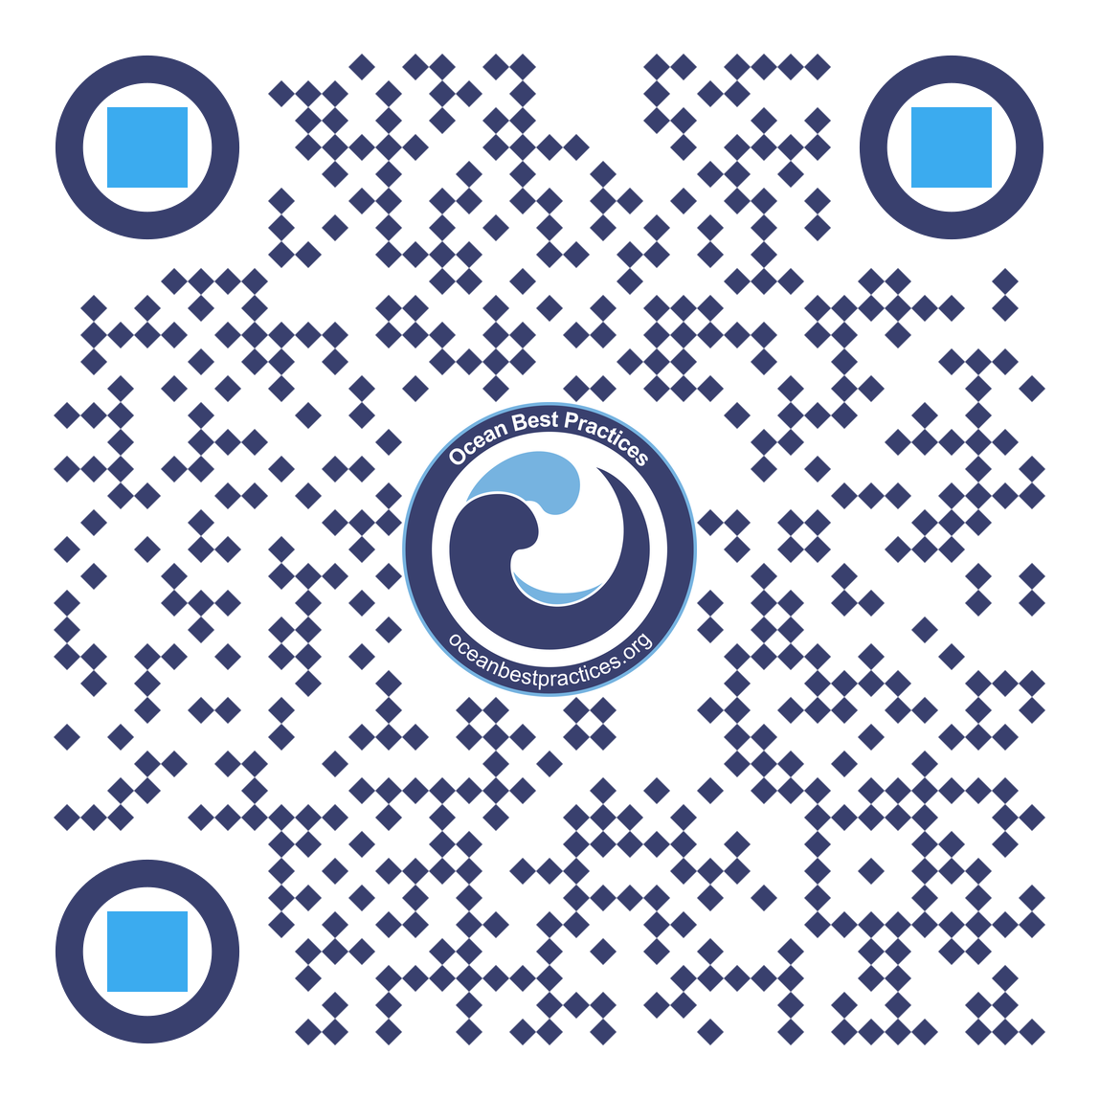
Thank you
oceanbestpractices.org
Photo credit: Tommy Bornmnan

