Slide 1

IUGG
Joint Tsunami Commission
Update
TOWS WG 2-3 Mar 2023, Agenda 2
TT TWO - TT DMP JOINT, 28 Feb 2023, Agenda J8
Maria Ana Baptista, Portugal
Laura Kong, ITIC

Slide 2
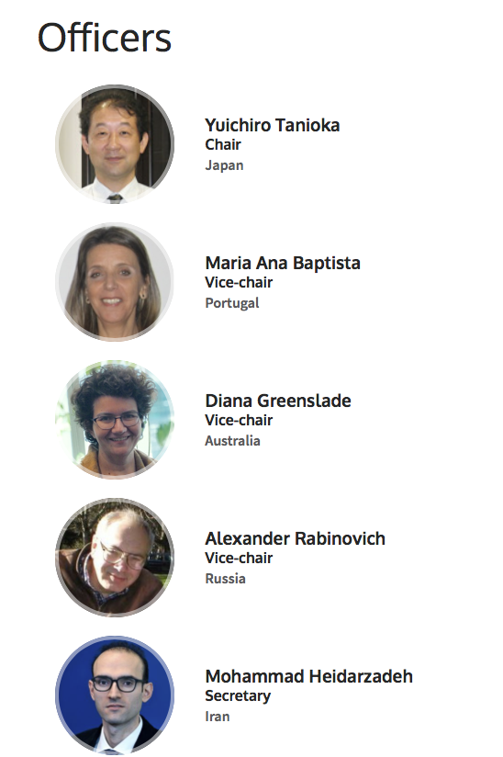
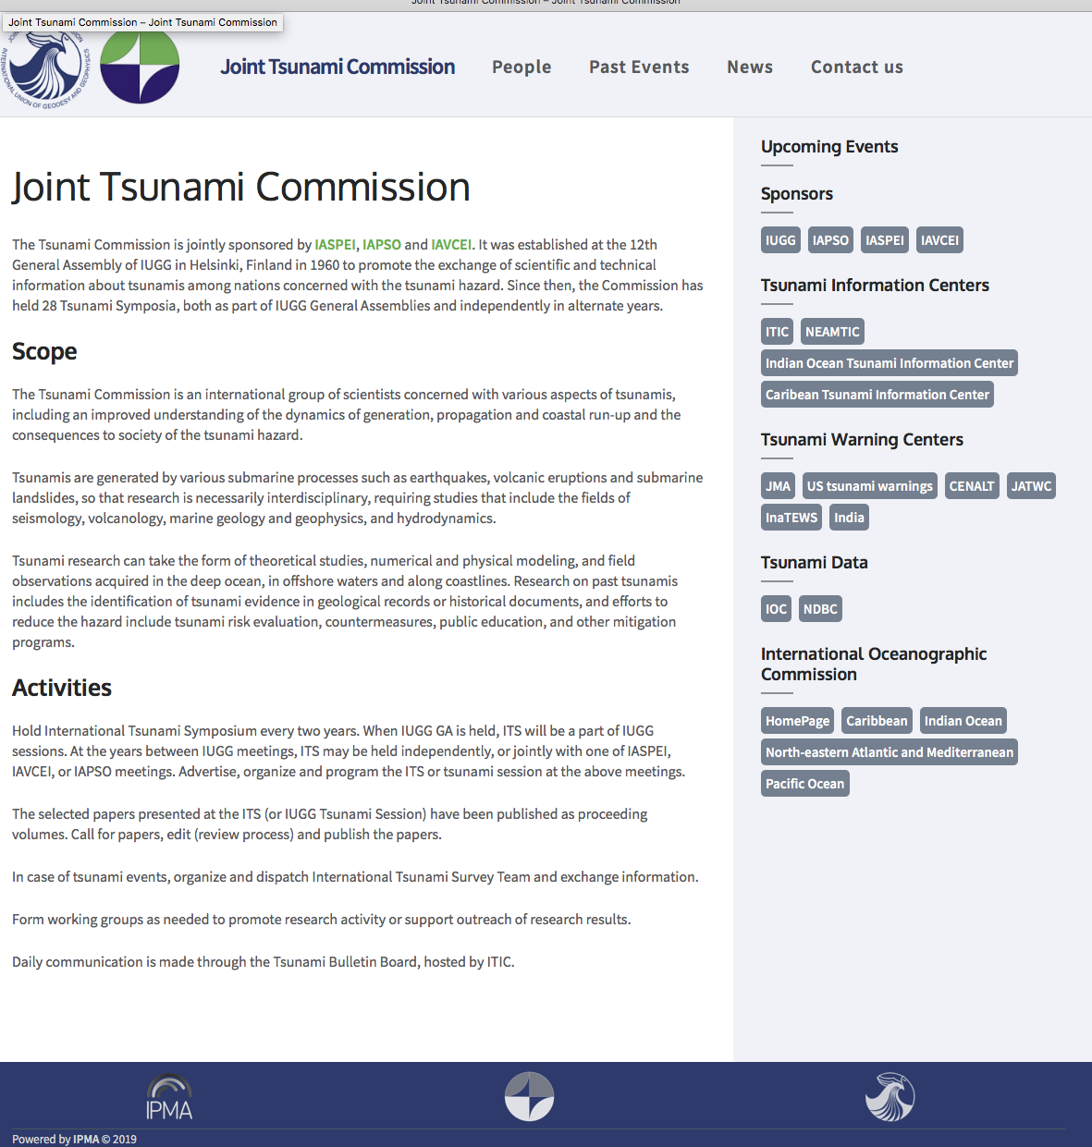
IUGG Joint Tsunami Commission
https://tsunamicommission.ipma.pt/home/
Elected 2019
Est 12th General Assembly of IUGG, 1960
Joint sponsored IASPEO, IAPSO, IAVCEI
Promote the exchange of scientific and technical information about tsunamis among nations concerned with the tsunami hazard
Last Business Meeting: 2 July 2022
Working Groups
  Tsunami Terminology – William Power, NZ
  Science-based Tsunami Warning - Laura Kong, USA
  Tsunami Magnitude - Vasily Titov, USA
  GNSS Data for Tsunami Warning - Tony Song, USA
  Meteotsunami - Ivica Vilibic, Croatia
  Tsunami Data – Slava Gusiakov, Russia

Slide 3
Meetings and Publications – 2022-2023
Meetings (part of JTC members convene)
July 2023, IUGG, JP05 Tsunamis (IAPSO, IASPEI, IAVCEI, IAMAS, IAG)
April 2023, EGU, Tsunamis from source processes to coastal hazard and warning
Dec 2022, AGU, Interdisciplinary Tsunami Science
May 2022, 2nd World Conference on Meteotsunamis
Proposed
    Sep 2023: IUGG JTC - PTWS Tsunami Symposium (ICG/PTWS-XXX, Tonga)
    Dec 2024: IUGG JTC - IOC 2nd International Tsunami Symposium
Publications
Sulawesi/Palu-2018 and Anak/Krakatau-2018 Tsunamis, Topical collection in Pure and Applied Geophysics, 19 papers
Tonga Volcanic Explosion 2022, Topical collection in Pure and Applied Geophysics, 6 papers (ongoing)

Slide 4
IOC Support
IOC Tsunami Glossary 2019 update – JTC Tsunami Terminology WG
Tsunami Generated by Volcanoes Report (TOWS ad hoc TT) – JTC Science-based Tsunami Warning WG
Meteotsunami Report (TOWS TT) – JTC Meteotsunami WG

