Slide 1
4.1 ANNUAL PROGRESS REPORT
WORKING GROUP 1
Monitoring and Detection Systems
Daniel McNAMARA – Chair,
Wilfried STRAUCH vice-chair (seismic network)
Laura GONZALES – vice-chair (sea-level network)
Gloria ROMERO – vice-chair (GNSS network)
16th Session of the IOC Intergovernmental Coordination Group (ICG) for Tsunami and Other Coastal Hazards Warning System for Caribbean (ICG/CARIBE EWS-XVII)
April 2023

Slide 2
          Charge to WG1:
          Monitoring and Detection Systems
          1. Advise member states on the monitoring and detection capabilities needed for operating national tsunami warning centers.
          2. Define the threshold criteria for the monitoring and warning systems.
          3. Assure the compliance with the agreed standards for the detection systems.
          4. Ensure the effectiveness of the warning system by promoting the open exchange of seismic, sea level and other observational data in real time.
          5. Promote the sharing of experience and expertise and capacity building essential to the effective monitoring and issuance of warnings.
          6. Support the establishment of a fully interoperable regional tsunami warning system.

Slide 3
Summary of 2021-2022 activities
        Update WG1 membership fact sheet
        Monthly Network Status Reports
          Seismic
            Sea-level
              GNSS
        Status of 2021-2022 Recommendations
        Summary of New Recommendations

Slide 4
        Update WG1 membership fact sheet
      Updated emails and membership contact information
      Removed inactive (retired) members
      Transitions in invited experts and members
        Added Annie Zaino, EarthScope Consortium NOTA - GNSS expert
        Removed Emily Wolin, USGS GSN, - seismic expert (left USGS)
        Removed Rick Benson IRIS
Recommendation
      Identify new USGS GSN and ANSS Seismic representatives

Slide 5
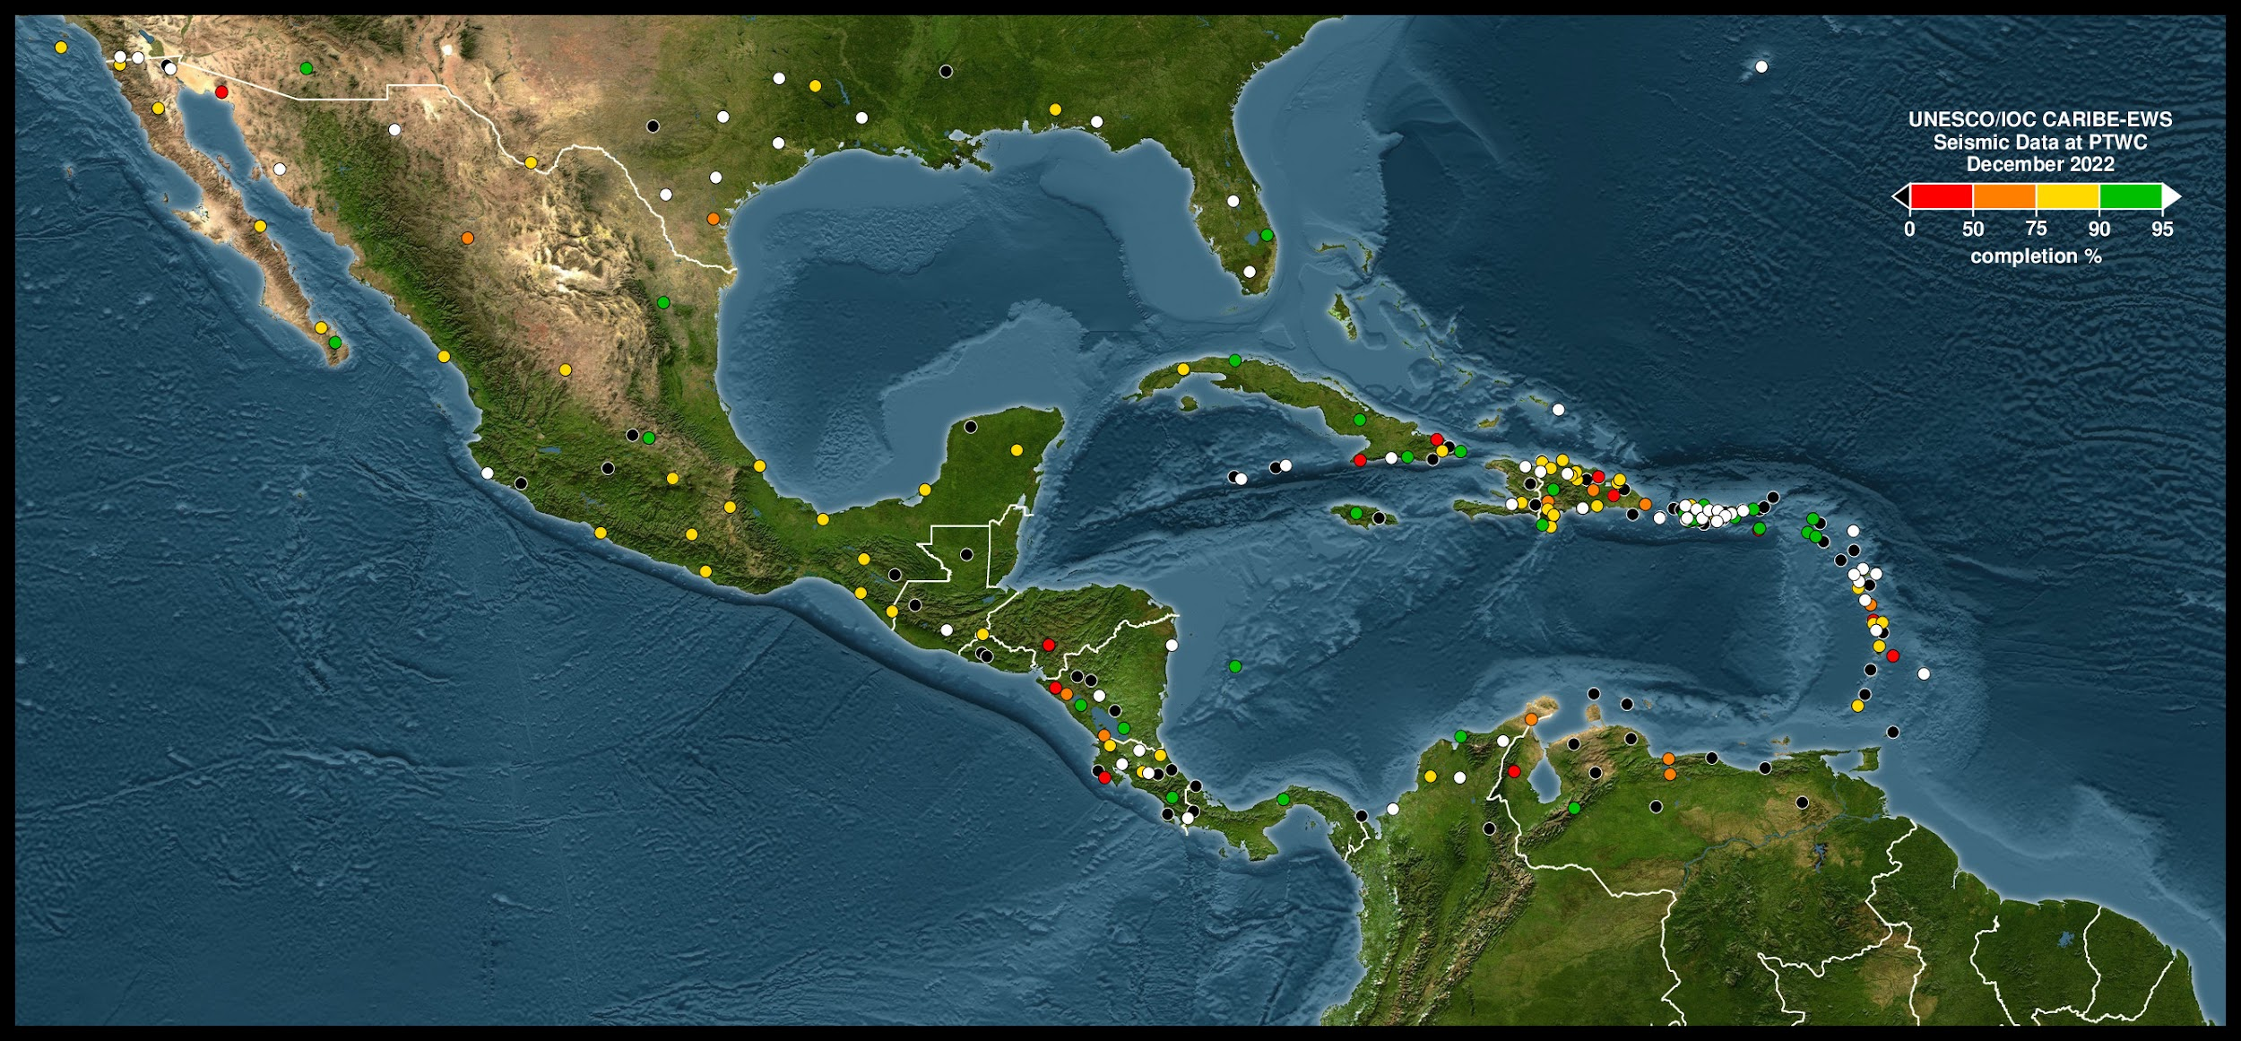
Seismic network status
December 2022
PTWC monthly maps of seismic station data availability.
      used for WG1 monthly email communications with network operators.

Slide 6

Seismic network status
New real-time seismic stations in the region
      PRSN/ANSS, CW Colombia, USVI
May 2022
Caption
Major seismic station outages have continued in 2022
      Many stations with status down is 2022
        PRSN
        location code issues resolved
        CU.GTBY back online
        AY.CAPH,AY.HINH,CM.CAP2
        connectivity issues resolved
      Significant outages of data from
          Honduras, Nicaragua, Costa Rica, Panama
      Continued gaps in Haiti, Venezuela, Trinidad
December 2022

Slide 7
Progress on 2021-2022 Seismic Recommendations
Explore the availability of new seismic stations at IRIS/EarthScope DS
Ongoing effort. Short list of regional stations in progress
Explore availability of Raspberry Shakes at IRIS/EarthScope
      Explore possibility at PTWC and NTWC
      Informal quote ($1/channel/month)
                Not supported by some regional operators
Explore the use of sea-floor cable instrumentation
    SME Dr. Matt Fouch invited to discuss SMART repeater technology
WG1 conduct a survey to determine consistency of station list and meta-data across
TWCs, PRSN, Earthscope DS and USGS NEIC
  ongoing effort to identify inconsistencies between Earthscope, PRSN and PTWC
  Intend to include USGS NEIC as available

Slide 8
Summary of new Recommendations
Seismic
Noting the significant outages of seismic networks in the Caribbean, WG1 recommends a study to quantify the impact of tsunami detection parameters and messaging performance;
Noting that while the PTWC reports significant seismic station outages throughout the Caribbean, WG1 recommends that the ITIC-CAR conduct a survey, with WG1, of alternate real-time stations available in the region. Sources to search include the Earthscope DS, Panama Canal authority, Raspberry shake server and other regional network with realtime data that is currently not streaming to the PTWC;
Noting the difficulty maintaining realtime data connections to the PTWC, recommends that, with permission from regional seismic network operators, CATAC act as a regional realtime seismic data aggregator/hub for central America and Earthscope DS act as a backup in order to assure the reliability;
Noting that tsunami warning time is strongly dependent seismic station distribution, WG21 recommends exploring the possibility of densifying seismic network instrumentation with new sea-floor cable technologies (SMART);
Noting the seismic station outages in the region, WG1 recommends a complete review and update of seismic meta-data and IP addresses at PTWC and NTWC for problem stations;
Encourages member state Canada to support capacity building by installing and repairing seismic instrumentation in Haiti with new federal funding opportunities;

Slide 9
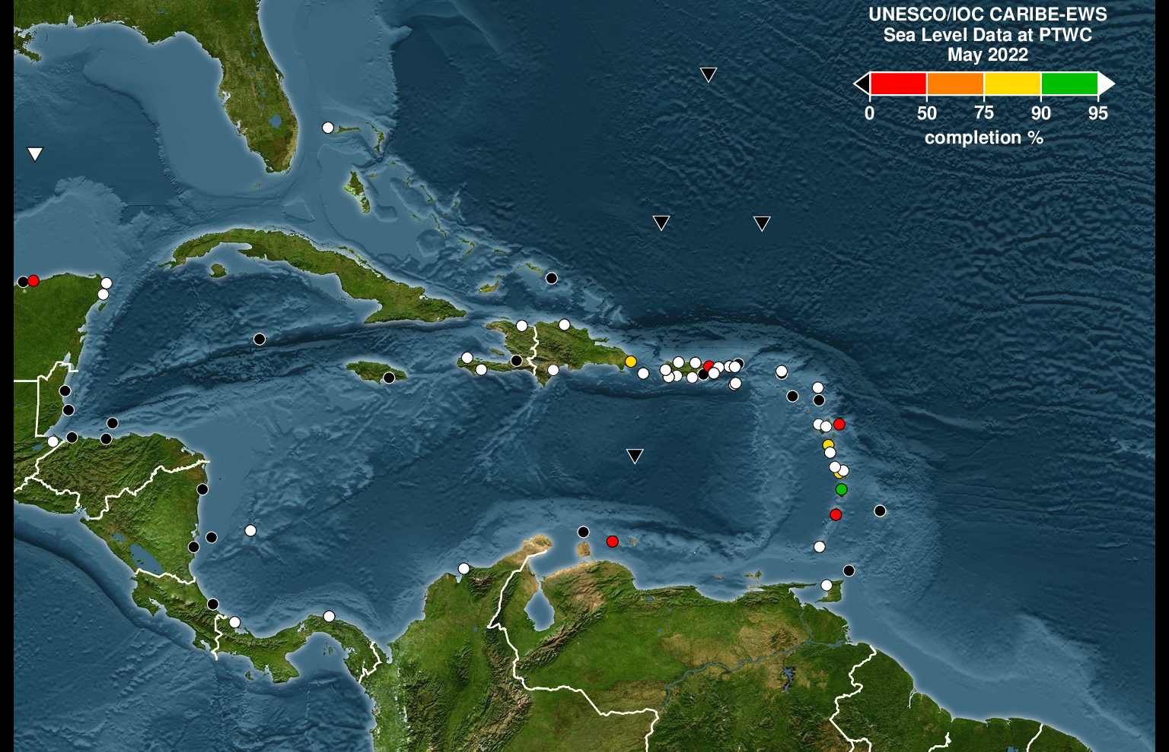

Sea level network status
May 2022
March 2023
Caption
PTWC monthly maps of sea-level station data availability.
      used for WG1 monthly email discussions with station operators.

Slide 10
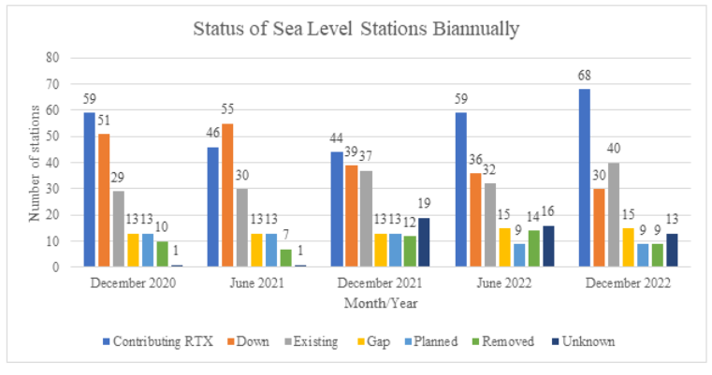
Sea-level network status
The number of stations has increased in 2022,
      however the overall number is down from pre-COVID era and
                not all new stations are currently operational in SLMF and Tide Tool
New stations installed in 2022
  Chateau Belair (St. Vincent), Cayman,
  Colombia, Puerto Rico
Two NOAA DARTs back online
Sea-level station outages have increased significantly over the past few years.
    Two NOAA Darts in the region are down
    Caribbean coast in Central America
    Haiti, Jamaica, St Martin and Barbados
NOC produced a maintenance manual for tide gauge operators

Slide 11
Progress on 2021-2022 Sea-level Recommendations
Recommend use of new NOC maintenance manual in Caribbean to improve uptime
WG1 will send trough the IOC secretariat the NOC Maintenance manual to Member States
Integrate the technical solutions in the training for sea level operators to be held on may 2023 (tentative).
WG1 Will compile the main issues and requirements that sea level operators have to integrate sea level stations into operational systems in order to consider the topics in the sea level training.
Survey of sea-level network operator status updates by WG1 and ITIC with the goal of improving the uptime of sea-level network, and strongly encourages the Member States that have non-operational stations to inform the Secretariat of their plans or needs for repair.
The survey was designed by WG1 and ITIC-CAR. It Will be sent to Member States by IOC secretariat in the coming weeks

Slide 12
Summary of New Recommendations
Sea-level
Appreciates the rapid deployment of sea-level monitoring instrumentation in response to the tsunami hazard posed by the eruptive activity and potential pyroclastic flows of La Soufrière Volcano on Saint Vincent and Mt Pelee on Martinique;
Notes that a high percentage of the stations in the CARIBE-EWS sea level network are currently non-operational and therefore can delay the proper assessment of tsunami events and the issuance of timely and accurate tsunami alerts;
Urge Member States and operators of sea level stations contributing to CARIBE EWS to maintain their sea-level stations in an operational status and regularly review and update the status of its stations in the IOC Sea Level Monitoring Facility and the ITIC-CAR reports prepared on behalf of the CARIBE EWS;
Recommends a survey of sea-level network operator status updates by WG1 and ITIC-CAR with the goal of improving the uptime of sea-level network, and strongly encourages the Member States that have non-operational stations to inform the Secretariat of their plans or needs for repair;
Encourages NOAA to rapidly repair two Darts that stopped transmitting data in 2022;
Recommends integration new stations into TWC operational systems;
Recommends use of new NOC maintenance manual in Caribbean to improve uptime;
Recommends Integration of technical solutions in the training for sea level operators to be held on May 2023.

Slide 13
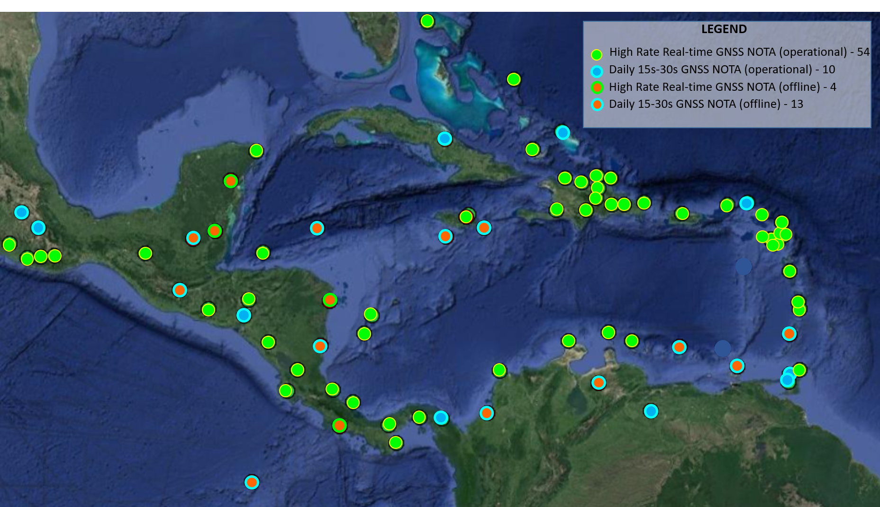
GNSS network status - Network of the Americas

Slide 14
GNSS network status
NETWORK OF THE AMERICAS (NOTA)
Significant fieldwork push starting March 2022 through April 2023 –network uptime increased from 45% to 80%. Upgrades of communications infrastructure to support real-time 1Hz streaming.
Result of
well funded network,
strong partnerships with local agencies and collaborators,
20+ international visits by UNAVCO/EarthScope engineers
Ongoing challenges
Geopolitical and safety restrictions on site visits by EarthScope engineers in some locations
Aging infrastructure and environmental conditions increases likelihood of failure (hurricanes, corrosion, flora/fauna)

Slide 15
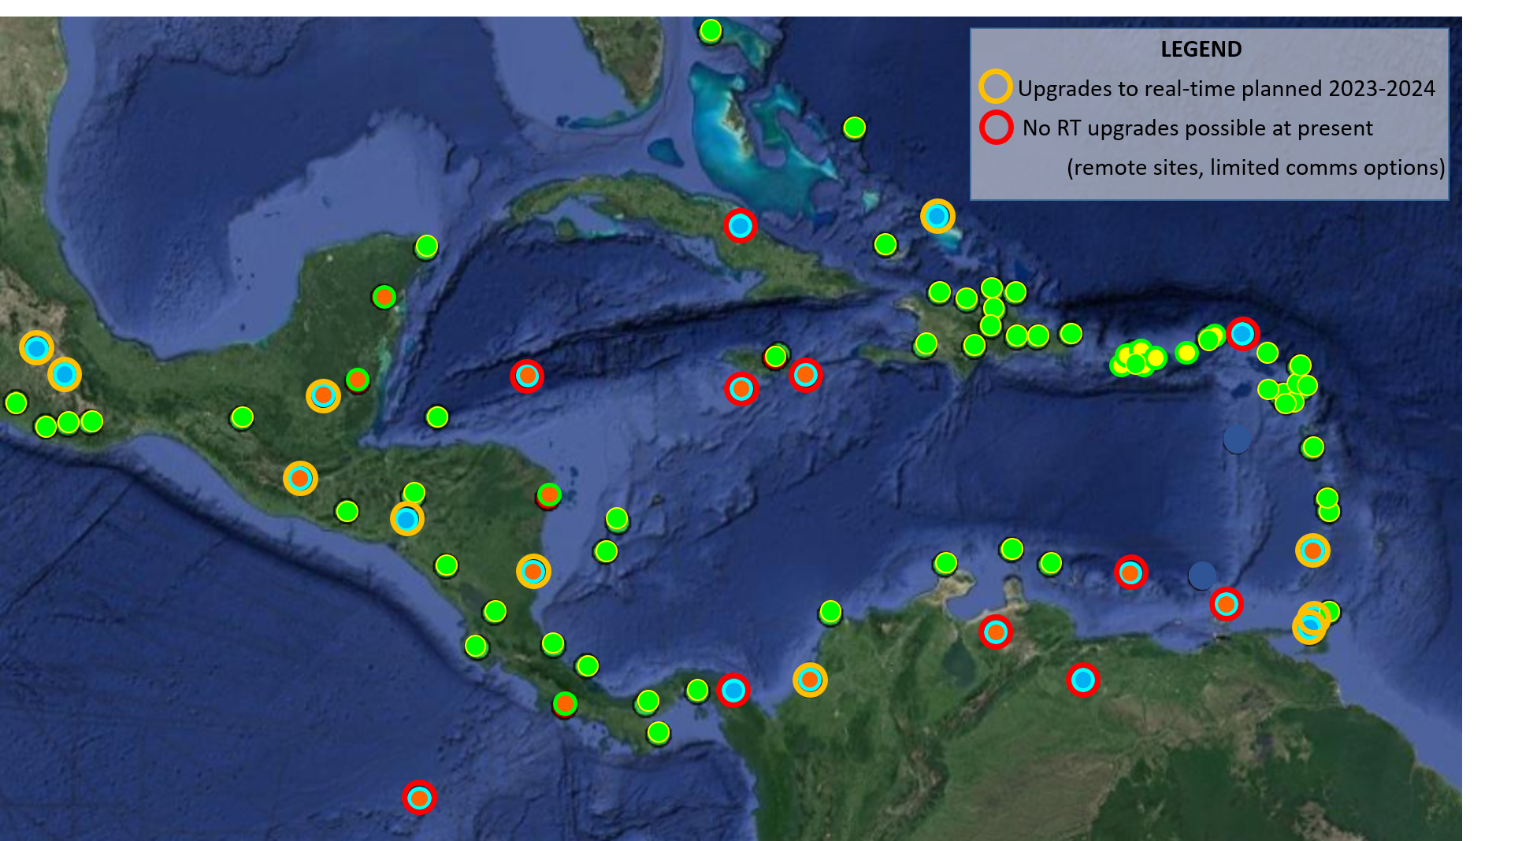
NOTA GNSS future work

Slide 16
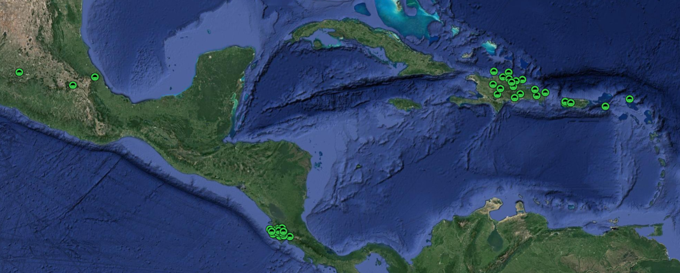
Progress on 2021-2022 GNSS Recommendations
    Support PRSN GNSS network operators workshop
      Invited Tim Dittman to discuss GNSS-R for tsunami detection
      Propose routing some or all of future contributing RT GNSS data streams through EarthScope RT system for streamlining and ease of integration into NOAA processing
      Existing EarthScope archive and/or RT contributors include PRSN, PI collaborations with agencies
      such as OVSICORI, and commercial/academic survey groups.
Non-NOTA geodetic stations currently contributing daily files and/or RT data to EarthScope Archive

Slide 17
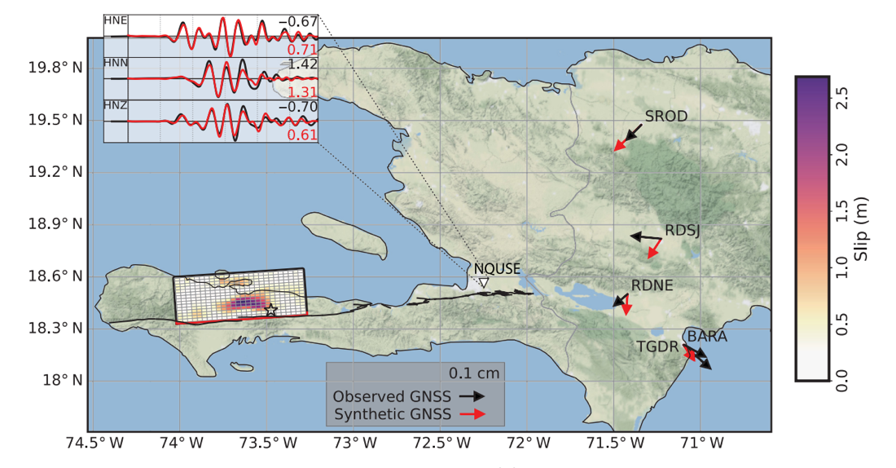
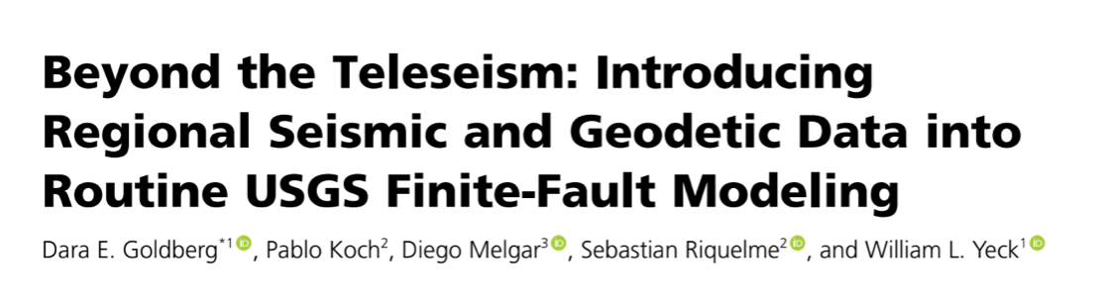
Summary of new Recommendations
GNSS
Recognizes the efforts of UNACVO/Earthscope to repair damaged stations and upgrade communications systems increase the availability of high rate (1 Hz), real-time GNSS data to improve earthquake and tsunamis detection and assessment, and further recommends adding and upgrading the GNSS stations needed to achieve earthquake detection requirements with sufficient redundancy;
Due to the saturation of seismic instrument for large magnitude earthquakes at near-source distances, WG1 recommends that the PTWC explore, develop and implement integrated seismic and GNSS systems for rapid earthquake source parameter estimation;
Recommends the the continuation of GNSS integration into real-time earthquake monitoring systems with periodic updates from NOAA on the progress of the system.
          Example: USGS is integrating both real-time GNSS and seismic into earthquake monitoring products
                ShakeAlert EEW
                finite fault models
                W-phase moment tensors

Slide 18
Comments and Questions?
Daniel McNAMARA – WG1 Chair
Wilfried STRAUCH vice-chair (seismic network)
Laura GONZALES – vice-chair (sea-level network)
Gloria ROMERO – vice-chair (GNSS network)

