Slide 1
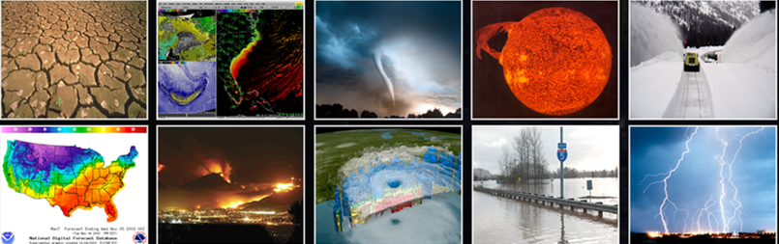
US National Report Summary
April 25 2023
National Weather Service

Slide 2
US Delegation (Costa Rica)
NOAA HQ: Mike Angove (Head of Del); Susan West (International Activities)
PTWC: Chip Mccreery ITIC-CAR: Christa von Hillebrandt
NCTR: Chris Moore
NCEI: Nic Arcos
NEIC (USGS): Paul Earle
VITEMA: Regina Brown
NASA: Tim Melbourne
Earthscope: Dan McNamara, Annie Zaino
PRSN: Glorymar Gomez

Slide 3
Focus Areas
Tsunami detection and measurement.
DART 4G,
GNSS/GFAST,
SMART Repeater,
regional wphase, Volcano, landslide and meteotsunami procedures
U.S. Tsunami Warning Center (TWC) Alignment.
TWC alignment: Full Service Back-up
Common analytic baseline/Observations
Hazard Simplification
Evaluating renaming “Advisory Category”. Social Science Study initiated
US TsunamiReady® Program
Through NTHMP, NOAA maintains 49 communities recognized by the US National Weather Service in Puerto Rico and the US Virgin Islands, including the strengthening of local and territorial capabilities

Slide 4
Focus Areas
UN Decade of Ocean Science
NOAA actively engaged in the UN Decade of Ocean Science for Sustainable Development under the IOC’s Ocean Decade Tsunami Programme (ODTP)--Two Contributions on (1) Instrumentation/Detection and (2) Global Preparedness
NOAA advocates for the development and implementation of SMART Cables, GNSS, and other emerging technologies that support direct detection and measurement
NOAA will continue to advocate and support (as funding permits) the implementation and maintenance of UNESCO/IOC Tsunami Ready Recognition Programme, including the Chairing of UNESCO/IOC Tsunami Ready Coalition by Dr. Laura Kong, Director of ITIC.
ITIC-CAR will continue to engage in the coordination of the UN Decade of Ocean Science for Sustainable Development in the Western Atlantic (WTA), including participation in the WTA Working Group for Safe Ocean and the endorsed Decade Project, Integrating Coastal Hazards Early Warning Systems (iCHEWS).

Slide 5
Other Tsunami Mitigation Activities and Best Practices
ITIC CAR has supported the coordination of the annual CARIBE WAVE exercise. Puerto Rico and USVI participated actively in both the 2022 and 2023 exercises. in 2023, 129,844 registered in Puerto Rico and 17,904 in the USVI.
ITIC CAR is supporting with funds from USAID the implementation of the UNESCO/IOC Tsunami Ready Programmed
ITIC CAR supported the finalization of UNESCO/IOC as Manual and Guide 86 “The Multi-Annual Community Tsunami Exercise Programme: Guidelines for the Tsunami and other Coastal Hazards Warning System for the Caribbean and Adjacent Regions.
NCEI and ITIC updated its Global Historical Tsunami, Significant Earthquake, and Significant Volcanic Eruption posters to 2022. The posters are distributed to warning and response personnel by the ITIC and are available digitally through both NCEI and the ITIC.
PMEL, ITIC, and PTWC continued the development of new features in the TsuCAT software and made it available to some of the training participants. TsuCAT v4.3 supports tsunami hazard assessment and tsunami exercises using the PTWC Products; the newest feature adds the option to automatically produce customized exercise injects. We will be giving an overview on Friday.
ITIC website updated compiled US and international resources on Vertical Evacuation, Maritime Guidance, Tsunami Events.
ITIC is developing online and blended training as an IOC Ocean Teacher Global Academy Specialized Training Center for Tsunamis. Courses available in 2023-2024 will be Tsunami Awareness, Tsunami Ready, and Tsunami Early Warning Systems.

Slide 6
Additional Questions

