Slide 1
Working Group 2 Hazard Assessment Progress Report
Prepared by
Nicolas Arcos (Chair) and Raphaël Paris (Vice-Chair)
Sixteenth session of the IOC Intergovernmental Coordination Group for the Tsunami and Other Coastal Hazards Warning System for the Caribbean and Adjacent Regions

Slide 2
WG2 Purpose & Functions
Purpose:
The Working Group 2 (WG2) on Tsunami Hazard Assessment primary objective is to advise the ICG on the identification and characterization of coastal hazards, their assessment and the required modeling.
Functions:
1. Review and evaluate the required methods and data sets, including bathymetry and coastal topography for determining the coastal hazards.
Advise the member states on the requirements for operating the appropriate models.
Develop capacity building for the appropriate modelling.

Slide 3
WG2 Meetings and membership
WG2 Virtual Meeting held
07 December 2021
31 August 2022
WG2 Members
31 members (five are Invited Experts)

Slide 4
Non-seismic sources
ICG/CARIBE-EWS XV “Recommends exploring ways to provide access to and/or compile non-seismic sources in CATSAM or another format”
Decisions made by WG2 on process for selecting scenarios:
The initial focus is to be on publications/reports that include numerical simulations. However, identifying sources that need to be simulated would benefit a future gap analysis.
  Public reports sponsored by national agencies should be considered equal to peer-reviewed publications as they undergo significant expert review.
  Other scenarios - unpublished work, master report, etc. can be considered after acceptance by the WG2.
  It is the work of the WG2 to propose scenarios that were discussed during expert meetings, but not to run the simulations.
  Both local and regional scenarios should be considered.
  Need to identify individuals with expertise outside of WG2. Perhaps making a recommendation at the next ICG for other WGs and Member States to provide experts willing to contribute time/resources.

Slide 5
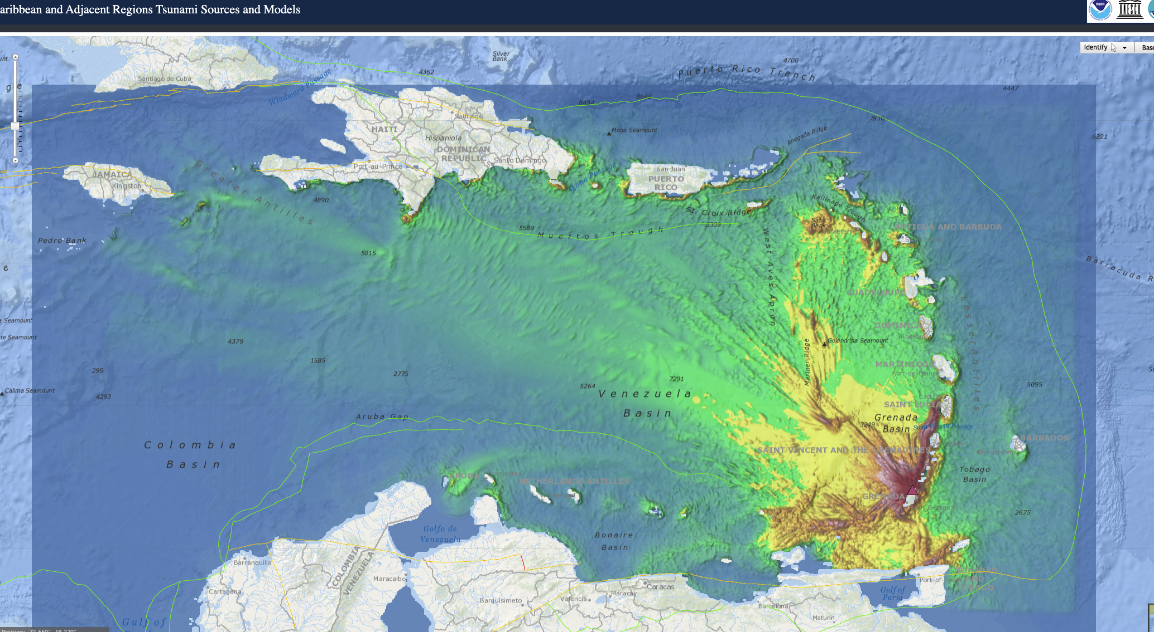
Non-seismic sources
Actions taken:
A published scenario was added to CATSAM (Kick'em Jenny landslide from Harbitz et al., 2012).
WG2 began compiling a (1) list of non-seismic sources already available in the literature (and including numerical simulations), (2) and a list of non-seismic sources discussed during an expert meeting in Martinique (2019, IOC-WR-291), but not yet simulated.
  To date: identified 35 modeled scenarios for possible use; and 15 scenarios for future modeling
Notes:
ICG/CARIBE-EWS XV “Recommends exploring ways to provide access to and/or compile non-seismic sources in CATSAM or another format”
TT TWO decided to create a new ad hoc team on "Tsunamis sources related to volcanoes", leaded by François Schindelé (CEA, France).

Slide 6
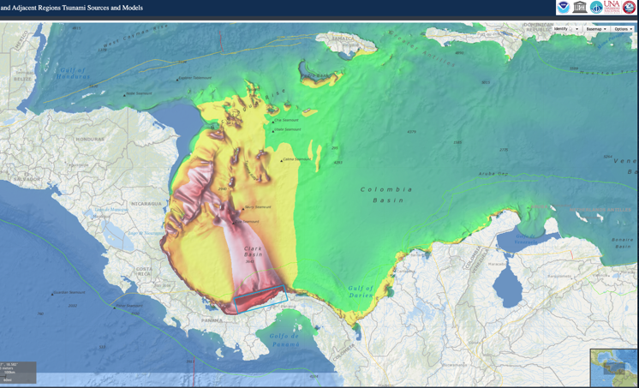
CATSAM (Caribbean and Adjacent Regions Tsunami Sources and Models) webmap - updates
The scenarios (~35) and their associated fault planes and sources from the Lesser Antilles Experts Meeting have been added.
  Thanks to Jorge Macías, Alberto López and all meeting participants for the significant contributions to this effort.
A landslide of Kick'em Jenny volcano scenario, as presented in Harbitz et al. (2012), has been added.
  Thanks to GTM-NGI (Global Tsunami Model - Norwegian Geotechnical Institute) and Dr. Harbitz for making this available
Caribe Wave 22 scenario was added: North Panama Deformed Belt.
Western Muertos Trough scenario updated.
Notes:
Next steps add Caribe Wave22 scenarios

Slide 7
CATSAM updates
Challenges in displaying IOC tide gauge stations, previously retrieved from a server-side "proxy" running at NCEI/WDS. Now a “Cron Job” (i.e., scheduled commands or tasks) has been setup that grabs the station list from IOC server and writes it to a file locally at NCEI/WDS.
Tsunami Ready layer removed at the request of ITIC as a Tsunami Ready interactive map is under development, as well as data not being up to date.
Bug fixes.
New URL for CATSAM: https://www.ncei.noaa.gov/maps/CATSAM/
Notes:
Challenges in displaying IOC tide gauge stations, previously retrieved from a server-side "proxy" running at NCEI/WDS. This approach required frequent restarts to display stations. Now a “Cron Job” (i.e., scheduled commands or tasks) has been setup that grabs the station list from https://www.ioc-sealevelmonitoring.org/service.php?query=stationlist and writes it to a file locally at NCEI/WDS
We are "scraping" the remote URL and saving it to a local JSON file 1x/day

Slide 8
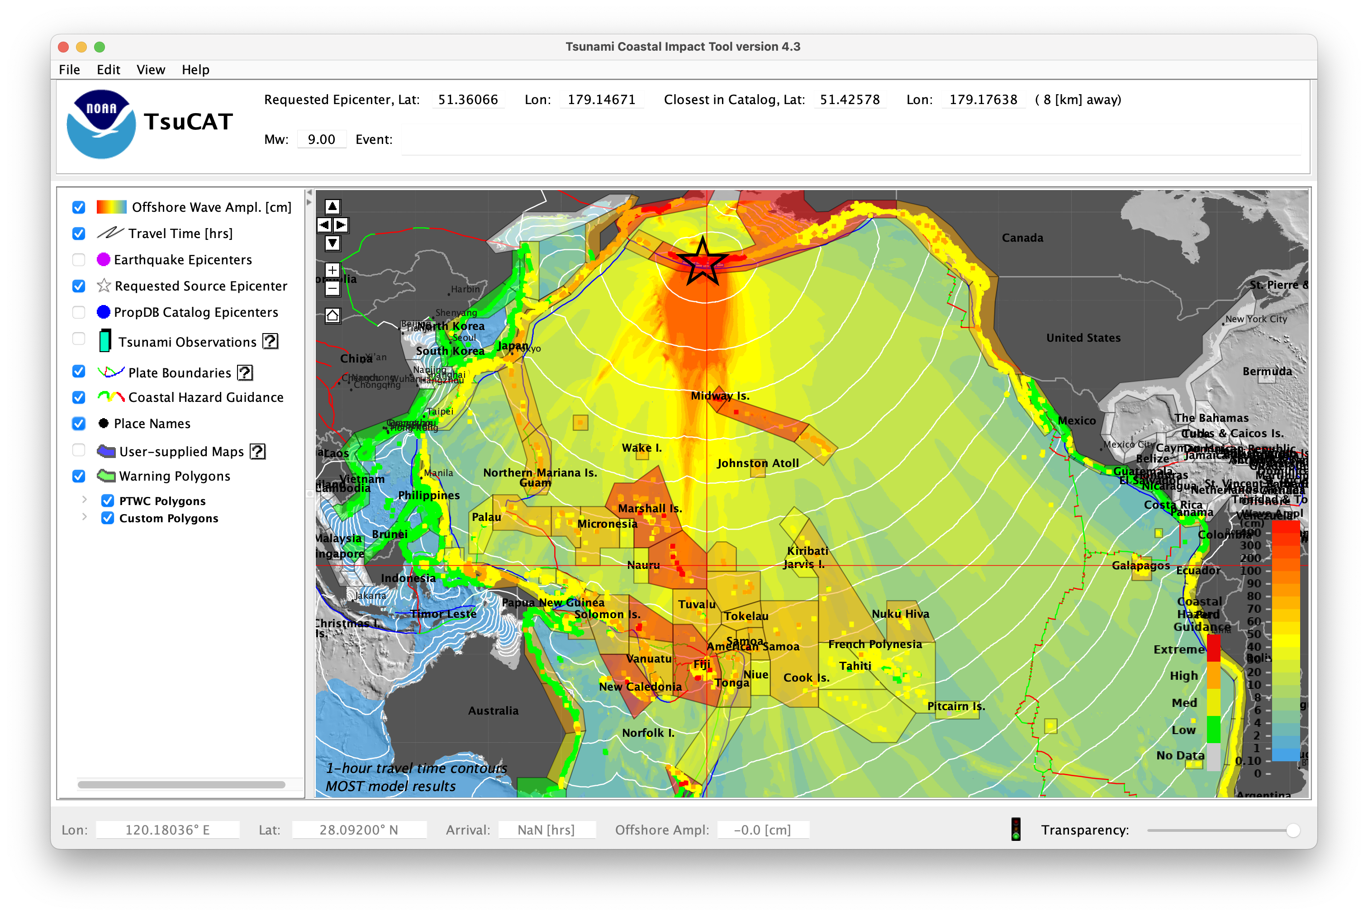
TsuCAT - Tsunami Coastal Assessment Tool
A new release, TsuCAT 4.3, has been released January 2023 through the NOAA/IOC International Tsunami Information Center (ITIC).
New release features are:
Updated PTWC text messages: injects and ETA ordering
Updated regional seismic sources in catalog – Lesser Antilles
Improved security, installation, proxy configuration
https://nctr.pmel.noaa.gov/TsuCAT/
Notes:
A new release of the Tsunami Coastal Assessment Tool, TsuCAT 4.3, was made available January 2023, including updated exercise messaging that more closely matches PTWC operational messaging, and new regional seismic sources that were vetted through the IOC Seismic Experts workshop series.

Slide 9
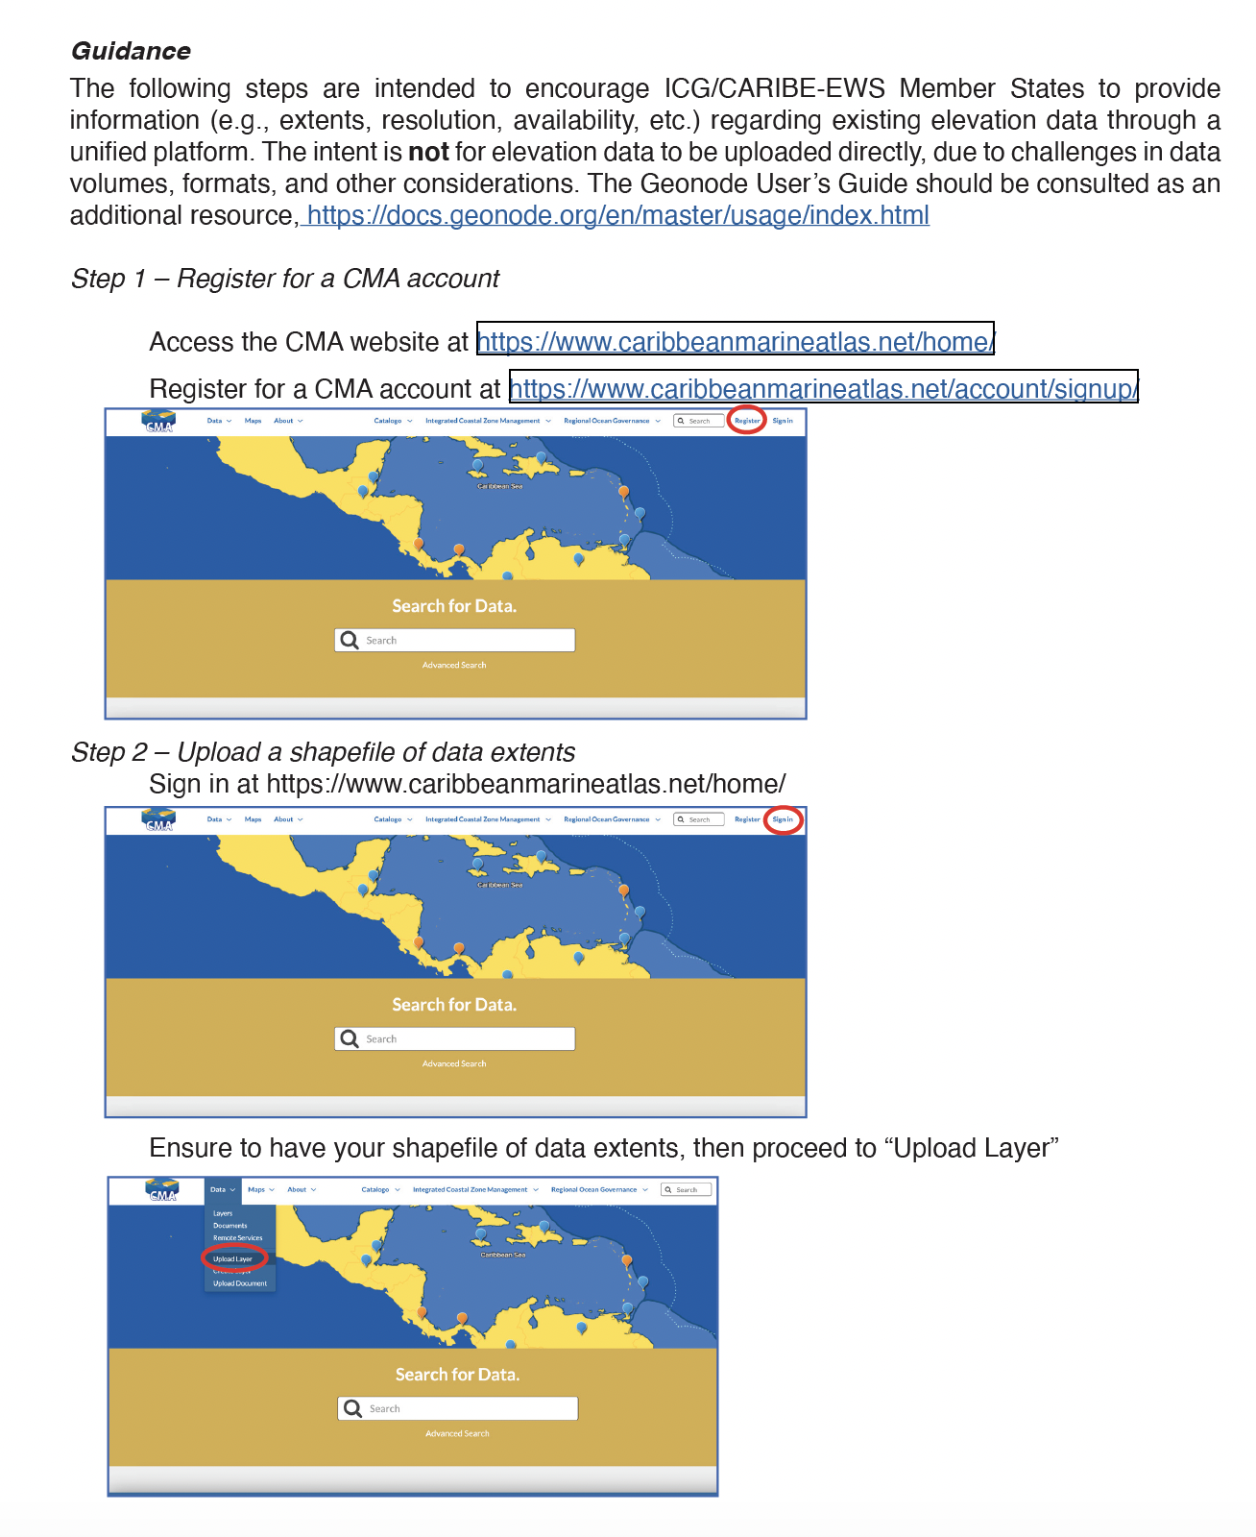
Elevation data sharing
ICG/CARIBE-EWS XV ““Recommends WG2 develop a “roadmap”, or general guidance, on how to upload elevation data to the Caribbean Marine Atlas (CMA), and encourages Member States to upload in CMA their elevation data, and to provide status of available data (e.g., extent, resolution, access, etc.) to WG2”
Actions taken:
Developed a guide on uploading elevation data to Caribbean Marine Atlas.
  Member States encouraged to upload their data, WG2 ask them to at minimum upload details on the available data (e.g., extent, resolution, where to obtain, etc. Helps identify data we didn’t know existed and is available (via request not necessarily online).
Notes:
ICG/CARIBE-EWS XV “Recommends WG2 develop a “roadmap”, or general guidance, on how to upload elevation data to the Caribbean Marine Atlas (CMA), and encourages Member States to upload in CMA their elevation data, and to provide status of available data (e.g., extent, resolution, access, etc.) to WG2”
Document available on WG2 website and Officer Meeting website. Request a wider broadcast at ICG or another mechanism so that it is received by appropriate individuals in Member States

Slide 10
Elevation data sharing
At the ICG/CARIBE-EWS Officer’s Meeting of January/February 2023, the Technical Secretary requested to fine-tune the DEM training proposal (2022) to the CARIBE-EWS context (e.g., identify countries that would benefit, etc.).
Actions taken:
Cursory Evaluation of Known Data
WG2 Chair and DEM experts from NCEI/WDS prepared a cursory evaluation of existing data that would benefit Member States being trained. A total of 16 Member States were identified.
This evaluation illustrates the knowledge of existing data, not data availability and should not be used to exclude participation by non-listed Member States.
Notes:
As a result of the data sharing challenges, the development of a proposal for “Digital Elevation Model Development Training Workshop” was developed in 2020 and updated in 2022. The need for improved capabilities in the area of collecting, processing, analyzing, and modeling elevation data (topographic and bathymetric) has been well documented by UNESCO/IOC’s “Workshop on Tsunami Modelling & Mitigation 2014” report, a product of the Experts Meeting Workshop on Tsunami Modeling and Mitigation held December 1-3, 2014 in Cartagena de Indias, Colombia. The DEM Workshop proposal was developed by WG2 Chair and DEM experts from NCEI/WDS. The proposal was re-submitted June 2022 to ICG/CARIBE EWS Technical Secretary, as requested. The proposal is intended to promote a sustainable approach to DEM development in the region, when data sharing is not possible.

Slide 11
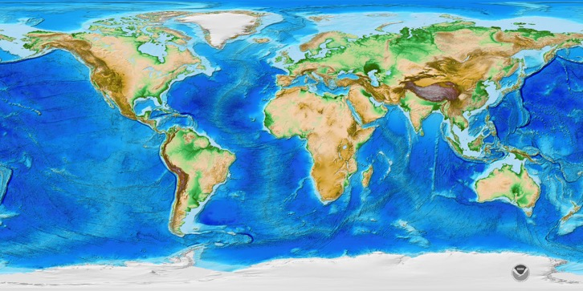
Elevation data sharing
ETOPO 2022 is available in Ice Surface and Bedrock versions that portray either the top layer of the ice sheets covering Greenland and Antarctica, or the bedrock below.
Biggest improvements of Caribbean interest are:
4x higher spatial resolution (15 arc-sec compared to 1 arc-minute)
Improved global bathymetry (mostly from GEBCO 2022)
Improved global topography with reduced elevation bias from vegetation/buildings (mostly from FABDEM, which is a Forest And Buildings removed Copernicus DEM).
https://www.ncei.noaa.gov/products/etopo-global-relief-model
Notes:
ETOPO1 had a grid resolution of about 2 km. The new ETOPO 2022 resolution will be an enhanced 15 arc-second resolution, about 0.5 km, which is four times higher than ETOPO1.

Slide 12
Understanding of the current state of evacuation mapping and planning process
ICG/CARIBE-EWS XV “Recommends re-opening the survey on tsunami evacuation mapping in the next intersessional period to obtain a better understanding of the current state of evacuation mapping and planning process in the region ”
Actions taken:
Recognized that another survey to evaluate this could burden Member States, considering the number of existing surveys
An alternative proposal within WG2 emerged to edit and amend the National Report to include questions on evacuation mapping and signage, so that these themes are addressed on a systematic and annual basis.
  WG4 also indicated the overlap between these questions and questions featured in the Caribe WAVE questionnaire, reflecting concern of duplication. However, the National Reports and Caribe WAVE questionnaires are sometimes not answered by the same national agency.
At the ICG/CARIBE-EWS Officer’s Meeting of June 2022, it was suggested that there may be further overlap with Key Performance Indicators (KPIs).
Notes:
With regards to the recommendation to understand the current state of evacuation mapping and planning processes, WG2 recognized that another survey to evaluate this could burden Member States, considering the number of existing surveys. An alternative proposal within WG2 emerged to edit and amend the National Report to include questions on evacuation mapping and signage, so that these themes are addressed on a systematic and annual basis. During this process, WG4 also indicated the overlap between these questions and questions featured in the Caribe WAVE questionnaire, again reflecting an ongoing concern of duplication. However, the National Reports and Caribe WAVE questionnaires are sometimes not answered by the same national agency. At the ICG/Caribe-EWS Officer’s Meeting of June 2022, it was suggested that there may be further overlap with Key Performance Indicators (KPIs). As a result, the Task Team for KPIs may consider how to collect this information on a systematic and annual basis.

Slide 13
Working Group Internal Work Plan/Key Proposed Activities
Prioritization of in-person Activities
Over 50% of WG2 members participated in this prioritization process. Results are in the table below, with only responses receiving a vote displayed
BOTH the Experts Meeting on “Non-seismic Sources of tsunamis for the Caribbean” AND Regional DEM Training should be equally weighted priorities. | 46.67%
Experts Meeting on “Non-seismic Sources of tsunamis for the Caribbean” is a TOP priority, and a Regional DEM Training is second priority. | 26.67%
Regional DEM Training is a TOP priority, and an Experts Meeting on “Non-seismic Sources of tsunamis for the Caribbean” is second priority. | 20.00%
Experts Meeting on “Non-seismic Sources of tsunamis for the Caribbean” is a TOP priority, and Regional DEM Training should NOT be a priority; WG2 should further evaluate other priorities. | 6.67%
*Note: the WG2 Chair abstained from prioritization voting
Notes:
Given the limited number of resources, WG2 members voted on the in-person activities to be prioritized in the next intersessional period, funding permitted. Over 50% of WG2 members participated in this prioritization process. The results show a slight majority favored an Experts Meeting on “Non-seismic Sources of Tsunamis for the Caribbean” as the top priority, and a Regional DEM Training as a second priority; while the overwhelming majority saw both activities as priorities. Section 2 and 4 of this report provides justification on the two activities considered. Results are in the table below, with only responses receiving a vote displayed

Slide 14
Working Group Internal Work Plan/Key Proposed Activities
Provide access to and/or compile non-seismic sources
Continue compiling a (1) list of non-seismic sources already available in the literature (and including numerical simulations), (2) and a list of non-seismic sources discussed during an expert meeting in Martinique (2019, IOC-WR-291), but not yet simulated
  In collaboration with ICG Technical Secretary, explore the possibility of a future Experts Meeting on Non-Seismic Sources of Tsunamis for the Caribbean.
Prioritize the compiled list of non-seismic sources to be displayed on CATSAM.
Begin process of enlisting volunteers with modeling experience to assist to get files prepared for display on CATSAM.
  Including assessment of which models are appropriate (i.e. validated, benchmarked, peer-reviewed, utilized in public reports sponsored by national agencies, etc.)

Slide 15
Working Group Internal Work Plan/Key Proposed Activities
Elevation Data Sharing
Continue to share and promote existing elevation data (e.g., bathymetry, topography).
Support any future DEM training by ensuring appropriate participants and/or agencies are made aware of the capacity building opportunity.
CATSAM
Continue updating CATSAM with new scenarios
Historical Tsunami Poster update
NCEI/WDS and ITIC will update the Historical Tsunami Effects in Caribbean, Central America, Mexico and Adjacent Regions poster.

Slide 16
Proposed recommendations
Importance of the active engagement of all members in the Working Group activities,
  Urges Member States to nominate members to actively engage in the Working Group.
Identification and characterization of tsunami sources
  Recommends WG2 work with Technical Secretary to organize an Experts Meetings on “Non-Seismic Sources of Tsunamis for the Caribbean”
  Recommends WG2 continue to compile and prioritize a list of non-seismic sources; encourages models of scenarios to be available, when possible
  Encourages the inclusion of appropriate tsunami scenarios in CATSAM

Slide 17
Proposed recommendations
Recognizing the need for adequate local bathymetric and topographic data to perform tsunami numerical modeling and obtain tsunami inundation and evacuation maps
  Encourages Member States to upload their elevation data, at a minimum to provide status of available data,
  Further Encourages the execution of a regional training on the development of digital elevation models (DEMs) for tsunami inundation modeling;
    This fits into WG2 Function 3: “Develop capacity building for the appropriate modelling”
Notes the National Reports and Caribe Wave questionnaires request evacuation mapping and signage information
  Request Task Team on Future Goals and Performance Indicator facilitate alignment and harmonization between survey efforts to avoid overloading Member States with work and considering resource limitations.

