Slide 1
ICG/NEAMTWS
Steering Committee Meeting
12-13 April 2023, Paris, France
Report of the
ICG/NEAMTWS
Technical Secretary
Denis Chang Seng
Programme Specialist and
ICG/NEAMTWS Technical Secretary
Tsunami Resilience Section
UNESCO IOC

Slide 2
THE TEAM
Dr Denis Chang Seng (Programme Specialist, Technical Secretary ICG/NEAMTWS)
Dr Derya Vennin (Associate Project Officer/ CoastWAVE Project Coordinator
Mr Alejandro Aldana (ICG/NEAMTWS Consultant)
Ms Maria Camila León Duque (New Intern)
Mr Jamel Abdallah (CoastWAVE Project Consultant)
Ms Esmeralda Borja (CoastWAVE Project Assistant)
Ms Claire Jaffrezic (Previous Intern and Consultant)
Ms Kim Servin (Previous Intern)

Slide 3
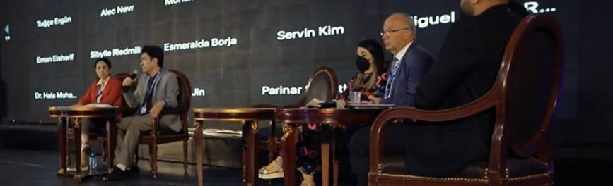
UN OCEAN SCIENCE DECADE FOR SUSTAINABLE DEVELOPMENT EVENTS
Resilient and Safer Coasts Side event at the African Conference on Priority Setting & Partnership Development for the UN Decade of Ocean Science for Sustainable Development, Current Status, Challenges and Opportunities Resilient and Safer Coast, 11 May 2022, Cairo, Egypt

Slide 4
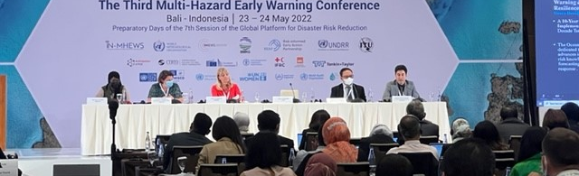
MHEWC-III
SUPPORTED THE ORGANIZATION AND PARTICIPATED IN THREE PANEL EVENTS AT THE THIRD MULTI-HAZARD EARLY WARNING CONFERENCE (MHEWC-III) HELD IN BALI, INDONESIA FROM 23 TO 24 MAY, 2022 BALI, INDONESIA

Slide 5
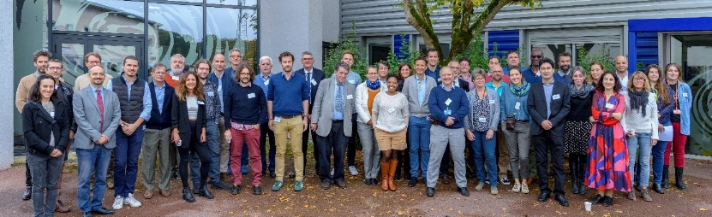
Credit : CENALT, CEA 2022
CENALT SCIENTIFIC WORKSHOP, 10 -YEARS OF CENALT, 29-30 SEPTEMBER, FRANCE, 2022

Slide 6
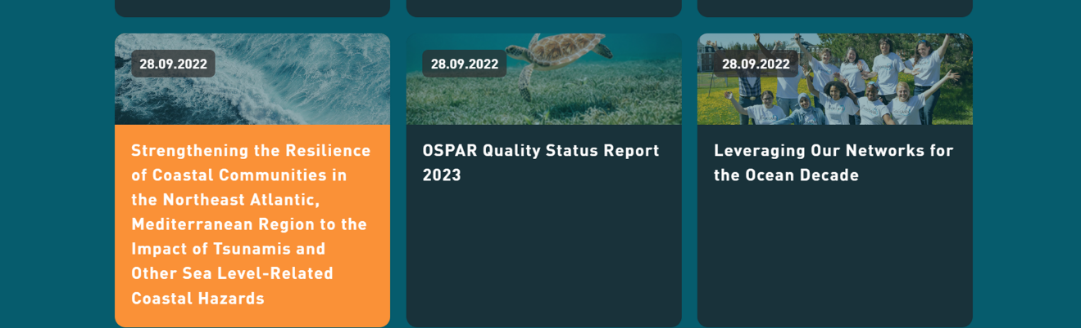
COASTWAVE PROJECT ENDORSED AS AN OCEAN DECADE ACTION IN OCTOBER 2022

Slide 7

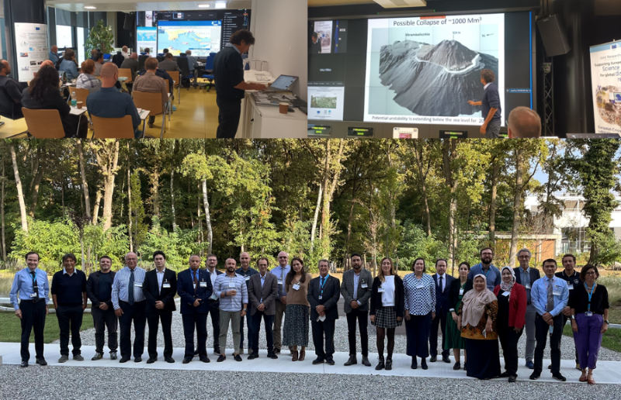
Source: JRC
CO-ORGANIZED WITH JRC A WORKSHOP ON THE NEAMTWS LOCAL TSUNAMI WARNING IN THE CONTEXT OF MULTI-HAZARD DISASTER RISK MITIGATION: REQUIREMENTS, CHALLENGES, OPPORTUNITIES, 4 - 5 OCTOBER 2022, ISPRA, ITALY(HYBRID)

Slide 8
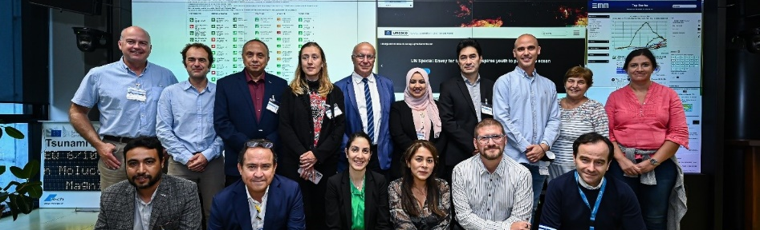
Source:Piero Cruciaiti
CO-ORGANIZED WITH JRC A COASTWAVE PROJECT WORKSHOP ON STANDARD OPERATING PROCEDURES (SOP) PLANNING AND IMPLEMENTATION FOR TSUNAMI RESPONSE IN NEAM REGION,5 - 6 OCTOBER 2022, ISPRA, ITALY

Slide 9
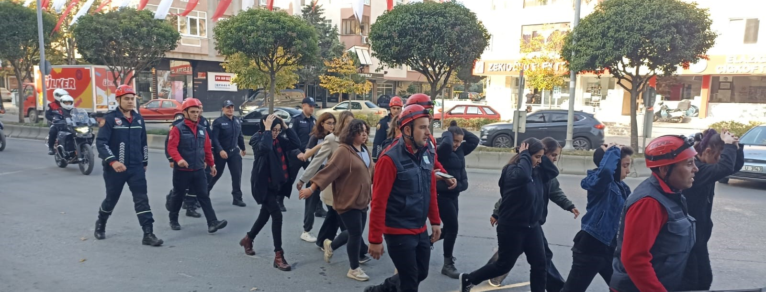
Source: KOERI
OBSERVERS TO THE FIRST TSUNAMI EXERCISE IN TÜRKIYE (ISTANBUL) ON 4 NOV 2022

Slide 10
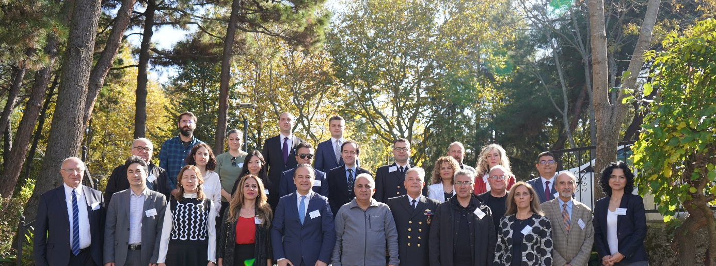
Source: KOERI
PARTICIPATED IN KOERI’S WORKSHOP ON TSUNAMI WARNING SYSTEM IN THE EASTERN MEDITERRANEAN AND CONNECTED SEAS: A DECADE OF ACHIEVEMENTS AND CHALLENGES, ISTANBUL, TÜRKIYE

Slide 11
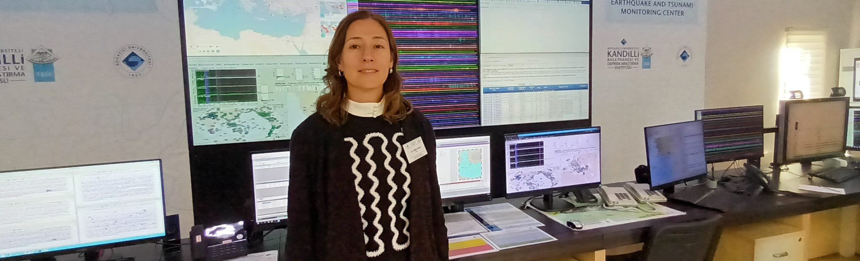
Source: UNESCO/Denis Chang Seng
AND VISITED THE KOERI TSP CENTER, 5 NOV 2022

Slide 12
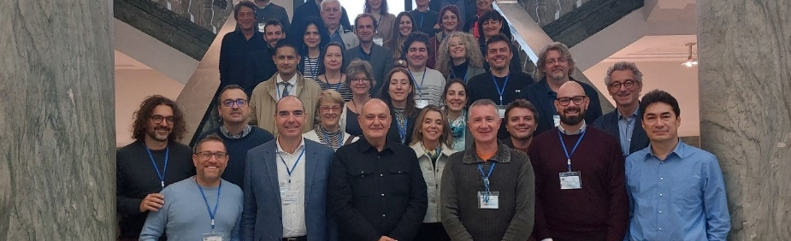
Source: INGV
CO-ORGANIZED WITH INGV, ITALY THE ICG/NEAMTWS EXPERTS MEETING, 28 - 30 NOVEMBER 2022, NAPLES, ITALY (HYBRID)

Slide 13
COMMISSIONED A STUDY/SURVEY ON UNDERSTANDING SEA-LEVEL RISK PERCEPTION AMONG YOUNGER CHILDREN, FINAL REPORT, DECEMBER 2022

Slide 14
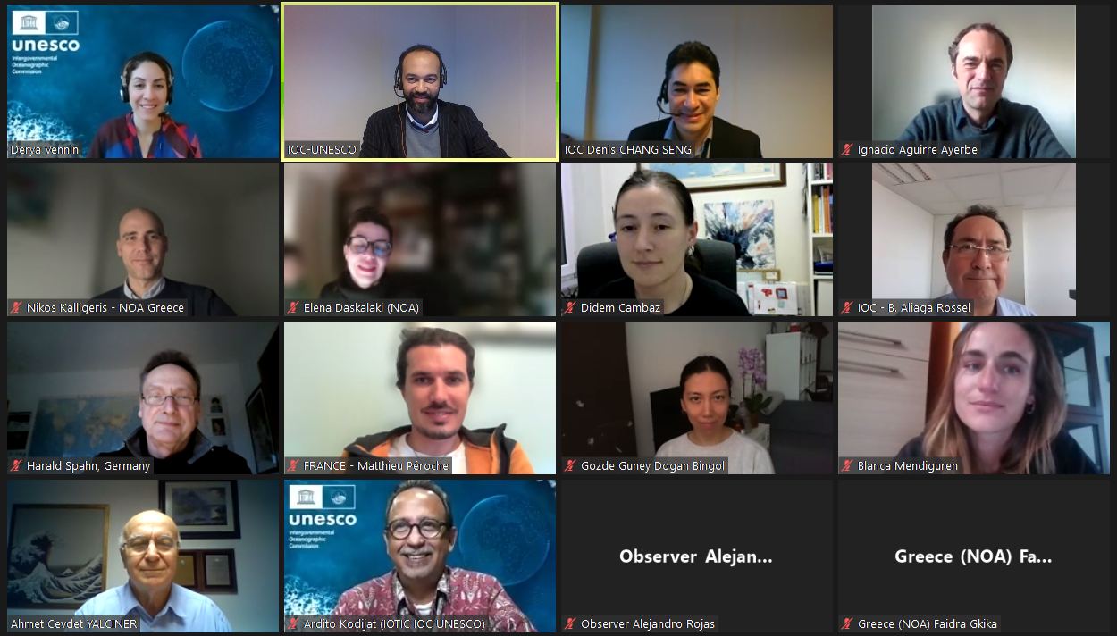
FIRST IOC-UNESCO DG ECHO COASTWAVE PROJECT TRAINING WORKSHOP ON TSUNAMI READY RECOGNITION PROGRAMME (TRRP), 16-17 FEB 2023 (Online)

Slide 15
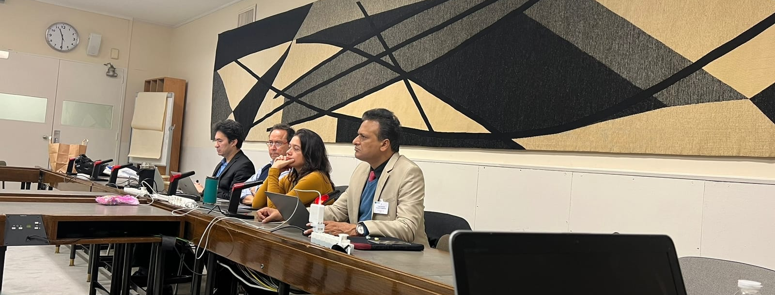
OCEAN DECADE TSUNAMI PROGRAMME SCIENCE DEVELOPMENT AND IMPLEMENTTION PLANS

Slide 16
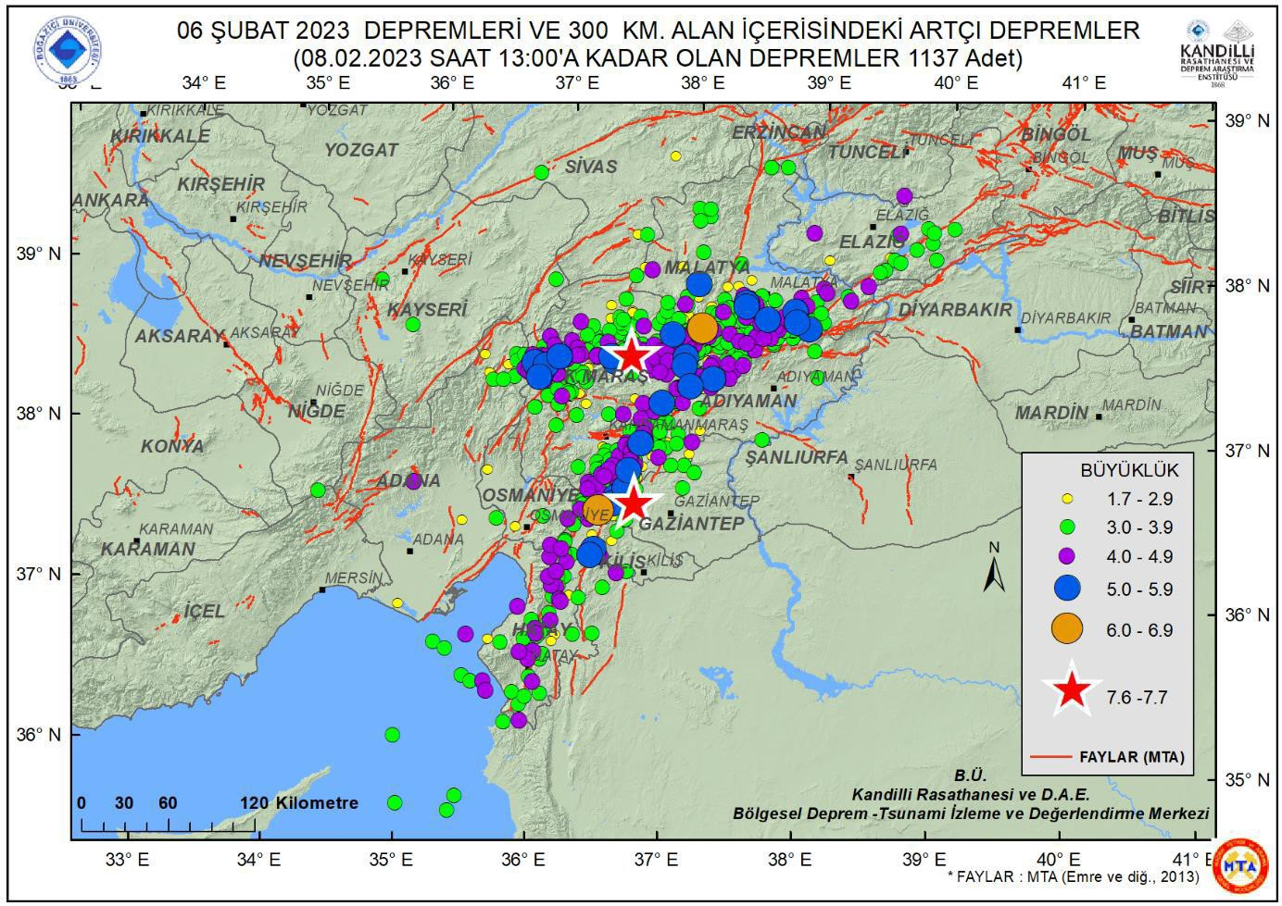
ICG/NEAMTWS RESPONSE
SITUATION BREIFS PREPARED ON THE DEADLY AND DAMAGING EARTHQUAKE IN TÜRKIYE AND SYRIAN BOARDER, TSUNAMI-RELATED SEA LEVEL ANOMALIES DETECTED IN TÜRKIYE

Slide 17
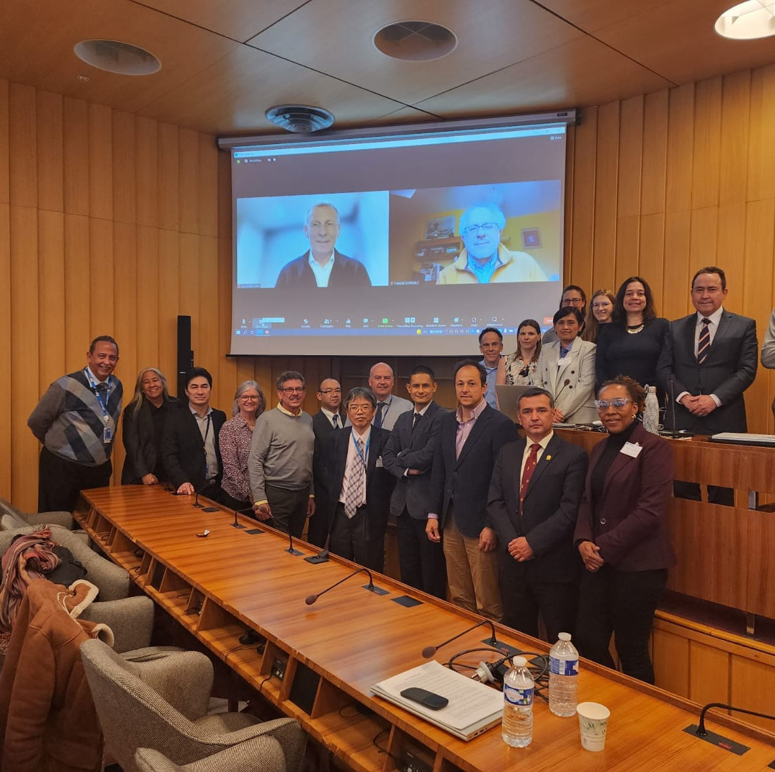
TOWS WG
SPECIAL STEERING COMMITTEE MEETING ON NEAMWAVE23 EXERCISE, 9 February 2023
TOWS-WG-INTER-ICG TASK TEAM ON DISASTER MANAGEMENT PREPAREDNESS (TT-DMP), 27-28 FEBRUARY 2023 (HYBRID)
SUPPORTED THE SIXTEENTH MEETING OF THE WORKING GROUP ON TSUNAMIS AND OTHER HAZARDS RELATED TO SEA LEVEL WARNING AND MITIGATION SYSTEMS, 2-3 MARCH 2023 (HYBRID)

Slide 18
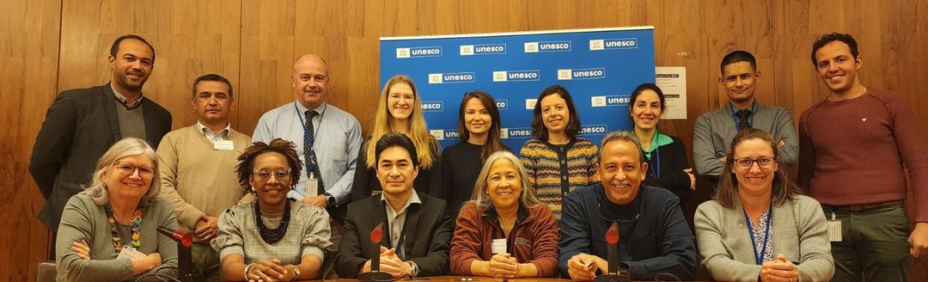
Source: UNECSO/ Ardito Kodijat
FIRST EVER MEETING OF THE TSUNAMI INFORMATION CENTRES (NEAMTIC, IOTIC, CARIB TIC, IOTIC), 1 MARCH 2023

Slide 19
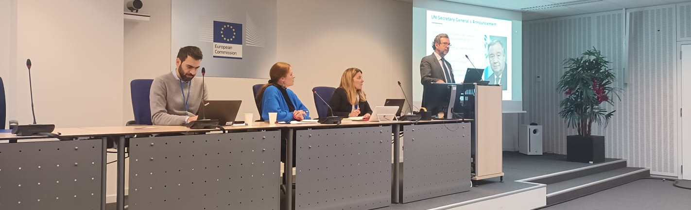
Source: UNECSO/ Denis Chang Seng
COASTWAVE PROJECT AT THE EUROPEAN COMMISSION DIRECTORATE-GENERAL FOR EUROPEAN CIVIL PROTECTION AND HUMANITARIAN AID OPERATIONS - EARLY WARNING SYSTEMS (EWS) EXPERT GROUP MEETING, 6-7 MARCH 2023, ERCC AUDITORIUM.

Slide 20
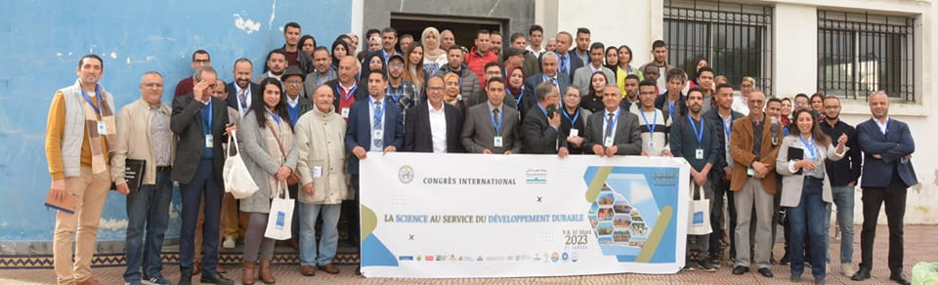
Source: EL KHALIDI Khalid
PARTICIPATED IN THE EVENTS AND ACTIVITIES IN EL JADIDA, MOROCCO, 9-11 MARCH 2023
INTERNATIONAL CONGRESS : LA SCIENCE AU SERVICE DE DEVELOPPEMENT DURABLE, 9-10 MARCH 2023 (2S2D), UNIVERSITY OF CHUAIB DUKKALI (UCD), EL JADIDA, MOROCCO
INTERNATIONAL DAY ON REINFORCEMENT OF RESILIENCE TO TSUNAMIS AND OTHER COASTAL RISKS
‘TSUNAMI WALK’ EXERCISE, 11 MARCH 2023
ON REINFORCEMENT OF RESILIENCE TO TSUNAMIS AND OTHER COASTAL RISKS
‘

Slide 21
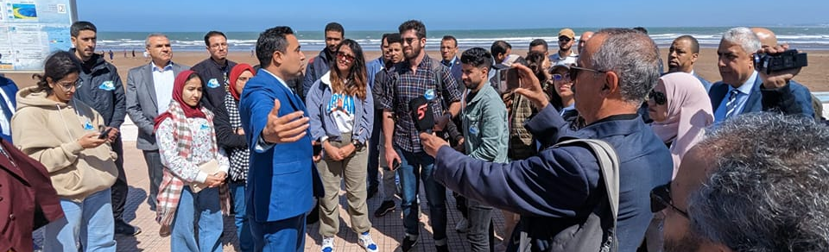
Source: EL KHALIDI Khalid
TSUNAMI WALK’ EXERCISE, 11 MARCH 2023

Slide 22
Communication and Outreach
ARTICLES PUBLISHED (17 )
Tsunami Ready Training to Boost the Implementation of Tsunami Ready in CoastWAVE Project Countries. Count: 76
Deadly and Damaging Earthquake in Türkiye and Syrian Boarder, Tsunami-related Sea Level Anomalies Detected in Türkiye. Count: 446
Dialogue on the Implementation of the New ICG/NEAMTWS 2030 Strategy to Further Advance NEAMTWS. Count: 243.
Assessing and Monitoring the Evolution of Sea Level Related Hazards Risk Perception in the NEAM region. Count: 252
COASTWAVE PROJECT ENDORSED AS “UN OCEAN DECADE PROJECT. Count: 660
Dialogue: How to holistically address requirements, challenges and opportunities of effective local tsunami warning in the multi-hazard disaster risk mitigation context. Count:279
Setting a Benchmark for the Development of Tsunami Standard Operating Procedures through CoastWAVE Project. Count: 582
Celebrating Ten Years of Tsunami Early Warning Operations in North-eastern Atlantic, Mediterranean and Connected Seas. Count: 388
KOERI’s Tsunami Warning System in the Eastern Mediterranean and Its Connected Seas: A Decade of Achievements and Challenges. Count: 263
Underwater volcanoes: exceptional images filmed in the Mediterranean: Count: 370

Slide 23
Communication and Outreach (Cont)
11. Global Tonga tsunami explained by a fast-moving atmospheric source. Count: 162
12. Third Multi-Hazard Early Warning Conference: Scaling Up action: Every Person on Earth Protected by Early Warning Systems within Five Years. Count: 427
13. Enhancing and Scaling up Actions for Resilient and Safer Coast Discussed/Highlighted at the African Conference on Priority Setting and Partnership Development for the United Nations Decade of Ocean Science. Count: 678
14. The 10-Year Research, Development and Implementation Plan for the Ocean Decade Tsunami Programme High on the Agenda at the ICG/NEAMTWS Steering Committee. Count: 560.
15. Tsu-Memo: April 15, 1979, the Montenegro tsunami. Count: 183
16. CoastWAVE Project Kick Off Workshop. Count: 820
17. Seventeenth Session of the ICG/NEAMTWS : Ten Tsunami Ready Recognized Communities by 2023. Count: 648

Slide 24
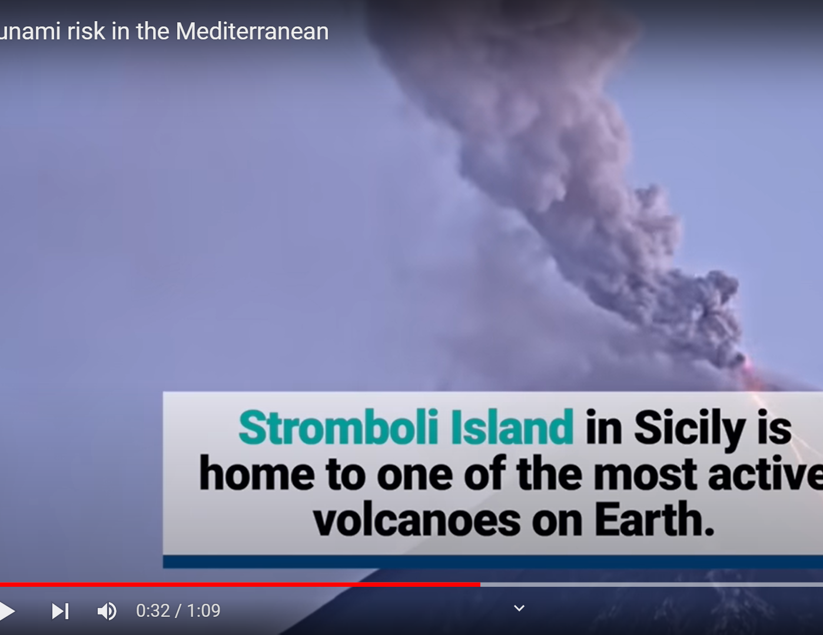
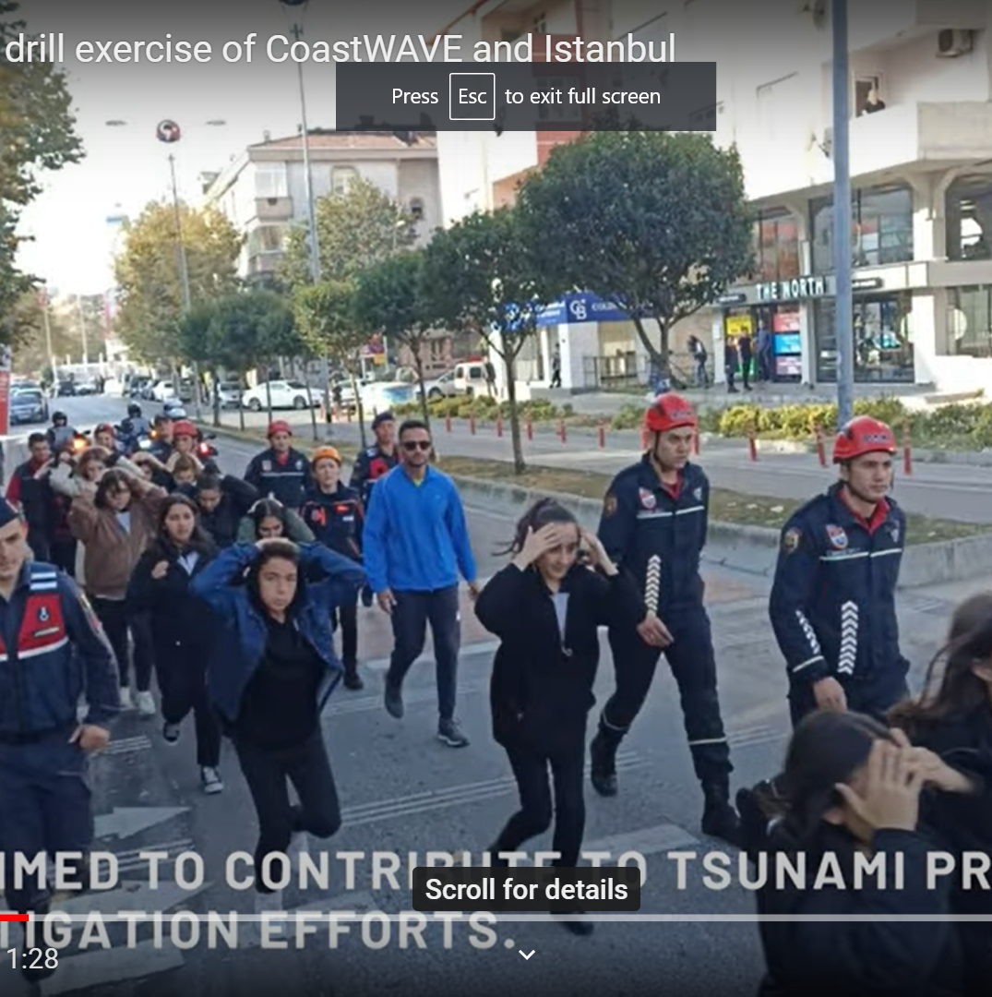
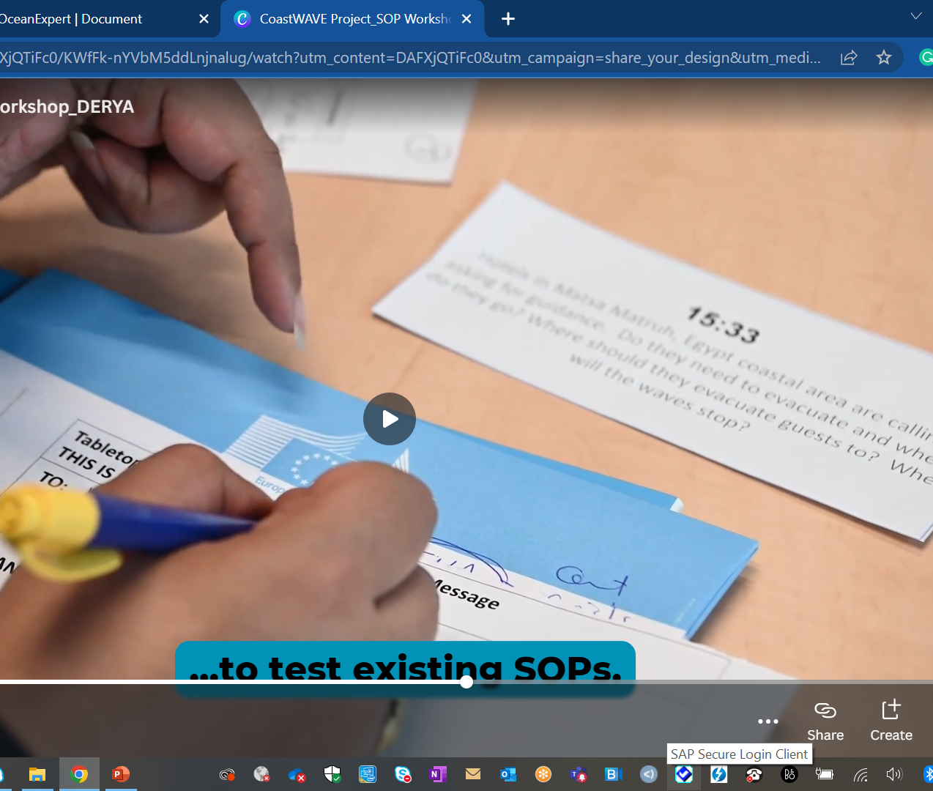
Communication and Outreach (Cont)
Videos (3)
Tsunami Risk in the Mediterranean
  1,311 views on YouTube
Tsunami Exercise Drill and Evaluation, Buyukcekmece, Turkey
  332 views YouTube
  3716 views on twitter
Tsunami SOP Training

Slide 25
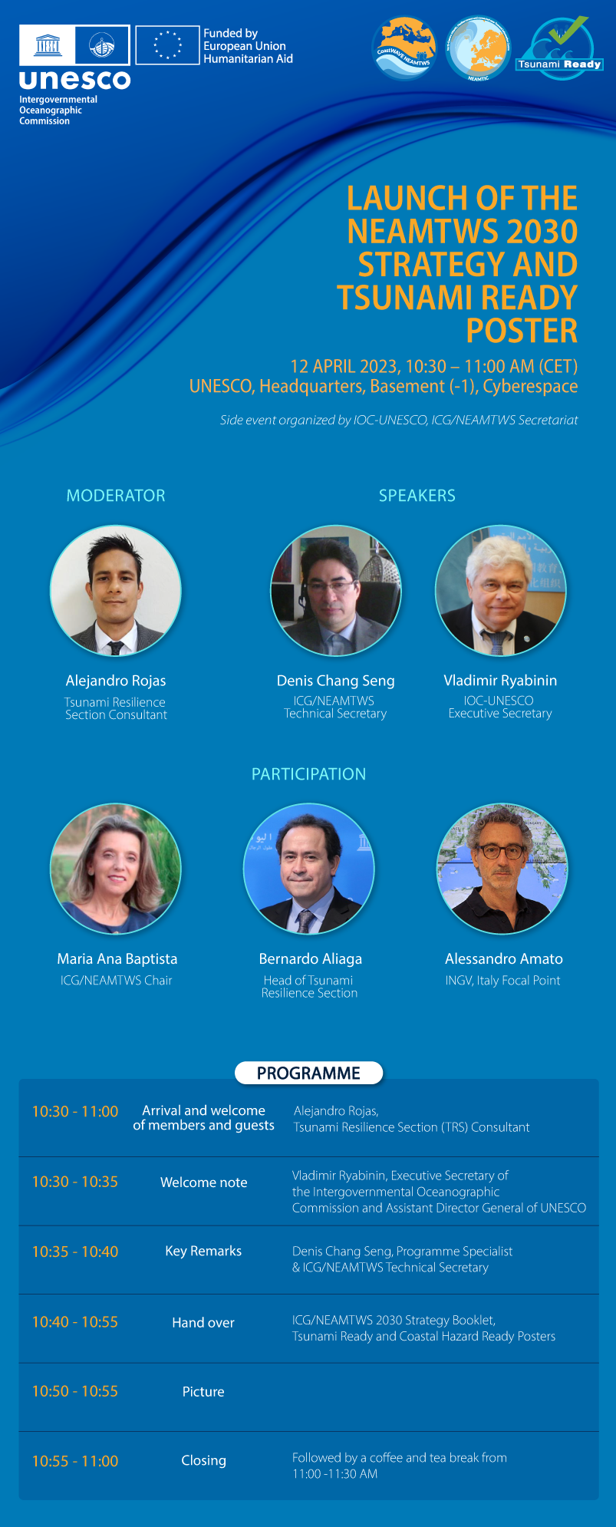
Communication and Outreach (Cont)
UNPACKING NEW TSUNAMI PRODUCTS
ICG/NEAMTWS 2030 STRATEGY IOC TECHNICAL SERIES 171
ICG/NEAMTWS 2030 STRATEGY COMMUNICATION DOCUMENT
NEW POSTERS (EWEA ACT-ON-TIME TSUNAMI READY SAFE OCEAN)
LAUNCH 10:30-11:00 FOLLOWED BY TEA/COFFEE/ LIGHT SNACKS
DISTRIBUTION TO NEAMTWS MEMBER STATES

Slide 26
NEXT
UPCOMING MEETINGS AND ACTIVITIES
STAKEHOLDER WORKSHOP ORGANISED BY THE AGITHAR (ACCELERATING GLOBAL SCIENCE ON TSUNAMI HAZARD AND RISK ANALYSIS) NETWORK ON THE 16-17TH OF MAY 2023.
NATIONAL SOP WORSHKOPS IN MAY-JUNE 2023
NEAMWAVE23 EXERCISE
WTAD 5 NOV 2023 (A FOCUS ON TUNAMI SURIVORS & EYEWITNESSES)
ICG/NEAMTWS-XVIII SESSION
EGYPT. HOSTED BY NIOF

