Slide 1
IPMA National Tsunami Warning Center - Status
Fernando Carrilho
NEAMTWS Steering Committee Meeting
Paris, 12-13 April 2023

Slide 2
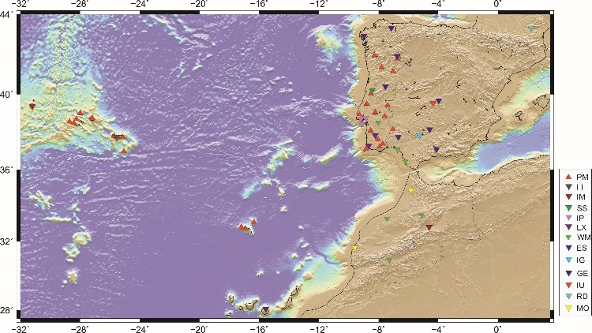
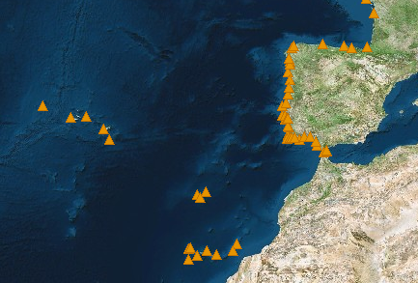
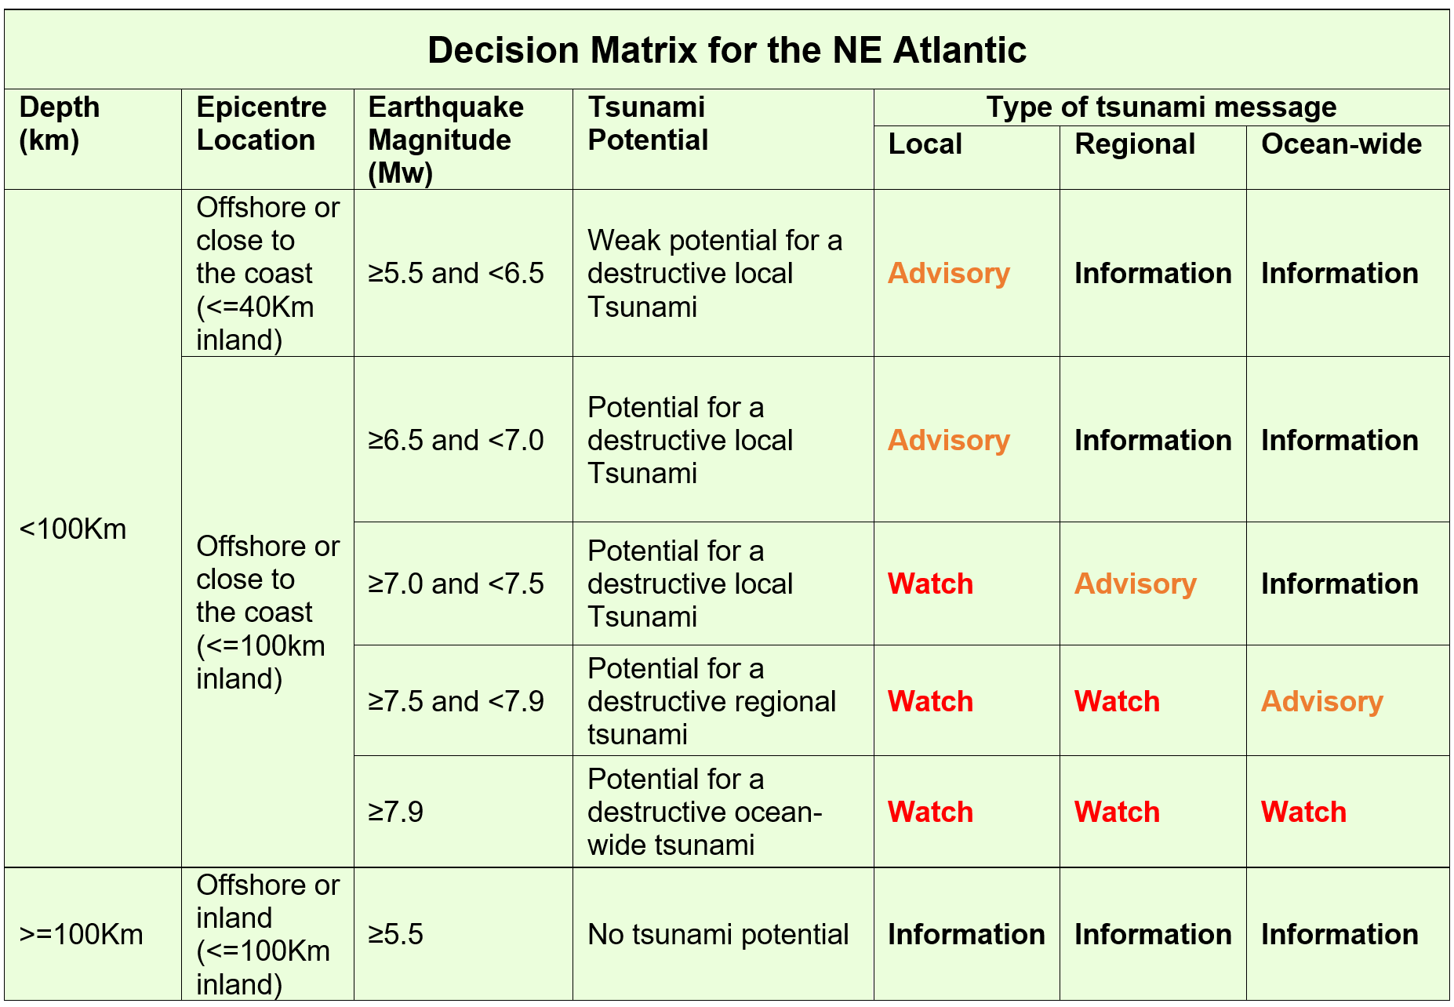
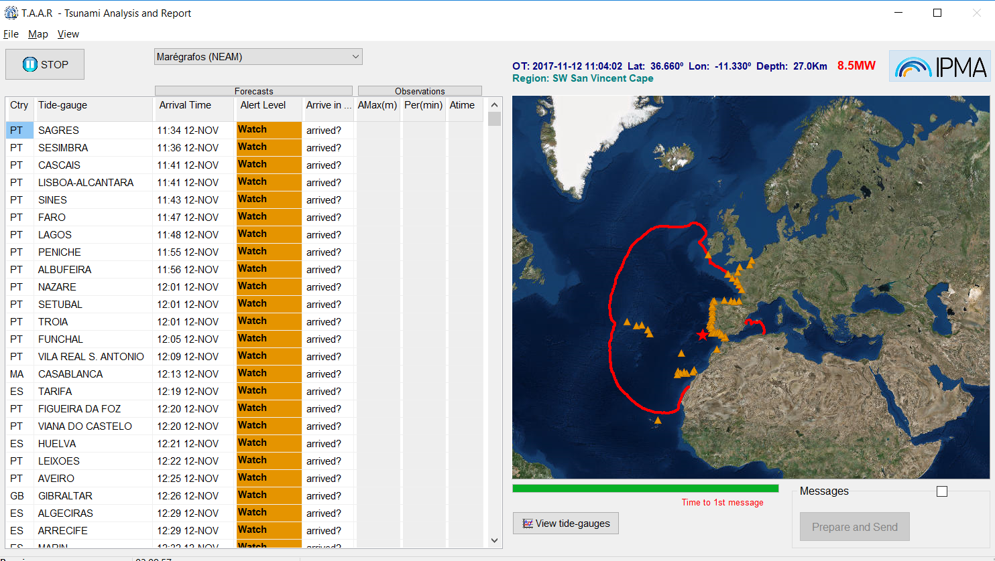
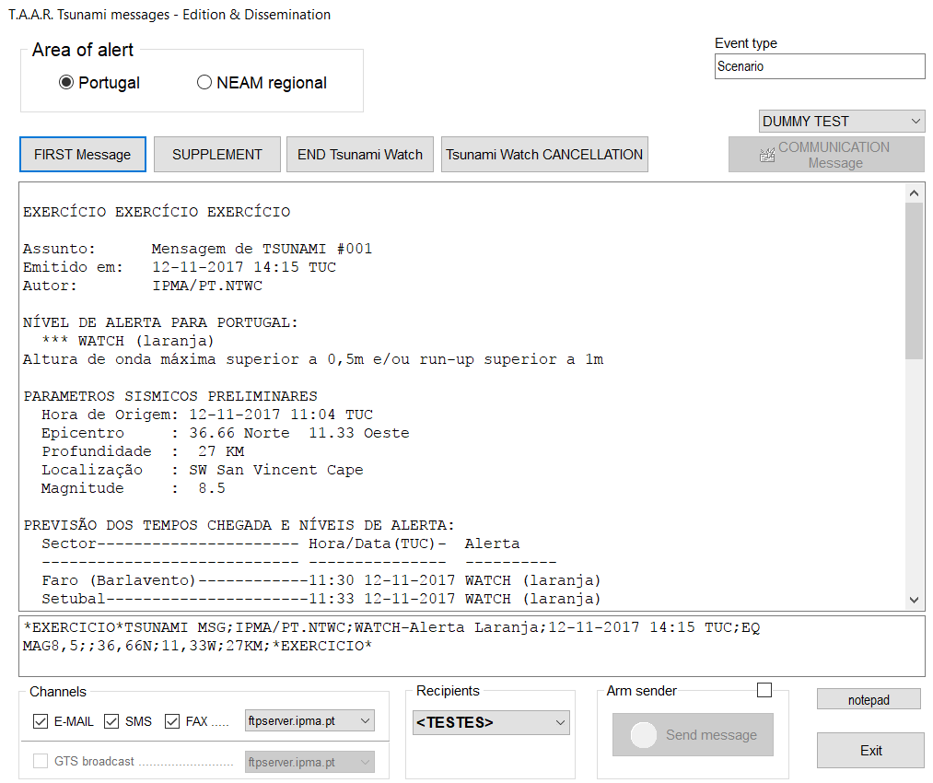
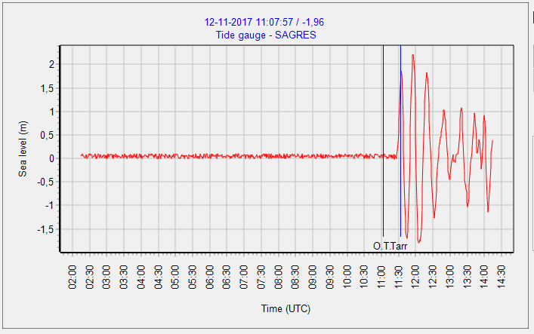
Schematic View
Seismic network
Tide-gauge network
Decision Matrix
Tsunami Analysis and Report
ALERT!
Civil Protection System

Slide 3
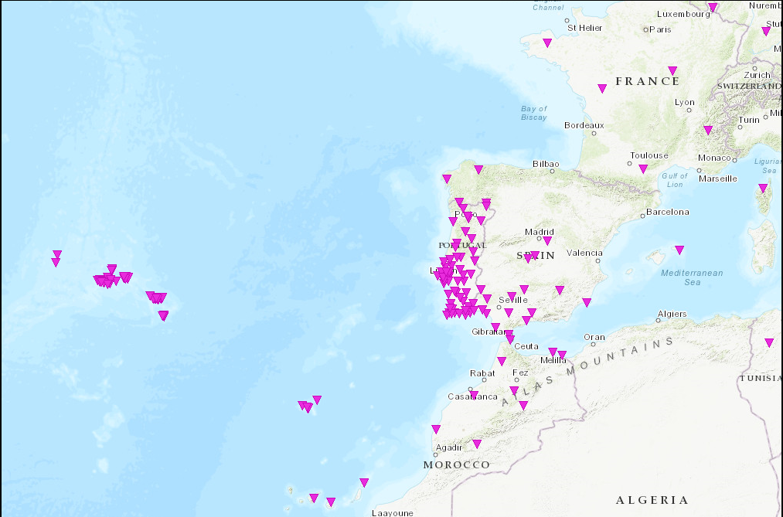
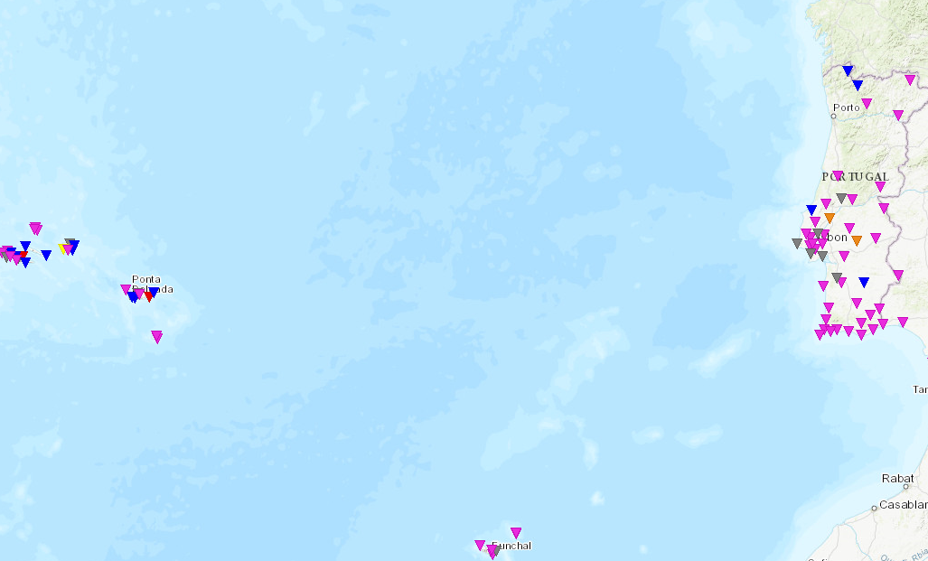
Seismic Network
VSAT
Internet
MPLS
IPMA broadband network (+ SM sensors co-located)
IPMA short-period network (+ SM sensors co-located)
IPMA/IST strong-motion network
Real-time, Internet (mobile, mini-link, fiber optic) & VSAT connection
Complemented with stations from other agencies: Portugal, Spain, Morocco, France and CTBTO (Internet, VPN and MPLS);
83 Broadband, 28 short-period and 97 accelerometers (real-time)
Broadband / Short-period
VSAT
Internet
Strong-motion

Slide 4
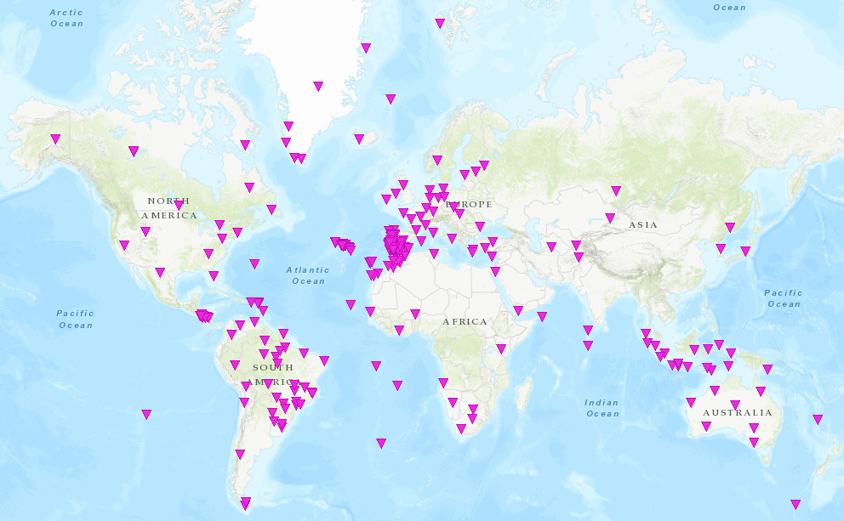
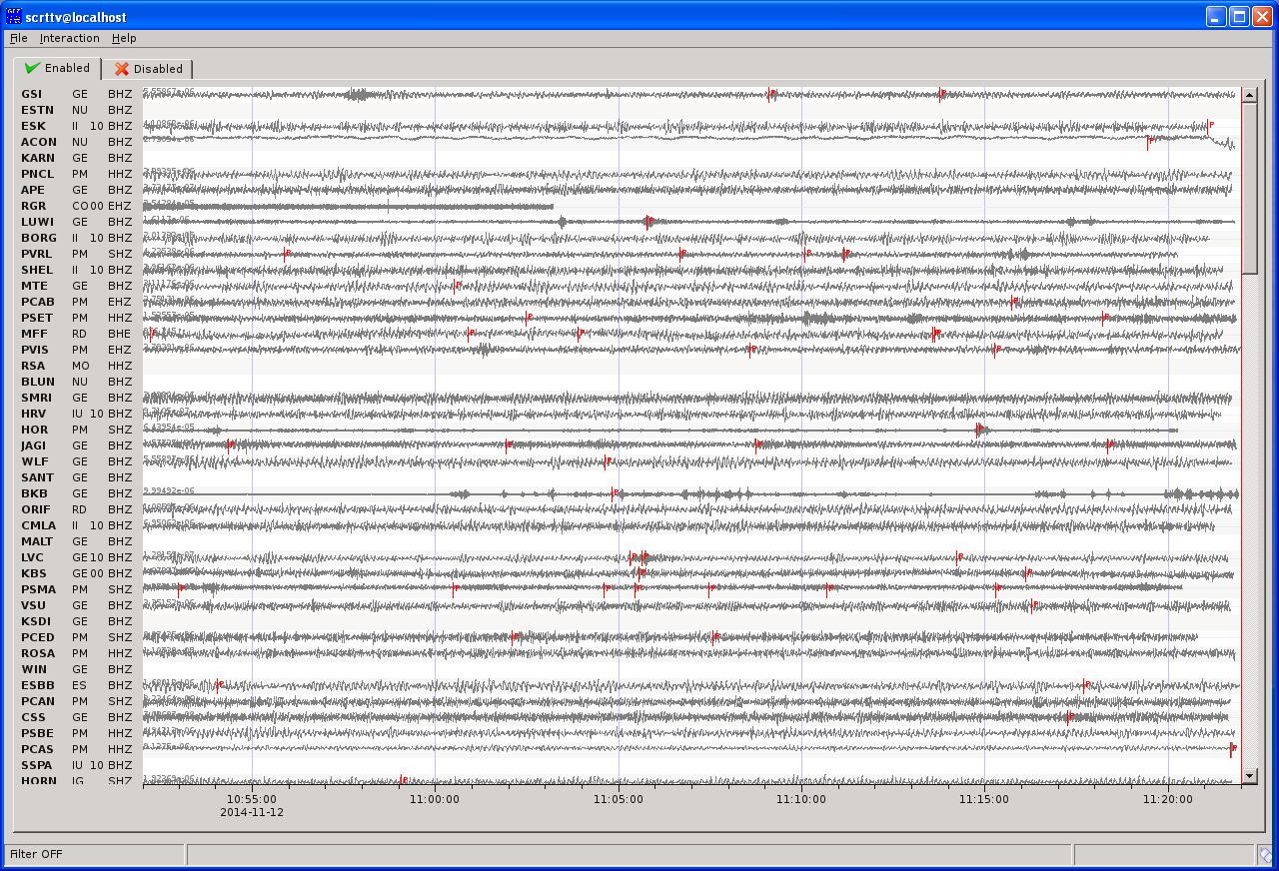
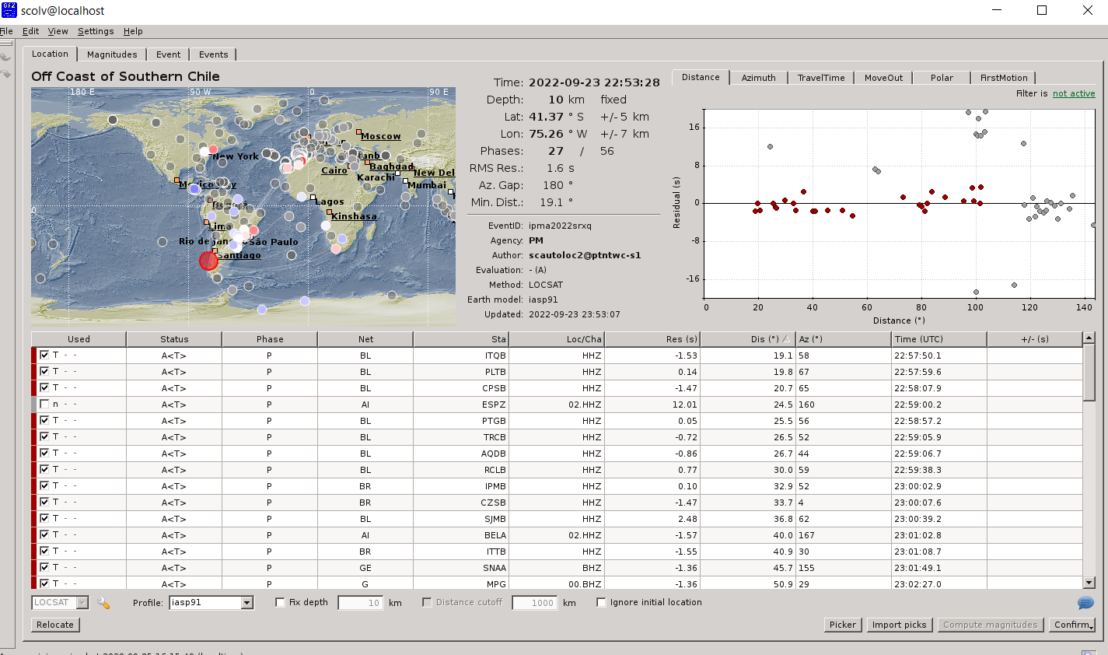
SeiscomP – Global Seismic Monitoring
Fast locations
Fast MW evaluations

Slide 5
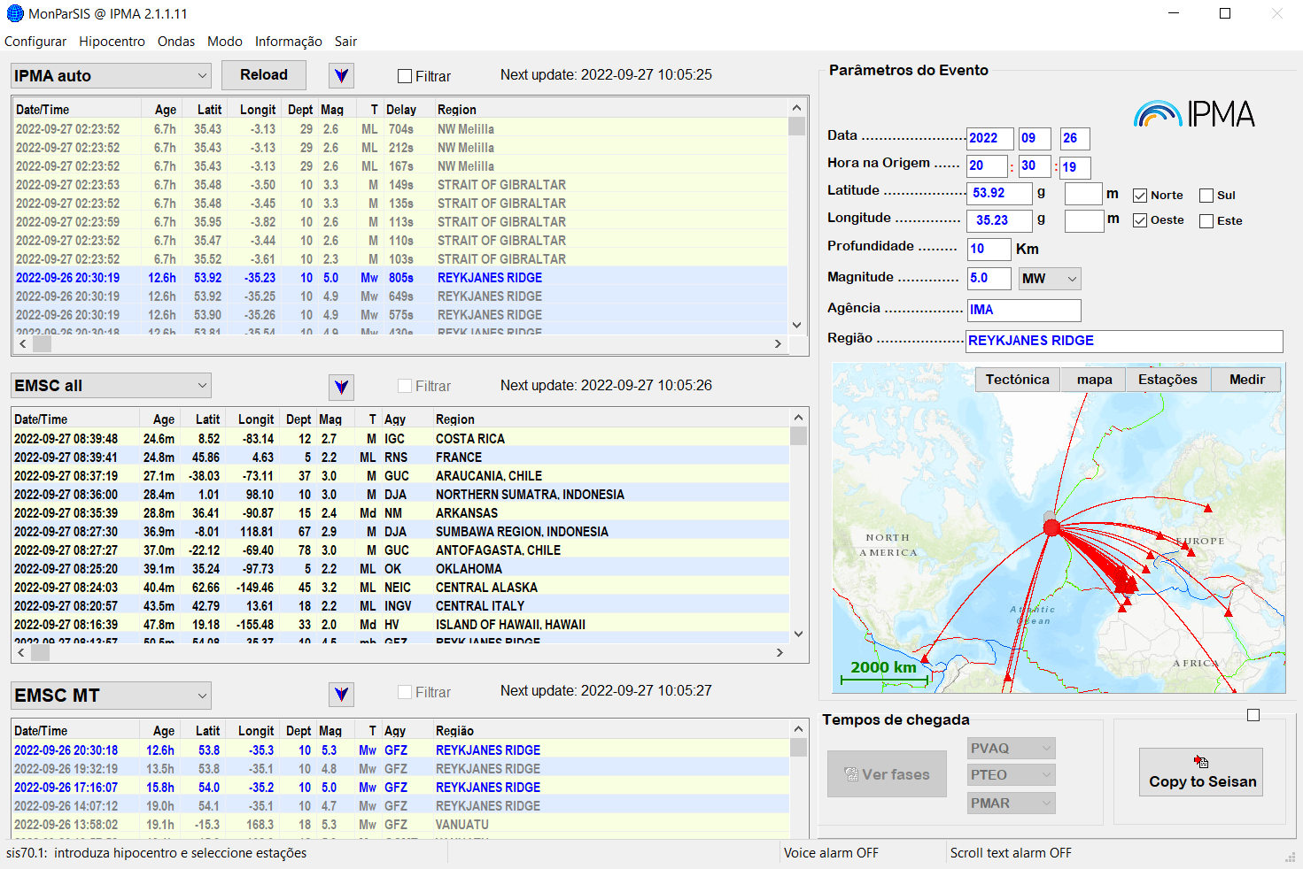
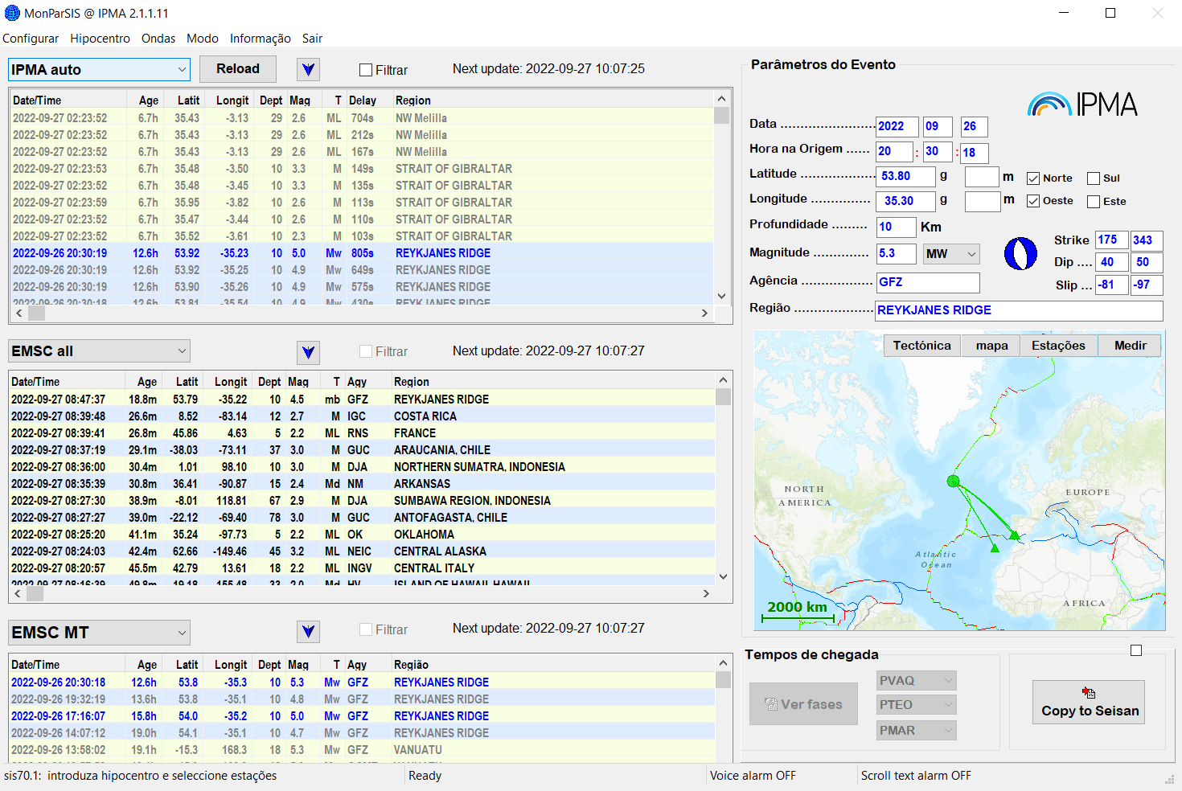
Seismic Monitoring
IPMA Automatic solutions
Other agencies solutions
(hypocenters/Mags/MT)

Slide 6
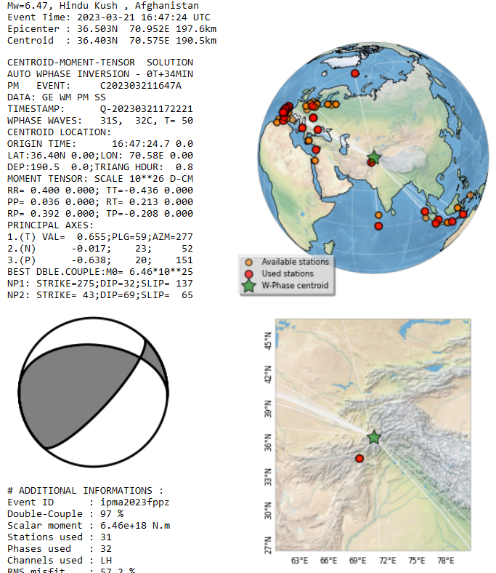
Seismic Monitoring
IPMA Automatic Mw & CMT
W-Phase method
Implemented on Seiscomp
in late Feb2023
Contribution:
(Luis Rivera & Anthony Jamelot

Slide 7
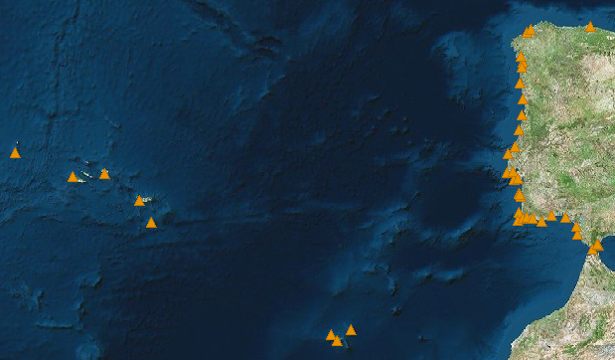
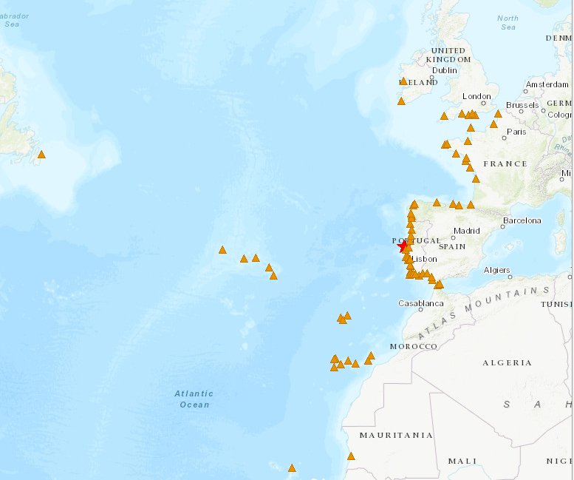
Tide-gauge network
Internet
MPLS
Internet
MPLS
70 stations
Sources:
CENALT, seiscomp/MPLS (SHAUM stations)
IH, webservice/Internet (Instituto Hidrográfico)
JRC, webservice/Internet
EMSO-PT/UBI/IPMA, webservice/Internet
DGT sites, webservice/Internet (Direção geral do Território)
IGN seiscomp/Internet (Puertos del Estado stations)
Instituto Hidrográfico
Puertos Del Estado (via IOC & IGN)
Direção Geral do Território
CNRST (via CNRST & JRC)
JRC (ipma & ign support)
IOC

Slide 8
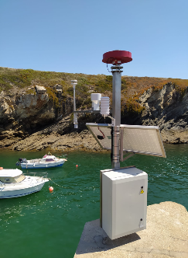
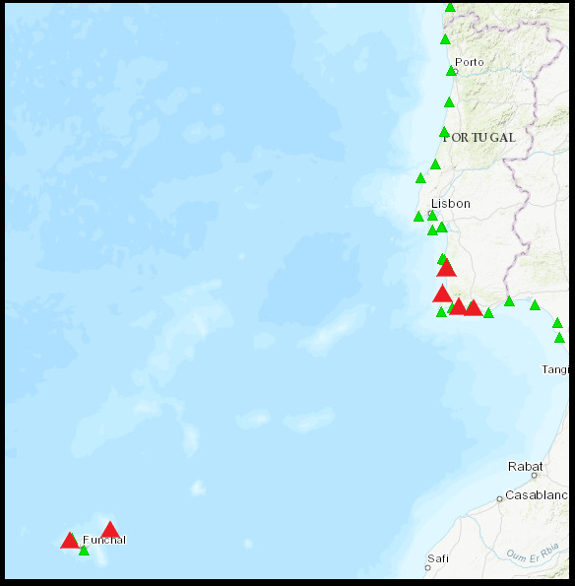
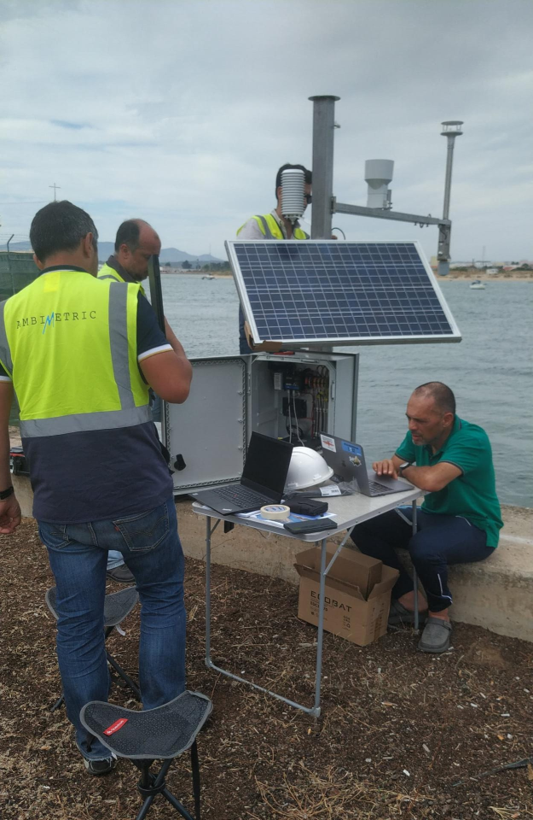
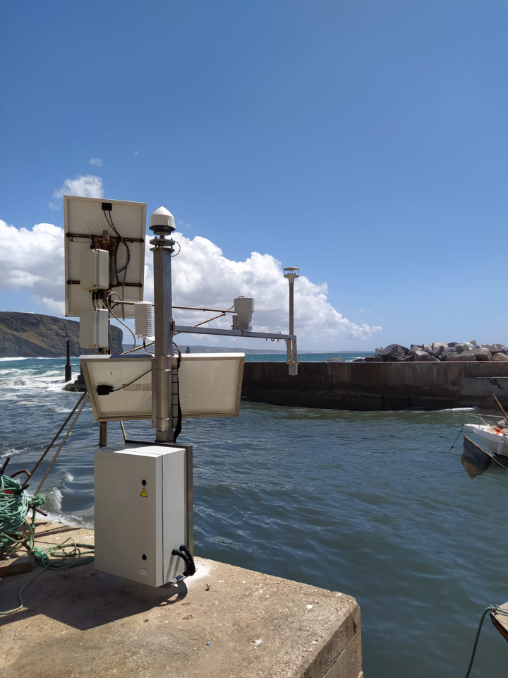
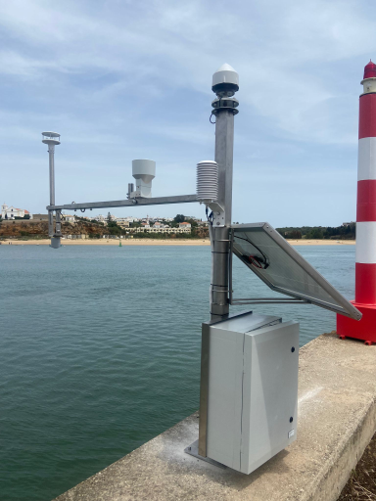
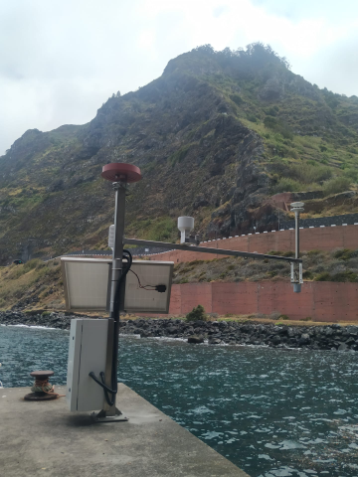
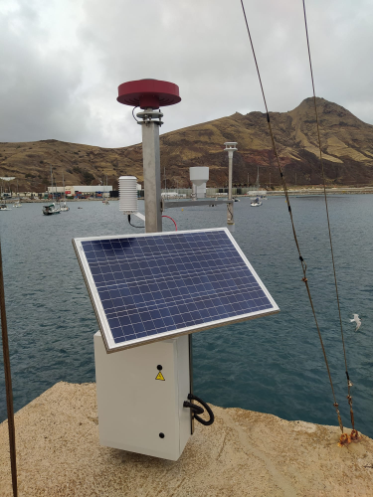
EMSO-PT
MultiParameter Stations
Porto Covo
Albufeira
GNSS
Tide-Gauge
Meteo
Atmospheric Pressure
Temperature
Humidity
Wind
Arrifana
Portimão
Solar Power
Mobile Internet
Local buffer
University of Beira Interior
Instituto Português do Mar e Atmosfera
Porto Moniz
Porto Santo

Slide 9
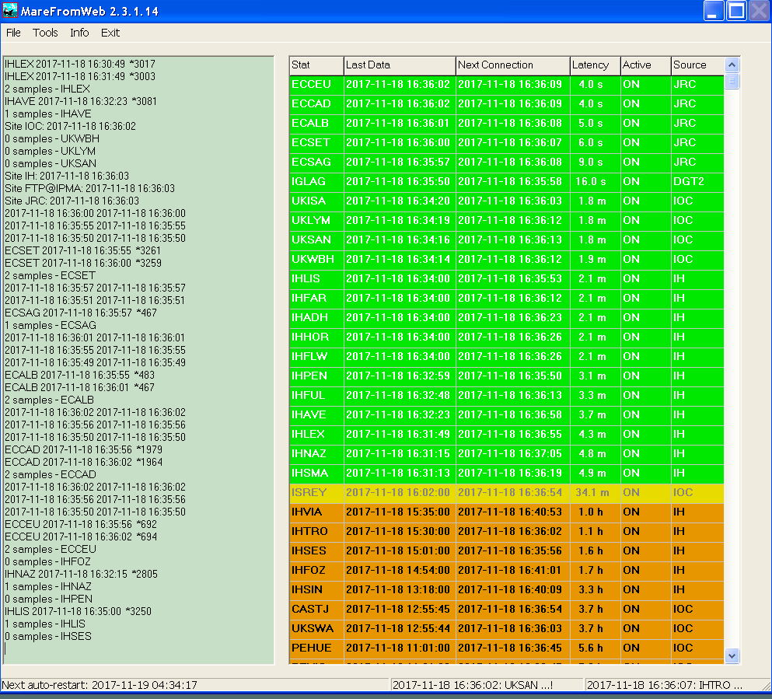
Tide-gauge data acquisition
and management
DGT
sites
IH
dataservice
JRC
dataservice
EMSO-PT/UBI/IPMA
ftp
IOC dataservice
CENALT
seiscomp
IGN
seiscomp
MareFromWeb
TREMOR01
Seiscomp

Slide 10
Decision Matrix

Slide 11
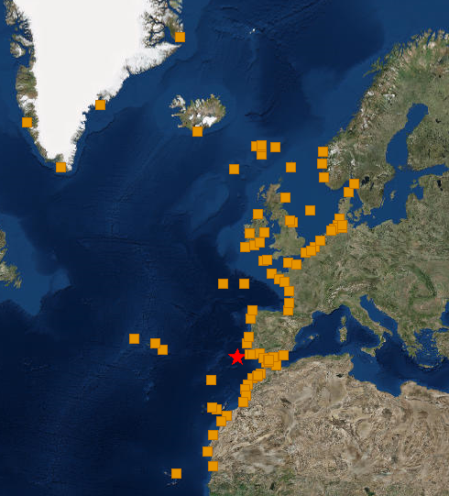
NEAMTWS - Forecast Points

Slide 12
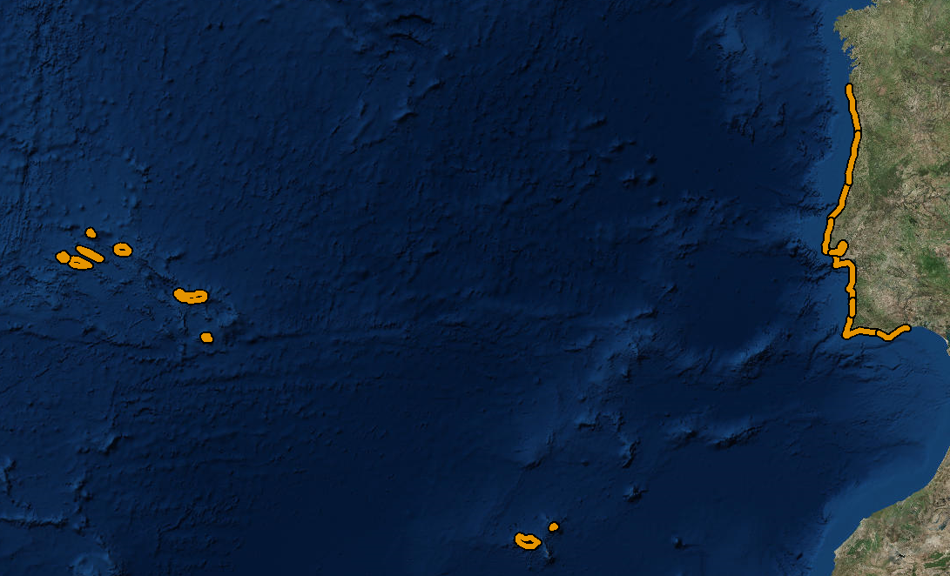
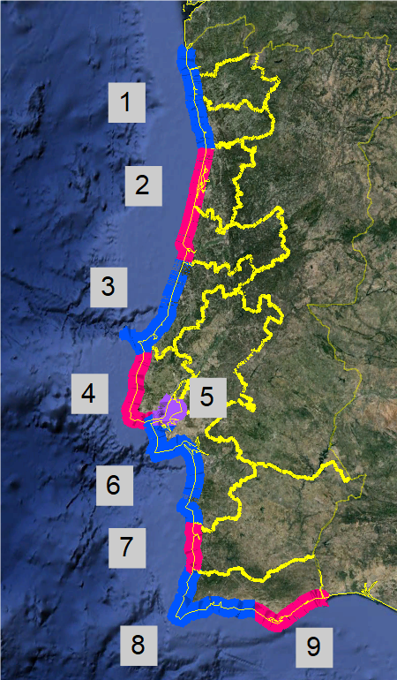
Forecast coastal segments
Mainland
1. Viana-Braga-Porto
2. Aveiro-Coimbra
3. Leiria
4. Lisboa Atlântico
5. Estuário Tejo
6. Setúbal
7. Beja
8. Faro Barlavento
9. Faro Sotavento
Islands
10-11. Madeira & Porto Santo
12-20. Azores islands
Islands
10-11. Madeira & Porto Santo
12-20. Azores islands

Slide 13
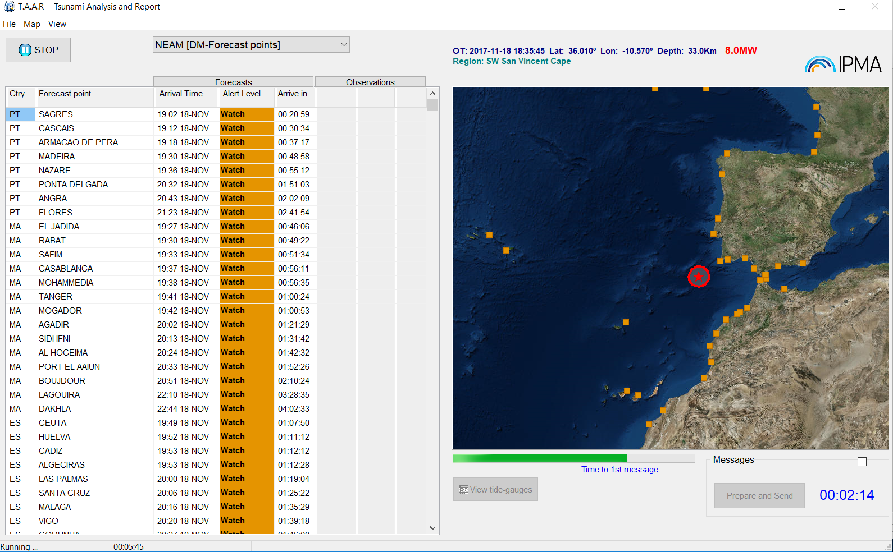
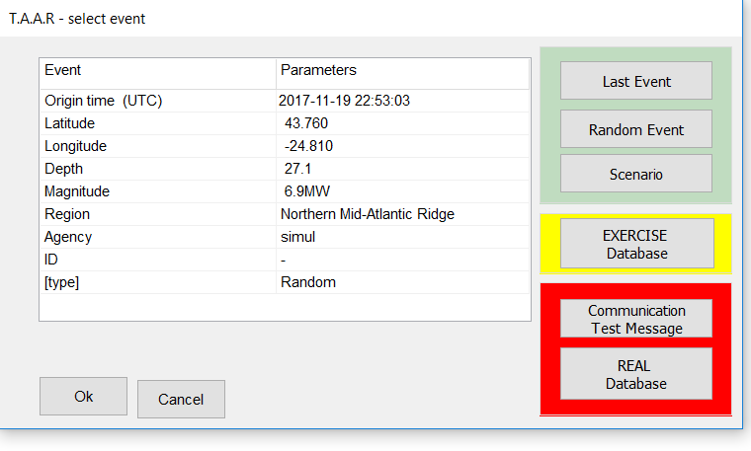
TAAR – Tsunami Analysis And Report
Testing purposes
(include random full scenarios)
Exercise Mode
(Neamwave21, others)
Real events and
Communication tests

Slide 14
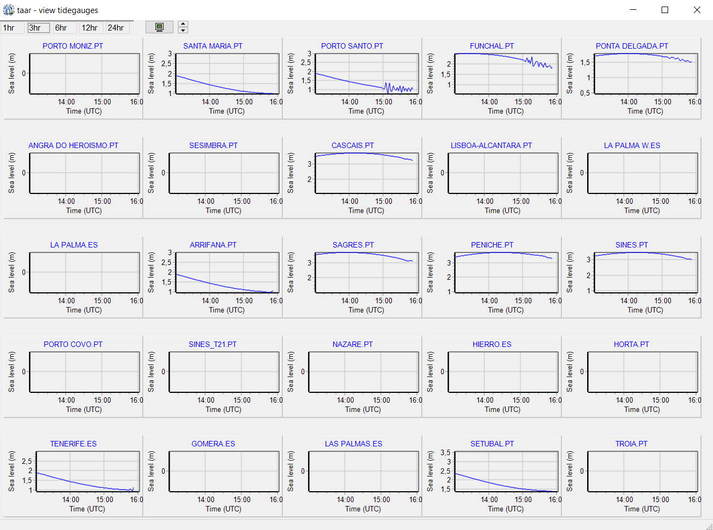
TAAR – Tsunami Analysis And Report

Slide 15
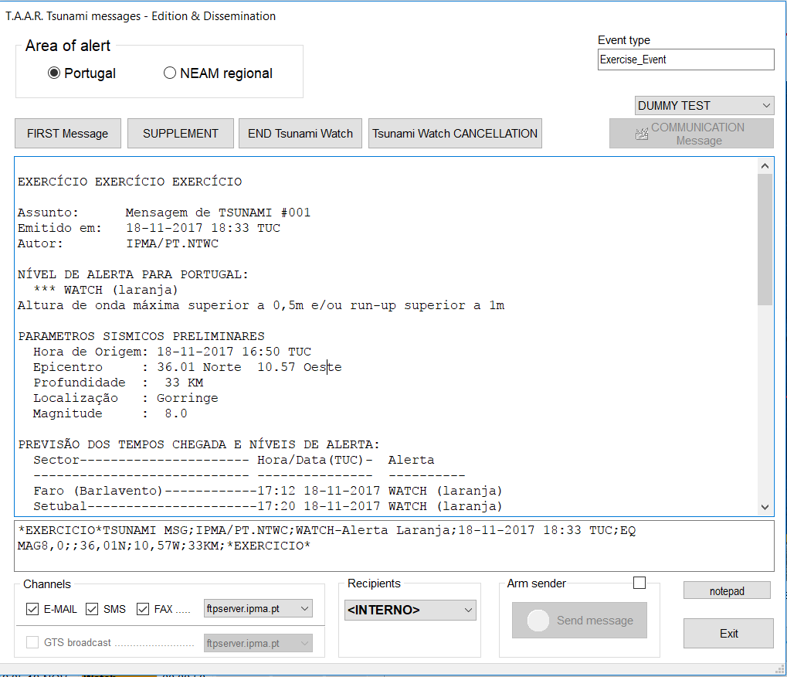
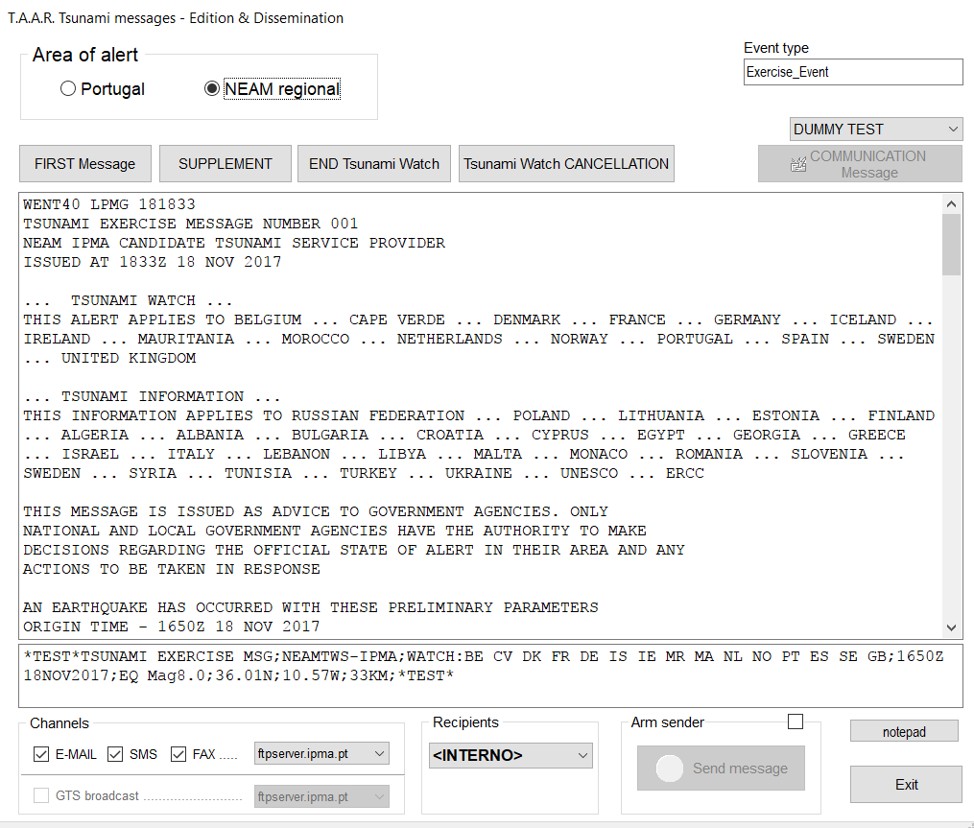
TAAR – Tsunami Analysis And Report
EMAIL
FAX
GTS
EMAIL
FAX
SMS
SMS

Slide 16
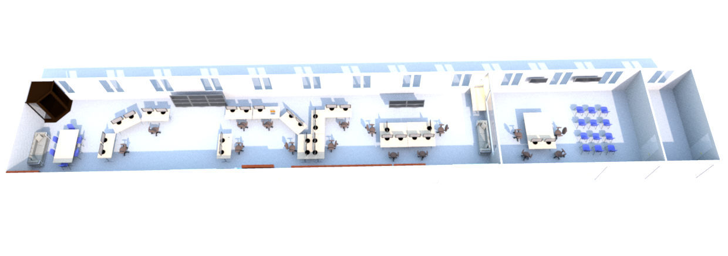
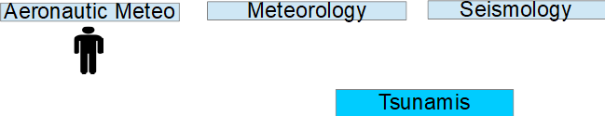

Operational Service

Slide 17
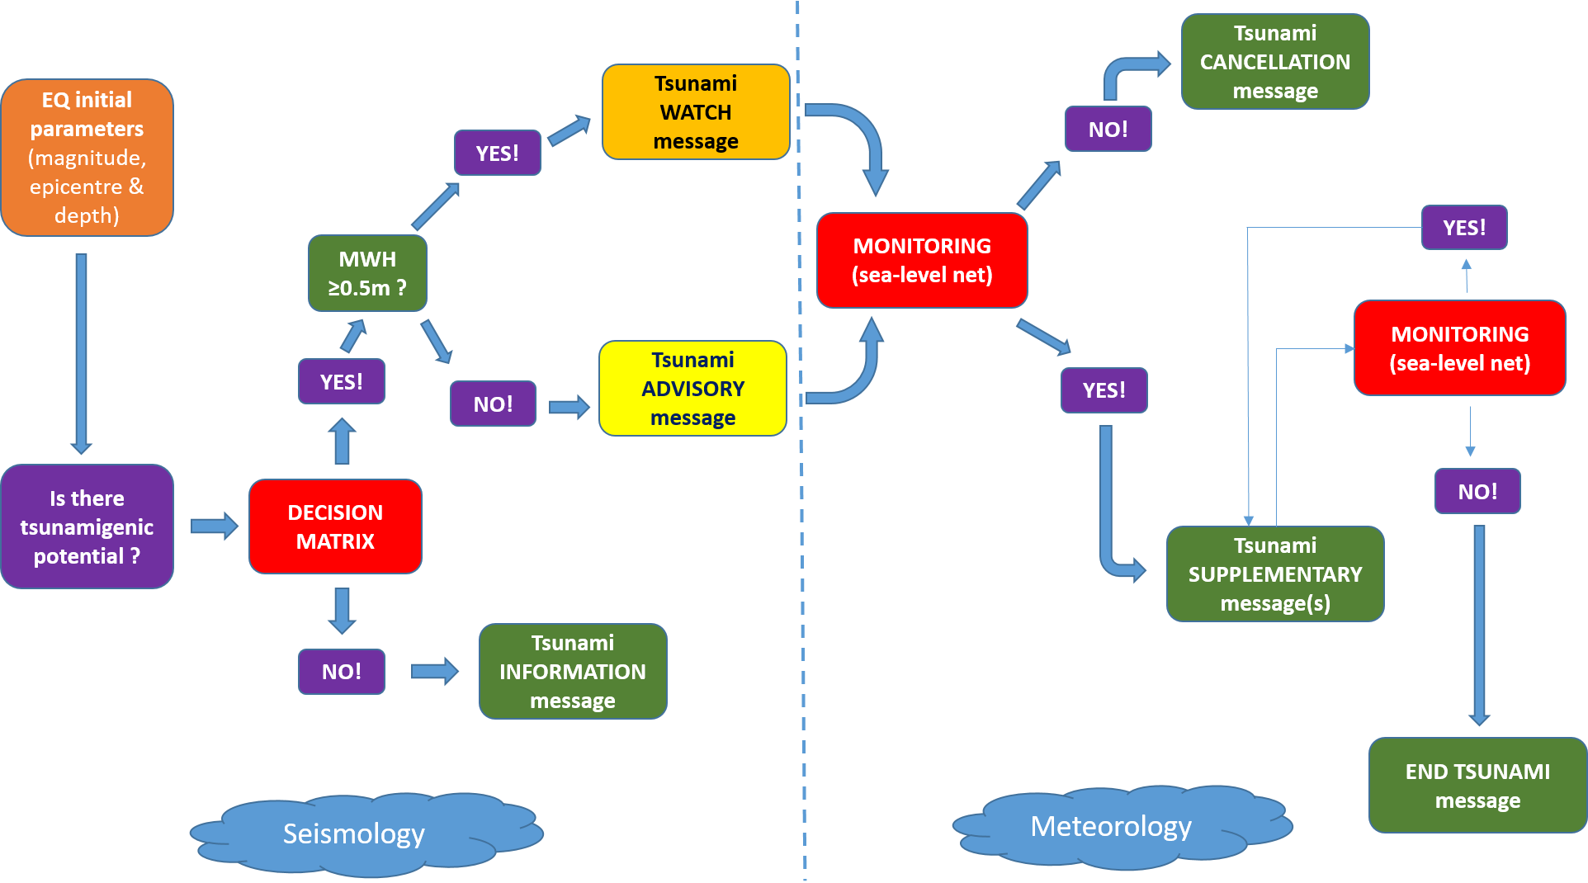

Slide 18
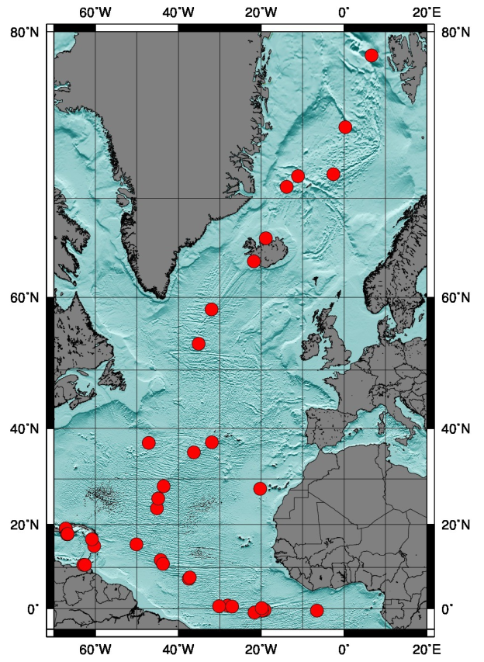
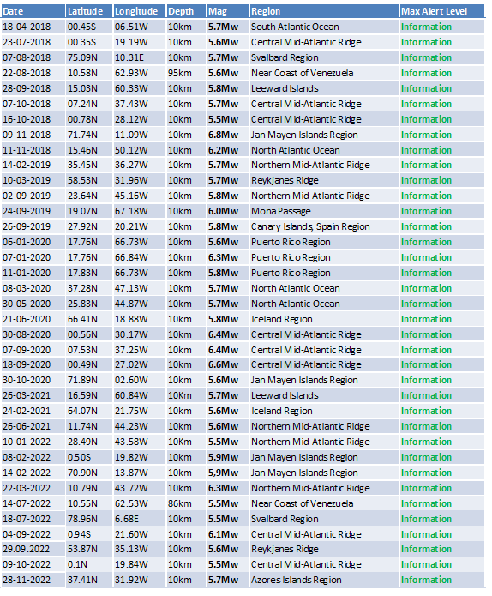
Regional level – TSP for NE Atlantic
Operation started on january 2018
Accreditation on 2019
37 Tsunami messages issued:
37 events

Slide 19
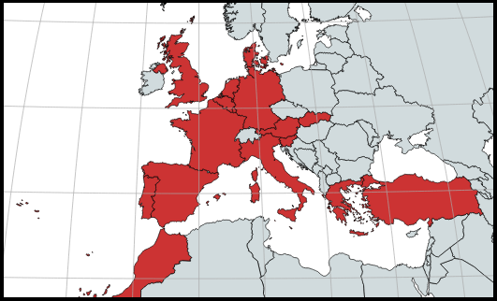
Regional level – TSP for NE Atlantic
Subscribers:
Portugal
Spain
Morocco
Denmark
France
Germany
UK
Turkey
Greece
Italy
IOC, ERCC and JRC

Slide 20
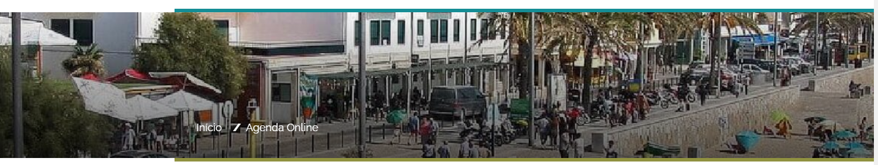

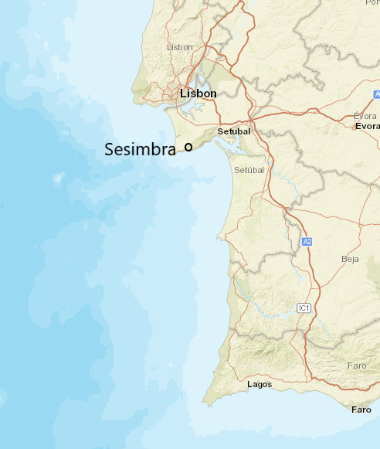
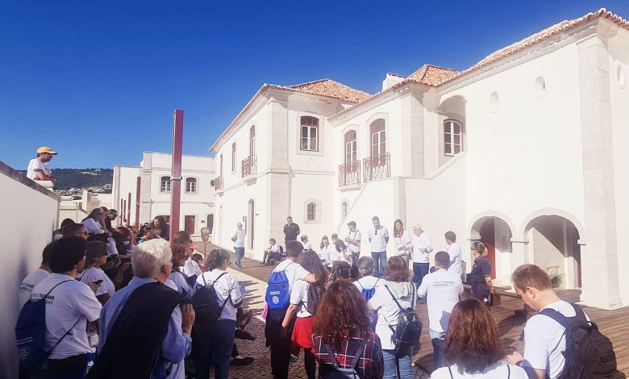
Tsunami Awareness Day
Secretary of state of Civil Protection
Sesimbra Mayor
ANEPC, IPMA, UNDRR

Slide 21
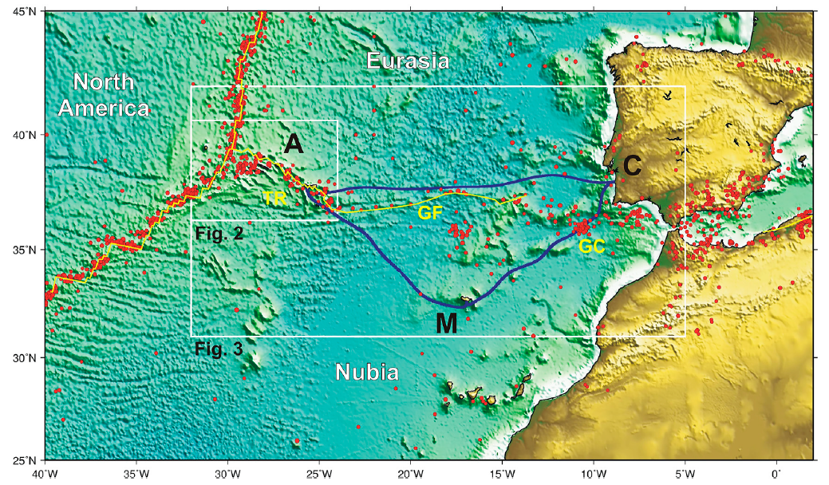


Future perspectives
New Submarine Cable Ring connecting PT Mainland-Azores-Madeira –
opportunity for a SMART system (SMART CAM)
December 2019
  Working group nominated by the Government recommended the implementation of “....Seismic and Environmental Detection”
September 2020
  Government published the decision of Renew the CAM ring including “Seismic and Environement Detection”
October 2021
  Project included in the general budget of the state for 2022
  SMART funcionalities included
September 2022
  Public company, IP TELECOM, formally designated to implement the project
November 2022
  Resolution of the Council of Ministers (nr. 104/2022, 2nov)
December 2022
  Call for proposals opened
from Matias et al., 2021

Slide 22
Thank you!

