Slide 1

Working Group 2+3:
Seismic, Geophysical and Sea Level measurements
Co-chairs
Anna von Gyldenfeldt (BSH)
Musavver Didem Cambaz (KOERI)
ICG/NEAMTWS Steering Committee 12-13 April 2023

Slide 2
WORKING GROUP II/III : Seismic, Geophysical & Sea Level Measurements: DRAFT PLAN OF ACTION for 2023
CO-CHAIRS : Anna von Gyldenfeldt (Federal Maritime and Hydrographic Agency / Germany),
Musavver Didem Cambaz (Kandilli Observatory and Earthquake Research Institute / Türkiye)
Strategic Area | Activity |  | Target / Result Indicators | Time Frame | Responsible Per/ Inst
Working Group 2+3: Seismic, Geophysical and Sea Level Measurements Anna von Gyldenfeldt (BSH, Germany) & Musavver Didem Cambaz (KOERI, Türkiye) | a) | Identify reference contacts for Seismic, Geophysical & Sea Level networks, to be included in the sensor data-bases, in order to facilitate bilateral agreements (persons not necessarily included in the list of experts). | IOC Circular Letter | 2023 | WG2+3 / IOC Secretariat
 | b) | Continue the evaluation of ocean bottom instruments, the progress of MS in the installations of offshore facilities and their possible inclusion in the operations of the TSPs. | Report to ICG | 2023 | WG2+3
 | c) | Maintain and strengthen cooperation with EC-JRC in providing real time data for the NEAMTWS. | Report to ICG and update relevant list | 2023 | WG2+3 / JRC
 | d) | Provide a list and/or identity online repositories of possible sea level stations by following developments in the EuroSea Project | Update list and compile online resources | 2023 | WG2+3
 | e) | Promotion of possible cooperation(s) with EuroGOOS Task Teams, like the one on HF radars for possible tsunami detection. | Report to ICG | 2023 | WG2+3
 | f) | Participation of WG2+3 co-chairs in meetings and the Steering Committee report progress to the ICG/NEAMTWS | 1 Co-Chairs meetings 2. Participation in SC 2023 3. Progress report to ICG/NEAMTWS | 2023 | WG2+3
 | g) | Explore, together with WG4, possibilities of conveying useful information of WG2+3’s work content through NEAMTIC (To be confirmed with the WG4 Co-Chairs at the next Steering Committees meeting). | Report to ICG | 2023 | WG2+3 / WG4
ICG/NEAMTWS Steering Committee 12-13 April 2023

Slide 3
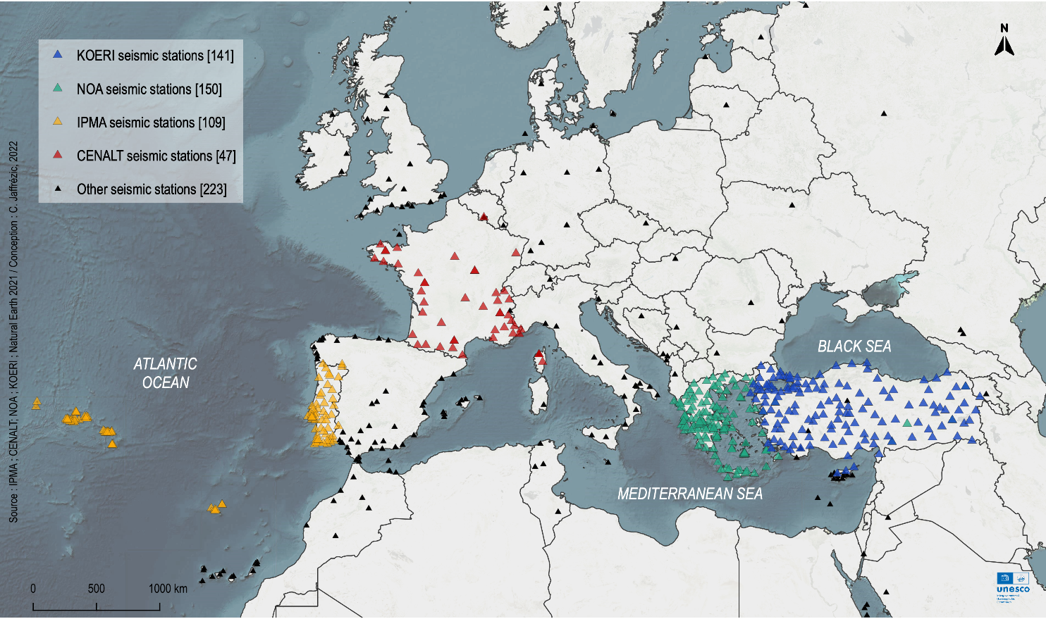
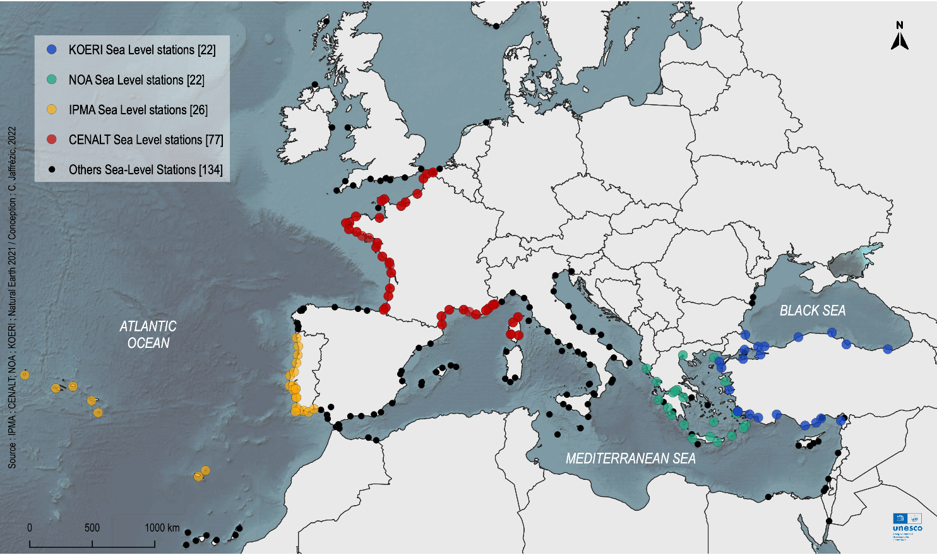
ICG/NEAMTWS Steering Committee 12-13 April 2023

Slide 4
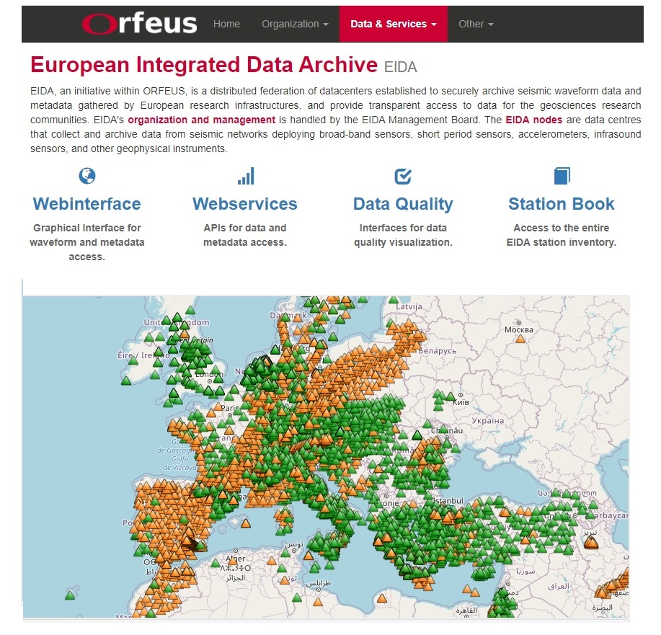
Publicly Accessible Seismic Stations
ICG/NEAMTWS Steering Committee 12-13 April 2023

Slide 5
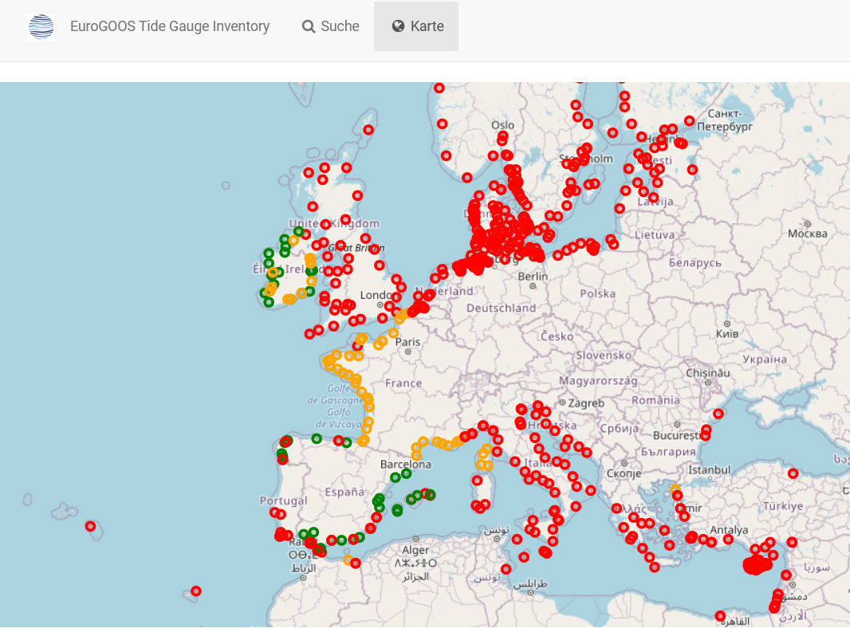
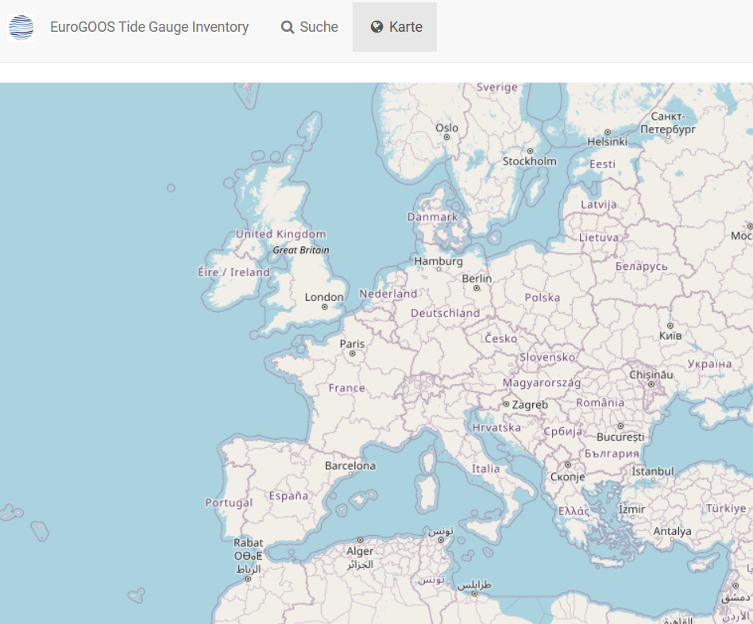
Publicly Accessible Sea Level Stations
EuroGOOS Tide Gauge Inventory
Metadata catalogue of all permanent, managed tide level monitoring stations across Europe and adjacent coastlines, including North Africa
ICG/NEAMTWS Steering Committee 12-13 April 2023

Slide 6
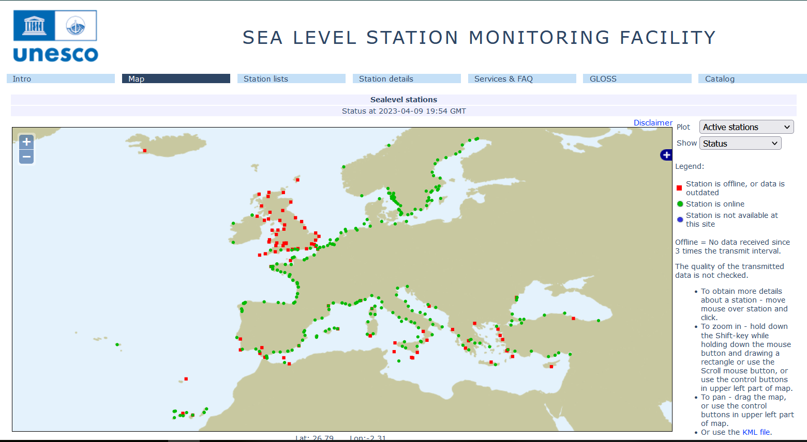
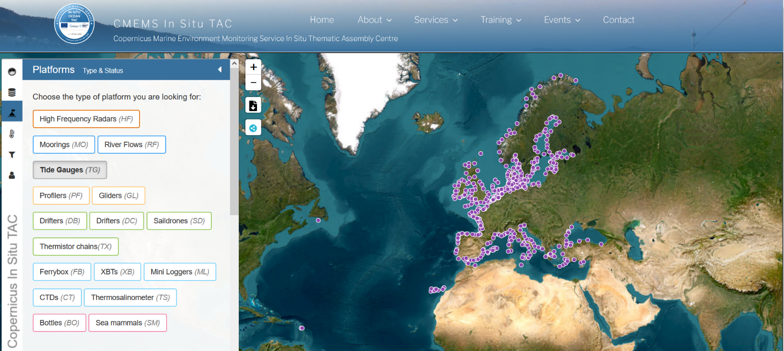
Publicly Accessible Sea Level Stations
IOC SLSMF
CMEMC In Situ TAC
Copernicus Marine Environment Monitoring Service In Situ Thematic Assembly Centre
ICG/NEAMTWS Steering Committee 12-13 April 2023

Slide 7
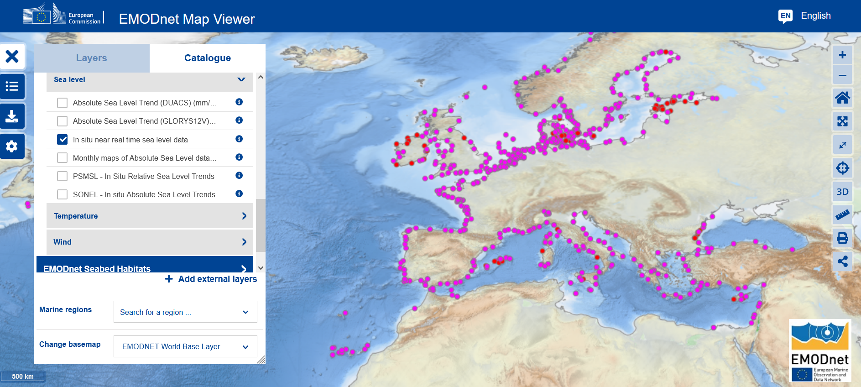
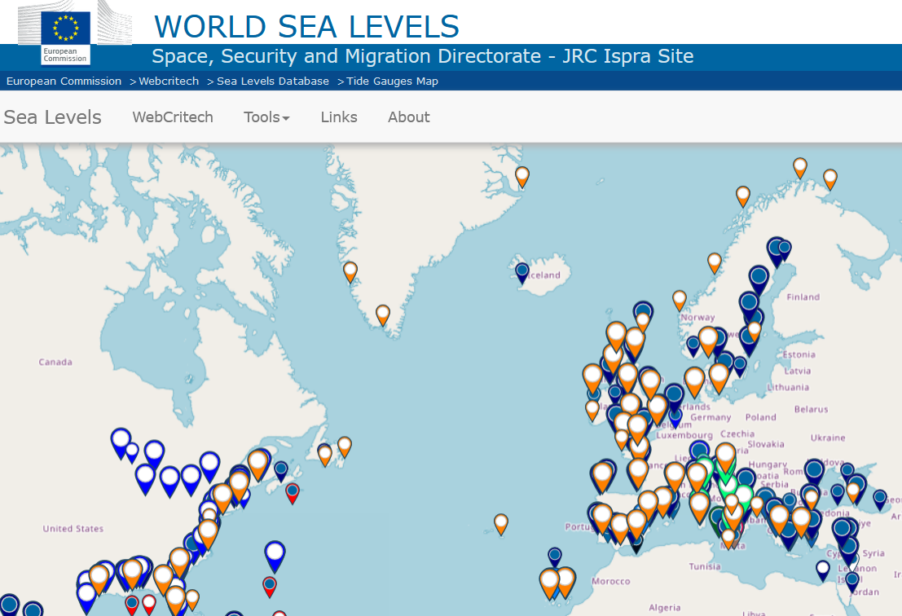
Publicly Accessible Sea Level Stations
EMODnet Physics
ICG/NEAMTWS Steering Committee 12-13 April 2023

Slide 8
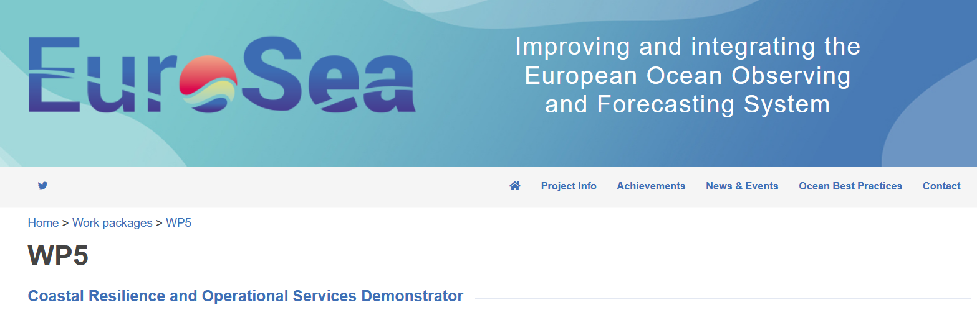
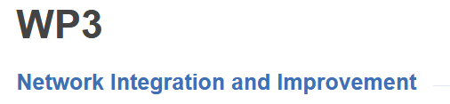

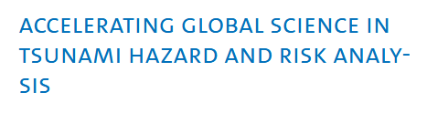
Projects
1.November 2019-31.12.2023
ICG/NEAMTWS Steering Committee 12-13 April 2023

Slide 9
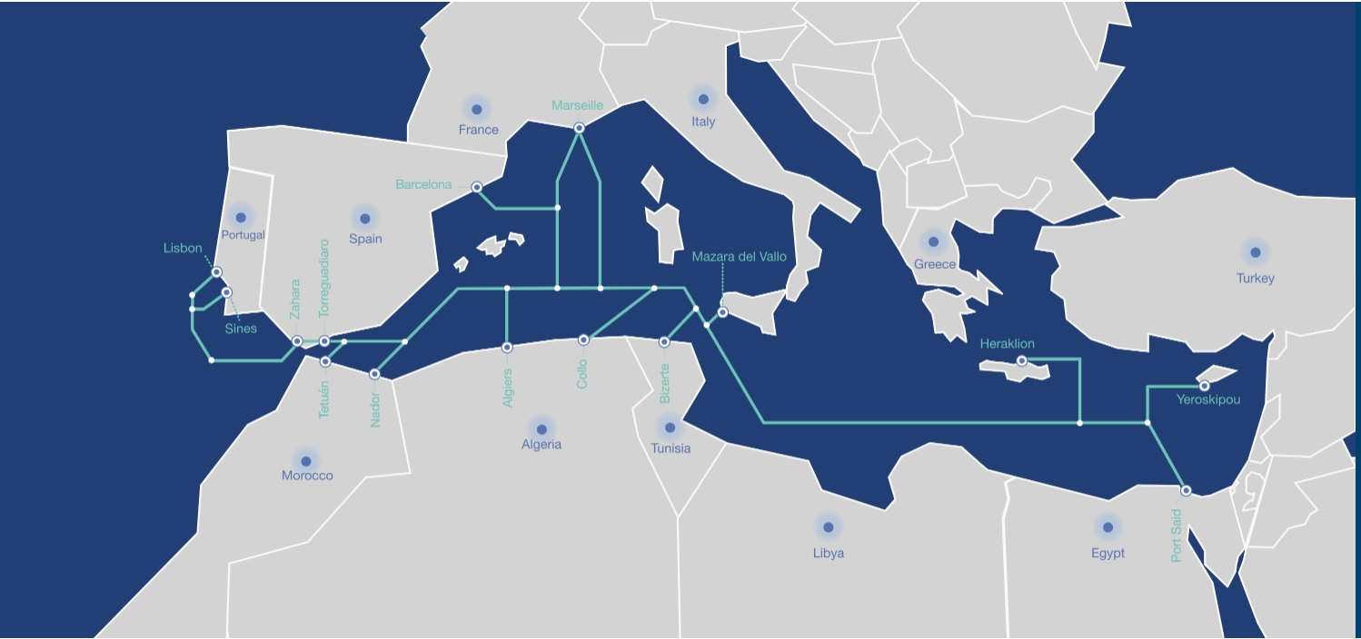
Projects
MEDUSA SUBMARINE CABLE SYSTEM
https://medusascs.com/
MEDUSA interconnects South European countries - Portugal, Spain, France, Italy & Greece - with North African countries - Morocco, Algeria, Tunisia & Egypt.
ICG/NEAMTWS Steering Committee 12-13 April 2023

