Slide 1

INGV Tsunami Alert Center (Italy)
NEAM Tsunami Service Provider
Alessandro Amato
NEAMTWS Steering Committee
12-13 April 2023, UNESCO HQ, Paris, France

Slide 2
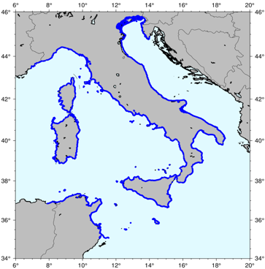

Pillar 1. New Tsunami Hazard Assessment for Italy
New Probabilistic earthquake model
Points of interest
List of earthquake scenarios (almost 9 Million)
Tsunami modeling (Tsunami-HySEA)
waveforms at point of interest
10 m isobath
5 km spacing
- - - >
+ local high resolution studies on specific targets
Distribution of tsunami height for all scenarios at all target points
Computationally heavy task performed thanks to
High Performance Computing on GPU clusters
Hazard aggregation &
uncertainty quantification
Hazard curves and maps for tsunami height at all target points and related uncertainty
HPC5@ENI

Slide 3
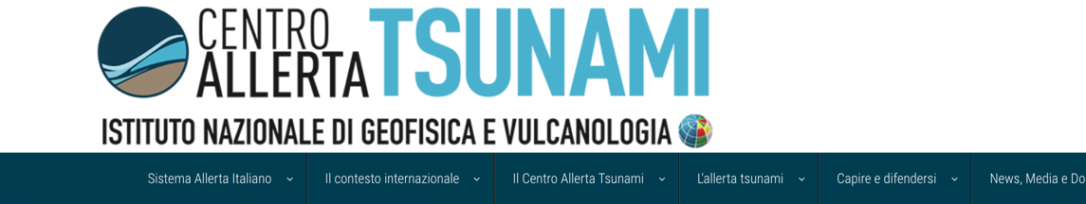
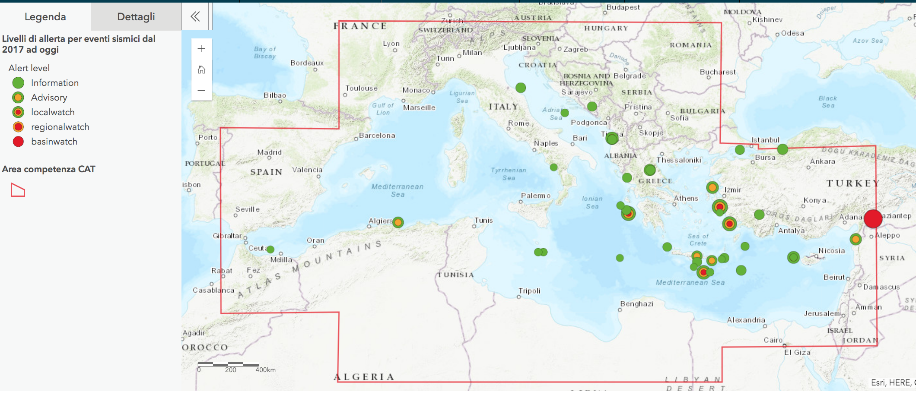
Pillar 2. Warning – last events
6-10 minutes time for issuing the most recent messages
Criticalities:
Basin Watch for Turkey earthquake
No tide gauges operating in Eastern Med. (except Turkey and partly Cyprus)
No diff. timing for distant countries
Long time for closing alert (lack of realtime modeling tools incl. PTF)

Slide 4
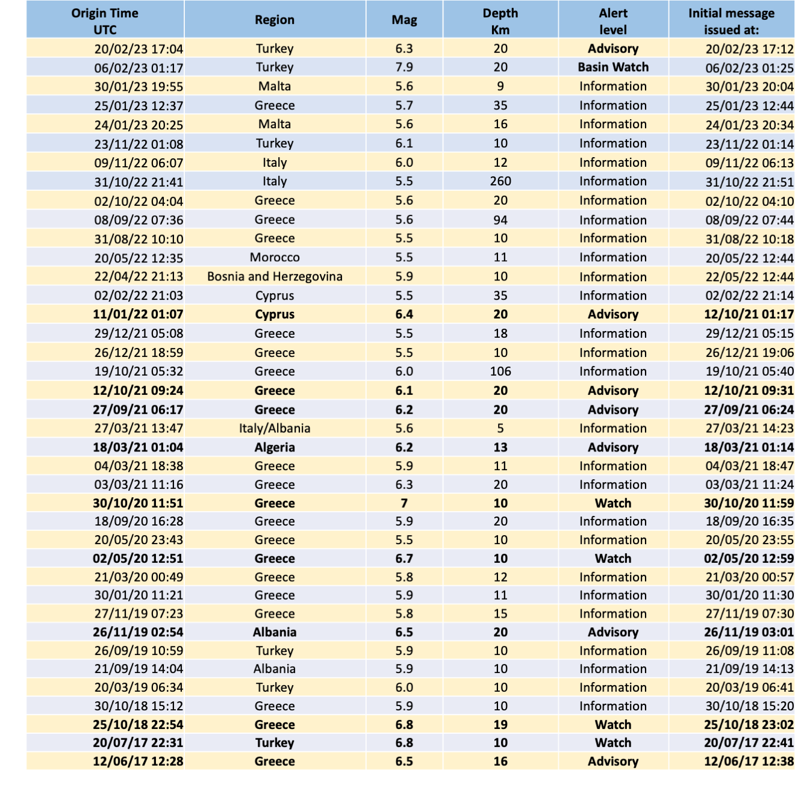
Events that triggered CAT-INGV 2017-2023/2
39 alerts since 2017
5 Watch
7 Advisory
27 Information
10 alerts in 2022 (6’-10’)
1 Advisory
9 Information
5 alerts in 2023 (7’-9’)
1 Basin Watch
1 Advisory
3 Information
2023
Notes:
Il terremoto in Turchia del 6/2/2023 è stato il primo evento ad avere generato un’allerta WATCH (massima= runup attesi maggiori di 1 metro) per tutto il Mediterraneo.
Vedere Matrice Decisionale prossima slide.

Slide 5
30 March 2023: 5’ information message for Chile event
TSUNAMI MESSAGE NUMBER 001
NEAM INGV IT-NTWC TSUNAMI SERVICE PROVIDER
ISSUED AT 1738Z 30 MAR 2023
... TSUNAMI INFORMATION ...
THIS ALERT APPLIES TO ARGENTINA ... CHILE
THIS ALERT IS ADDRESSED TO ALL COUNTRIES AND INSTITUTIONS SUBSCRIBED
TO THE SERVICES OF INGV TSP IN ITS MONITORING AREA
THIS MESSAGE IS ISSUED AS ADVICE TO GOVERNMENT AGENCIES. ONLY
NATIONAL AND LOCAL GOVERNMENT AGENCIES HAVE THE AUTHORITY TO MAKE
DECISIONS REGARDING THE OFFICIAL STATE OF ALERT IN THEIR AREA AND ANY
ACTIONS TO BE TAKEN IN RESPONSE.
AN EARTHQUAKE HAS OCCURRED WITH THESE PRELIMINARY PARAMETERS
ORIGIN TIME - 1733Z 30 MAR 2023
COORDINATES - 35.64 SOUTH 73.53 WEST
DEPTH - 117 KM
LOCATION - CHILE_PERUVIAN_POINT_OF_VIEW
MAGNITUDE - 6.6
ALERT LEVEL IS ASSIGNED ACCORDING TO THE ABOVE ESTIMATIONS OF
EARTHQUAKE PARAMETERS AND BASED ON ICG/NEAMTWS DECISION MATRIX
EVALUATION OF TSUNAMI INFORMATION
BASED ON HISTORICAL EARTHQUAKE AND TSUNAMI MODELLING THERE IS NO
THREAT THAT A TSUNAMI HAS BEEN GENERATED THAT CAN CAUSE DAMAGE OR
MAJOR EFFECT IN THE REGION. THIS MESSAGE IS FOR INFORMATION ONLY

Slide 6
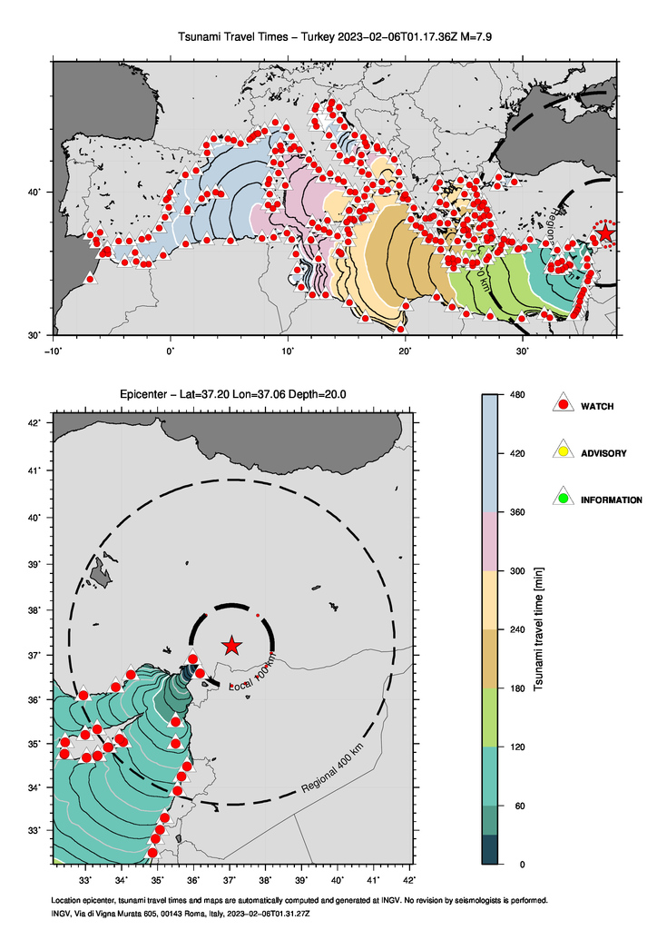
Turkey – 6 February 2023 – Decision Matrix

Slide 7
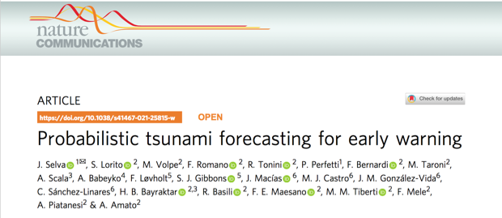
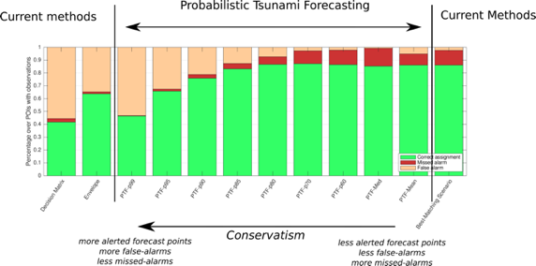
Alert Levels: Probabilistic Tsunami Forecasting
MAIN STEPS TOWARDS OPERATION
Procedure is currently under continuous test in parallel with the Decision Matrix
Review COMPLETED (Jan. 27, 2023) by INGV Scientific Committee through a selected panel of international reviewers (5). Positive, with request for other testing
Further tests ongoing
Ongoing coordination with Italian CP Department - Decisions on thresholds
Acceleration after the Turkey event of Feb. 6, 2023, in order to limit false alarms
- PTF treats explicitly data and forecast uncertainties
- PTF enables alert level definition according to any predefined level of conservatism

Slide 8
Turkey – 6 February 2023 – PTF

Slide 9
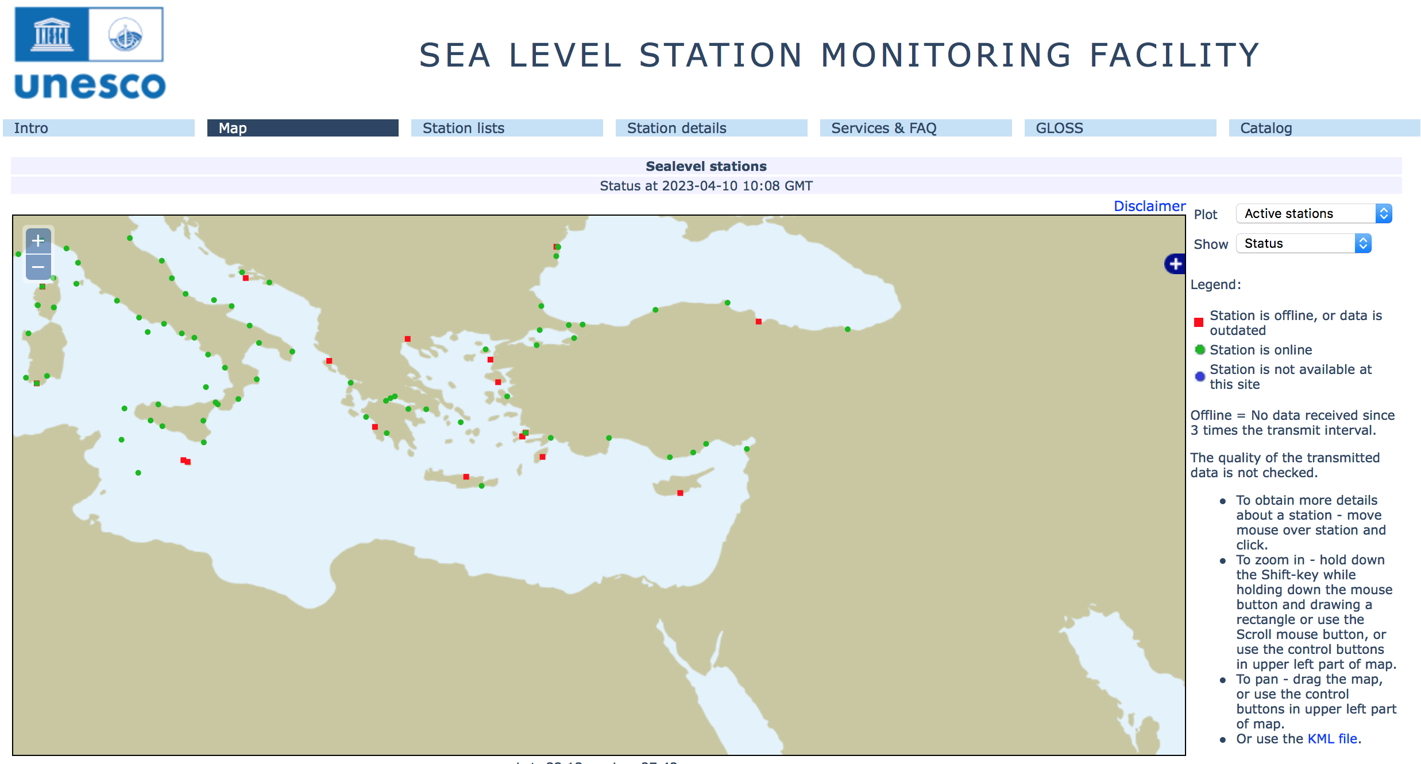

Slide 10
Pillar 2. Warning – Ongoing developments 2022-23
(on sea level monitoring)
Two DART-like buoys in the Ionian Sea (TUO project, coord. S. Lorito) in 2023-2024
One DART-like buoy with INGV-made technology (G. D’Anna, EMSO-MedIt project)
Pressure sensors on EMSO Observatories and SMART cables
Pressure sensors on oil/gas offshore platforms (Ionian, Adriatic)
ISPRA: New generation tide gauges in Italy (and possibly some deep-sea pressure sensors)
GNSS monitoring for rapid source characterization

Slide 11


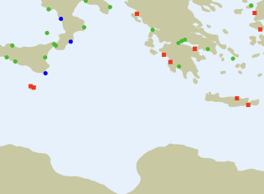
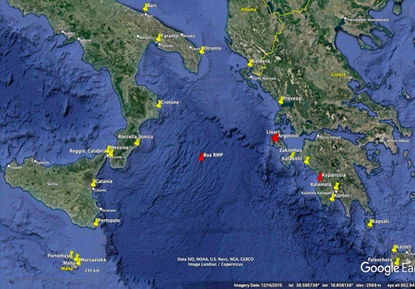

WP 8
Coordinator
Stefano Lorito
INGV
+
TUO
TsUnami Observation
2 (+1) DARTs in the Ionian Sea - exact positions to be determined (+ 1)
Assigned Budget: 3 M€

Slide 12
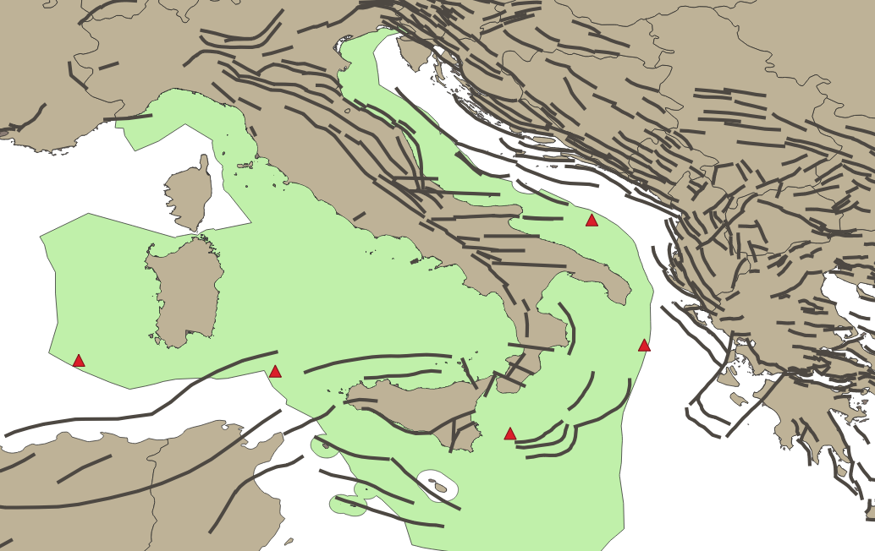
ISPRA buoys 2023-2025

Slide 13
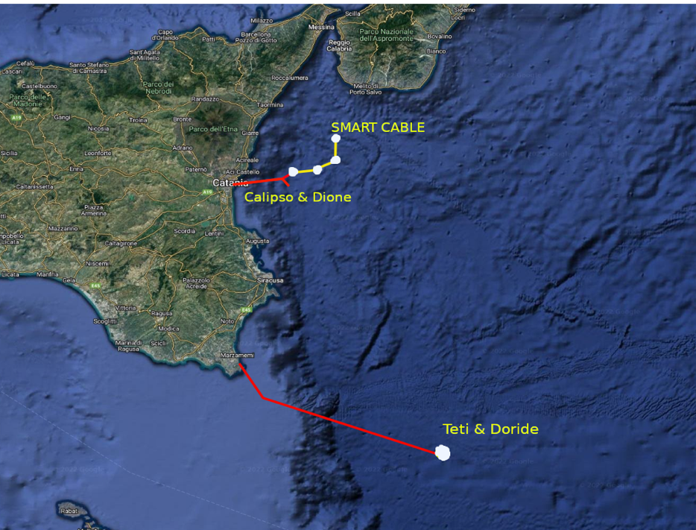
Installations of pressure sensors ongoing in the Ionian Sea at observatories PON INSEA & SMART Cable (G. Marinaro)
Pressure sensors to be installed on
CALIPSO & DIONE (-2100 m)
TETI & DORIDE (-3500 m)
3 Pressure sensors to be installed on the SMART CABLE
(at about 6 km distance)
CATANIA
PORTOPALO

Slide 14
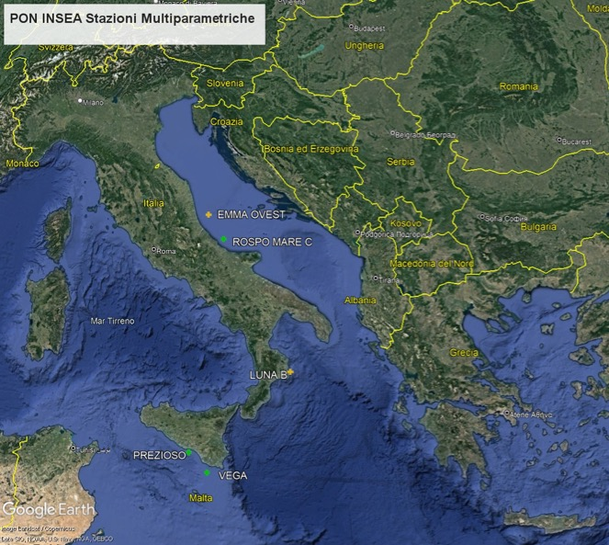
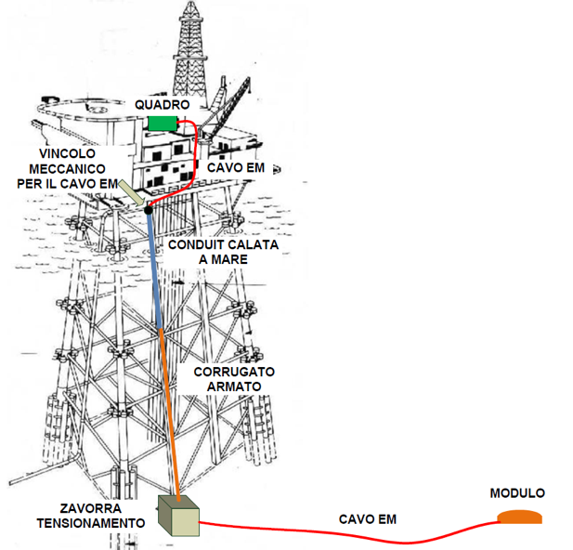
Pressure sensors on 5 oil / gas platforms in the Adriatic, Ionian seas and Sicily channel
Test: October 2022
Installation: March/April 2023

Slide 15
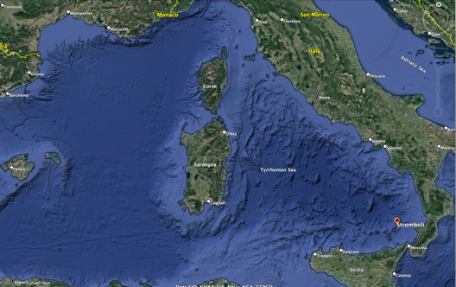
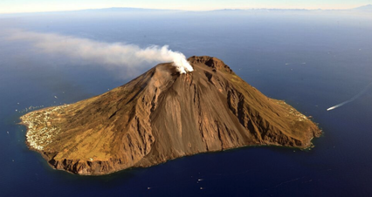
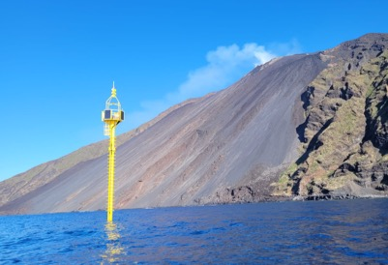
New Task: Local system at Stromboli Island (with Univ. Of Florence)
During the last 10 years the University of Florence installed a monitoring and alerting system for local tsunamis, consisting of 2 elastic beacons (equipped with pressure sensors).
Starting from September 2022, CAT-INGV has the responsibility of managing and developing this system (in close collaboration with the University of Florence) and of integrating it with the National and, hopefully, with the NEAM Tsunami Warning System.
Recent events triggering tsunamis: 2002 (landslide), 2019 (pyroclastic flow), small events in 2022
Tsunami generated and measured on Dec. 4
Ongoing hazard assessment …
Integration between local system and NEAM procedures ongoing
Aeolian Archipelago
Sciara del Fuoco
Elastic Beacon

Slide 16
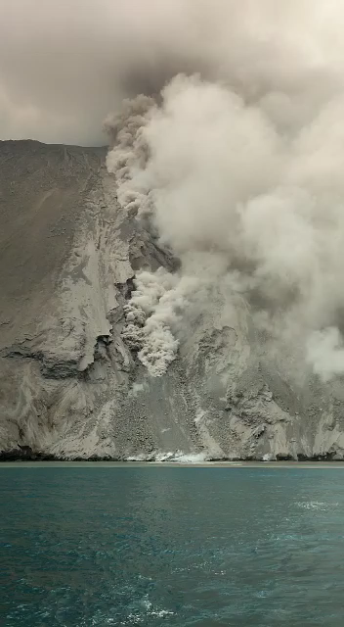
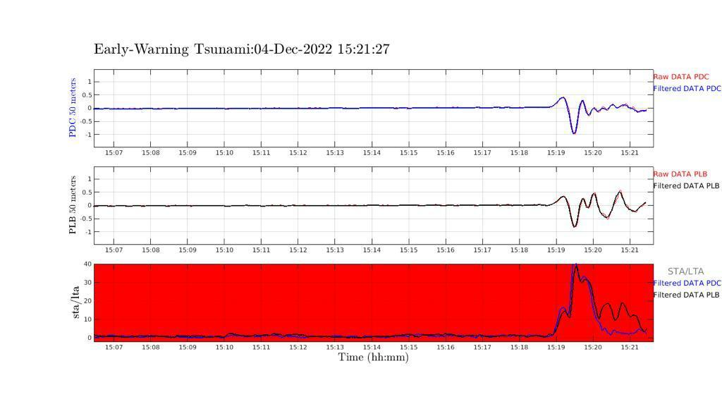
Stromboli
December 4, 2023
News (2/23): Real time data from the 2 beacons received at CAT
(but analysis and automatic alerting procedure still in Stromboli by UniFI → DPC -> public alert)

Slide 17

Pillar 3- Awareness and Response
(WG4 Report)
Risk perception studies
  A study on global RP studies (Cugliari et al., Frontiers, in press 2022)
  New regions in central-southern Italy + a national sample (NHESS, in press 2022)
  Specific studies in schools and other stakeholders (online questionnaire – mobile phones)
Tsunami Ready
  Advancements in the 3 Italian candidates (see TT-Tsunami Ready)
  New request (Otranto, Apulia)
CAT website updates
  24 News in 2022 (Italian and English)
  New features on the home page map and on contents
WTAD 2022 activities
  Report in WG4

Slide 18
CAT website – Last news /English + Italian
Articles
Tsu-Memo: April 1, 1946 and the establishment of the first Tsunami Warning Center.
Tsu-Memo: 11.03.11 Japan's tsunami and lost and found objects
09.02.23 - Minturno takes final steps to become first Italian Tsunami Ready municipality
06.02.2023 - Turkey and Syria (updating), WATCH tsunami warning for M 7.9 earthquake
30.01.23 - Malta, information message for sea earthquake
25.01.23 - Greece, information message for earthquake in sea
24.01.23 – Malta, information message for earthquake in sea
Stromboli, Dec. 4, 2022: tsunami yes or no?
23.11.22 - INFORMATION message for earthquake in Turkey
09.11.22 - information message for earthquake offshore Marche coast (Pesaro-Urbino)

Slide 19
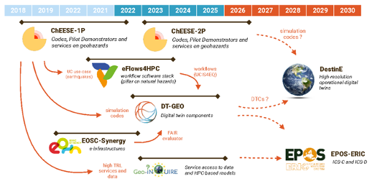
Participation in ongoing projects

