Slide 1
PTWS Tsunami Ready Implementation February 2023 (PTWS-SC, TOWS TT-TMP)
Dr. Laura Kong
Director
UNESCO/IOC International Tsunami Information Centre

Slide 2
What is UNESCO IOC Tsunami Ready Recognition Programme
IOC Manual and Guides 74:
2.1 Framework, Background, and History

Slide 3


Global Frameworks
Societal Outcomes
A Clean Ocean
A Healthy and Resilient Ocean
A Productive Ocean
A Predicted Ocean
A Safe Ocean
An Accessible Ocean
An Inspiring and Engaging Ocean
Tsunami Ready In UN Ocean Decade of Ocean Science for Sustainable Development
The Ocean
We Need
for the Future
We Want
UN Decade of Ocean Science for Sustainable Development
2021-2030
Enhance multi-hazard early warning services for all geophysical, ecological, biological, weather, climate and anthropogenic related ocean and coastal hazards, and mainstream community preparedness and resilience.
Notes:
A clean ocean where sources of pollution are identified and reduced or removed,
A healthy and resilient ocean where marine ecosystems are understood, protected, restored and managed,
A productive ocean supporting sustainable food supply and a sustainable ocean economy,
A predicted ocean where society understands and can respond to changing ocean conditions,
A safe ocean where life and livelihoods are protected from ocean-related hazards,
An accessible ocean with open and equitable access to data, information and technology and innovation,
An inspiring and engaging ocean where society understands and values the ocean in relation to human wellbeing and sustainable development

Slide 4

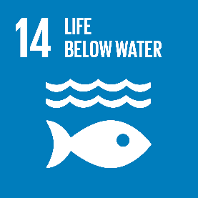


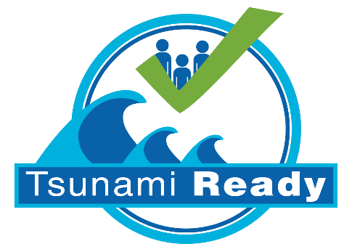
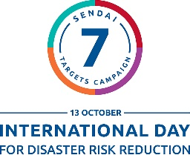

Global Frameworks
SAFE
OCEAN
Sustainable
Development Goals
2015-2030
Not oceans and shores that do not have coastal hazards (i.e- Tsunami).
….. is coastal area and ocean that is understood, observed, can be predicted, and where the people can continue to interact with the sea and oceans for their livelihood and lifestyle without having the fear of coastal hazards (tsunamis), as they already have the awareness, knowledge, preparedness, skills, and abilities to safe themselves in case of an emergency (tsunami)
UN Decade of Ocean Science for Sustainable Development
2021-2030
Sendai Framework for DRR 2015 - 2030
World Tsunami Awareness Day
Notes:
Save Ocean dalam konteks tsunami Bukan Lautan dan Pesisir yang aman dari Tsunami. Tetap Lautan yang Pesisir dimana masyarakatnya dapat terus berinteraksi dengan laut untuk kehidupannya tanpa dipehuhi rasa takut akan bahaya tsunami dikarenakan sudah memiliki kesadaran, pengetahuan, keterampilan, dan kemampuan untuk menghadapi tsunami.

Slide 5


Global Frameworks
OCEAN DECADE TSUNAMI PROGRAMME
Seeking Major Advances in SCIENCE and PREPAREDNESS
RESILIENCE!
Communities respond to tsunami threats by combining accurate 1. Real-time impact forecasts with 2. Deep community preparedness. Tsunami disaster impacts are minimized, enabling rapid restoration of critical infrastructure and services
New observational and analysis technologies to move from a high-uncertainty assumption-based capability to a low-uncertainty dynamic-based capability
Comprehensive institutional & community preparedness and capacity building efforts aimed at achieving IOC Tsunami Ready designation across all socio-economic categories

Slide 6

Global Frameworks
OCEAN DECADE TSUNAMI PROGRAMME
Seeking Major Advances in SCIENCE and PREPAREDNESS
THE MAIN SOCIAL OUTCOME
BY 2030
TO MAKE 100%
OF COMMUNITIES AT RISK OF TSUNAMI PREPARED FOR AND RESILIENT TO TSUNAMIS
Tsunami Coalition: collaborative with critical UN stakeholders, civil protection, others ==> Raise profile. Facilitate resourcing
Capacity Development: augmented through IOC Ocean Teacher Global Academy (OTGA) ==> Global reach, deep curricula

Slide 7
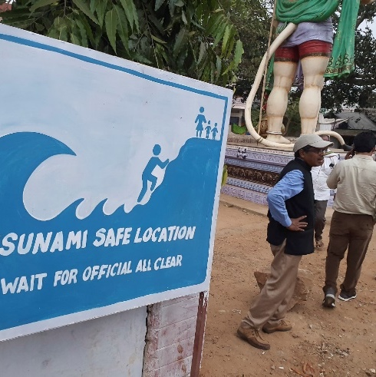
Why do you need Tsunami Ready ?
An advanced tsunami early warning system will not save life if the community at risk does not have the knowledge and capacity to respond to the early warning.
There is a high risk of loss of life and property in coastal communities with weak or no community preparedness for tsunami emergencies
In near-field* tsunami situations, the community needs to react and take action without official warning or guidance
If the warning chain to the community is weak or broken, the community must be prepared to take action on its own initiative
Lack of or limited focus on community preparedness leaves a community more at risk during a tsunami event
* When a tsunami arrives in less than 1 hour from its source. Usually within a 100 – 200km range of the epicentre

Slide 8



History of the Implementation of Tsunami Ready
IOC Assembly approved UNESCO/IOC Tsunami Ready Recognition Pilot Programme
IOC Assembly established IOC Ocean Decade Tsunami Programme including Tsunami Ready
Globally 100% At-Risk Communities Tsunami Ready
US NOAA National Weather Service established TsunamiReady® Program
2001
2015
2021
2030
2011
2017
2022
US NWS initial funding for joint NWS and UNESCO/IOC TsunamiReady® pilot in Caribbean and international community
United Nations declared Decade of Ocean Science for Sustainable Development 2021 - 2030
UNESCO/IOC established
Tsunami Ready Recognition Programme
Notes:
Tsunami Ready was established in 2001 by NOAA’s NWS. It’s goal is to empower communities to be ready for the next tsunami through better planning, preparedness, and response. In 2011, the US program was first piloted in the Caribbean, and last year in June 2022, it was adopted as a global programme with the goal of making 100% of At-risk communities Tsunami Ready by 2030 as part of the United Nations Decade of Ocean Science.

Slide 9
Benefits of Tsunami Ready Programme
Strengthens tsunami preparedness of coastal communities
Improved assessments of Hazards, Risk, Inundation, and Evacuation
Improved early warning systems/warning chain
Improved public awareness, understanding of tsunami threat and preparedness
Tests awareness and preparedness through regular exercises
Strengthens preparedness for other hazards
Improves community planning
Encourages a consistent and sustainable approach to disaster risk reduction
Contributes to the aims of the Sendai Framework for Disaster Risk Reduction and Sustainable Development Goals
International recognition from UNESCO IOC as Tsunami Ready Community

Slide 10
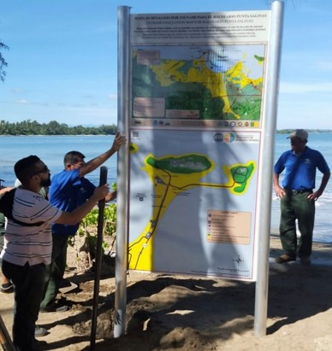
UNESCO IOC Tsunami Ready Approach
Bring the ownership of preparedness to the community
Ensure structural and systematic approach in building community preparedness
A collaborative effort to achieve a level of tsunami preparedness through the fulfilment of a set of established best practice guideline and indicators
Tsunami Ready is implemented on a voluntary basis and entails a “bottom-up” process with the community taking the initiative to build its own capacity. This approach ensures ownership of the process that strengthens its sustainability

Slide 11
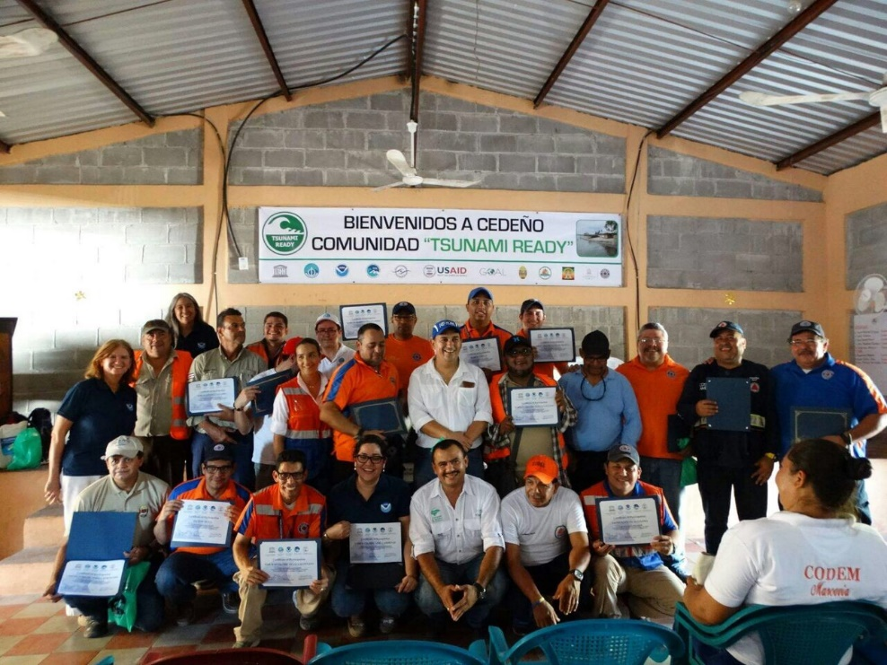
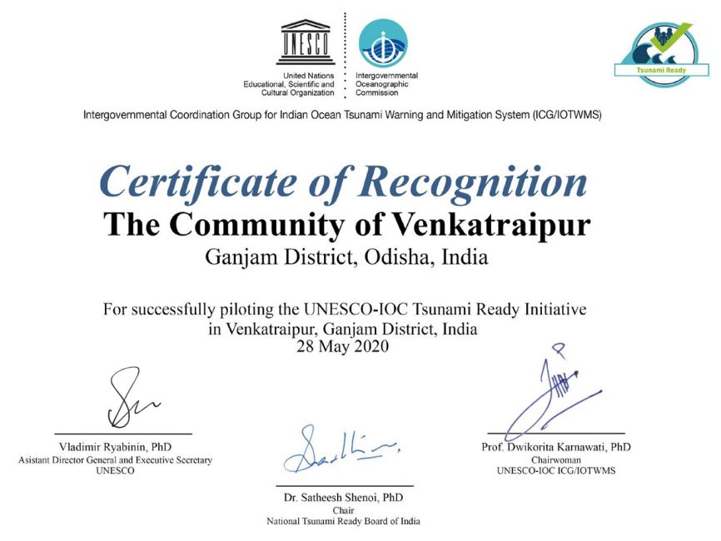
Why apply for Tsunami Ready recognition?
To appreciate the effort and achievements of the community
To motivate the community to continue to improve its level of preparedness
To enhance the sustainability of preparedness in the community
As leverage to for improvement and collaboration
To motivate others to follow the example of good practices

Slide 12
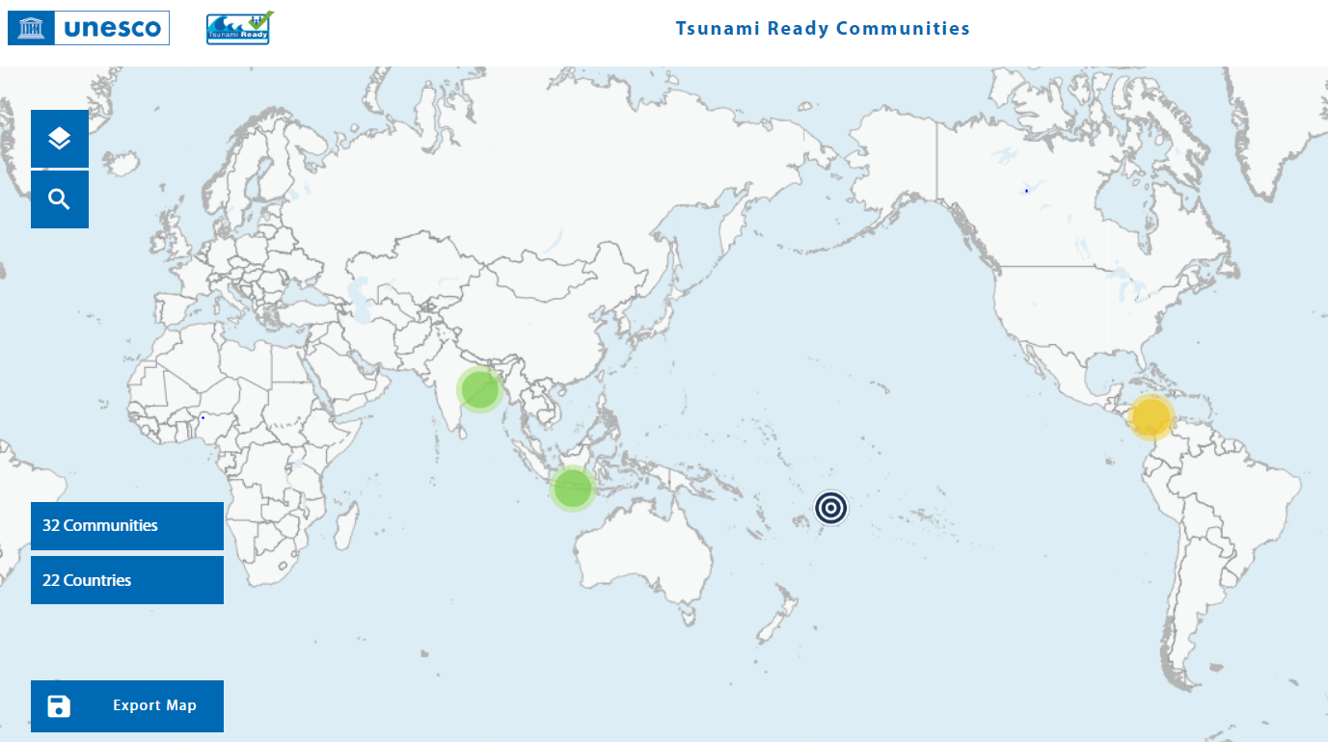
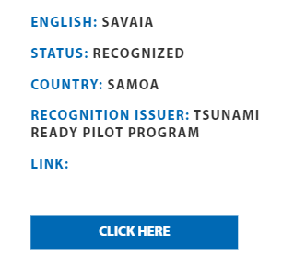
Benefits of UNESCO IOC Tsunami Ready Recognition
Prestige, as a community that has set good example of best practices and is internationally recognized as Tsunami Ready
Included in the Global Map of Tsunami Ready Communities
Potential economic benefits, in terms of increased investment and tourism
Notes:
Need a “click on” for larger picture

Slide 13
Tsunami Ready Disclaimer
A Tsunami Ready recognition does not imply approval or promise that a community can or will perform at a certain level in case of a tsunami. Tsunami Ready recognition does not mean that a community is tsunami proof; it is rather an acknowledgment and recognition of the measures adopted by the community to cope with their tsunami risk

Slide 14
What is UNESCO IOC Tsunami Ready Recognition Programme
IOC Manual and Guides 74:
4.1 Available Tools and Supports

Slide 15

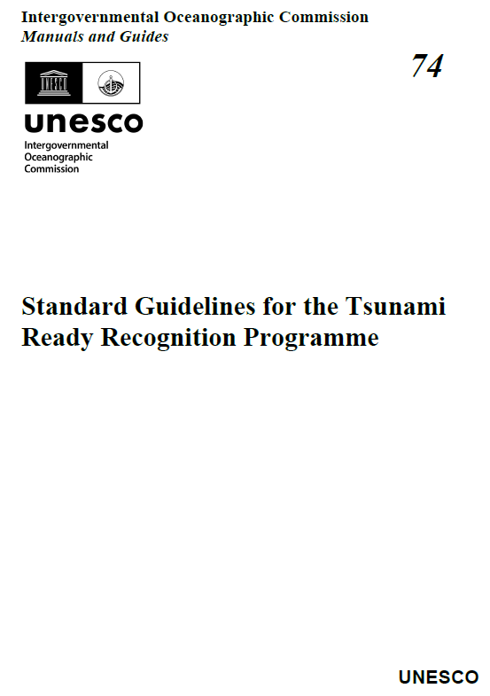
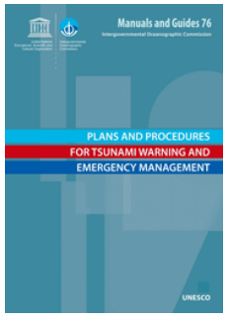
Manual and Guides
1
Manual and Guide No 58
Manual and Guide No 74
Manual and Guide No 76
https://unesdoc.unesco.org/ark:/48223/pf0000218967
https://oceanexpert.org/downloadFile/50068
https://unesdoc.unesco.org/ark:/48223/pf0000256552

Slide 16
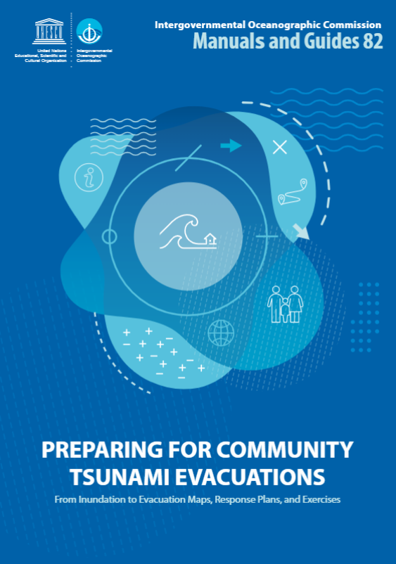
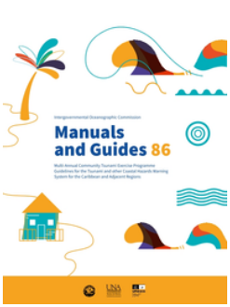
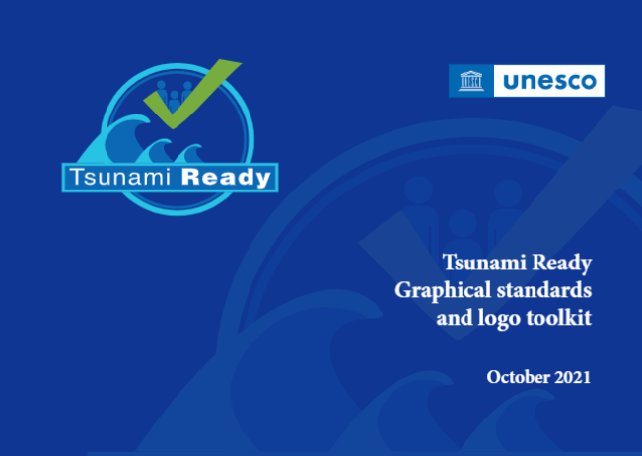
Manual and Guides
Manual and Guide No 82
Manual and Guide No 86
Use of the Tsunami Ready logo would need to request the approval from UNESCO/IOC Tsunami Unit. Please contact: ioc-tsu@unesco.org for permission.
Multi-annual community tsunami exercise programme: guidelines for the tsunami and other coastal hazards warning system for the Caribbean and Adjacent Regions
https://unesdoc.unesco.org/ark:/48223/pf0000373019?posInSet=17&queryId=947ca611-1880-4ded-bb5a-4bd61c93c161
https://unesdoc.unesco.org/ark:/48223/pf0000380936
https://unesdoc.unesco.org/ark:/48223/pf0000380540.locale=en

Slide 17
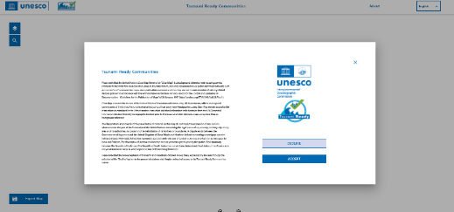
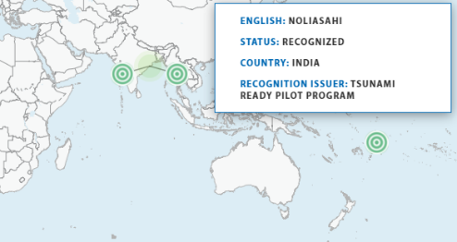
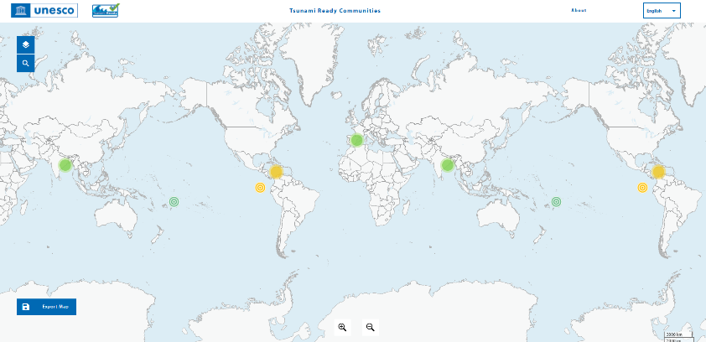
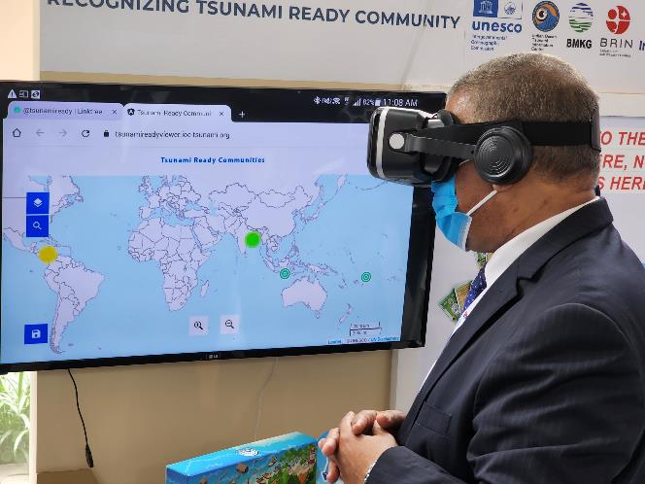
Global Tsunami Ready Map
2
https://tsunamireadyviewer.ioc-tsunami.org/

Slide 18


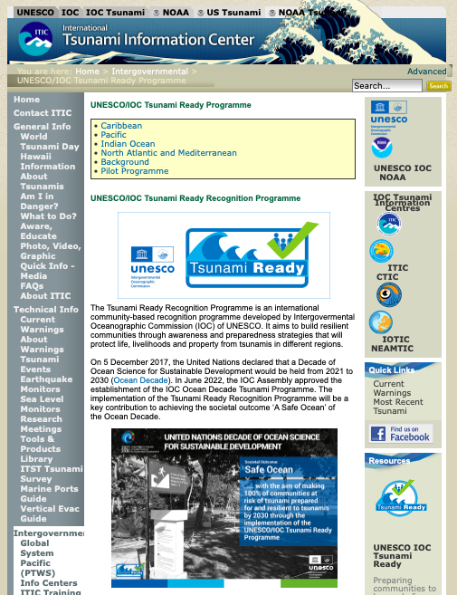
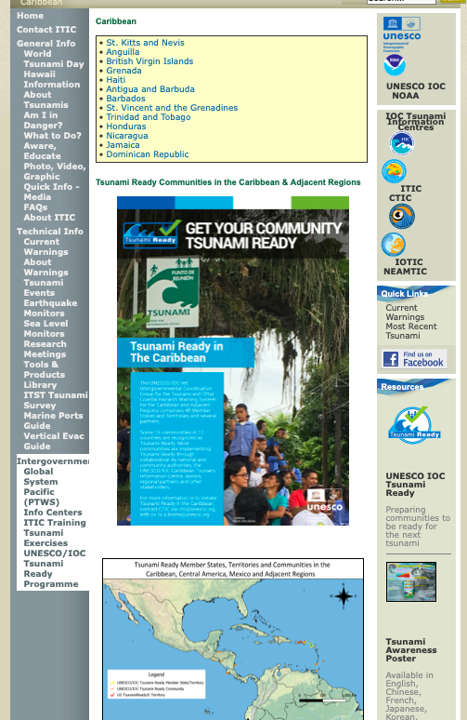
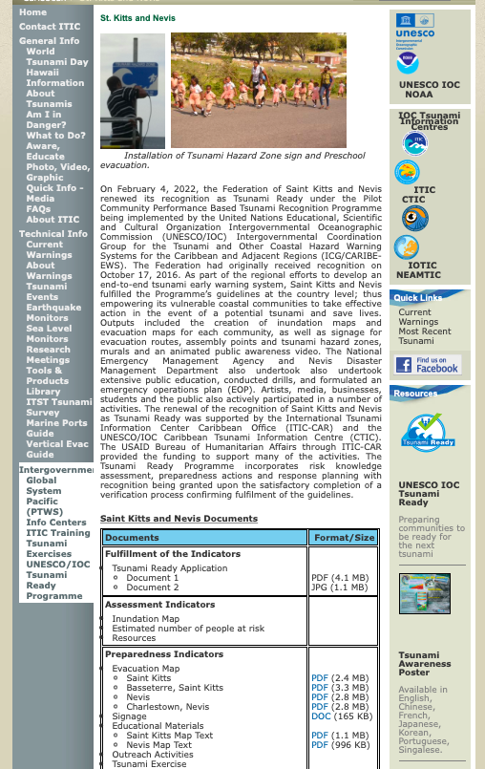
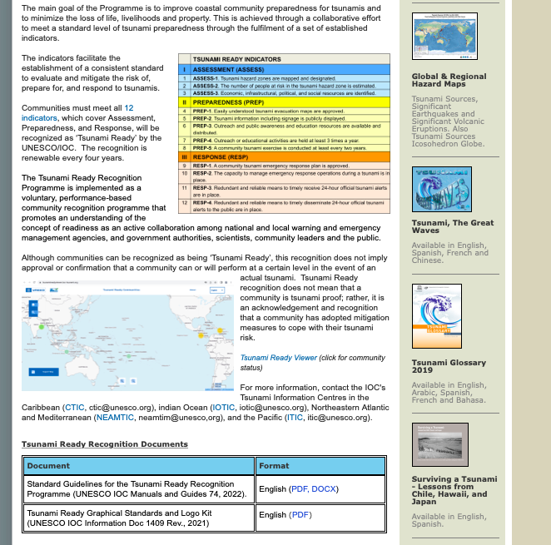
UNESCO IOC Tsunami Ready web site
www.tsunamiready.org
Tsunami Ready Viewer

Slide 19
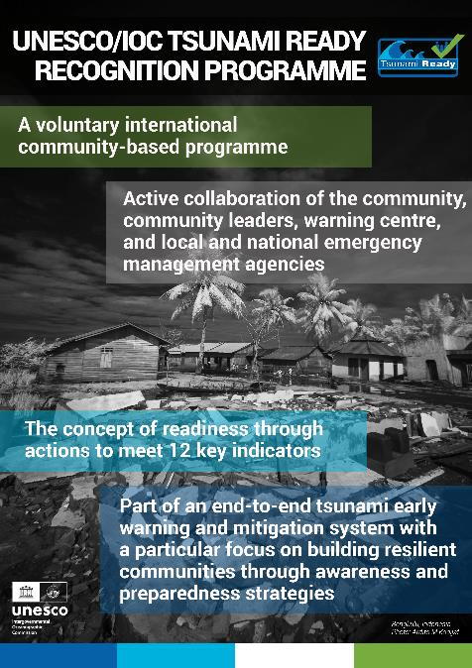
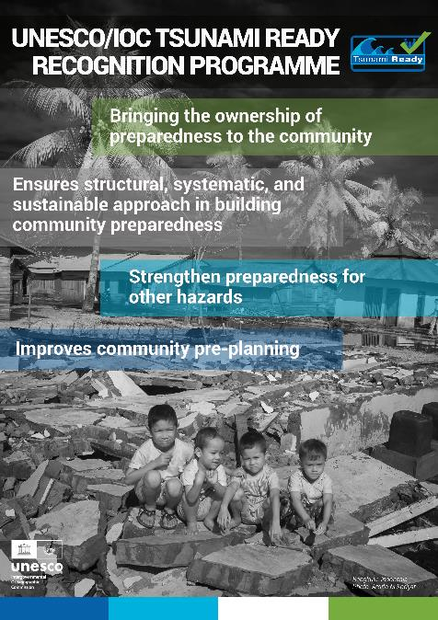
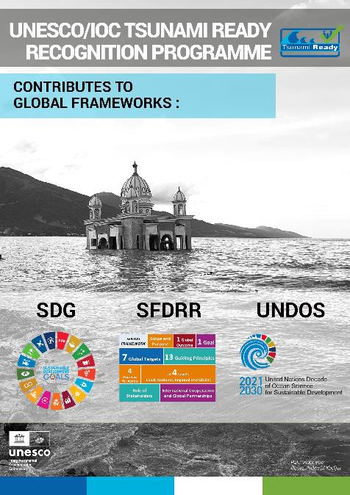
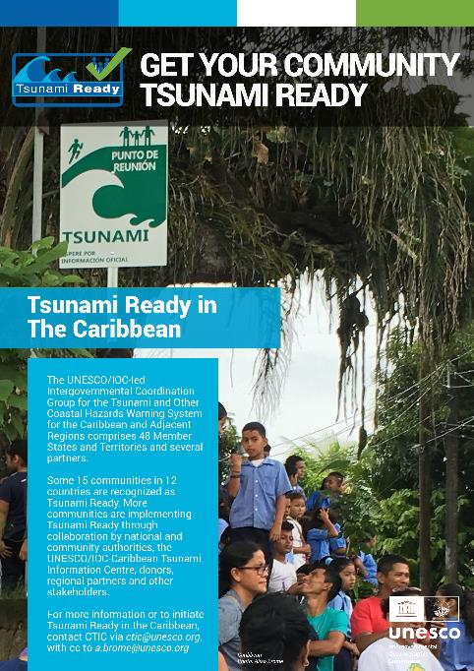
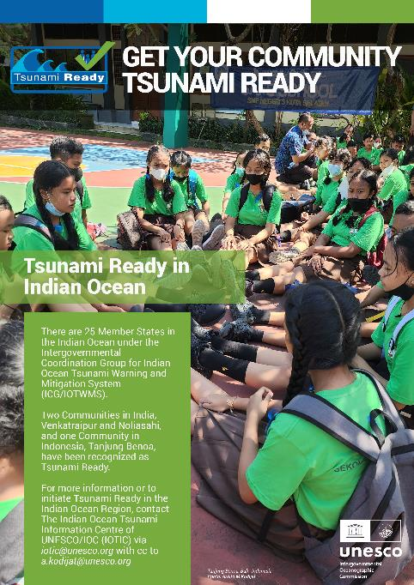
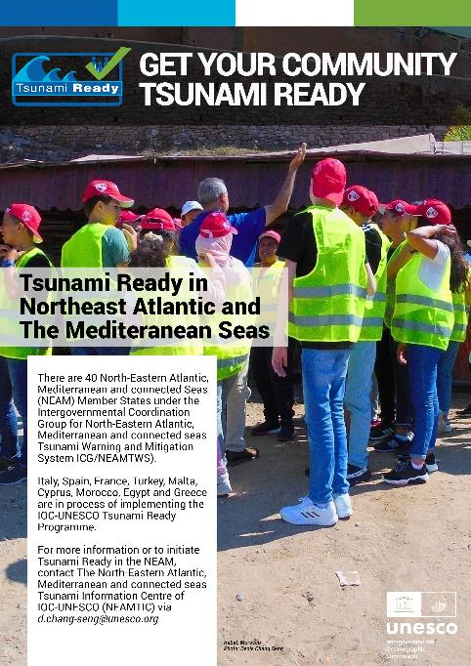
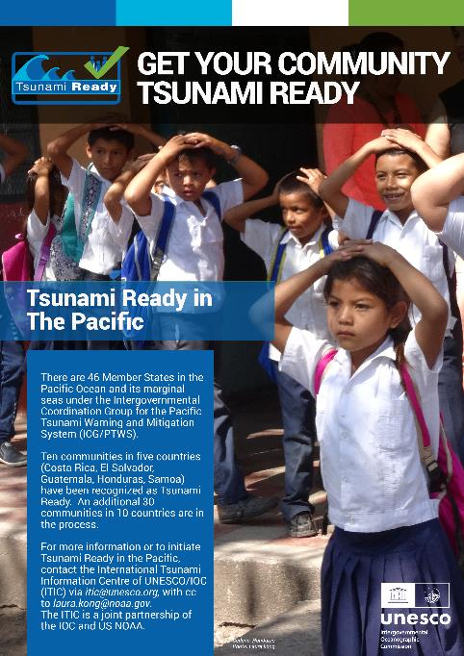
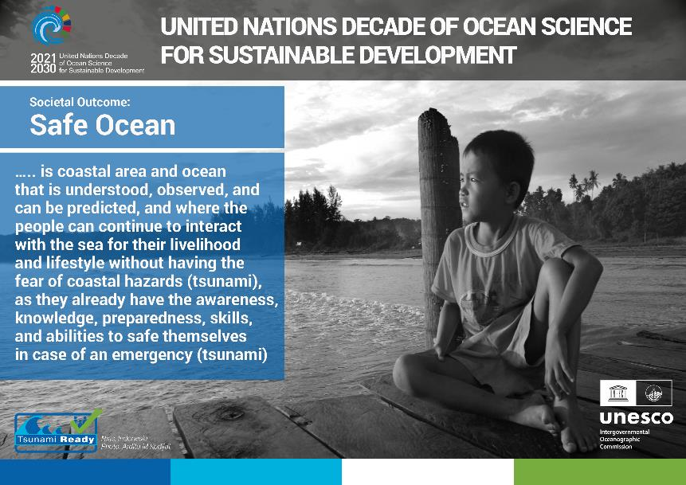
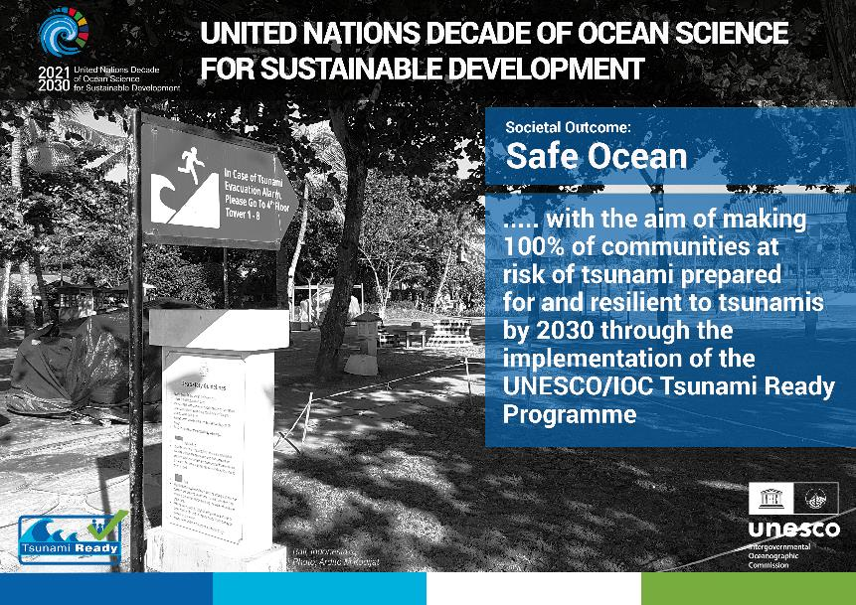
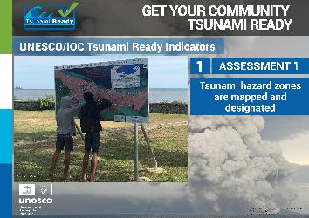
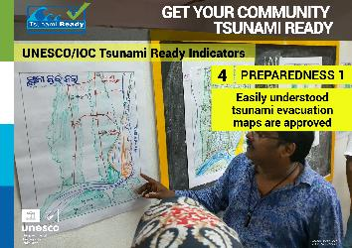
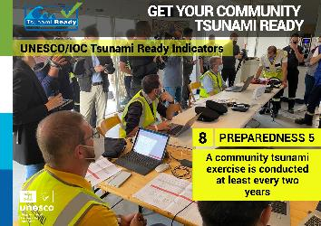
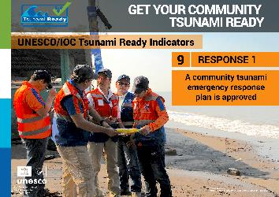
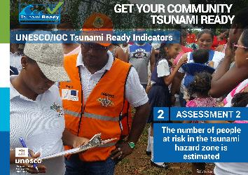
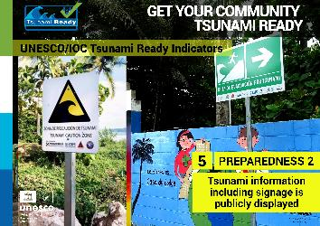
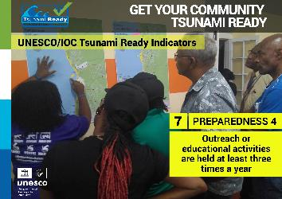
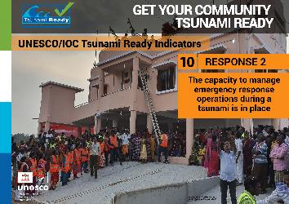
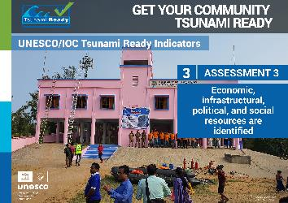
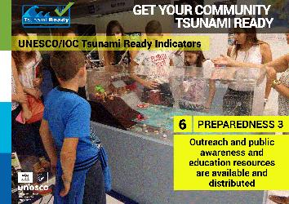
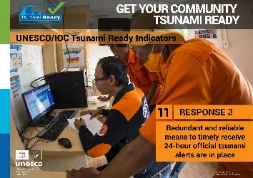
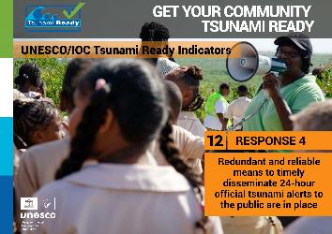
Tsunami Ready Posters
4
21 E-Posters Tsunami Ready

Slide 20
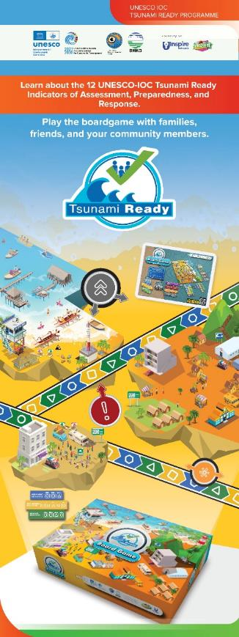
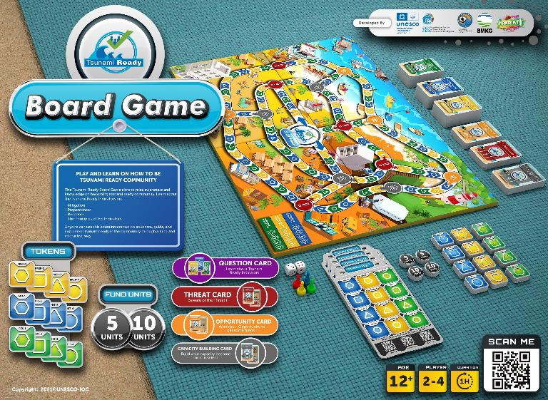
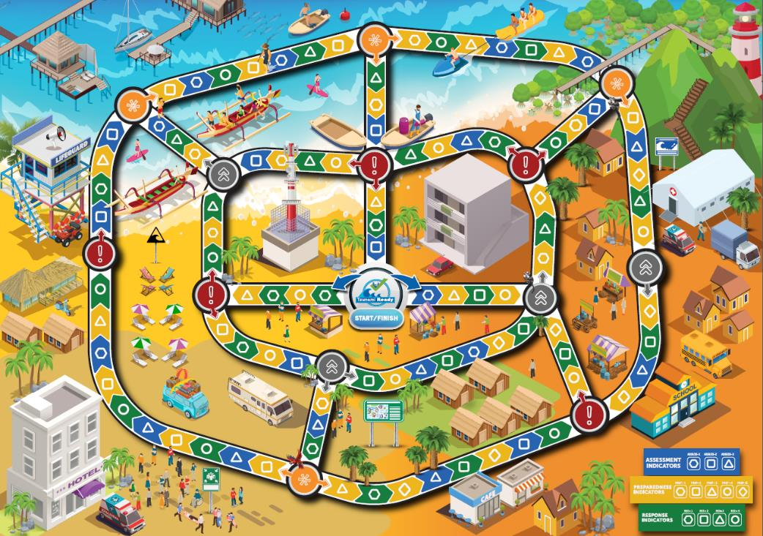
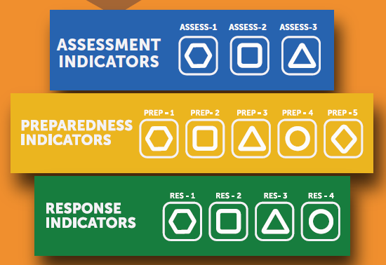
Tsunami Ready Game
5
Could be played in different levels
Beginner (+ 1 hour)
Middle (+ 2 hours)
Advanced (> 2 hours)
Cards 375 (+ 300 questions, 75 instructions)
To introduce the 12 Tsunami Ready Indicators to the stakeholders
(12 + years)

Slide 21
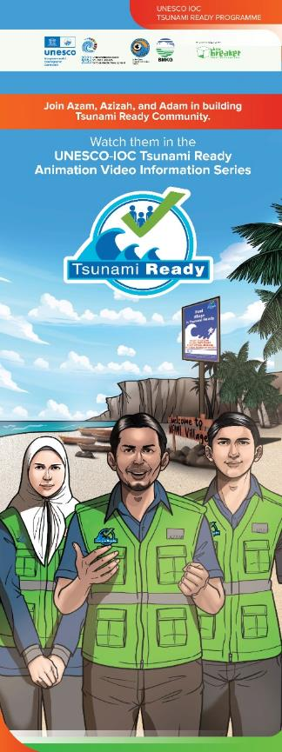
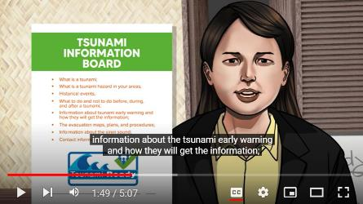
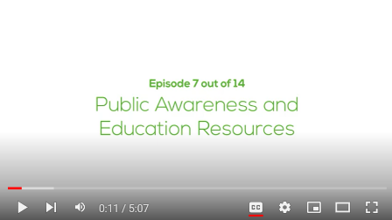
Tsunami Ready Videos
6
Story line:
Following the journey of Azam, Azizah, and Adam in building their Village “Nami” to be a Tsunami Ready Community based on UNESCO-IOC Tsunami Ready Indicators
Video 1: Tsunami Ready (an introduction) + 7:10 minutes
Video 2: Tsunami Hazard for Tsunami Ready Community + 8:02 minutes
Video 3: Knowing people at risk of tsunami + 4:48 minutes
Video 4: Resource and capacity for Tsunami Ready Community + 6:57 minutes
Video 5: Public Tsunami Information in Community + 5:32 minutes
Video 6: Tsunami Evacuation Map for the community + 5:15 minutes
Video 7: Public Awareness and Education Resources + 5:07 minutes
Video 8: Outreach Activities in Tsunami Ready Community + 4:39 minutes
Video 9: Community Tsunami Exercise + 6:49 minutes
Video 10: Community Tsunami Emergency Operation Plan + 5:28 minutes
Video 11: Building Capacity in community for Emergency Response + 7:50 minutes
Video 12: Linking the Community to the Tsunami Warning Chain + 4:40 minutes
Video 13: Providing warning to the community + 5:27 minutes
Video 14: Getting Tsunami Ready Recognition + 6:50 minutes
IOTIC YouTube Channel: https://www.youtube.com/channel/UCFSPN4dJXOvFrMIkmlQdumQ
Playlist: https://www.youtube.com/playlist?list=PLDzuUvIHTe3BLFcgDGXOAkwcCdTQ6VngH

Slide 22









Tsunami Awareness Course (OTGA) – 3 Modules
Tsunami Basics – 1, 2
Tsunami Warning Systems – 1, 2
Tsunami Preparedness – 1, 2

Slide 23


Tsunami Ready Courses (available in 2023/2024)
8
The training is targeted for Government Officials (i.e. from National or Local Disaster Management Offices, National Tsunami Warning Centres, Gov Institutions) and Programme / Project planner and implementor (Donors, Funding agencies), etc.
Module 1
Tsunami Ready for Officials and Programme Implementors
(1 Course)
The training is targeted for Community leaders, Non-Governmental Organizations (NGOs), Civil Society Organizations (CSOs), Academics and Scientists, Community members, Private, Business, etc.
Course 1
Introduction to Tsunami Ready
& the Indicators
What is Tsunami Ready
Why is it important
What is the benefit of implementing TR
What are the indicators
Why are these indicators
Module 2
Tsunami Ready for Community
(2 Courses)
Course 2 Implementing Tsunami Ready
What do community do to start to implement TR
Who are the stakeholder and the technical organization
How to approach the organizations
The training is targeted for Disaster Risk Reduction Facilitators for Disaster risk reduction workers and volunteers who are interested in assisting the community in capacity building for tsunami preparedness, etc.
Module 3
Tsunami Ready for Facilitators
(3 Courses)
Course 3 Facilitating Tsunami Ready
What does each of these indicator means and the relation of each indicators
How to work on each of the Indicators

Slide 24


Tsunami Ready Training – TEMPP
Tsunami Evacuation Maps, Plans, and Procedures (TEMPP) – IOC MG 82 Preparing for Community Tsunami Evacuations: from inundation to evacuation maps, response plans and exercises (2020)
Manual (English, Spanish)
Supplement 1 (Detail Module Explanations, Guidance) (English)
Specialized Documents
http://itic.ioc-unesco.org/index.php?option=com_content&view=category&layout=blog&id=2166&Itemid=2640

Slide 25


IOC Manual and Guide 82 (2019) - TEMPP
PREPARING FOR COMMUNITY TSUNAMI EVACUATIONS:
FROM INUNDATION TO EVACUATION MAP, RESPONSE PLANS, AND EXERCISES
4 Foundation Blocks
Key element of tsunami response involves evacuation, including self-evacuation of exposed people & key assets to safer areas
Effective and successful evacuations require proper planning by relevant authorities.

Slide 26




Tsunami Ready Supports
Tsunami Information Centers
PTWS - ITIC
USA NOAA – IOC Partnership 1965
Chile SHOA Associate Director 1998
NEAMTWS - NEAMTIC
EC DG ECHO
France, Greece, Italy, Portugal 2011-13
TIC to advocate, facilitate, guide, and support the member states in the Tsunami Ready Implementation through trainings, workshops, or capacity building as needed (regional and/or national).
IOTWMS- IOTIC
Indonesia BMKG – IOC Partnership 2012 (formerly JTIC since 2006)
CARIBE-EWS - CARIBETIC
Barbados– IOC Partnership 2015
(approved 2007)

Slide 27
ICG/PTWS-XXIX.4 Disaster Risk Management and Preparedness
Recognizing the 31st Session of the IOC Assembly, June 2021, via IOC Decision A-31/3.4.1 approved the establishment of the Ocean Decade Tsunami Programme and a Scientific Committee to develop a Draft 10-Year Research, Development and Implementation Plan for the Ocean Decade Tsunami Programme based on the concept paper “Protecting Communities from the World's Most Dangerous Waves: A Framework for Action under the UN Decade of Ocean Science for Sustainable Development”
Recognizing further that the 31st Session of the IOC Assembly, June 2021, via IOC Decision A-31/3.4.1 also approved the establishment of a special Tsunami Ready Coalition in collaboration with other critical stakeholders across the UN structure as well as national civil protection agencies and will report to the TOWS-WG on Tsunami Ready aspects of the programme,
Recognizing the UN Decade for Ocean Science societal outcome includes a Safe Ocean, where life and livelihoods are protected from ocean-related hazards, such as tsunamis,
Recognizing further that to achieve the UN Decade societal outcome of a Safe Ocean, the global aim is to make 100% of communities at risk of tsunami prepared for and resilient to tsunamis by 2030 through the implementation of the UNESCO/IOC Tsunami Ready Programme and other initiatives,
Notes that the Working Group 3 will contribute to the special Coalition for Tsunami Ready

Slide 28
Global Frameworks
OCEAN DECADE TSUNAMI PROGRAMME
Seeking Major Advances in SCIENCE and PREPAREDNESS
THE MAIN SOCIAL OUTCOME
BY 2030
TO MAKE 100%
OF COMMUNITIES AT RISK OF TSUNAMI PREPARED FOR AND RESILIENT TO TSUNAMIS
Tsunami Coalition: collaborative with critical UN stakeholders, civil protection, others ==> Raise profile. Facilitate resourcing
Capacity Development: augmented through IOC Ocean Teacher Global Academy (OTGA) ==> Global reach, deep curricula

Slide 29
ICG/PTWS-XXIX.4 Disaster Risk Management and Preparedness
Adopts and continues to implement the UNESCO-IOC Tsunami Ready Guidelines and Indicators as the international standard for evidence-based community preparedness for tsunamis,
Urges Member States to use these Guidelines to implement Tsunami Ready in their communities,
Encourages Member States to identify the communities at risk from tsunamis where Tsunami Ready and like initiatives would be targeted,
Noting that some Member States already have similar tsunami hazard mitigation programs in place, encourages Member States that apply other programmes, to confirm alignment with the twelve UNESCO IOC Tsunami Ready Indicators in relevant communities and report outcomes,
Mandates the International Tsunami Information Centre (ITIC) to facilitate implementation of and documentation collation for UNESCO IOC Tsunami Ready Programme and other like initiatives in the PTWS,
Requests WG 3 to:
Explore, in cooperation with the TOWS Task Team on Disaster Management and Preparedness, ways to recognize communities that choose not to implement the UNESCO/IOC Tsunami Ready programme, as compliant with the Tsunami Ready indicators,
Help identify sources of funding in support of the implementation of Tsunami Ready.

Slide 30










100% AT-RISK COMMUNITIES TSUNAMI READY
UN OCEAN DECADE TSUNAMI PROGRAMME:
STRATEGY: Be Aware, Be Prepared
FRAMEWORK:
Harmonized global guidelines UNESCO IOC Tsunami Ready
Performance-based Community Recognition
ACTION: National programs empower Communities
GLOBAL MEASURE
Standard Guidelines for the Tsunami Ready Recognition Program, UNESCO IOC TS 74

Slide 31
Tsunami Ready Recognition 1 year timeline
YEAR
YEAR
0 - 3 months
3 - 6 months
6 - 9 months
9 - 12 months
Bi-weekly progress and support meetings
Outreach/educational resources and tsunami exercise
PREP-3, PREP-4, PREP-5
Inundation mapping
ASSESS-1
Risk assessment
ASSESS-2, ASSESS-3
Evacuation mapping
PREP-1
Signage preparation
PREP-2
Signage installation
PREP-2
SOP and capacity to respond preparation
RESP-1-4
SOP and capacity to respond revisions
RESP-1-4
Tsunami Ready Application
Submit Application
Tsunami Ready Board meeting
Recognition Process
Tsunami Ready Recognition ceremony

Slide 32
PTWS
Tsunami Ready
Progress

Slide 33

KEY UPDATES SINCE DECEMBER 2021
20 communities in 6 countries have official recognition under the Tsunami Ready Recognition Programme
This includes 3 communities in Honduras, Costa Rica and Samoa for whom recognition needs renewal
TOTAL: Countries 11 Communities 22+
Costa Rica has 5 new communities recognised in 2022
One further community has a confirmed plan to become recognized (Panama), and implementation is underway in the Galapagos (Ecuador
There is further progress in the implementation in communities from at least 6 countries (Ecuador, Costa Rica, Marshall Islands, Federated States of Micronesia). Recognition is expected to be completed in approximately 14 communities in 2023 or early 2024.
Additionally, 5 further member states have expressed interest to implement : Vanuatu, Solomon Islands, Tonga, Samoa, and France

Slide 34
CONFIRMED – RECOGNIZED OR ACTIVE
Recognized officially: 6 Countries, 20 Communities
Honduras: Cedeno (expired), Omoa, Tornabe/Tela
El Salvador: La Libertad, Tamanique
Costa Rica: Ostional (expired), Tamarindo, Samara, Quepos, Uvita, Coco, Puerto Jimenez, Tivives, Dominical, Playa Hermosa
Guatemala: Sipacate, San JosePort
Nicaragua: Corn Islands, Bluefields (Caribbean Coast)
Samoa: Savaia (expired)
TOTAL: Countries 11 Communities 22+
Actively pursuing - In process: 6 Countries, 12 communities
Ecuador: Galapagos, Puerto Ayora, Puerto Baquerizo Moreno, Puerto Villamil
Costa Rica: Hermosa (Carillo) , Cahuita
Marshall Islands: Majuro
Federated States of Micronesia: Chuuk, Pohnpei, Yap
Palau
Panama: Puerto Armuelles

Slide 35
PROBABLY: Interested with Progress (natl funding): 5 Countries
Vanuatu: Implement as a Programme. Some activities and advances per Country's initiatives.
*Community is defined as a Village Previously, VanReady Project (JICA) - schools
Solomon Islands: Implementing Community Based Disaster Risk Management (CBDRM) programme since 2010.
*15 communities in the Western Province (CBDRM).
*TR target: 5 communities
Tonga: Implement as a Programme will validate tsunami preparedness that has been done.
*Target 38 communities across Tonga (16 on Tongatapu, 2 in ‘Eua, 13 in Ha’apai, 5 in Vava’u and 2 in the Niuas)
*Some indicators are already completed in these target communitie”
Samoa: Implementing Community Climate and Disaster Risk Management (CCDRM) programme since 2015. Southern coast of Upolu.
*Targeted 107 villages on coast of two main islands Upolu and Savaii including Manono and Afulima islands.
*In 2023, Samoa DMO is targeting 15 villages mostly on the coastal area of Apia.
France: French Polynesia, New Caledonia

Slide 36
Capacity to Implement Tsunami Ready TR Indicators
In Pacific Islands

Slide 37
Responding Countries
Federated State of Micronesia 1
Federated State of Micronesia 2
Federated State of Micronesia Pohnpei State
Fiji
French Polynesia
Kiribati
Nauru
New Caledonia
Samoa
Solomon Islands
Tonga
Vanuatu

Slide 38
Does your country have an interest to implement the IOC-UNESCO Tsunami Ready Recognition Programme (TRRP)?
Yes
12
3
9
Does your country already have the National Tsunami Ready Board
Yes
No
8
4
Have the community(ies) interested to implement TRRP been identified
Yes
No
There is a list of the communities the country identified

Slide 39
Based on the Identified Communities:
Has there been any tsunami awareness and preparedness activities in those community(ies)?
Yes
11
No
1
Has there been any tsunami hazard assessment undertaken in those communities?
6
6
Yes
No

Slide 40
Capacity to develop or strengthen the IOC-UNESCO Tsunami Ready Indicators
Can be easily done through national and/or local resources (mobilize national expertise and funding)
Can be done through national and/or local resources but need ITIC and/or ICG/PTWS technical expertise support
Need technical expertise and support through ITIC and/or ICG/PTWS regional activities
Need ITIC and/or ICG/PTWS technical expertise and support through national activities

Slide 41
 | national and/or local resources (mobilize national expertise and funding) | national and/or local resources but need technical expertise support | Need technical expertise and support through ITIC – ICG/PTWS regional activities | Need ITIC – ICG/PTWS technical expertise and support through national activities
Capacity to develop tsunami hazard map | 6 | 3 |  | 3
Train the community on information on the estimate number of people that live in the tsunami hazard zone. | 6 | 3 | 3
Train the community on inventory of available economic, infrastructural, political and social resources to reduce tsunami risk at the community level | 6 | 3 | 3
ASSESSMENT INDICATORS

Slide 42
Building Tsunami Ready 1. Strategy
2. Implementation Advocacy

Slide 43
1. Building Tsunami Ready - strategy
REGIONAL (what, why, how with examples) – 3-day Pacific Island Countries (11 countries (technical, DMO)
COUNTRY PROCESS
National Programme – Community, How many vulnerable, How long, How much
National Training (what, why, how) – 1-day
National Stakeholder Workshop (how, implement, actions) – 2-day
SUCCESS PIC = 1. Funding, 2. Govt Champion, 3. NGO/Comm orgs
2017 – only 1 (already done) so no cost
Central America – DIPECHO Funding
Marshall Islands, Micronesia, Palau – USAID
Fiji – USAID, Australian Humanitarian Partnership (NGP for community efforts)

Slide 44
2. Implementation, TR Advocacy for PTWS
WG or TT exist for ICG/CARIBE-EWS, ICG/IOTWMS, ICG/NEAMTWS
Propose similar in PTWS for Tsunami Ready
Where should it sit? WG under SC, TT under WG 3, TT of UN Decade
Terms of Reference, ex. IOTWMS (complex), CARIBE-EWS and NEAMTWS (simple)
IOTWMS: TR Focal Points, Monitor and evaluate TR implementation, Guidance on Hazard Risk, Annual implementation report to Steering Group
CARIBE-EWS: Effectiveness Eval Instrument – conduct / analyze findings

Slide 45
ICG/IOTWMS-XII.1. Working Group 3 on Tsunami Ready Implementation
Terms-of-Reference
Liaise with other working group(s) and task team(s) within the ICG/IOTWMS and with working groups from the other ocean basins through the TOWS-WG to:
Monitor and evaluate the implementation Tsunami Ready Recognition Programme, National Warning Chains, and related activities to deliver tsunami resilient and prepared communities for the Indian Ocean
Provide guidance on tsunami hazard and risk assessment, including for tsunamis generated by non-seismic and complex sources
Provide guidance to Member States on reviewing and enhancing national tsunami warning chains.
Provide guidance on how to nationally initiate IOC-UNESCO Tsunami Ready Recognition Programme (TRRP) and similar initiatives
Facilitate sharing of experiences between Member State Tsunami Ready Focal Points (TRFPs)

Slide 46
ICG/IOTWMS-XII.1. Working Group 3 on Tsunami Ready Implementation
Terms-of-Reference
Update Member States on IOC-UNESCO TRRP developments and other related initiatives
Develop exercise tools and coordinate implementation of IOWAVE Exercises and other drills as required
In collaboration with IOC-UNESCO IOTIC and IOC-UNESCO Secretariat for ICG/IOTWMS, identify capacity development and resource needs of Member States to implement TRRP, national tsunami warning chains, and related activities
Assist with training programmes of Member States implemented by IOC-UNESCO IOTIC and coordinated by IOC-UNESCO ICG/IOTWMS Secretariat to facilitate enhanced national tsunami warning chains and at-risk communities becoming resilient and prepared for tsunamis
Provide an annual report on Tsunami Ready implementation to the Steering Group
Members: WG1 and WG2 and RWG-NWIO chairs, WG2 and WG1 tsunami warning chain relevant experts, ICG/IOTWMS TRRP and exercise experts, Member State Tsunami Ready Focal Points (TRFP), invited experts, IOTIC, Secretariat.

Slide 47
ICG/CARIBE-EWS - TASK TEAM TSUNAMI READY
Terms of Reference - Role and Responsibilities. The Task Team will:
Support and provide guidance to the CARIBE EWS in the implementation of the UNESCO IOC Tsunami Ready Recognition Programme.
Develop an evaluation instrument aimed at measuring the effectiveness of UNESCO IOC Tsunami Ready Recognition Programme in recognized communities.
The Task Team will implement the evaluation instrument and analyze its findings in collaboration with ITIC-CAR and CTIC.
Facilitate Member States to conduct pre- and post-evaluation instruments to measure the social impact of UNESCO IOC Tsunami Ready Recognition Programme.
Assist CTIC, in association with member states, in determining the target number of communities pursuing the Tsunami Ready Recognition.
Composition
Tsunami Task Team members are nominated within the context of their personal capacities and irrespective of institutional affiliation

Slide 48
ICG/NEAMTWS: Task Team on Tsunami Ready
Mandate. The Task Team on Tsunami Ready Team will:
Promote the Tsunami Ready programme in the NEAM region and encourage Member States to join the program;
Coordinate and foster cooperation among NEAM countries and other regions worldwide on the Tsunami Ready programme in place, as well as exchange knowledge, experiences and best practices;
Provide advice on the procedures to achieve a Tsunami Ready recognition;
Adapt the standards in NEAM region according to the IOC UNESCO Tsunami Ready
guidelines;
Report to and have a strong interaction with the ICG/NEAMTWS/WG4.
Modus operandi
The Task Team on Tsunami Ready will mainly work by correspondence. Online meetings will be scheduled as required and agreed.
Membership
Nominated experts by Member States according to the IOC Circular Letter No2821.
The list of experts can be updated by Member States, if needed; WG 4 members on request to join the Task Team of Tsunami Ready through their respective Tsunami National Contacts; Steering Committee members.

Slide 49
Challenges and Issues
Needs and Gaps per Indicator:
ASSESS-1 – Bathymetry

