Slide 1
Overview of TOWS-WG Proposal to the World-Wide Navigational Warning Service Sub-Committee (WWNWS-SC) on
Tsunami Service Provider Messages for the Maritime Community
Only for potential or confirmed tsunamis >0.3m in TSP’s Area of Service (AOS)
Disseminated to IMO/IHO NAVAREA Coordinators covering that TSP’s AOS
Issued when TSP issues a Quantitative, not Qualitative, forecast
Only reissue if forecast changes
Issue a final message when threat mostly passed
NAVAREA Coordinators turn into maritime safety messages issued via SafetyNet to ships at sea.
Message Content
NAVAREA names (21 of these world-wide)
General Area (e.g., Western Pacific, South China Sea)
Key Subject (e.g., Confirmed Tsunami Threat, Final Message)
Tsunami Source (e.g., a magnitude 8.4 earthquake on May 17, 2020 at 0718 UTC in the Solomon Islands)
List of countries and islands with threat >0.3m and corresponding harbors
Amplifying remarks (e.g., strong currents, coastal flooding, etc.)
Cancellation Details – up to local authorities to determine

Slide 2
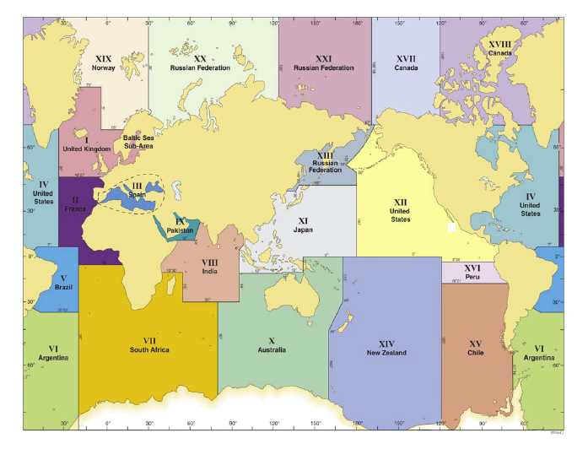
Global NAVAREAs

Slide 3
Sample Message 1
NAVAREA XI, NAVAREA XIII, NAVAREA X
NORTHEAST PACIFIC COASTS
TSUNAMI THREAT MESSAGE [or whatever the correct term will be] ISSUED BY PACIFIC TSUNAMI WARNING CENTRE [fill in name of the issuing TSP] in support of the UNESCO/IOC PACIFIC TSUNAMI WARNING AND MITIGATION SYSTEM [fill in name of the regional system] AT DDHHMM UTC MMM YY. [This clearly identifies that the message has been issued by the recognised expert]
A TSUNAMI HAS BEEN GENERATED BY A MAGNITUDE 8.4 EARTHQUAKE THAT OCCURRED IN VICINITY OF [Position] DD-MM N/S DDD-MM E/W, THE RYUKYU ISLANDS DDHHMM UTC MMM YY [this is the date/time of the earthquake, rather than the originating message]
HAZARDOUS TSUNAMI WAVES ARE FORECAST FOR SOME COASTS OF JAPAN, THE PHILIPPINES, AND INDONESIA [from a list of countries/islands]
TSUNAMI WAVES ARE NOT A HAZARD TO SHIPS IN DEEP WATER BUT CAN CAUSE STRONG CURRENTS AND RAPID SEA LEVEL CHANGES IN SHALLOW WATER, AS WELL AS INUNDATION OF THE COAST. SHIPS APPROACHING THE COAST SHOULD CONSULT LOCAL AUTHORITIES REGARDING LOCAL CONDITIONS AND ADVICES.

Slide 4
Sample Message 2
NAVAREA XI, NAVAREA XIII, NAVAREA X
NORTHEAST PACIFIC COASTS
TSUNAMI CANCELLATION MESSAGE [or whatever the correct term will be] ISSUED BY PACIFIC TSUNAMI WARNING CENTRE [fill in name of the issuing TSP] in support of the UNESCO/IOC PACIFIC TSUNAMI WARNING AND MITIGATION SYSTEM [fill in name of the regional system] AT DDHHMM UTC MMM YY. [This clearly identifies that the message has been issued by the recognised expert]
THE THREAT HAS NOW LARGELY PASSED FOR THE TSUNAMI GENERATED BY A MAGNITUDE 8.4 EARTHQUAKE THAT OCCURRED IN IN VICINITY OF [Position] DD-MM N/S DDD-MM E/W, THE RYUKYU ISLANDS DDHHMM UTC MMM YY [this is the date/time of the earthquake, rather than the originating message]
HOWEVER, SHIPS APPROACHING THE COAST SHOULD STILL CONSULT LOCAL AUTHORITIES REGARDING LOCAL CONDITIONS AND ADVICES.

