Slide 1
PTWS Earthquake Source Zone Expansion Proposal
Chip McCreery, PTWC Director
charles.mccreery@noaa.gov
808-725-6301

Slide 2
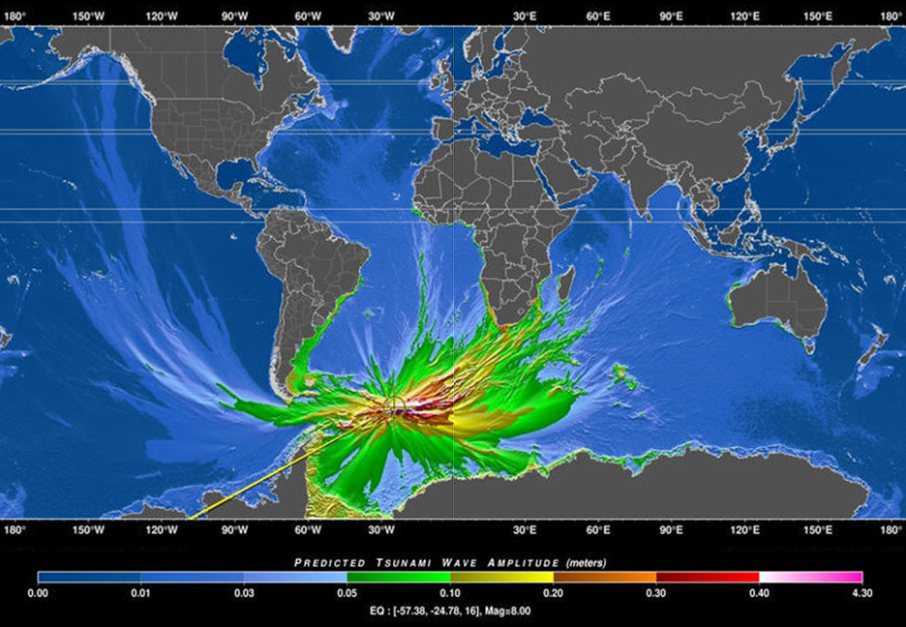
RIFT Model of 8/12/21 Tsunami
RIFT Model of the Tsunami from the 8/12/21 South Sandwich Islands Mw 8.1 Earthquake

Slide 3
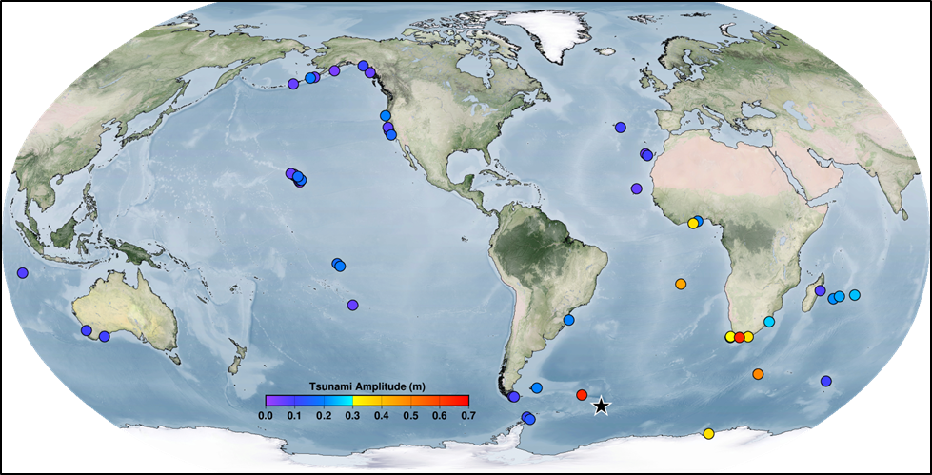
Tsunami Observations from 8/12/21

Slide 4
PTWC Current Staff
South Sandwich Islands are part of the CARIBE-EWS Earthquake Source Zone (ESZ), but not PTWS ESZ.
Since the year 2000, 33 earthquakes of magnitude 6.5 or larger have occurred there -- prompting a PTWC Tsunami Information Statement for the CARIBE-EWS, but nothing for the PTWS.
Tsunamis from this region are more of a threat to PTWS coasts than to CARIBE-EWS coasts.
Recommend expanding the PTWS ESZ to include this seismic zone.
R

Slide 5
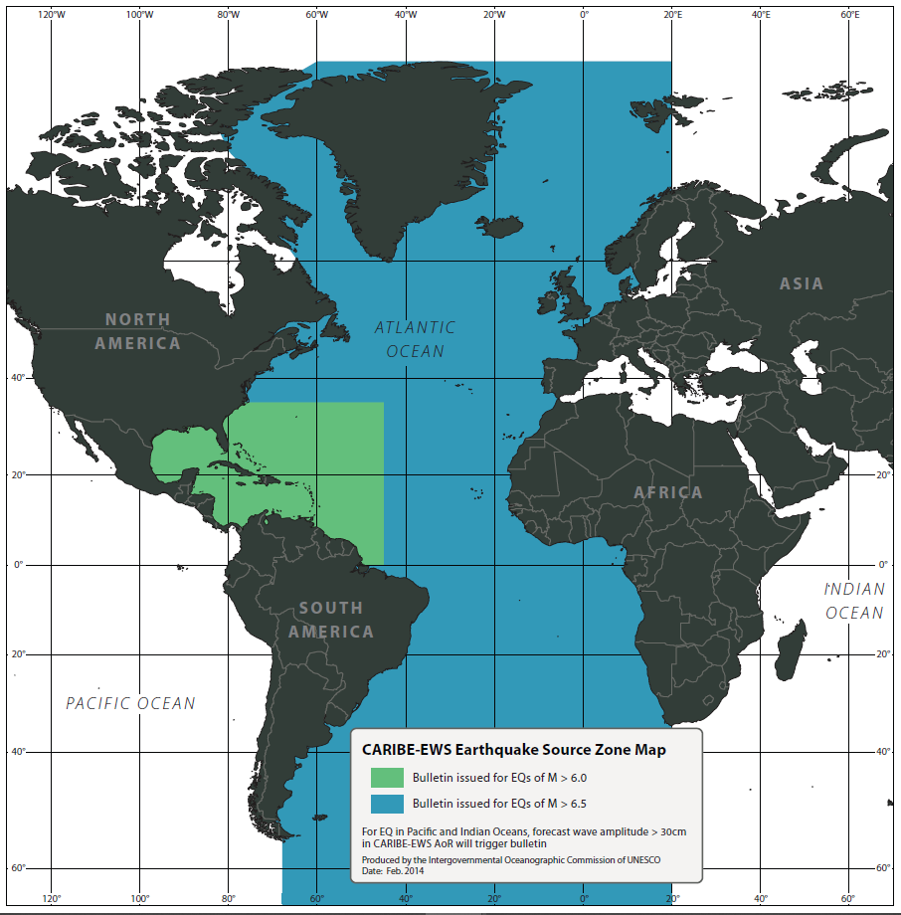
CARIBE-EWS Earthquake Source Zone

Slide 6
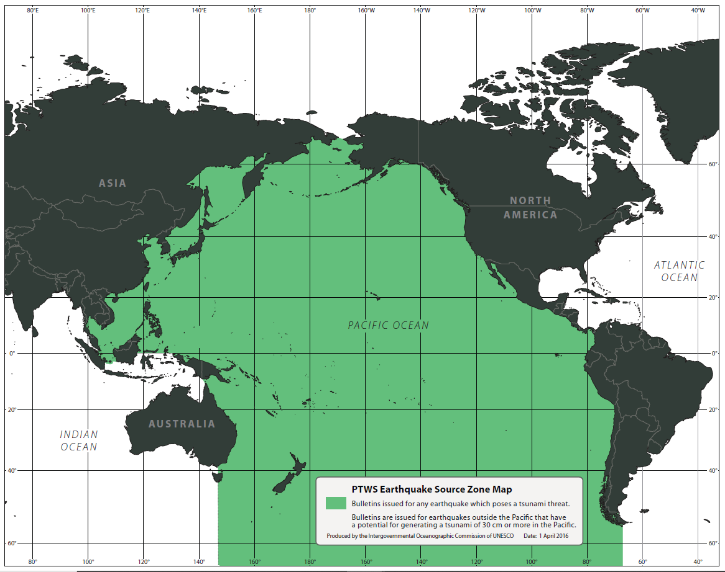
Current PTWS Earthquake Source Zone

Slide 7
Proposed PTWS Earthquake Source Zone
Expansion to include the Scotia Arc Seismic Zone containing the South Sandwich Islands

Slide 8
Thank You

