Slide 1
Pacific Tsunami Warning Center
Interim Procedures for Tsunamis from the Hunga Tonga – Hunga Ha`apai Volcano
Charles McCreery
Pacific Tsunami Warning Center
charles.mccreery@noaa.gov

Slide 2
General Challenges with Non-Seismic Tsunamis from Volcanoes, Landslides, Meteo, Bolides, etc.
No rapid alert
  Seismic waves give an alert within minutes of any large earthquake
  But no such alert for a landslide, volcano, bolide or meteo-tsunami
  Alert is only on later detection of tsunami waves
No source location
  Earthquake hypocenter and origin time quickly determined
  Landslide, volcano, meteo-tsunami source location only estimated later from tsunami arrival times on different gauges
No source mechanism
  Earthquake parameters and tsunami source mechanism can be determined quickly to estimate tsunami impacts and drive forecast models
  Landslide, volcano, and meteo-tsunami source mechanisms are only determined later – after event is over
No Forecast
  Earthquake-driven tsunami impacts can be numerically forecast
  Non-seismic tsunamis can only be observed and reported
No Pre-Scripted Standard Products
  Appropriate products may need to be constructed on-the-fly to fit the situation
  Recipients may not respond appropriately to these products

Slide 3
Alerting and Forecasting for Future HTHH Tsunamis
Messages use the same PTWC Product IDs as PTWC uses for earthquake - generated tsunamis in the PTWS
Message content is similar but modified for the HTHH source
Amplitude forecast is based on scaling the 1/15/2022 observations to match current event observations
This is a “Best Effort” forecasting approach with caveats
  Tsunami generation mechanism at the HTHH may not be the same as on 1/15/22
  Atmospheric pressure wave generation may or may not be present for a future event
  Scaling for either type of generation mechanism may not be linear (e.g., if half as big on one gauge then half as big everywhere)
  Amplitude forecasts are only for gauge locations, not entire coasts
  Estimated arrival times are only based on the normal tsunami travel time calculation from the volcano – not on the atmospheric disturbance generation.

Slide 4
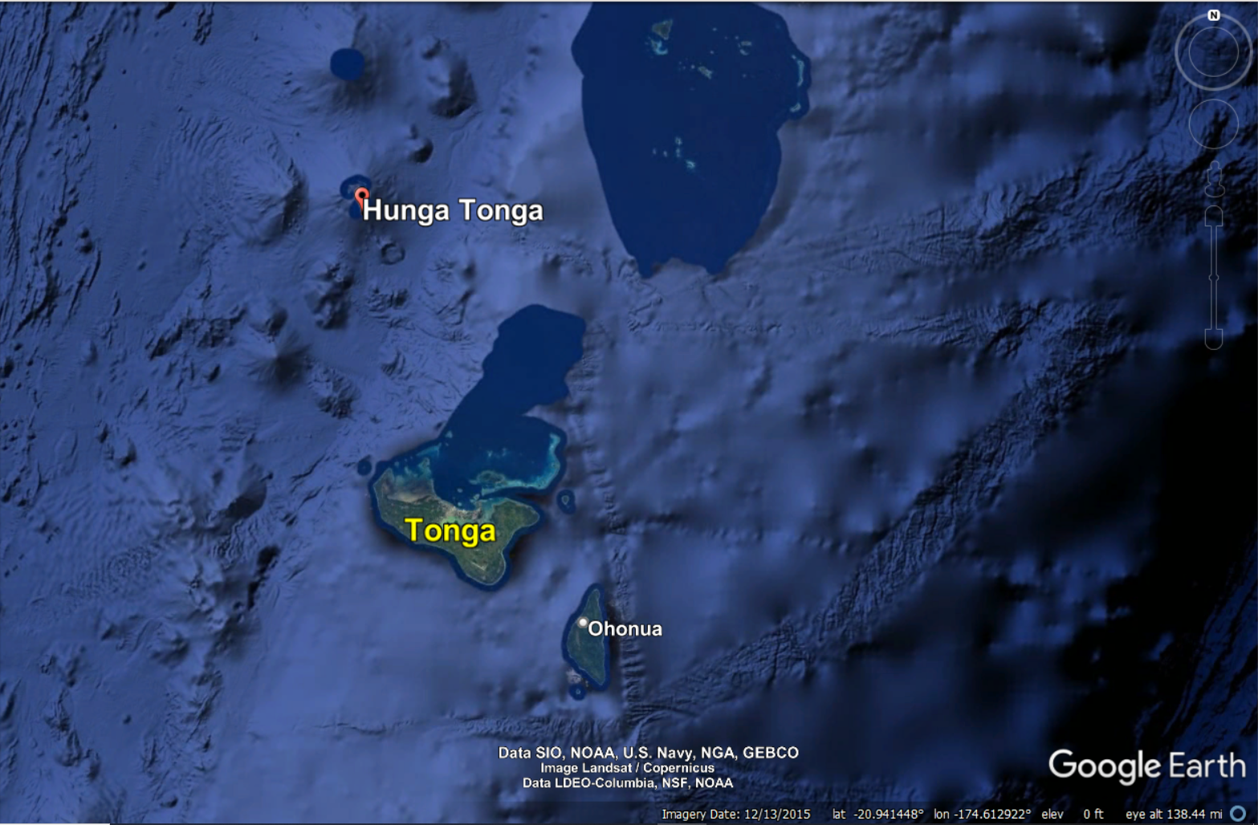
HTHH is about 70 km north of Tongatapu Island
Volcano
Nuku`alofa
Sea Level Gauge
Tongatapu
Island

Slide 5
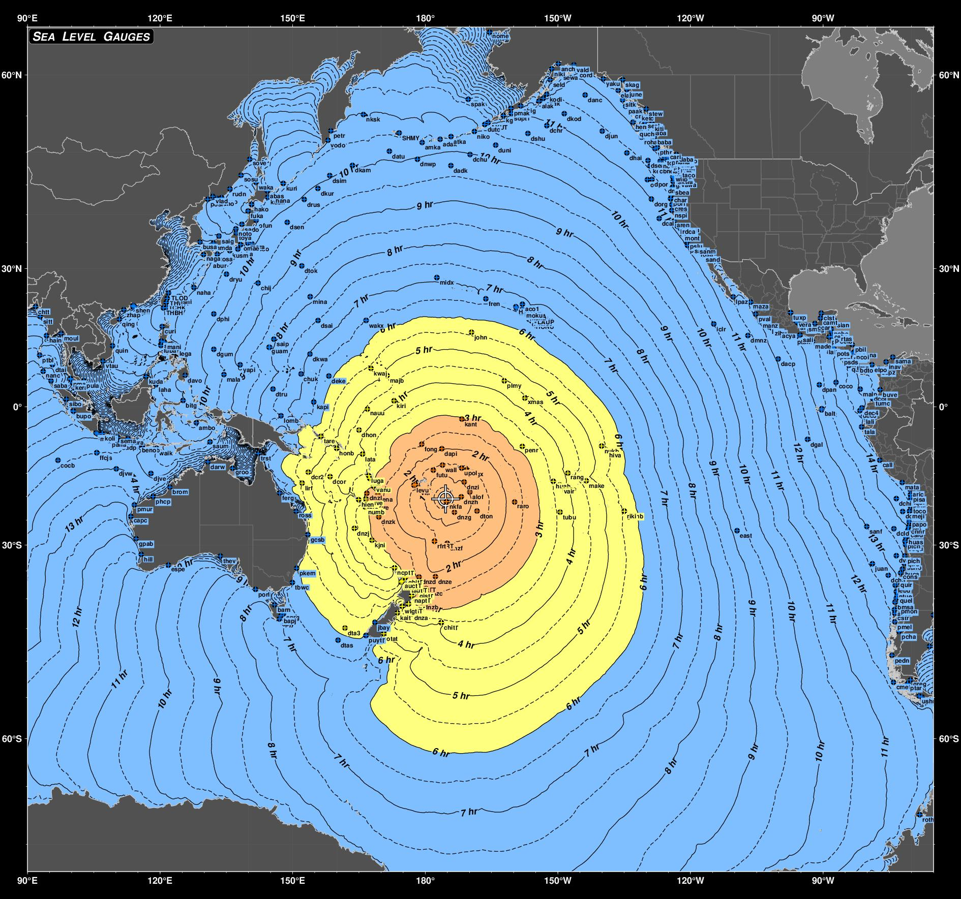
Classic Tsunami Travel Times from HTHH
Volcano
Nuku`alofa
Sea Level Gauge

Slide 6
HTHH Event Response at PTWC
PTWC will be alerted by tsunami waves at the Nuku`alofa gauge or any other nearby gauge (~15 minutes after volcanic event)
PTWC will immediately call the Tonga NTWC (Met Office) to report the waves
The first arrival time and tsunami amplitude at the Nuku`alofa gauge will be measured and recorded.
An initial PTWS Threat Message will be issued, nominally for all coasts within 3 hours tsunami travel time, that includes:
  ETAs from HTHH based on the Nuku`alofa arrival time
  An amplitude forecast at tide gauges based on scaling from the Nuku`alofa amplitude
  ETAs at those tide gauges

Slide 7
Sample Message Product
ZCZC WEPA40 PHEB 041555
TSUPAC
TEST...TSUNAMI MESSAGE NUMBER 1...TEST
NWS PACIFIC TSUNAMI WARNING CENTER HONOLULU HI
1555 UTC FRI MAR 4 2022
...THIS MESSAGE IS FOR TEST PURPOSES ONLY...
...TEST PTWC TSUNAMI THREAT MESSAGE TEST...
**** NOTICE **** NOTICE **** NOTICE **** NOTICE **** NOTICE *****
THIS IS A TEST MESSAGE. THIS MESSAGE IS ISSUED FOR INFORMATION
ONLY IN SUPPORT OF THE UNESCO/IOC PACIFIC TSUNAMI WARNING AND
MITIGATION SYSTEM AND IS MEANT FOR NATIONAL AUTHORITIES IN EACH
COUNTRY OF THAT SYSTEM.
THIS IS A TEST MESSAGE. NATIONAL AUTHORITIES WILL DETERMINE THE
APPROPRIATE LEVEL OF ALERT FOR EACH COUNTRY AND MAY ISSUE
ADDITIONAL OR MORE REFINED INFORMATION.
**** NOTICE **** NOTICE **** NOTICE **** NOTICE **** NOTICE *****

Slide 8
Sample Message Product
ZCZC WEPA40 PHEB 041555
TSUPAC
--------------------------------------------------------------
TEST... VOLCANIC ACTIVITY IN TONGA GENERATED A TSUNAMI ...TEST
--------------------------------------------------------------
TEST... PRELIMINARY VOLCANO PARAMETERS ...TEST
-------------------------------------------
* ACTIVITY TIME 1530 UTC MAR 4 2022
* COORDINATES 20.5 SOUTH 175.4 WEST
* LOCATION TONGA
TEST... EVALUATION ...TEST
--------------------------
* THIS IS A TEST MESSAGE. VOLCANIC ACTIVITY OCCURRED IN THE
TONGA ISLANDS AT 1530 UTC ON FRIDAY MARCH 4 2022.

Slide 9
Sample Message Product
TEST... TSUNAMI THREAT FORECAST ...TEST
---------------------------------------
* THIS IS A TEST MESSAGE. HAZARDOUS TSUNAMI WAVES FROM THIS
VOLCANIC ACTIVITY ARE POSSIBLE ALONG SOME COASTS OF
TONGA... NIUE... AMERICAN SAMOA... WALLIS AND FUTUNA...
SAMOA... KERMADEC ISLANDS... FIJI... TOKELAU... COOK
ISLANDS... VANUATU... TUVALU... NEW ZEALAND... KIRIBATI...
HOWLAND AND BAKER... NEW CALEDONIA... FRENCH POLYNESIA...
JARVIS ISLAND... SOLOMON ISLANDS... PALMYRA ISLAND...
NAURU... MARSHALL ISLANDS... KOSRAE... JOHNSTON ISLAND...
PAPUA NEW GUINEA... AUSTRALIA... PITCAIRN... POHNPEI...
WAKE ISLAND... HAWAII AND NORTHWEST HAWAII
* THIS IS A TEST MESSAGE. BASED UPON THE INITIAL
OBSERVATIONS... THIS TSUNAMI IS FORECAST TO BE ABOUT 0.5
TIMES THE SIZE OF THE JANUARY 15 2022 TSUNAMI FROM THE SAME
VOLCANO IN TONGA.

Slide 10
Sample Message Product
* THIS IS A TEST MESSAGE. THE FOLLOWING ARE FORECAST MAXIMUM
TSUNAMI AMPLITUDES RELATIVE TO NORMAL SEA LEVEL AT COASTAL
GAUGES WITHIN CURRENT THREAT AREA. THE FORECAST FOR EACH
GAUGE IS BASED UPON SCALING THE MAXIMUM TSUNAMI AMPLITUDE
MEASURED ON THAT GAUGE FOR THE JANUARY 15 2022 TSUNAMI USING
THE SCALE FACTOR GIVEN ABOVE. TSUNAMI WAVES ALONG OTHER
COASTS IN THE REGION OF EACH GAUGE MAY BE LARGER OR SMALLER
THAN AT THE GAUGE. A SIMILAR SCALING OF ANY KNOWN JANUARY 15
IMPACTS ALONG THOSE COASTS CAN BE USED AS A GUIDE.
COORDINATES FIRST WAVE FORECAST MAX
GAUGE LOCATION LAT LON ETA (UTC) TSUNAMI AMPLITUDE
-------------------------------------------------------------
NUKUALOFA TO 21.1S 175.2W 03/04 1548 0.41M/ 1.34FT
DART 5401003 23.4S 173.4W 03/04 1612 0.10M/ 0.34FT
DART 5401002 29.7S 175.0W 03/04 1655 0.05M/ 0.16FT
PAGO PAGO AS 14.3S 170.7W 03/04 1656 0.31M/ 1.02FT
APIA UPOLU WS 13.8S 171.8W 03/04 1706 0.09M/ 0.28FT
SUVA VITI LEVU FJ 18.1S 178.4E 03/04 1712 0.13M/ 0.43FT
DART 5401001 36.0S 177.7W 03/04 1737 0.04M/ 0.11FT
RAROTONGA CK 21.2S 159.8W 03/04 1745 0.45M/ 1.48FT
DART 5501004 36.1S 178.6E 03/04 1757 0.05M/ 0.18FT
EAST CAPE NZ 37.5S 178.2E 03/04 1814 0.13M/ 0.43FT
FONGAFALE TV 8.5S 179.2E 03/04 1819 0.06M/ 0.20FT
MARE NEW CALEDONIA F 21.5S 167.9E 03/04 1822 0.38M/ 1.23FT

Slide 11
Sample Message Product
TEST... RECOMMENDED ACTIONS ...TEST
-----------------------------------
* THIS IS A TEST MESSAGE. GOVERNMENT AGENCIES RESPONSIBLE FOR
THREATENED COASTAL AREAS SHOULD TAKE ACTION TO INFORM AND
INSTRUCT ANY COASTAL POPULATIONS AT RISK IN ACCORDANCE WITH
THEIR OWN EVALUATION... PROCEDURES AND THE LEVEL OF THREAT.
* THIS IS A TEST MESSAGE. PERSONS LOCATED IN THREATENED COASTAL
AREAS SHOULD STAY ALERT FOR INFORMATION AND FOLLOW
INSTRUCTIONS FROM NATIONAL AND LOCAL AUTHORITIES.

Slide 12
Sample Message Product
TEST... ESTIMATED TIMES OF ARRIVAL ...TEST
------------------------------------------
* THIS IS A TEST MESSAGE. ESTIMATED TIMES OF ARRIVAL -ETA- OF
THE INITIAL TSUNAMI WAVE FOR PLACES WITHIN THE THREAT
REGION. ACTUAL ARRIVAL TIMES MAY DIFFER AND THE INITIAL WAVE
MAY NOT BE THE LARGEST. A TSUNAMI IS A SERIES OF WAVES AND
THE TIME BETWEEN WAVES CAN BE FIVE MINUTES TO ONE HOUR.
LOCATION REGION COORDINATES ETA(UTC)
------------------------------------------------------------
NUKUALOFA TONGA 21.0S 175.2W 1540 03/04
HOLEVA TONGA 18.6S 173.9W 1606 03/04
NIUE ISLAND NIUE 19.0S 170.0W 1631 03/04
NIUATOPUTAPU TONGA 15.9S 173.8W 1635 03/04
PAGO PAGO AMERICAN SAMOA 14.3S 170.7W 1652 03/04
FUTUNA ISLAND WALLIS AND FUTUN 14.3S 178.2W 1655 03/04
WALLIS ISLAND WALLIS AND FUTUN 13.2S 176.2W 1659 03/04
APIA SAMOA 13.8S 171.8W 1706 03/04
RAOUL ISLAND KERMADEC ISLANDS 29.2S 177.9W 1709 03/04
SUVA FIJI 18.1S 178.4E 1712 03/04
NUKUNONU ISLAND TOKELAU 9.2S 171.8W 1737 03/04
PUKAPUKA ISLAND COOK ISLANDS 10.8S 165.9W 1739 03/04
RAROTONGA COOK ISLANDS 21.2S 159.8W 1745 03/04

Slide 13
Sample Message Product
TEST... POTENTIAL IMPACTS ...TEST
---------------------------------
* THIS IS A TEST MESSAGE. A TSUNAMI IS A SERIES OF WAVES. THE
TIME BETWEEN WAVE CRESTS CAN VARY FROM 5 MINUTES TO AN HOUR.
THE HAZARD MAY PERSIST FOR MANY HOURS OR LONGER AFTER THE
INITIAL WAVE.
* THIS IS A TEST MESSAGE. IMPACTS CAN VARY SIGNIFICANTLY FROM
ONE SECTION OF COAST TO THE NEXT DUE TO LOCAL BATHYMETRY AND
THE SHAPE AND ELEVATION OF THE SHORELINE.
* THIS IS A TEST MESSAGE. IMPACTS CAN ALSO VARY DEPENDING UPON
THE STATE OF THE TIDE AT THE TIME OF THE MAXIMUM TSUNAMI
WAVES.
* THIS IS A TEST MESSAGE. PERSONS CAUGHT IN THE WATER OF A
TSUNAMI MAY DROWN... BE CRUSHED BY DEBRIS IN THE WATER... OR
BE SWEPT OUT TO SEA.

Slide 14
Sample Message Product
TEST... TSUNAMI OBSERVATIONS ...TEST
------------------------------------
* THIS IS A TEST MESSAGE. THE FOLLOWING ARE TSUNAMI WAVE
OBSERVATIONS FROM COASTAL AND/OR DEEP-OCEAN SEA LEVEL GAUGES
AT THE INDICATED LOCATIONS. THE MAXIMUM TSUNAMI AMPLITUDE IS
MEASURED WITH RESPECT TO THE NORMAL TIDE LEVEL.
GAUGE TIME OF MAXIMUM WAVE
COORDINATES MEASURE TSUNAMI PERIOD
GAUGE LOCATION LAT LON (UTC) AMPLITUDE (MIN)
-------------------------------------------------------------
NUKUALOFA TO 21.1S 175.2W 1550 0.39M/ 1.3FT 04

Slide 15
Sample Message Product
TEST... NEXT UPDATE AND ADDITIONAL INFORMATION ...TEST
------------------------------------------------------
* THIS IS A TEST MESSAGE. THE NEXT MESSAGE WILL BE ISSUED IN
ONE HOUR... OR SOONER IF THE SITUATION WARRANTS.
* THIS IS A TEST MESSAGE. FURTHER INFORMATION ABOUT THIS EVENT
MAY BE FOUND AT WWW.TSUNAMI.GOV.
* THIS IS A TEST MESSAGE. COASTAL REGIONS OF HAWAII... AMERICAN
SAMOA... GUAM... AND CNMI SHOULD REFER TO PACIFIC TSUNAMI
WARNING CENTER MESSAGES SPECIFICALLY FOR THOSE PLACES THAT
CAN BE FOUND AT WWW.TSUNAMI.GOV.
* THIS IS A TEST MESSAGE. COASTAL REGIONS OF CALIFORNIA...
OREGON... WASHINGTON... BRITISH COLUMBIA AND ALASKA SHOULD
ONLY REFER TO U.S. NATIONAL TSUNAMI WARNING CENTER MESSAGES
THAT CAN BE FOUND AT WWW.TSUNAMI.GOV.

Slide 16
The PTWC Interim Procedures - Dissemination
Dissemination will be through all the normal ways that current PTWS messages are sent
  GTS
  Email
  Fax
  AFTN
There are no graphical products
An SMS will be sent with the first message to alert key government officials in Tonga
The Tonga Meteorological Office will be called to
Messages will appear on the tsunami.gov website, but will indicate an earthquake with a magnitude of 1
Messages will be issued at least once an hour until the threat has passed

Slide 17
HTHH Event Response at PTWC - Continued
The tsunami will be monitored on sea level gauges as it propagates and additional measurements will be made
Based on the additional tide gauge readings:
  The forecast will be adjusted if necessary
  The threat area will be expanded or contracted
A final Threat Message will be issued when readings on all (or most) gauges are below 0.3m amplitude and when no further impacts above 0.3m are anticipated elsewhere.
Note: An HTHH Information Statement has also been implemented to cover any non-threat situation where a message may be useful.

Slide 18
Thank You
Charles McCreery
Pacific Tsunami Warning Center
charles.mccreery@noaa.gov

