Slide 1
Report on the ICG/PTWS WG2 Activities from ICG XXIX to March, 2023
PTWS-SG
6th-9th March, 2023
Paris HQ
Bill Fry, New Zealand
Chair WG2

Slide 2
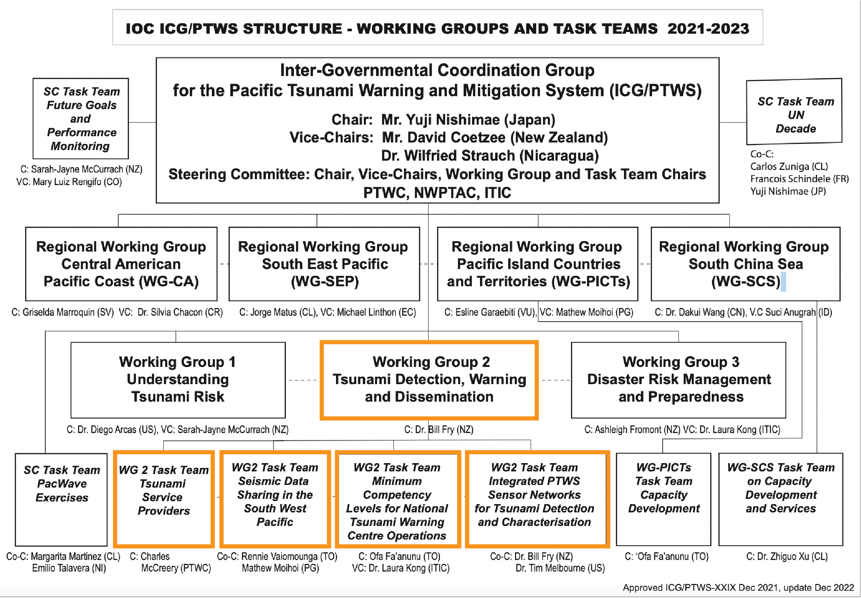

Slide 3
Task Team Seismic Data Sharing
Noted that the ORSNET Data Sharing Memorandum of Agreement (MOA) ensures that all local stations are shared with third party from the Regional ORSNET server. National Seismic Data are not to be shared without the consent of relevant ORSNET member state.
Noted that ORSNET MOA has been endorsed by Fiji and is with other member countries for consideration.
Noted that all ORSNET countries are sharing seismic data with PTWC from local stations with the exception of Samoa, PNG and a few stations in Solomon Islands.
Commended Geoscience Australia for collaboration with the Kingdom of Tonga to establish 8 new seismic stations in response to the HTHH event.
Commended the deployment of the twelve dart buoys in the SW Pacific by New Zealand and thanked New Zealnd for re-establishing the buoy network to full functionality closest to the Tonga Trench, noting that the real-time data is accessible online and feeding into warning centres.

Slide 4
Task Team Seismic Data Sharing
Recent work presented at the SDS TT meeting suggests that currently available data in the SW Pacific is insufficient to meet the ambitious Decade goals for seismic information to underpin tsunami forecasting.
Data to support determination of Mww, the best rapid earthquake magnitude and location estimation for underpinning tsunami forecasting, is available for most regionally tsunamigenic events within about 30 minutes after the earthquake.
It was noted that the geography of the region makes tsunami early warning particularly challenging. Results show that the dominant limitation of more rapid, reliable and consistent Mww determination is the azimuthal distribution of the network and target 15-minute forecasts may be possible with more widespread availability of data. The results strongly support open access data for all available seismic stations.

Slide 5
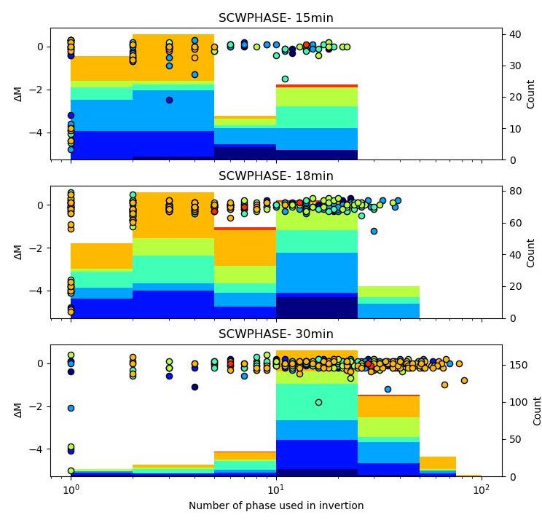
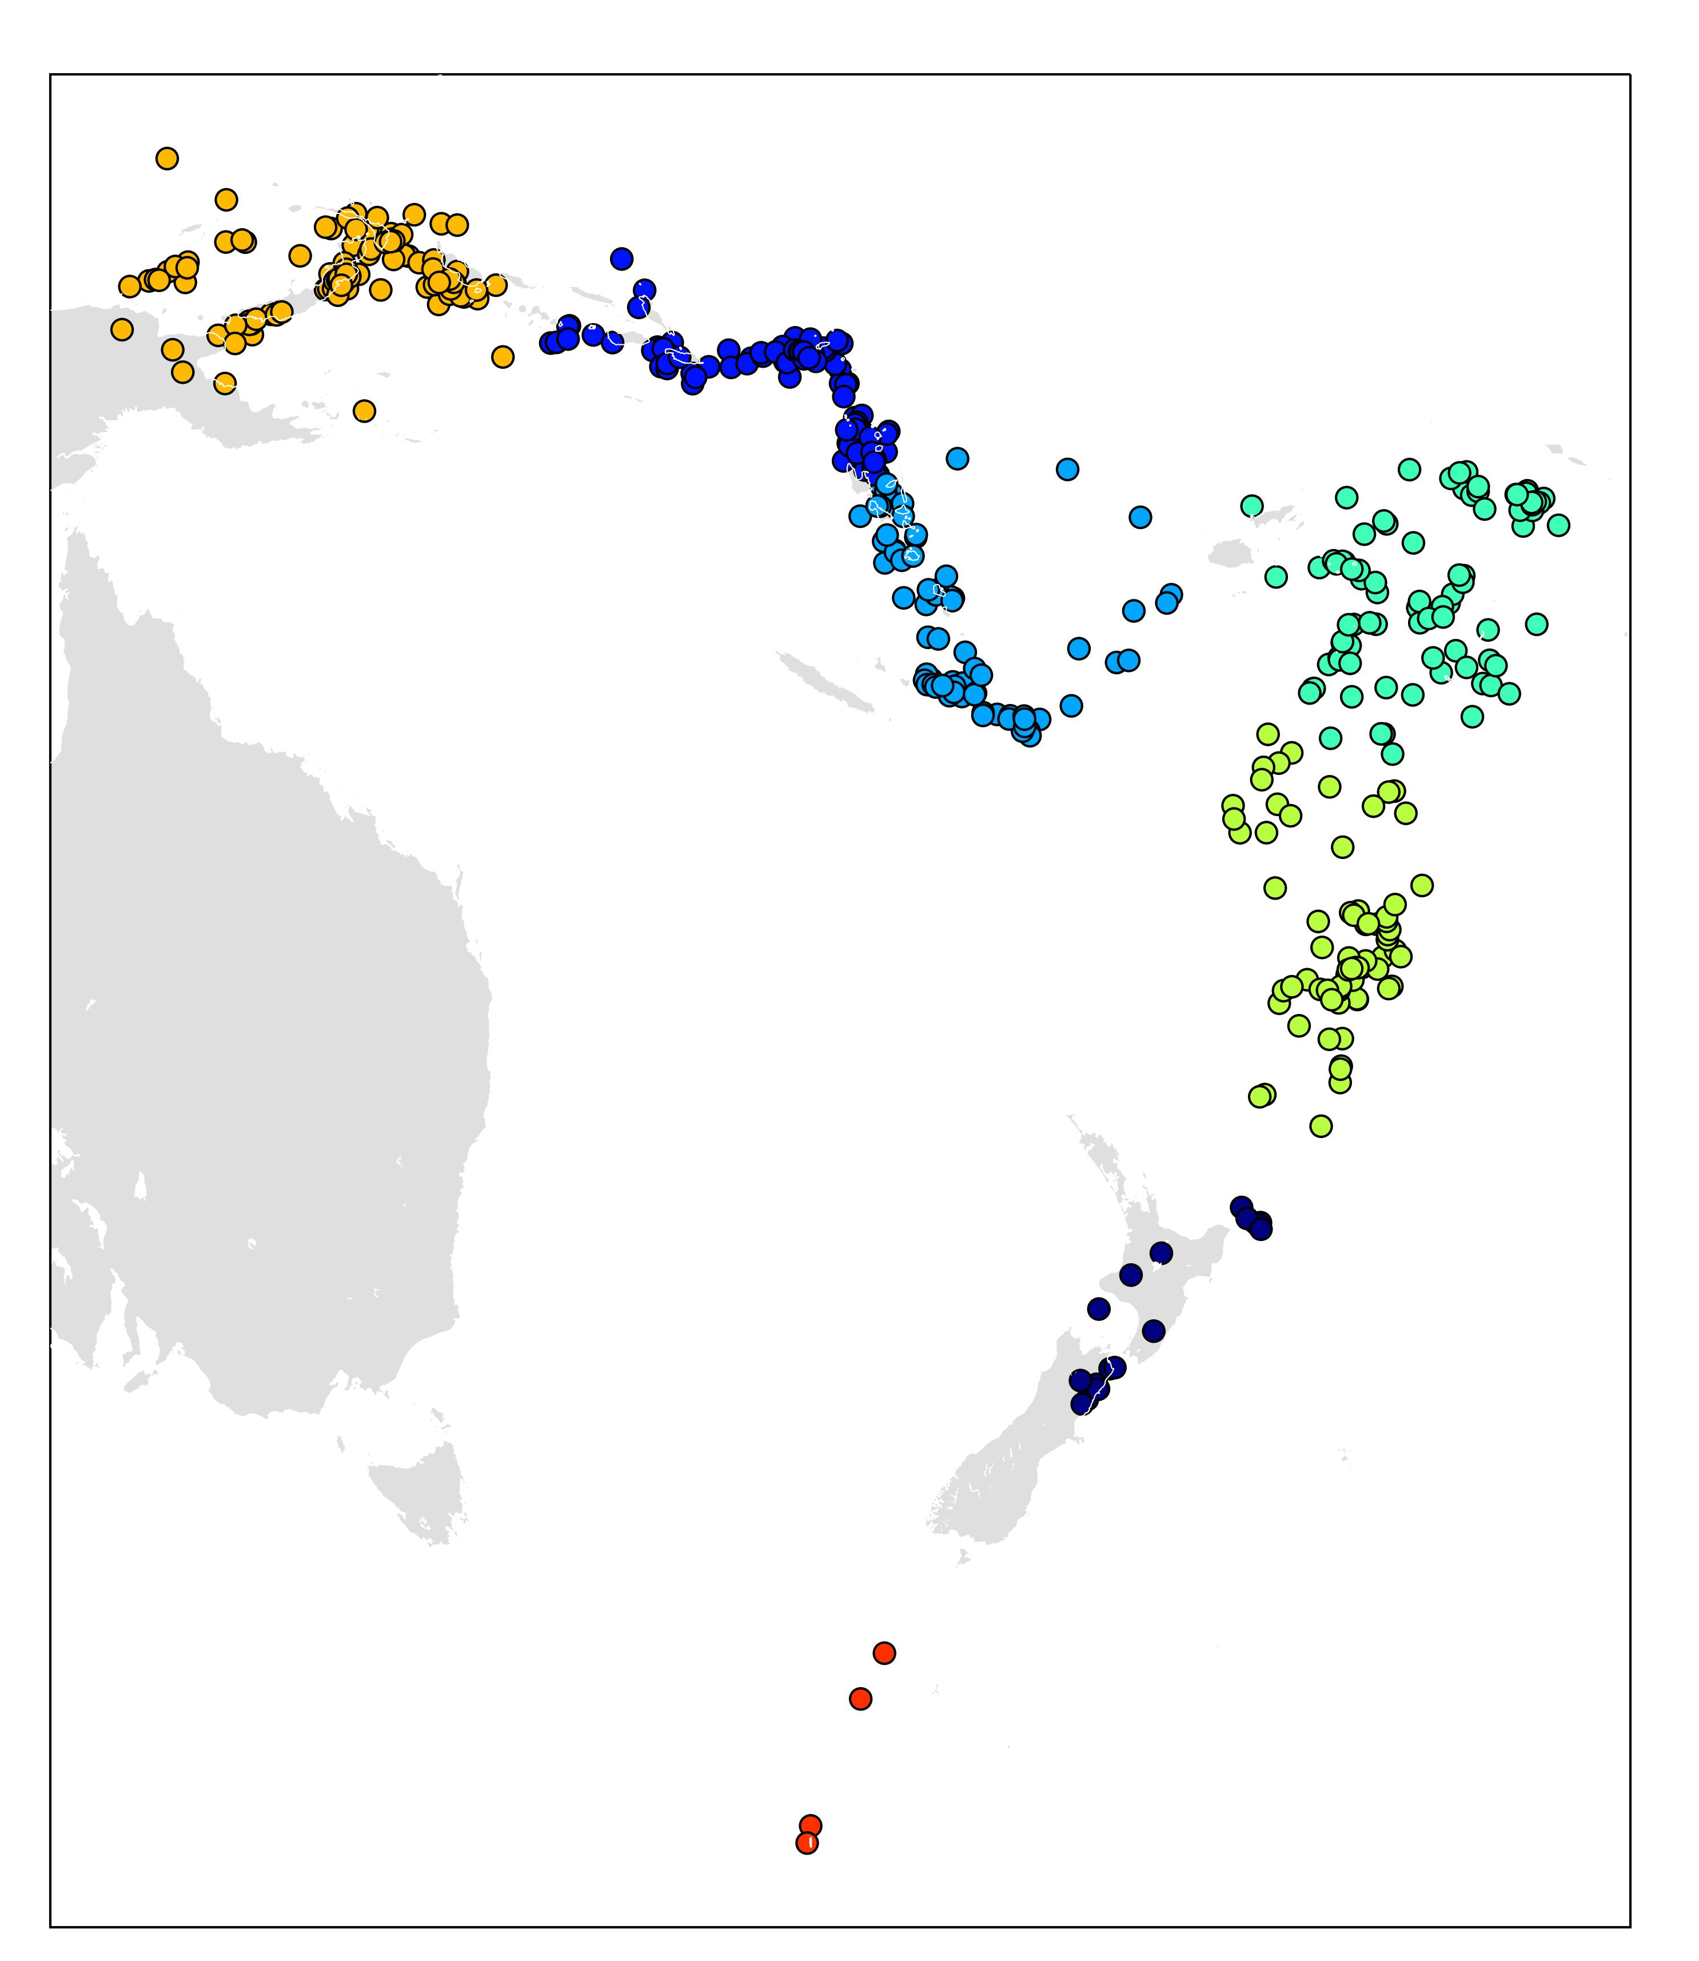
Regional Mww estimation vs. number of phases
Work from RCET Programme (Te Pū Ao / GNS Science), including partner organisations CPPT and Geoscience Australia
!Lack of data!

Slide 6
Task Team Integrated Sensor Network
Created to understand the role of sensor networks, emerging sensing technology and tsunami early warning approaches in the PTWS early warning context.
Considered data include real-time seismic data, real-time ocean observations including DARTs and coastal tide gauges, geodetic (GNSS) and potential SMART Cable deployments.
We note, the scope of the task team has evolved with developments around TEW goals of the Decade of Ocean Science

Slide 7
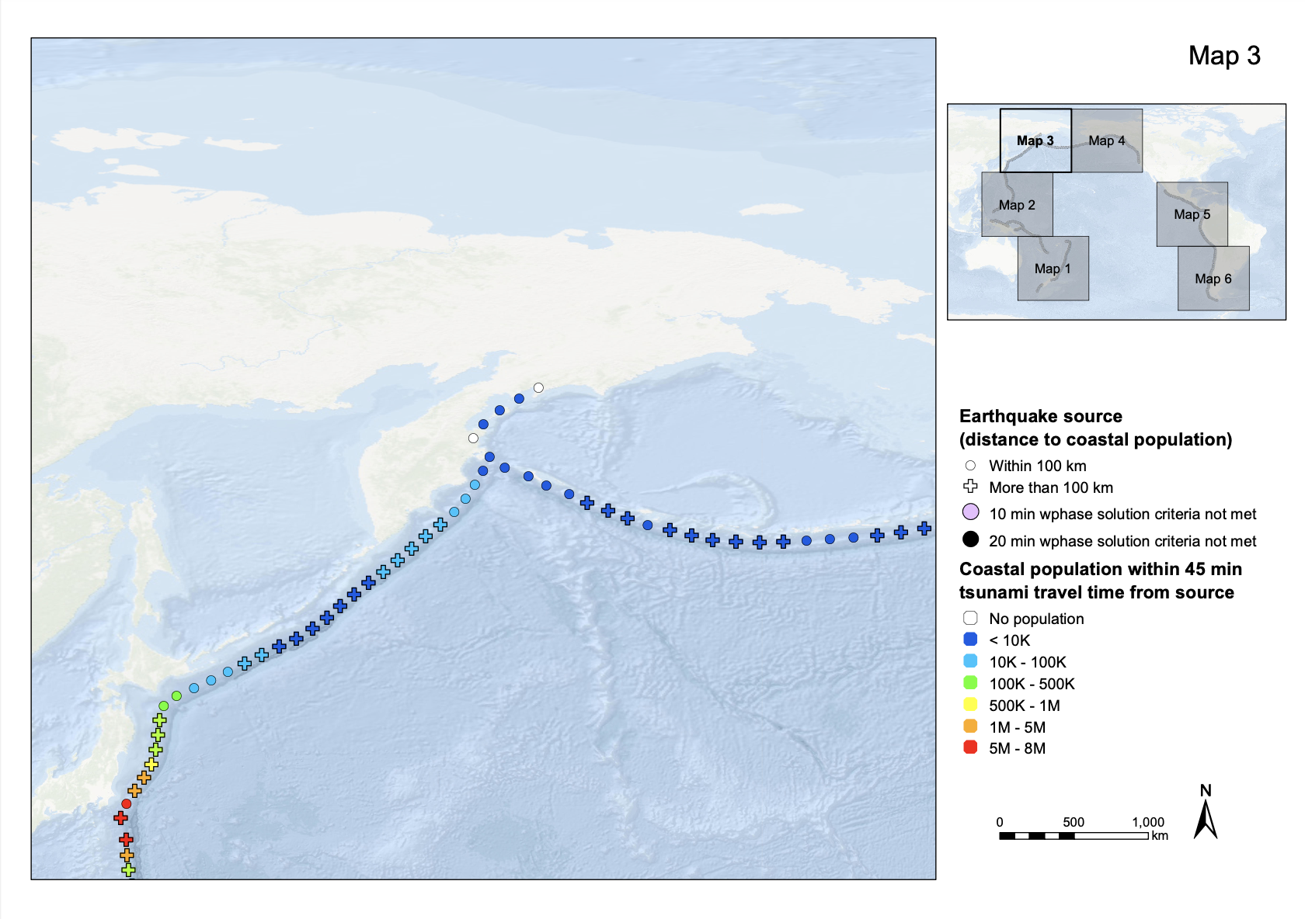
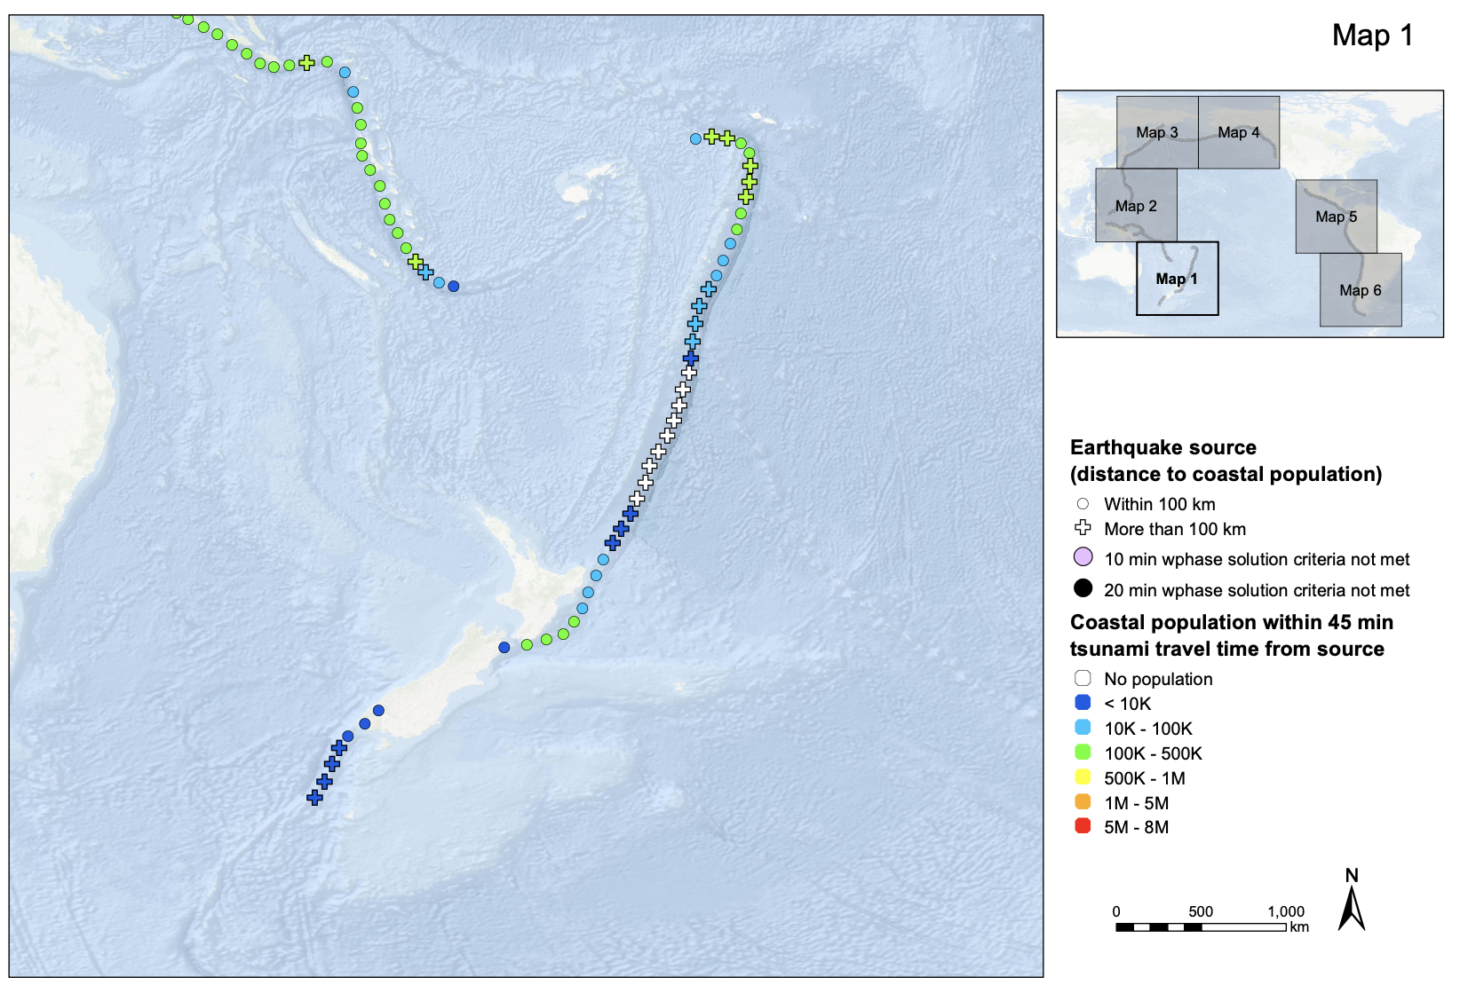
Task Team Integrated Sensor Network – TOWARD RISK

Slide 8
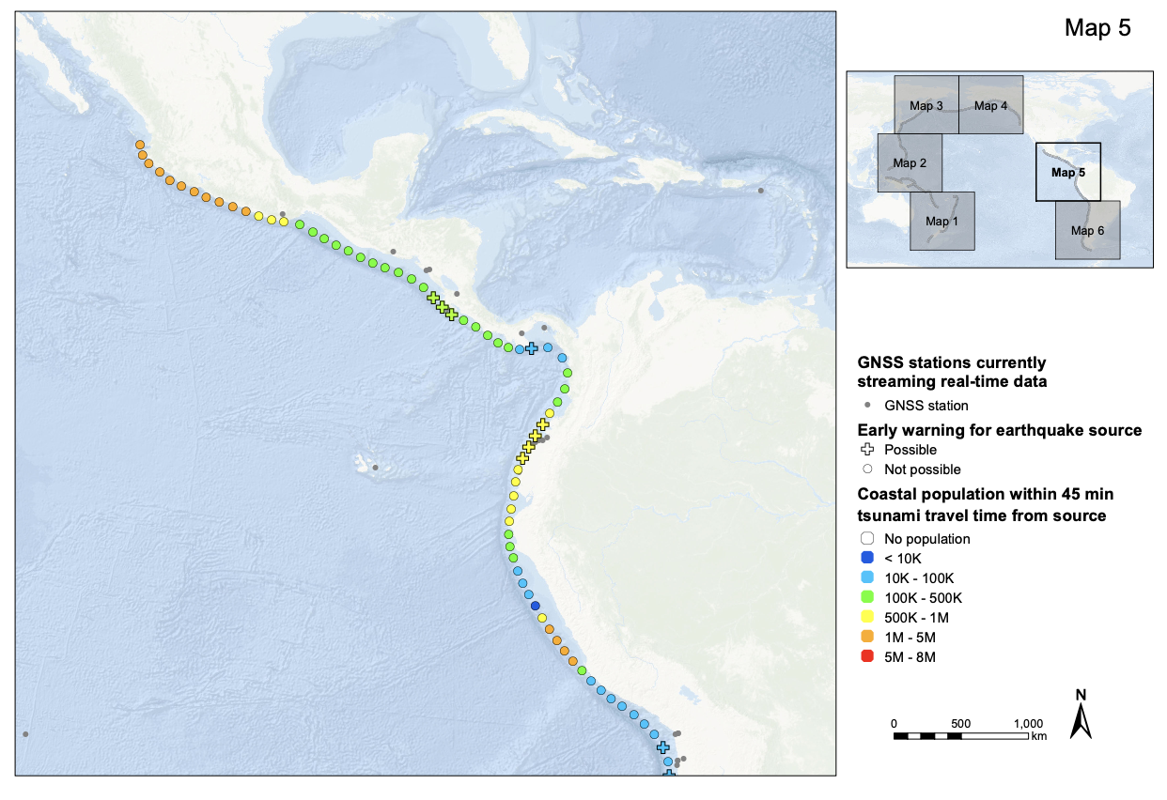
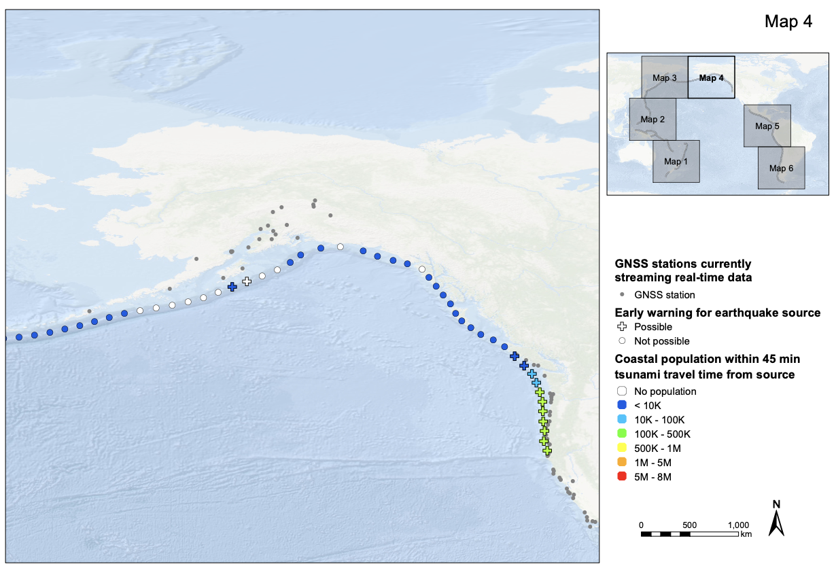
Task Team Integrated Sensor Network – TOWARD RISK Step 2: Calculating coverage

Slide 9
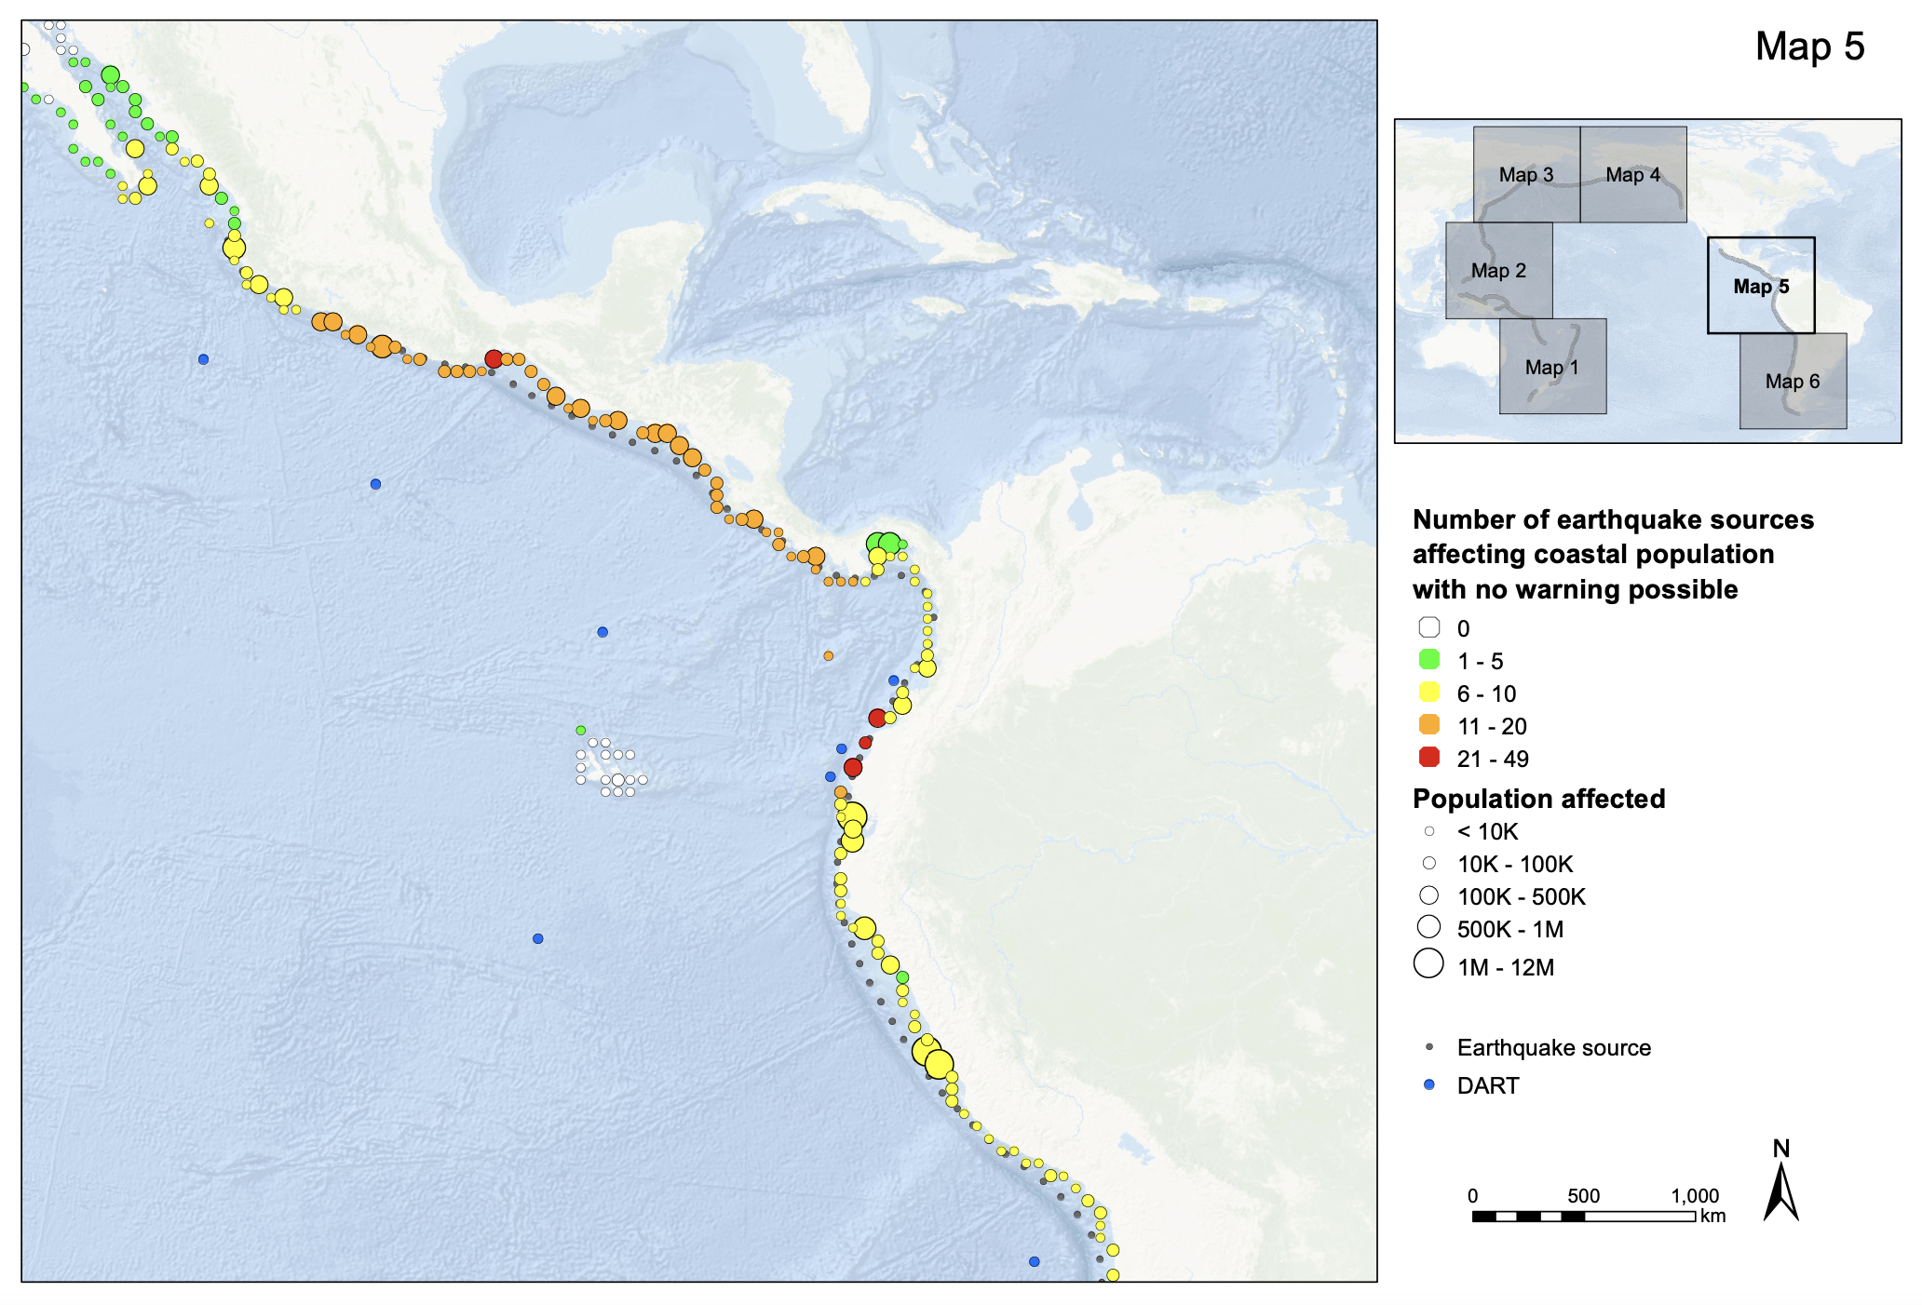
Task Team Integrated Sensor Network – TOWARD RISK Step 3: Cumulative risk per coastal population
Work concluding. Targetting report finalization before September ICG.
Based on 20 minutes of pre-arrival warning

Slide 10
Task Team Minimum Competency for NTWC
Competency Framework piloted, NTWC Training, Tonga 14-24 Oct 2019.
Recent TT work has identified gaps in the framework and competency including:
  Need to better understand volcano monitoring within NTWC
  Utility of learning from operational staff at PTWC in Hawaii or other NTWC;
  Need for Met Svc operational staff familiarize with Seismic Monitoring
  Following Impact Based Forecasting Training in the Solomon Islands Met Service, a nned was identified for forecasters to understand DRR aspects in issuance of warnings. It is recommended to be included in NTWC competency framework.
  It is noted that PICT warning centers equipped with tools but staff needs to be trained
  National initiative and perhaps support needed from stakeholders/partners (ITIC to implement, UNDRR, SPC to scope issues in region)

Slide 11
Ad hoc HTHH Response
WG2 contributed to immediate response and recovery through the daily meetings with Tonga Met and TGS and convened ad hoc debrief meetings three times; 20 January, 3, 10 February.
By end of January there existed a draft interim operational procedure for PTWC based on sea level observations from the coastal tide gauge at Nukua’lofa and NZDART network. Procedures were stood up by February 2022.
17 August : User’s Guide for interim procedures Published (CL-2902)
6 September : ICG/PTWS HTHH Interim Procedures and PTWS Products Informational Webinar
PICT drill in the PacWave 2022 to test interim procedures
The event response highlighted the urgent need to address atypical tsunamis within our ICG.

Slide 12
DRAFT recommendations
WG2 notes with appreciation
The continued efforts of ORSNET to provide open access seismic
The efforts of Geoscience Australia (GA) and the Kingdom of Tonga to establish 8 new seismic stations in response to the HTHH event.
The deployment of the twelve dart buoys in the SW Pacific by New Zealand and thanked New Zealnd for re-establishing the buoy network to full functionality closest to the Tonga Trench, noting that the real-time data is accessible online and feeding into warning centres.
The efforts of ITIC, Australia, New Zealand and USA to support the immediate response to and recovery from the January 15, 2022 eruption of HTHH and subsequent tsunami.
The efforts of the PTWC and ad hoc task team to rapidly deliver interim procedures for HTHH tsunamigenic activity after the Jan 15, 2022 eruption and tsunami.

Slide 13
DRAFT recommendations
WG2 recommends that the ICG PTWS
Continues to support initiatives promoting open access data sharing among member states in support of tsunami monitoring and forecasting.
Supports the task team on minimum competency levels by considering delegation of responsibility to scope need in region on competency framework and to map and develop framework among PICTs.
Urgently explore options for detection and forecasting of tsunamis generated from non-earthquake sources with instrumentation and data currently available. It is recommended that an additional task team be convened for this purpose.

Slide 14
DRAFT recommendations
WG2 further recommends that the ICG PTWS
Extend all 4 task teams within WG2 until at least the ICG XXX in September, 2023.
Consider extending the scope of the TT on the Integrated Sensor Network to address global capability in TEW in support of Decade targets or recommending the analysis be extended within TOWS WG.
Consider appointing a Vice-Chair to WG2

Slide 15
Thank you very much for your kind attention.

