Slide 1
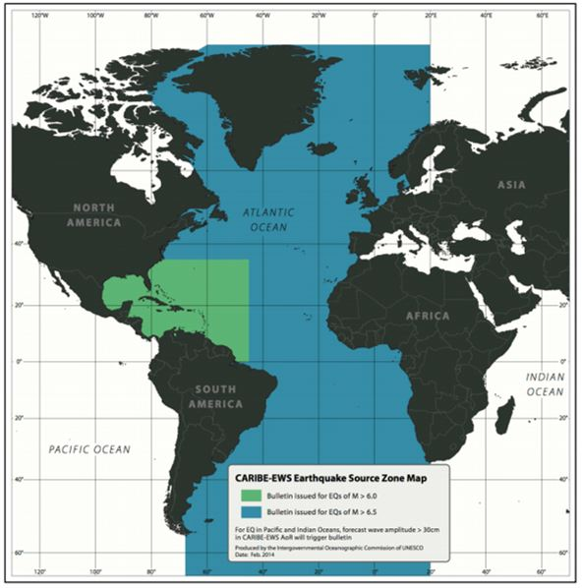
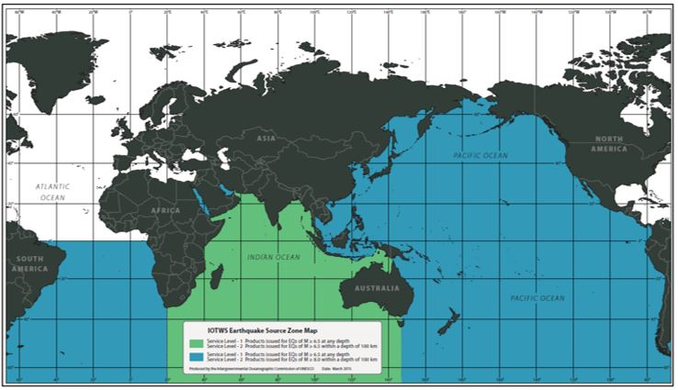
9 Updates to Area of Coverage and ESZ Maps of the ICG
CARIBBE-EWS Earthquake Source Zone Map
IOTWMS Earthquake Source Zone Map

Slide 2
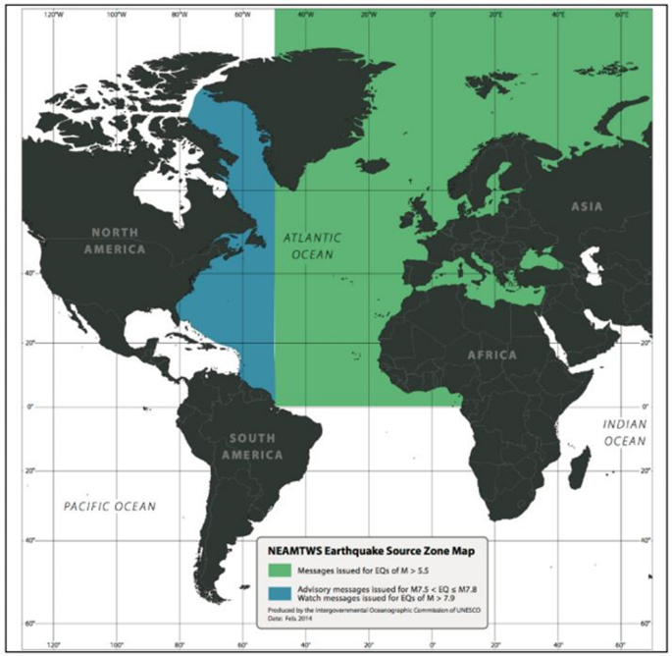
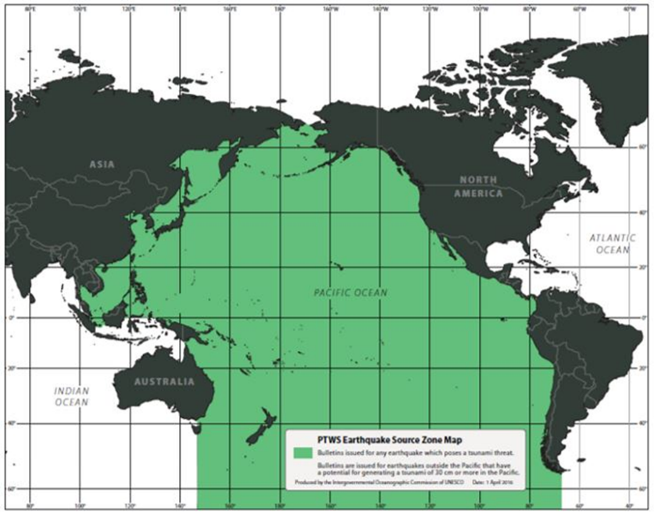
9 Updates to Area of Coverage and ESZ Maps of the ICG
NEAMTWS Earthquake Source Zone Map
PTWS Earthquake Source Zone Map

Slide 3
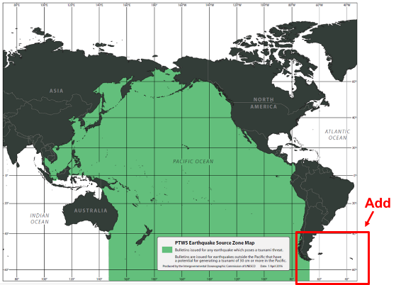
(Expansion of the ICG/PTWS ESZ)
9 Updates to Area of Coverage and ESZ Maps of the ICG
Decision in the ICG/PTWS 29th session
In the PTWS XXIX session, PTWS decided that the PTWS Earthquake Source Zone be expanded to include the southernmost Atlantic seismic region
to routinely provide Member States of the PTWS with information about the frequent large earthquakes from this region and any subsequent tsunami threat.
Comment from Argentina
The working document (ICG/PTWS-XXIX/3) for the EC, which corresponds to the report of the ICG/PTWS XXIX session, was posted to the EC web site on 12th June. Argentina has not been given sufficient time for assessment of the document.
There are no detailed information about the expansion of the ESZ. The specific region of to be expanded is not also presented. Argentina cannot deeply analyzed the PTWS proposal.

Slide 4
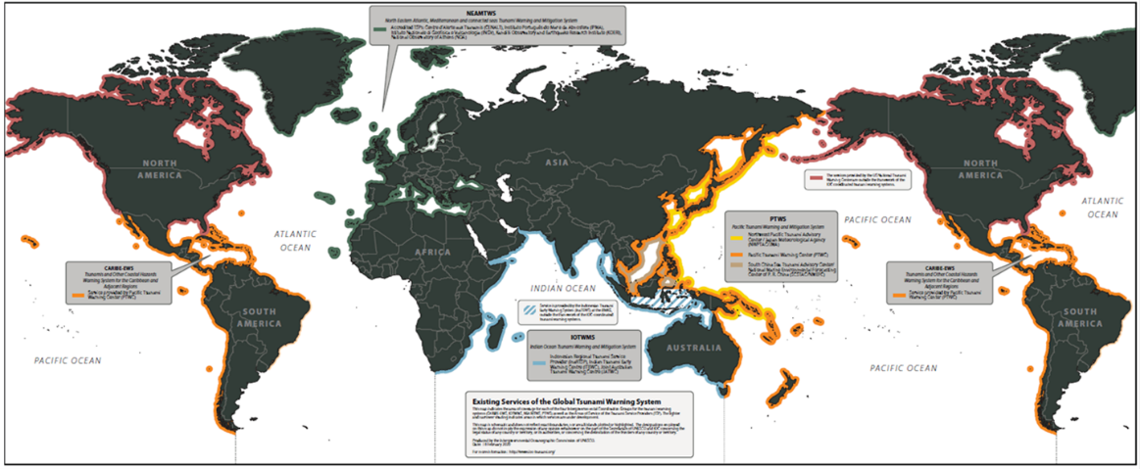
9 Updates to Area of Coverage and ESZ Maps of the ICG
(Area of Service of ICGs)

Slide 5
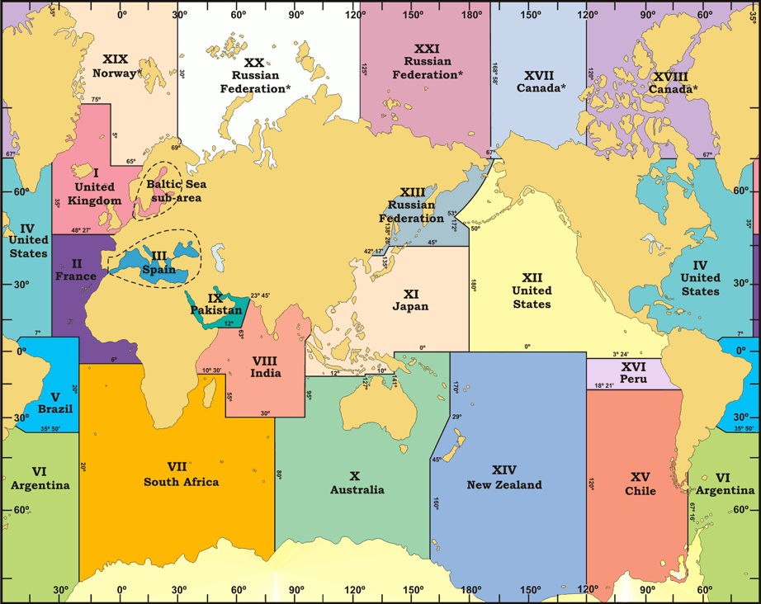
10 Provision of Tsunami Information of the TSPs to Maritime Community for Navigational Warning
Seven NAVAREA Coordinators
NAVAREA | Country
X | Australia
XI | Japan
XII | United States
XIII | Russian Federation
XIV | New Zealand
XV | Chile
XVI | Peru

Slide 6
10 Provision of Tsunami Information of the TSPs to Maritime Community for Navigational Warning
The TTTWO in TOWS-WG 12th Session
Recommendation 9: Approve the proposal on TSP Messages for the Maritime Community and requests the ICGs to consider the proposal for implementation in their respective basins. Further, IOC Secretariat is to share the final proposal with WWNWS-SC and facilitate coordination between ICGs and the WWNWS-SC for operationalising the service.
The TOWS-WG 12th Session
The Group approved the proposal on TSP Messages for the Maritime Community and requested the ICGs to consider the proposal for implementation in their respective basins. (see Appendix 4 to Annex IV).
The TOWS-WG 16th Session
The Group recommended the IOC Assembly at its 32nd session in 2023 to instruct the regional ICGs:
TSPs in collaboration with NAVAREA operators test the tsunami maritime safety products in 2023/24, with a view to operationally implementing in 2024/25;

Slide 7
10 Provision of Tsunami Information of the TSPs to Maritime Community for Navigational Warning
(Draft Messages)
Example 1 – A TSP initial message for a tsunami affecting 3 NAVAREAs
NAVAREA XI, NAVAREA XIII, NAVAREA X
NORTHEAST PACIFIC COASTS TSUNAMI THREAT MESSAGE [or whatever the correct term will be] ISSUED BY PACIFIC TSUNAMI WARNING CENTRE [fill in name of the issuing TSP] in support of the UNESCO/IOC PACIFIC TSUNAMI WARNING AND MITIGATION SYSTEM [fill in name of the regional system] AT DDHHMM UTC MMM YY. [This clearly identifies that the message has been issued by the recognised expert]
A TSUNAMI HAS BEEN GENERATED BY A MAGNITUDE 8.4 EARTHQUAKE THAT OCCURRED IN VICINITY OF [Position] DD-MM N/S DDD-MM E/W, THE RYUKYU ISLANDS DDHHMM UTC MMM YY [this is the date/time of the earthquake, rather than the originating message] HAZARDOUS T
SUNAMI WAVES ARE FORECAST FOR SOME COASTS OF JAPAN, THE PHILIPPINES, AND INDONESIA [from a list of countries/islands] TSUNAMI WAVES ARE NOT A HAZARD TO SHIPS IN DEEP WATER BUT CAN CAUSE STRONG CURRENTS AND RAPID SEA LEVEL CHANGES IN SHALLOW WATER, AS WELL AS INUNDATION OF THE COAST. SHIPS APPROACHING THE COAST SHOULD CONSULT LOCAL AUTHORITIES REGARDING LOCAL CONDITIONS AND ADVICES.
Example 2 – A TSP final message for a tsunami affecting 3 NAVAREAs
NAVAREA XI, NAVAREA XIII, NAVAREA X NORTHEAST PACIFIC COASTS TSUNAMI CANCELLATION MESSAGE [or whatever the correct term will be] ISSUED BY PACIFIC TSUNAMI WARNING CENTRE [fill in name of the issuing TSP] in support of the UNESCO/IOC PACIFIC TSUNAMI WARNING AND MITIGATION SYSTEM [fill in name of the regional system] AT DDHHMM UTC MMM YY. [This clearly identifies that the message has been issued by the recognised expert]
THE THREAT HAS NOW LARGELY PASSED FOR THE TSUNAMI GENERATED BY A MAGNITUDE 8.4 EARTHQUAKE THAT OCCURRED IN IN VICINITY OF [Position] DD-MM N/S DDD-MM E/W, THE RYUKYU ISLANDS DDHHMM UTC MMM YY [this is the date/time of the earthquake, rather than the originating message] HOWEVER, SHIPS APPROACHING THE COAST SHOULD STILL CONSULT LOCAL AUTHORITIES REGARDING LOCAL CONDITIONS AND ADVICES.

