Slide 1
The Intergovernmental Coordination Group for the Pacific Tsunami Warning and Mitigation System Steering Committee (ICG/PTWS SC) Meeting, 6 - 9 March 2023
Report on Regional Working Group
on Tsunami Warning and Mitigation System for the South China Sea Region
South China Sea Tsunami Advisory Center

Slide 2
OUTLINE
1. Tenth Meeting of ICG/PTWS WG-SCS (online)
2. SCSTAC Operation
3. SCSTAC Capacity Building
4. SCSTAC Product Manual (TS-149) Revision
5. Backup SCSTAC (HONGKONG)
6. Regional Training and Workshop

Slide 3
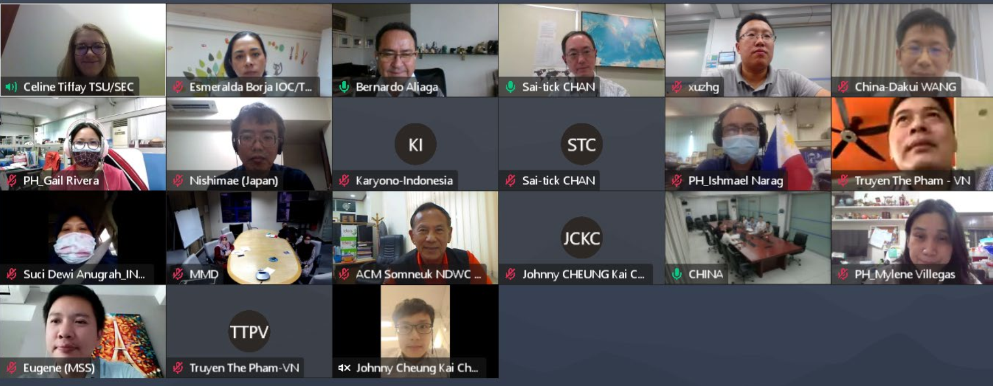
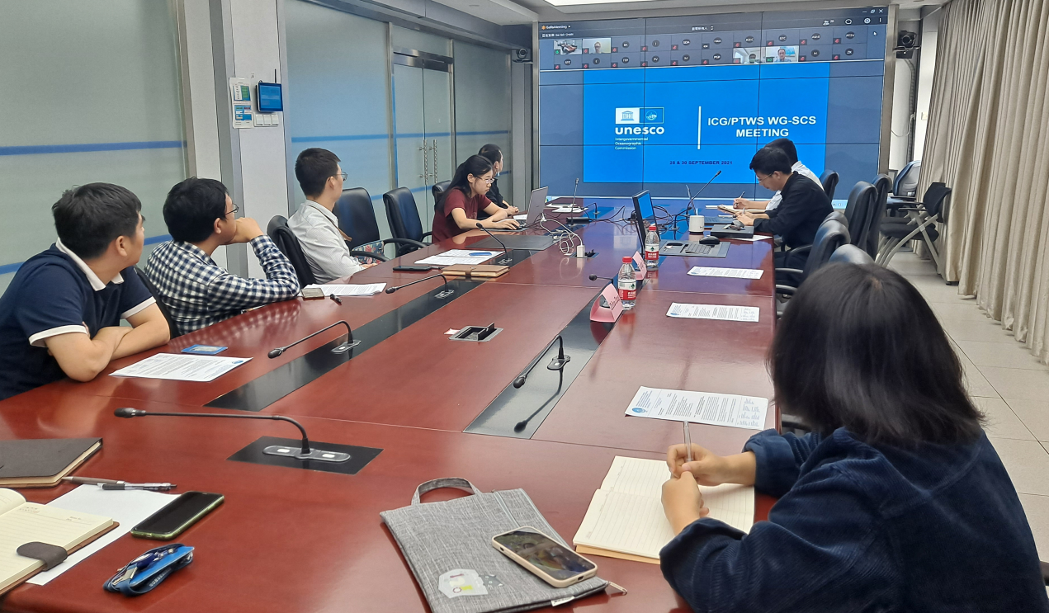
1. Tenth Session of ICG/PTWS WG-SCS (online)
Held on 28 & 30 September 2021
Attended by Brunei Darussalam, China, Indonesia, Malaysia, the Philippines,
Singapore, Thailand, Vietnam, NWPTAC

Slide 4
1. Tenth Session of ICG/PTWS WG-SCS (online)
Noting that the purpose of Task Team on the Establishment of a South China Sea Tsunami Advisory Center (TT-SCSTAC) has been largely completed, and the demand to further strengthen capacity development and Services in the South China Sea region,
Recommends dissolving the Task Team on Establishment of a South China Sea Tsunami Advisory Center of the Regional Working Group on Tsunami Warning and Mitigation in the South China Sea;
Further recommends the establishment of a Task Team on Capacity Development and Services.

Slide 5
Terms of Reference
Regional Working Group on Tsunami Warning and Mitigation in the South China Sea Region Task Team on Capacity Development and Services
To coordinate training workshops and other technical exchanges on topics related to earthquake and tsunami for enhancing the tsunami warning capabilities of the WG-SCS Member States.
To facilitate implementation of the International Staff Programme for short-term secondment of staff from WG-SCS Member States to SCSTAC on an annual basis.
To explore ways for furthering the sharing and exchange of relevant data and information in the South China Sea region.
To ascertain the latest requirements of WG-SCS Member States for tsunami advisory service provided by SCSTAC.
Membership: Representatives of Member States of the ICG/PTWS WG-SCS (Brunei Darussalam, Cambodia, China, Indonesia, Malaysia, the Philippines, Singapore, Thailand and Vietnam) and invited experts; representatives of PTWC and NWPTAC (JMA); with Chair and Vice-Chair to be elected either by the WG-SCS or the ICG/PTWS.

Slide 6
1. Tenth Session of ICG/PTWS WG-SCS (online)
Noting further that the backup centre will be named as “Backup South China Sea Tsunami Advisory Center (Hong Kong)” [BSCSTAC (Hong Kong)], and satisfactory progress has been made in BSCSTAC to build up backup capability,
Agrees to commence trial operation of BSCSTAC (Hong Kong) in the first quarter of 2022, with specific date to be decided by SCSTAC and announced by the IOC Secretariat to WG_x0002_SCS Member States through a circular letter;
Agrees to commence full operation of BSCSTAC (Hong Kong) upon satisfactory performance in the trial operation period, with specific date to be decided by SCSTAC and announced by the IOC Secretariat to WG-SCS Member States through a circular letter;

Slide 7
1. Tenth Session of ICG/PTWS WG-SCS (online)
Welcomes SCSTAC's proposal to continue with the International Staff Programme to host 2 or 3 experts from the Member States of the WG-SCS in 2022 subject to the condition of the Covid-19 pandemic, with the travel and local expenses covered by SCSTAC, and requests the IOC to make the announcement to all Member States’ TNCs and NTWCs of WG-SCS regarding the matter;
Accepts with appreciation the offer of China to keep the possibility of hosting an in-person meeting of ICG/PTWS-WG-SCS-XI in 2022 in Guangzhou, Guangdong Province, China, with dates and venue to be discussed and determined in consultation with the Secretariat and the Chairperson.

Slide 8
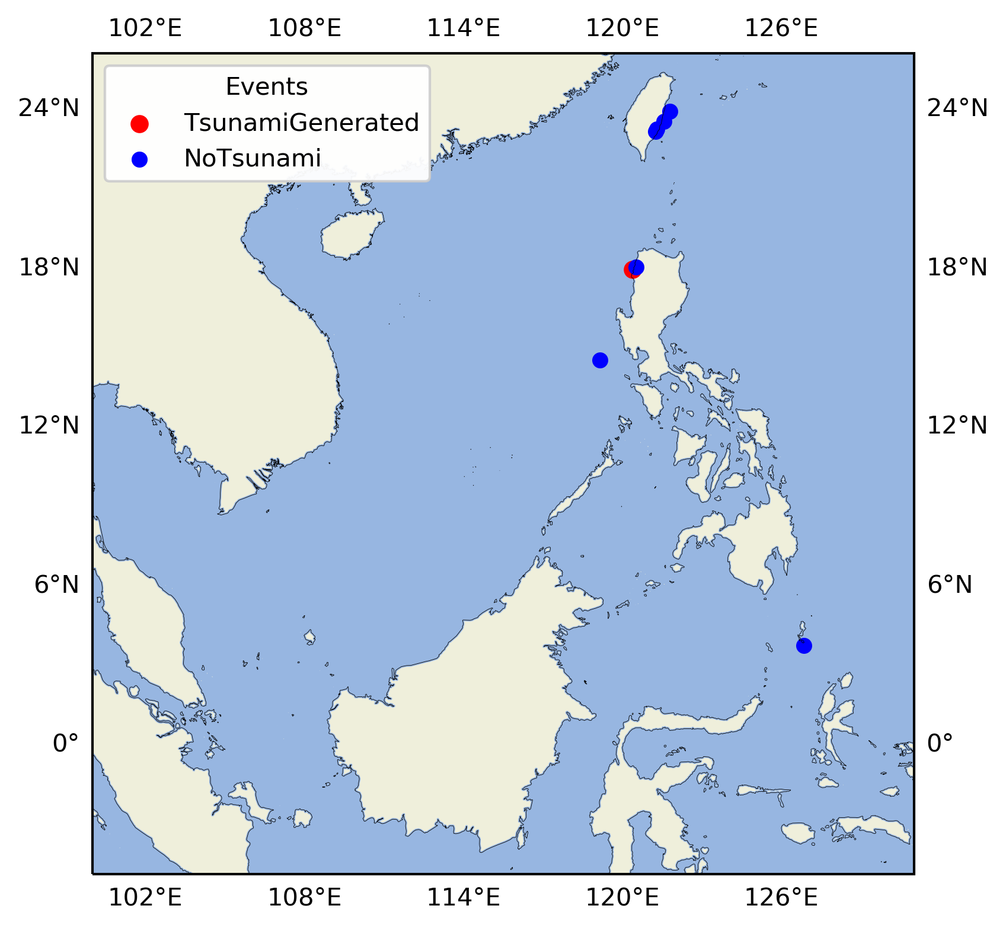
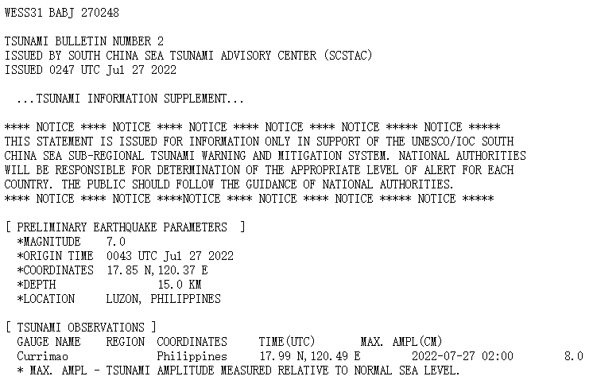
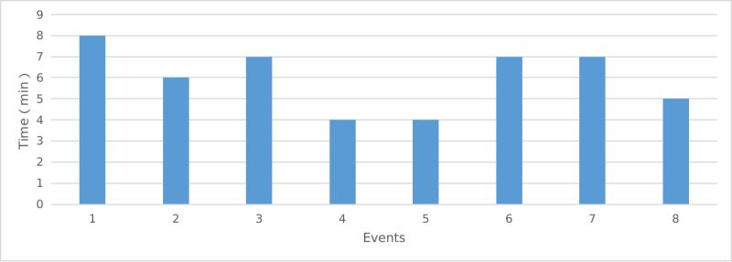
2. SCSTAC Operation
Tsunami Warning Servies of SCSTAC in 2022
SCSTAC issued 10 bulletins for 8 earthquake events occurred around the SCS region in 2022.
First bulletins were issued in less than 8 minutes.
The tsunami with 8 cm amplitude generated in Philipines on 27 July 2022.
SCSTAC conducted tsunami exercise in SCS region on 13 Oct 2022

Slide 9
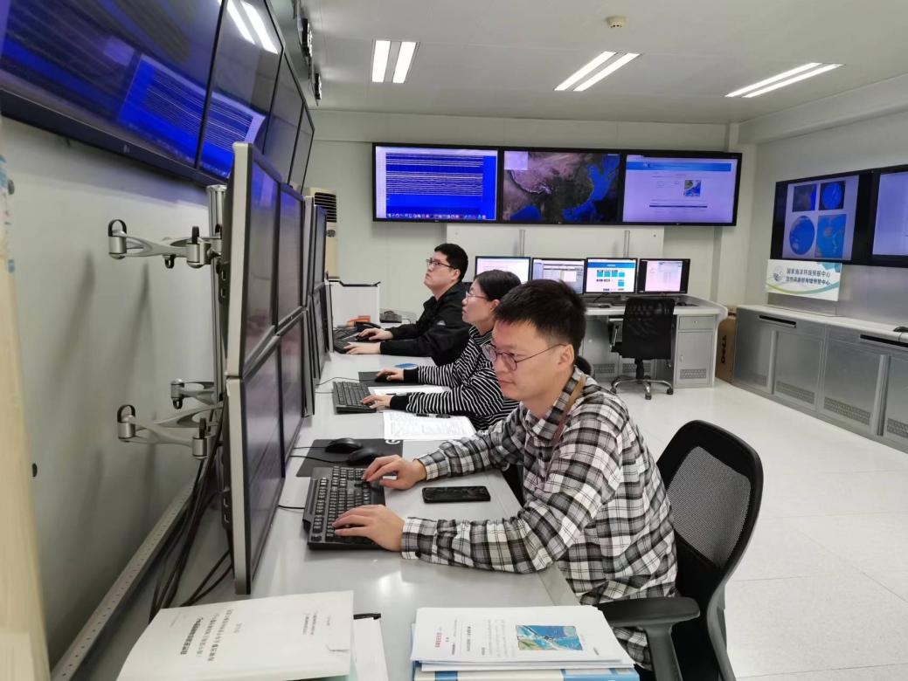
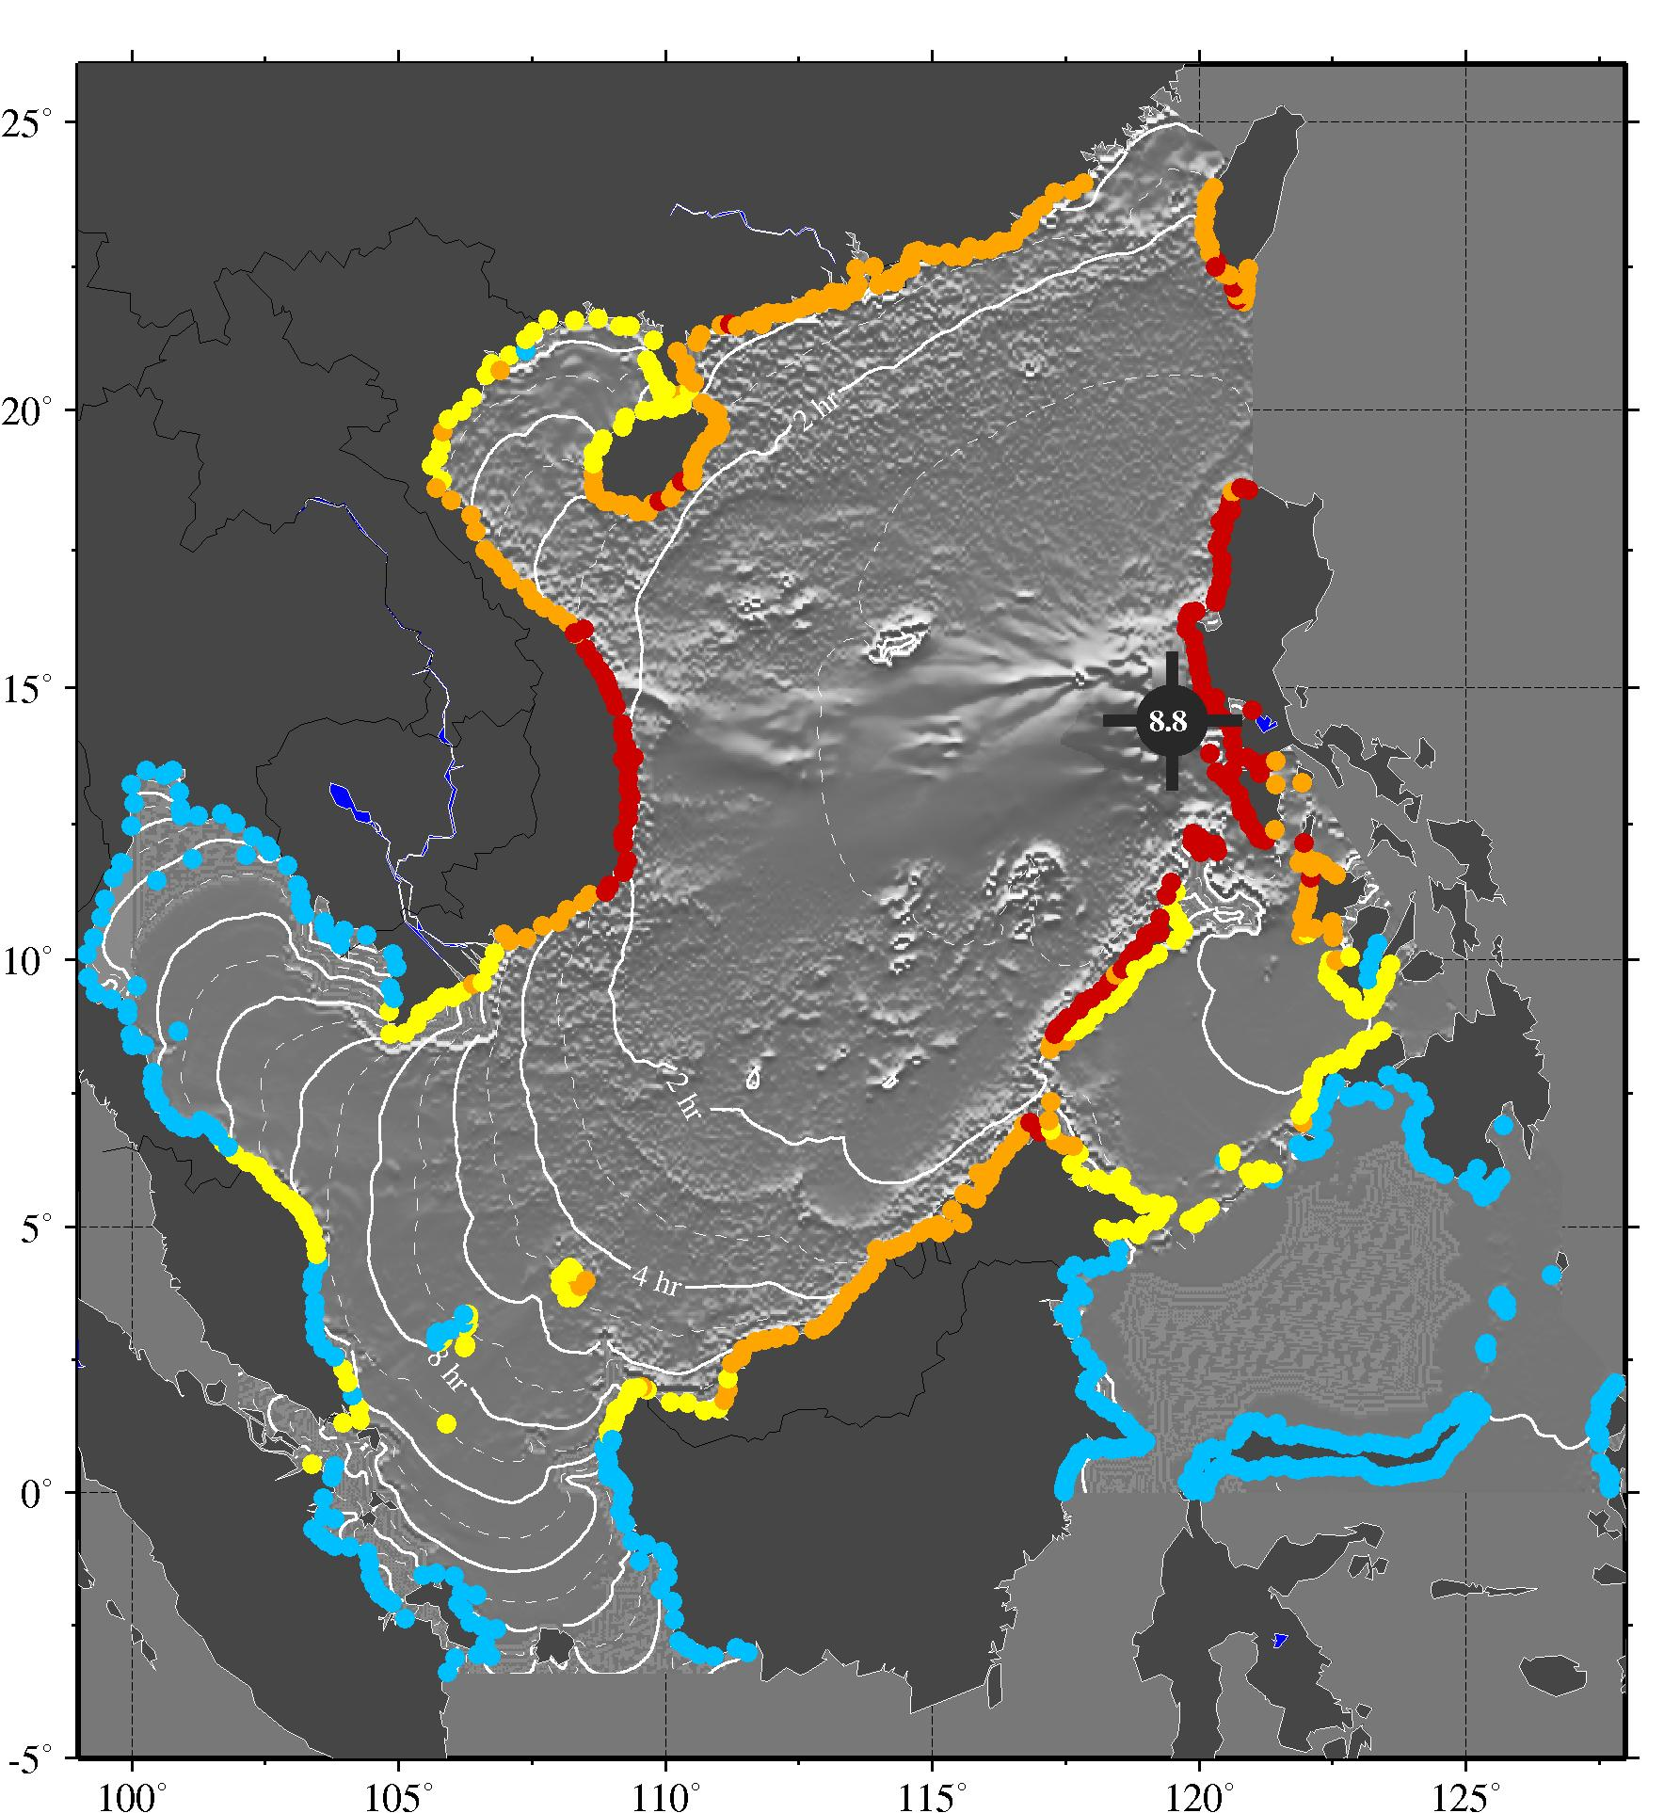
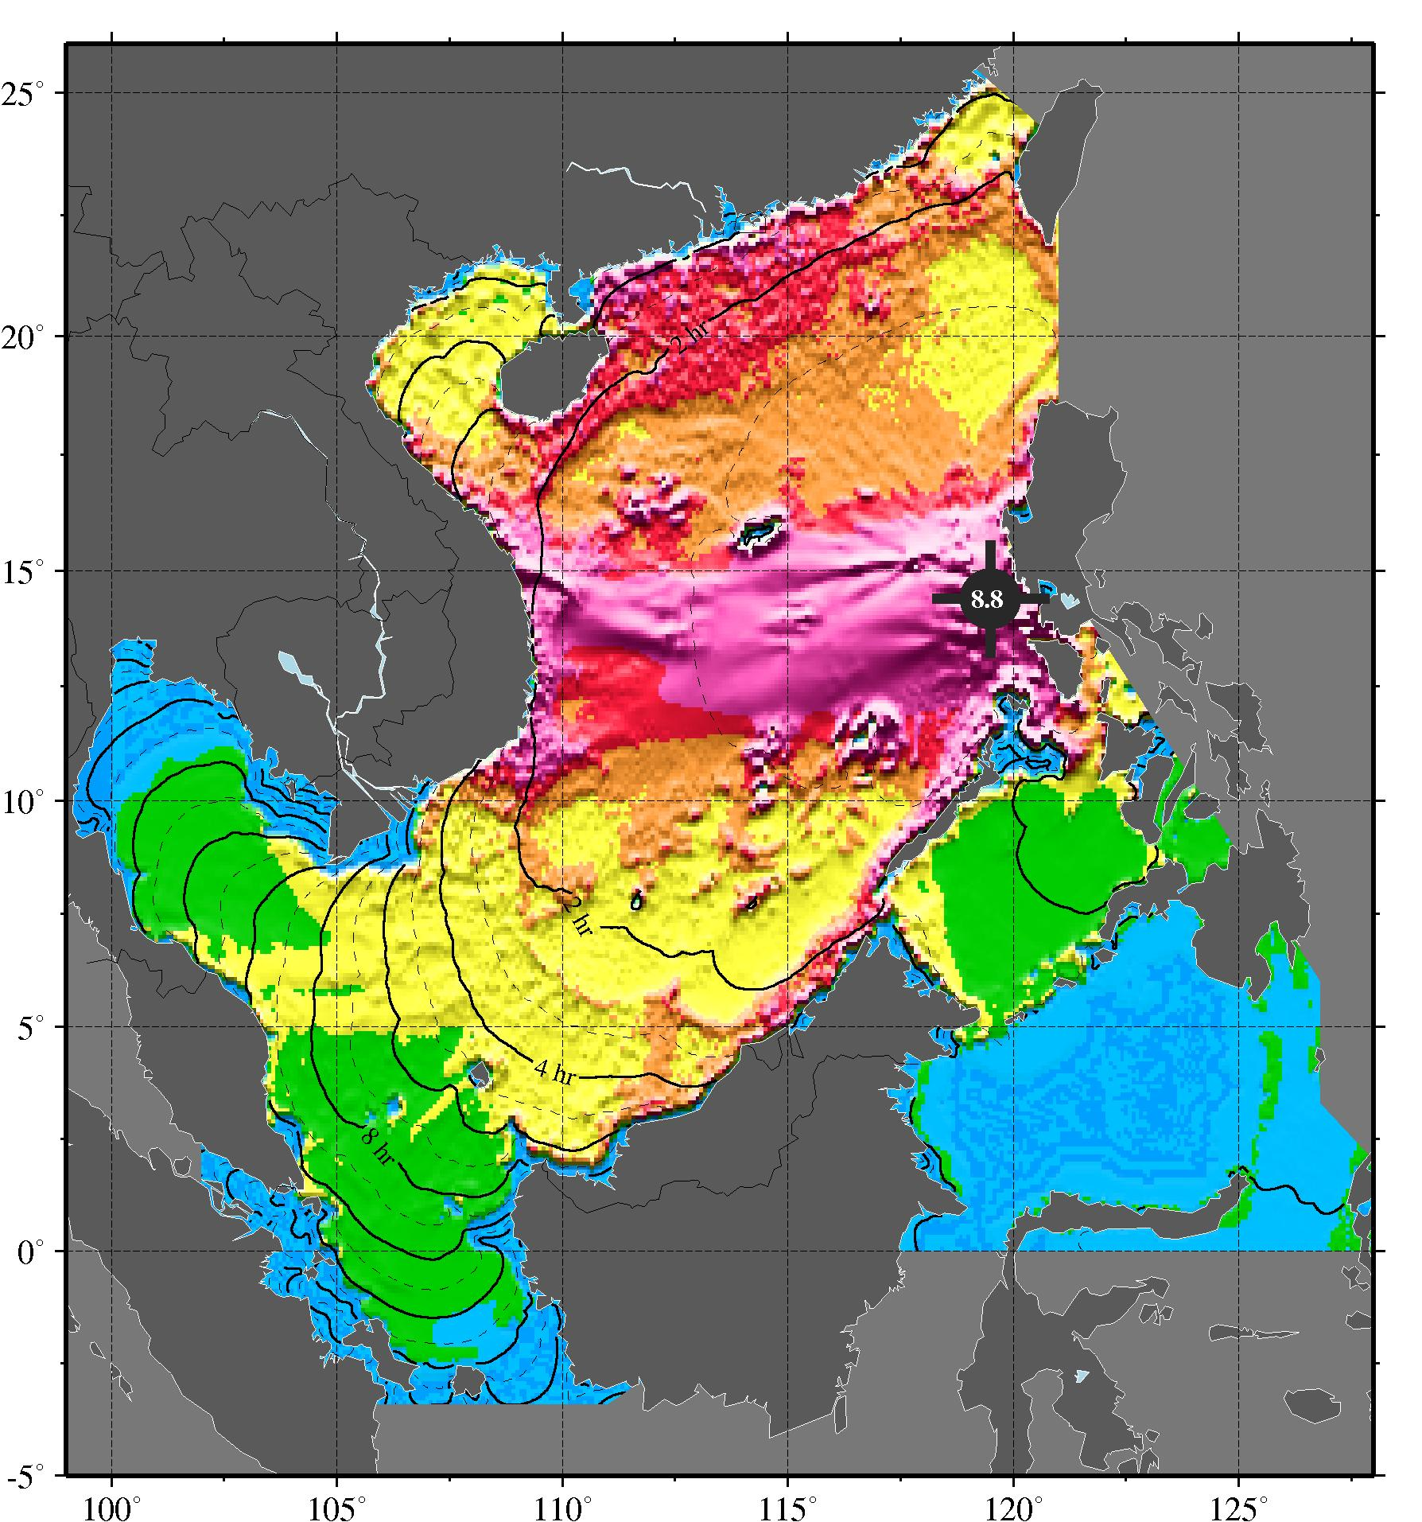
2. SCSTAC Operation - Pacwave22
**TEST** PACWAVE22 TSUNAMI EXERCISE **TEST**
ISSUED BY SOUTH CHINA SEA TSUNAMI ADVISORY CENTER (SCSTAC)
ISSUED AT 0000Z 13 OCT 2022
THIS IS A COMMUNICATION TEST BULLETIN FOR PACWAVE22 TSUNAMI EXERCISE.
THIS IS A TEST TO VERIFY COMMUNICATION LINKS AND DETERMINE
TRANSMISSION TIMES INVOLVED IN THE DISSEMINATION OF OPERATIONAL
TSUNAMI ADVICE PRODUCTS FROM THE SOUTH CHINA SEA TSUNAMI ADVISORY
CENTER TO DESIGNATED 24-HOUR TSUNAMI WARNING FOCAL POINTS OF THE SOUTH
CHINA SEA TSUNAMI WARNING SYSTEM.
THIS TEST MESSAGE IS SENT BY GTS, FAX AND EMAIL.
RECIPIENTS ARE REQUESTED TO PLEASE RESPOND BACK TO ICG PTWS TASK TEAM
ON PACWAVE22. GUIDANCE FOR THE EXERCISE CAN BE FOUND IN
THE PACWAVE22 EXERCISE MANUAL LOCATED AT
WWW.PACWAVE.INFO
PLEASE RESPOND BEFORE THE DUE DATE SPECIFIED IN THE EXERCISE MANUAL.
THANK YOU FOR YOUR PARTICIPATION IN THIS COMMUNICATION TEST
PLEASE TAKE NOTE OF THE TIME YOU RECEIVE THIS MESSAGE AND THE METHOD(S)
BY WHICH YOU RECEIVE THIS MESSAGE AND REPORT BACK THROUGH THE EXERCISE
PACWAVE POST-EXERCISE ONLINE EVALUATION SURVEY BY 23 OCTOBER 2022

Slide 10
2. SCSTAC Operation - Communication Tests
SCSTAC conducted 3 communications tests on 11 Feb, 21 May, and 13 Sep 2022. The purpose was to verify that communications links to the recipient organizations of its tsunami advisories in the SCS countries and territories were functioning properly.

Slide 11
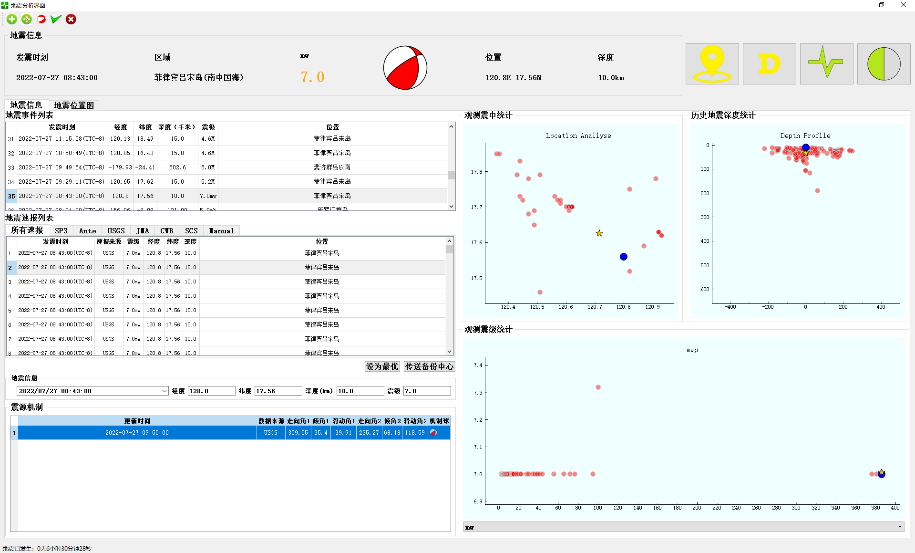
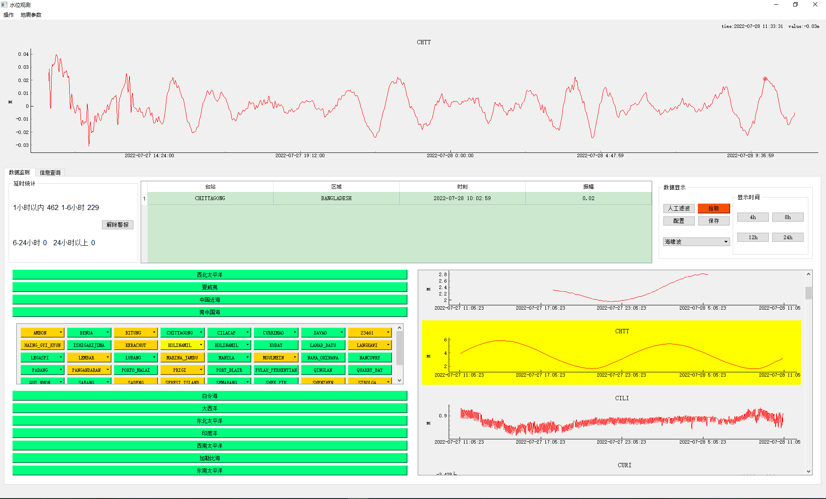
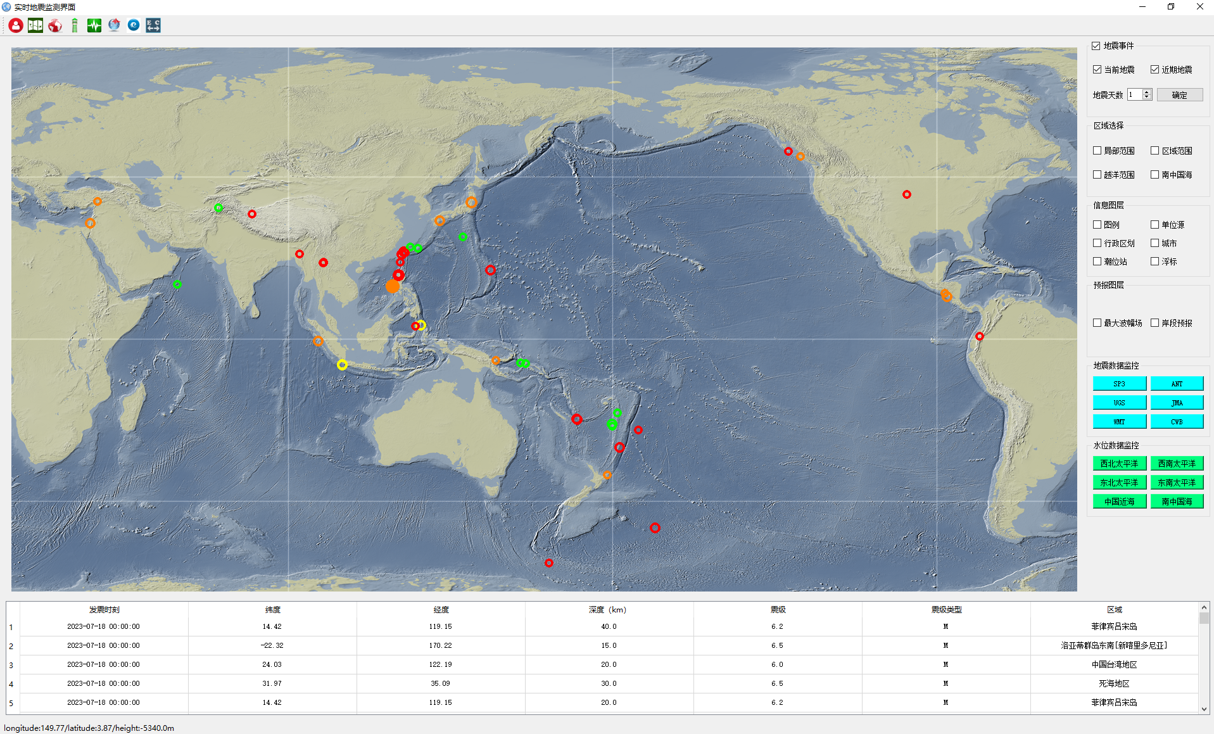
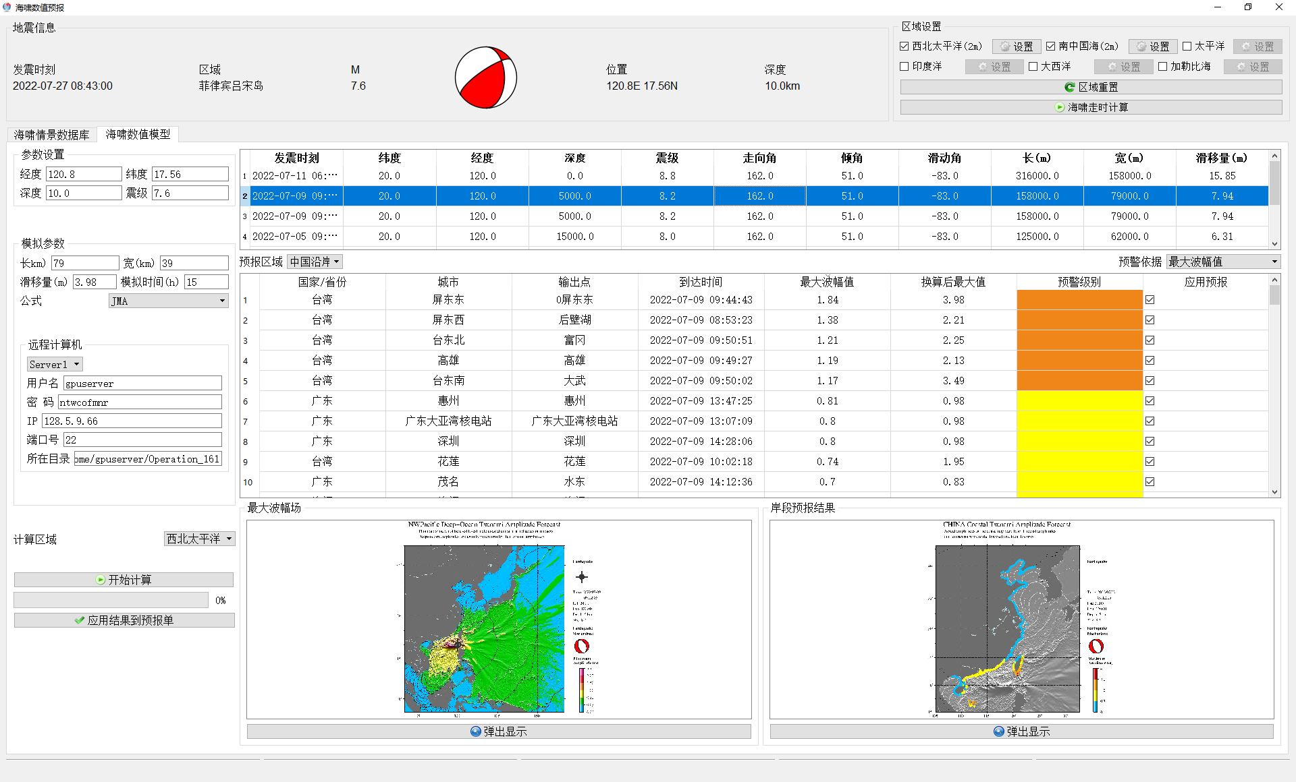
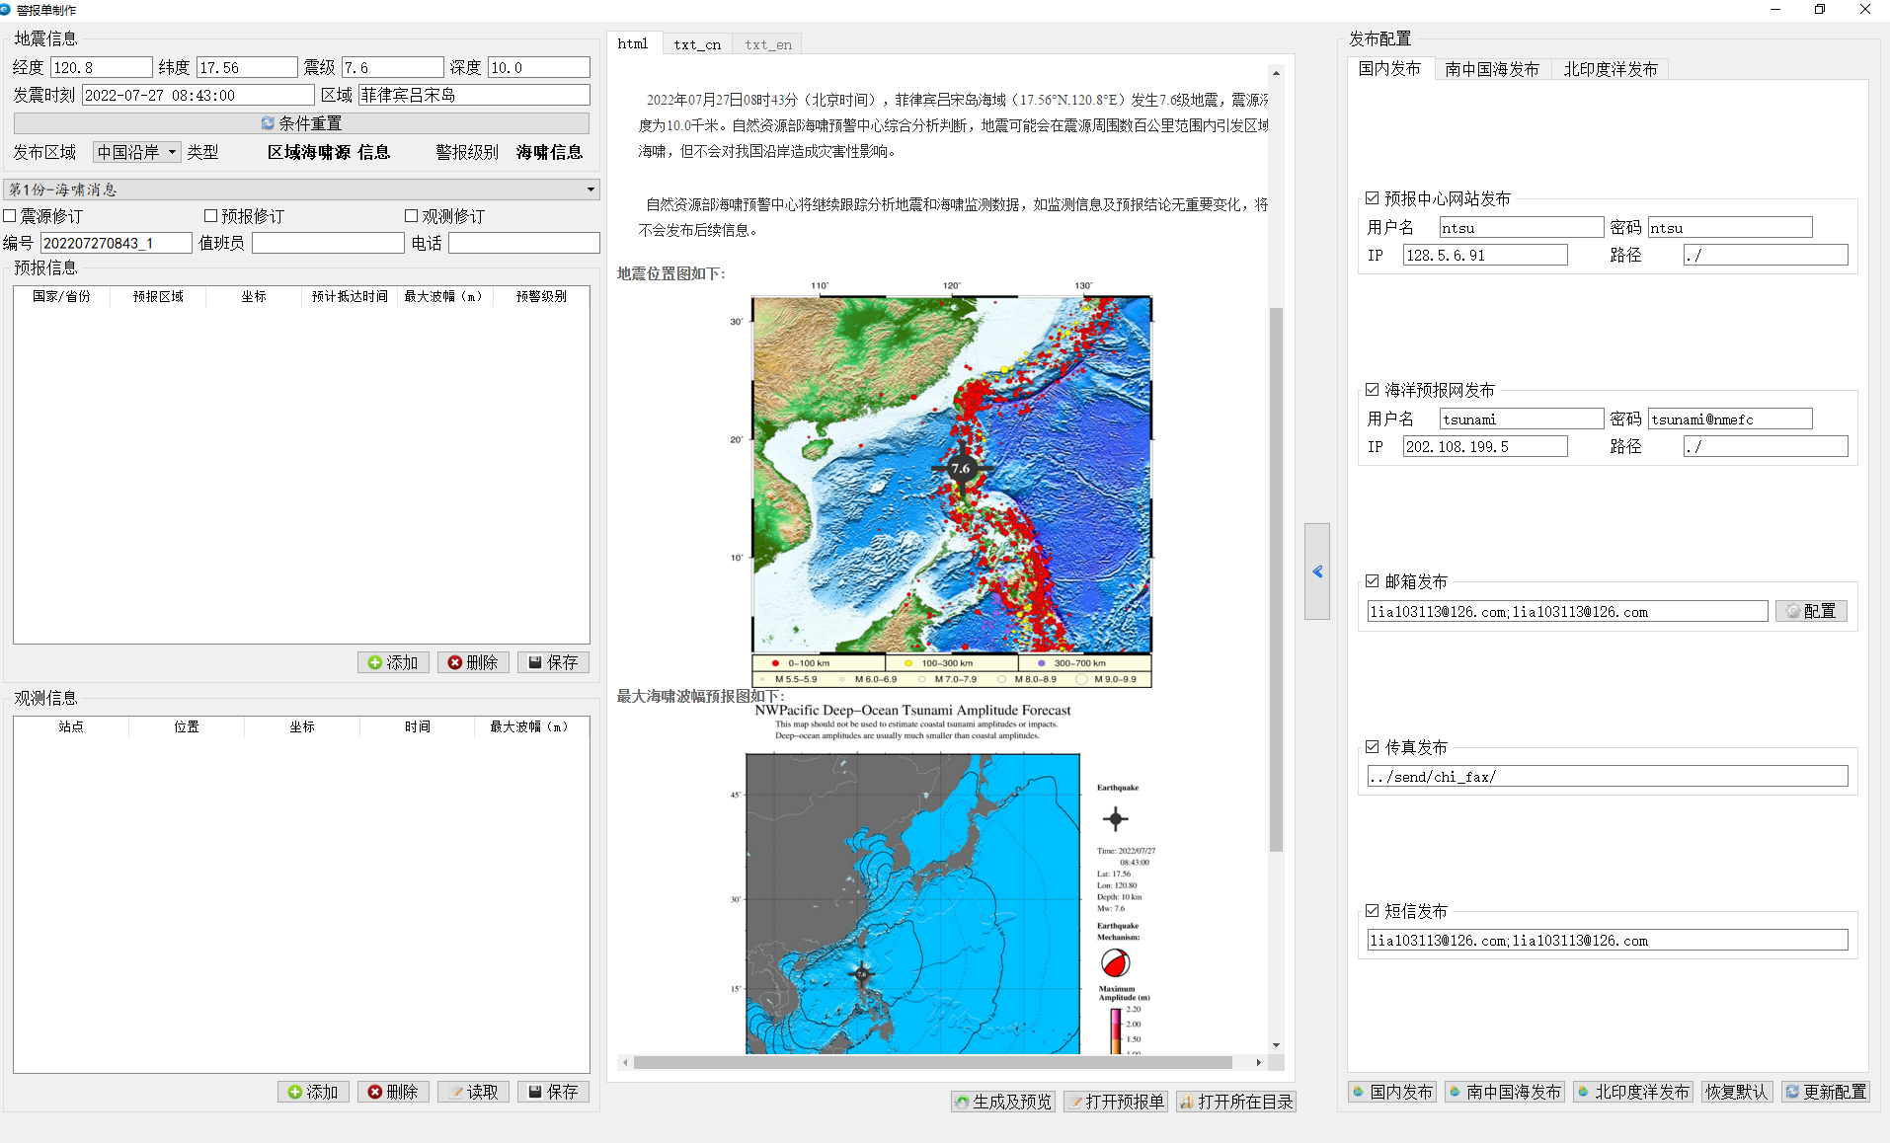
3. SCSTAC Capacity Building
Smart Tsunami Information Processing System
The Smart Tsunami Information Processing System (STIPS) is a tsunami early warning and products release system, which developed by SCSTAC colleagues using Python and extension packages, and it has been put into full operation at the end of 2022.
Earthquake
Earthquake analysis
Sea level data dispaly and interaction
Earthquake monitoring
Earthquake parameters
Tsunami forecasing
Sea level monitoring
Products dissemination
Map view
Tsunami forecasing
Products-making and dissemination

Slide 12
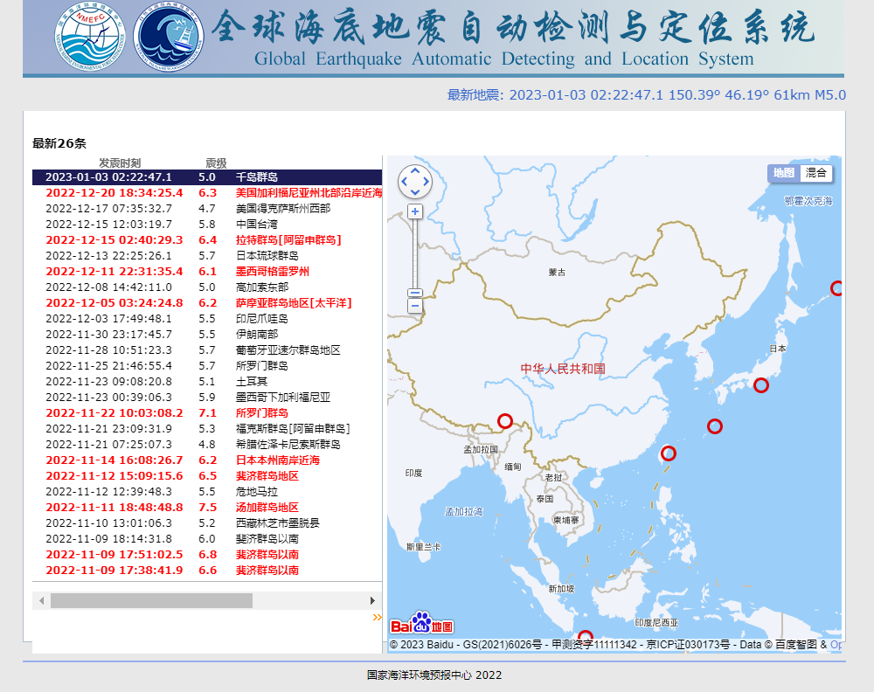
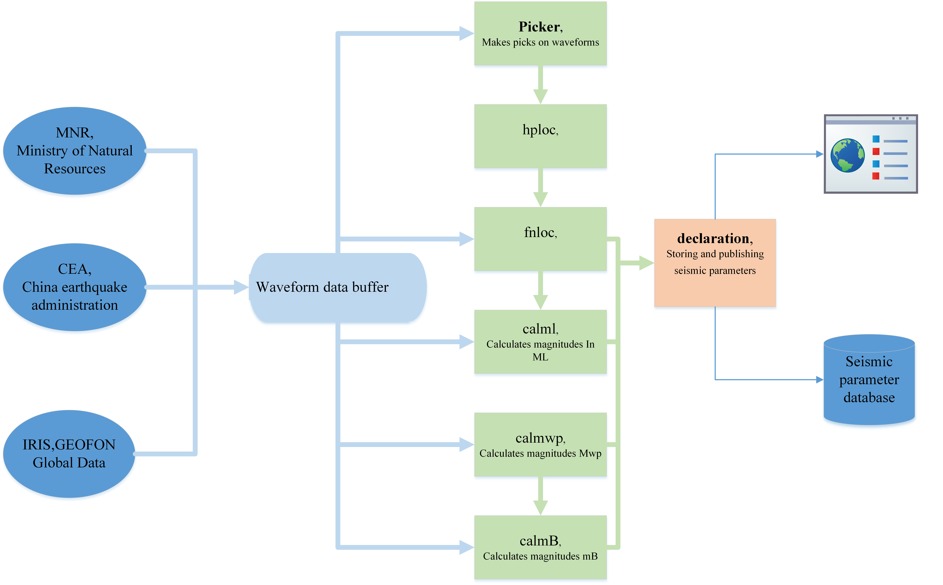
3. SCSTAC Capacity Building
Global Earthquake Automatic Detecting and Location System
Real-time seismic waveform process module
Earthquake automatic location module
Earthquake magnitude calculation module
Parameters storage and release module
System function module architecture diagram

Slide 13
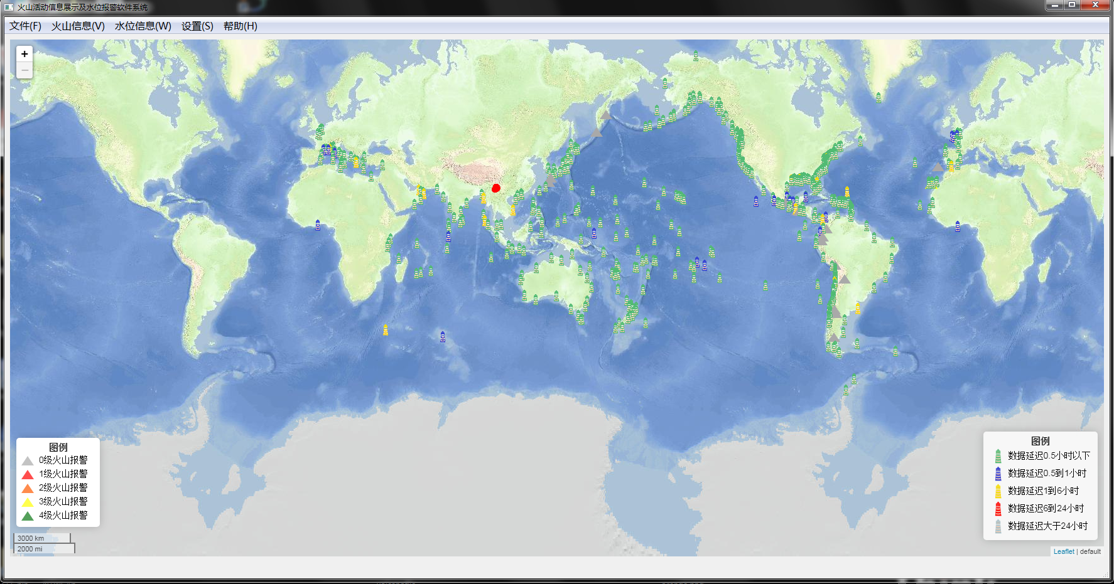
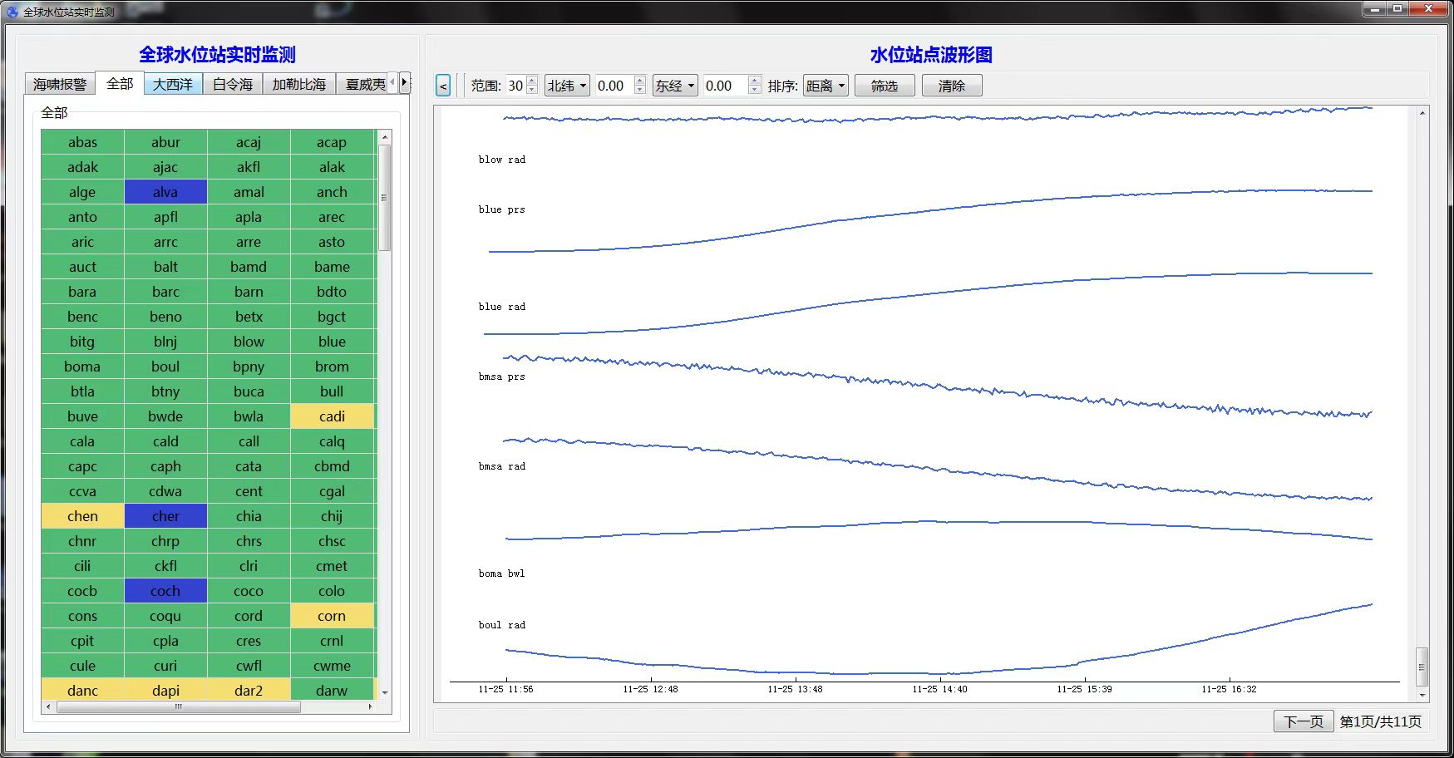
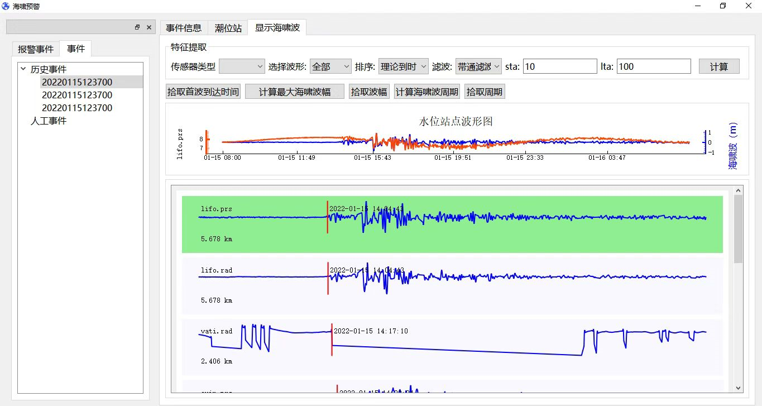
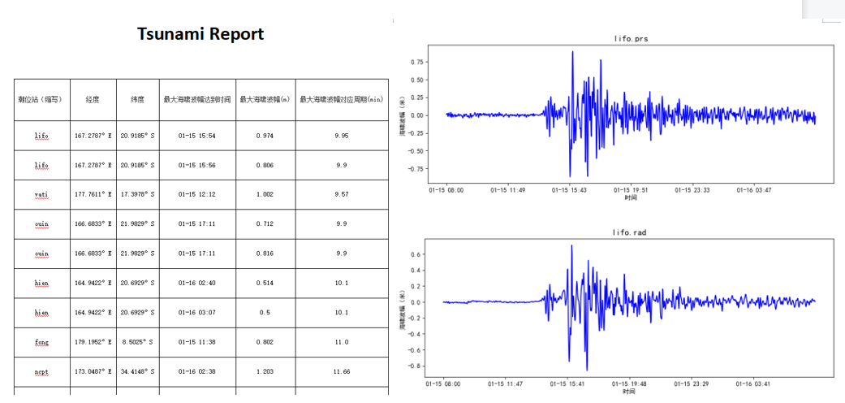
3. SCSTAC Capacity Building
Volcanic Eruption Detecting and Sea Level Alarm System
Map view
Near real-time sea level data display
Capture volcanic ash alerts online;
Analyze volcanic eruption information in near real-time;
Monitor water level fluctuations to detect the tsunami;
Display information such as the eruption time and the type of eruption;
Generate global volcanic activity maps annually and monthly;
The system has been commanded for trial operation since Dec. 2022.
Interactive analysis
Tsunami observation report

Slide 14




3. SCSTAC Capacity Building
GPU-Boost on tsunami modeling
Efficiency Improvement of Tsunami Modeling for the SCS Region
Tesla is for rack-mounted server; Geforce is used to workstaion, and much cheaper.
Efficiency Improvement of Tsunami Modeling for the SCS Region
Year | GPU | Grid Resolution | Time Step | Modeling Duration | Time Consuming
2016 | Nvidia Tesla K40 | 2 arc-min | 4 s | 18 hrs | ~ 17 s
2019 | Nvidia Tesla V100 |  |  |  | ~ 6 s
2021 | Nvidia Geforce RTX 2080Ti |  |  |  | ~ 6 s
2022 | Nvidia Tesla A100 |  |  |  | less than 3 s
K40
V100
A100

Slide 15
4. SCSTAC Product Manual (TS-149) Revision
According to ICG/PTWS-WG-SCS-IX MEETING(2019, Jakarta):
Tsunami bulletins issued by IOTWS, PTWC, NWPTAC and SCSTAC, including the RSTPs (India, Indonesia and Australia) are of different formats. Discussed if IOC would consider having a standard format for the advisory bulletins.
Action taken:
Matter further discussed at Task Team on Tsunami Watch Operations (TT TWO) meeting held in Feb 2021, with experience of IOTWMS shared. IOTWMS felt CAP was more appropriate at the national level rather than at the regional TSP level and CAP messages made available by TSPs would not serve the intended purpose. IOTWMS recommended to encourage and assist Member States to implement CAP in their national service, including developing CAP guidance for NTWCs. Discussion on-going.
Follow-up action:
Task Team on Tsunami Watch Operations (TT TWO - ICG/PTWS) meeting was held in January 2023 with the attendance of PTWC, NWPTAC and SCSTAC. A unified product framework was discussed, and CAP format was recommended by SCSTAC. Maybe it needs to be further discussed in this meeting, and then to be confirmed by Member States.

Slide 16
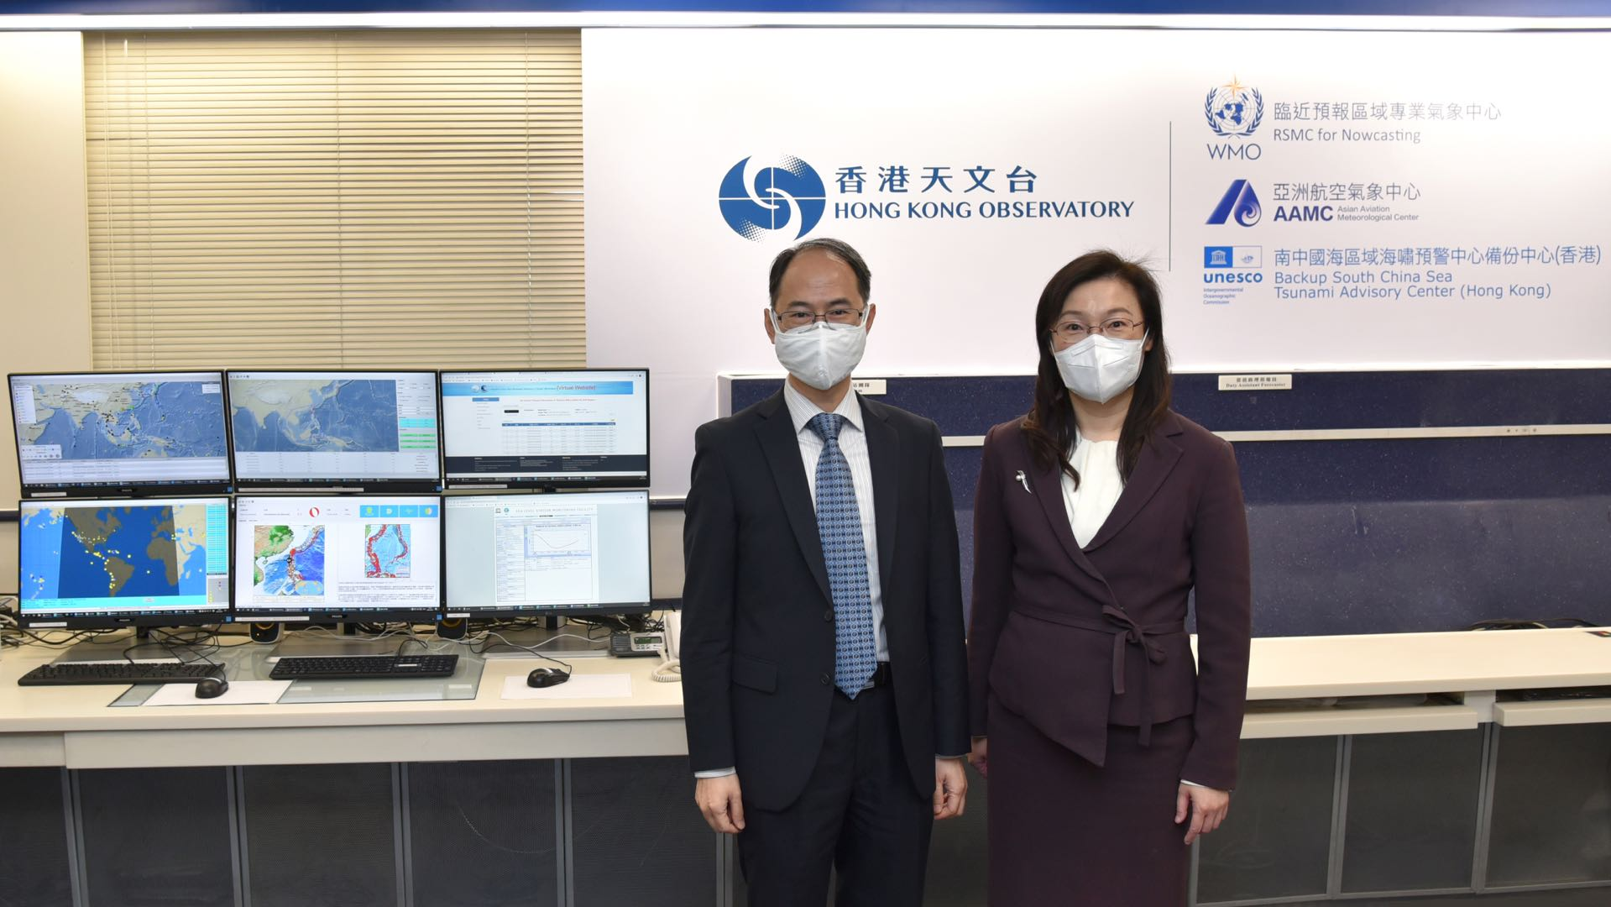
5. Backup SCSTAC (HONGKONG)
During the ICG/PTWS-WG-SCS-IX on 27–28 August 2020, it was agreed that SCSTAC should work with the Hong Kong Observatory (HKO) to build backup capability. The BSCSTAC will be operated at the HKO Headquarters. It will be manned round the clock by watchstanders and will also be responsible for global earthquake monitoring and local tsunami warning. It is scheduled to be activated during the cool season each year in consultation with SCSTAC.
The BSCSTAC DSS was adapted from the DSS of SCSTAC. It includes full graphical user interface, real time seismic and water level monitoring, GPU-accelerated tsunami model, and auto preparation and dissemination of products.
BSCSTAC was put into trial operation on 29 March 2022.
Activation of BSCSTAC
Scheduled Activation
Non-scheduled Activation
Two ~ Four weeks during Winter in every year
In case of SCSTAC mulfunction

Slide 17
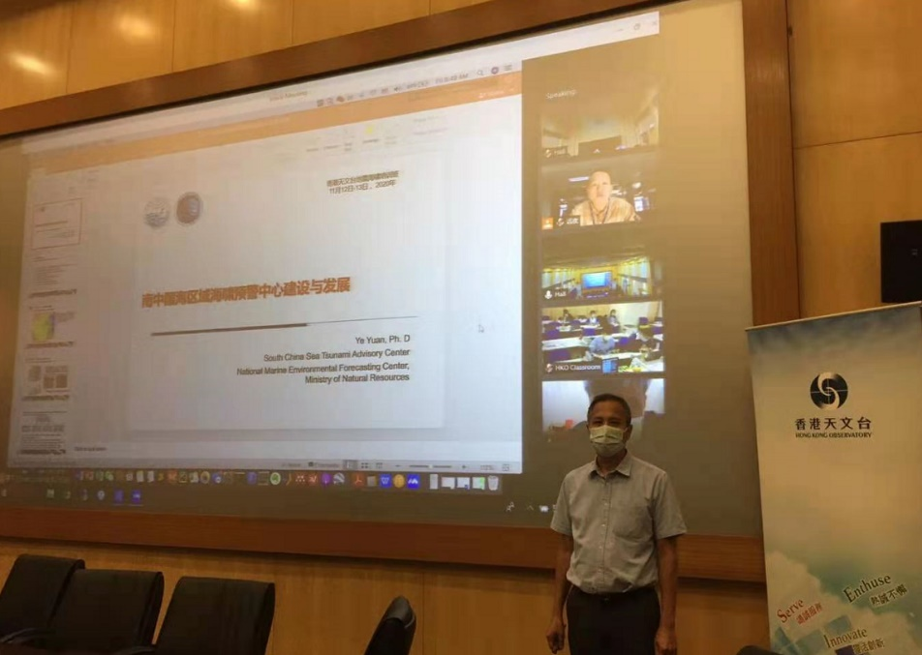
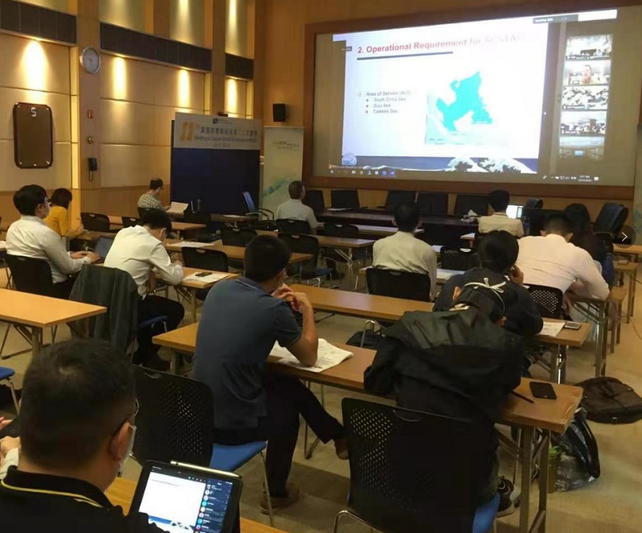
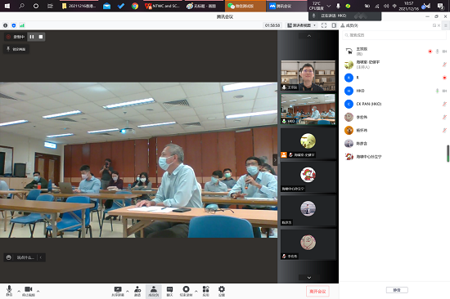
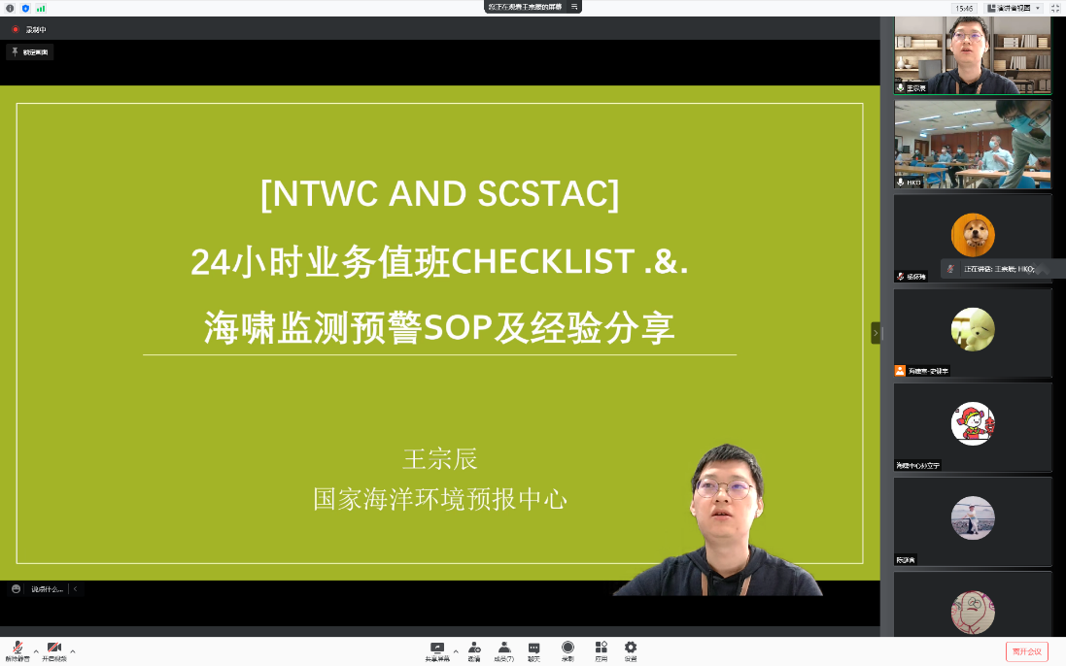
5. Backup SCSTAC (HONGKONG) - Operation Training
14~15 December 2020
On-line meeting
Earthquake knowledge
Tsunami knowledge
Tsunami governance
Decision support system
Routine operation
16~17 December 2021 On-line meeting
Earthquake detection
Tsunami warning SOPs
Tsunami DSS operation
Tsunami alert criteria
Operation experience

Slide 18
5. Backup SCSTAC (HONGKONG) - Trial Operation
Key performance indicators during the trial operation of BSCSTAC (up to 31 December 2022)
Key Performance Indicators of SCSTAC | Target valuesof SCSTAC operations | Performance of BSCSTAC at trial operation
Elapsed time from earthquake to issuance of initialtsunami products with preliminary earthquake parameters | Within12minutes | 11.5 minutes
Probability of detection of earthquakes with Mw>=6.0 | 100% | 100%
Accuracy of preliminary earthquake parameters on hypocenter location/magnitude/depth | 0.3°/ 0.3 / 30km | 0.23°/ 0.21 / 13km
Accuracy of the EstimatedTime of Arrival(ETA) and amplitudes of the tsunamis actually is triggered | Within10% of travel time | No events occurred for testing
Percentage of Member States that receive productsissued by SCSTAC | 100% | Products not issued to Member States
Percentage of time theSCSTAC is operating and able to respond to a tsunami event | 100% | 100%
Regularcommunicationtests | Twice per year | No communication test arranged

Slide 19
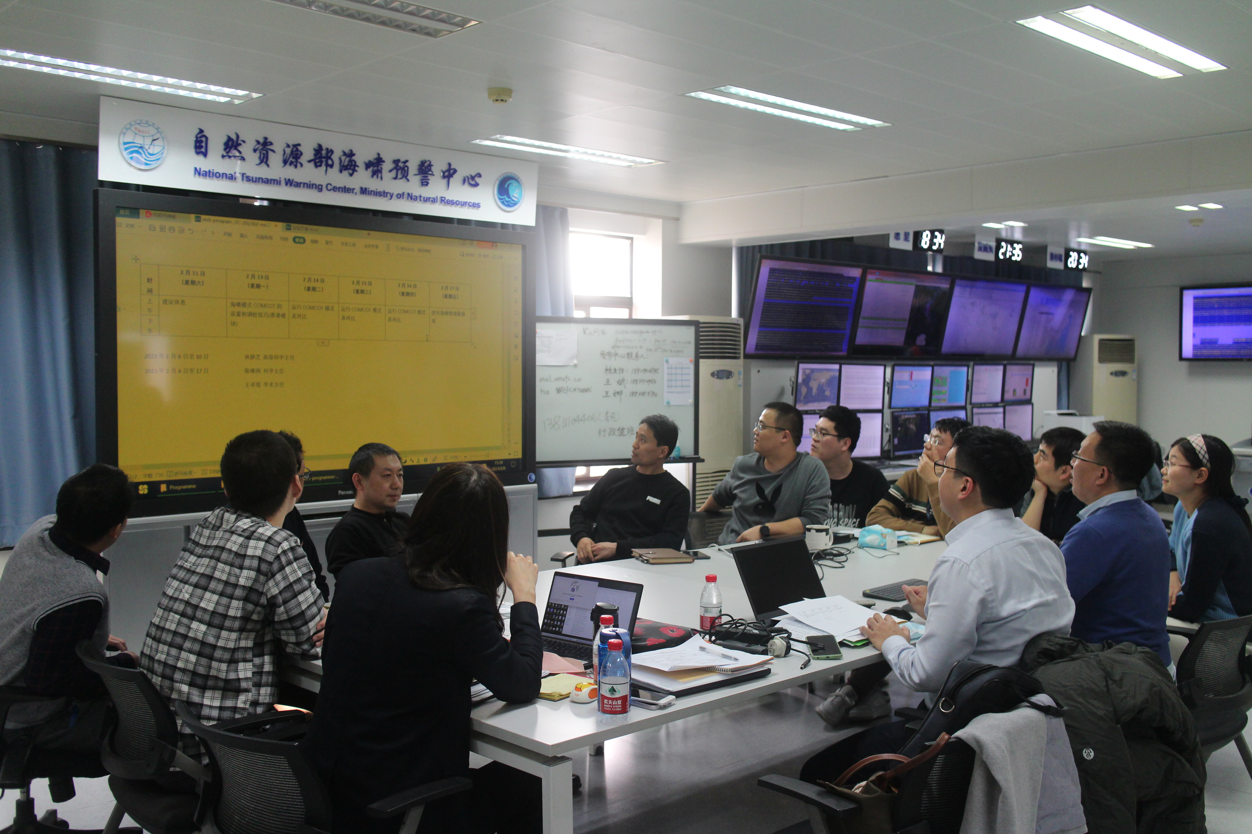
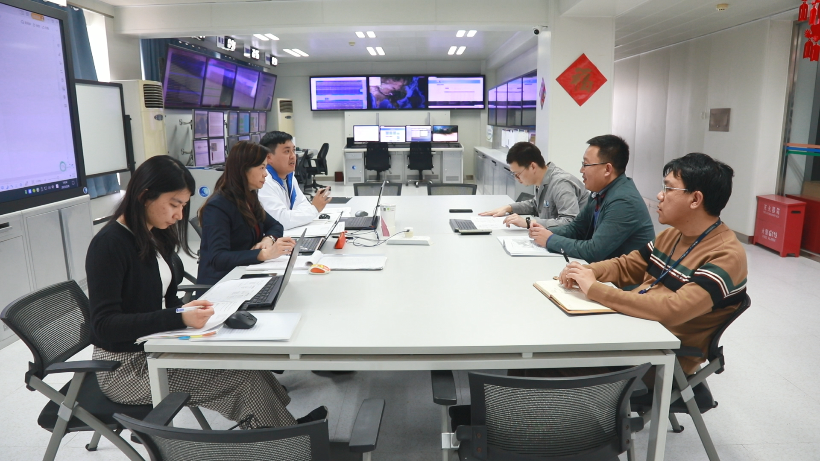
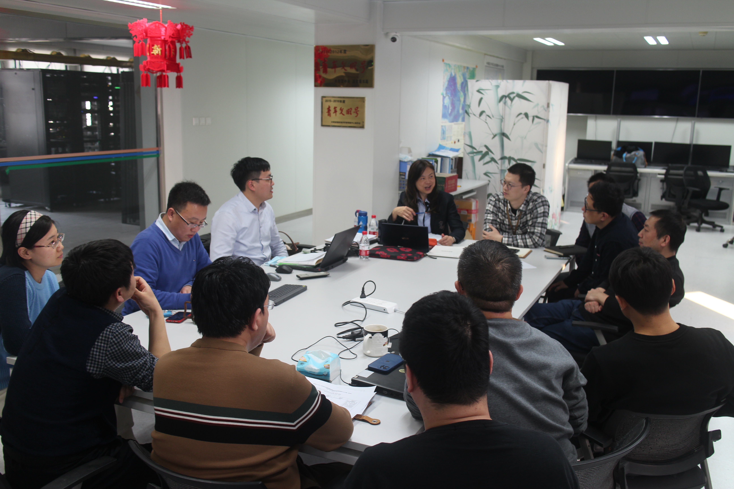
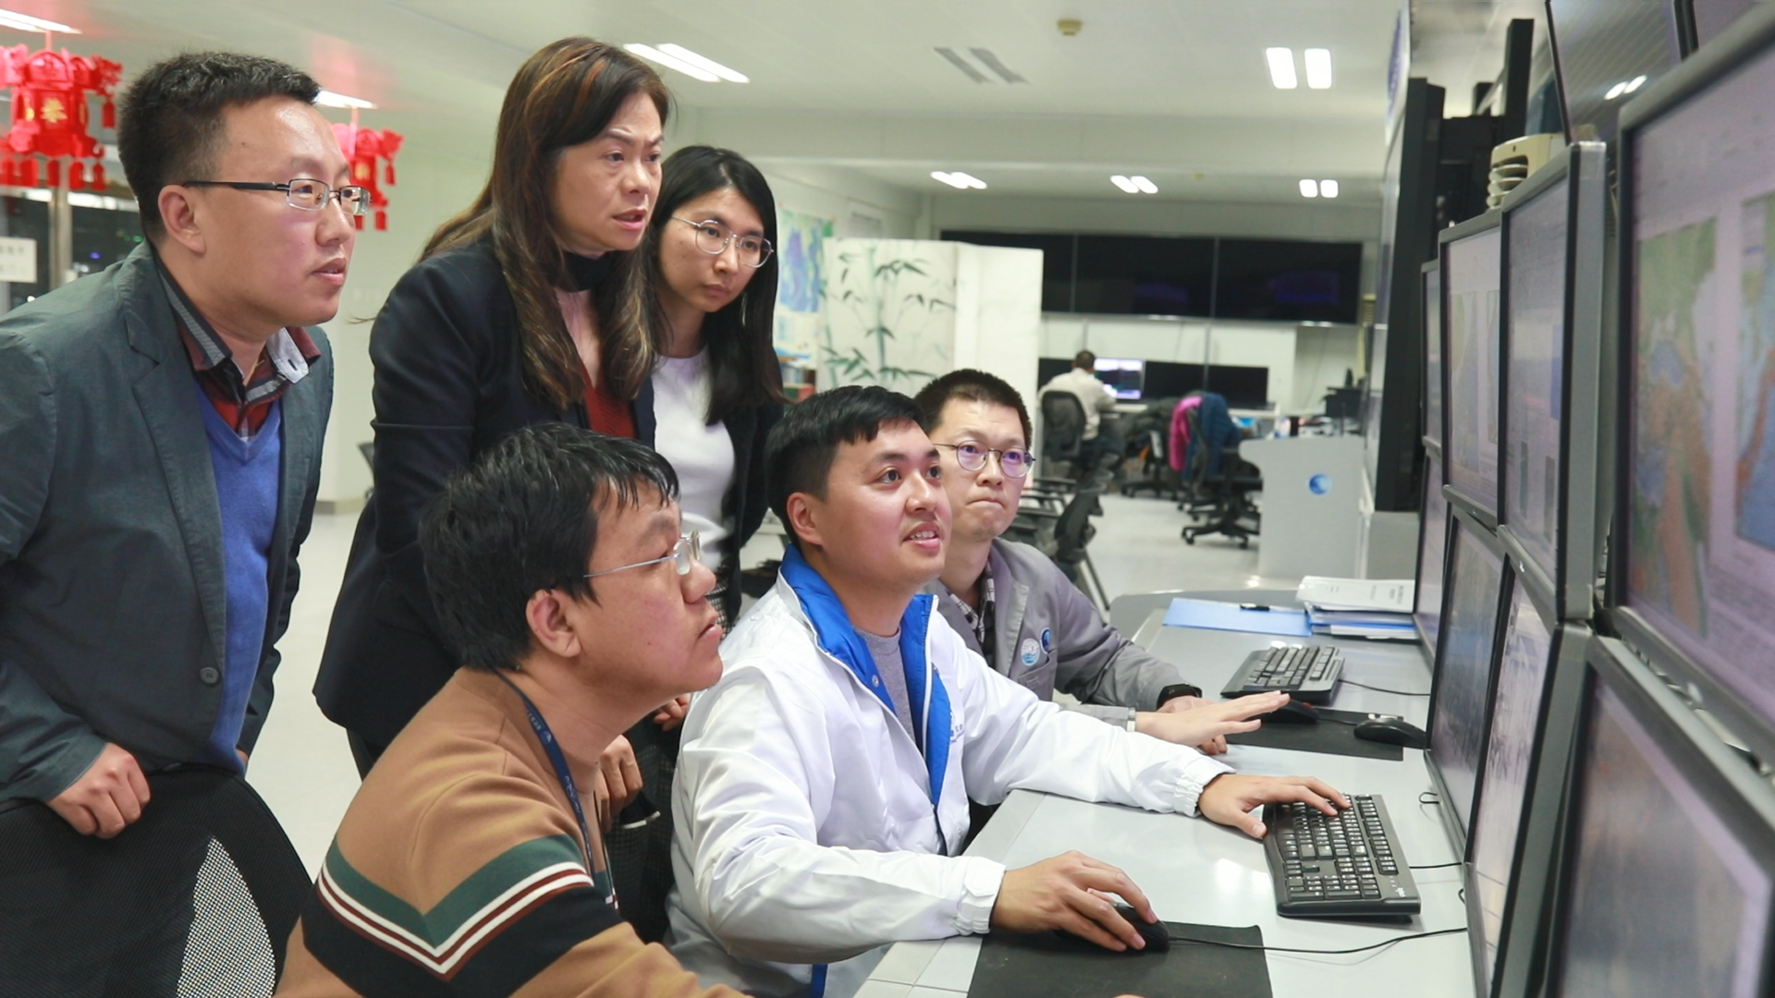
Face to face communications between SCSTAC and BSCSTAC, 6-18 February 2023
5. Backup SCSTAC (HONGKONG)
Topics:
Trial operation
Warning work flow
Earthquake detection
Tsunami modelling
Product making
Experience and skills
Threat criterias
Supervision

Slide 20
5. Backup SCSTAC (HONGKONG) - Operation
On 1 March 2023, National Environmental Forecasting Center of China issued letter of approval to the Hong Kong Observatory on official operation of Backup SCSTAC (Hong Kong) commencing March 2023
The Backup SCSTAC (Hong Kong) will be launched for official operation on 29 March 2023 (an opening ceremony will be held on that day)
Backup SCSTAC will conduct a communication test for the registered SCSTAC Focal Points in April (tentatively on 11 April)
IOC has been asked to issue a Circular Letter on the official operation of Backup SCSTAC (Hong Kong) and the communication test

Slide 21
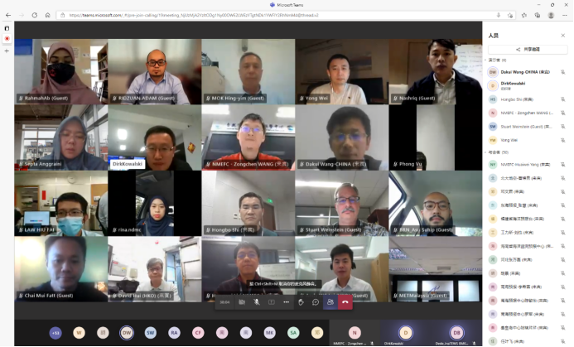
6. Regional Training and Workshop
Training for seismic and tsunami warning operators on strengthening standard operating procedures for seismic data and tsunami warning in the South China Sea region, 9-10 December 2021, Online
http://www.nmefc.cn/newsDetail?infoId=165c9a06-03fd-11ed-a620-df73c9babc45

Slide 22
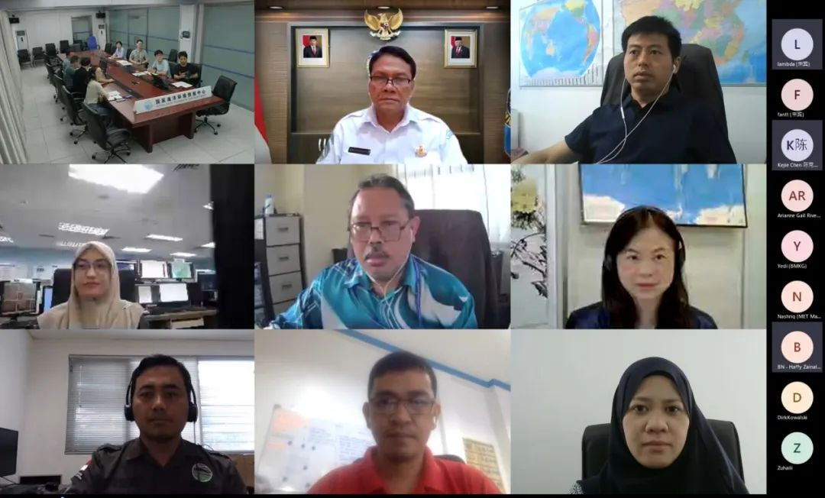
6. Regional Training and Workshop
First NMEFC-BMKG Workshop on Non-seismic Tsunamis and Complex Tsunamis, 14 July 2022, [Online]
http://www.nmefc.cn/newsDetail?infoId=10d9a07acf6d49328e506dd5922e98b0

Slide 23
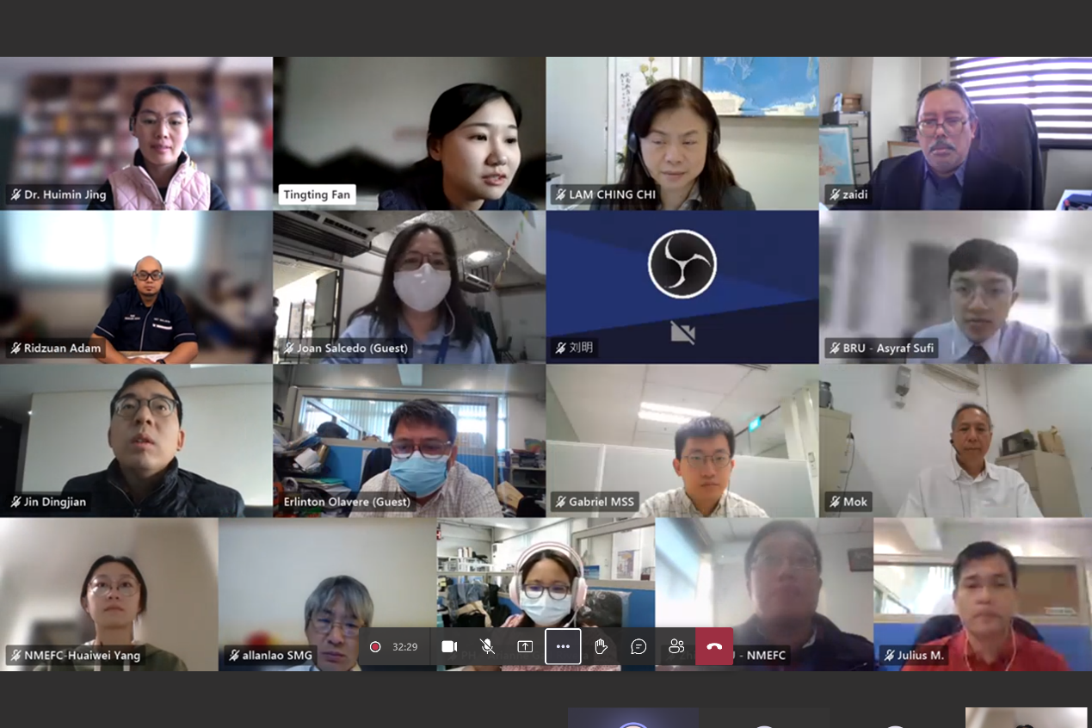
6. Regional Training and Workshop
2022 International Symposium on Applied Technologies for Earthquake and Tsunami Monitoring, Early Warning and Disaster Mitigation in the South China Sea Region, 20th December 2022, Online
http://www.nmefc.cn/newsDetail?infoId=bd8d534d6716423183fa9fcc4403cd0c

Slide 24
The Intergovernmental Coordination Group for the Pacific Tsunami Warning and Mitigation System Steering Committee (ICG/PTWS SC) Meeting, 6 - 9 March 2023
Thank you!

