Slide 1

TOWS-WG-XVI, 2-3 March 2023, Paris, France (WMO joined virtually)
Sarah Grimes, Marine Services
Hassan Haddouch, WIS
Cyrille Honore, DRR, MHEWS and Public Services

Slide 2
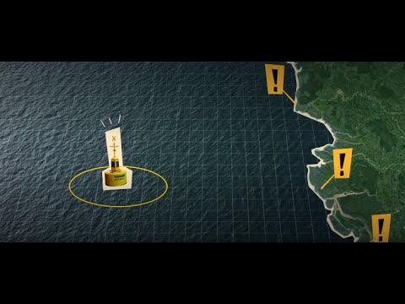

Met Services & Tsunami EWS
Multiple roles:
>35% Meteorological Services globally are Tsunami Service Providers – operational 24/7
Even more Meteorological services back up the National Service Provider, and/or support with infrastructure
In some regions, majority of NMHS are involved in tsunami early warning process eg. 80% NMHS in the Pacific Islands
How do National Meteorological and Hydrological Services and WMO support Tsunami Early Warnings?

Slide 3
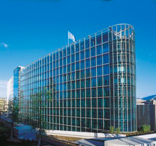
WMO & Tsunami EWS
WMO support NMHS, to strengthen their efforts in tsunami early warning, and maximise
efficiencies
2 Key areas where WMO supports the tsunami EWS process:
Infrastructure, especially via the WMO Information System (WIS), and observations
Early Warning Services, especially to strengthen the last mile of communication
Recap of relevant WMO structures:
SERCOM (SC-MMO* & SC-DRR), INFCOM*, Research Board* (*IOC rep)
WMO-IOC Joint Collaborative Board:
Co-Chairs: Albert Martis (WMO), Srinivasa Kumar (IOC )
Services Members: Alexander Frolov (IOC), John Parker (WMO)
WMO-IOC Strategy approved by WMO & IOC, June 2021

Slide 4


WMO Information System (WIS) WIS 2.0
NCs / DCPCs are going to implement a WIS2 Node to exchange data in WIS2
The WIS2 Node shares data from an HTTPS service and sends notifications to MQTT subscribers
No need to provide access to all the users in the world, only to some WIS2 Global Services
WIS2 node is the component to provide data and associated metadata
WIS2 node replaces the GTS Message Switching System
Global
Services
Downloads data
Receives notifications of new data
Subscribes to
WIS2 node

Slide 5







Global Services
Downloads core data
Subscribes to topics
Discovers data/services
Downloads recommended data
Global Cache
Global Broker
Global Discovery Catalogue
Global Monitoring
WIS2 node
A storage providing a copy of the WMO Core data from the NCs/DCPCs to be accessed by the users.
Data will be open to everyone.
Some Global Caches are required globally for resilience.
Providing notifications of all the data available in the Global Caches or in originating centers.
Users will subscribe to a Global Broker to get notifications of new data to be downloaded from Global Caches or WIS2 node
Monitoring of data exchanged in WIS2.
Sensor Centers will make available statistics from data in real time
Global Monitoring Center will collect statistics from Sensor Centers and provide web accessible maps and results.
It is a discovery catalogue of data and services.
Provides an API to list the available data and services
Harvests metadata from the WIS2 Nodes.

Slide 6
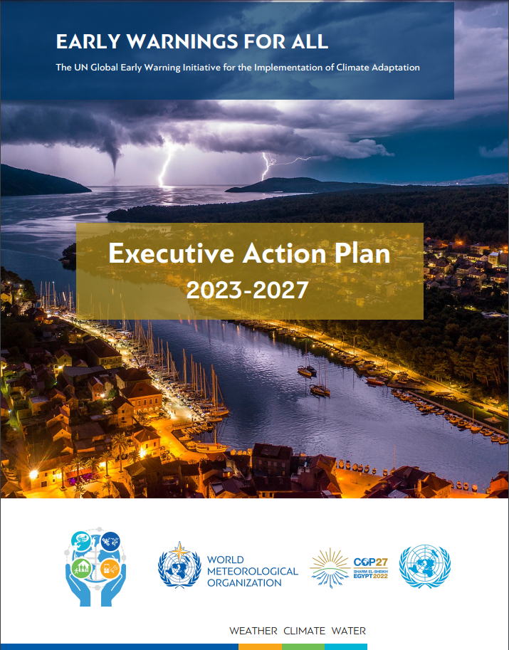
Early Warnings for All Initiative
UN SG
Announced on World Met Day 2022
Action Plan developed by WMO
Launched at COP-27 (Nov 2022)
https://public.wmo.int/en/earlywarningsforall

Slide 7
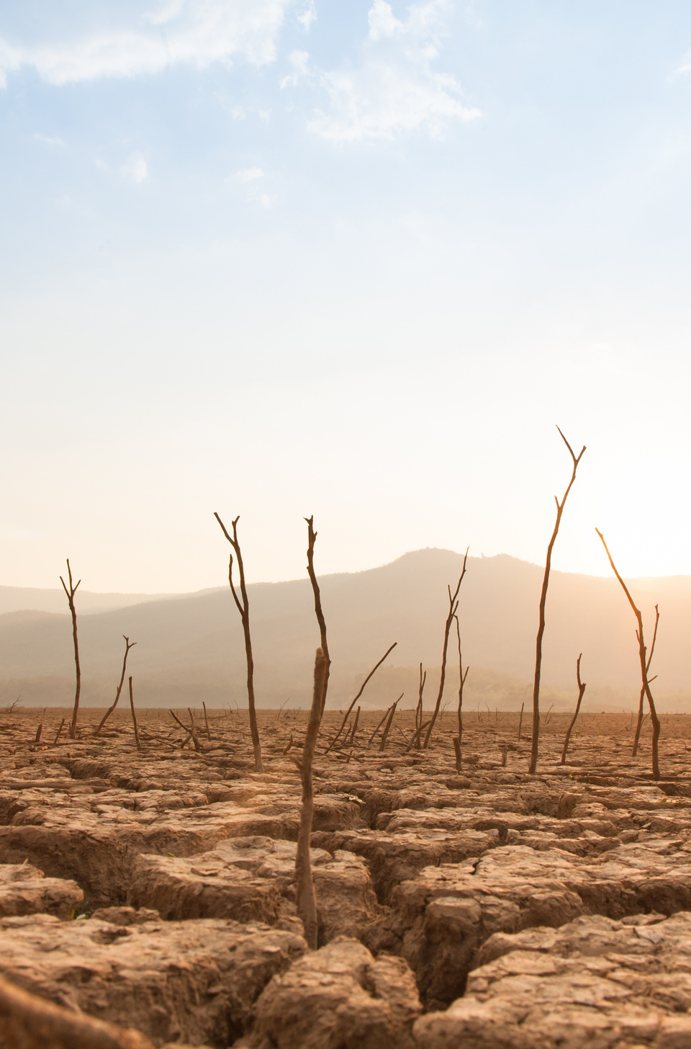

EW4ALL Current Status and Future Developments
Senior Leadership Board: co-chaired by Petteri Taalas (WMO SG) and Ms. Mami Mizutori (UNDRR) key UN organizations , ITU, IFRC, up to 3 private sectors representatives and funding agencies
Pillar implementation: initial thoughts by lead agencies of each pillar, in consultation with the partner organizations.
Pillar 1, UNDRR (Ms. Loretta Hieber-Girardet)
Pillar 2, WMO (Mr. Cyrille Honoré)
Pillar 3, ITU (Ms. Vanessa Gray)
Pillar 4, IFRC (Ms. Tiziana Bonzon)
Pillar 5, UNDRR-WMO (Mr. Animesh Kumar, Ms. Assia Alexeiva) (pillar 5 is monitoring and evaluation)

Slide 8
MHEWS System – People Centered Approach
Empower those threatened by Hazards to act in sufficient time and in appropriate manner, and must build on partnership within and across relevant sectors

Slide 9
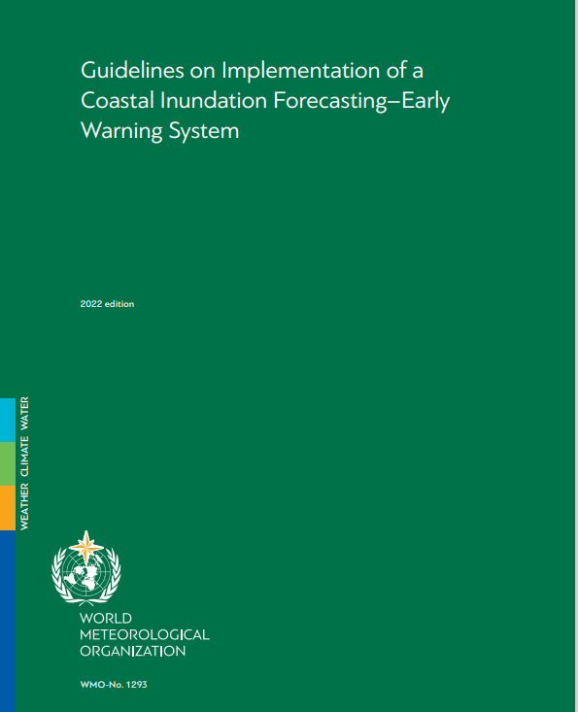
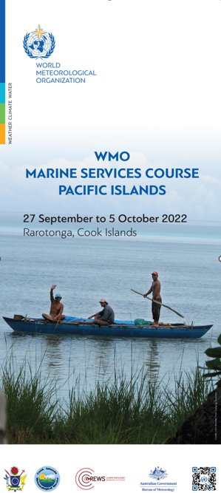
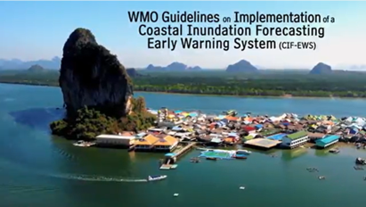

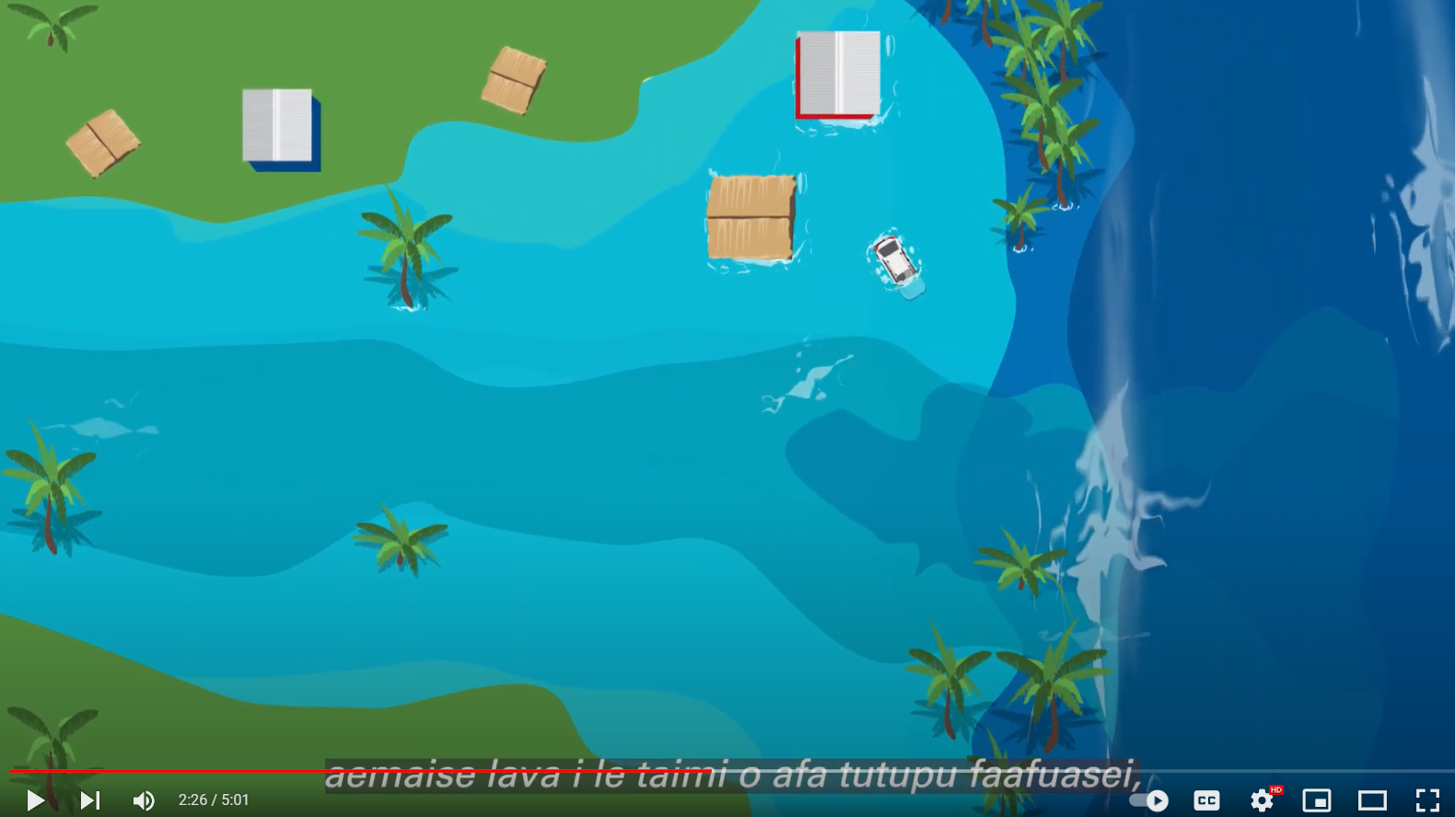
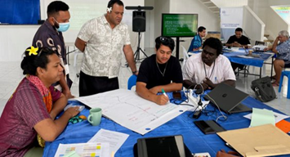


Other touchpoints
CAP – encouraging NMHS to use this, where appropriate for TEWs.
Coastal Inundation (and links to MHEWS/tsunami)
WMO 1293 Coastal Inundation Guidelines and video, published
Awareness videos – local languages – Pacific and Caribbean: coastal inundation, value of ocean buoys
WWNWS/WWMIWS Joint TT Hazards
WMO Marine Services Course:
Pacific Islands - Tsunami session linked to MHEWS
Caribbean and Africa regions (phase 1) completed
Other regions in 2023

Slide 10
Meteo-tsunami
Atmospheric forcing of a long range wave (non seismic, atypical)
Driven by air-pressure disturbances often associated with fast-moving weather events
They are progressive waves limited to the tsunami frequency band of wave periods (two minutes to two hours)
Meteo-tsunami are forecast by NMHS and in most cases, from the marine weather operational areas (not from the tsunami early warning areas)
WMO requests to the WMO-IOC JCB, that 'meteo-tsunami' is raised for discussion at the next JCB meeting, to clarify the roles and responsibilities of WMO and IOC, and how best to support Members.
WMO further requests to support WMO expert membership on the Task Team for Meteotsunami, to continue to work on the details of a potential future detection and alerting service.

Slide 11
2023/2024 events of interest
EW4ALL Senior Leadership Group 1st meeting 21 March
World Met Day, WMO 150th Anniversary, 23 March
Sendai Framework Mid Term review High level meeting 18-19 May
Congress 19, May 22 – Jun 2; WMO EC-77, Jun 3-4
WMO SERCOM-3, March 2024

Slide 12
Thank you
Merci

