Slide 1
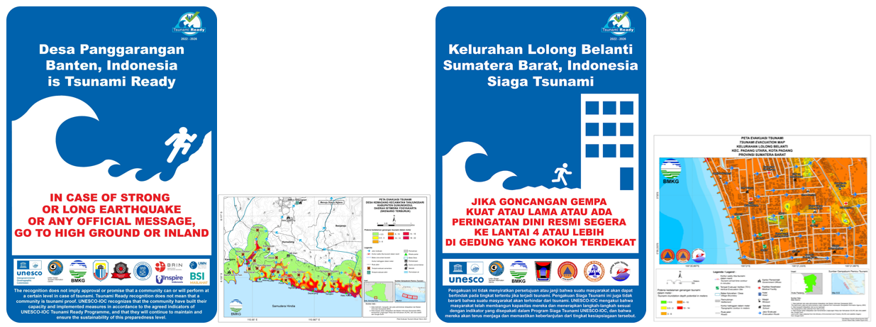
Tsunami Ready Board Signages

