Slide 1

 | MEETING OF THE INTER-ICG TASK TEAM ON DISASTER MANAGEMENT AND PREPAREDNESS INTERGOVERNMENTAL OCEANOGRAPHIC COMMISSION UNESCO
 | 27 - 28 February 2022 - Hybrid
NEAMTWS-WG 4-Cecilia Valbonesi

Slide 2
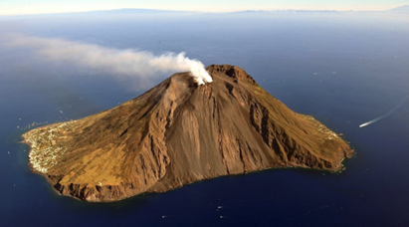
Stromboli
In August 2022 a 2-year agreement between INGV and Italian Universities has been signed to maintain and improve the local volcano and tsunami monitoring systems
For the tsunami system, main topics are i) hazard assessment; ii) improve the warning system; iii) increase risk awareness
Notes:
Il CAT si occupa di tutte le 3 aree per la riduzione del rischio: 1) stima della pericolosità – 2) Monitoraggio e Allerta – 3) Mitigazione (azioni sul territorio, studio percezione rischio, Tsunami Ready ecc.)

Slide 3
Stromboli
The Dec. 4, 2022, tsunami (1.5m peak-to-peak locally) has triggered several actions that revealed some criticalities, both in the alert dissemination and in the reactions by local authorities, media, etc.

Slide 4
Stromboli / criticalities
Need for a more detailed “zonation” of the alerted areas
Improve the sea level monitoring onland and offshore
Evaluate the possibility to monitor tsunami “precursor” phenomena (instability, magma injection, tremor, etc.)
A more detailed testing protocol
Clarify communication procedures with media (language, uncertainty, etc.)
Study risk awareness and perception of residents and tourists (focus groups developed in next months)

Slide 5
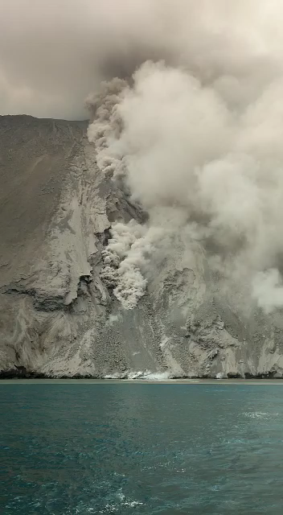
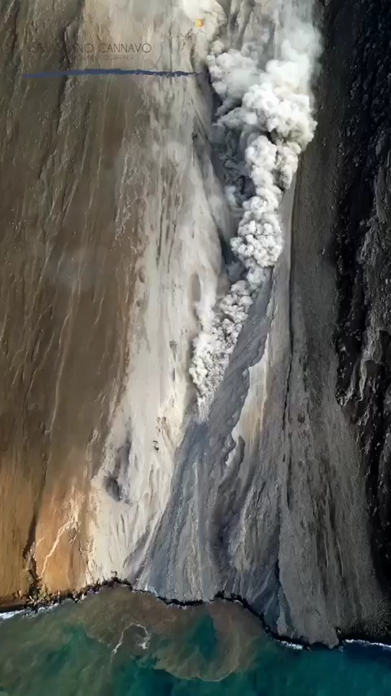
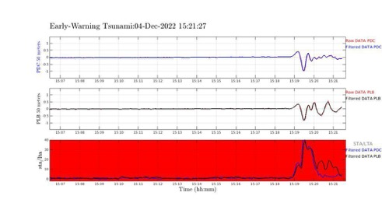
Stromboli
2022, Dec. 4: (small) tsunami induced by a pyroclastic flow
Sciara del Fuoco
Tsunami recorded at the two elastc beacons in front of the Sciara del Fuoco

Slide 6
Thank you for your attention
Notes:
As testified by this Factsheet, for about 15 years we have been building the NEAMTWS

