Slide 1
Indian Ocean World Tsunami Awareness Day Webinar
Wednesday, 10 November 2021
Ardito M. KODIJAT
TOWS WG Task Team on Disaster Management and Preparedness
21-22 February 2021

Slide 2
International Cooperation:
A Strategic Pathway for the
Indian Ocean Tsunami Warning and Mitigation System
Within the Context of UN Decade for Ocean Science
Indian Ocean World Tsunami Awareness Day Webinar
Wednesday, 10 November 2021

Slide 3

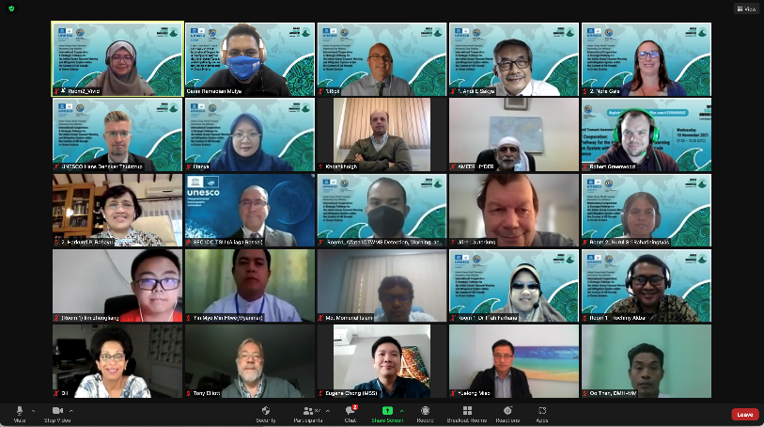
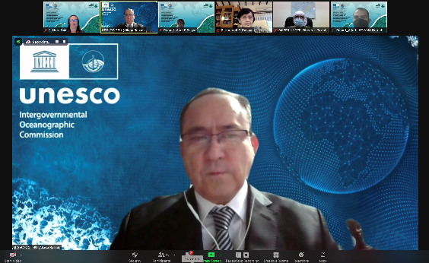
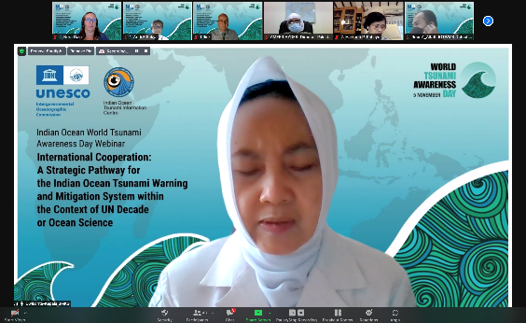
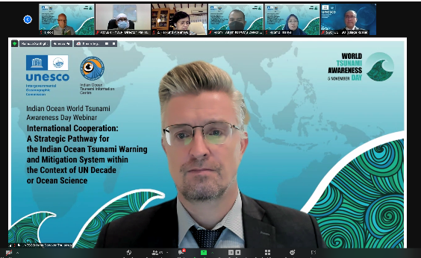
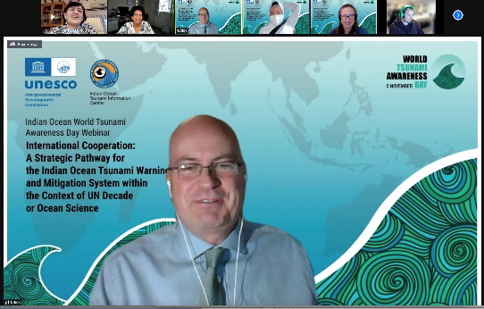
78
Attendees

Slide 4
Webinar Background Information
Protecting Communities from the World’s Most Dangerous Waves: A Framework for Action under the UN Decade of Ocean Science for Sustainable Development
Tsunami Dedicated Program within UNDOS
Medium Term Strategy IOTWMS 2019 – 2024
Country Action for UN Decade of Ocean Science
Webinar Sessions
Closed Session
Strategic Pathway Discussion with break-out groups
      Tsunami Detection, Warning, and Dissemination
      Tsunami Risk, Community Awareness and Preparedness
Open Session
Streamed through IOTIC Facebook
Announcement of Indian Ocean Youth Video Competition Winners

Slide 5
Discussion Starting Point
Pillar IOTWMS | UNDOS Tsunami Dedicated Decade
Risk Assessment and Reduction: hazard and risk identification and risk reduction Awareness and Response: public education, emergency planning and response | Access to data, tools and communication platforms, protocols and training to timely and effectively warn coastal and maritime communities 100% of communities at risk of tsunami prepared for and resilient to tsunamis by 2030 through the implementation of the UNESCO/IOC Tsunami Ready Programme
Detection, Warning and Dissemination: rapid detection and warning dissemination down to the last mile | Expansion of existing and deployment of new technologies addressing observational gaps; Wide expansion of real and near-real time data access and availability Access to data, tools and communication platforms, protocols and training to timely and effectively warn coastal and maritime communities
Interpretation Tsunami Dedicated Decade in the context of IOTWMS’ Pillars

Slide 6
Discussion Topics in Breakout Room
IOTWMS Tsunami Decade Program
Tsunami Detection, Warning, And Dissemination
IOTWMS Tsunami Decade Program
Tsunami Risk, Community Awareness and Preparedness
Topic
Strengthen the access to data, tools and communication platforms, protocols and training to timely and effectively warn coastal and maritime communities
Expansion of existing and deployment of new technologies addressing observational gaps
Why
Wide expansion of real and near-real time data access and availability
Strengthen communities at risk of tsunami prepared for and resilient to tsunamis through the implementation of the UNESCO/IOC Tsunami Ready Programme
Access to data, tools and communication platforms, protocols and training to timely and effectively warn coastal and maritime communities
What
/how
Who

Slide 7
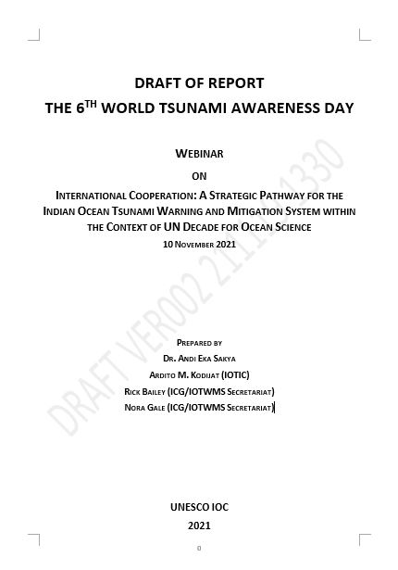

Slide 8
Discussion Outputs
Tsunami Detection, Warning, And Dissemination
IOTWMS Tsunami Decade Program |  | WHY Aiming At Improving | What / How would be the program and/activities | Who should be involved, engage, and be the lead or actor
1 | Expansion of existing and deployment of new technologies addressing observational gaps | Level of timeliness and certainty of tsunami detection. SOP for tsunami detection, warning and cancellation; To identify potential seismic and sea level monitoring gaps To identify fit-for-purpose integrated observational systems Need to also detect and warn for atypical tsunamis | Demonstration of the importance and identifiable value add of reducing the level of uncertainty of tsunami detection in support of warnings; Continuous expansion of existing and deployment of new innovated observational system to and demonstrate meet user needs; Continue advocacy through furthering of knowledge as the result of R&D, especially in seismic and sea level observing gaps National and regional exercises for both upstream and downstream warning components to demonstrate needed added value of data Actively pursue strategic partnerships with other relevant and potential national and international data and information providers | National agencies responsible in TEWS and MHEWS Secretariat IOTWMS and IOTIC (RP); R&D Agencies, Universities, and other scientific organizations such as IUGG Commercial entities, such as ITU National and international data and information providers relevant to tsunami early warning.

Slide 9
Discussion Outputs
Tsunami Detection, Warning, And Dissemination
IOTWMS Tsunami Decade Program |  | WHY Aiming At Improving | What / How would be the program and/activities | Who should be involved, engage, and be the lead or actor
2 | Wide expansion of real and near-real time data access and availability | Level of timeliness and certainty of tsunami detection and warning SOP for tsunami warning and cancellation; To guarantee prompt and adequate flow of warning information along warning chain | Continuous advocacy on the importance of reducing the level of uncertainty of tsunami detection and warning through timely access to required data; Continuous advocacy to help ensure readiness of users of enhanced detection and warning systems Strongly advocate the importance of data sharing amongst the Member States as well as with the TSPs for more effective early warning, by monitoring and highlighting data gaps Development of MOUs on data access Actively pursue strategic partnerships with other relevant and potential national and international data and information providers | National agencies responsible in TEWS, MHEWS, R&D, Universities; Secretariat IOTWMS and IOTIC (RP); National and international authorities responsible for data access National and international data and information providers relevant to tsunami early warning

Slide 10
Discussion Outputs
Tsunami Detection, Warning, And Dissemination
IOTWMS Tsunami Decade Program |  | WHY Aiming At Improving | What / How would be the program and/activities | Who should be involved, engage, and be the lead or actor
3 | Access to data, tools and communication platforms, protocols and training to timely and effectively warn coastal and maritime communities | Level of timeliness and certainty of tsunami detection and warning information And ensuring the SOP for tsunami detection, warning, and cancellation TO guarantee prompt and adequate flow of warning information along warning chain | Demonstrations of the effectiveness of enhanced warnings reaching the level of local community Regular training on SOPs for early warning to demonstrate value add of data, tools and training itself Engage and integrate with other agencies, institutions, organization working on early warning as part of the multi-hazard approach. Actively pursue strategic partnerships with other relevant and potential national and international groups involved in R&D, data and warning tool development | NTWCs, DMOs (Nat & Local); Maritime authorities; Community leaders and DM/DRR Org. NGO or CSO in context of UITR. National and international early warning agencies, organizations, or institutions, i.e. WMO and others Scientific organizations such as IUGG Youth and young professionals platforms and organization

Slide 11
Discussion Outputs
Tsunami Risk, Community Awareness and Preparedness
IOTWMS Tsunami Decade Program |  | Why Aiming At Improving | What / How would be the program and/activities | Who should be involved, engage, and be the lead or actor
1 | Strengthen the access to data, tools and communication platforms, protocols and training to timely and effectively warn coastal and maritime communities | To overcome silo working condition, bridge the gap between upstream and downstream Maintain momentum and avoid complacency at all levels Include multi-hazard to economize efforts to train and warn coastal and marine communities Tsunami warning to save lives and economic assets i.e critical infrastructures | Build communication platform between upstream and downstream including intra agency SOPs Reach the last mile of the community by conducting regular preparedness training programmes | The wider community including all stakeholders: Government, businesses, people, scientist and researchers, private sector and the media

Slide 12
Discussion Outputs
Tsunami Risk, Community Awareness and Preparedness
IOTWMS Tsunami Decade Program |  | Why Aiming At Improving | What / How would be the program and/activities | Who should be involved, engage, and be the lead or actor
2 | Strengthen communities at risk of tsunami prepared for and resilient to tsunamis through the implementation of the UNESCO/IOC Tsunami Ready Programme | Improve tsunami risk awareness , knowledge, preparedness, and response. Build capacity in the downstream warning component Improve understanding of the Tsunami Ready Indicators Strengthen the link between upstream and downstream Business continuity at community level Increase awareness of Atypical Tsunamis Government planning for coastal and spatial planning | Strengthen the community through scientific support, taking science to community, linking early warning system with scientific decision making Translating complex science knowledge into simple knowledge for the community to understand | Communities along the coast, Scientist and educators, local schools, government and parliament, critical infrastructures, etc.

Slide 13





Discussion Outputs: The Pathway
UN Ocean Decade
(100%) Communities at risk of tsunami prepared for and resilient to tsunamis with timely warning and reduced uncertainties
Challenges of the present
Lack of active and consistent engagement of all relevant organizations nationally.
Working in Silos, within and between the upstream and downstream agencies
Multi-hazard Vs Combination of Single Hazards DRR → integration of single hazards into multi-hazard framework → deliver community education in context of multi-hazard
Maintaining commitment and awareness for low risk - high consequence hazard from penta-helix/multi entity (government, community, business entities, academia, broadcast media)
Challenges along the route
Maintaining sustainable funding, either for maintaining existing and implementing new observing systems, or for R&D on supporting the effort in implementing new technologies;
Working in Silos, within and between the upstream and downstream agencies
Integrating Multi-hazard warning;
Working in Silos, within and between the upstream and downstream agencies
Engagement of MS and communities at risk in Tsunami Ready programme

Slide 14
Discussion Outputs:
Webinar Recommendation
Continue to encourage Member States to put priority into the effort of improving the timeliness, reducing uncertainty levels in tsunami detection and warning, and implementation of Tsunami Ready.
Review new technologies and design optimal observing networks and associated warning tools required to improve timeliness and accuracy of tsunami warnings for seismic and non-seismic tsunamis;
Facilitate the development on the new paradigm of people centered disaster warning;
Develop training materials to strengthen the linkage between upstream and downstream stakeholders and to break the silos paradigm for better early warning and response, especially for atypical tsunami;
Continue to facilitate regional, national, and local communities of Member States to pro-actively learn about tsunami ready indicators and implement tsunami ready to improve readiness level in tsunami emergency responses;
Member States to engage and encourage authorities to support exchange data for faster, better and more accurate tsunami early warning and response.
Develop minimum essential requirement to support member states in their TEWS, including SIDS/LCD.
* Based on Tsunami Dedicated Program within UNDOS outcome

Slide 15








Thank you
Thank you
Follow us
iotic.ioc-unesco.org
www.iotsunami.org
facebook.com/iotsunami
Ardito M. KODIJAT
a.kodijat@unesco.org
iotsunami
@iotsunami
UNESCO-IOC Indian Ocean Tsunami Information Centre
IOTIC-BMKG Programme Office
Disaster Risk Reduction and Tsunami Information Unit
UNESCO Jakarta Office
youtube.com/iotsunami
iotic@unesco.org

