Slide 1
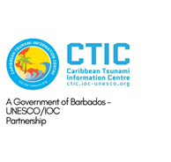

CARIBE EWS - NEW PROJECTS INCLUDING OCEAN DECADE ACTIONS
MEETING OF THE INTER-ICG TASK TEAM ON DISASTER MANAGEMENT AND PREPAREDNESS Online
21-22 February 2022
Alison Brome
Programme Officer for Coastal Hazards, UNESCO/IOC/TSU-CTIC
Christa G. von Hillebrandt-Andrade
Deputy Director, NOAA NWS ITIC Caribbean Office, ICG CARIBE-EWS WG IV Chair

Slide 2
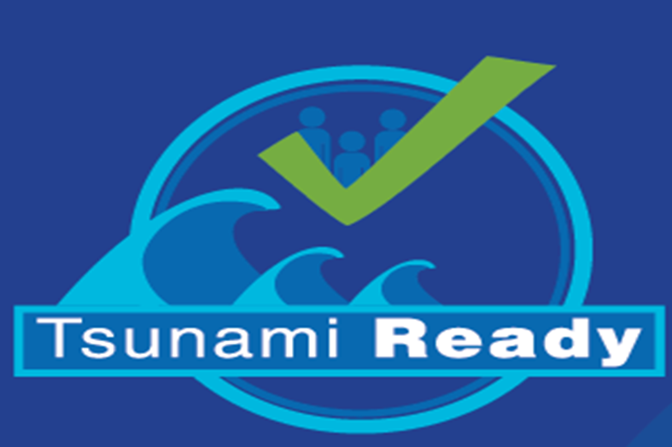
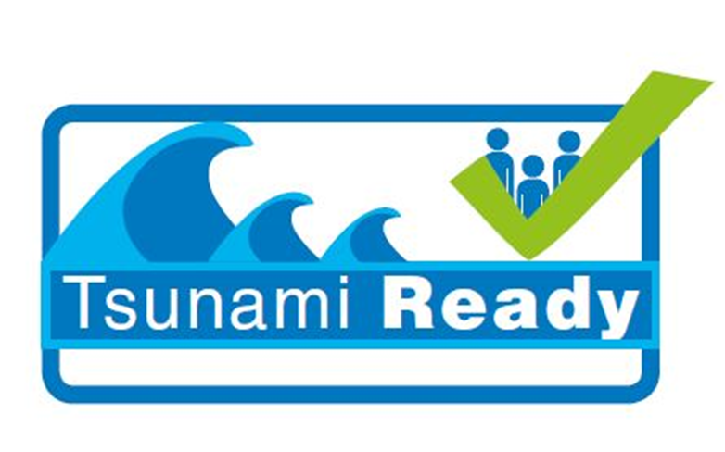
CARIBE EWS TR Communities Feb 2022 – 2023
A total of nine (9 ) new Tsunami Ready Communities are scheduled to be recognized in eight (8) Member States
Two (2) communities will be due for renewal
UNESCO/IOC
Barbados
Puerto Plata, Dominican Republic
Grenada (St. George’s to Point Salines)
Jamaica
Trinidad and Tobago
Status
*NOAA-ITIC-CAR
Barbados
Dominica
Saint Lucia
St. Vincent and the Grenadines (St. George)
* Funded by United States Agency for International Development-Bureau of Humanitarian Assistance (USAID-BHA)
Renewals
St. Patrick, Grenada
Fort Liberte, Haiti

Slide 3
IOCARIBE-led UN Decade Actions for CARIBE EWS
Integrating Coastal Hazard Early Warning Systems and Services for the Tropical Americas and Caribbean (iCHEWS TAC):
Identification of organizations to lead or co-lead, including CTIC, CDEMA, CEPREDENAC and Member State partner institutions in Panama, Barbados, Guatemala, France
Start Date: 01/06/2022
End date: 3/12/2030
Total Budget: USD $3,000,000
Beneficiaries – 34 Member States and Territories
Prioritize the integration of existing and new coastal hazards early warning systems and services considering four components: Monitoring and Warning, Risk Knowledge, Warning Dissemination and Communication, and Response Capabilities, supported by capacity development.
Ocean-related hazards and their impacts to be considered including Tropical Cyclones , Climate Change, Tsunami, Sargassum, Wastewater, Oil Spills, and Coral Bleaching + COVID-19.
Contributes to Decade Outcomes - 4, 5 and 6

Slide 4
IOCARIBE-led UN Decade Actions for CARIBE EWS
TAC Ocean Observing and Forecasting System (TAC-OOS):
Start Date: 01/06/2022
End date: 31/12/2030
Total Budget: USD 100,000,000
Beneficiaries – 34 Member States and Territories
Objective is for co-design and operation of a sustained, regional integrated ocean observation and forecasting system to provide essential information for the sustainable development, well-being, and safety of the region’s oceans.
Alignment with prosperityGOOS 2030 Strategy, using a Value Chain approach, connecting OBSERVATIONS through DATA MANAGEMENT for use in ANALYSES and MODELS to create APPLICATIONS.
Promote development of regional National Observing Systems and collaborate with global Ocean Decade Programs both for capacity building and education.
Contributes to Decade Outcomes - 4, 5 and 6

Slide 5
UN Decade Actions for CARIBE EWS
Safe Ocean Laboratory 05-07 April 2022 Satellite Activities:
The Blue Line - Using Modeling and GIS Tools to Identify Tsunami and other Coastal Inundation Limits: Jamaica Case Study
Bringing tsunami preparedness to the people: MG 86 + document on integrating Migrants into DRR
Visualize potential impacts from sea level rise through maps and photos - NOAA Sea Level Rise Viewer - this also includes tsunami and could be a way forward with the Blue Line
Warning & Responding to Atypical Tsunamis - A Major Challenge for the UN Ocean Decade
SMART Subsea Cables for Observing the Earth and Ocean, Mitigating Environmental Hazards, and Supporting the Blue Economy - opportunity to speak up on SMART in the Caribbean
Building blocks to achieve 100% of at-risk communities recognized Tsunami Ready (TR)
Decade Actions by Member States

Slide 6
Questions, Comments Thank You Alison and Christa

