Slide 1



WORLD TSUNAMI AWARENESS DAY 2021 – CARIBE EWS “Substantially enhance international cooperation to developing countries through adequate and sustainable support to complement their national actions for implementation of the present Framework by 2030.”
MEETING OF THE INTER-ICG TASK TEAM ON DISASTER MANAGEMENT AND PREPAREDNESS Online
21-22 February 2022
Alison Brome
Programme Officer for Coastal Hazards, UNESCO/IOC/TSU-CTIC

Slide 2
UNESCO/IOC-CTIC Activities
Supported concept development of global UNDRR-led WTAD Activities including TOWS XIV
Regional Activities focused on Tsunami Ready (TR) Programme and UN Ocean Decade
UNDRR-led VII Regional Platform Disaster Risk Reduction in the Americas and the Caribbean 01-04 November 2021 (Virtual)
Ideas Incubator Session (Side Event) – “Tsunami Ready: Towards A Safer Ocean” video & PPT
Innovator Platform Session (Virtual Exhibition) – showcased WTAD videos past and present, CTIC’s work, other materials including from Member States, live chats and sessions, comments, poll
WTAD Videos: 2 CARIBE EWS videos showcasing international collaboration for TR
Partners – Caribbean Disaster Emergency Management Agency (CDEMA), Coordination Center for the Prevention of Disasters in Central America and the Dominican Republic (CEPREDENAC) and Delegation of the European Union
NOAA ITIC-CAR and St. Kitts and Nevis national officials – TR nomination & renewal processes

Slide 3
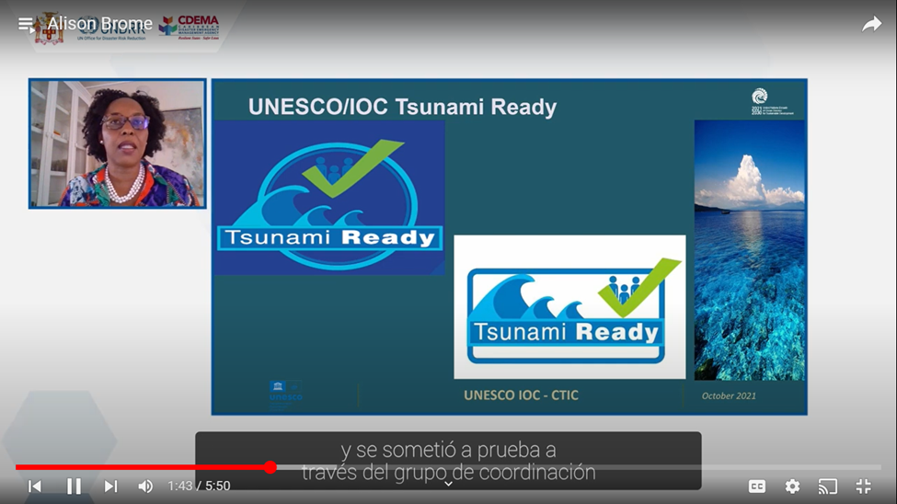
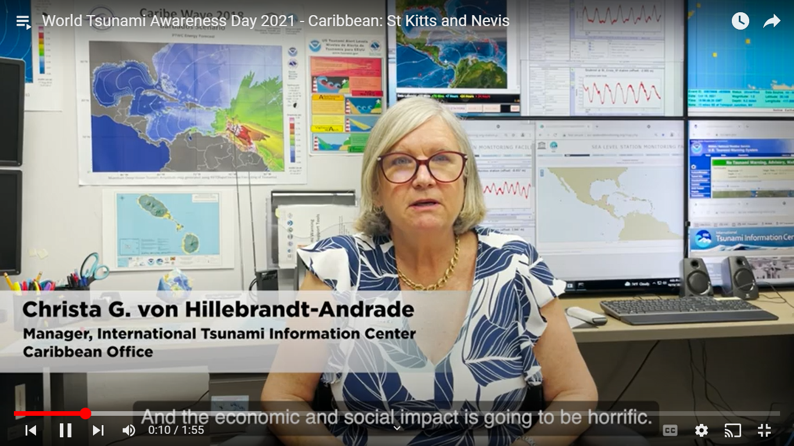
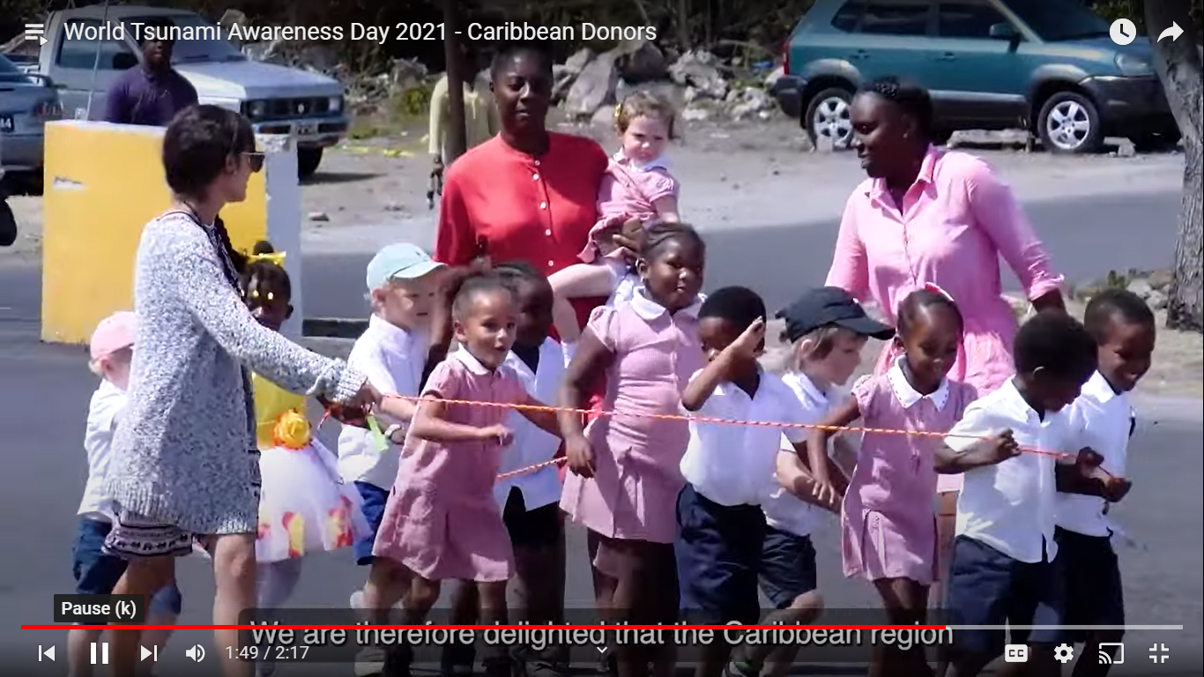
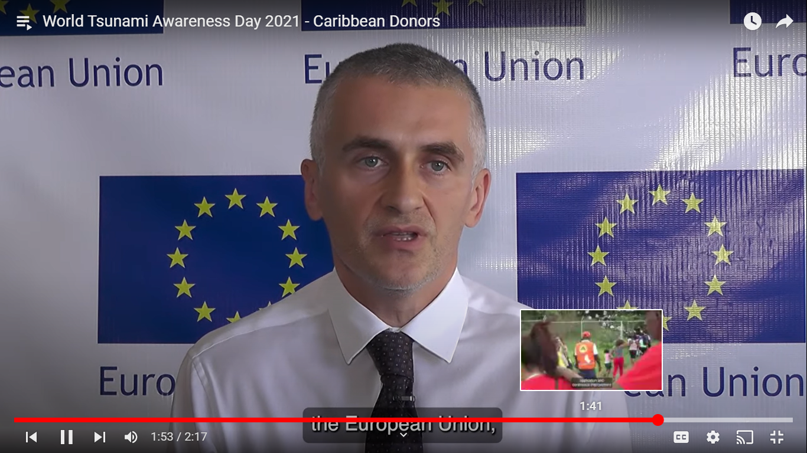
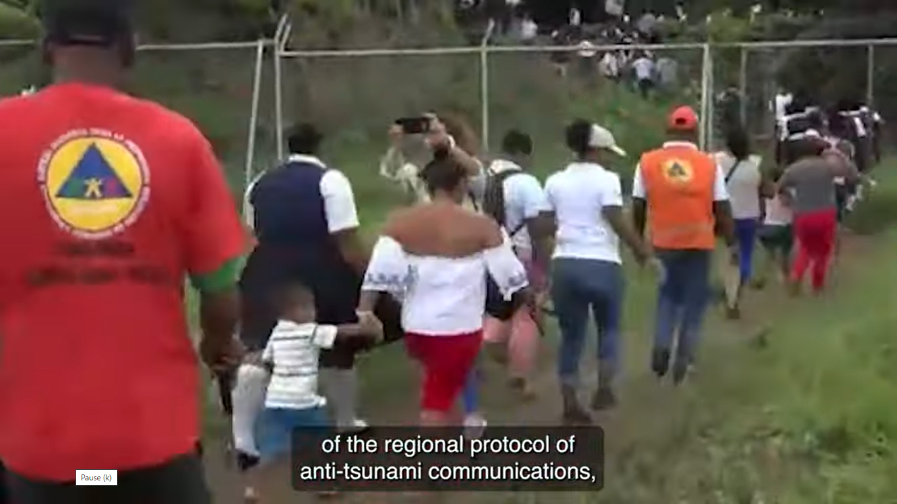
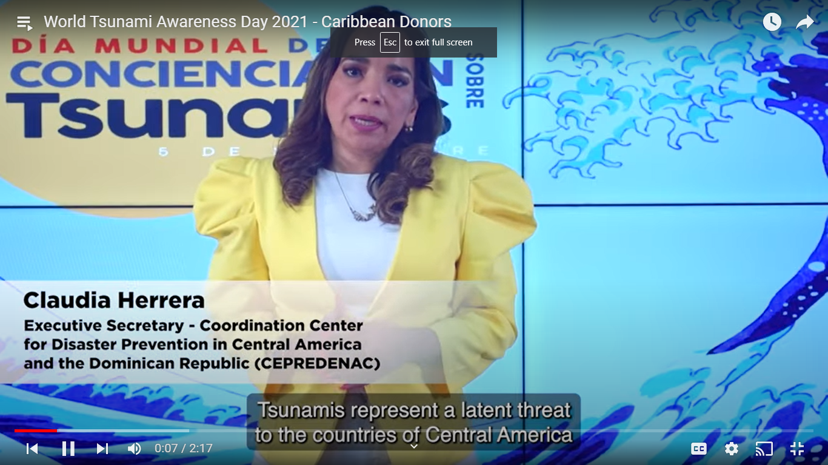
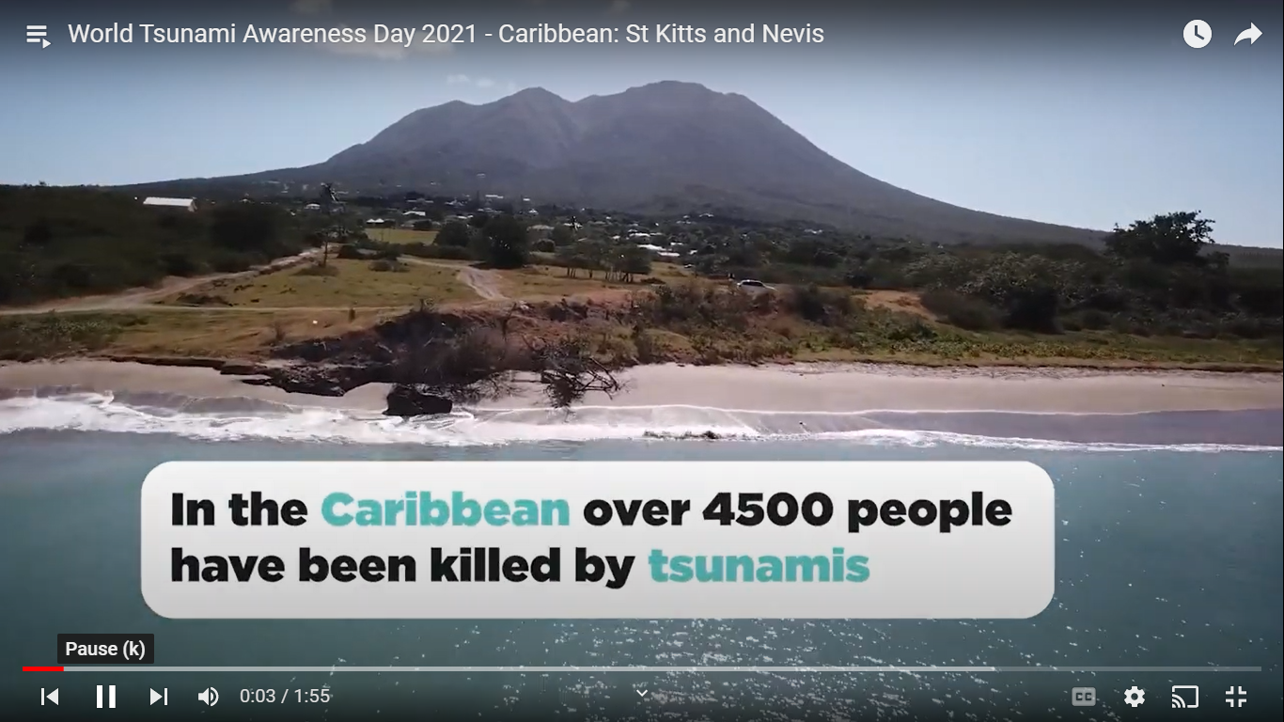
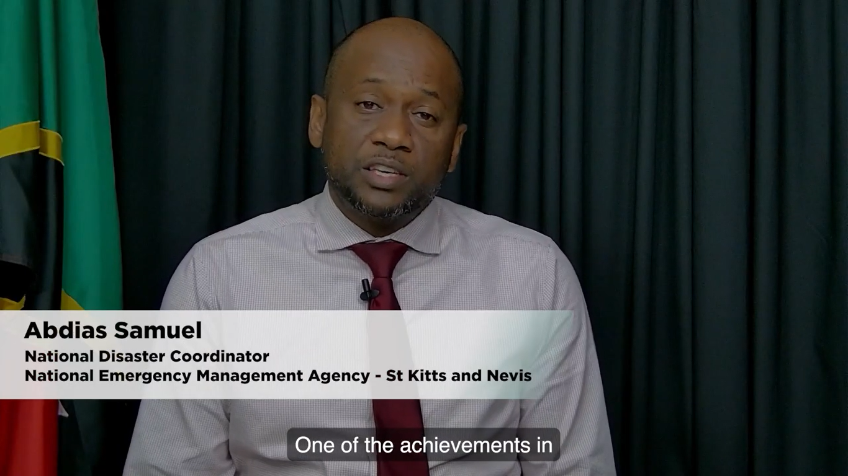
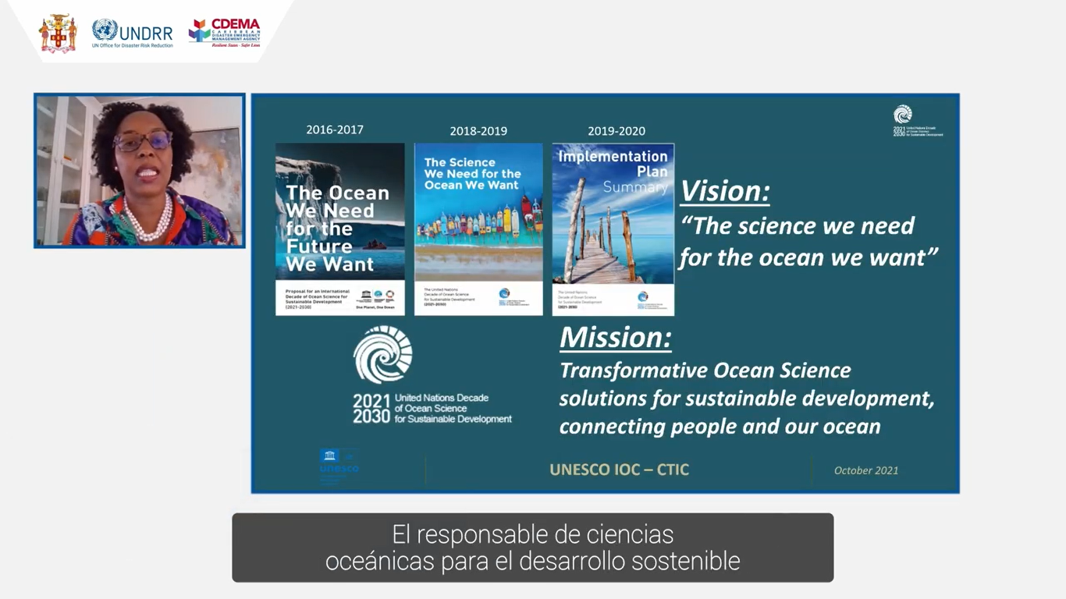

Slide 4
WTAD Considerations
WTAD provides international and regional organisations as well as Member States with a prime opportunity to work together
WTAD - effective medium for promoting CARIBE EWS activities such as Tsunami Ready and CARIBE WAVE Exercise internationally and regionally
WTAD offers an additional avenue for Member States for enhanced outreach
COVID 19 has impacted the scale and nature of possible WTAD events especially at MS level
Limited funding for activities
Video production can be time consuming for coordinators and participants
Strategy to be considered for capturing MS activities and use of all resources and materials post WTAD

Slide 5
Questions, Comments Thank You

