Slide 1







Strengthening the Resilience of Coastal Communities in the North-East Atlantic and Mediterranean Region to the Impact of Tsunamis and Other Sea Level-Related Coastal Hazard
MEETING OF THE INTER-ICG TASK TEAM ON DISASTER MANAGEMENT AND PREPAREDNESS
21-22 Feb 2022
IOC EU ECHO NEAMTWS CoastWAVE Project
Denis CHANG SENG, PhD Programme Specialist
Tsunami Unit, Technical Secretary (ICG/NEAMTWS) Global Ocean Observing System (GOOS) IOC Focal point for MHEWS/ IN-MHEWS IOC of UNESCO

Slide 2
Building on Current Achievements Enhancing, Sustaining and Scaling Up

Slide 3
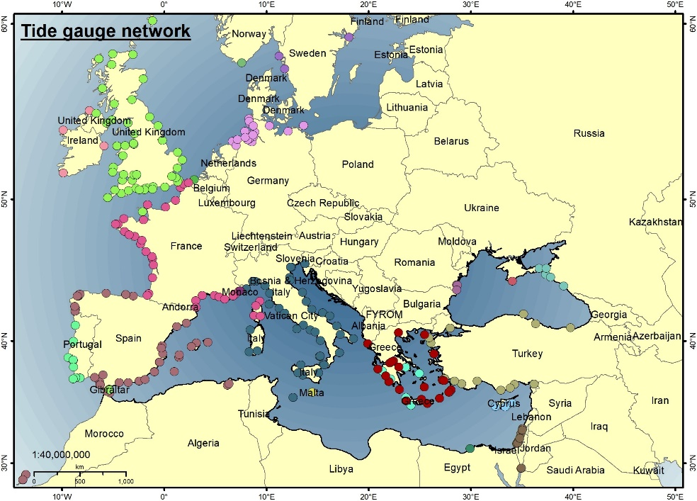
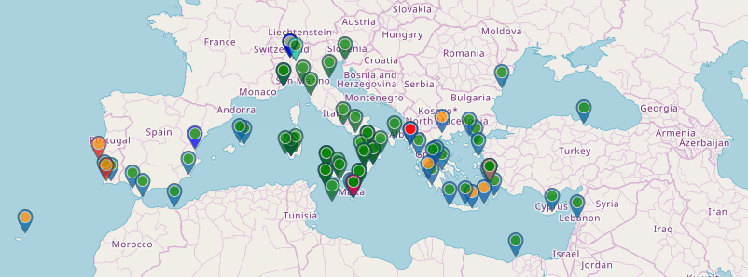
JRC IDSL Network Testing Inexpensive Device for Sea-Level Measurement (IDSL) https://webcritech.jrc.ec.europa.eu/tad_server/
Map of sea level networks used by NEAMTWS Tsunami Service Providers
Need to maintain/repair few instruments damaged
Missing coverage of north Africa coasts

Slide 4
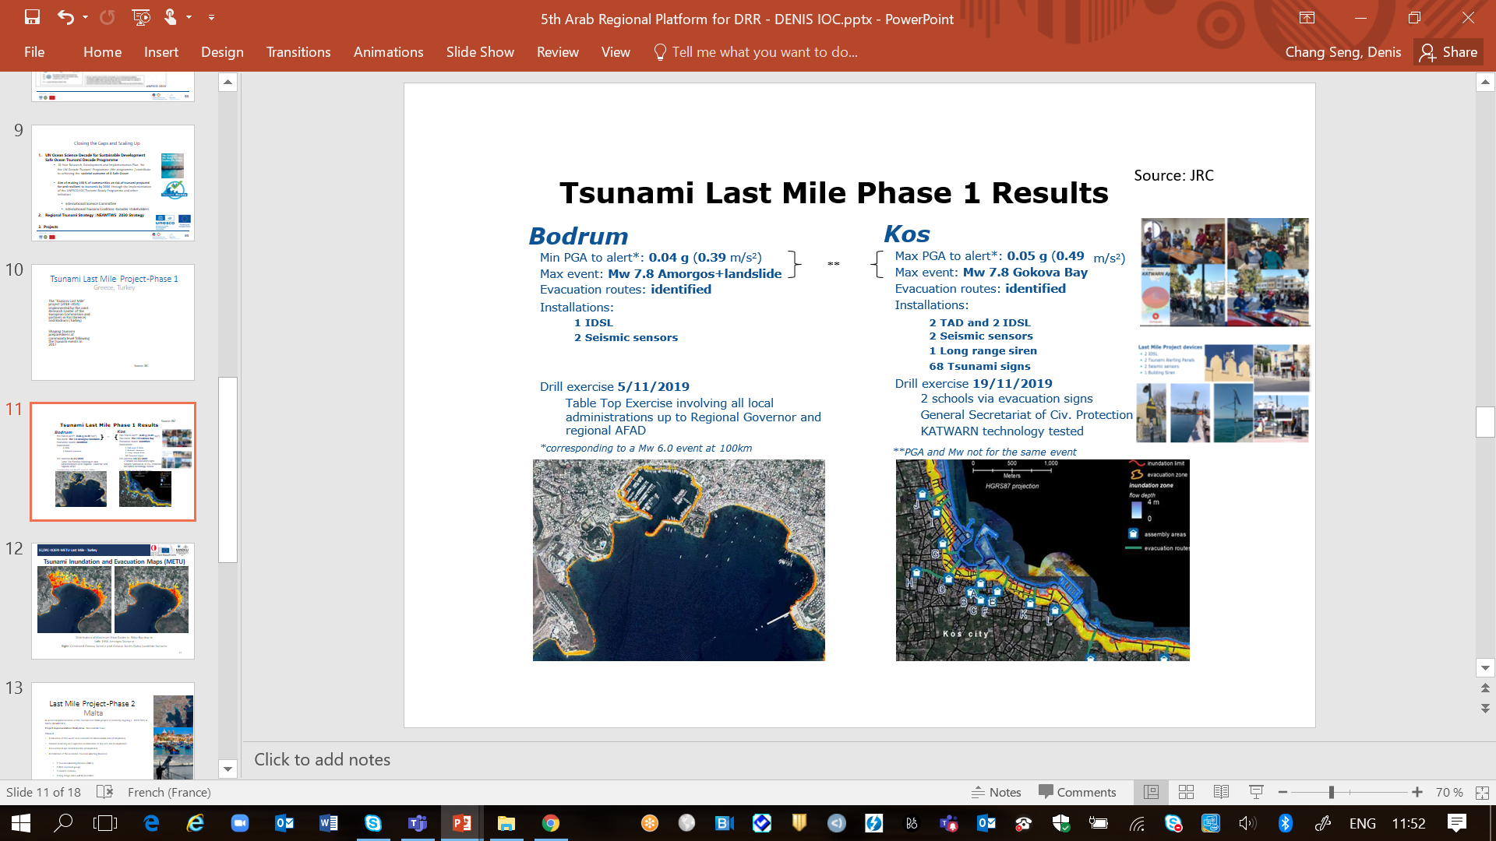
Tsunami Last Mile Project-Phase 1 Greece & Turkey
The 'Tsunami Last Mile' Phase 1 project (2018-2021) was implemented by the JRC and partners in Kos (Greece) and Bodrum (Turkey)
The TLM project has shaped tsunami preparedness at community level following the tsunami events in 2017
Source: JRC

Slide 5
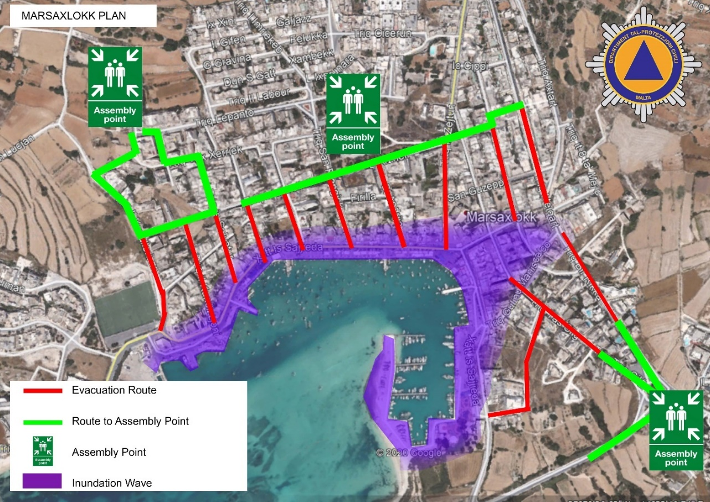
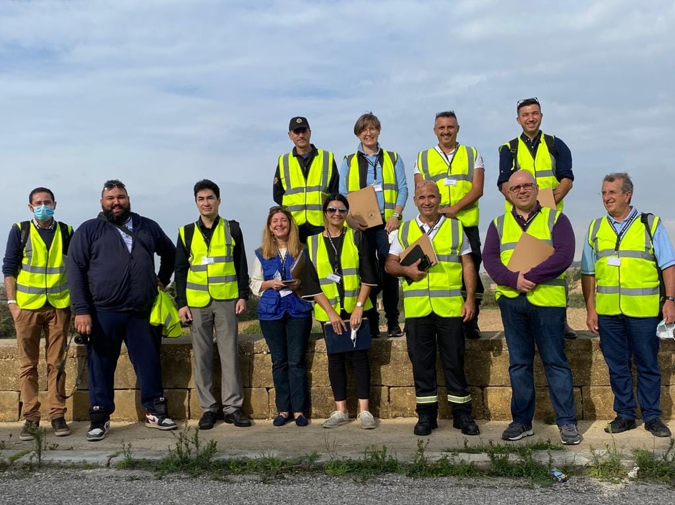
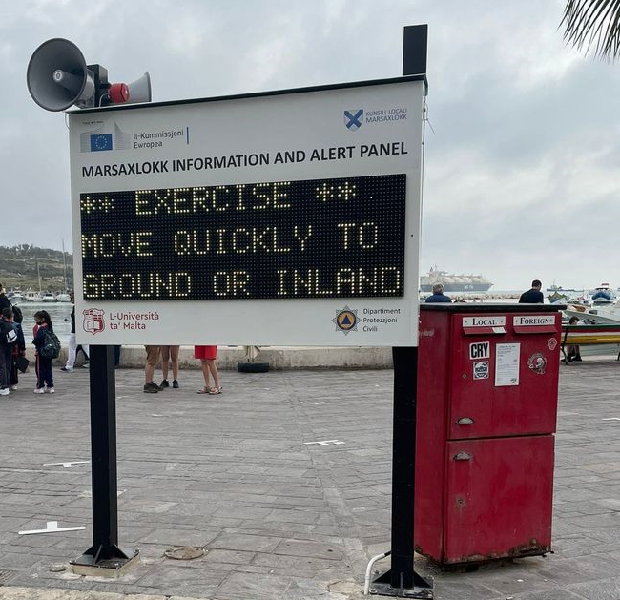
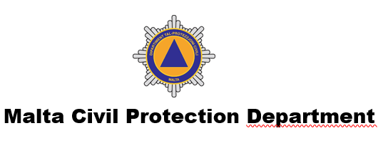
JRC Last Mile Project Phase 2 Malta
First Mission since Feb 2020
Project Implementation Study Area: Marsaxlokk town (Floating Population of 7000)
Malta first end-to-end exercise, 5 Nov 2021
Source Malta CPD /JRC / M. Santini 2021

Slide 6
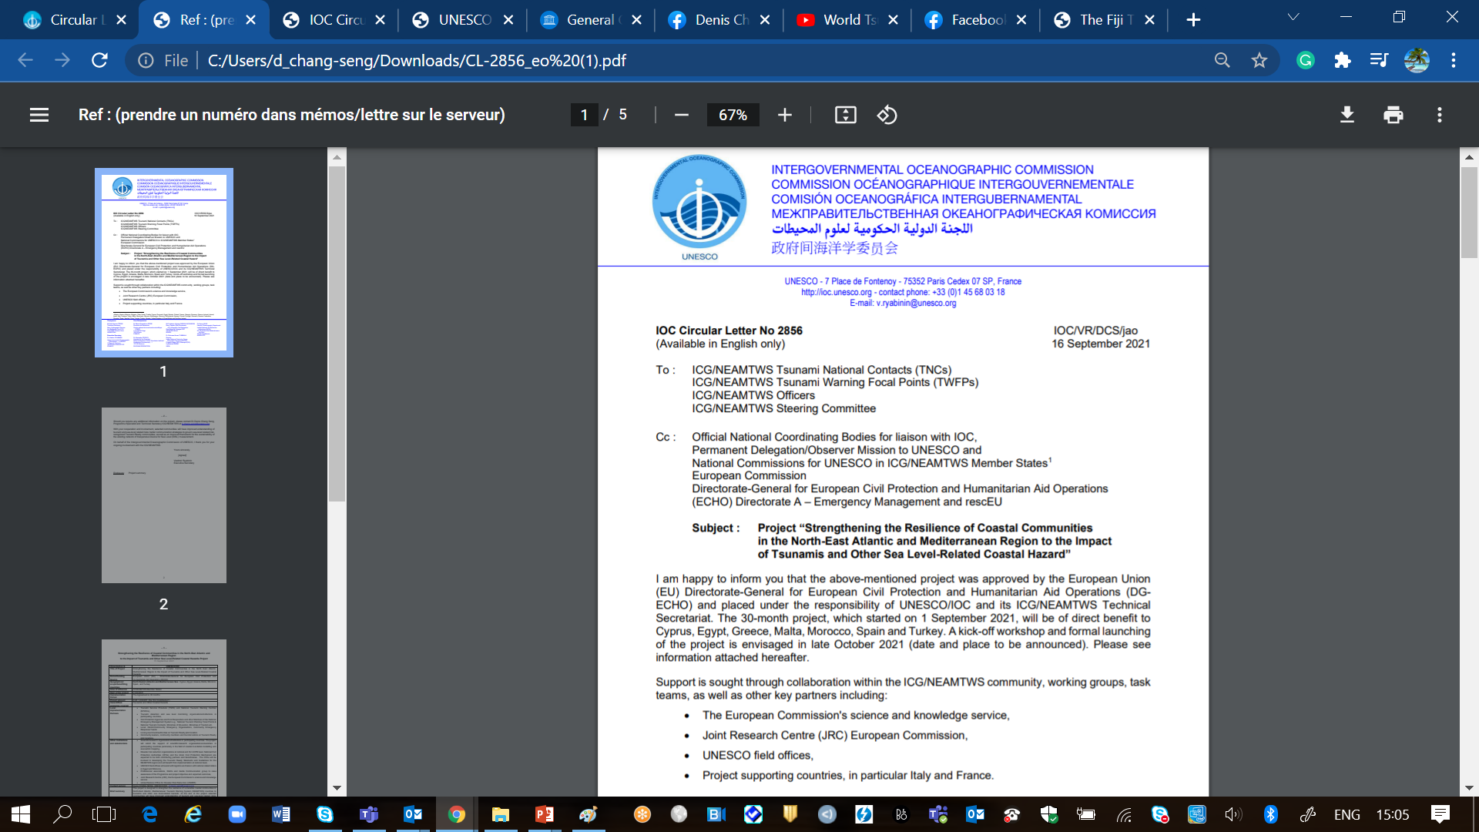
IOC EU ECHO NEAMTWS PROJECT
Project “Strengthening the Resilience of Coastal Communities in the North-East Atlantic and Mediterranean Region to the Impact of Tsunamis and Other Sea Level-Related Coastal Hazard”
Approved by the European Union (EU) Directorate-General for European Civil Protection and Humanitarian Aid Operations (DG ECHO)
Geographical scope/benefitting countries | North Eastern Atlantic and Mediterranean Sea: Cyprus, Egypt, Greece, Malta, Morocco, Spain, and Turkey
Technical Advise | France and Italy
Area of influence | 40 NEAMTWS Member States
Period | 01/09/2021 --- 30/03/2024
Grand Total: 1.2 M Euros

Slide 7
Greece, Samos
Source: Nikos Kalligeris

Slide 8
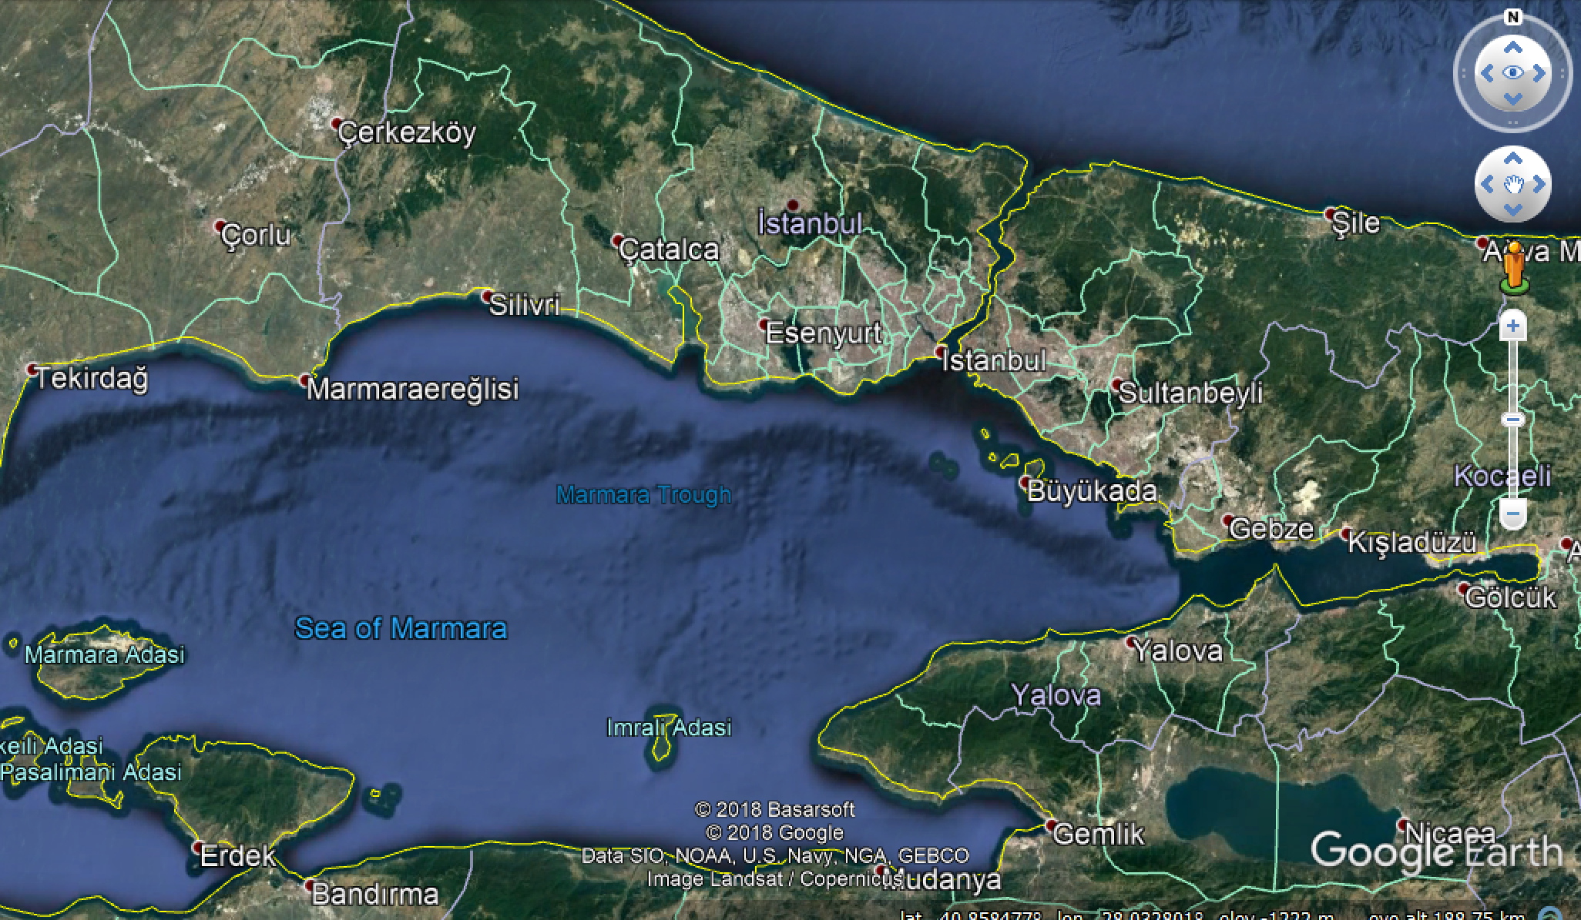



Turkey, Istanbul
Source Ahmert Yalciner/ Ocal Necmioglu

Slide 9
Egypt, Alexandria –Port Said
Source
Egypt/ Prof. AmrZakariaHamouda

Slide 10
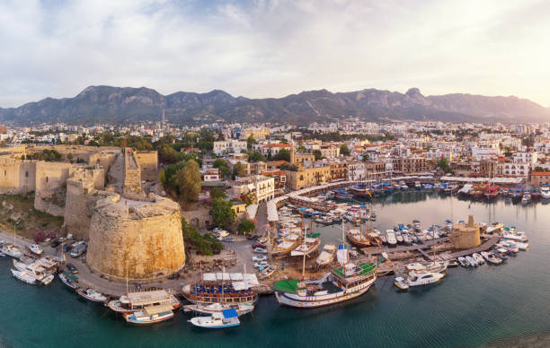
Cyprus

Slide 11
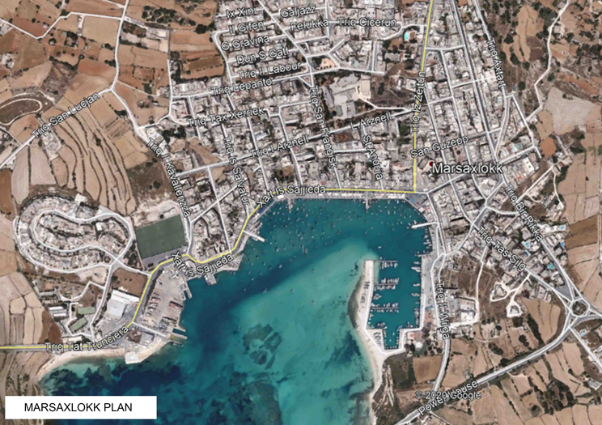
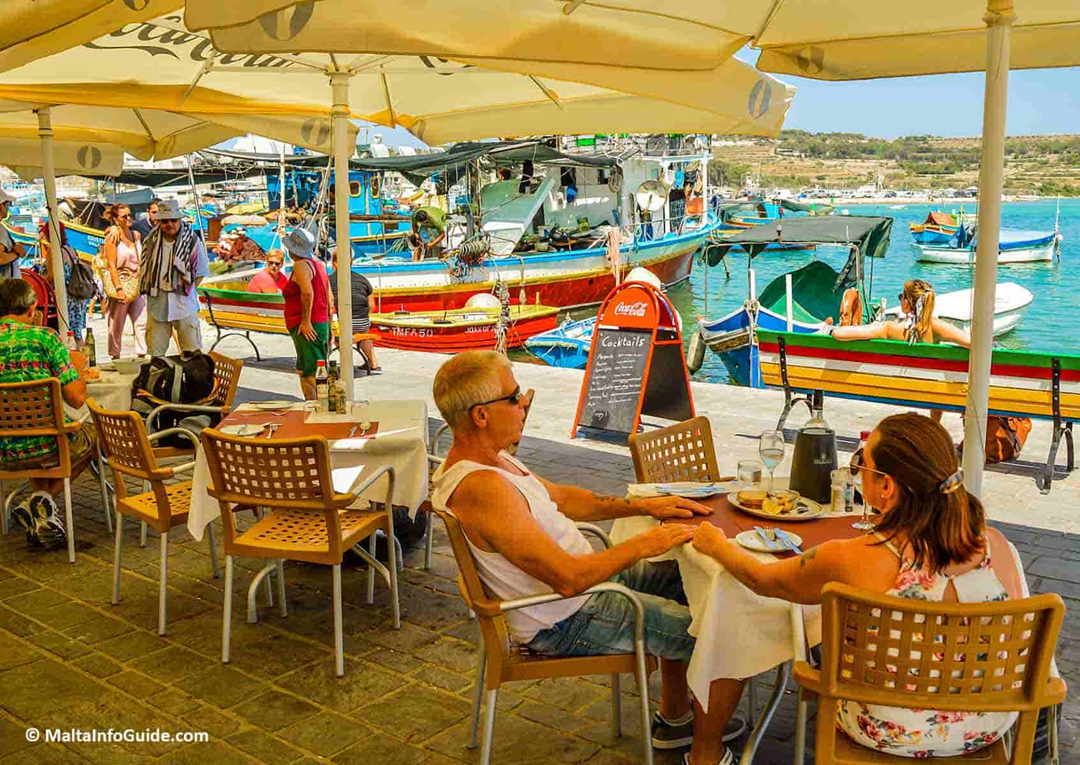
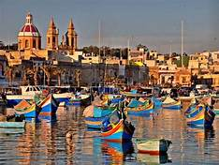
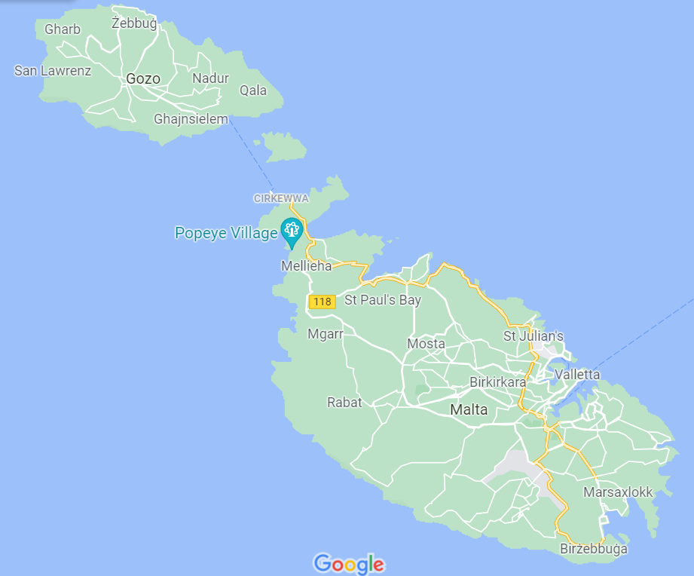
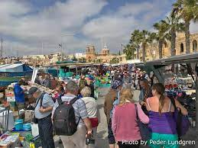
Malta, Marsaxlokk Village
Source Pauline Galea

Slide 12
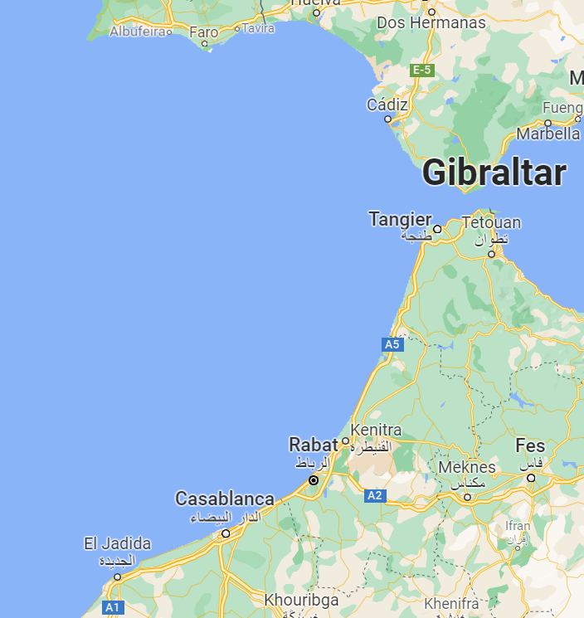
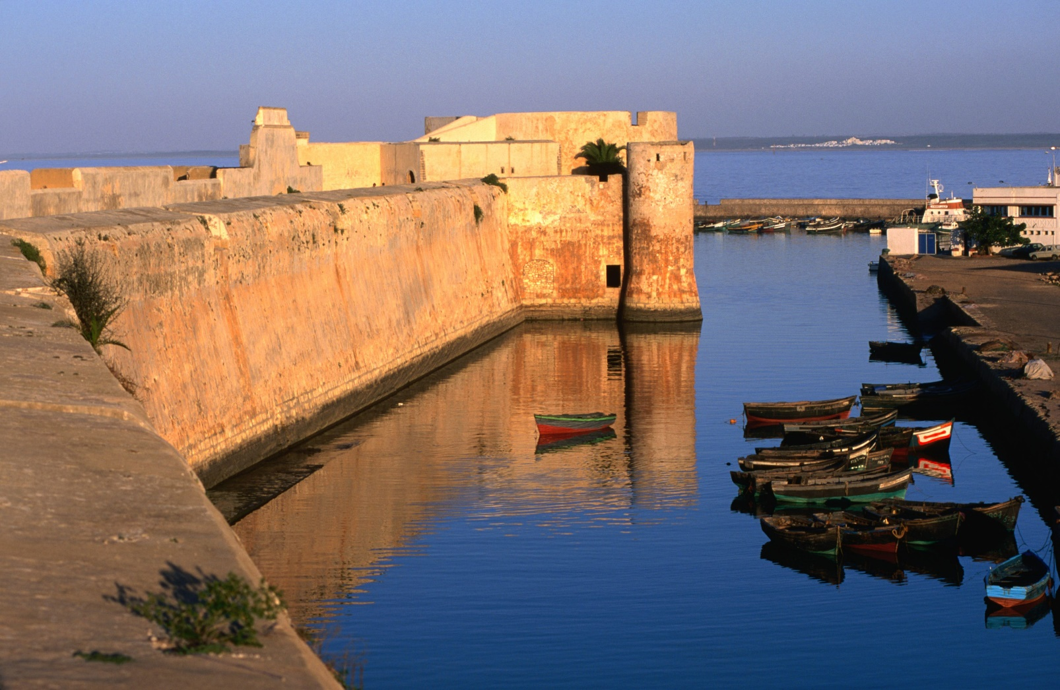
Morocco, El Jadida)

Slide 13

PROJECT GOALS
Project Management, Monitoring etc.
30K EURO
Tsunami Ready Recognized Communities
Alert Systems
Detection & Monitoring
Risk Perception & Communication Strategies
450K
Euros
Improved understanding of tsunami and sea-level related risks.
Better communication strategies to govern sea-level related risk
Enhanced real time detection and monitoring capacities
Improved framework for the sustainability of the existing Inexpensive Device for Sea Level (IDSL) Network
Improved alert/warning capacity
At least seven Tsunami Ready recognized communities by 2023
207 K EURO
16 K
Euros
465 K EURO

Slide 14
PROJECT OUTCOMES
Tsunami Ready pilot programmes based on standards and guidelines developed and adopted by the ICG/NEAMTWS
Understanding and communication of tsunami and other sea-level related risk in selected communities enhanced.
Selected coastal communities are better prepared to respond to SL-related hazards
Access to near real time detection and alert technology to provide early warning of rapid onset sea level-related hazards
Longer term sustainability of the Inexpensive Device for Sea Level (IDSL) network to provide early warning of rapid onset sea level-related hazards in NEAMTWS countries enhanced
1
2
3
4
5

Slide 15
PROJECT IMPLEMENTING PARTNERS & STAKEHOLDERS
TSPs
Sea Level Monitoring & Tsunami Detection Organizations
Local Government
Community Leaders & members
Ministry of Education (schools)
Scientific organizations , Universities
NGOs
Media
JRC
UNDRR
UNESCO Field Offices
Ministry of Tourism (Hotels)
Community Emergency Organizations & Response Teams
NTWCs

Slide 16
REVISED WORKPLAN FLEXIBLE & ADAPTIVE Situation and Context Specific

Slide 17
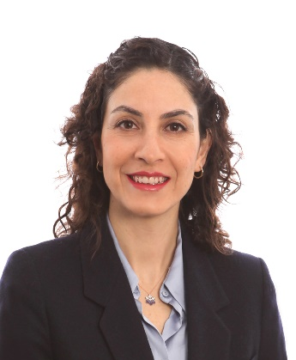

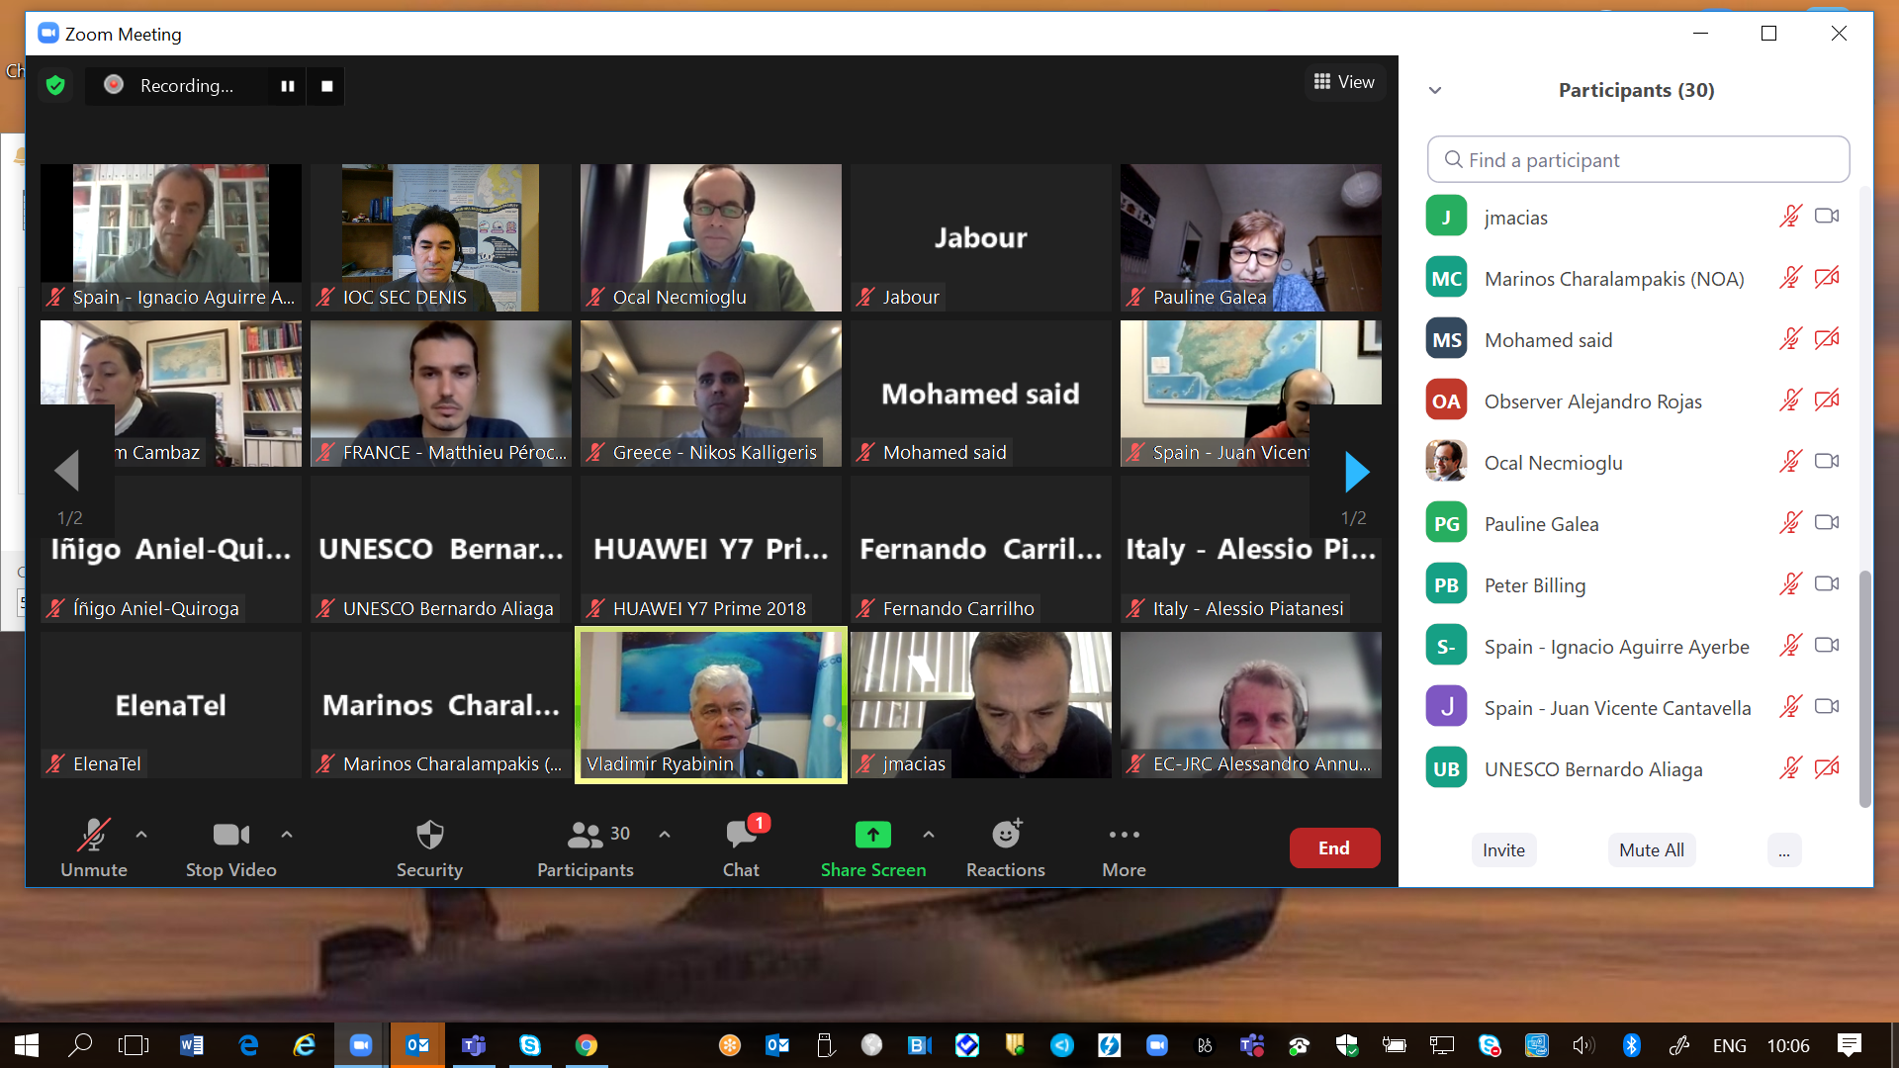
The Project Inception Phase (3/4 Months)
Recruitment of two project staff
Project Assistant (Administration, Finance and Budget)
Associate Project Officer (Project Coordinator)
Organized Kick-off project workshop,17 & 20 Dec 2021
Implementation

Slide 18

END

