Slide 1


STATUS OF CARIBE EWS TSUNAMI READY PILOT COMMUNITIES
MEETING OF THE INTER-ICG TASK TEAM ON DISASTER MANAGEMENT AND PREPAREDNESS Online
21-22 February 2022
Alison Brome
Programme Officer for Coastal Hazards, UNESCO/IOC/TSU-CTIC
Christa G. von Hillebrandt-Andrade
Deputy Director, NOAA NWS ITIC Caribbean Office, ICG CARIBE-EWS WG IV Chair
Stephanie Soto
Contractor, NOAA NWS ITIC Caribbean Office

Slide 2
Outline
Tsunami Ready (TR) in Context of UN Decade
Status of CARIBE EWS TR Communities Feb 2021 – Feb 2022
Considerations and Constraints

Slide 3
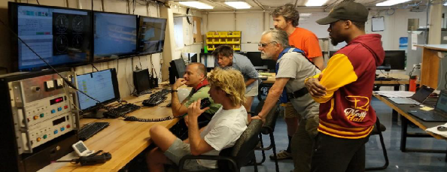
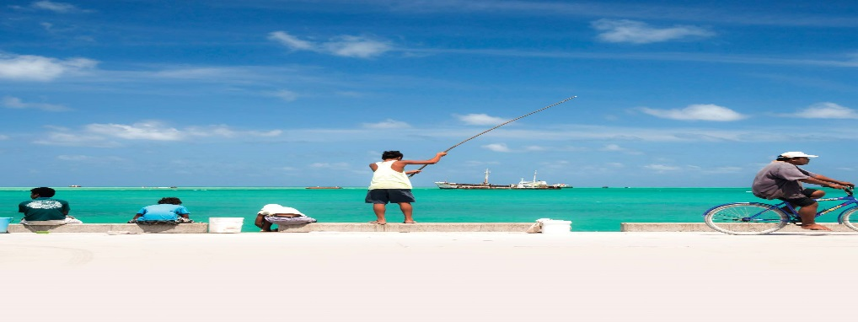
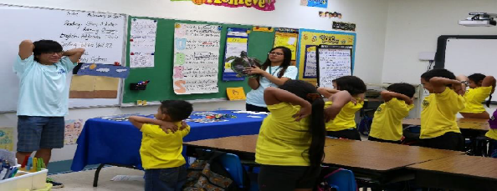
TR in Context of UN Ocean Decade
UN Decade Societal Outcome 5
A Safe Ocean where Life and livelihoods are protected from ocean-related hazards
UN Decade Goal - Tsunamis
To make 100% of communities at risk of tsunamis prepared for and resilient to tsunamis by 2030 through the implementation of the Tsunami Ready Programme and other initiatives
Tsunami Ready Coalition
Establishment of a Tsunami Ready Coalition of stakeholders to deliver a strategic plan to facilitate the implementation of the Comprehensive Decade Tsunami Programme through the UNESCO/IOC Tsunami Ready Programme and other initiatives

Slide 4

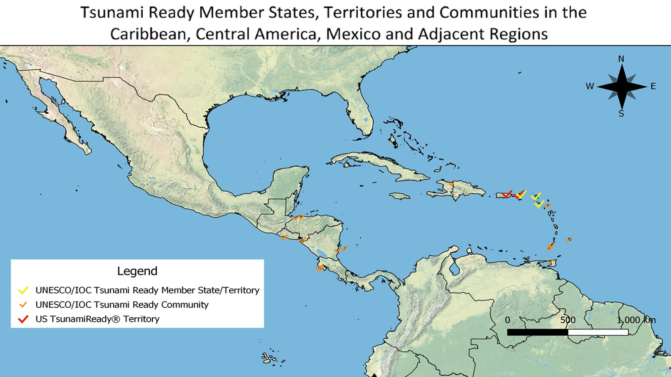

Status of CARIBE EWS TR Communities Feb 2021 – 2022
Tsunami Ready Interactive Map Viewer – up-to-date, comprehensive,
visual snapshot
14 recognized TR communities in CARIBE EWS
British Virgin Islands - met requirements for TR renewal
Old Harbour Bay, St. Catherine, Jamaica - met requirements for recognition
St. Kitts and Nevis – met requirements for TR renewal
St. George, St. Vincent and the Grenadines – progressing
Holetown, Barbados and Belize City, Belize - postponed

Slide 5
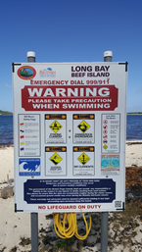
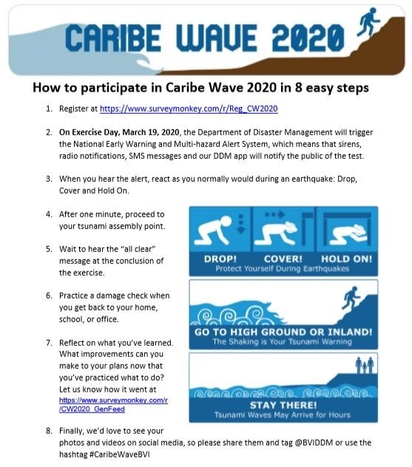
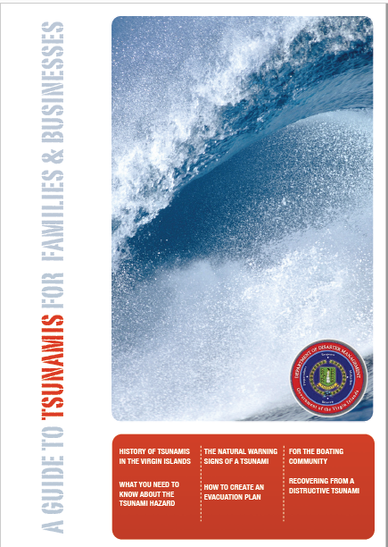
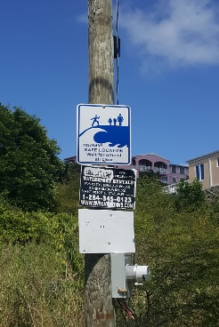
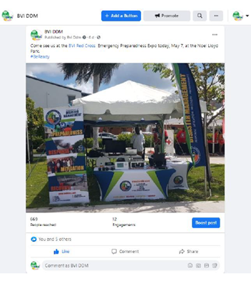
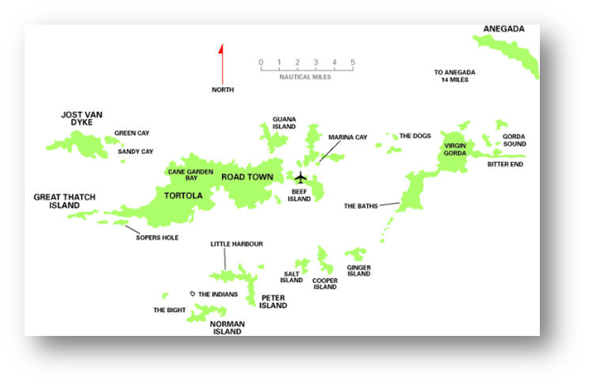
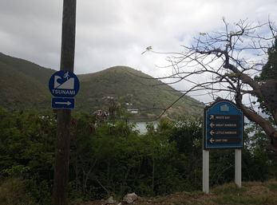
British Virgin Islands: Multi-Island, Territory-wide Renewal
Total population approx. 35,000
National led recognition 13 May 2014, renewed 26 June 2017, impacted by 2017 Atlantic Hurricane Season - loss of signage and equipment, COVID-19 impact
2018 – 2022:
National support for signage replacement, UNESCO/IOC-CTIC-DIPECHO support for equipment
Protocol updated for PTWC Enhanced Prods
RTRPB met 02 Nov 2021 and confirmed eligibility, administrative request for name change by MS under consideration by UNESCO, Tsunami Ready Ceremony pending

Slide 6
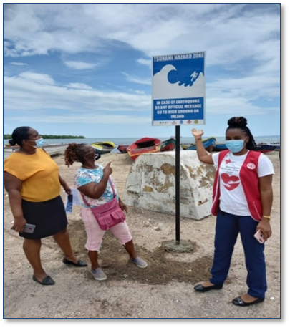
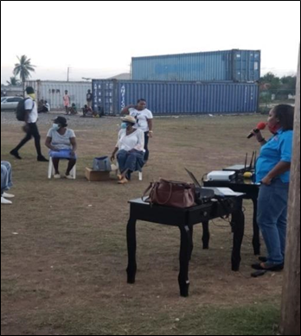
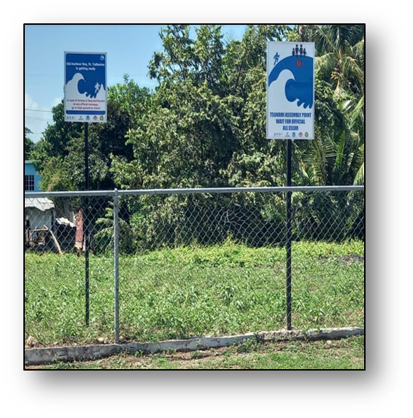
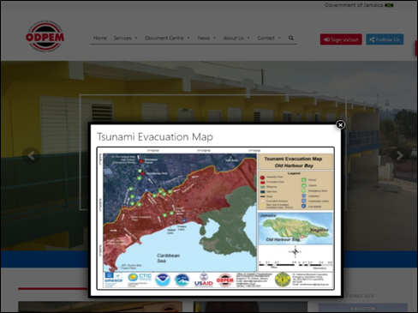
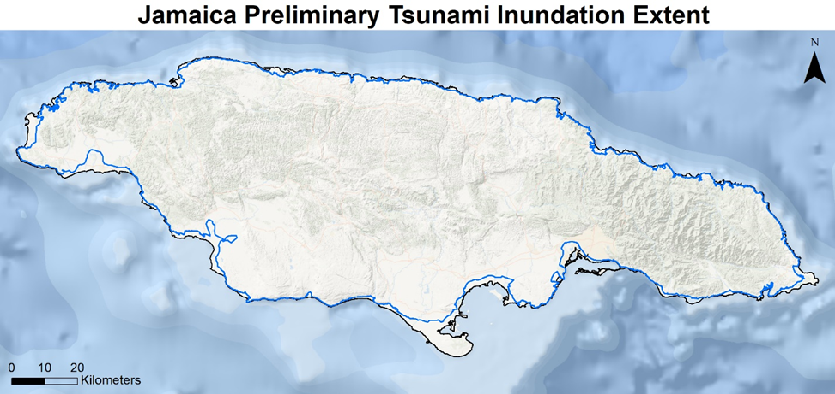

Old Harbour Bay, St. Catherine, Jamaica
Located on Jamaica’s SE coast, approx. population is 5,543
Application submitted, deemed eligible by IOC, national authorities engaged, Tsunami Ready Ceremony pending
National Verification Committee (multidisciplinary, national and local) established for implementing community outreach programmes and overseeing the installation of tsunami evacuation signage
National Tsunami Ready Board established, chaired by ODPEM in accordance with TR Guidelines
Preliminary “blue line” developed
PAE – stickers, CARIBE WAVE video, jingle, events
NOAA ITIC-CAR led, USAID-BHA funded

Slide 7
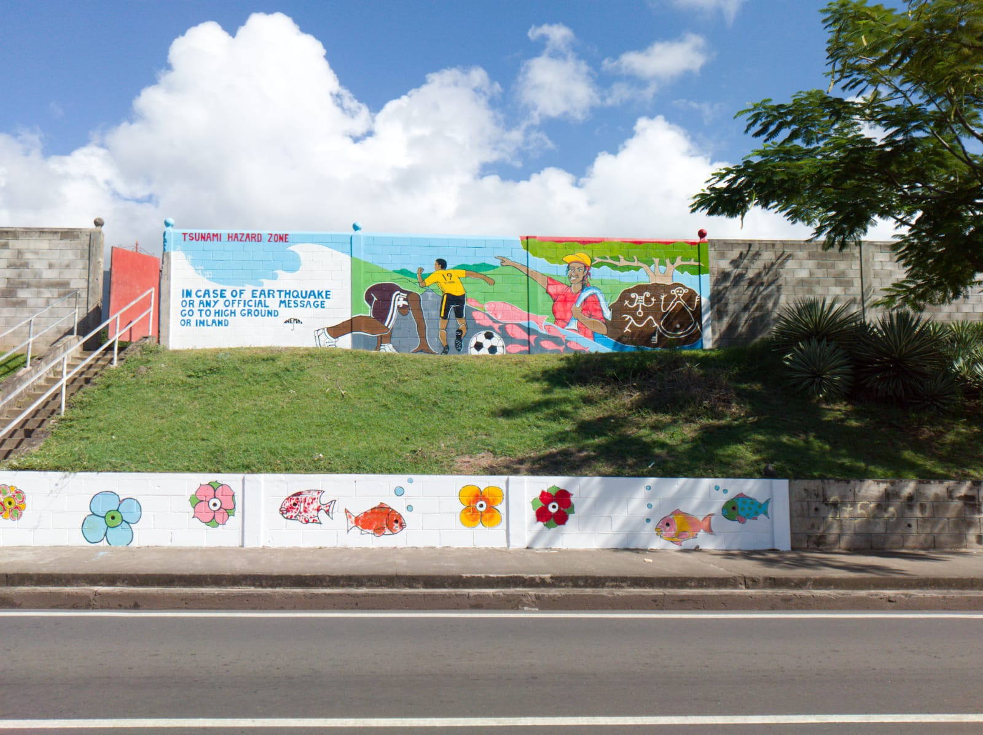
St. Kitts and Nevis: Multi-Island, Territory-wide Renewal
Recognised October 2016
Population in evacuation zone is approx. 22,500
RTRPB met 04 Feb 2022 and confirmed eligibility for renewal, meeting report under finalization, national authorities to be engaged re: Tsunami Ready ceremony
Murals, updates to evacuation map, signage and SOPs, PSAs, videos https://www.youtube.com/watch?v=qmNIYatq5gk, https://www.youtube.com/watch?v=RhDLyTkly5o
Renewal process impacted by COVID-19
NOAA ITIC-CAR led, USAID-BHA funded

Slide 8
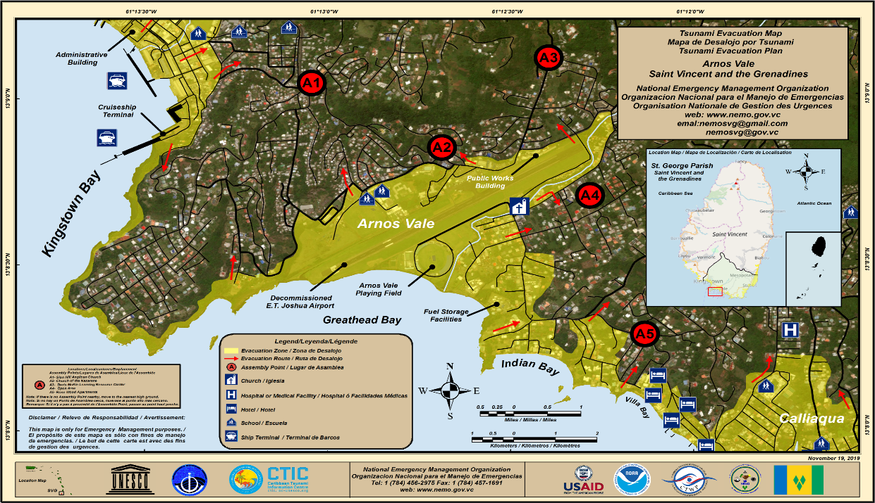
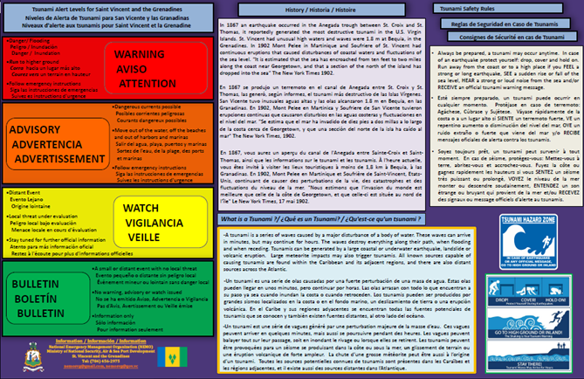
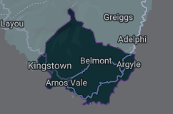
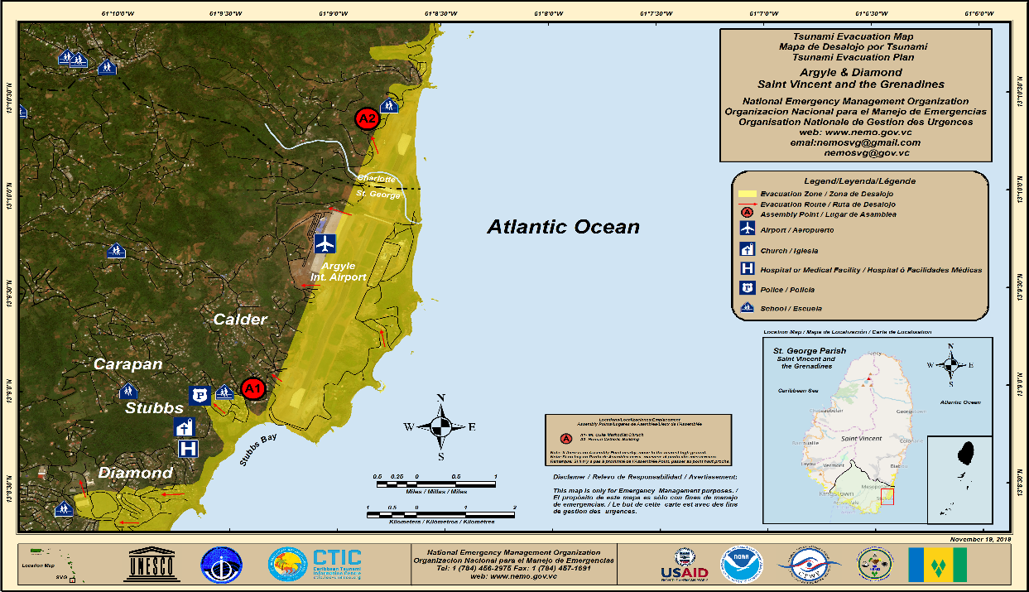
St. George, St. Vincent and the Grenadines
Recognition process initiated in 2018, impacted by COVID-19, dengue outbreak, La Soufriere volcanic eruption
Inundation maps completed, preparedness requirements fulfilled, revision of national SOPs significantly advanced and other response requirements fulfilled, signage to be installed
NOAA ITIC-CAR led, USAID-BHA funded

Slide 9
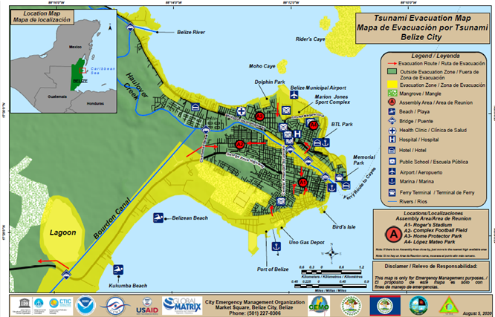
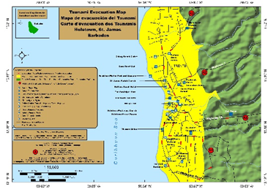
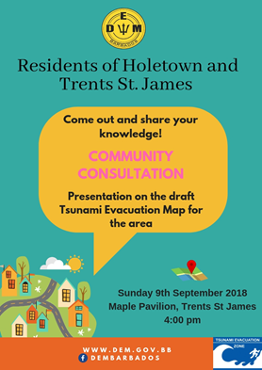
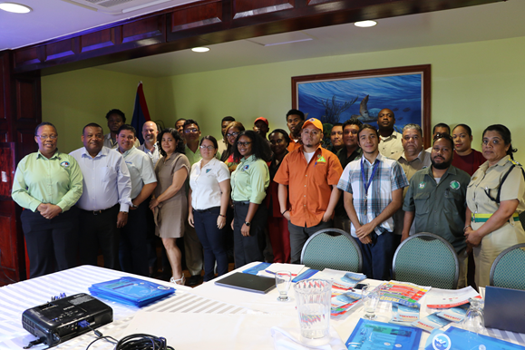
Postponed TR Pilots
Belize City, Belize
Mapping workshop convened, draft evacuation map developed
Comprehensive national support required for other preparedness and response requirements, and signage
NOAA NOAA ITIC-CAR led, USAID-BHA funded
Holetown, Barbados
Nationally led
Draft inundation & evacuation maps done, PAE conducted
National SOP developed by UNESCO/IOC- CTIC DIPECHO Project
Funding support requested, UNESCO/IOC-CTIC led project to complete nomination in 2022

Slide 10
Considerations
National priority and support are critical for successful Tsunami Ready implementation
Availability of funding
Impact of other hazards e.g. Hurricanes, COVID-19, Dengue, La Soufriere Volcanic Eruption to be considered in mitigation strategy
Critical role of annual CARIBE WAVE Exercise to Tsunami Ready process
Administrative Process – MS and IOC level
Promotion of CARIBE EWS Tsunami Ready Programme and Communities – websites and social media (IOC, CTIC, ITIC, MS), partners and WTAD

Slide 11
Questions, Comments
Thank You
Alison, Christa, Stephanie

