Slide 1




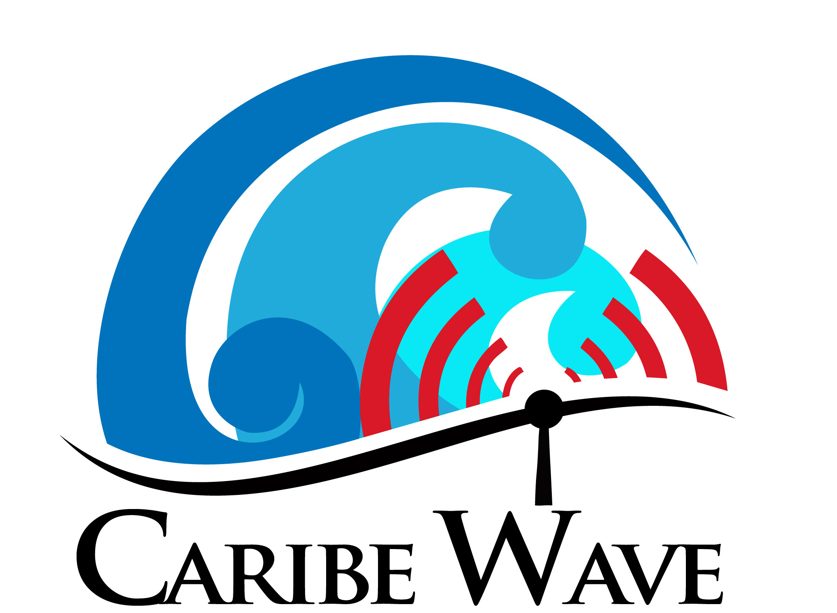
Hunga-Tonga-Hunga-Ha'apai Tsunami Observations in the Caribbean and Adjacent Regions and the August 14, 2021 Haiti Earthquake and Tsunami
JOINT MEETING OF THE INTER-ICG TASK TEAMS ON DISASTER MANAGEMENT AND PREPAREDNESS and TSUNAMI WATCH OPERATIONS
VIRTUAL
February 21, 2022
Dr. Elizabeth A. Vanacore
Seismologist, Puerto Rico Seismic Network
ICG CARIBE-EWS CARIBE WAVE TT CHAIR
Christa G. von Hillebrandt-Andrade
Deputy Director, NOAA NWS ITIC Caribbean Office
ICG CARIBE-EWS WG IV Chair
Alison Brome
Coastal Hazards Officer
CTIC, UNESCO/IOC

Slide 2
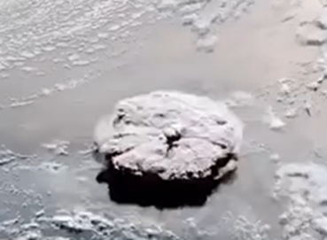

Hunga-Tonga Eruption and Shockwave
Satellite Image of Eruption of Hunga-Tonga Volcano
(GOES-WEST and Himawari-8).
At 0415 UTC January 15, 2022, a large volcanic eruption occurred at the Hunga-Tonga-Hunga-Ha'apai Volcano in Tonga in the South Pacific. The explosive eruption sent ash, steam, and gas 39 kilometers (24 miles) into the air and was recorded by international satellites

Slide 3
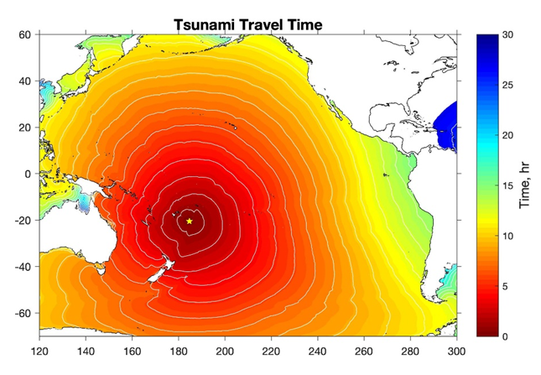
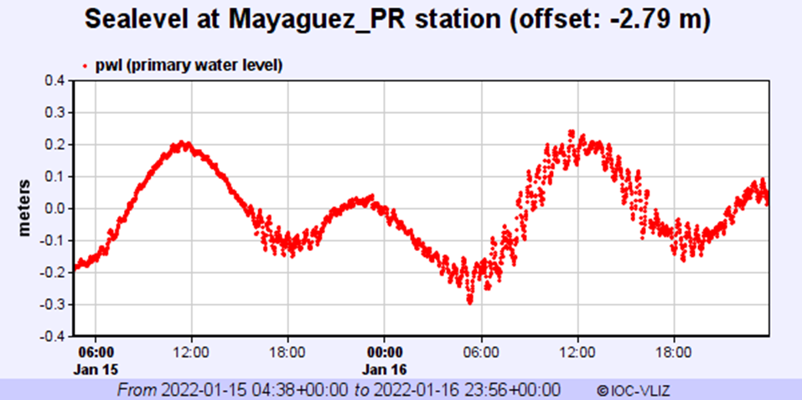
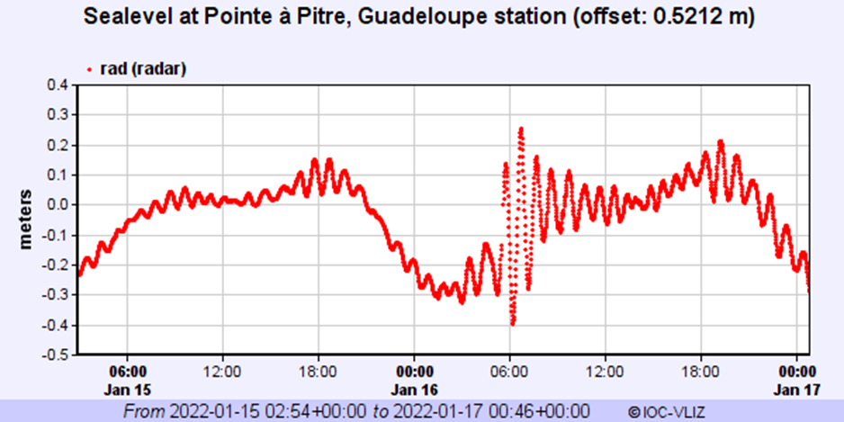
Tsunami Observations from HTHH in the CARIBE
Sea Level graph
Pressure graph
Travel Time
Pressure Wave

Slide 4
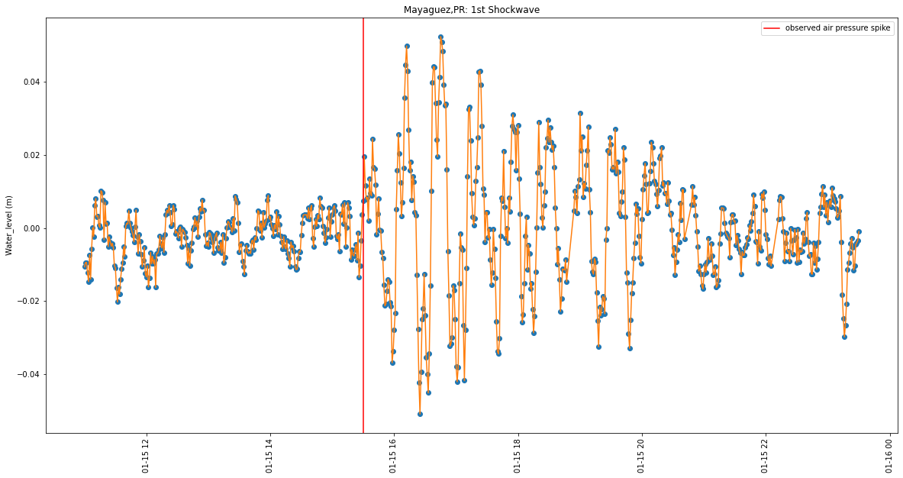
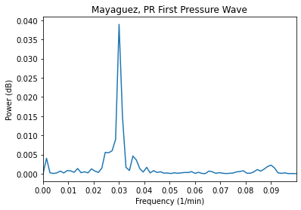
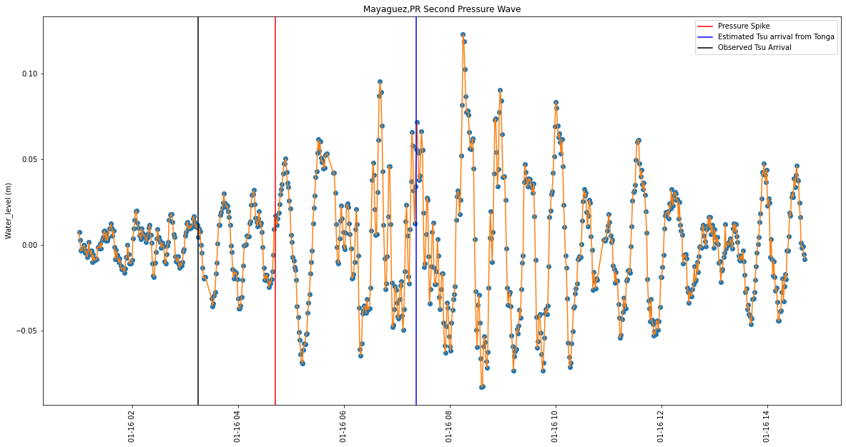
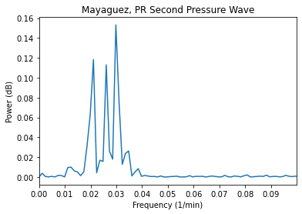
Caribe-EWS Ad-Hoc Working Group

Slide 5
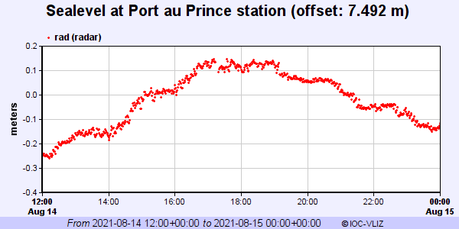
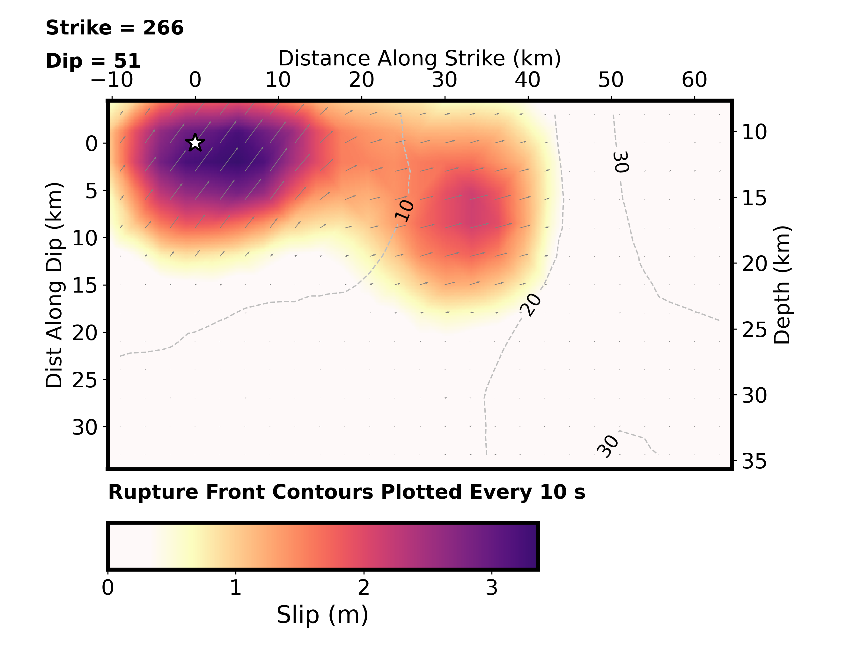
M7.2 Haiti August 14, 2021 12:29:08 (UTC)
Oblique reverse motion along the Enriquillo-Plantain Garden fault zone
Human Impact:
2,248 dead
12,763 injured
329 missing
53,815 houses destroyed
83,770 houses damaged
Finite Fault: USGS
Protection Civile (Haiti), 2021

Slide 6
Notifications (UTC)
17 MS & Territories responded to After Action Review issued by UNESCO/IOC-CTIC
PTWC Timeline
12:38 Tsunami Information Statement
13:14 Initial Threat Message
14:16:00 Final Threat Message
Other Sources:
Haiti: 12: 29 - Ground Shaking
Guatemala: approx. 12:05 - local seismic network
All responding MS confirmed receipt of PTWC messages

Slide 7
Receipt of PTWC Messages & Actions
Only Haiti issued evacuations and reported self-evacuations

Slide 8
Considerations
Seismic events outside region e.g. Hunga-Tonga, Canary Islands resulted in increased calls, emails, engagement by MS, regional agencies e.g. CDEMA, other stakeholders and public on potential impact for CARIBE region
Haiti event assessment reflected reliance on email for receipt of PTWC messages, requiring continued efforts to enhance redundancy
Haiti event assessment revealed continued desire for capacity building in sea level, SOPs, risk assessment and inundation modelling, community awareness and preparedness, exercises and drills, media awareness, seismic. Only 1 MS indicated no training was required

