Slide 1

J3 WAVE Exercises
NEAMWave
Coordinated by Task Team on Tsunami Exercise ICG/NEAMTWS
co-chairs: Ceren Ozer Sozdinler (Turkey)
Marinos Charalampakis (Greece)
MEETING OF THE INTER-ICG TASK TEAM ON DISASTER MANAGEMENT AND PREPAREDNESS Online, 21–22 February 2022

Slide 2





NEAMWave history
1st exercise in NEAM region
4 scenarios by 4 TSPs
Phase A and Phase B
4 scenarios by 4 TSPs
Phase A, Phase B & Phase C
4 scenarios by 5 TSPs
1 joint scenario by 2 TSPs
Phase A, Phase B & Phase C
3 scenarios by 5 TSPs
2 joint scenarios by 2 TSPs
Phase A, Phase B & Phase C
recommendation for joint scenario by 3 TSPs

Slide 3
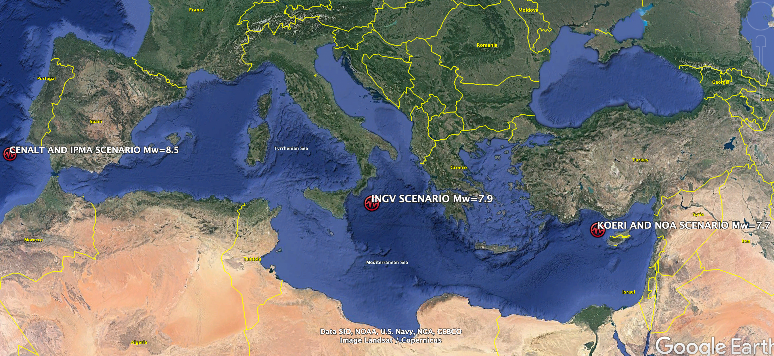
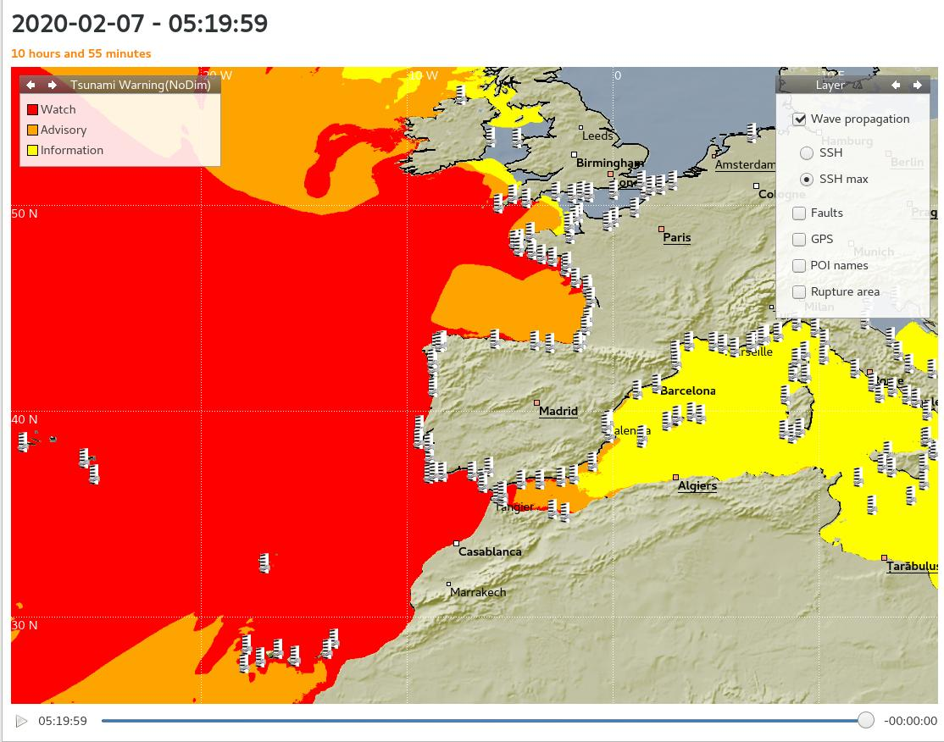
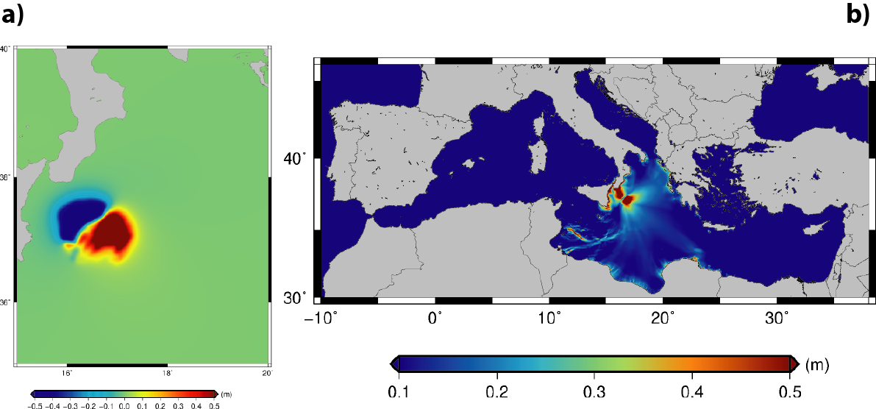
NEAMWave21 Scenarios
North Eastern Atlantic;
Joint scenario (Mw=8.5) by IPMA & CENALT
Central Mediterranean;
Single scenario (Mw=7.9) by INGV
Eastern Mediterranean;
Joint Scenario (Mw=7.7) by NOA & KOERI

Slide 4
Dates of NEAMWave
Usually in November
Before the ICG/NEAMTWS
NEAMWave21

Slide 5
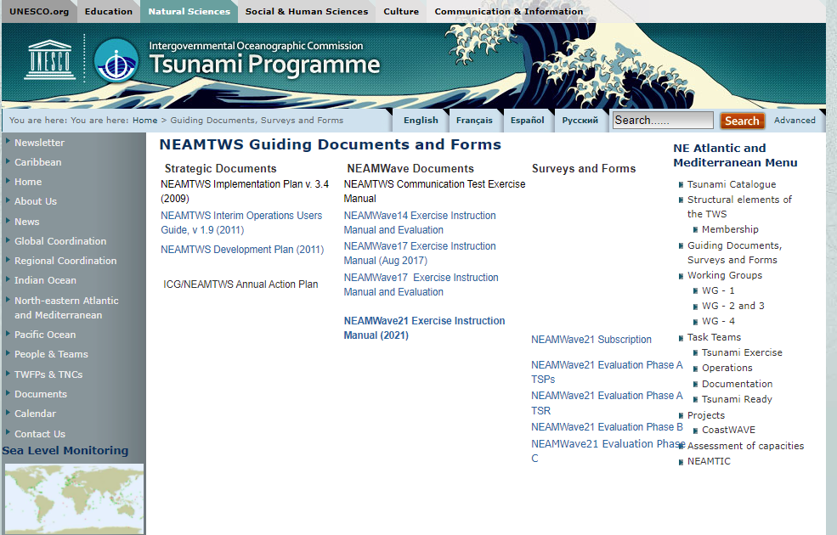
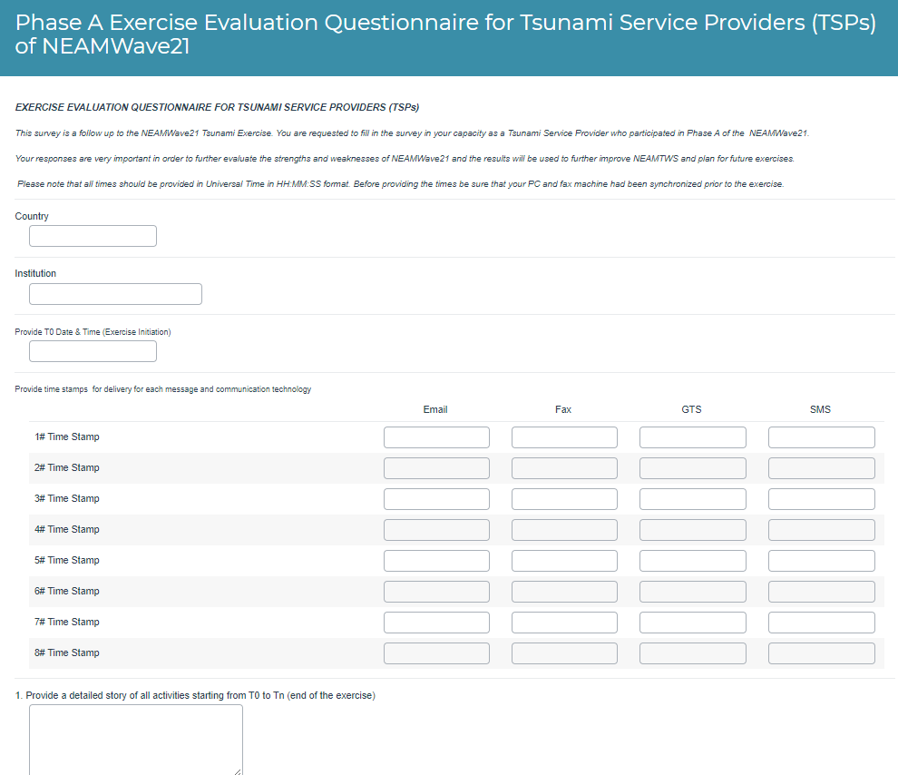
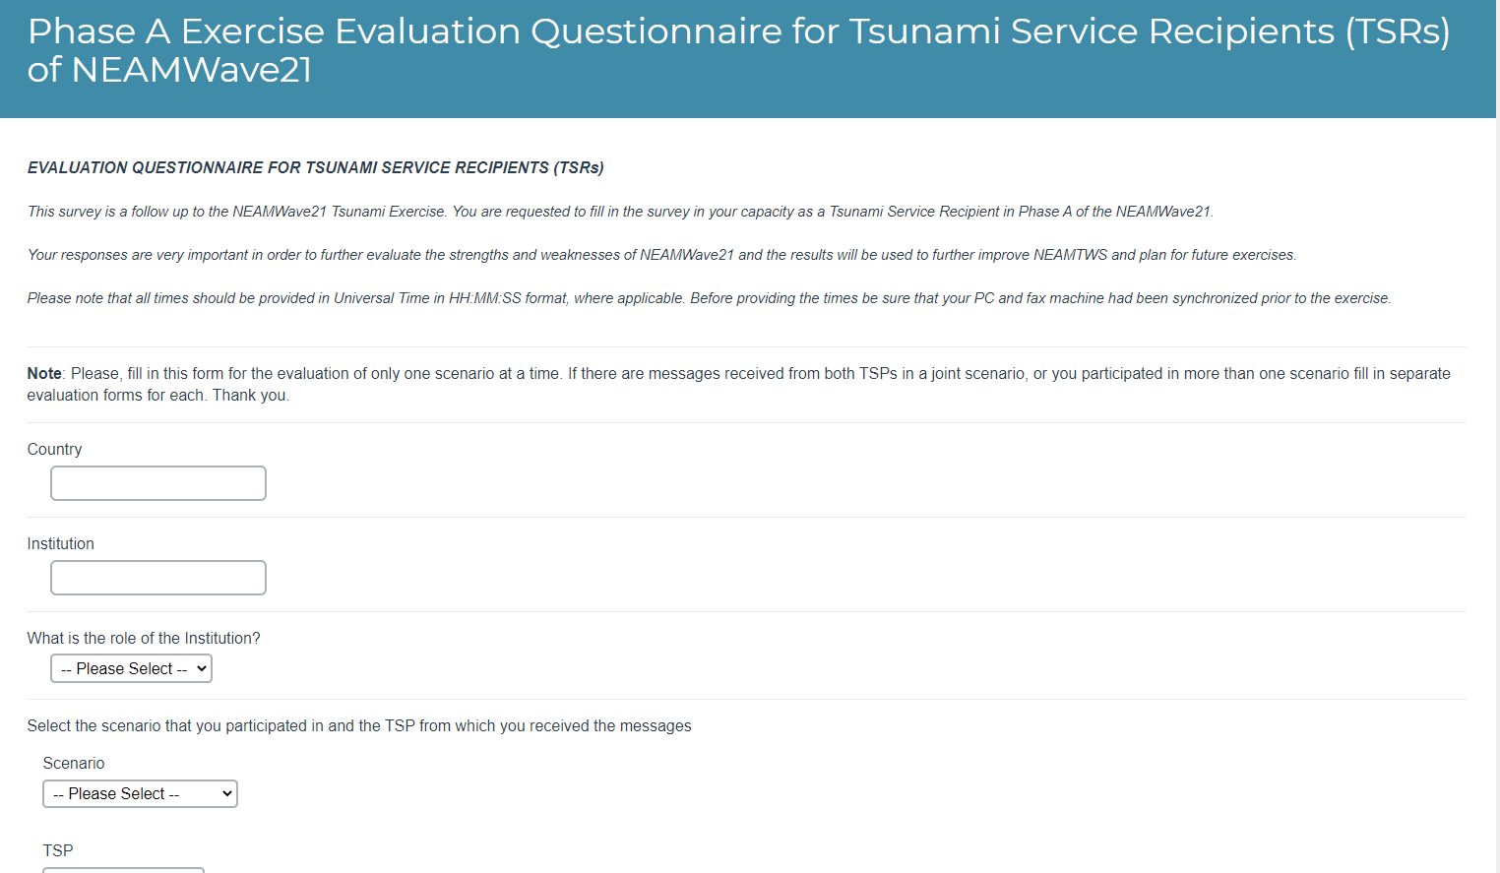
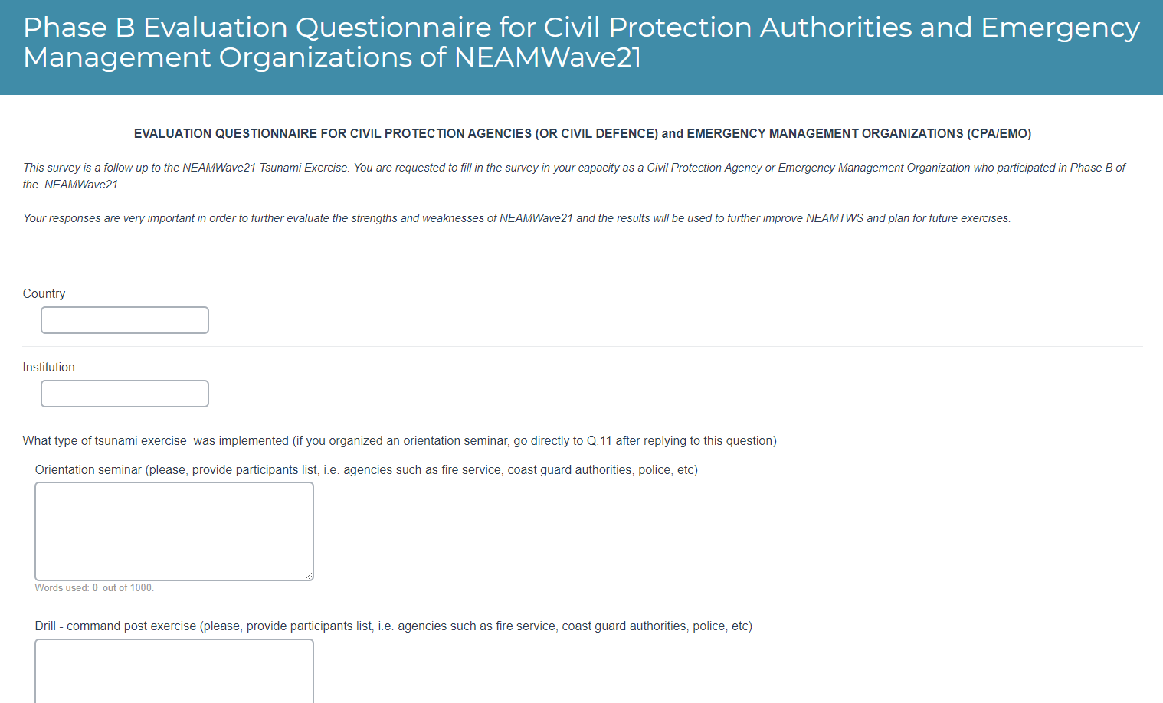
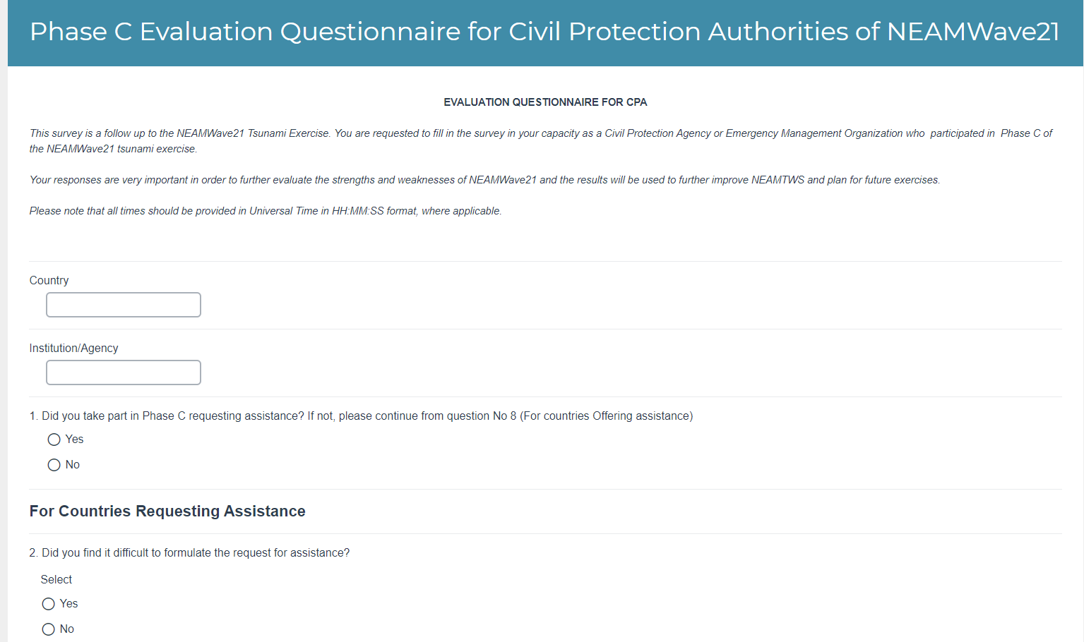
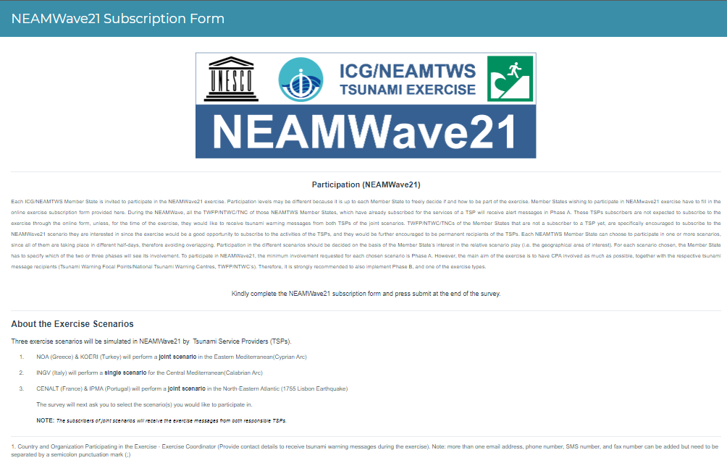
Online forms for Subscription and Evaluation
Prepared using Alchemer Platform!

Slide 6
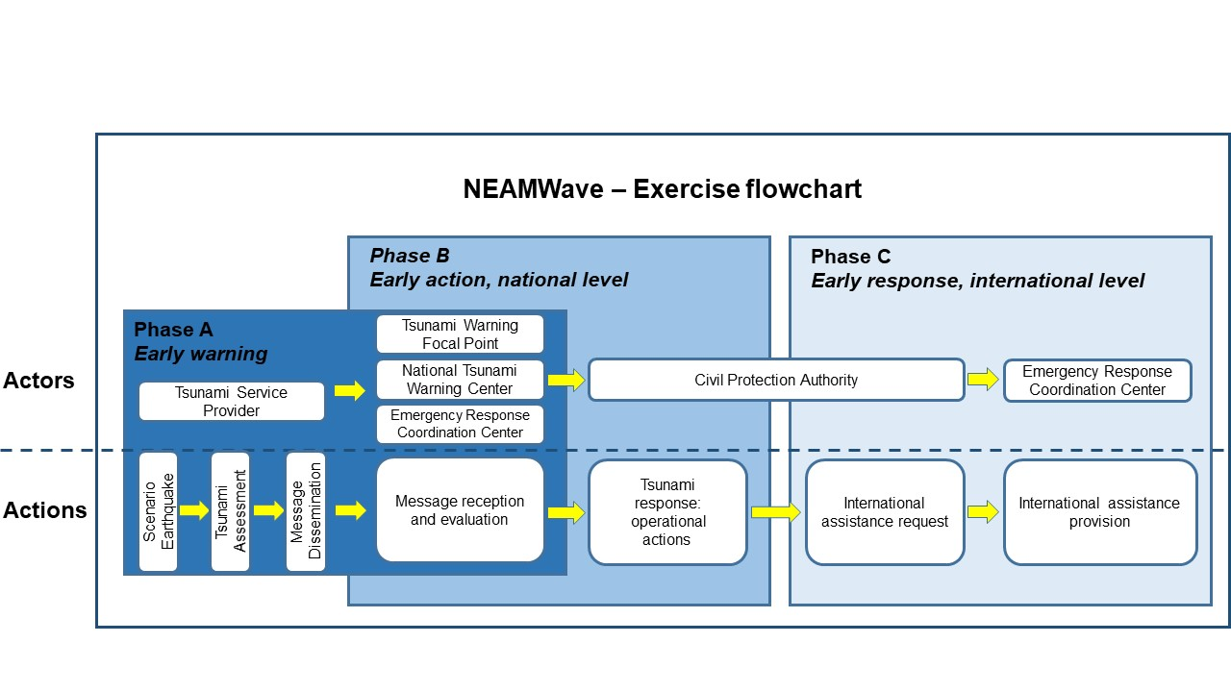
Exercise Phases
Notes:
Tsunami Watch Provider = TSUNAMI WATCH PROVIDERS
Tsunami Warning Focal Point/Tsunami National Contact
Civil Protection Agency = TSUNAMI WATCH RECEIVERS
Emergency Response and Coordination Centre

Slide 7
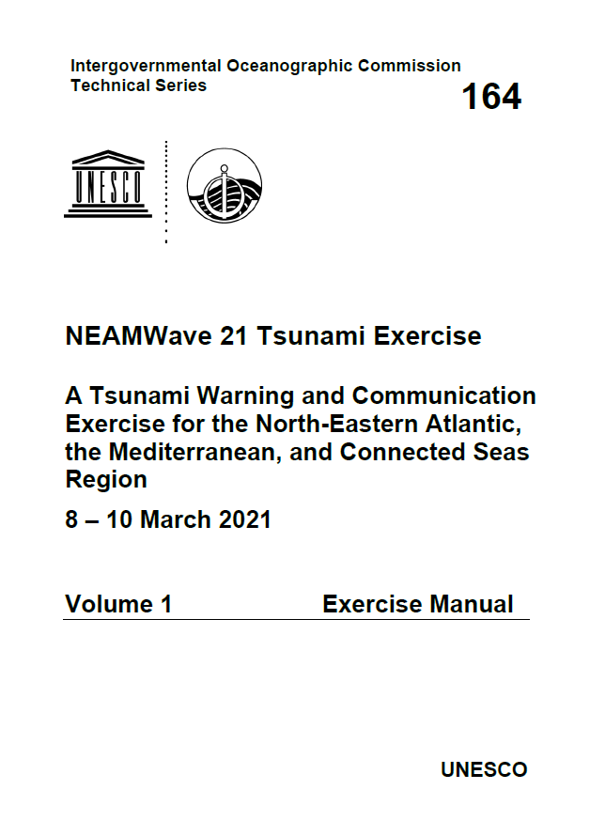
Update of NEAMWave manual
NEAMWave Tsunami Exercise Manual comprises two parts.
- Part 1 is the Exercise Instructions. It is the generic information part of the NEAMWave Exercise Manual, containing general and extensive information about the overall activities, the general scope, objectives and concepts, the roles of participants, as well as media arrangements.
- Part 2 is the Exercise Supplements. It contains more specific information about the actual exercise that is going to take place. It details the exercise scenarios in NEAMWave, the registration procedures for participation, the contact information of exercise team members, as well as the evaluation procedure of the exercise.

Slide 8
Objectives (1/2)
NEAMWave objectives:
● Validate and evaluate the Tsunami Service Provider (TSP) dissemination process of issuing Tsunami Messages in the NEAM region.
● Validate and evaluate the procedures for countries to receive the Tsunami Messages issued by the TSP through their National Tsunami Warning Centres (NTWC), the country Tsunami Warning Focal Points (TWFP) or the country Tsunami National Contacts (TNC).
● Test the dissemination of the warning messages to the relevant agencies that are responsible for emergency response (CPA).
● Assess the organizational decision-making process about public warnings and evacuations thus raising awareness of launching and contributing to the development of a national policy to tackle the tsunami risk.

Slide 9
Objectives (2/2)
NEAMWave Objectives:
● Identify best practices (to be shared), criticalities (to be addressed by the program in the future activities) and room for improvements in the entire process (including the procedures already tested between TSPs and TWFPs/NTWCs and also the heterogeneous panorama of national capacities to handle tsunami risk).
● Test procedures for international assistance between the European Commission and participating Member States

Slide 10
Success Criteria
NEAMWave Success Criteria:
1. Achieve a high level of engagement from national emergency managers and civil protection agencies.
2. Exercise and evaluate the national and local warning dissemination and response mechanisms put in place by Member State CPAs upon the reception of a tsunami warning from their TWFPs.
3. Apply recommendations and lessons learnt from previous tsunami exercises.
4. Identify issues both and communication and emergency planning that should be improved.

Slide 11
Best Practices
NEAMWave Best Practices:
1. Use online tools for the subscription and evaluation of the exercise.
2. Make only the essential changes to the exercise manual (e.g. scenarios and specific objectives), in order to sustain a general knowledge about the exercise.
3. Balance between the minimum number of scenarios and the maximum potential participating MS.
4. Use joint scenarios to strengthen the cooperation among the TSPs.
5. Organize targeted workshops for different types of participants (e.g. TSPs, CPAs etc).
6. Tailor made national messages (language) and enhanced products (maps) to users.
7. Carry out exercise in a multi-hazard crisis context and within World Tsunami Awareness Day framework.

Slide 12
Lessons Learnt
NEAMWave Lessons Learnt:
1. Have simple and clear ways for the participation and evaluation of the exercise.
3. Plan early and timely preparation and distribution of exercise material to the participants.
4. Use evaluation forms with more predefined answers, which should be sufficient for the evaluation of the exercise. Free text may be optional, for those you wish to submit a more in depth evaluation.
5. Civil Protection Agencies / Organizations participation are key to success and advancing exercises in NEAM region.

Slide 13
in the future…
NEAMWave in the future:
1. Opportunity for greater synergies within Tsunami Ready recognized communities.
2. Strengthening networks and partnerships with Civil Protection Agencies/Organizations.
3. Greater use and application of enhanced products, including proper effective use of Probability Tsunami Hazard Information

Slide 14
Thank you for your attention!
MEETING OF THE INTER-ICG TASK TEAM ON DISASTER MANAGEMENT AND PREPAREDNESS Online, 21–22 February 2022

