Slide 1



PLANNING FOR WTAD 2022
JOINT MEETING OF THE INTER-ICG TASK TEAMS ON DISASTER MANAGEMENT AND PREPAREDNESS and TSUNAMI WATCH OPERATIONS
AGENDA ITEM J10
VIRTUAL
February 22, 2022
Christa G. von Hillebrandt-Andrade
Deputy Director, NOAA NWS ITIC Caribbean Office
ICG CARIBE-EWS WG IV Chair

Slide 2
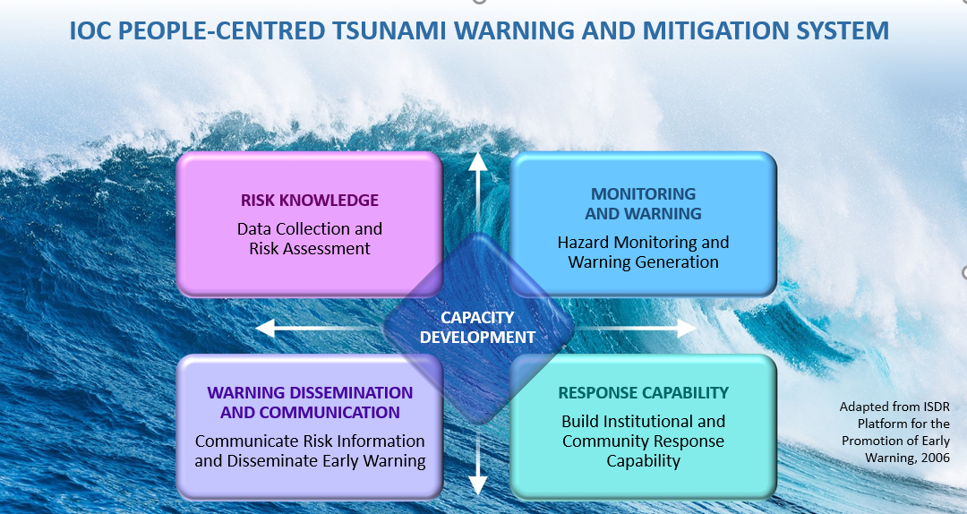
WTAD 2022
ACCESS TO MULTI-HAZARD WARNING SYSTEMS AND DISASTER RISK INFORMATION AND ASSESSMENTS

Slide 3
WTAD 2022
Links with:
TOWs Framework
Tsunami Evacuation Mapping
Tsunami Exercises
Ocean Decade Safe Ocean
Global Tsunami Decade Programme
Science and Technology – Tonga and atypical tsunamis/source agnostic
Tsunami Ready
Caribbean proposed decade project integrating coastal hazard early warning systems and services (iCHEWS)

Slide 4
WTAD 2022
Videos:
TSPs
El Salvador – Tsunami integrated into their all hazards early warning
WAVE exercises
Tsunami Ready as example of last mile
Virtual Event
Leaving no one behind in alerting – address challenges and solutions for gender, generational, disabilities, SIDS, LCD challenges

Slide 5
Questions, Comments
Thank you for participating!
elizabeth.vanacore@upr.edu
christa.vonh@noaa.gov

