Slide 1

TOWS Task Team on Tsunami Watch Operation (TTTWO) Task Team on Disaster Management and Preparation (TT DMP) 21- 22 February 2022
J11 NEXT SYMPOSIUM

Slide 2
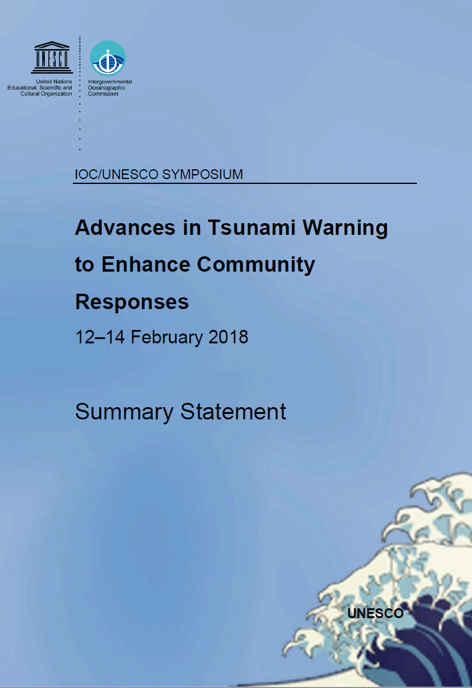
1st Unesco Tsunami Symposium 2018
The Assembly of the Intergovernmental Oceanographic Commission (Unesco-IOC) decided in 2017 to conduct a symposium on enhancing existing operational tsunami forecasting to further develop warning products and enhance timely , accurate, reliable and effective decision-making and community response.
The Symposium on Advances in Tsunami Warning to Enhance Community Responses was organized on 12-14 February 2018 at UNESCO, Paris.
Participants : 25 countries, 6 international organizations,105 participants
One of recommendation in the STATEMENT was to Encourage a repeat of this type of symposium.

Slide 3
TOWS XIV report (2021)
16.2 NEXT SYMPOSIUM
The provisional date for the symposium is 2022, serving as the first UNESCO-IOC Symposium during the 2021–2030 Decade of Ocean Science. Two other symposiums are expected to be organized in 2026 (mid-term) and 2030 (end of the decade).
The goal would be to examine lessons learnt from past events and recent efforts in further developing tsunami warning and mitigation systems to enable enhanced community responses. Future needs and suggested developments will contribute to the following areas:
(i) Detection and Warning;
(ii) Emergency Management;
(iii) Community Awareness and Preparedness;
(iv) National Initiatives;
(v) International Initiatives.
.

Slide 4
TOWS XIV report (2021)
16.2 NEXT SYMPOSIUM
1. Review the latest and potential new technologies and procedures for estimating tsunami threat and test their suitability and feasibility for providing more timely and accurate warnings.
2. Consider ways of estimating uncertainties associated with threat assessments and optimal ways of conveying these uncertainties to decision-makers.
3. Examine ways of utilizing enhanced tsunami threat information in making decisions with regards to emergency responses.
4. Provide information on the latest technologies for disseminating tsunami warning information to responders and communities.
5. Formulate roadmaps for developing and implementing new technologies, procedures, and their application to enable more effective community responses to tsunami threats.
6. Explore lessons and practice with regards to the uptake and implementation of the Tsunami Ready Programme.
7. Explore lessons of the COVID pandemic impact on the Tsunami Watch operation and Tsunami evacuation/drill process.

Slide 5
TOWS XIV report (2021)
16.2 NEXT SYMPOSIUM
Recommendation 6: In regard to the next Tsunami Symposium, incorporate more diversity in the organizing committee by inclusion of all regions; consider a venue that can accommodate a hybrid meeting that would enable the most people to successfully participate and engage; and explore funding opportunities. ORGANIZING COMMITTEE
CO-CHAIRS : TT TWO or Scientific Committee TT DMP IUGG – JTC Unesco IOC – Tsunami Unit Other UN organization ?
Dates and place ?
Funding ?

