Slide 1


Global Ocean Observing System & Marine Technology Society
‘industry dialogue’
The Global Ocean Observing System
www.goosocean.org
Emma Heslop, Programme Specialist GOOS and OCG, IOC/UNESCO
DBCP-37 November 2021

Slide 2
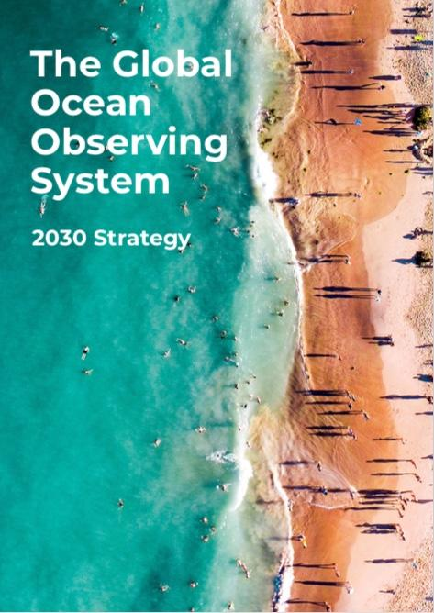
Vision
A truly global ocean observing system that delivers the essential information needed for our sustainable development, safety, wellbeing and prosperity
“If we are to meet the innovation challenges associated with building a fully integrated global ocean observing system, reliance on inter-governmental and government funding – even from the richest nations – will be insufficient. Backing and expertise from the private sector are needed’’

Slide 3
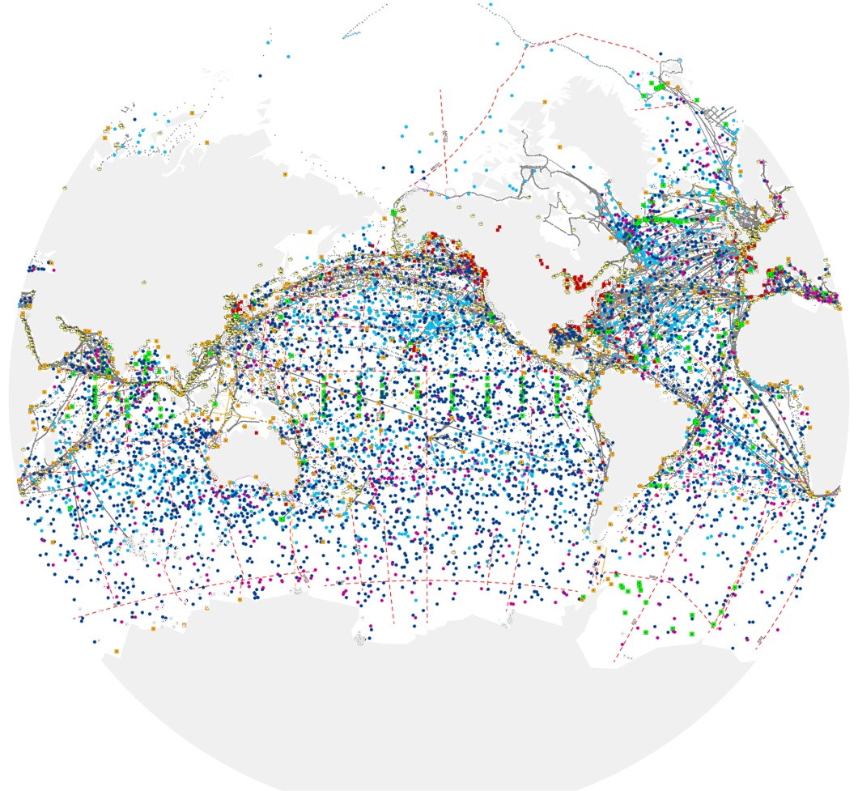
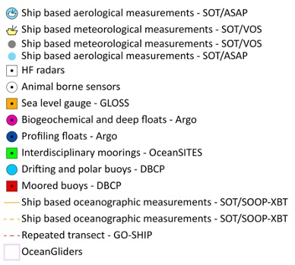
The Global Ocean Observing System
a key infrastructure for climate, weather,
disaster risk reduction, and ocean health
86 countries, 8,000+ observing platforms
12 global networks under OCG
700 Sofar drifting buoys
100? Saildrone’s in operation
Arial drones for coastal monitoring?
www.ocean-ops.org/reportcard2020
Notes:
Already have new commercial ‘networks’ developing
Particularly in the area of now autonomous technologies
What will a map of the future look like? Global Observing System - a mix of commercial and government activities
Some issues:
Data availability – publicly funded based on FAIR data principals – Findable, Accessible, Interoperable and reusable – all of which enable us to make maximum use of the investment in the data collected
Best Practices and Standards – data users, data quality
Visibility as a part of the system
Embrace diversity/diverse business models in the system, but still deliver a global ocean observing system – ocean information to user – talk about these points/share information

Slide 4
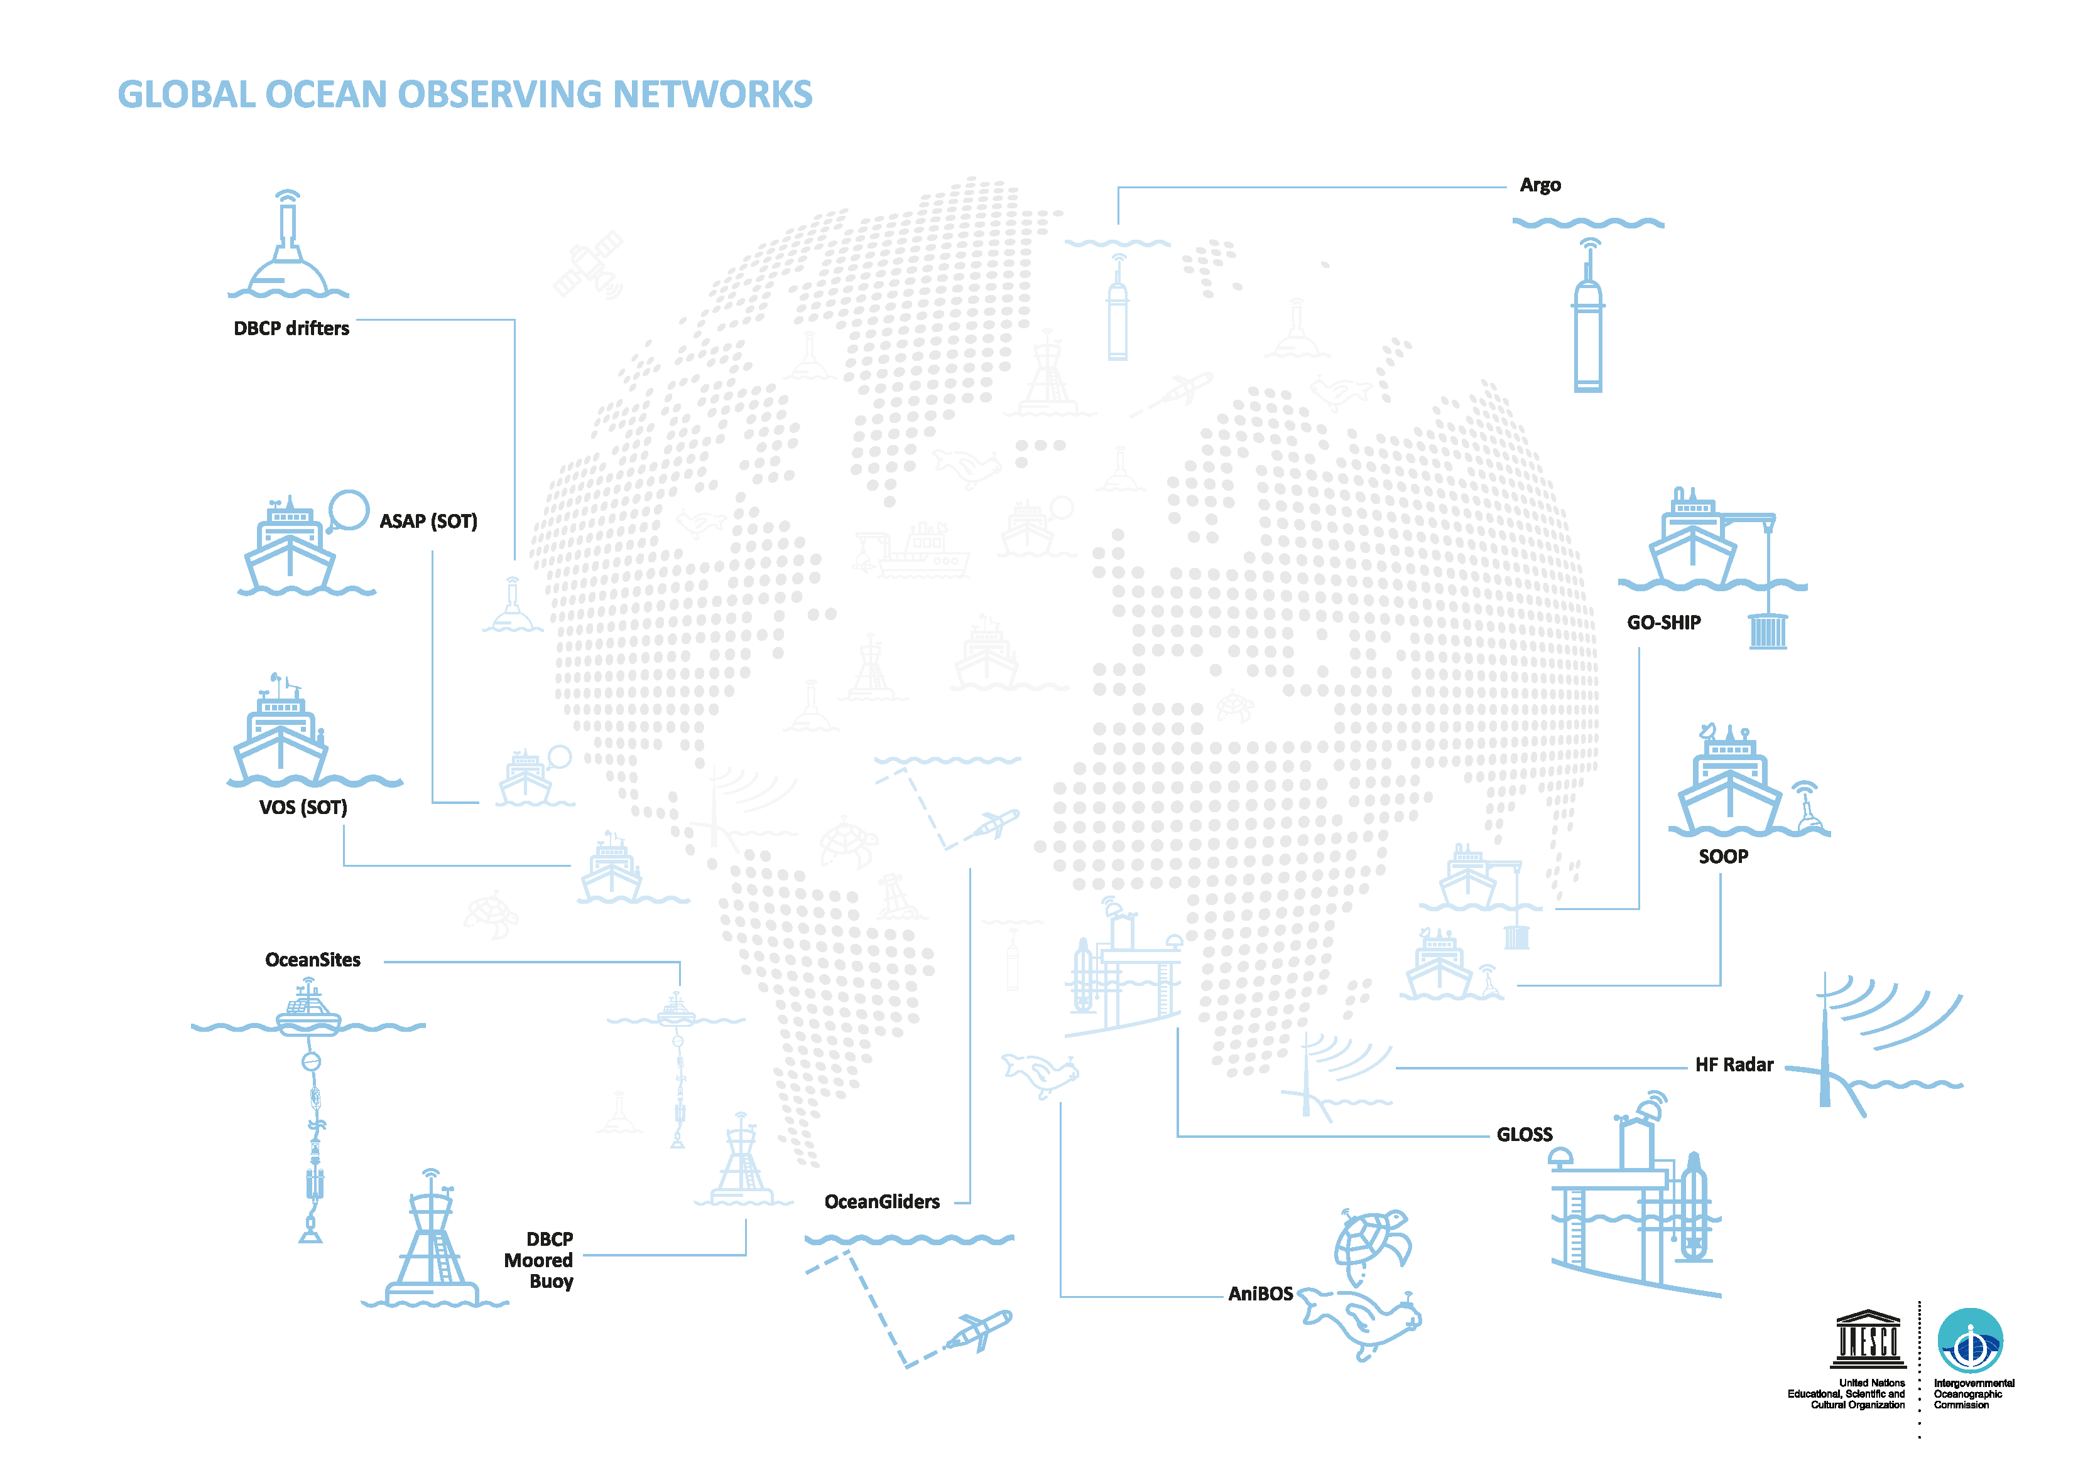

Observation Coordination Group Issues Raised
  No efficient and internationally recognised way to fast track promising technology to fill gaps
  High unit costs
  Sub-standard/variable manufacturing i.e. no universal standards
  Long-term product support and maintenance
  Limited suppliers and fragile supply chains
www.ocean-ops.org/reportcard
Notes:
Number of issues raise by the observing community through the Observations Coordination Group

Slide 5




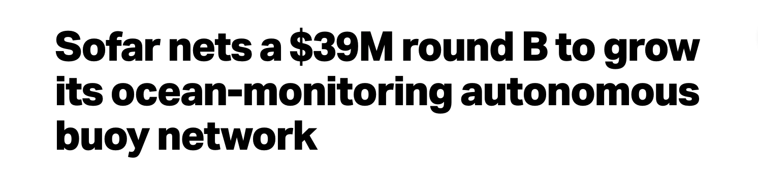
Suppliers issues raised
Highlight market immaturity
  No consistent forward view of global observing system technology needs
  Lack of visibility of market potential - purchases are often single or a few units at a time although the global market is larger
  Fragmented market, low order numbers and often working with many small individual users, scale of access
  Many different users asking for different and specific configurations, developments and adaptations.
www.ocean-ops.org/reportcard
Notes:
Number of issues raise by the observing community through the Observations Coordination Group

Slide 6
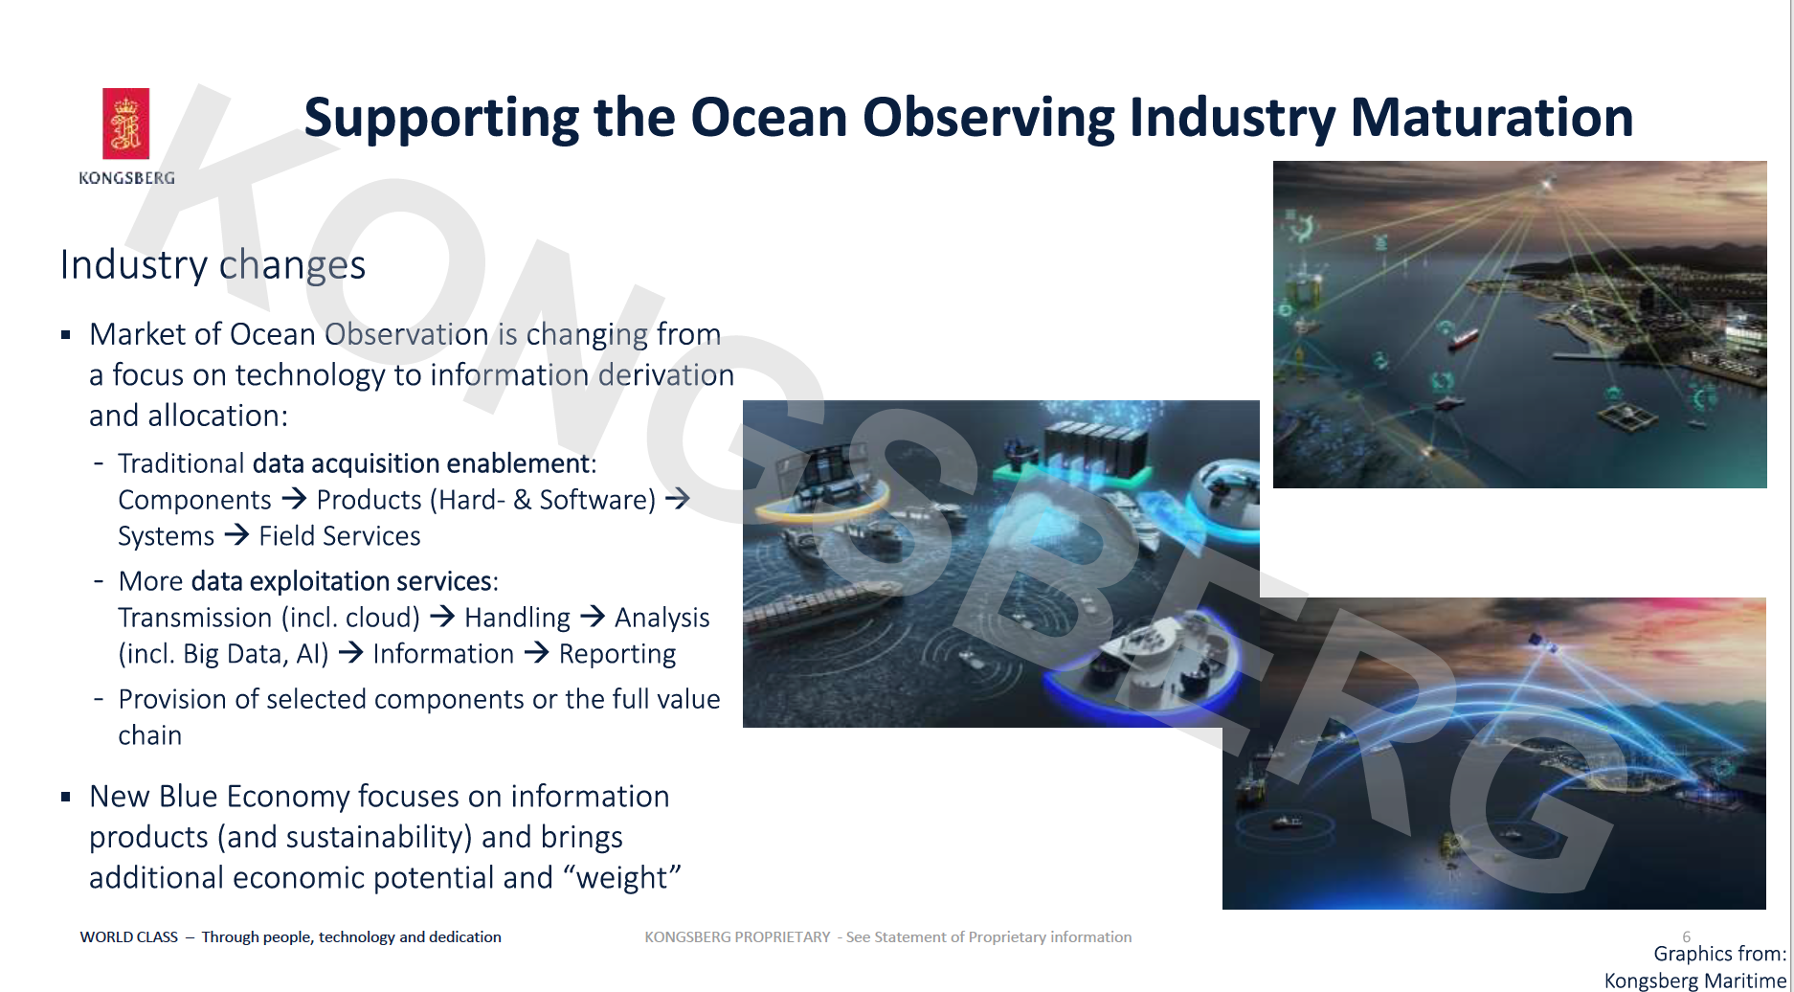
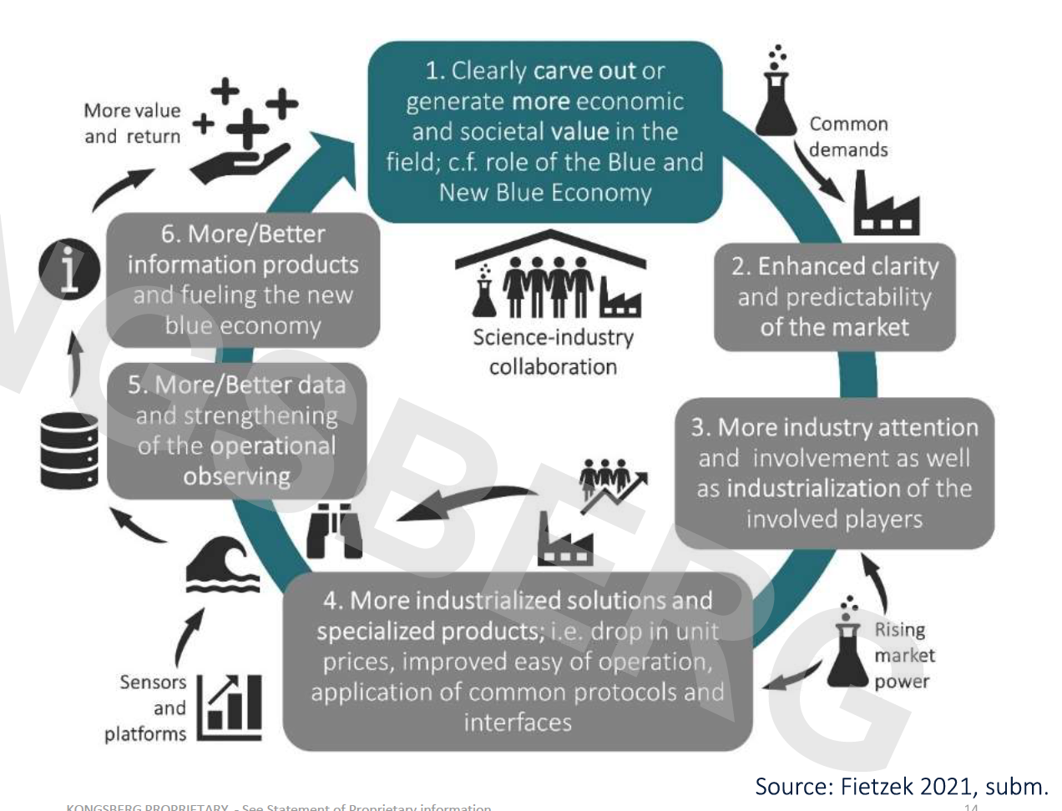
Notes:
Fietzek, P. (2020). Awakening a strong Ocean Observing Industry through Science-Industry Collaboration. In The New Blue Economy (working title; book in preparation). Elsevier.
Ocean Enterprise activities, supplier or service provider, estimated annual revenue in the order USD 7 billion in the US alone (2017).
Demand for instruments and services is increasing and becoming more operational, yet both suppliers and implementers experience frustration
Recent growth in new commercial networks, where and how do they fit with the GOOS
Need greater innovation in downstream services and digital technology solutions

Slide 7

GOOS - MTS ‘Industry Dialogue’
In order to meet the ‘big ask’ of society for ocean information in this crucial next decade, we need an active and vibrant dialogue between industry, academia and government about how to achieve a more efficient, dynamic and fit-for-purpose ocean observing system, and to maximize the strengths of all sectors.
Create a forum for compact and meaningful dialogue with new and established companies, academia, and government
Aim to dismantle barriers and highlight opportunities towards achieving a mature a vibrant Ocean Observing Enterprise,
Co-design with industry partners, compact but sustained engagement, will result in a set of recommendations that both MTS and GOOS have the ability and interest to act upon.

Slide 8
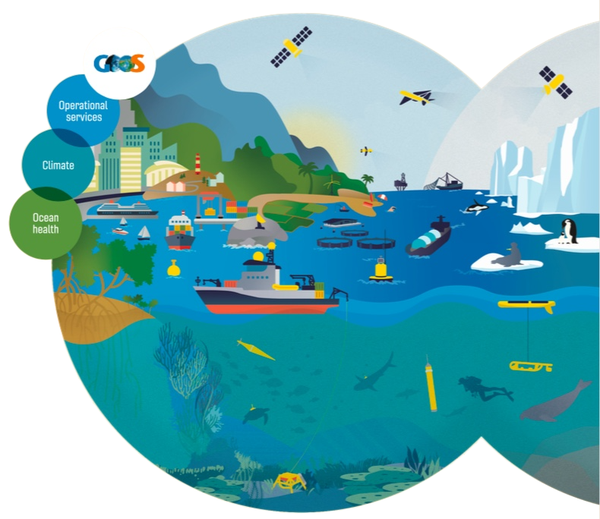
Questions for discussion:
What key issues you would like raised through the Industry Dialogue?
What key areas most need innovation or new technologies?
What experiences have you had engaging with Private Sector and opportunities that you see to constructively engage?
goosocean.org

Slide 9
The industrialization of ocean observing should be advanced with clear benefits for all involved stakeholders (Fietzek, 2020)
GOOS has a key role to play in this interface
GOOS will need new technology to fulfil the 2030 Strategy, but there no clear way to identify and fast track promising solutions
The FOO, TRL, EOVs have created some level of structure but need to go further
Notes:
Series of 6 Topical Industry dialogues – starting Sept 2021
Each session will provide recommendations – building up to a consolidated paper 2022
Supports observing enterprise - industry dialogue. Supports Ocean Decade

Slide 10
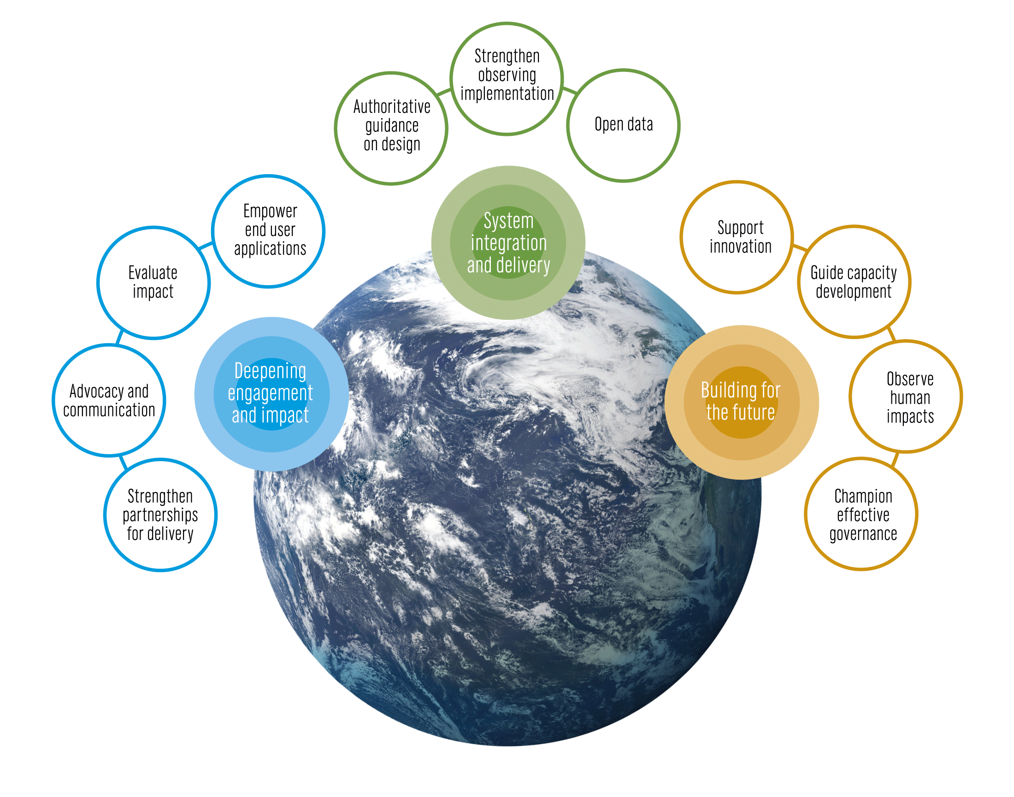
The GOOS 2030 Strategy
Vision
A truly global ocean observing system that delivers
the essential information needed for our sustainable development, safety, wellbeing and prosperity
Mission
To lead the ocean observing community and create the partnerships to grow an integrated, responsive and sustained observing system
goosocean.org/2030strategy
Notes:
The IOC Assembly in 2019 adopted a Global Ocean Observing System 2030 Strategy which now informs our work.
[vision] [mission]
Suite of Strategic Objectives which have become important to our planning:
System integration and delivery are the ‘core’ of GOOS ‘business’ today
Deepening engagement and impact are key priority areas for work – including developing partnerships for delivery, advocacy and communications
Building for the future are about building the additional pieces we need for a fully integrated system, including capacity development and innovation, and leading the development of a governance system for the future system that includes say partners and other stakeholders

Slide 11
The GOOS 2030 Strategy
Vision
A truly global ocean observing system that delivers
the essential information needed for our sustainable development, safety, wellbeing and prosperity
Mission
To lead the ocean observing community and create the partnerships to grow an integrated, responsive and sustained observing system
goosocean.org/2030strategy
Notes:
The IOC Assembly in 2019 adopted a Global Ocean Observing System 2030 Strategy which now informs our work.
[vision] [mission]
Suite of Strategic Objectives which have become important to our planning:
System integration and delivery are the ‘core’ of GOOS ‘business’ today
Deepening engagement and impact are key priority areas for work – including developing partnerships for delivery, advocacy and communications
Building for the future are about building the additional pieces we need for a fully integrated system, including capacity development and innovation, and leading the development of a governance system for the future system that includes say partners and other stakeholders

