Slide 1
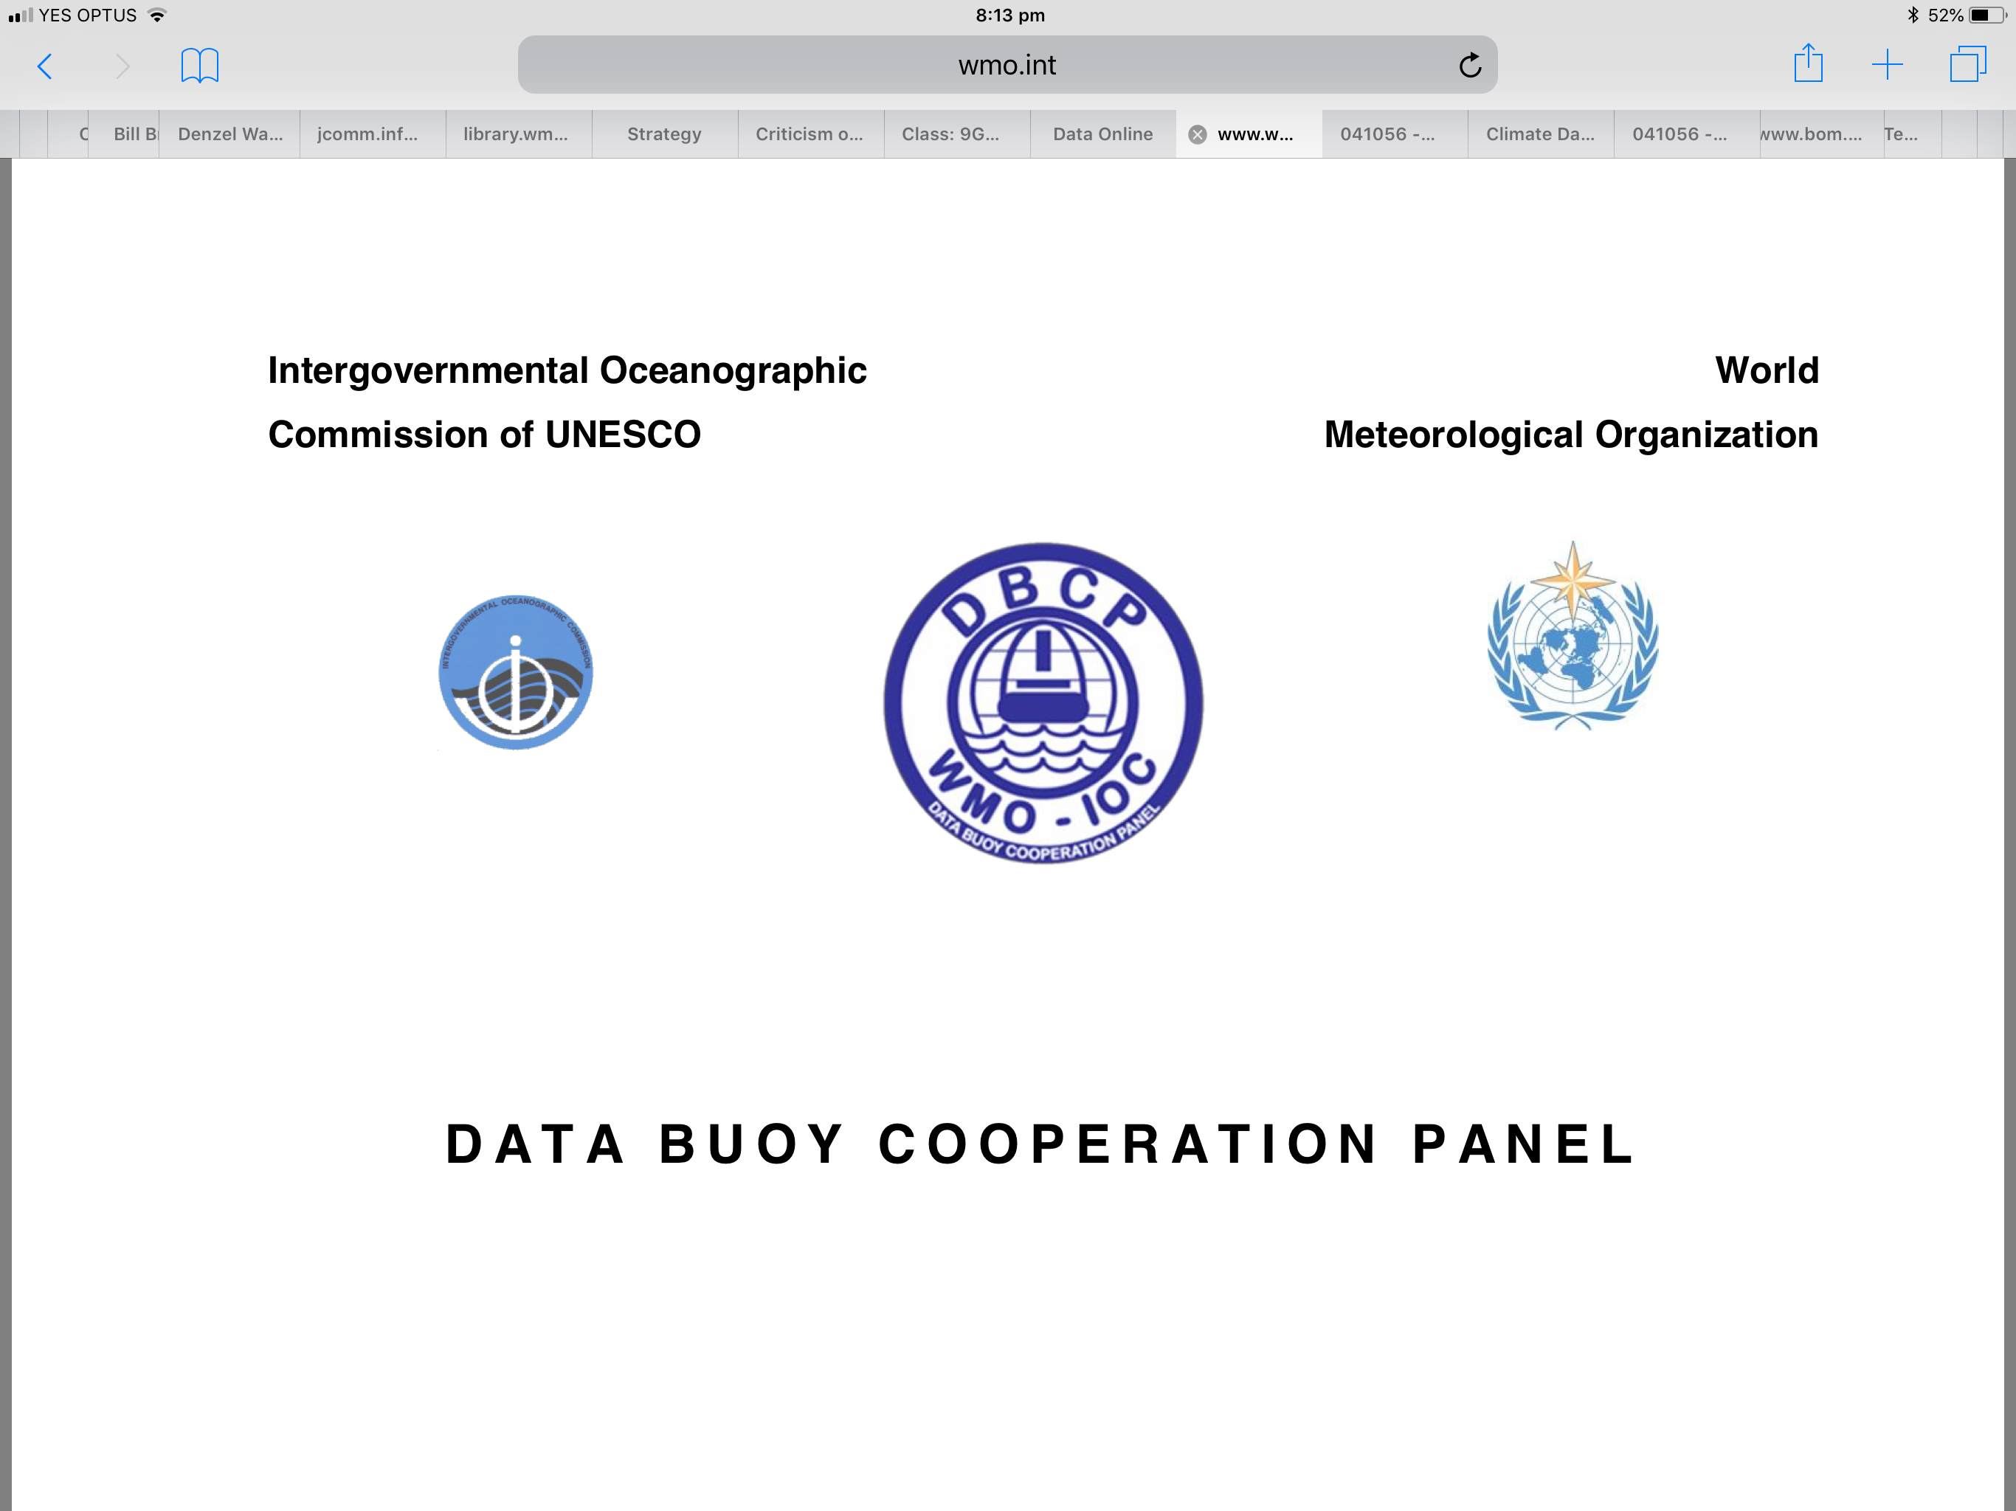



Welcome to DBCP 37
Live From Across the World
8-11 November 2021
Boris Kelly-Gerreyn
Chair, DBCP
Notes:
Hello. My name is Boris Kelly-Gerreyn and I am the chair of the DBCP. And on behalf of the DBCP executive board, I am absolutely delighted to be welcoming you all to our 37th annual meeting, live from all across the world! The DBCP is in its fourth decade bringing together a global community dedicated and committed to in situ ocean observations which contribute so significantly to our scientific understanding of the Earth system and also underpin critical services that help to save lives all around the world. We are meeting virtually for the second time as a result of this very challenging global pandemic and while I'm on this matter, I sincerely hope that you are all keeping well and keeping safe. I know it's been tough but we hope for better times ahead!

Slide 2

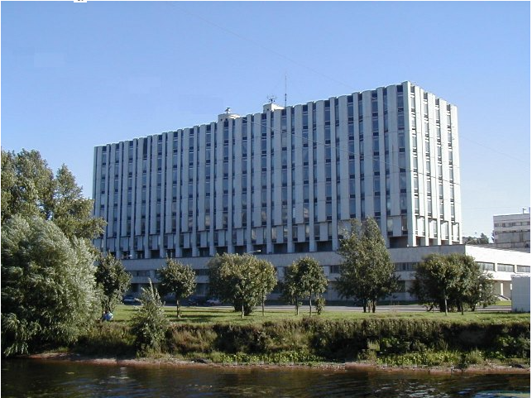
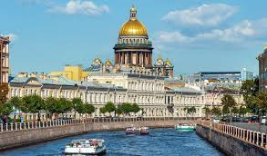
DBCP-36 & 37 – Our original destination!
State Scientific Centre of the Russian Federation
The Arctic and Antarctic Research Institute
Thank you for offering to host DBCP-37
Igor A. Shumakov (PR of the Russian Federation)
Vasily Smolyanitsky
Ashik Igor
In beautiful St Petersburg…
Notes:
DBCP 36 and 37 was originally destined for one of the most beautiful cities in the world-St Petersburg. We have to thank our colleagues from the Russian Arctic and Antarctic Research Institute who very generously offered to host us in their sublime city, not once but twice! In particular Igor Shumakov, Vasily Smolyanitsky and Ashik Igor for their efforts in bringing about this wonderful offer. Instead, we are all meeting virtually which although does not bring us closer to the marvels of the Hermitage Museum, brings a whole host of other benefits.

Slide 3
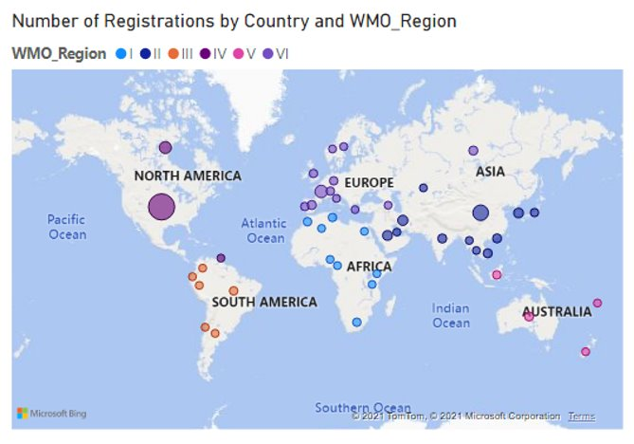
Participation at DBCP 37 is amazing!
137 registrations
46 members
All Six Regional Associations
6 new participants:
  Armenia, Kazakhstan, Myanmar, Nigeria, Tanzania, Tunisia
26% female (32% at DBCP36) let's grow this!
Notes:
Participation at DBCP 37 is amazing. In a normal year we will have anywhere between 15 to 20 odd countries participating at our annual meeting. This year we have more than double that amount. Last year we had 39 countries participate and this year 46 countries are joining us. And as with last year, we have about 140 participants registered with us across all WMO regional associations for the week. This year we also welcome six new participants – to Armenia, Kazakhstan, Myanmar, Nigeria, Tanzania and Tunisia and I say, and I hope I get this right!, 's bari galust, qoş keldiñiz, kyaosopartaal, kaabo, Karibu and marhababik – Welcome! We definitely want to see greater participation from women as part of our focus on inclusion and diversity, so 25% is a reasonable start, but we want to do so much more!

Slide 4
Key developments since DBCP 36
New Strategy launched following broad consultation
PI-5 virtual training capacity building workshop (May & June)
Funded wave buoy purchase and deployment – announcement of recipient pending
A new Task Team - Environmental Stewardship
Ran OCG workshop on environmental stewardship in May 21
Overall healthy and resilient network for global drifters array, however North Atlantic overly sampled and Indian Ocean under sampled.
65% of Moored Buoys reporting in BUFR 315008 in 2021
~100% drifter metadata now synchronized with OSCAR/WIGOS databases
Data flow mapping
Emerging relationships with commercial data suppliers

Slide 5
Challenges
Reduced reporting of data from tropical mooring array
  Overall ~70%,
  24% for Indian Ocean
Need more uptake of barometer upgrade and wave sensors
  Barometer: GDA~60%, coastal 63%, Tropical 13%, tsunameter 0
  Wave: drifters 1%, moored 66%
Low/no BUFR migration of coastal buoys & tsunameters

Slide 6
Future Plans
A new era for the DBCP
  Refresh Executive Board (at DBCP 37)
  Implement DBCP strategy
  New task team focused on users
Prioritise deployments in under sampled areas (e.g. Indian Ocean)
Actively promote barometer upgrade program
Embed ourselves deeply in the UN Decade
Strengthen relationships with commercial entities
Lead International Workshops
  Tsunami detection innovation workshop
  Operational Wave Measurements
  PI-6 capacity building workshop

Slide 7
The need for the DBCP has never been greater
  WMO unified data policy, GBON¹ and SOFF²
  UN Decade of Ocean Science for Sustainable Development
  UN Sustainable Development Goals – SDG 13 & 14
  GOOS 2030
  OceanObs19 in action
  Paris Agreement
  COP 26
¹Global Basic Observing Network
²Systematic Observations financing facility
Notes:
As we've heard from Anthony and Albert just now, the landscape that we operate in has shifted considerably in the last few years and continues to do so at some pace.

Slide 8
The week ahead – it's packed!
Making the most of our virtual time together
Encouraging engagement and discussion (hearing from you)
Strong user focus
Key highlights:
    Session 2 (Monday) - Science and Technology Workshop
    Session 5 (Tuesday) - User Impact Stories (Tsunamis and Hurricanes)
    Session 6 (Wednesday) - The DBCP strategy
    Session 8 (Wednesday) - Environmental Stewardship task team
    Session 9 (Thursday) - Engagement with the commercial sector
    Session 12 (Thursday) - Election outcomes for new executive board
Notes:
So what lies ahead this week. We have a packed and exciting agenda for you which has been designed so that we can make the most of our virtual time together. We are very very keen to encourage you to be engaged throughout the week and particularly in the Q&A. We really want to hear from you. You will see that in the agenda we have a strong user focus which is something that plays into our strategic planning. The key sessions that I would draw particular attention to include today's science and technology workshop which showcases the impact that drifting and moored buoy data have on science, technology and other uses. Tomorrow we have two guest speakers drawn from our key user community ( tsunami warnings and Hurricane warnings). On Wednesday we present our new strategic direction and then on Thursday we we'll hear about growing engagement with the commercial sector and be able to announce the outcomes of the elections for the new executive board. I don't know about you but I am very excited about all of this and much more.

Slide 9
Election instructions
Eligible voters are DBCP National Focal Points or DBCP Panel Members authorised to vote by their Permanent Representatives.
Voting opens now and closes at 2359 UTC on 10 November 2021.
Instructions with links to the vote have been sent to eligible voters
For technical difficulties, please contact Long Jiang (ljiang@wmo.int)
For any other queries, please contact Dominique Berod (dberod@wmo.int) and Boris Kelly-Gerreyn (Boris.Kelly-Gerreyn@bom.gov.au).

Slide 10

Notes:
And so with that level of excitement to keep you going, I say thank you very much in as many languages as I pretend to know how to say it in and look forward to your active participation. With that I will now hand you over to Long Jiang our technical coordinator to take you through the virtual meeting instructions. Over to you Long.

Slide 11
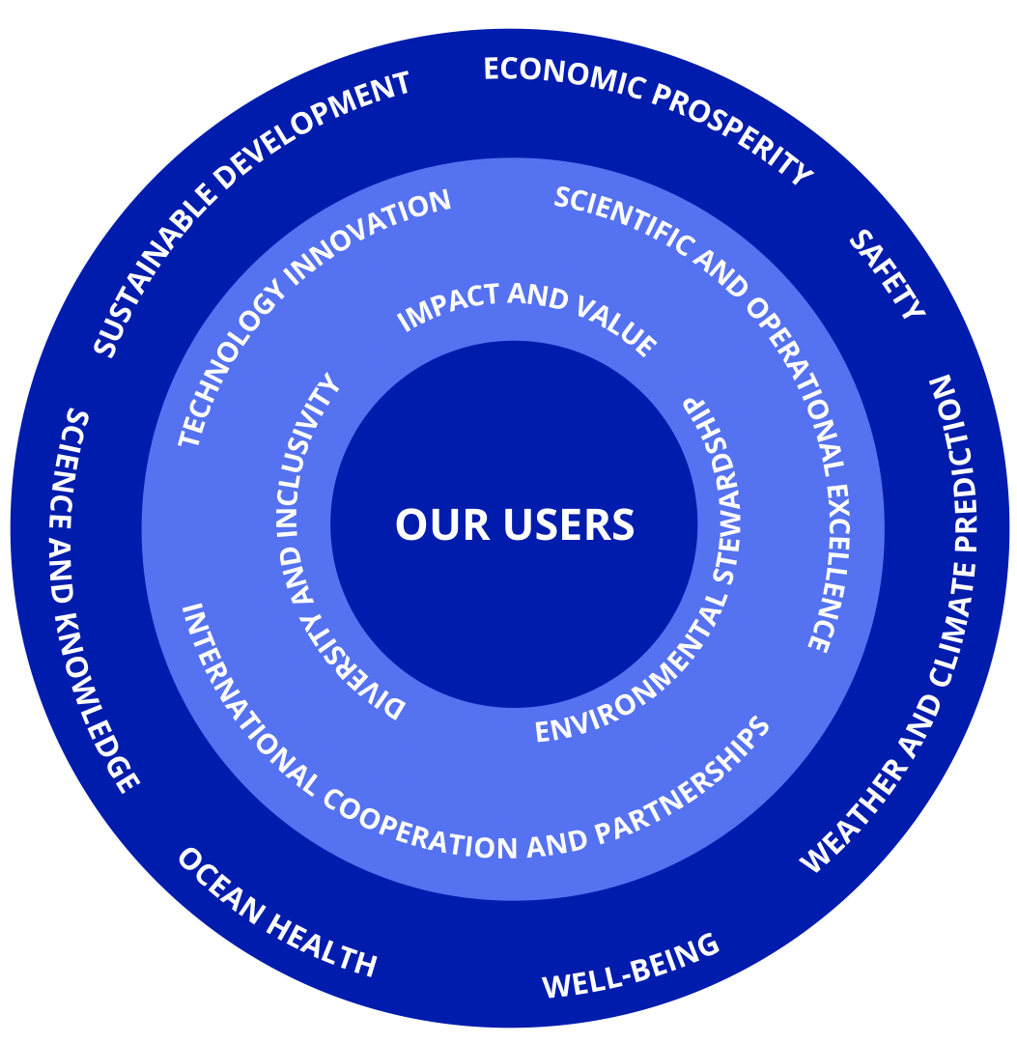
DBCP 37

