Slide 1
Global Drifter Program
Rick Lumpkin and Luca Centurioni
DBCP 37

Slide 2
1. Statistics
How many meetings did you have this year ? Many (Weekly Extreme Events and Ocean Observations (EEOO) telecons; weekly GDP telecons)
How many actions do you have ? None
How many actions have been completed or will be completed this year ? N/A
How many actions have not progressed ? N/A
How many new actions have been added? N/A

Slide 3
2. Realignment of ToRs to DBCP strategy
1. How many Strategic Pillars does your TT align to? 1 (Impact and value), 2 (Scientific and operational excellence), 3 (Technology innovation), 4 (Environmental stewardship), 5 (International cooperation and partnerships), 6 (Diversity and Inclusivity)
2. How many Strategic Actions does your TT align to? 1.1-1.8; 2.1-2.4; 3.1-3.4 (BGC for future consideration); 4.1-4.3; 5.1-5.4; 6.2 (and full support for 6.1, 6.3).
3. Which is/are the Key Strategic Pillar/s for your TT? 1 (Impact and value), 2 (Scientific and operational excellence), 3 (Technology innovation), 5 (International cooperation and partnerships)
4. Which is/are the Key Strategic Action/s for your TT? All actions in these key pillars
5. What is/are the indicator(s) measuring success of your TT? Number of publications; improvements to marine forecasts; drifter array coverage.

Slide 4
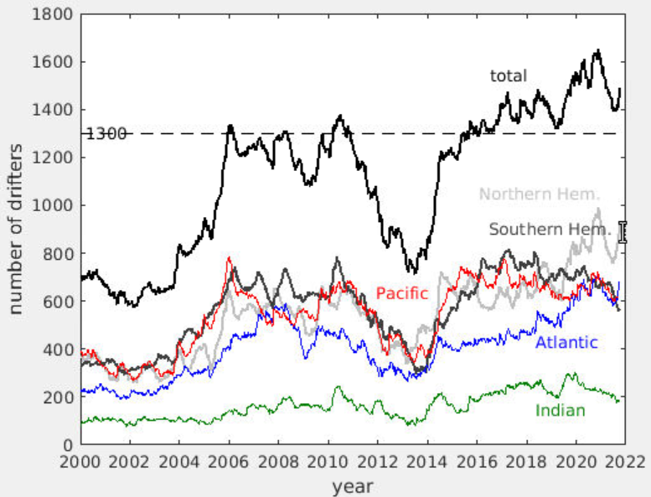
3. Key highlights this year
Development and testing of A-sized drifters for deployments from P-3 research aircraft next hurricane season
Global array maintained at annual average of 1530 drifters despite pandemic constraints

Slide 5
4. Key focus areas for next year
Seek barometer upgrade partners to increase fraction of array with barometers for improved marine weather forecasts
Grow array of directional wave spectrum drifters alongside array of drogued drifters measuring ocean currents
Strengthen connections with operational agencies such as NOAA/National Weather Service/Ocean Prediction Center

Slide 6
5. Key take-home messages
While Global Drifter Array coverage was impacted by increased Iridium transmission costs and the pandemic, deployments are now increasing in high-need regions
Continued DBCP assistance in advertising the Barometer Upgrade Program is welcome
The GDP thanks the DBCP for actively supporting engagement with partners (esp. SIDS) seeking to deploy wave drifters

